Slide 1
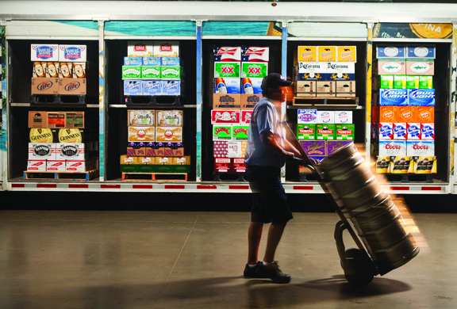

Beer Industry Overview
Lester Jones, Chief Economist
National Beer Wholesalers Association
October 15, 2018

Slide 2
Length of Expansions:
Current vs. Previous Five Longest

Slide 3
What will kill this expansion?
Most common, high interest rates as Fed responded to rising inflation – Late 1950s, late 1960s, late 1980s
Special category – oil shock inflation – In 1974 caused a recession as higher prices eroded purchasing power
Other categories: Collapse of dot.com investment boom of late 1990s, together with stock market crash. Collapse of housing and excess leverage that led up to 2008-09 financial crisis.

Slide 4
Total U.S. Goods Producing vs Service Providing
BLS Employment: Jan 2008 to Sept 2018
For now, the country has historically low unemployment rates, consistently adding new jobs, and experiencing wage growth across broader categories.

Slide 5
U.S. Population by Age
2017
40 is the most irrelevant age?
Two generations at formidable transition points in their lives
3 out of 4 people are 21+
Source: U.S. Census and NBWA 2017.

Slide 6
Big Shifts in Demographics by Age 2010 vs 2017
-1.2 million
+6.3 million
-4.3 million
+14.8 million
Source: U.S. Census and NBWA 2017.

Slide 7
People of all ages define the American Dream the same way (Bank of the West's 2018 Millennial Study)
All three generations define the American Dream the same way: owning a home, being debt-free, and retiring comfortably.
Most millennials, Gen Xers, and baby boomers believe the American Dream is still attainable, according to the Bank of the West's 2018 Millennial Study.
Indulgence gap' could be a factor in the future of the wine industry (Rob McMillan, Silicon Valley Bank)
Millennials begin to make the opening moves of their careers. Buying homes and starting families. “Substituting diapers for wine.”
Baby boomers will begin to reach retirement age in about five years and living on a fixed income. That’s going to change the way they spend.
When coupled with the specter of less boomer spending and consumption, millennials’ inability to spend on wine, “changes the dynamics greatly”

Slide 8
States Leading the 2nd Echo Baby Boom?
Growing Pop < 1 year old ( > 1%)
Declining Pop <1 year ( -0.1% to -0.5%)
Declining Pop <1 year (-0.6% -1.9%)
US population age less than 1 year old fell -0.5% in 2017 (16,000)
Source: US Census, 2018 and NBWA Industry Affairs

Slide 9
US Demographics
Legal Drinking Age Adults (21+ / LDA)
US Fertility Rates Have Plummeted Into Uncharted Territory. 60.2 babies were born in 2017 for every 1,000 women of 'childbearing' age (15-44) – a low not seen in the US since officials began charting.
Source: Compiled by NBWA from U.S. Census Bureau 2018

Slide 10
US Income Distribution
Share of Households by Income Group
Source: https://www.census.gov/data/tables/2018/demo/income-poverty/p60-263.html

Slide 11
Beer Segment Shares
Growing High-End Beyond 40 Share
Source: Beer Marketers Insights, 2018.

Slide 12
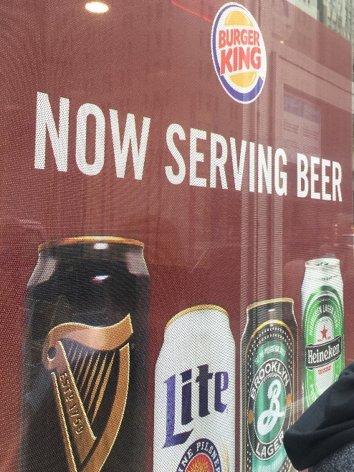
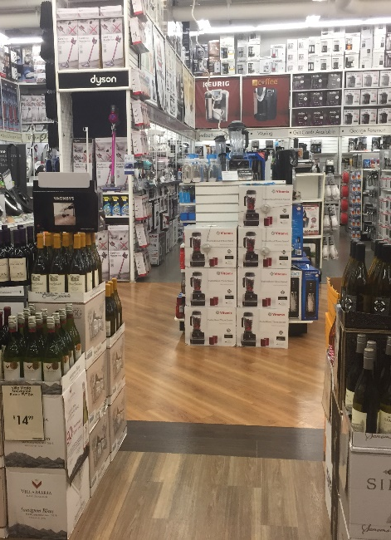
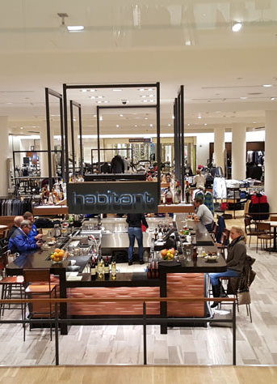
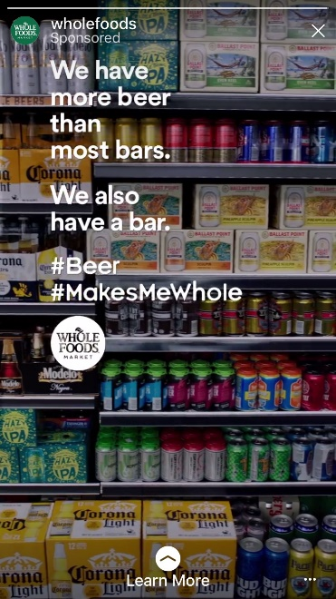
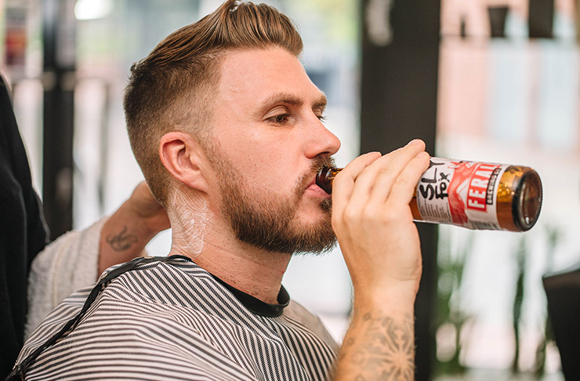
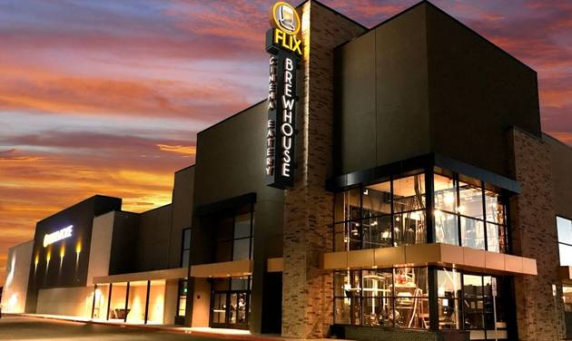
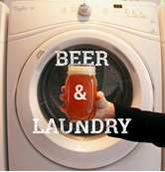
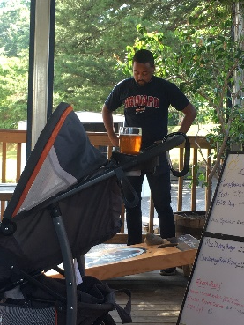
Access to Alcohol is Expanding!
Fast Food
Bed, Bath and Beyond
Nordstrom's
Whole Foods
Barbers and Salons
Taprooms
Movie Theaters
Laundromats

Slide 13
Total U.S. Retail Establishments Selling Alcohol 2008 to 2018
Source: TDLinx Account Tracker Report: Beer, Wine or Spirit Selling Accounts, 2018.

Slide 14
Additional Retail Accounts In U.S.
Selling Alcohol
Source: TDLinx Account Tracker Report: Beer, Wine or Spirit Selling Accounts, 2018.

Slide 15
The End of the Traditional Bar and Tavern?
U.S. BLS: Establishment Counts
Number of Establishments in Private NAICS 722410 Drinking places, alcoholic beverages for All establishment sizes in U.S. TOTAL

Slide 16
Permits Grow Across All Segments
Total U.S. 2010 to 2018 (June)
Source: U.S. TTB, 2018

Slide 17
TTB Permitted Brewery Count
9,482 Permits as of June 2018
State | Count | State | Count | State | Count
Alabama | 52 | Kentucky | 75 | North Dakota | 23
Alaska | 50 | Louisiana | 47 | Ohio | 350
Arizona | 135 | Maine | 148 | Oklahoma | 52
Arkansas | 48 | Maryland | 128 | Oregon | 366
California | 1,168 | Massachusetts | 213 | Pennsylvania | 439
Colorado | 474 | Michigan | 484 | Rhode Island | 31
Connecticut | 114 | Minnesota | 229 | South Carolina | 88
Delaware | 36 | Mississippi | 18 | South Dakota | 32
DC | 14 | Missouri | 157 | Tennessee | 129
Florida | 364 | Montana | 104 | Texas | 356
Georgia | 108 | Nebraska | 57 | Utah | 43
Hawaii | 32 | Nevada | 48 | Vermont | 86
Idaho | 80 | New Hampshire | 101 | Virginia | 311
Illinois | 313 | New Jersey | 134 | Washington | 518
Indiana | 220 | New Mexico | 118 | West Virginia | 31
Iowa | 121 | New York | 504 | Wisconsin | 285
Kansas | 55 | North Carolina | 352 | Wyoming | 41
Source: NBWA and TTB, August 2018.

Slide 18
Brewery Permits per 100,000 Residents
2018 LDA Pop (est)
State | Count | State | Count | State | Count
Alabama | 1.44 | Kentucky | 2.28 | North Dakota | 4.21
Alaska | 9.48 | Louisiana | 1.38 | Ohio | 4.05
Arizona | 2.59 | Maine | 14.2 | Oklahoma | 1.84
Arkansas | 2.18 | Maryland | 2.84 | Oregon | 11.53
California | 3.99 | Massachusetts | 4.07 | Pennsylvania | 4.54
Colorado | 11.27 | Michigan | 6.51 | Rhode Island | 3.85
Connecticut | 4.22 | Minnesota | 5.57 | South Carolina | 2.32
Delaware | 4.93 | Mississippi | 0.83 | South Dakota | 5.11
DC | 2.57 | Missouri | 3.47 | Tennessee | 2.57
Florida | 2.22 | Montana | 13.11 | Texas | 1.77
Georgia | 1.42 | Nebraska | 4.14 | Utah | 2.06
Hawaii | 2.97 | Nevada | 2.11 | Vermont | 18.01
Idaho | 6.47 | New Hampshire | 9.72 | Virginia | 4.92
Illinois | 3.32 | New Jersey | 1.98 | Washington | 9.23
Indiana | 4.53 | New Mexico | 7.74 | West Virginia | 2.25
Iowa | 5.28 | New York | 3.36 | Wisconsin | 6.61
Kansas | 2.63 | North Carolina | 4.59 | Wyoming | 9.8
US Average = 3.92
Source: NBWA and TTB, August 2018.

Slide 19
TTB Brewery Permits Issued Per Day
2010 to YTD June 2018
Source: www.ttb.gov/beer/beer-stats.shtm and NBWA Industry Affairs, 2018

Slide 20



Alcohol Consumption Over Time
Do You Have Occasion to Drink Alcohol?
Source: Gallup Poll, 2018.

Slide 21
Total U.S. Ethanol Per Capita
2010 to 2017
Source: Compiled by NBWA from TTB, Discus and BIG, 2018 (2017 wine volumes estimated by NBWA)

Slide 22
Average Weighted ABV for All Beer
2000 to 2017
Average Weighted ABV = Sum of ethanol from each top 100 brands / total volume
Covers 90% of total industry volume the balance of 10% is weighted at 5%
All Craft Style = 5.4% weighted ABV vs All Light Beer = 4.2% weighted ABV
Source: NBWA industry Affairs, 2018

Slide 23
ABV by Beer Segment 2017
Source: NBWA industry Affairs, 2018

Slide 24
SKU COUNTS BY SEGMENT
300,000+ SKUs IN LIQUID REFRESHMENT MARKET

Slide 25
Differences Across Age Groups
Consumed Alcohol Past 30 Days
Source: NBWA and Scarborough USA+ 2018 Release 1

Slide 26
Differences Between Genders
Alcohol Past 30 Days
Source: NBWA and Scarborough USA+ 2018 Release 1

Slide 27
Summary
Economics and demographics are taking industry to news places
Marketplace is responding with many new suppliers, retailers, and products
Plenty of challenges and even opportunities ahead

Slide 28
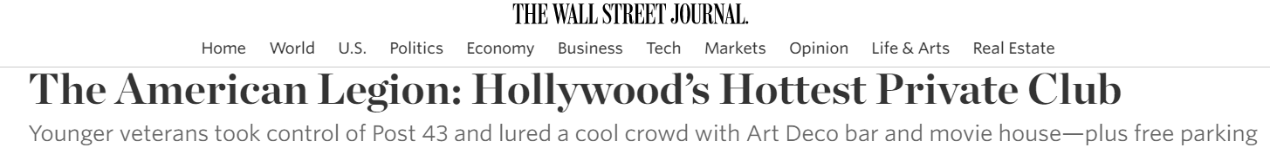
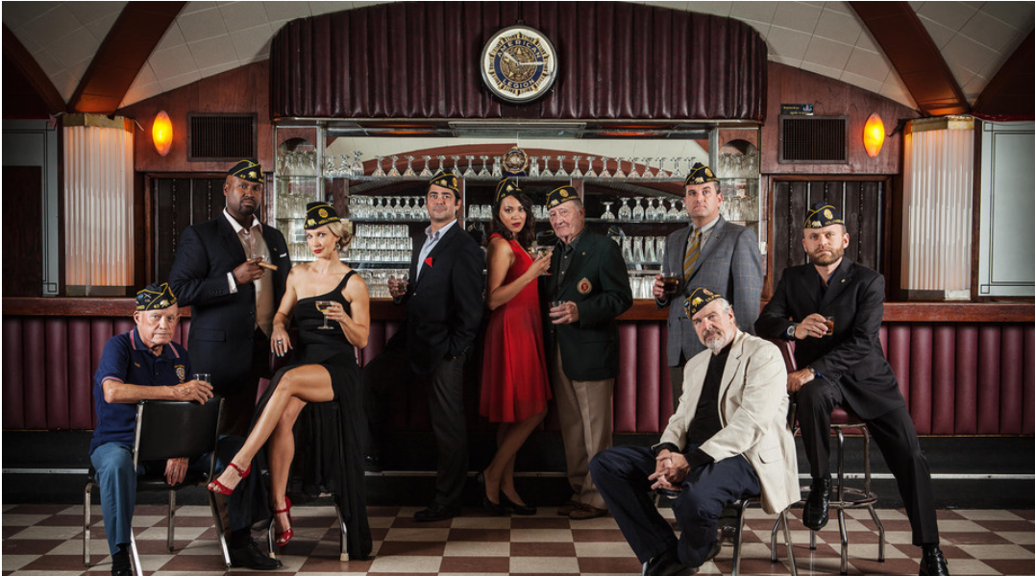

Slide 29
Thank You
Lester Jones, NBWA ljones@nbwa.org

