Slide 1
Let's embrace the recent Pathways enhancements!
Toastmasters International
Enhancing Member Experience and Club Success
Notes:
Original PPT slidedeck developed by Wendy Pesavento, October 2025
Updated PPT slidedeck developed by Maryann Reichelt, October 16, 2025

Slide 2
Agenda
Pathways Overview
Enhanced Pathways Requirements
Affected Paths
What Stays the Same
Resources
Next Steps

Slide 3
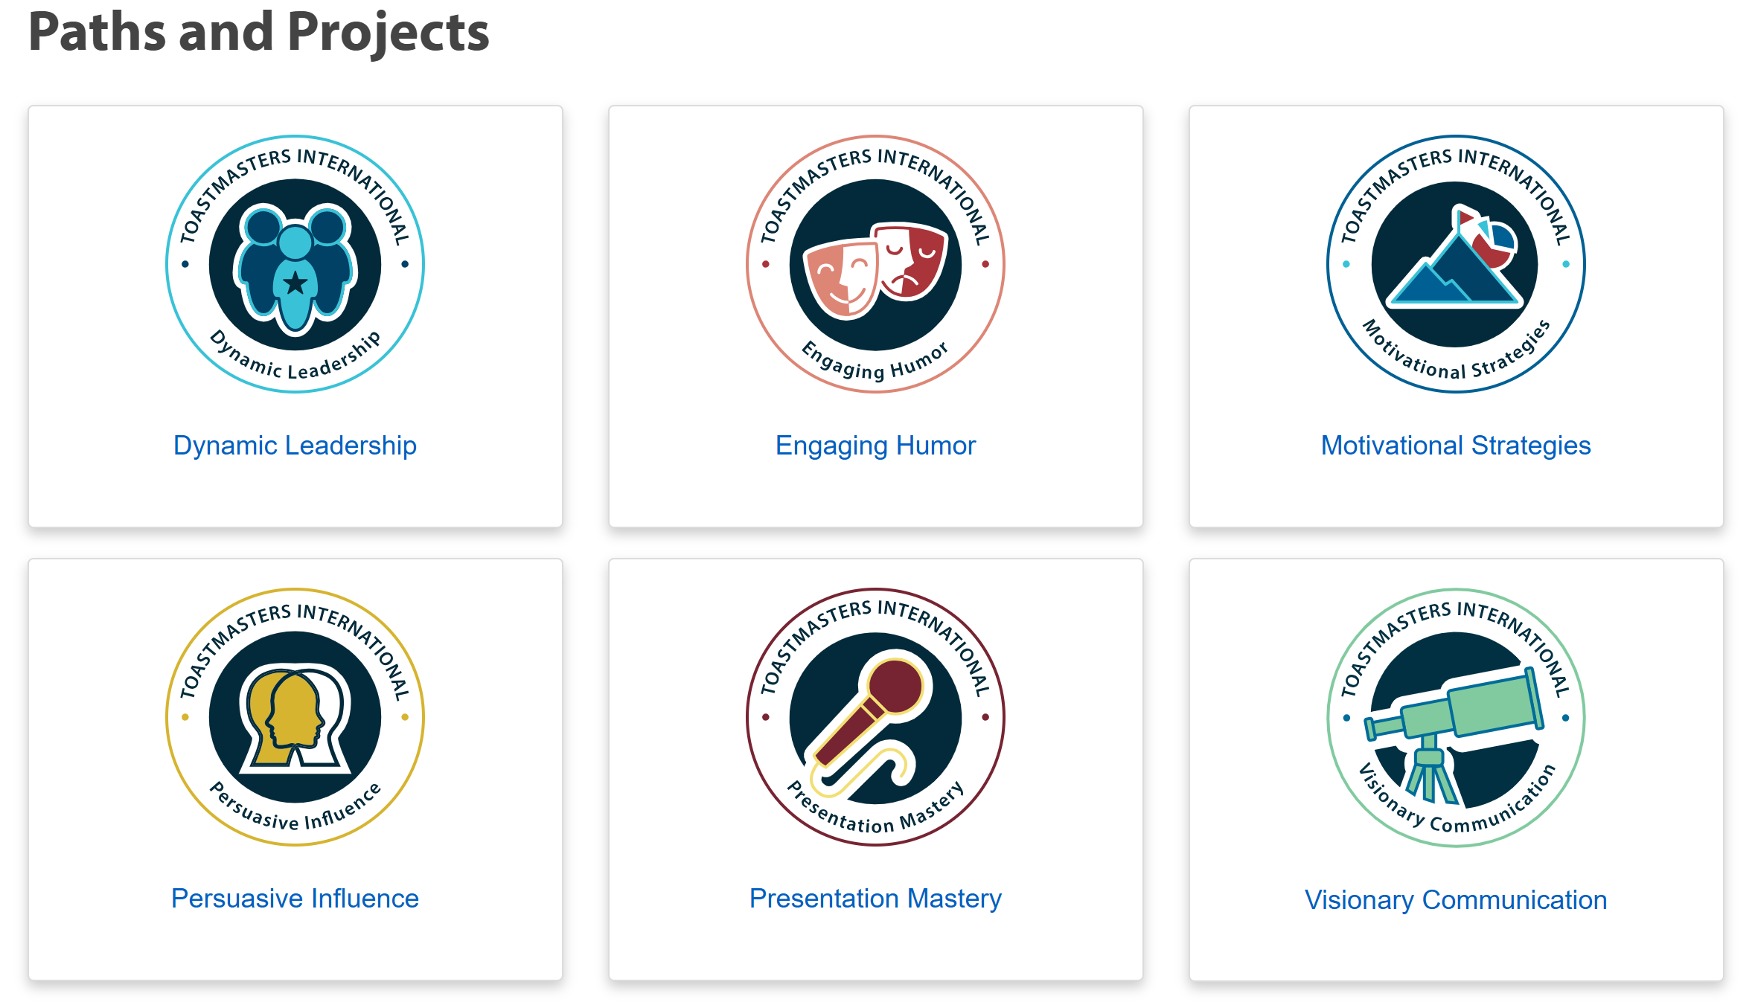
Pathways Overview
Notes:
These are the Paths that are affected by the October 2025 enhancements.

Slide 4
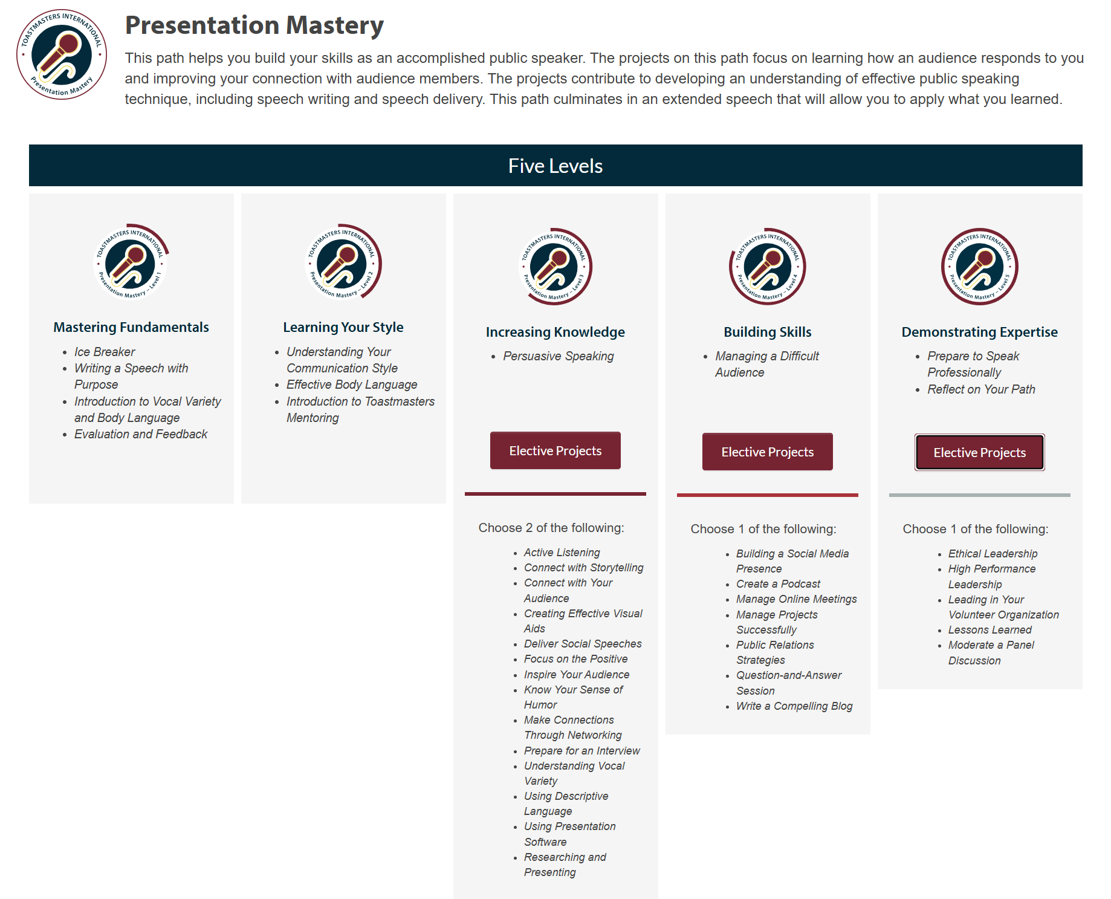
Pathways Overview

Slide 5
What Are the New Enhanced Pathways Requirements?
Complete current Pathways projects levels 1-5 (No change)
Serve in club meeting role(s) in path levels 1-5 (New)
Add Education Series presentation(s) in levels 3-5 (New)
Notes:
Enhancements for each Level will appear above that Level’s projects.
Meeting Roles will NOT be tracked in Base Camp. Clubs can discern if a member may complete meeting roles out of Level order.
The Board of Directors has determined that members must complete their required meeting roles within the relevant level to receive credit. For example, a role completed in Level 1 cannot count toward Level 3
Education Series Presentations will appear similar to Electives and be tracked in Base Camp.

Slide 6
Level | Meeting Roles
1 | Table Topics Speaker (1) Evaluator (1) Timer or Ah Counter (1)
2 | Grammarian (1) Table Topics Master (1) Evaluator (1) Toastmaster, Timer or Ah-Counter (1)
3 | Toastmaster (1) Evaluator (1) Table Topics Master, Table Topics Speaker or Introductory Mentor (1)
4 | Toastmaster (1) General Evaluator (1) Evaluator (1) Table Topics Speaker, Table Topics Master, Specialized Role or repeat role listed above (1)
5 | General Evaluator (2) Toastmaster (2) Evaluator (2) Other roles: Table Topics Speaker, Table Topics Master, Grammarian, Timer Ah-Counter, Mentor, or Specialized Role (1)
Required Meeting Roles for Each Level

Slide 7
Education Series for Enhanced Pathways
Level 3 | Successful Club Series (1) | 10-15 minutes
Level 4 | Successful Club Series (1) Better Speaker Series (1) | 10-15 minutes
Level 5 | Successful Club Series (1) Leadership Excellence Series (1) | 10-15 minutes

Slide 8
Level 3 Successful Club Series Select 1
Creating the Best Club Climate
Meeting Roles and Responsibilities
Keeping the Commitment
Going Beyond Our Club
Notes:
The other options will appear in Levels 4 and 5

Slide 9
Level 4: Select 1 from Each Series
Successful Club Series
Better Speaker Series
Finding New Members
Closing the Sale
How to be a Distinguished Club
Toastmasters Education Program
Beginning Your Speech
Concluding Your Speech
Controlling Your Fear
Impromptu Speaking
Selecting Your Topic
Know Your Audience
Organizing Your Speech
Creating an Introduction
Preparation and Practice
Using Body Language

Slide 10
Level 5: Select 1 from Each Series
Successful Club Series
Leadership Excellence Series
Moments of Truth
Evaluate to Motivate
Mentoring
Visionary Leader
Developing a Mission
Values and Leadership
Goal Setting and Planning
Delegate to Empower
Building a Team
Giving Effective Feedback
The Leader as Coach
Motivating People
Service and Leadership
Resolving Conflict

Slide 11
What Materials Are Provided By Toastmasters International For Each Presentation ?
Example: Successful Club Series “Moments Of Truth Materials”:
Manual
Powerpoint

Slide 12
Affected Paths
Enhancements apply to 6 paths:
• Dynamic Leadership
• Engaging Humor
• Motivational Strategies
• Persuasive Influence
• Presentation Mastery
• Visionary Communication

Slide 13
What Stays the Same
• Existing project requirements remain unchanged.
• Completed levels remain completed.
• Members in legacy* or translated paths can participate but not required.
* Effective Coaching, Innovative Planning, Leadership Development, Strategic Relatiinships, Team Collaboration
Notes:
Legacy and translated Paths will NOT contain the 2025 Pathways enhancements. Similar to Windows 11 needing to be installed since Windows 10 will not be supported after October 2025,

Slide 14
Resources
Meeting Roles Descriptions
  www.toastmasters.org/membership/club-meeting-roles
Successful Club Series
  https://www.toastmasters.org/resources/the-successful-club-series-set
Better Speaker Series
  www.toastmasters.org/resources/ the-better-speaker-series-set
Leadership Excellences Series
www.toastmasters.org/resources/the-leadership-excellence-series-set
Tracking Tool
  https://d54tm.com/pathways-1

Slide 15
Important Next Steps
Understand Meeting Roles.
Review/Download Education Series content.
Sign up for/perform Meeting Roles.
Prepare/present Education module(s).
Track new enhancements.

Slide 16
Let's embrace the recent Pathways enhancements!
Toastmasters International
Enhancing Member Experience and Club Success
Notes:
Original PPT slidedeck developed by Wendy Pesavento, October 2025
Updated PPT slidedeck developed by Maryann Reichelt, October 16, 2025

