Slide 1
Base Camp Changes are Coming
Dick Poirier
17 Sep 2024
Notes:
Duration: 45 min
Slides created by Heather Blase (blase_heather_m@cat.com) for the District 54 Toastmasters Leadership Institute (TLI) – Summer 2022

Slide 2
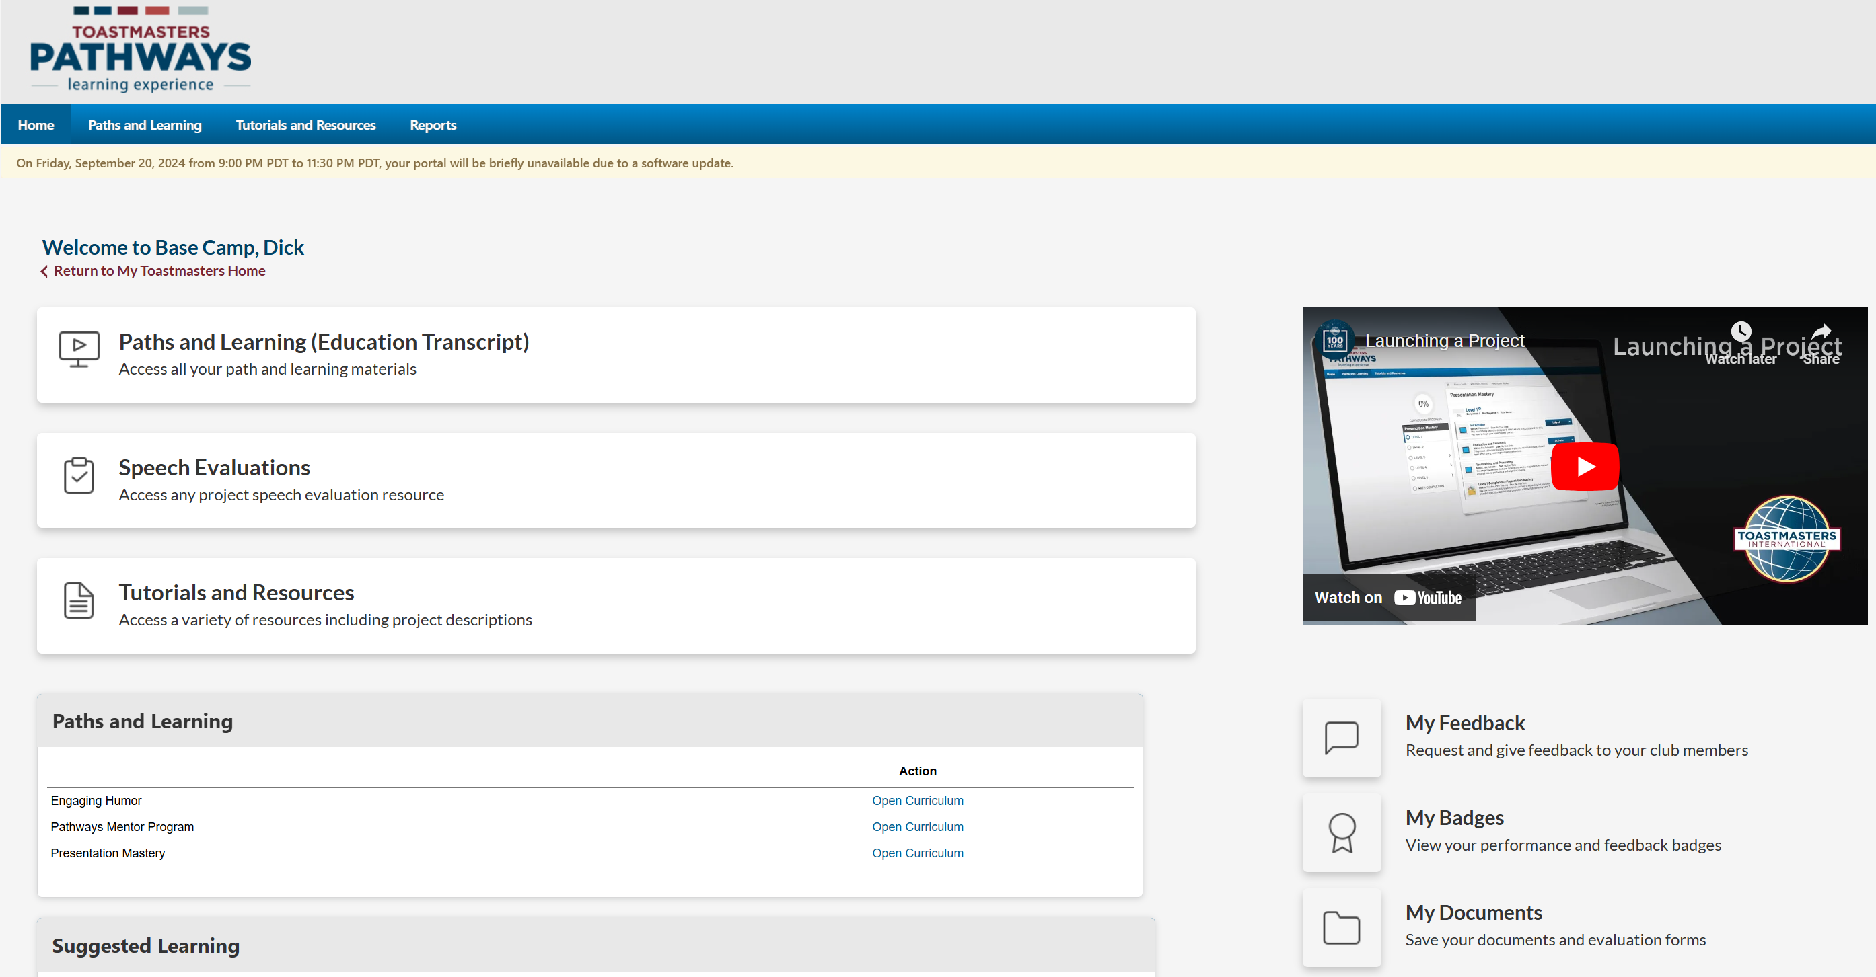
Bye-bye Old Base Camp
Temporarily Out of Service
for system upgrades & testing
October 9 – October 25

Slide 3
Base Camp Upgrades
6 Paths Remaining
Dynamic Leadership
Engaging Humor
Motivational Strategies
Presentation Mastery
Persuasive Influence
Visionary Communication
Easier navigation
Level Approval in Base Camp => Club Central (one step)
Mobile device accessibility
Visually Impaired friendly
Easy share accomplishments to social media
From 11 Paths => 6 Paths + Explorations (2 new after launch)

Slide 4
Actions needed before the Oct 9 shutdown
Ensure BCM approves pending achievements
EH1 APPROVED

Slide 5
Actions needed before the Oct 9 shutdown
Ensure BCM approves pending achievements
Download Project PDF(s) & Eval Form you plan to work in October

Slide 6
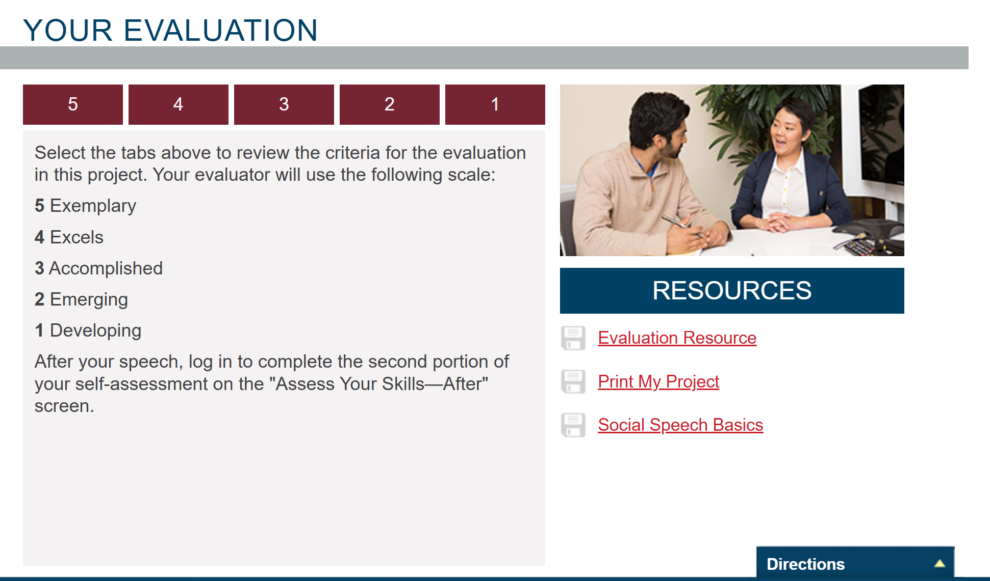
Actions needed before the Oct 9 shutdown
Ensure BCM approves pending achievements
Download Project PDF(s) & Eval Form you plan to work in October

Slide 7
Actions needed before the Oct 9 shutdown
Ensure BCM approves pending achievements
Download Project PDF(s) & Eval Form you plan to work in October
Download Completion Certificates

Slide 8
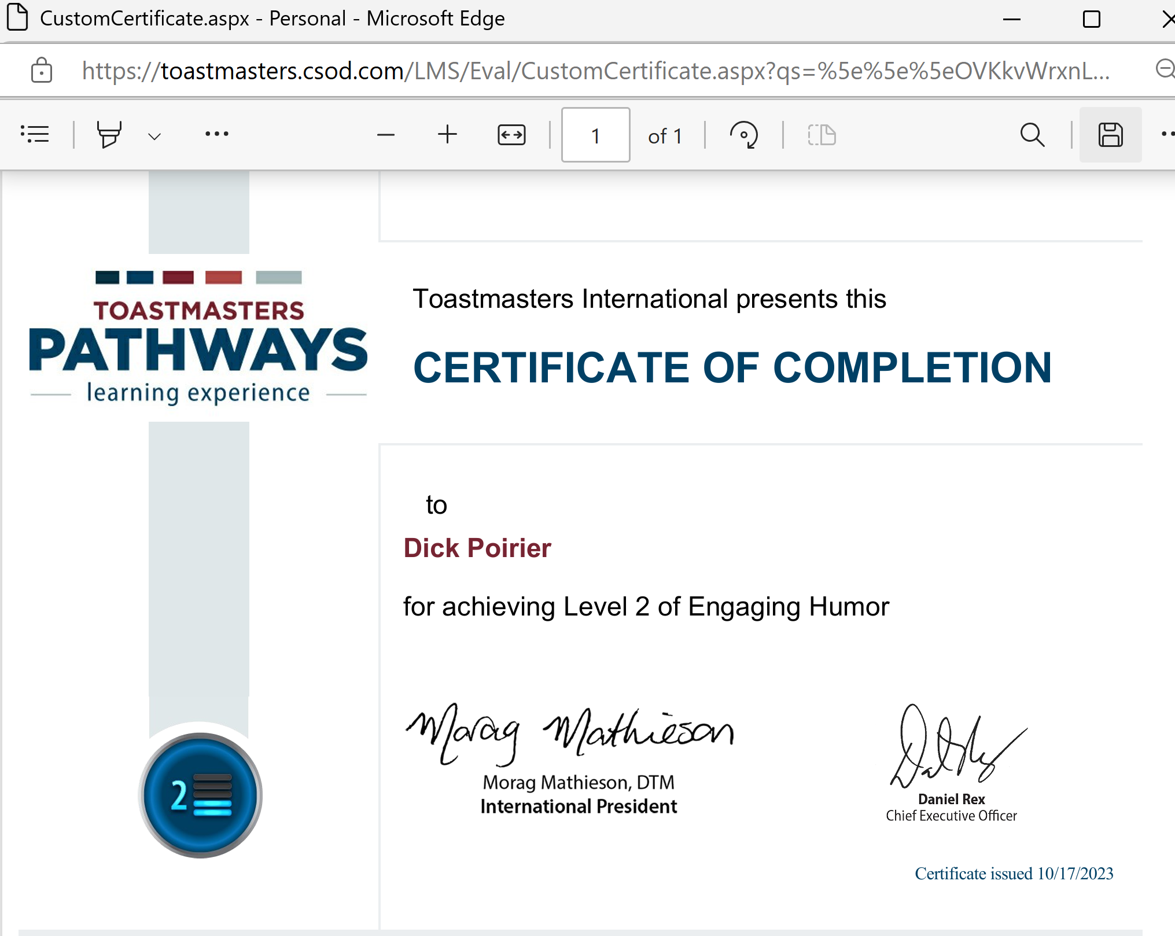
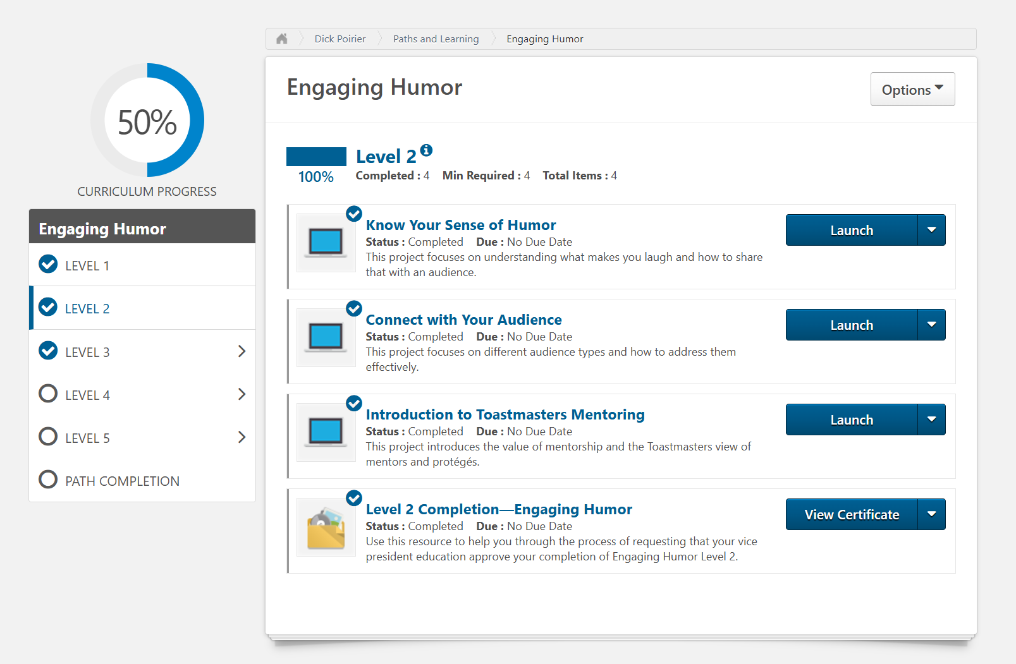
Actions needed before the Oct 9 shutdown
Ensure BCM approves pending achievements
Download Project PDF(s) & Eval Form you plan to work in October
Download Completion Certificates

Slide 9
Actions needed before the Oct 9 shutdown
Ensure BCM approves pending achievements
Download Project PDF(s) & Eval Form you plan to work in October
Download Completion Certificates
Download Documents/Feedback/Badges

Slide 10
Actions needed before the Oct 9 shutdown
Ensure BCM approves pending achievements
Download Project PDF(s) & Eval Form you plan to work in October
Download Completion Certificates
Download Documents/Feedback/Badges

Slide 11
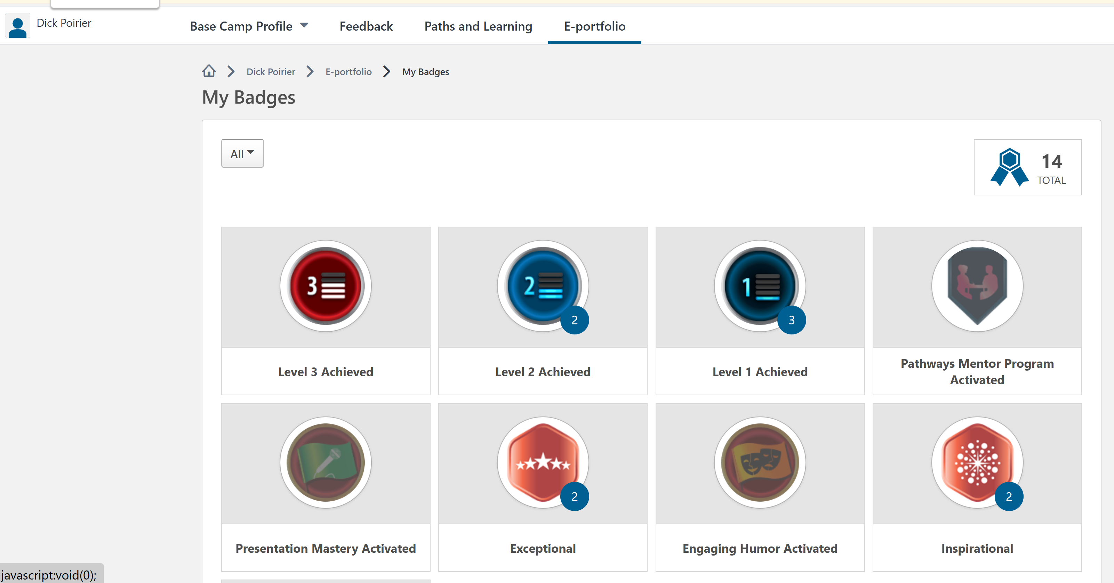
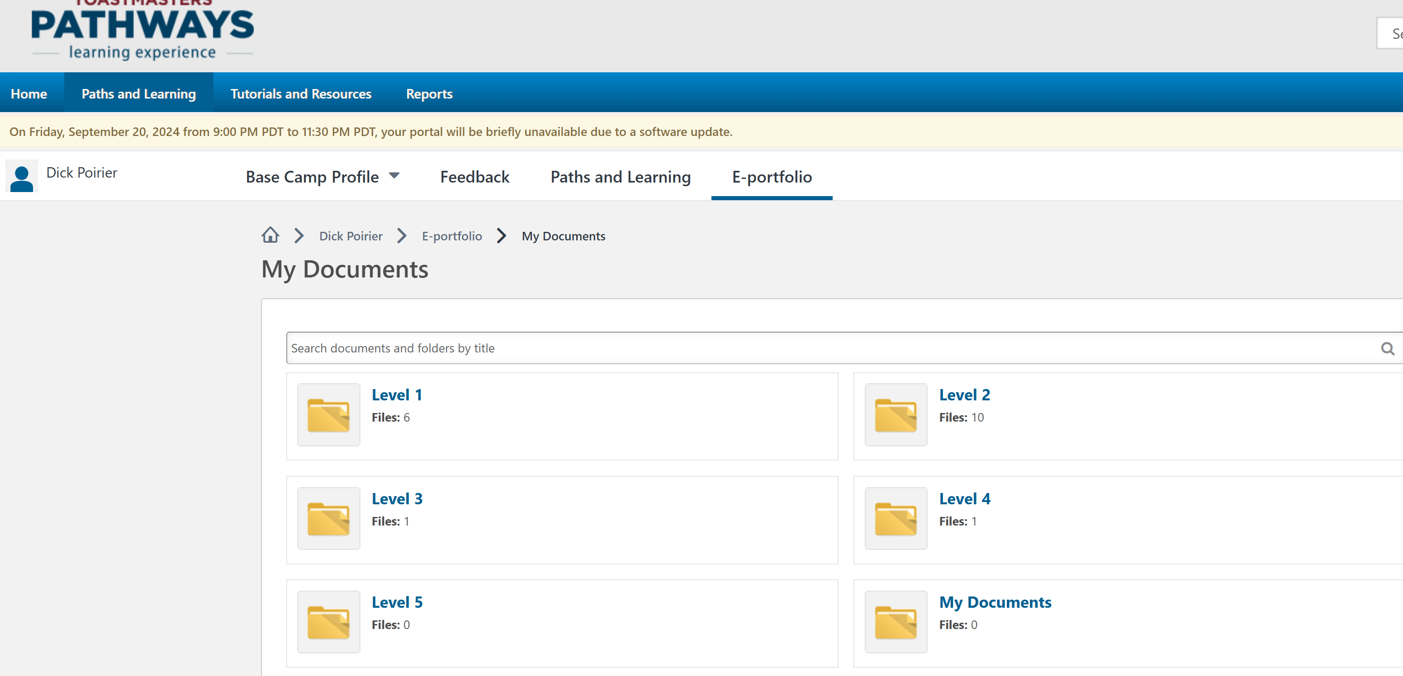
Actions needed before the Oct 9 shutdown
Ensure BCM approves pending achievements
Download Project PDF(s) & Eval Form you plan to work in October
Download Completion Certificates
Download Documents saved

Slide 12
Other Actions needed before the Oct 9 shutdown
Save (if desired):
Skills Assessment info
Questionnaire responses (Understanding Comm or Ldrship Styles)
Story Collection in Engaging Humor Path
Meeting Roles (we have these in Easy Speak)

Slide 13
Actions after the Oct 9 shutdown
Submit for approval any projects completed during shutdown
Ensure BCM approves these achievements
Separate entry in Club Central no longer needed
Enjoy the new and improved Pathways!

Slide 14
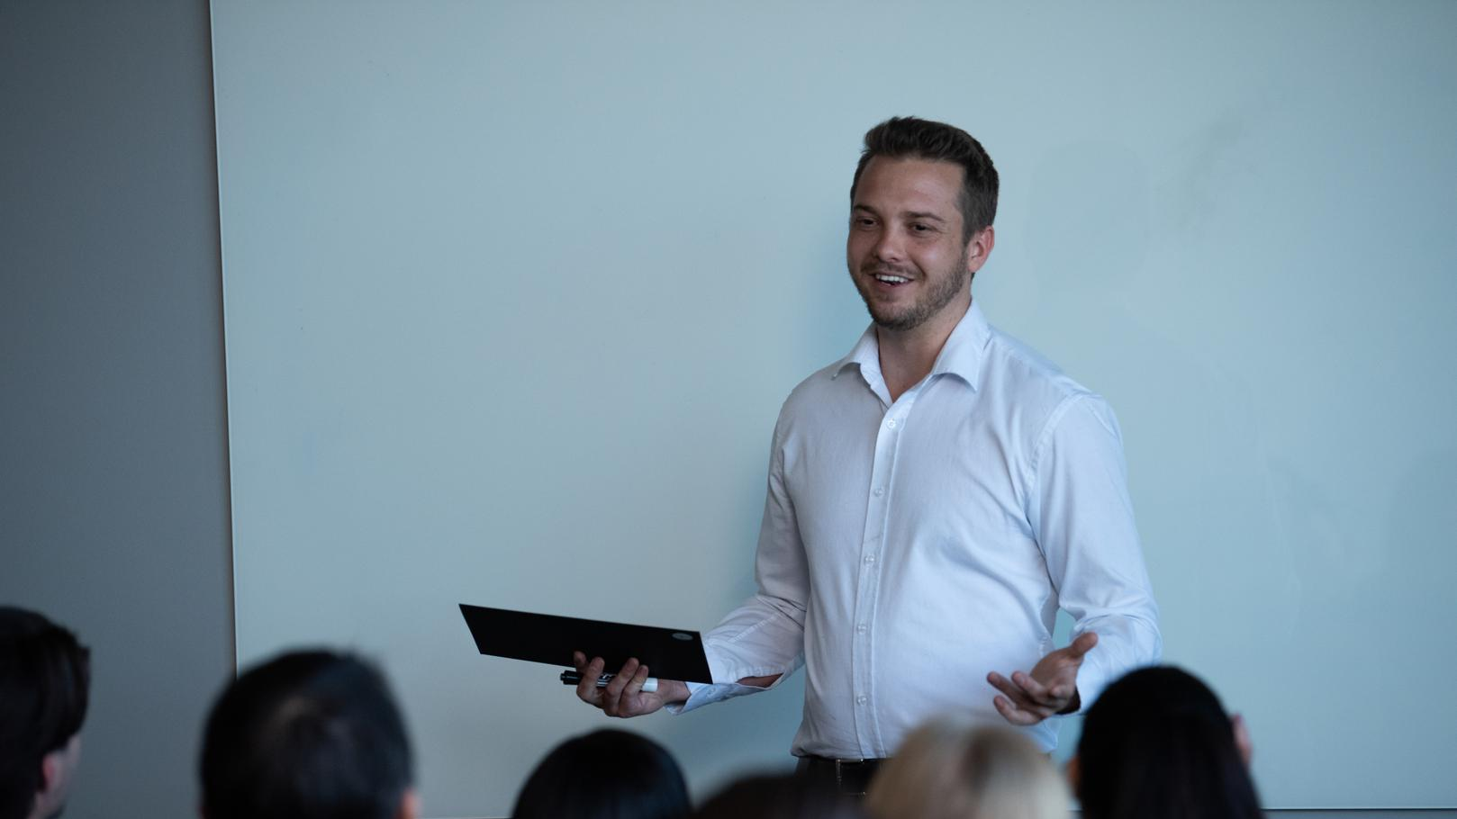
Questions?
Notes:
INSTRUCT attendees to take a moment to complete the evaluation form.

