Slide 1
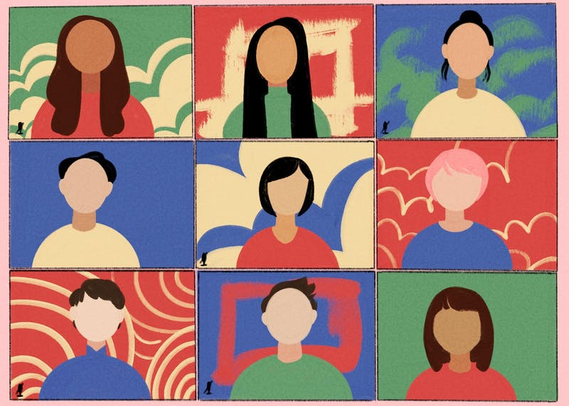
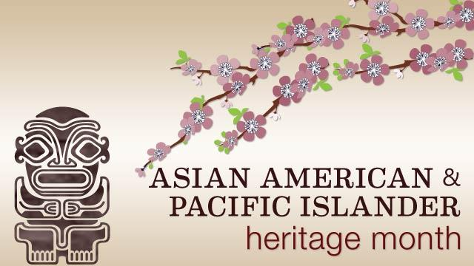
Heritage Month
Created by Qiong Chen

Slide 2
What is AAPI Heritage Month?
AAPI stands for Asian Americans and Pacific Islanders. According to the Asian Pacific Institute, this term includes "all people of Asian, Asian American or Pacific Islander ancestry, who trace their origins to the countries, states, jurisdictions and/or the diasporic communities of these geographic regions."
In honor of Asian American and Pacific Islander Heritage Month, it's important to better understand who makes up the large and diverse community that celebrates it, as using the proper terminology can help you be a better ally and show support to AAPI communities. Asia is the largest continent and consists of arguably 50 countries, and it's made up of a little more than 4 billion people . While the World Bank's Pacific Island member countries have a combined population of about 2.3 million people.

Slide 3
Who is identified as AAPI?
Who may be identified as Asian?
Today, the U.S. Census Bureau classifies Asians as "having origins in any of the original peoples of the Far East, Southeast Asia, or the Indian subcontinent," including (but not limited to) China, Japan, Thailand, Malaysia, Korea, India, Cambodia, Vietnam or the Philippines.
Who may be identified as Pacific Islander?
Pacific Islanders are people whose origins belong to Polynesia, Micronesia, and Melanesia. This classification includes (but is not limited to) Native Hawaiian, Samoan, Tahitian, Guamanian, Fijian and Papua New Guinean people (It helps to look at Pacific Islander countries' geographic location).

Slide 4
When is AAPI Heritage Month and how do we celebrate?
Asian American and Pacific Islander (AAPI) Heritage Month is observed annually in May to celebrate the contributions that generations of AAPIs have made to American history, society, and culture in the United States.

Slide 5
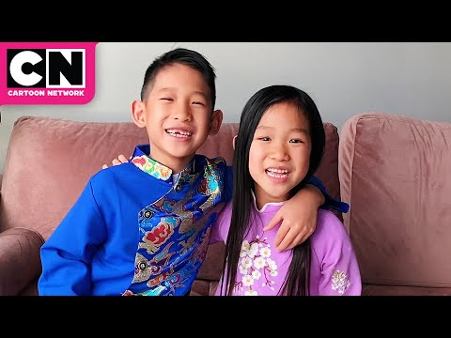
Kids around the world celebrate AAPI Heritage Month!

Slide 6
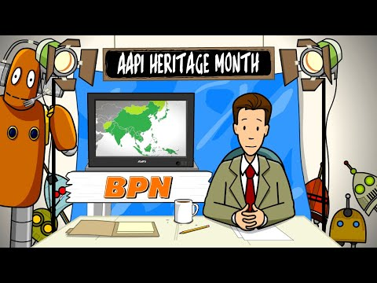

Slide 7
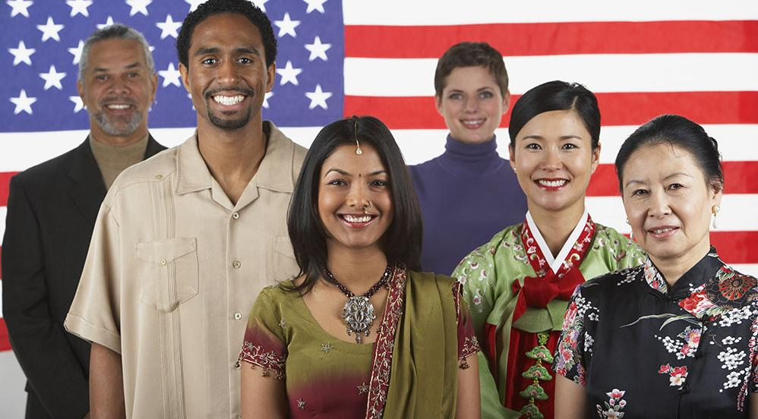
Representative picture of American with AAPI heritage

Slide 8
Like how we celebrate Hispanic Heritage Month and Black History Month, AAPI Heritage Month will bring us to the world of AAPI heroes that made great contributions to our world in all walks of life!

Slide 9
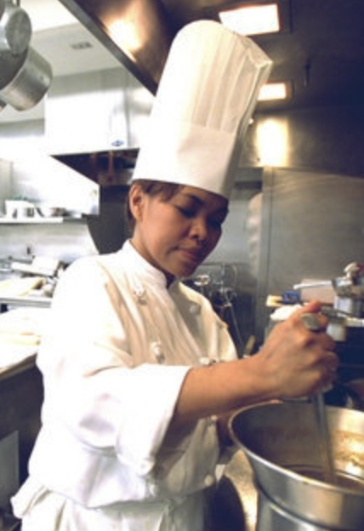
Today is 5/3/2021, our AAPI hero is
Cristeta Comerford
Cristeta Pasia Comerford (born October 27, 1962) is the first Asian and first female White House Executive Chef.
Cristeta “Cris” Comerford was born Cristeta Pasia in Sampaloc, Manila, Philippines and now works in the most famous house in the United States. She attended Manila Science High School before attending the University of the Philippines, Diliman in Quezon City where she majored in food technology. At the age of 23, she left the university without a degree to the United States where she got her first job at a Sheraton Hotel near the O’Hare International Airport. After working at a few hotels and restaurants in Chicago, Washington, D.C, and in Vienna, she was recruited to work in the Clinton White House by White House executive chef Walter Scheib III in 1995. She continued to work until Scheib’s resignation in 2005. Following Scheib’s resignation, first lady Laura Bush appointed Comerford as the White House executive chef. In August 2005, Comerford became the first minority and first female to hold the position.
Comerford continues to work as the White House executive chef, creating menus for social events, official dinners, and more. She is also a member of the Club Chefs du Chef, the world’s most exclusive society of chefs that consists of chefs to world leaders.
--adapted from Wikipedia

Slide 10
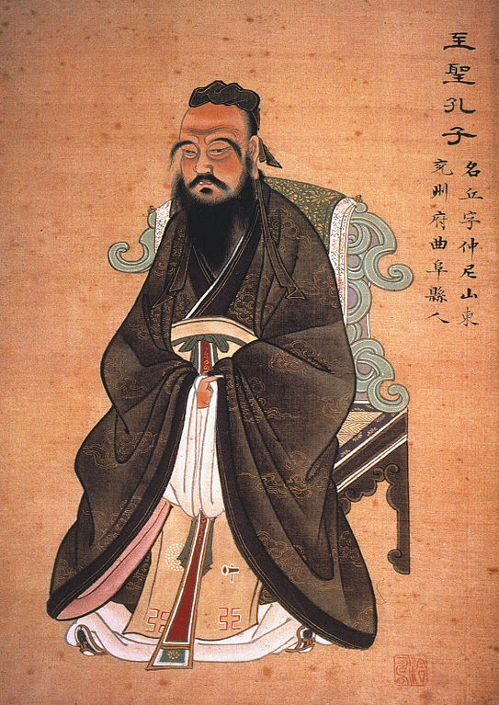
Today is 5/4/2021, our AAPI hero is
Confucius (Kong Qiu)
Master Kong Qiu was, known popularly as Confucius in the west (孔夫子; pinyin: Kǒng Fūzǐ, "Master Kǒng"; 551–479 BCE) , was a minor government official and a specialist in the governmental and family rituals of his native state.
Confucius/Kong Qiu hoped to disseminate knowledge of the rites and inspire their universal performance. 250 years after his death, during the Han dynasty (202 BCE-220 CE), his teachings became “Confucianism” as we know it today. Confucius/Kong Qiu transmitted instructions not only on specific rituals and values but also a hierarchical social structure combined with the weight of the past. Confucius/Kong Qiu, and those who followed his teachings, remain an essential influence on the structure of modern societies in China, Korea, and Vietnam.
--adapted from Wikipedia

Slide 11
Today is 5/5/2021, our AAPI hero is
Keisuke Honda
Keisuke Honda (本田 圭佑, Honda Keisuke, born June 13,1986) is a Japanese professional football player and manager.
He scored one of the goals of the 2010 World Cup with his free kick against Denmark that helped send Japan into the Round of 16. He has played professionally in Russia, Italy for AC Milan, Mexico and is currently starring for the Melbourne Victory in the A-League. He scored 37 goals for Japan’s national team including the 2018 World Cup. He is still the top scoring Asian footballer at the World Cup. He is also currently serving as the manager for the Cambodian Men’s national team.
--adapted from Wikipedia

Slide 12
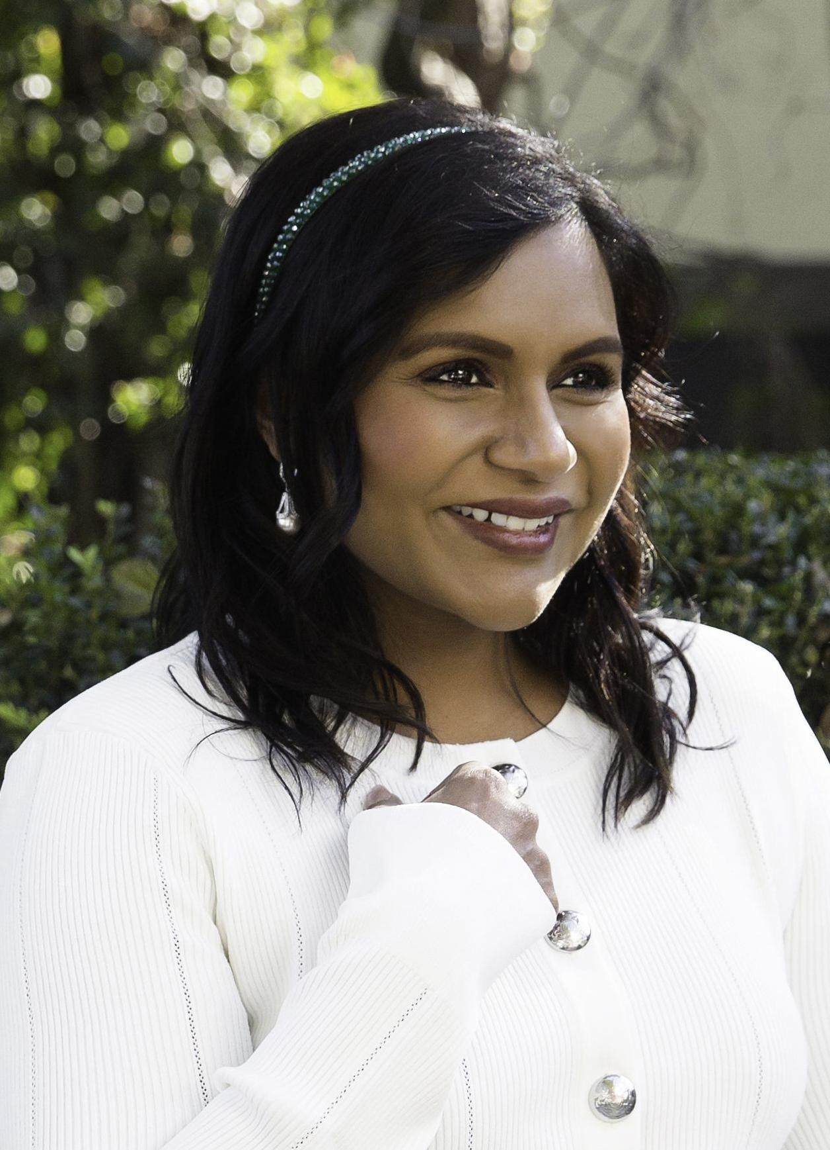
Today is 5/6/2021, our AAPI hero is
Mindy Kaling
Vera Mindy Chokalingam (born June 24, 1979), known professionally as Mindy Kaling (/ˈkeɪlɪŋ/), daughter of Indian immigrants, is an American actress, comedian, and author, known as the starring role and executive producer of The Mindy Project as well as Kelly Kapoor in The Office as a writer, executive producer, and occasional director. An alumnus of Dartmouth College, she has also written the autobiographies, Is Everyone Hanging Out Without Me? (and Other Concerns) and Why Not Me?
--adapted from Wikipedia

Slide 13
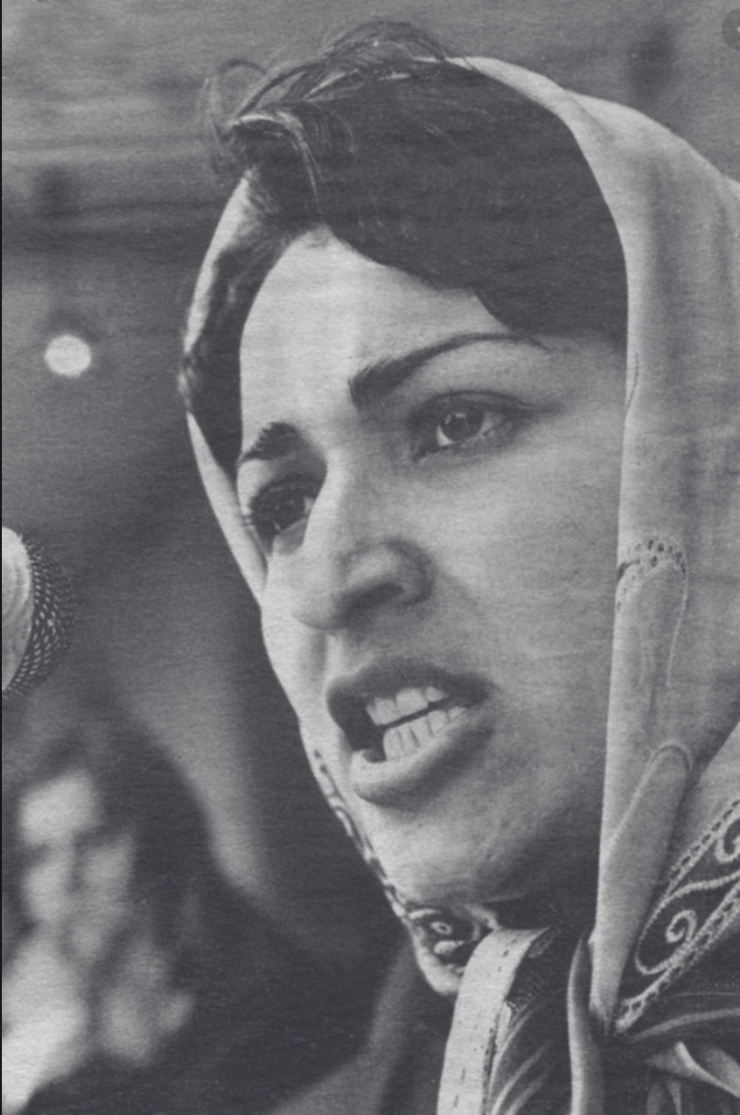
Today is 5/7/2021, our AAPI hero is
Meena Keshwar Kamal
Meena Keshwar Kamal (Pashto/Persian: مینا کشور کمال‎; February 27, 1956 – February 4, 1987), commonly known as Meena, was an Afghan feminist and revolutionary political activist who fought for women’s rights in Afghanistan. Kamal founded the Revolutionary Association of the Women of Afghanistan (RAWA), a Marxist organization that seeks to empower Afghan women in society and encourage them in their radical voices.
Kamal started her activism while in high school as students across the country were inspired to join activist movements that were spreading across the globe. Her heart as an activist was cultivated even deeper when she attended university, so much so that she left her studies to devote herself to organizing and women’s education initiatives. Kamal founded a bilingual magazine that encouraged feminist thought. She also openly stood against Russian military invaders and organized the public against their influence. Kamal was assassinated in 1987 for her revolutionary efforts.
--adapted from Wikipedia

Slide 14
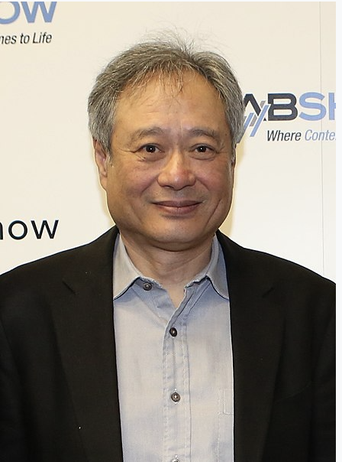
Today is 5/10/2021, our AAPI hero is
Ang Lee
Ang Lee OBS (Chinese: 李安; pinyin: Lǐ Ān; born October 23, 1954) is a Taiwanese film director, producer, and screenwriter. Born in the Pingtung County of southern Taiwan, Lee was educated in Taiwan and later in the United States. During his filmmaking career he has received international critical and popular acclaim and a range of accolades.
Lee has been nominated for nine Academy Awards, of which he has won three: Best Foreign Language Film for Crouching Tiger Hidden Dragon and Best Director for Brokeback Mountain and Life of Pi, becoming the first non-white director to win the latter.
For The Wedding Banquet and Sense and Sensibility, Lee won the Golden Bear at the Berlin International Film Festival; for Brokeback Mountain and Lust Caution, he won the Golden Lion at the Venice Film Festival. Lee is one of four directors to win the Golden Lion twice and the sole filmmaker to have been awarded the Golden Bear twice. Lee has also been awarded Directors Guild of America Awards, Golden Globes and British Academy Film Awards, among others, and is the recipient of the Order of Brilliant Star, the second highest civilian honor bestowed by the government of Taiwan.
--adapted from Wikipedia

Slide 15
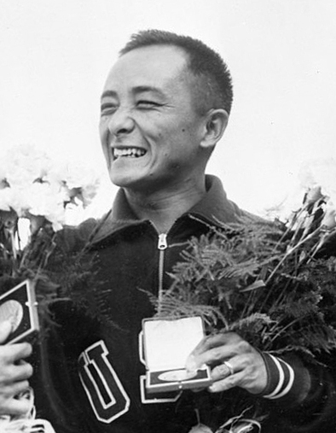
Today is 5/11/2021, our AAPI hero is
Sammy Lee
Ww
Sammy Lee (Original name: Samuel Lee; August 1, 1920 – December 2, 2016) was an American physician and diver. He was the first Asian American man to win an Olympic gold medal for the United States (the second Asian American to win a gold medal overall)^{[2]} and the first man to win back-to-back gold medals in Olympic platform diving.
Under the tutelage of renowned diving coach Jim Ryan, Lee won the United States National Diving Championships in 1942 in both the 3-meter springboard and the 10-meter platform events, becoming the first person of color to capture the United States national championship in diving. In 1946, he again triumphed at the 10-meter platform event while finishing third at the 3-meter springboard competition at the national diving competition in San Diego.
At the 1948 Summer Olympics in London, England, Lee earned a bronze medal in the 3-meter springboard and a gold medal in 10-meter platform diving events.^{[1][4]} In so doing, he became the second Asian American to earn a gold medal, behind only Vicki Draves, who won an Olympic gold medal two days earlier in springboard diving.
--adapted from Wikipedia
Notes:
5/3

Slide 16
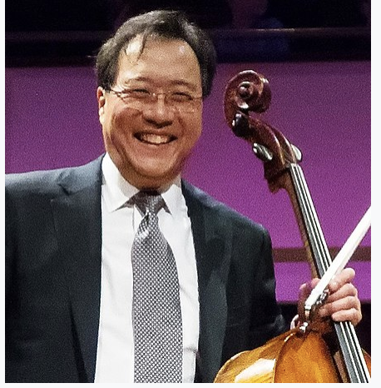
Today is 5/12/2021, our AAPI hero is
Yo-Yo Ma
Yo-Yo Ma (born October 7, 1955) is an American cellist. Born in Paris, France, to Chinese^{[3]} parents and educated in New York City, United States, Ma was a child prodigy, performing from the age of four and a half. He graduated from The Juilliard School and Harvard University, and has performed as a soloist with orchestras around the world. He has recorded more than 90 albums and received 18 Grammy Awards.
In addition to recordings of the standard classical repertoire, he has recorded a wide variety of folk music, such as American bluegrass music, traditional Chinese melodies, the tangos of Argentinian composer Ástor Piazzolla, and Brazilian music. He has collaborated with artists including jazz singer Bobby McFerrin, guitarist Carlos Santana, Sérgio Assad and his brother, Odair, and singer-songwriter and guitarist James Taylor. Ma's primary performance instrument is a Montagnana cello crafted in 1733 and valued at US$2.5 million.
He has been a United Nations Messenger of Peace since 2006. He was awarded The Glenn Gould Prize in 1999, the National Medal of Arts in 2001,the Presidential Medal of Freedom in 2011, and the Polar Music Prize in 2012.
Ma is included in Time magazine's 100 Most Influential People of 2020.
Yo Yo Ma’s official website: https://www.yo-yoma.com/.
--adapted from Wikipedia

Slide 17
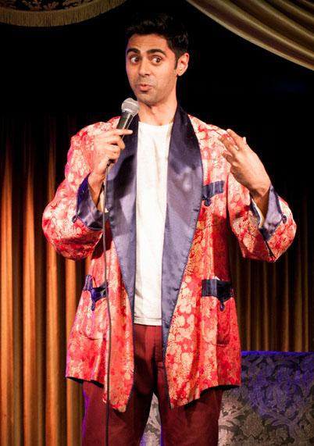
Today is 5/13/2021, our AAPI hero is
Hasan Minhaj
Coming from a North Indian Muslim family and born in the US, Hasan Minhaj (/ˈhʌsən ˈmɪnhɑːdʒ/; born September 23, 1985) is an American comedian, writer, producer, political commentator, actor, and television host. From 2014 to 2018, he was The Daily Show’s senior correspondent and in 2017, his stand-up comedy special, Homecoming King debuted on Netflix.
In April 2019, he was named one of TIME’s 100 most influential people.

Slide 18
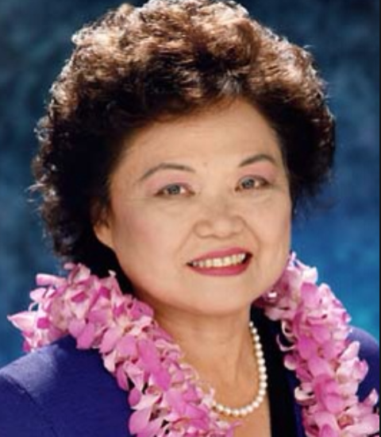
Today is 5/14/2021, our AAPI hero is
Patsy Matsu Takemoto Mink
Patsy Matsu Takemoto Mink (December 6, 1927 – September 28, 2002) was an American attorney and politician from the U.S. state of Hawaii. She was a third generation Japanese immigrant and raised in Hawaii. After receiving her JD at the University of Chicago, she was the first woman of color elected to Congress. She co-authored “Title IX Amendment of the Higher Education Act” and served a total of twelve terms in the House of Representatives
Mink was the first East Asian-American woman to seek the presidential nomination of the Democratic Party. She ran in the 1972 election, entering the Oregon primary as an anti-war candidate. She was the federal Assistant Secretary of State for Oceans and International Environmental and Scientific Affairs from 1977 to 1979. From 1980 to 1982, Mink served as the president of Americans for Democratic Action and then returned to Honolulu, where she was elected to the Honolulu City Council, which she chaired until 1985. In 1990, she was again elected to the U.S. House, serving until her death in 2002. During her second six terms in office, she continued to work on legislation of importance to women, children, immigrants, and minorities.
--adapted from Wikipedia

Slide 19
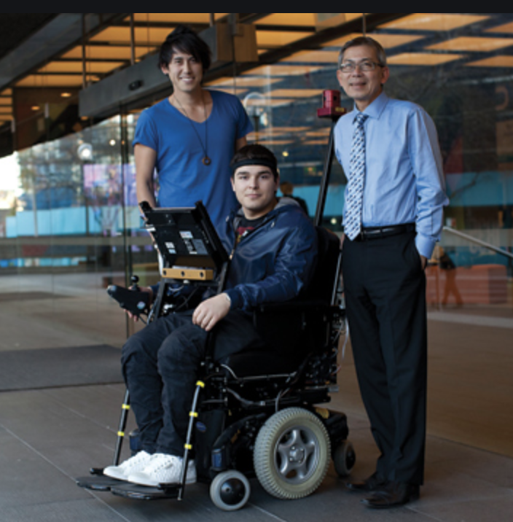
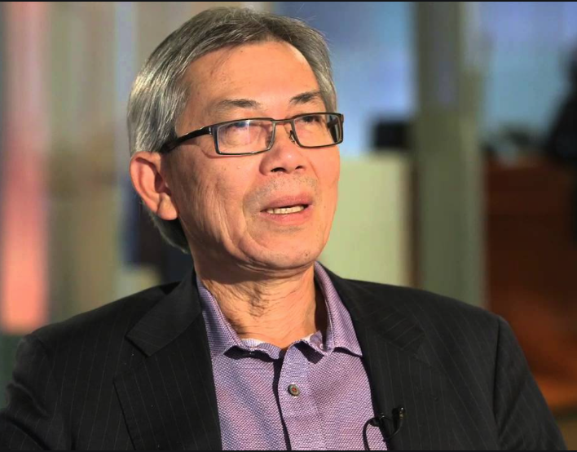
Today is 5/17/2021, our AAPI hero is
Hung Nguyen
Dean of the Faculty of Engineering and Information Technology, University of Technology, Sydney, Dr. Hung Nguyen developed the Aviator smart wheelchair technology in 2011. Aviator was developed in the form of two wheelchairs, TIM (Thought-controlled Intelligent Machine) and SAM (Semi Autonomous Machine). The system directs and controls the chairs' navigation by reading the user’s head movements and brain waves.
--adapted from itZone

Slide 20
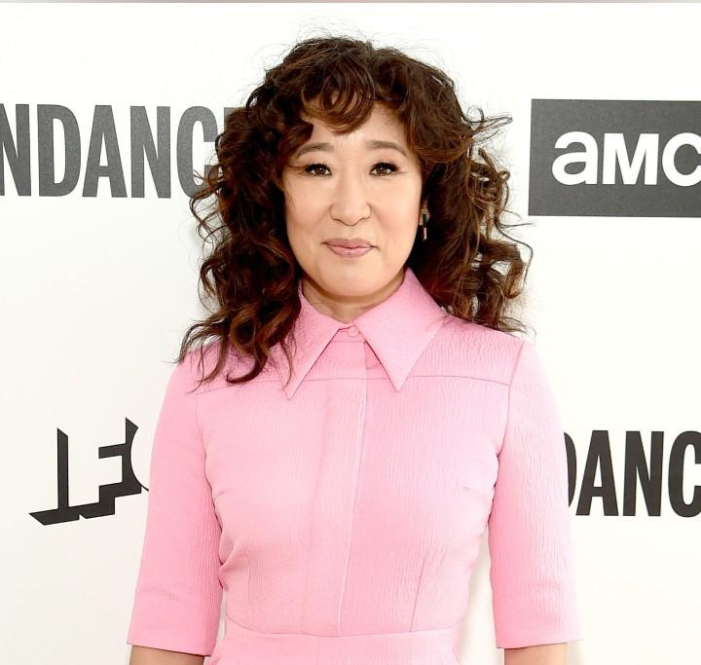
Today is 5/18/2021, our AAPI hero is
Sandra Oh
Sandra Miju Oh (born July 20, 1971) is daughter of Korean immigrants and starred in Grey’s Anatomy and Killing Eve. She won two Golden Globe Awards, four Screen Actors Guild Awards, and six Primetime Emmy Award nominations. She recently became the first Asian actress to host the Golden Globe Awards.
Oh hosted the 28th Genie Awards in 2008, and became the first Asian woman to host the Golden Globe Awards at the 76th ceremony in 2019.^{[2]} In March 2019, she became the first Asian-Canadian woman to host Saturday Night Live, and was just the third actress of Asian descent to do so, after Lucy Liu in 2000 and Awkwafina in 2018.^{[3]} She was also the first actress of Asian descent to be nominated for the Primetime Emmy Award for Outstanding Lead Actress in a Drama Series and the first Asian woman to win two Golden Globes.^{[4]} In 2019, Time magazine named Oh one of the 100 most influential people in the world.^{[5]} In addition to her Canadian citizenship, Oh has been a naturalized American citizen since 2018.
--adapted from Wikipedia

Slide 21
Today is 5/19/2021, our AAPI hero is
Naomi Osaka
Naomi Osaka(大坂 なおみ, Ōsaka Naomi, Japanese pronunciation: [o̞ːsäkä näo̞mi], born October 16, 1997) is a women’s tennis star born to a Haitian father and a Japanese mother who grew up in the US starting from age 3. She recorded her first professional win in 2014 against US Open champion Samantha Stosur. She defeated her longtime idol and inspiration, Serena Williams in the 2018 US Open.

Slide 22
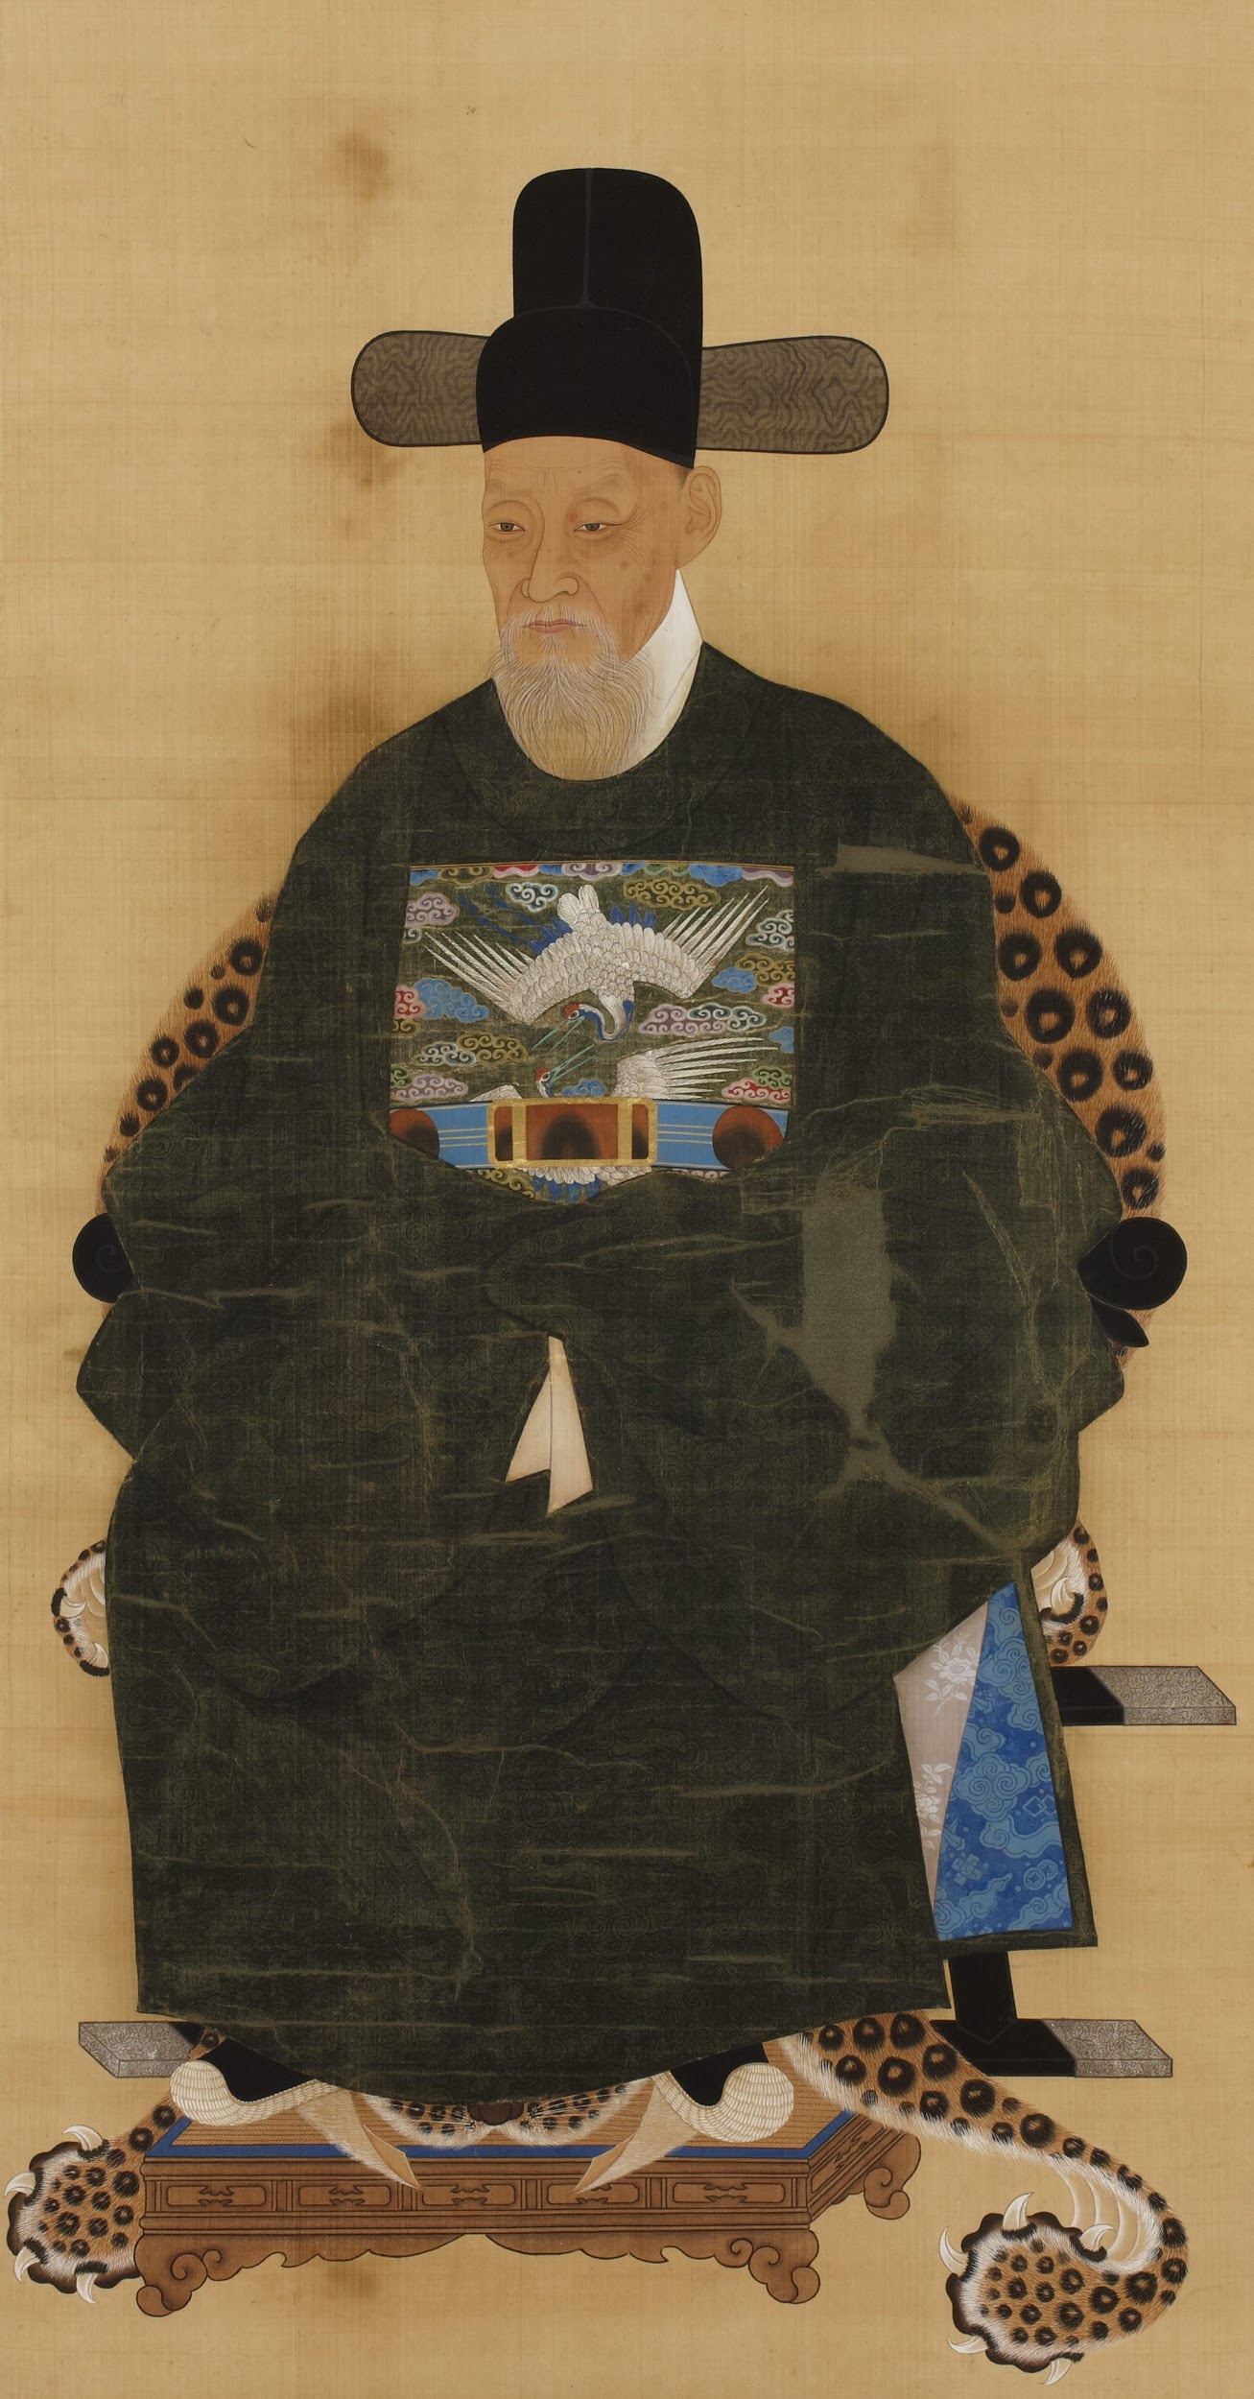
Today is 5/20/2021, our AAPI hero is
Choi Seok-jeong
Choi Seok-jeong (Korean: 최석정; Hanja: 崔錫鼎; 1646–1715) is a Korean mathematician. He published Gusuryak which contained Latin squares of order nine used to construct a magic square in 1700, predating Leonard Euler by at least 67 years. In the same book, he also published the hexagonal tortoise problem that involves a hexagonal lattice, like the hexagonal pattern on some tortoises' shells, to the (N) vertices of which must be assigned integers (from 1 to N) in such a way that the sum of all integers at the vertices of each hexagon is the same.
--adapted from Wikipedia

Slide 23
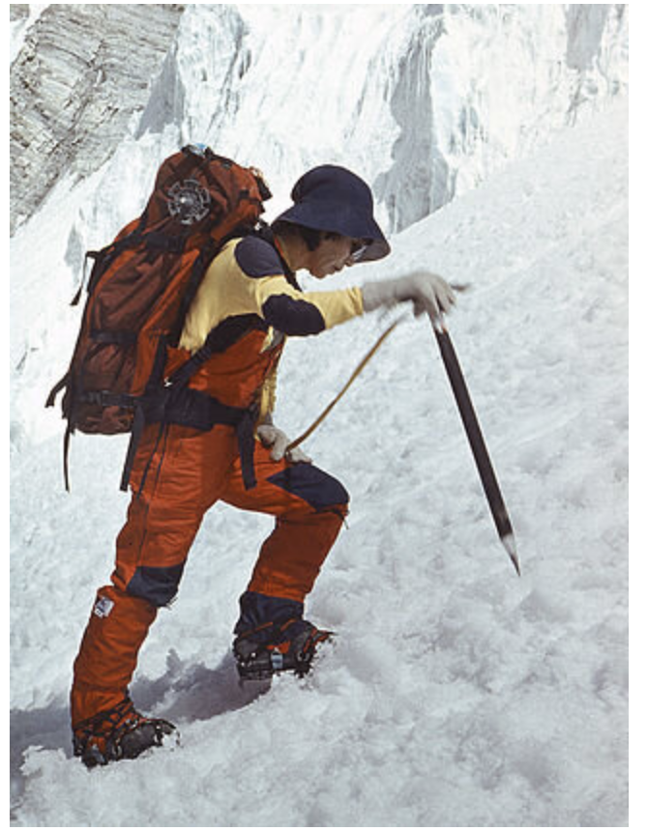
Today is 5/21/2021, our AAPI hero is
Junko Tabei
Junko Tabei (田部井 淳子, Tabei Junko, born Junko Ishibashi; September 22,1939 – October 20, 2016) was a Japanese mountaineer and the first woman to reach the top of Mt. Everest. She was also the first woman to climb the highest peak on every continent. She founded the Joshi-Tohan Club, which was a women-only mountaineering club in Japan—the first of its kind.
She wanted to create a space for women in Japan to discover climbing, and as a way to combat the discrimination she had encountered in all-male climbing groups. Tabei refused to take corporate sponsors and funded all her own trips. She funded her climbs through tutoring children in English, accepting paid public appearances and leading mountain climbing tours. She was also an avid environmentalist whose postgraduate studies focused on the degradation of Mt. Everest due to the waste left behind from climbing tourism. Tabei revolutionized the ideals of who a Japanese woman, wife and mother could be. By the end of her life in 2016, she had scaled 70 mountains, many of which were some of the highest in the world.
--adapted from Wikipedia

Slide 24
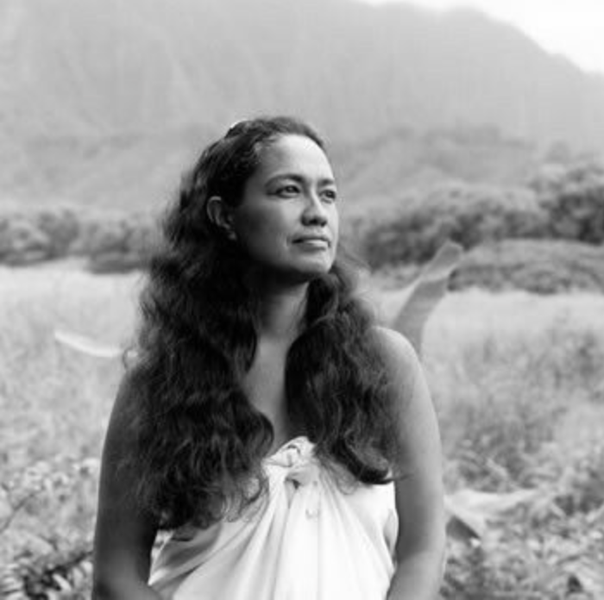
Today is 5/24/2021, our AAPI hero is
Haunani-Kay Trask
Haunani-Kay Trask is an Indigenous Hawaiian educator, activist, Hawaiian nationalist, author, poet, filmmaker and all-around badass. Born in 1949 to a politically active family, many of whom advocated for Hawaiian statehood, Trask has dedicated her life to advocating for a free and independent Hawaiʻi and to keeping Hawaiian culture alive while brutalized under imperial rule. Trask became heavily involved in the anti-Vietnam War movement while studying at the University of Wisconsin, and she became an active supporter of the Black Panther Party while studying at the University of Chicago. It was during her university studies that she made the connection to the symbiotic relationship that racism and capitalism share, and how the system exploits marginalized communities across the globe. Trask has worked tirelessly advocating for Hawaiian sovereignty, has participated in, and organized, protests for land rights. Trask famously confronted white male anthropologists who claimed expertise on Hawaiian culture and politics and spent years teaching at the University of Hawaiʻi at Manoa on the subjects of Polynesian women, political movements in Hawaiʻi and the Pacific Islands. She is a founding member of the Kamakakuokalani Center for Hawaiian Studies at the university and has written numerous books. Trask anchored and produced First Friday, a monthly public television show highlighting cultural and political issues that impact Native Hawaiians. In 2019, she was awarded the Angela Y. Davis Prize for her work in education, activism and the arts.
--adapted from Wikipedia

Slide 25
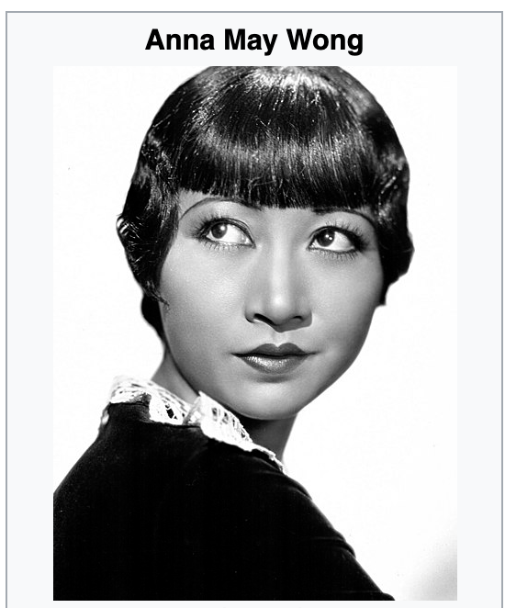
Today is 5/25/2021, our AAPI hero is
Anna May Wong
Anna May Wong (born Wong Liu Tsong; January 3, 1905 – February 3, 1961) was an American actress, considered to be the first Chinese American Hollywood movie star,^{[1]} as well as the first Chinese American actress to gain international recognition.^{[2]} Her varied career spanned silent film, sound film, television, stage, and radio.
While working on films in the United States, Wong was still asked to play stereotypical Asian roles. When the director of the film Dangerous to Know asked her to use Japanese mannerisms when playing a Chinese character, Wong refused. Wong later accepted another stereotypical role in Daughter of the Dragon because she was promised that she would be able to appear in a Josef von Sternberg film. She later appeared in one of her most famous films, Shanghai Express, with her friend Marlene Dietrich. After this movie in 1932, Wong spent the next year touring China. She returned to the United States in the 1950s and became the first Asian American to lead a US television show for her work on The Gallery of Madame Liu-Tsong. Wong was also planning to return to film in the United States. Unfortunately, Wong died on February 3, 1961 of a heart attack. She was 56 years old. After her death, the Asian-American Arts Awards and the Asian Fashion Designers group named annual awards after her.
Appearing in over sixty movies throughout her career, Anna May Wong was the first Chinese American film star in Hollywood. In addition to her roles in silent films, television, and stage, Wong landed a role in one of the first movies made in Technicolor. Internationally recognized, her legacy continues to influence entertainers around the world.
--adapted from Wikipedia

Slide 26
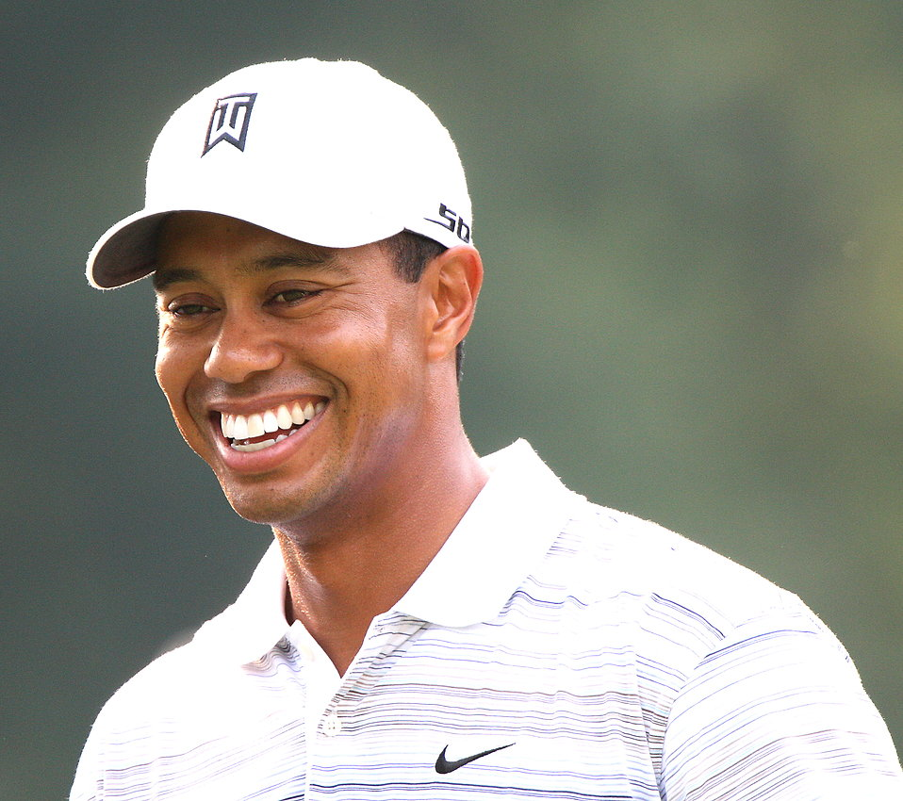
Today is 5/26/2021, our AAPI hero is
Tiger Woods
Eldrick Tont "Tiger" Woods (born December 30, 1975) was born to an African-American army officer and a Thai mother. He is a professional golfer who became the youngest man and first African American to win the U.S. Masters in 1997 at only 21. He won another 13 majors and was named the PGA Player of the Year 10 times over the following 12 years. He claimed another victory 11 years later at the 2019 Masters, overcoming ongoing personal problems from 2009.

Slide 27
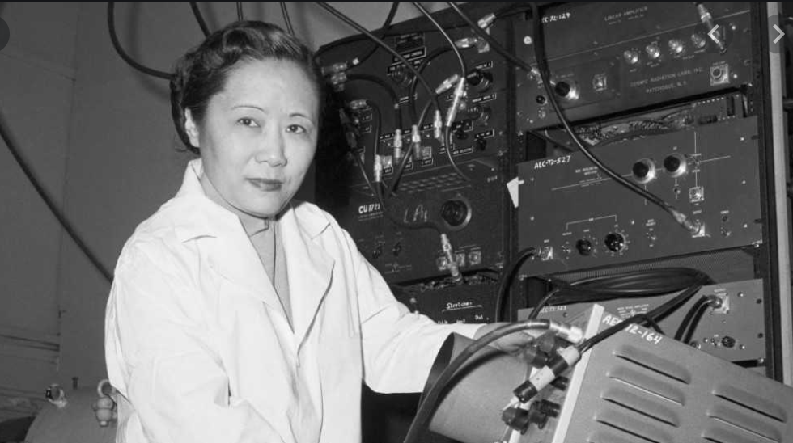
Today is 5/4/2021, our AAPI hero is
Anna May Wong
Today is 5/27/2021, our AAPI hero is
Dr. Chien-Shiung Wu
The First Lady of Physics
Chien-Shiung Wu (1912-1997) was a Chinese American physicist. During the Manhattan Project, she worked at Columbia University, helping develop the process for separating uranium metal into U-235 and U-238 isotopes by gaseous diffusion. This process was replicated at a grand scale at the K-25 Plant in Oak Ridge. She also developed improved Geiger counters for measuring nuclear radiation levels.
https://www.atomicheritage.org/profile/chien-shiung-wu
.
Dr. Wu received numerous awards for her work, including eight honorary degrees, the National Medal of Science (1975), the first Wolf Prize in Physics awarded by the state of Israel (1978), the first Research Corporation Award given to a woman (1959), and the first Comstock Award given to a woman from the National Academy of Sciences (1964). She was elected as a member of the National Academy of Sciences in 1958, and in 1990, Dr. Wu became the first living scientist with an asteroid named after her.
As one of the world’s foremost nuclear physicists, Dr. Wu’s work was instrumental in shaping modern physical theory and blazing a trail for women in science.
--adapted from Wikipedia and Atomic Heritage Foundation

Slide 28
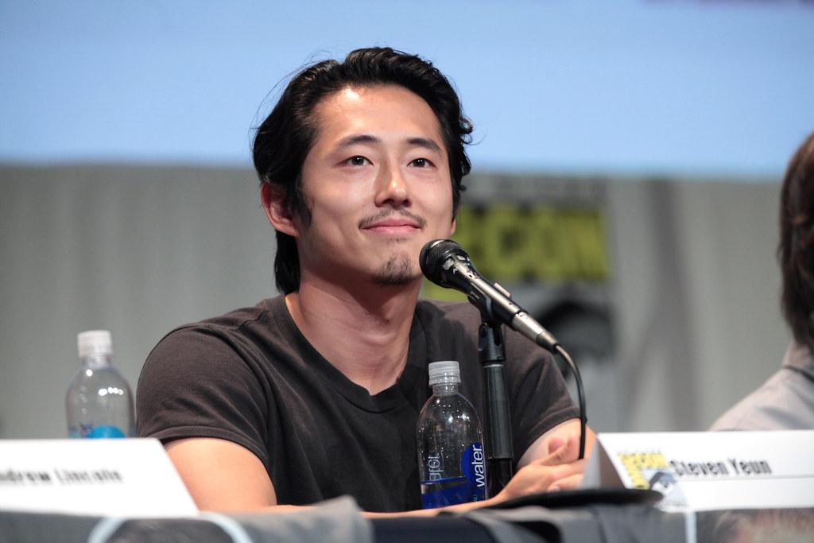
Today is 5/28/2021, our AAPI hero is
Steven Yeun
Steven Yeun (/jʌn/; Korean: 연상엽; born Yeun Sang-yeop; December 21, 1983) was born in Seoul, South Korea and immigrated to Canada then the US, Yeun is a Korean-American actor, voice actor, and singer, best known for his role as Glenn Rhee on The Walking Dead. His other works include the critically acclaimed Okja and Sorry to Bother You. He has just welcomed his second baby with his wife, photographer Joana Pak.
Steven Yeun Just Became the First Asian-American Best Actor Nominee in Oscars (2021) History.
--adapted from Wikipedia

Slide 29
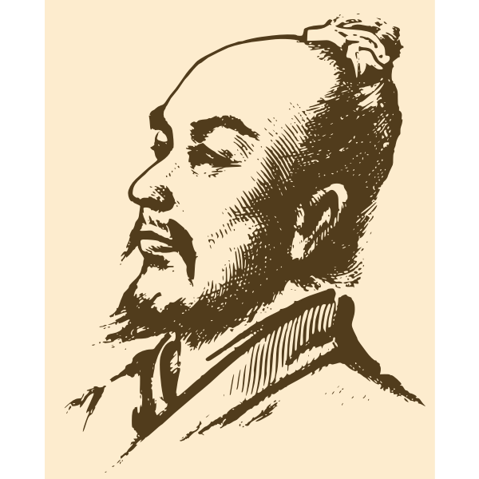
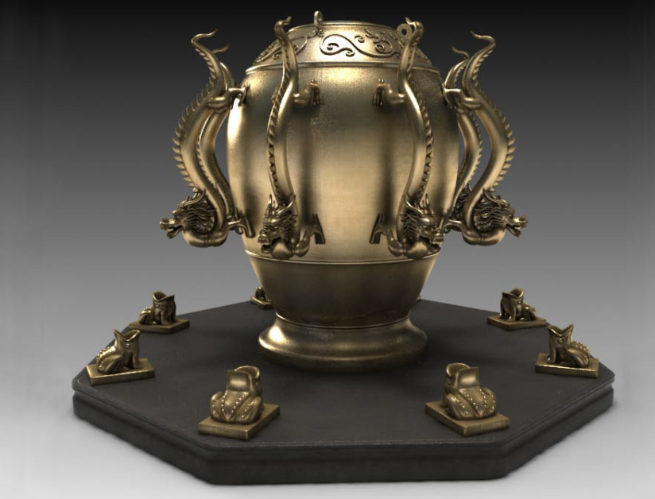
Today is 5/29/2021, our AAPI hero is
Zhang Heng
Zhang Heng (Chinese: 張衡; AD 78–139), formerly romanized as Chang Heng, was a Chinese polymathic scientist and statesman who lived during the Han Dynasty. He developed the first seismograph for detecting earthquakes in 128 CE. Its function was to determine the direction of an earthquake. In 138 CD, his instrument indicated an earthquake occurring in Longxi, a thousand kilometers away. It was the first time that mankind was able to detect an earthquake. Modern seismographs only began development in Europe in 1848.
--adapted from Wikipedia

