Slide 1
AAPI-Week 4
What is Angkor Wat?

Slide 2

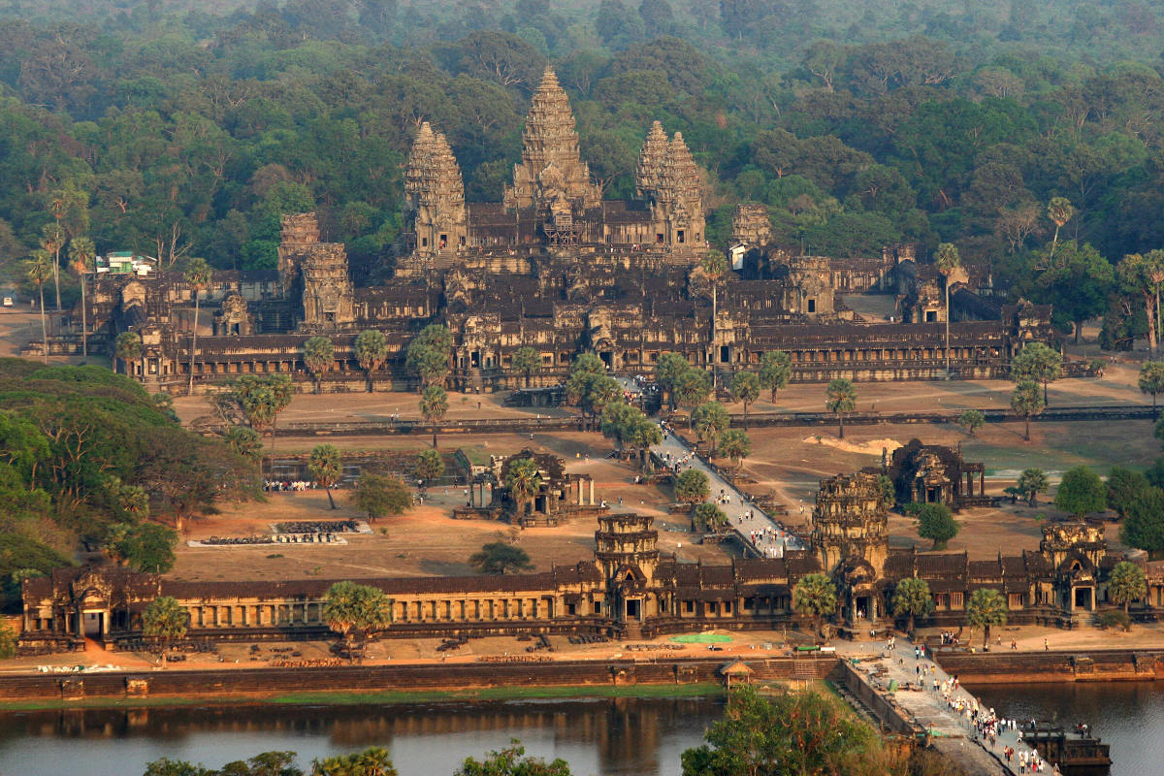
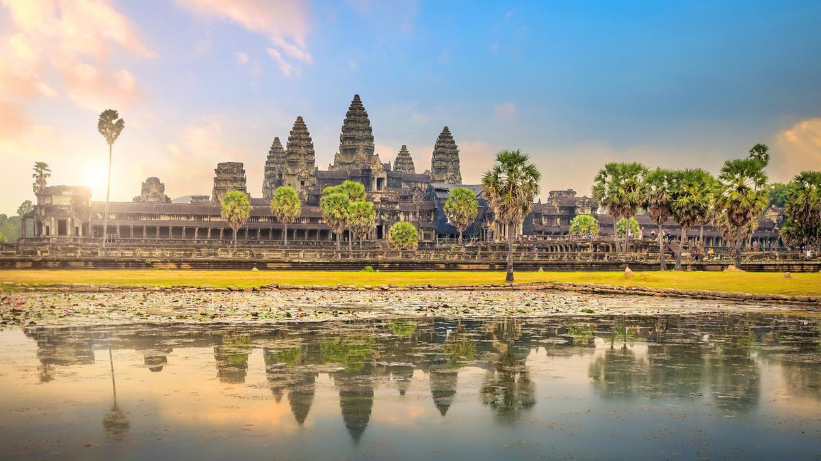
Angkor Wat means “Temple City”
is the largest temple complex in the world by land area, located in Cambodia
was built in the early 12th century
is UNESCO World Heritage Site
Notes:
这里介绍一下Cambodia is a country in Asia
It’s also in flag of Cambodia

Slide 3
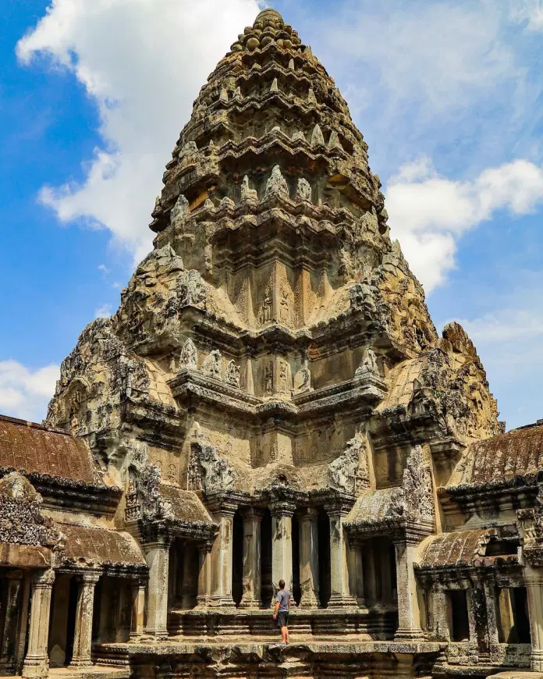
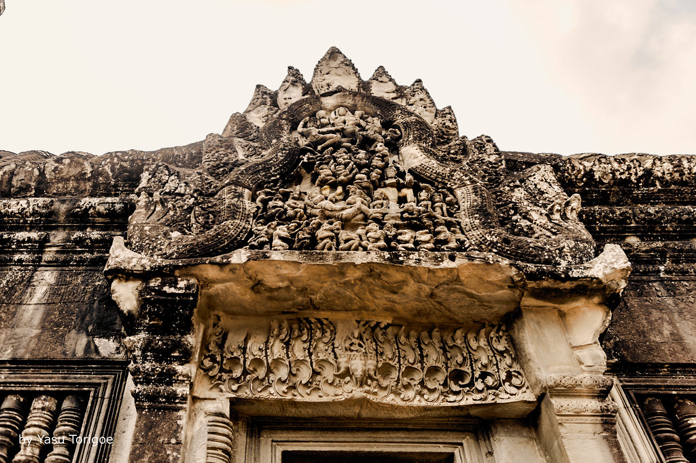
It’s made of 5 million tons of sandstone.
The stones were laid without mortar with very tight joints that are sometimes hard to find.

Slide 4
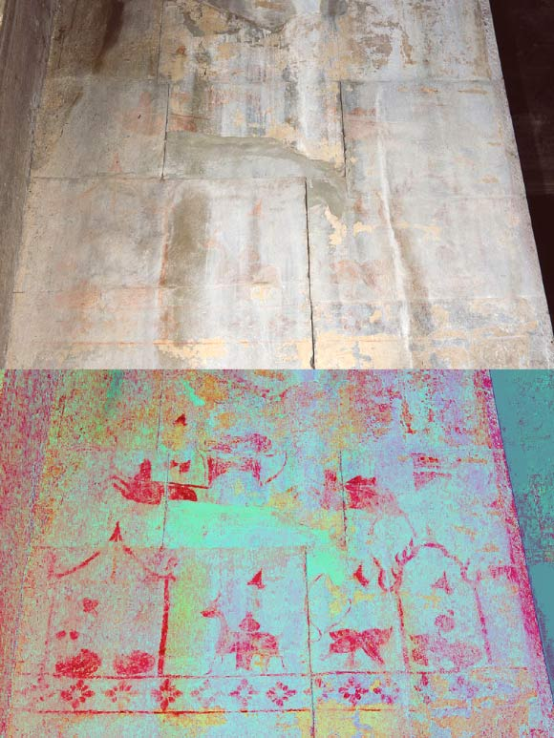
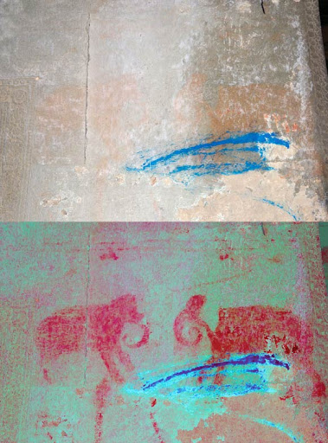
Many surfaces of the Angkor temples were once painted. Today, only small traces of the paint remains on just a few temples.
Notes:
A hidden image at Angkor Wat temple showing life scenes. The enhanced image is below, and the original image is above.

Slide 5
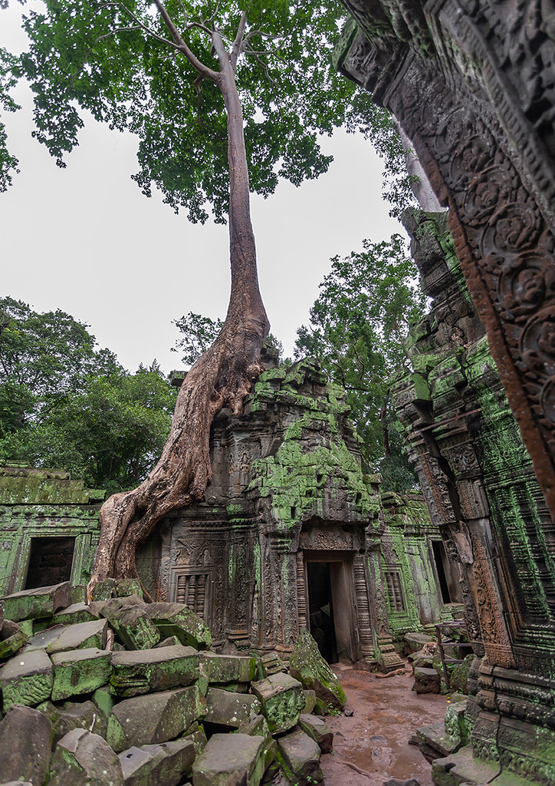
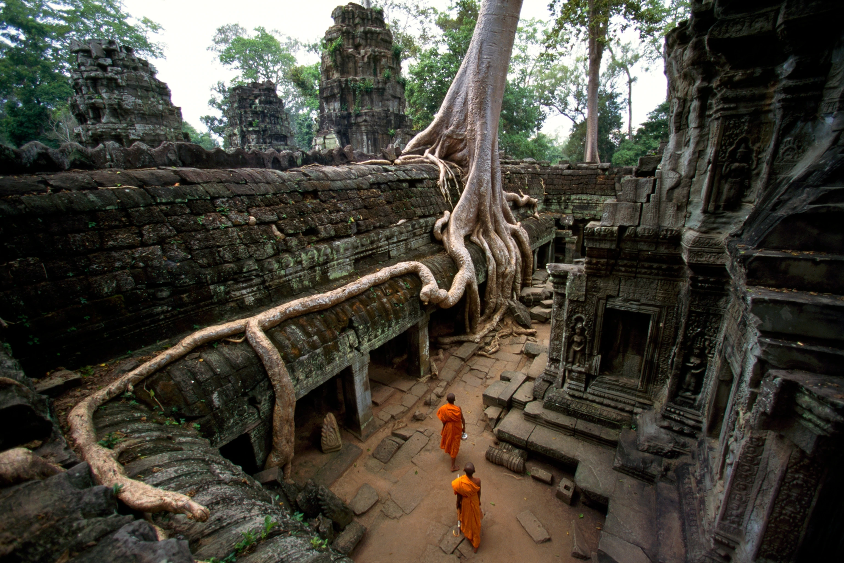
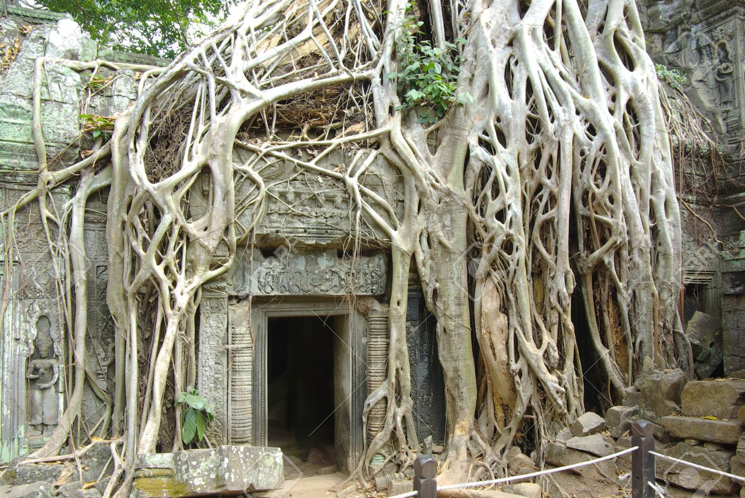
Since 1993, expert teams from multiple countries have been working to preserve and examine the temple complex.
Notes:
Besides weather damage, huge roots are also destroying the temple.

Slide 6
Video Time
https://www.youtube.com/watch?v=MSpPUFdYpJI&t=54s

Slide 7
Read Aloud
Grade 1-3 How to Solve a Problem:
The Rise (and Falls) of a
Rock-Climbing Champion
Grade 4-5 Hiromi’s Hands
Part 3

Slide 8
ALTERNATIVE RESOURCES
BY Ziyan Xu
This presentation template was created by Slidesgo, including icons by Flaticon, infographics & images by Freepik and illustrations by Stories.
AUTHORIZED TO PUBLISH ON ONE BOOK ONE WORLD MI WEBSITE.
Copyright © 2021 1Book1World-MI- All Rights Reserved.

