Slide 1
AAPI-Week 2

Slide 2
Review:
What is AAPI?
When is AAPI Heritage Month?
Asian Americans and Pacific Islanders
May

Slide 3
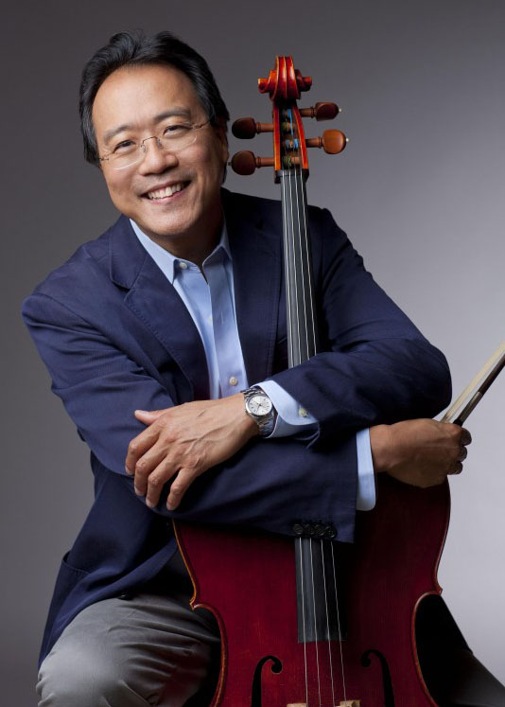
Yo-Yo Ma 马友友
a well-known cellist
(born October 7, 1955)
performed before audiences at age five and performed before presidents Dwight D. Eisenhower and John F. Kennedy when he was seven
has performed as a soloist with orchestras around the world
has recorded more than 90 albums and received 18 Grammy Awards
Notes:
His mother was a singer, and his father was a violinist and professor of music

Slide 4
Bach: Cello Suite No. 1 in G Major, Prélude
https://www.youtube.com/watch?v=1prweT95Mo0

Slide 5
Last year, Yo-Yo Ma launched Songs of Comfort project to provide comfort in a time of anxiety and fear.
Let’s listen to a song from this project:
“Rain Falling From Roof” by Wu Tong and Yo-Yo Ma.
In this video, Mr. Wu Tong is going to play an instrument called Sheng. The sheng is a Chinese free reed instrument consisting of vertical pipes. It has a history of more than 2000 years.

Slide 6
Rain Falling From Roof
https://www.youtube.com/watch?v=gIXGfMbw1No

Slide 7
Read Aloud
1-3 Grade: Ocean Meets Sky
4-5 Grade: Hiromi’s Hands
Part 1 (1/3)

Slide 8
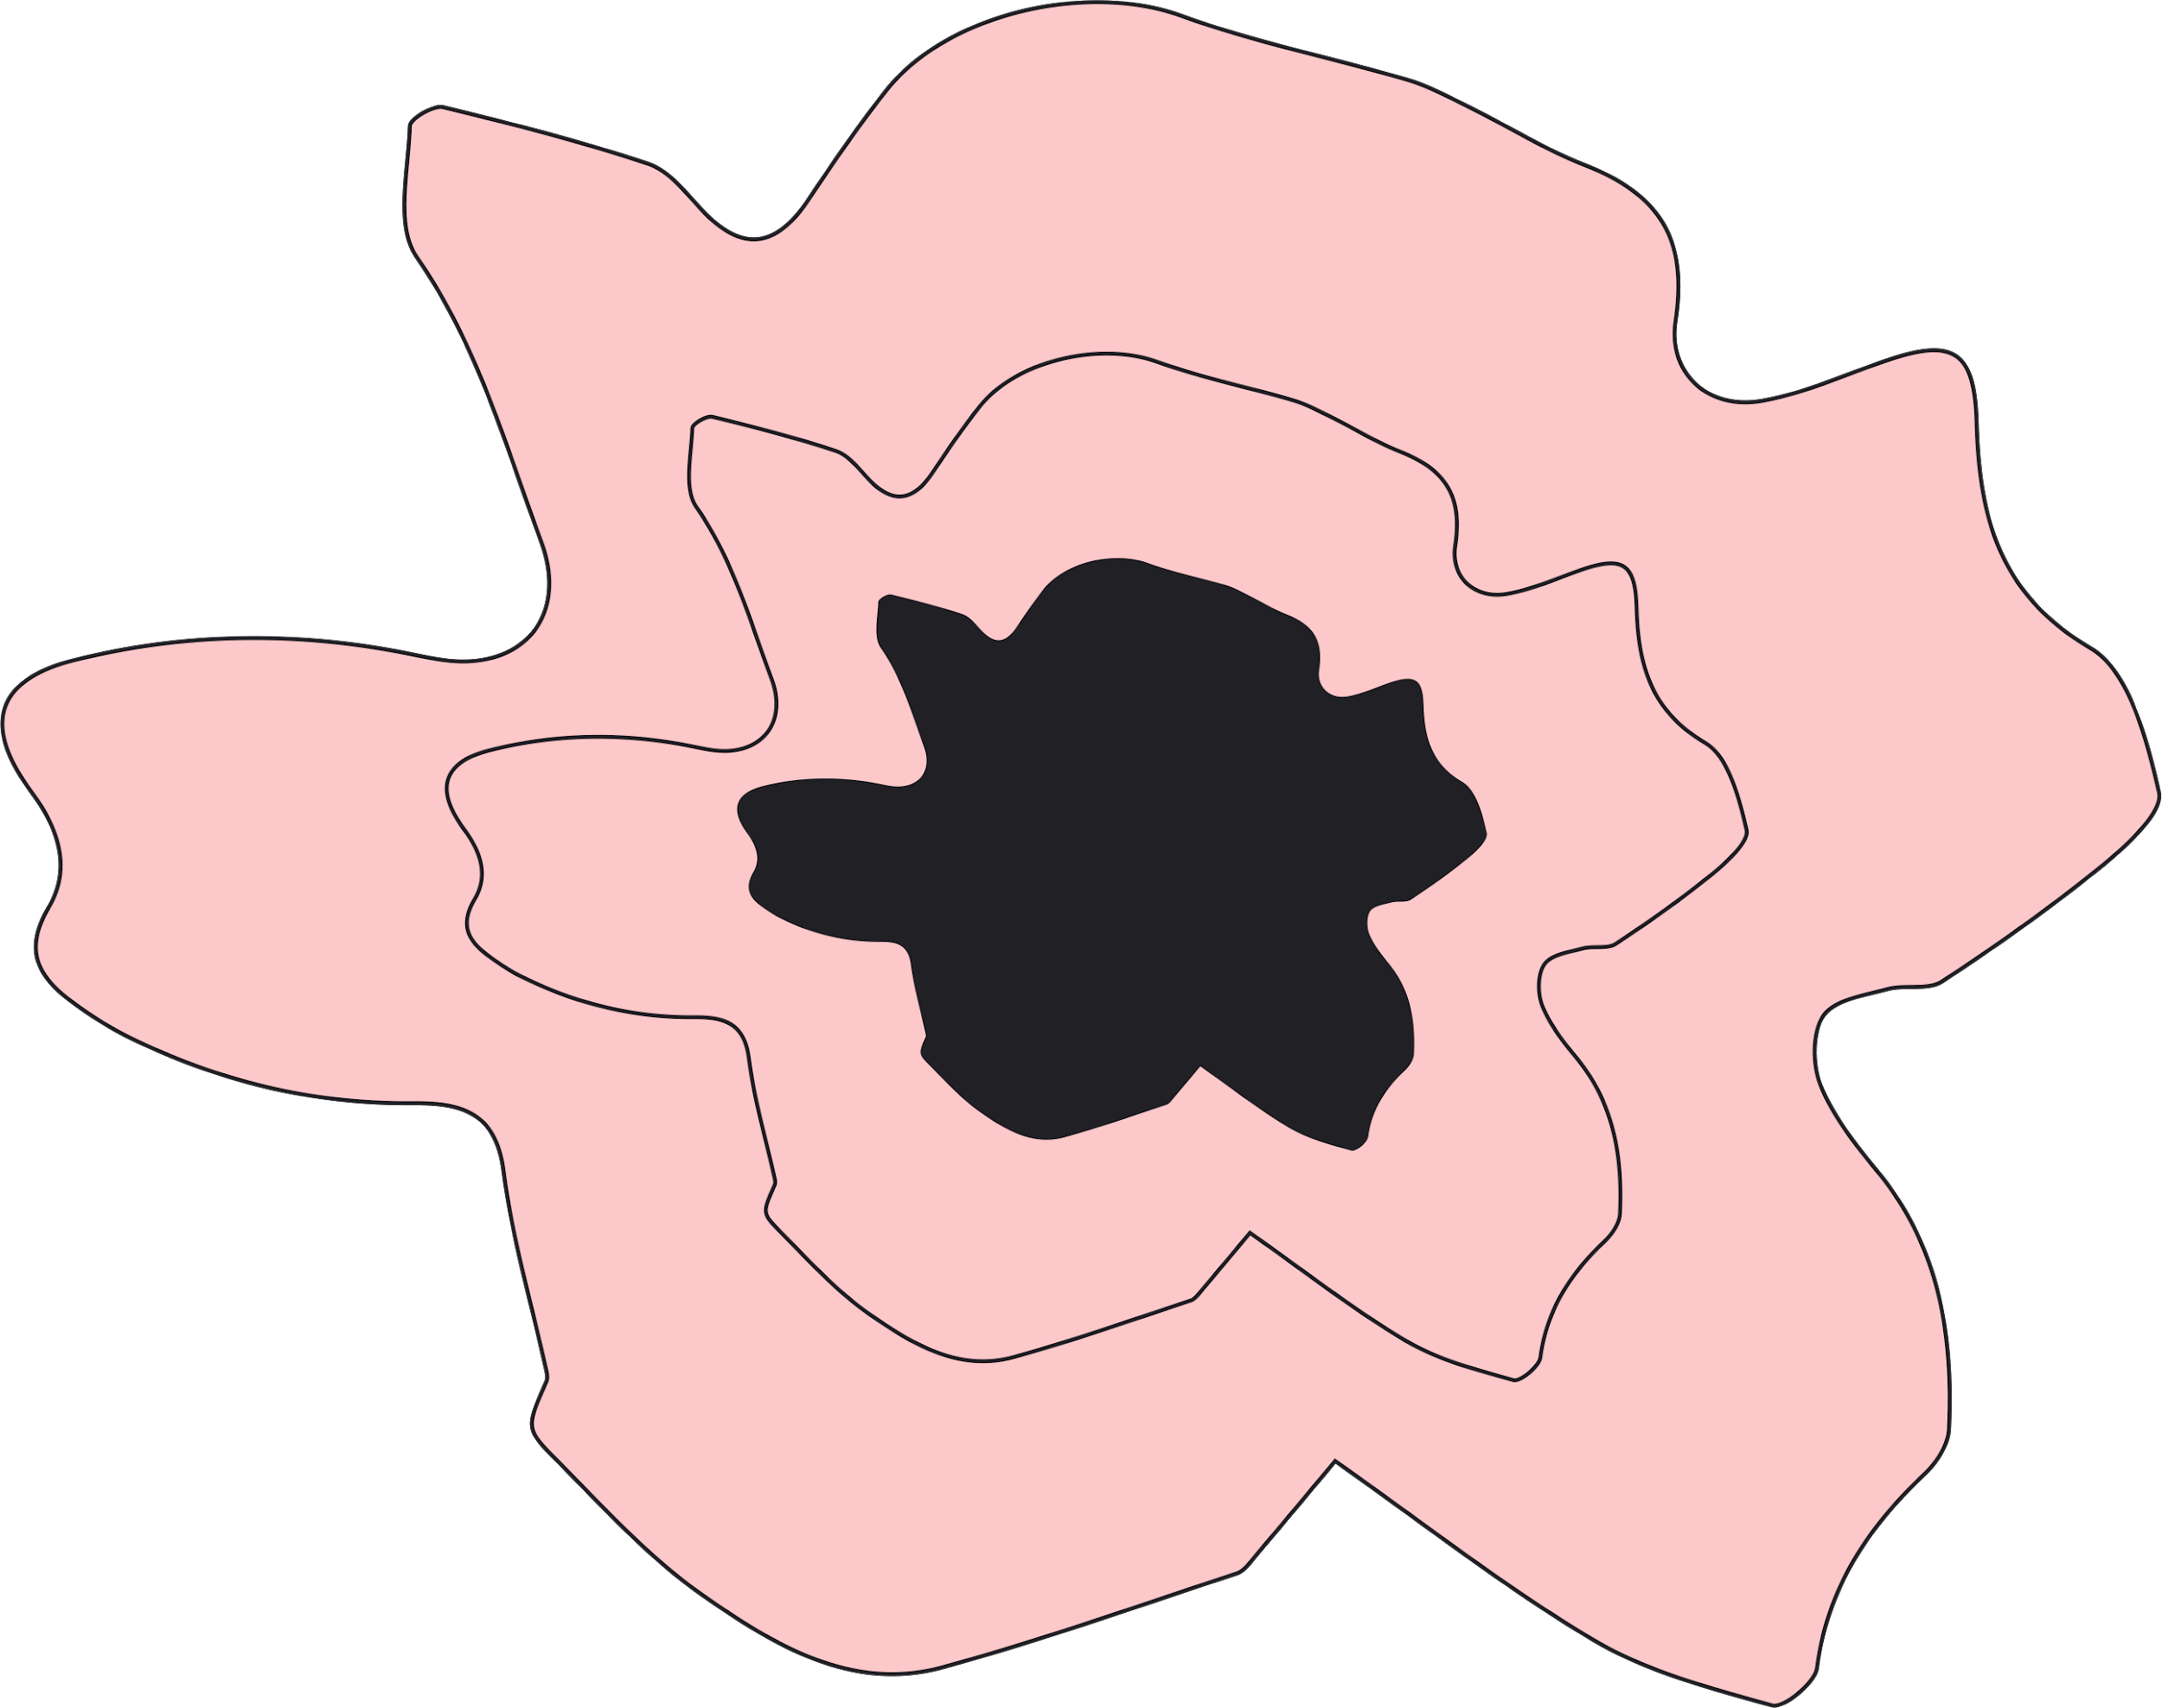
Alternative resources
BY Ziyan Xu
This presentation template was created by Slidesgo, including icons by Flaticon, infographics & images by Freepik and illustrations by Stories.
AUTHORIZED TO PUBLISH ON ONE BOOK ONE WORLD WEBSITE.
Copyright © One Book One World - All Rights Reserved.

