Slide 1
Culture
#2
What is AAPI Heritage?

Slide 2
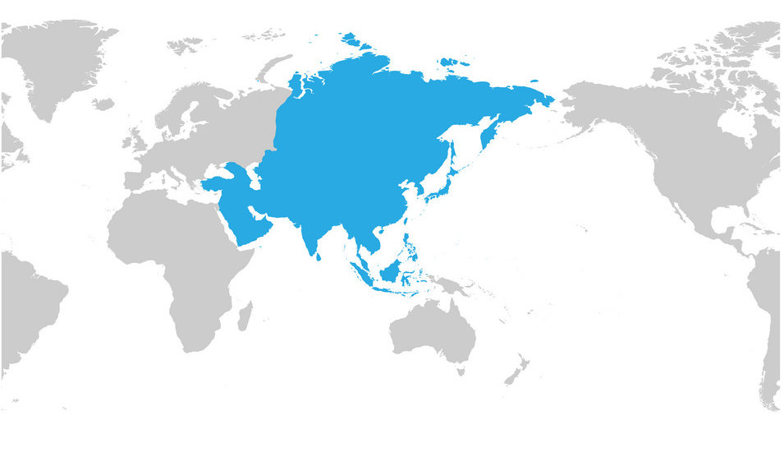
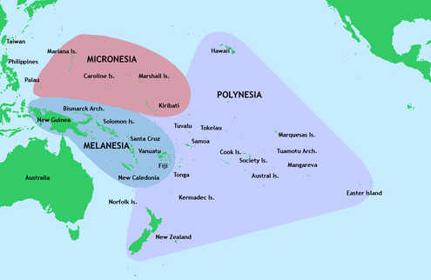
What is AAPI?
Asian Americans and Pacific Islanders (AAPI) is a term sometimes used in the United States to include both Asian Americans and Pacific Islander Americans.

Slide 3
AAPI Heritage Month
May
for recognizing the contributions and influence of AAPI Americans to the history, culture, and achievements of the United States

Slide 4
May was designated for two reasons:
On May 7, 1843, the first Japanese immigrant arrived in the United States.
On May 10, 1869, the Golden spike was driven into the First Transcontinental Railroad, which was completed by Chinese immigrants.

Slide 5
AAPI Culture in Chinese Class
4-week cultural sessions
Introduce people and activities
Asian American culture book read aloud

Slide 6
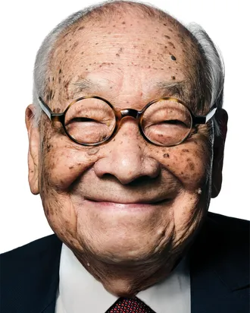
I. M. Pei 贝聿铭
Was a Chinese-American architect
(26 April 1917 – 16 May 2019)
Born in Guangzhou, raised in Hong Kong and Shanghai
Studied Architecture in MIT and Harvard
Winner of The Pritzker Architecture Prize
Notes:
The Pritzker Prize, which is sometimes referred to as the Nobel Prize of architecture.

Slide 7
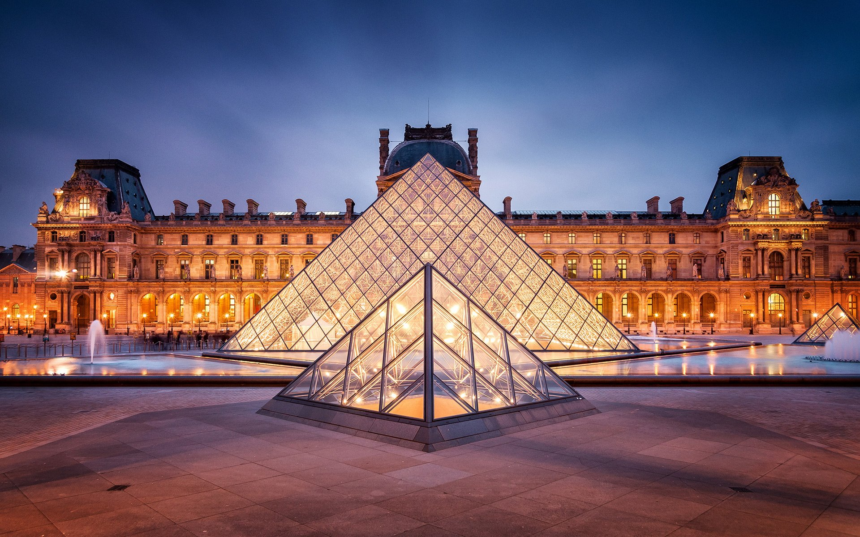
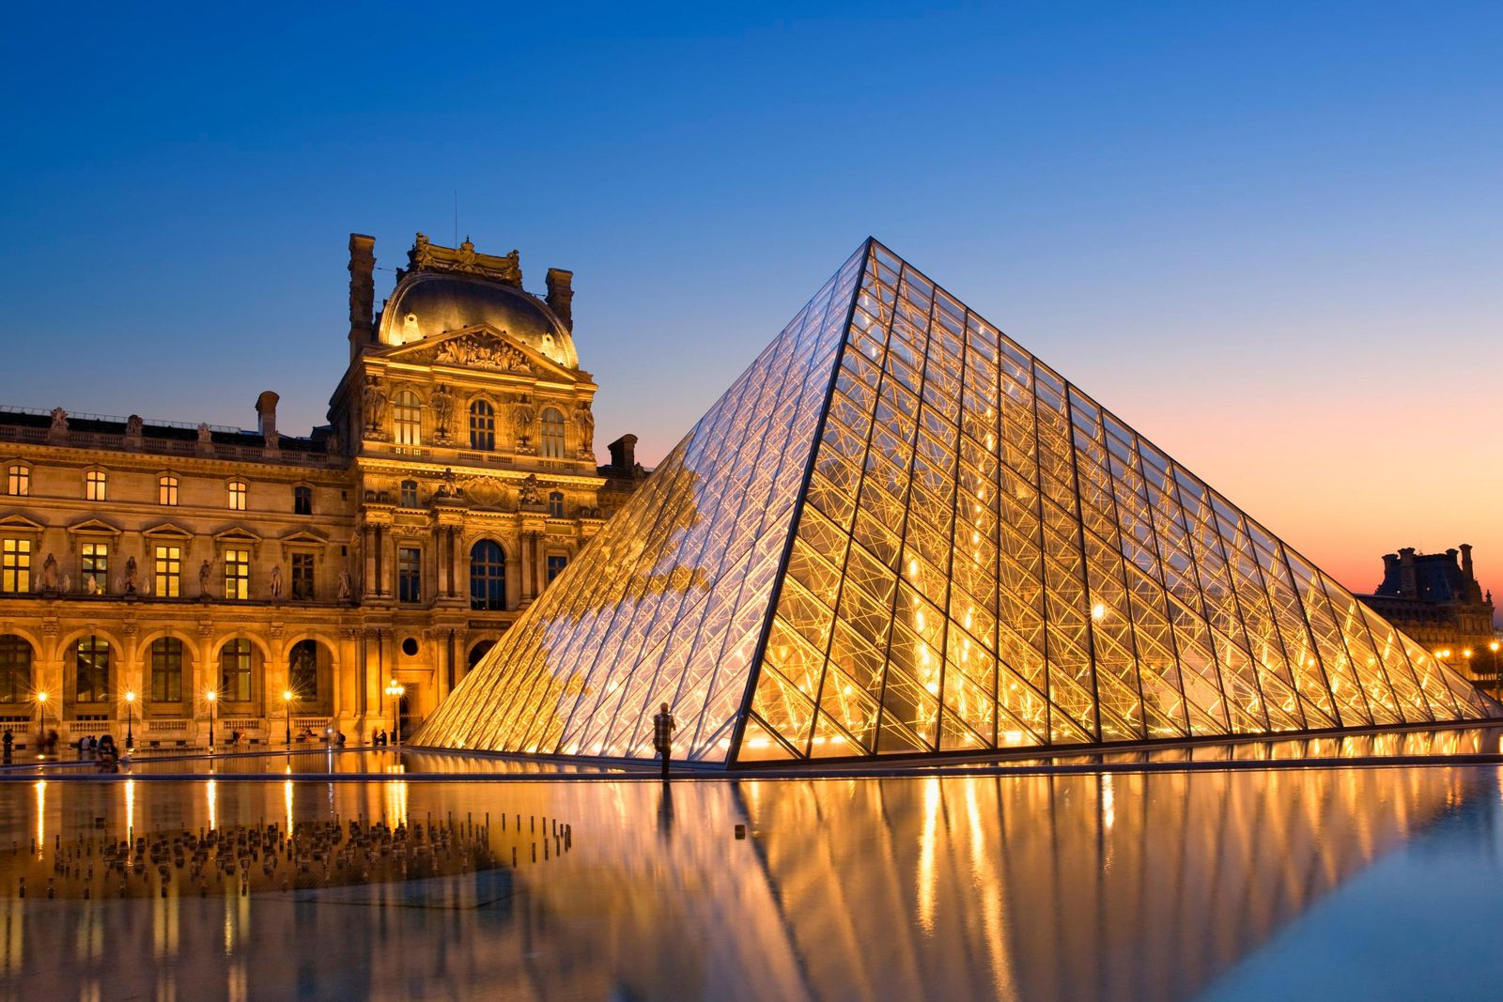
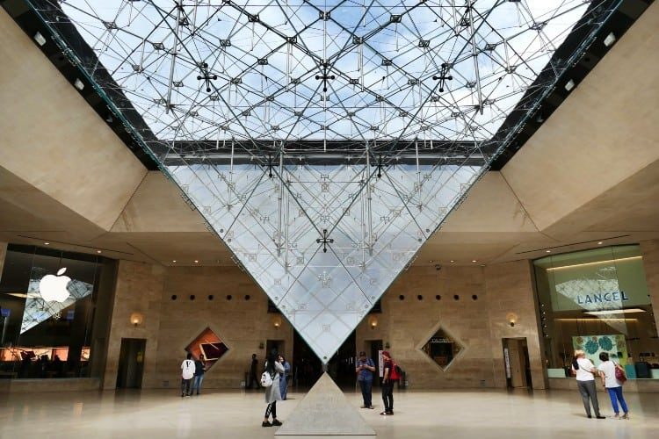
I. M. Pei 贝聿铭
Building:
Louvre Pyramid
1989

Slide 8
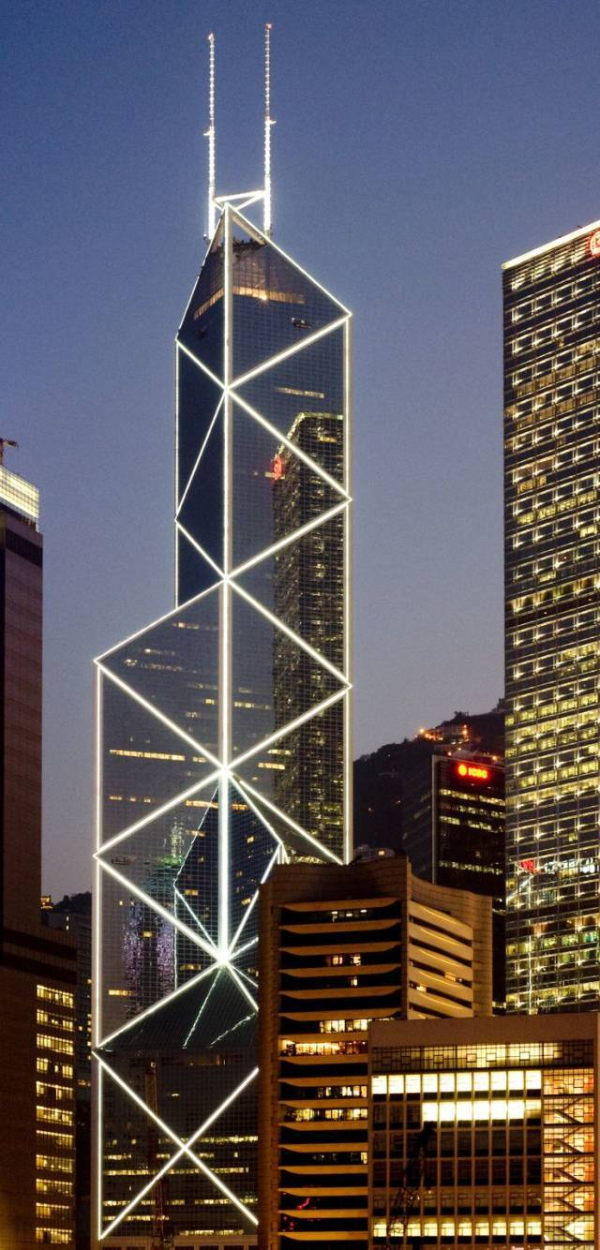
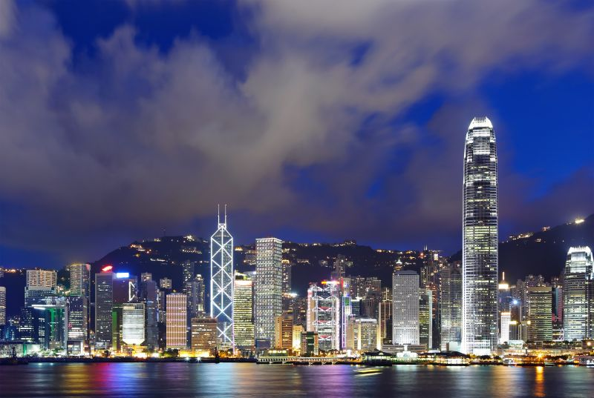
I. M. Pei 贝聿铭
Building:
Bank of China Tower (Hong Kong)
1990
Notes:
It was once the tallest building in Hong Kong. At a height of 315.0 m (1,033.5 ft), reaching 367.4 m (1,205.4 ft) high including masts, it is now the fourth tallest building in Hong Kong.

Slide 9
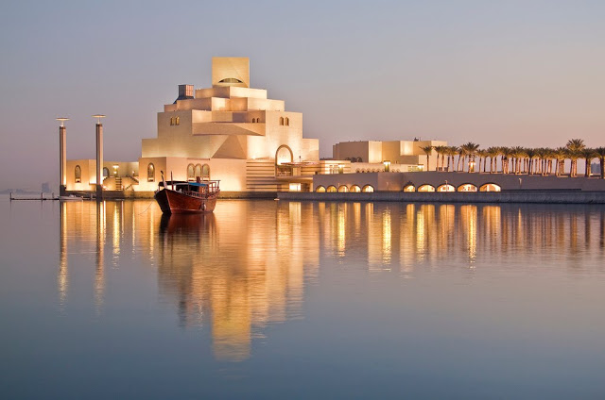
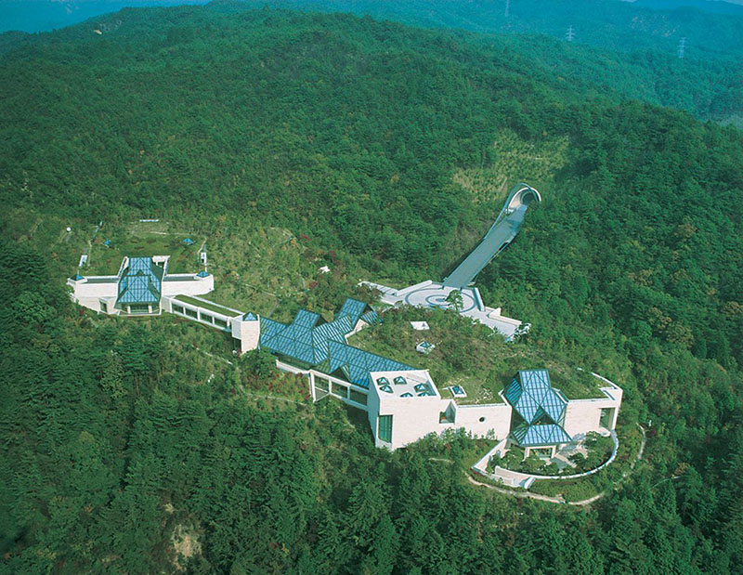
Other Buildings:
Mino Museum
Kyoto, Japan
The Museum of Islamic Art
Doha, Qatar

Slide 10
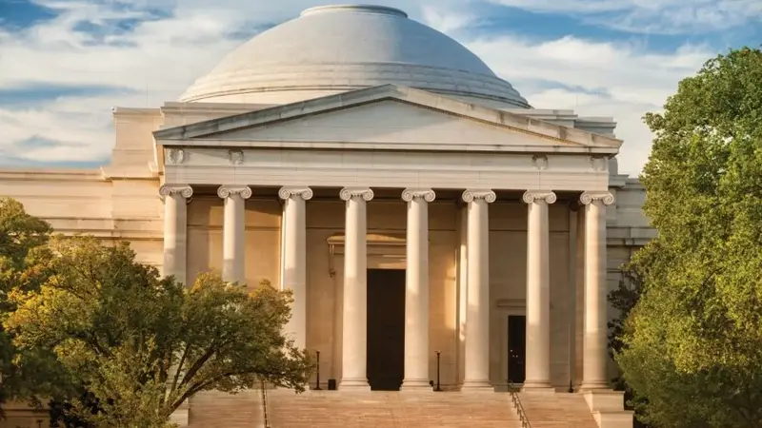
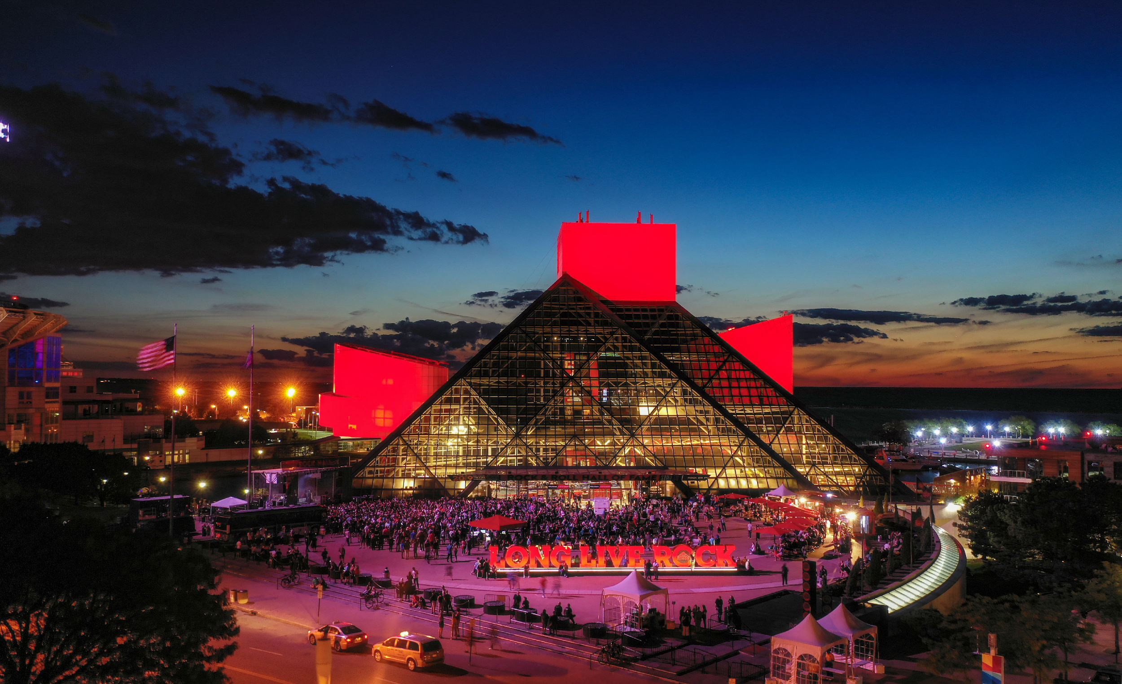
Other Buildings:
The Rock and Roll Hall of Fame
Cleveland, Ohio
National Gallery of Art
Washington, D.C.

Slide 11
READ ALOUD
G1-3: A Big Mooncake For Little Star
G4-5: Sam and the Lucky Money

Slide 12
ALTERNATIVE RESOURCES
BY Ziyan Xu
This presentation template was created by Slidesgo, including icons by Flaticon, infographics & images by Freepik and illustrations by Stories.
AUTHORIZED TO PUBLISH ON ONE BOOK ONE WORLD WEBSITE.
Copyright © One Book One World - All Rights Reserved.

