Slide 1
AAPI-Week 3

Slide 2
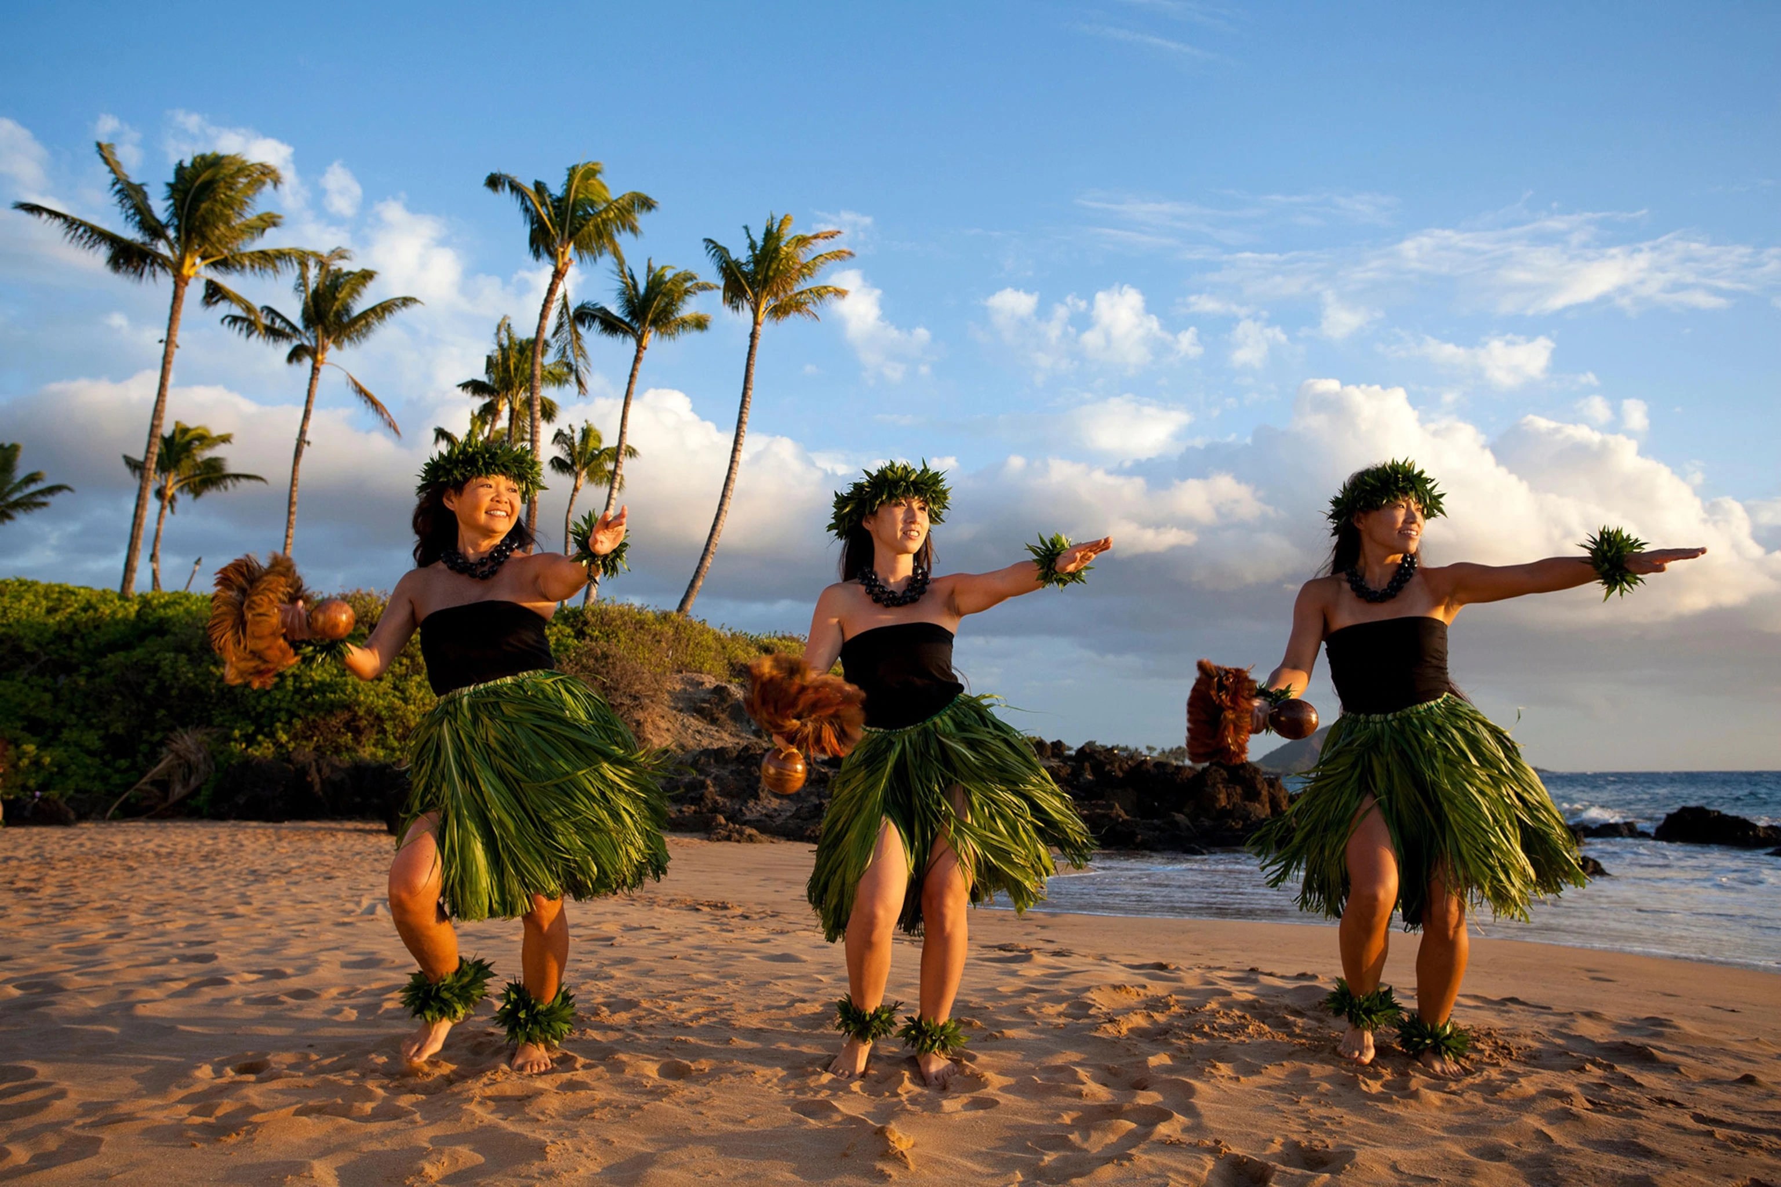
Hula Dance
a Polynesian dance form accompanied by chant or song
was developed in the Hawaiian Islands by the Polynesians who originally settled there
dramatizes or portrays the words of the chant or song in a visual dance form

Slide 3
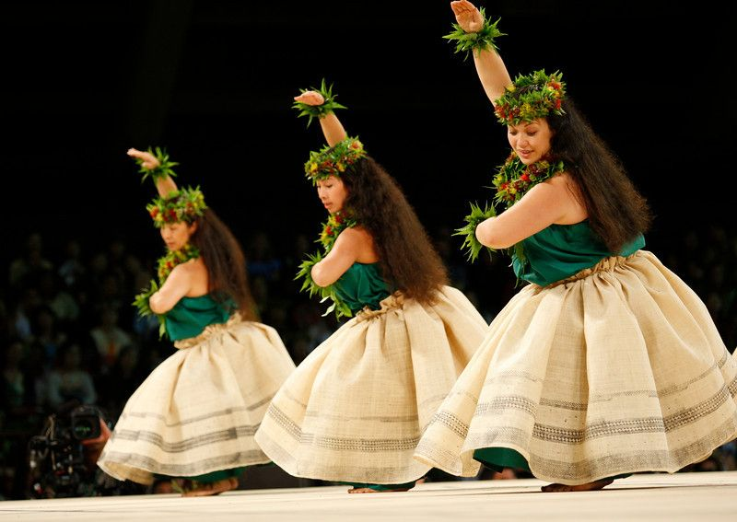
Hula Dance
There are also two main positions of a hula dance: either sitting (noho dance) or standing (luna dance). Some dances utilize both forms.
Hula dancing is a complex art form, and there are many hand motions used to represent the words in a song or chant.
Notes:
For example, hand movements can signify aspects of nature, such as the swaying of a tree in the breeze or a wave in the ocean, or a feeling or emotion, such as fondness or yearning.

Slide 4
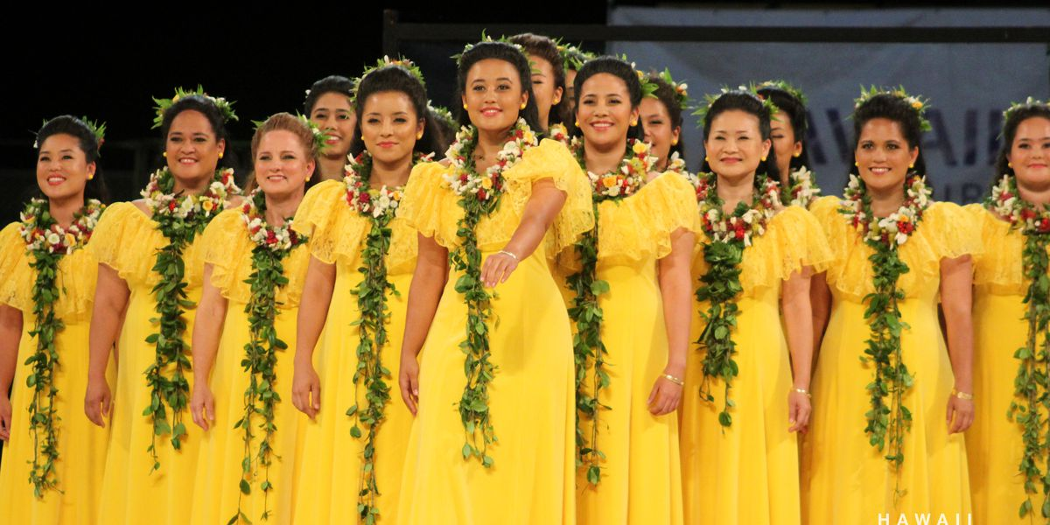
Merrie Monarch Festival
The Merrie Monarch Festival is a week-long cultural festival that takes place annually in Hilo, Hawaii during the week after Easter.
It honors King David Kalākaua, who was called the "Merrie Monarch" for his patronage of the arts and is credited with restoring many Hawaiian cultural traditions during his reign, including the hula.

Slide 5
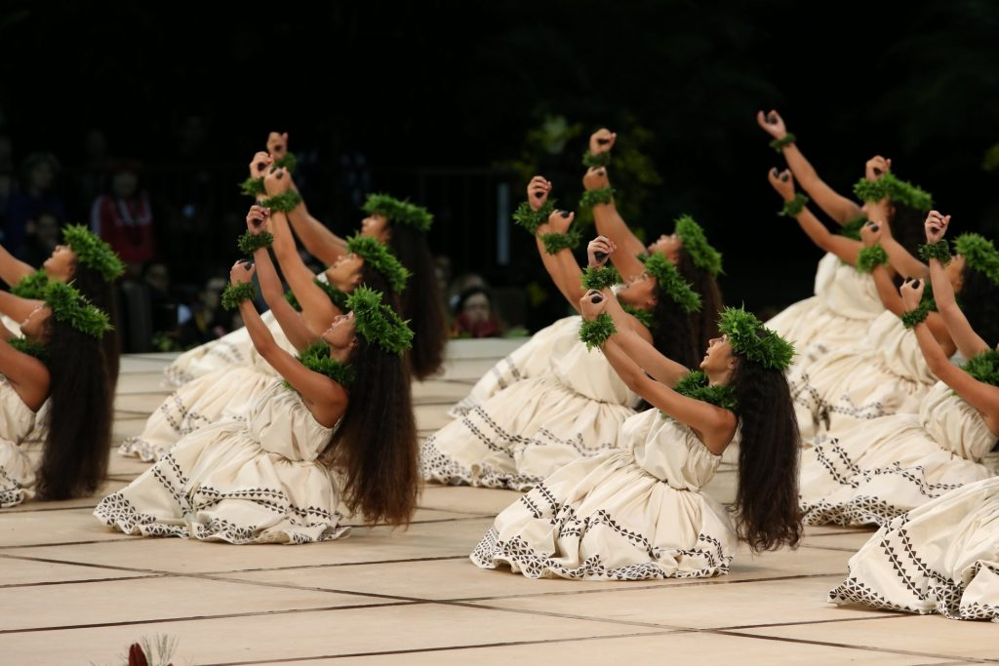
Merrie Monarch Festival
The festival is considered the most prestigious of all hula contests.
Miss Aloha Hula
Group hula kahiko (traditional style)
Group hula ʻauana (modern style)

Slide 6
https://drive.google.com/file/d/1FSfeRCztYrxkRyxxjNcxw-_wwnWo37Sk/view?usp=sharing
What It Takes to be a Hula Champion
(Miss Aloha Hula)

Slide 7
Read Aloud
Grade 1-3 Cora Cooks Pancit
Grade 4-5 Hiromi’s Hands
Part 2 （图书三分，这是第二部分）

Slide 8
ALTERNATIVE RESOURCES

