Slide 1
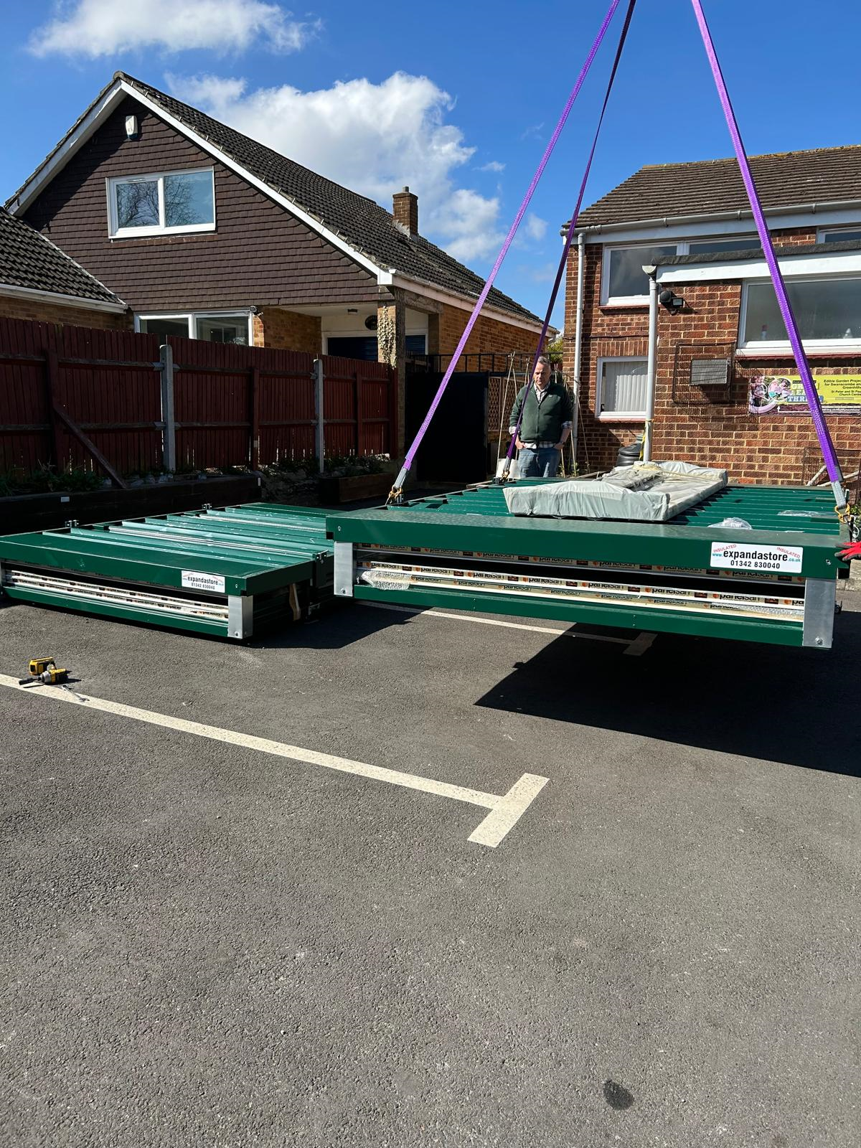
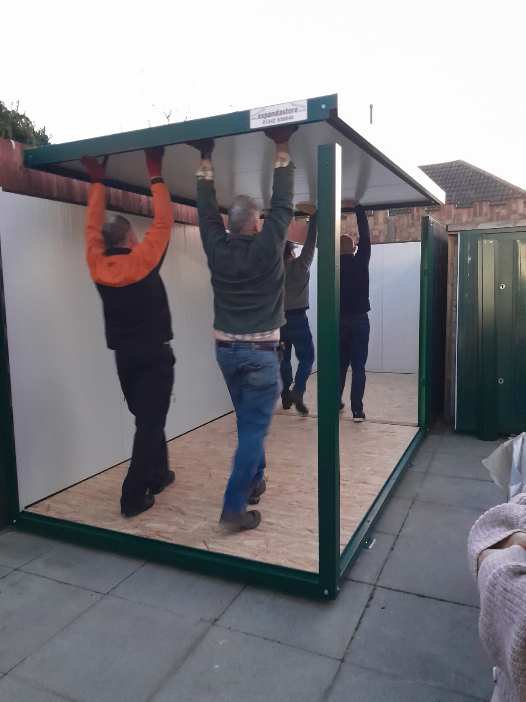
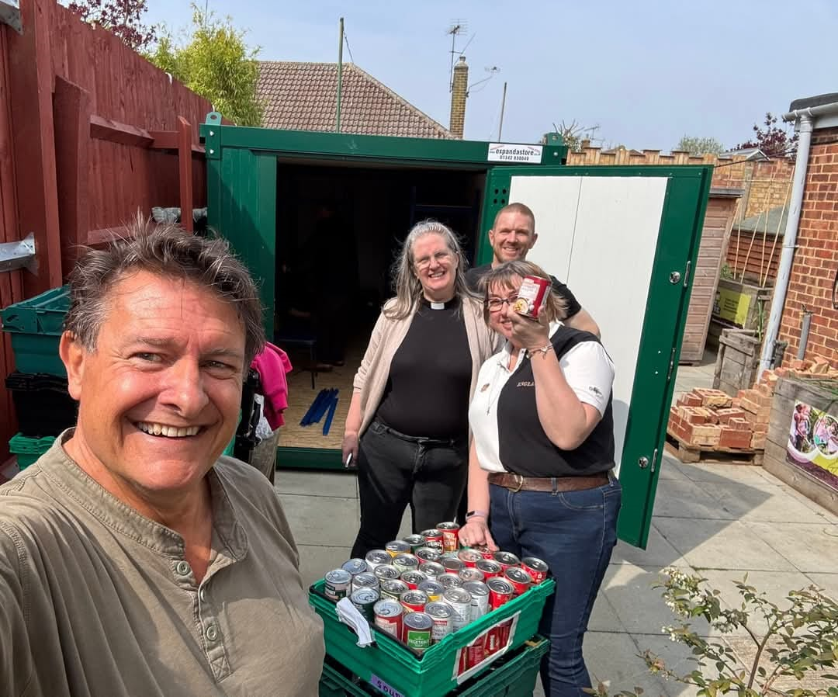
MCK - Mary’s Child Kent
Newsletter June 2025.
We love, support and care for families and
individuals in need in our local community.
What do we do?
This month our newsletter focus is on our Legal and Advocacy work
MCK is committed to supporting families and individuals in our community during times of hardship. Jeremy, our legal adviser provides support on benefits, housing and immigration issues and is available to be seen at The Community café at St Mary Greenhithe every Wednesday morning between 9am – 1pm. People are seen on a first come first served basis, no appointment is necessary.
Jeremy has been very successful in securing PIP, and other benefits for people as well as resolving housing and immigration issues. We believe that this area of work is a crucial part of our ethos as a charity, offering a holistic approach.
For further information please contact the office on the email at the end of this newsletter.
“As of today, I will no longer be in need of the MCK's food bank services. I can't begin to thank you enough for the help you've given me this last month, even just the willingness and welcome has meant a lot to me.”
“I and my family are thankful to you, and we owe you our gratitude. I really do not know what I would have done with my immigration status or where I would have been if God did not bring you our way.“
Swanscombe Food Bank is now open!
A huge thank you to everyone who contributed financially to allow us to purchase a permanent
home for the MCK Swanscombe Food Bank. We were supported by businesses and local organisations as well as generous individuals.
This is now open and fully functioning allowing us as a charity to support those families and individuals who are in need in the local area.
MCK runs three food banks in the local area and your support can truly make a difference to families and individuals who are struggling to make ends meet. So, we ask if you feel you can support us you can drop donations to the church office (contact details are at the end of this newsletter).
Together, we can make a positive impact and create a brighter future for our community.

Slide 2
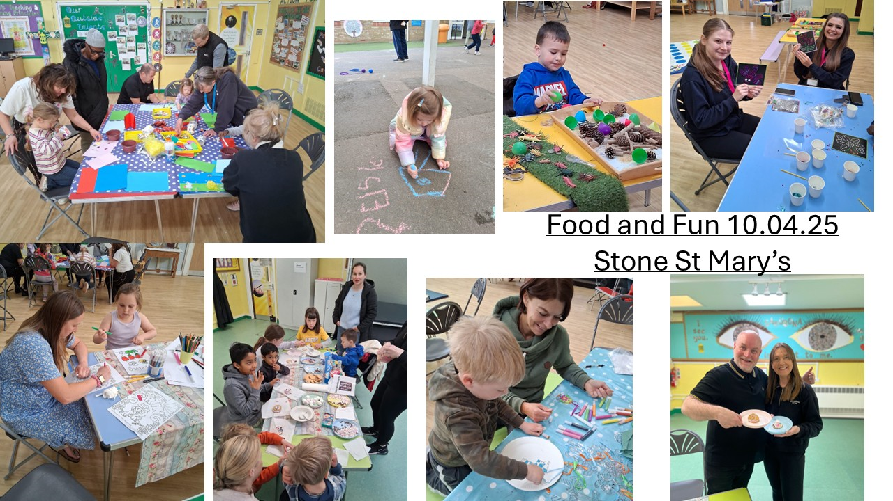
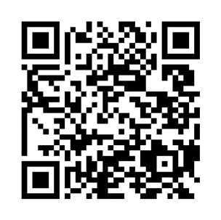
Upcoming Events
Food and Fun
MCK ran five very busy sessions of Food and Fun during the Easter holidays across various local venues. These events are always well attended and offer a range of crafts, games and activities as well as a healthy and nutritious buffet style lunch. These events are free to attend but spaces must be booked.
Food and Fun will be running again during the summer holidays 2025- dates to be confirmed.
MCK is generously supported by individuals who give financially as well as local organisations, businesses and grant trusts. We are very grateful for everyone’s support. We were fortunate to recently receive grants from Swanscombe and Greenhithe Town Council, and Beaverbrooks. We have also received donations from other local groups, businesses and organisations. These gifts and donations help us to support families and individuals in our local area, whether through
the food banks, our food and fun events or support from our legal adviser.
How can you support us?
Contact Information
Become a volunteer by helping us at special events, food and fun etc…
Donate items to one of our food banks
You can also support us financially in a variety of different ways. Cash, cheque, standing order or by scanning the QR code below.
The Church Office
131 Mounts Road
Greenhithe
DA9 9ND
www.mckcharity.co.uk
Jude Andrews
Operations Manager
office@mckcharity.co.uk
jude@mckcharity.co.uk
07512 460221
Follow us on Facebook
MCK – Mary’s Child Kent

