Slide 1
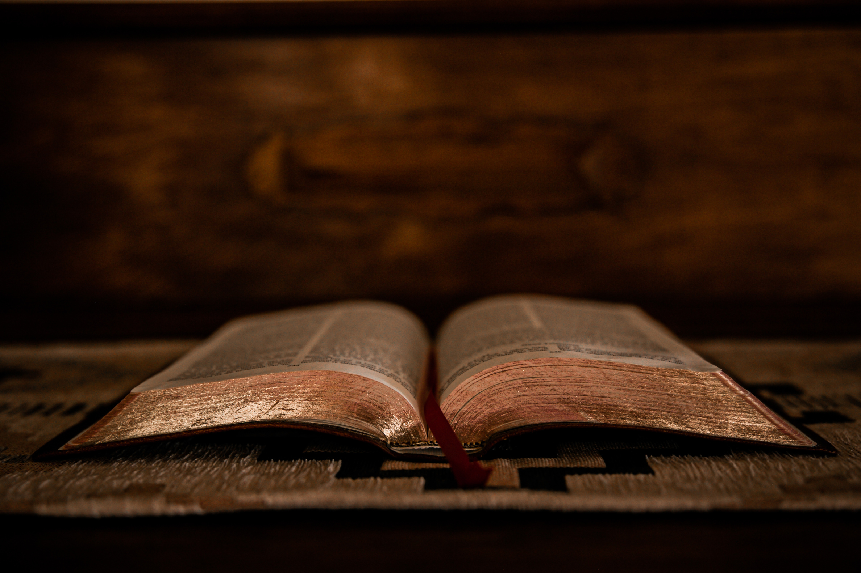
“Anchored In Christ:
Living Faithfully In Every Season”

Slide 2
Lesson 2: Strength In Weakness – Understanding how God’s power is made perfect in our weakness.

Slide 3
Biblical Foundations ...

Slide 4
  2 Corinthians 12:9 – “But He said to me, ‘My grace is sufficient for you, for My power is made perfect in weakness.’ Therefore I will boast all the more gladly about my weaknesses, so that Christ’s power may rest on me.”
This verse highlights how God’s strength is revealed when we acknowledge our limitations.

Slide 5
  Isaiah 40:29 – “He gives strength to the weary and increases the power of the weak.”
God provides endurance when we feel exhausted.

Slide 6
  Philippians 4:13 – “I can do all things through Christ who strengthens me.”
This verse reassures us that our strength comes from Him.

Slide 7
Why Weakness Can Be a Blessing…

Slide 8
  It Draws Us Closer to God – When we recognize our need for Him, we deepen our faith.

Slide 9
  It Allows God to Work Through Us – Our limitations create opportunities for God’s power to shine.

Slide 10
  It Builds Humility – Depending on God keeps us from relying solely on ourselves.

Slide 11
How To Apply This Lesson ...
  Acknowledge Your Need for God – Instead of resisting weakness, embrace it as an opportunity to grow spiritually.
  Pray for Strength – Ask God to empower you in difficult moments.
  Encourage Others – Share testimonies of how God has strengthened you.

Slide 12
Strength in Weakness – Understanding How God’s Power Is Made Perfect in Our Weakness.

Slide 13
Objective: Introduce the biblical truth that God’s power is made perfect in our weakness.

Slide 14
God’s Power in Our Weakness…
2 Corinthians 12:9 – “But He said to me, ‘My grace is sufficient for you, for My power is made perfect in weakness.’ Therefore I will boast all the more gladly about my weaknesses, so that Christ’s power may rest on me.”

Slide 15


Slide 16
What does Paul mean by “boasting in weakness”?

Slide 17
How does weakness invite God’s presence?

Slide 18

Reflections

Slide 19
What weakness have you tried to hide or overcome on your own?

Slide 20
How might God be inviting you to surrender it?

Slide 21
Objective: Explore how God renews strength when we feel exhausted or overwhelmed.

Slide 22
Strength for the Weary…
Isaiah 40:29 – “He gives strength to the weary and increases the power of the weak.”

Slide 24
What does it mean to be “weary” spiritually, emotionally, or physically?

Slide 25
How does God renew our strength?

Slide 26
Reflections

Slide 27
When have you felt spiritually drained?

Slide 28
What practices help you receive God’s strength?

Slide 29
Objective: Understand how Christ strengthens us to face all circumstances.

Slide 30
Christ Empowers Us…
Philippians 4:13 – “I can do all things through Christ who strengthens me.”

Slide 32
What does “all things” mean in context?

Slide 33
How do we access Christ’s strength daily?

Slide 34
Reflections

Slide 35
What challenge are you currently facing?

Slide 36
How can you lean on Christ’s strength instead of your own?

Slide 37
Objective: Reframe weakness as a spiritual gift that draws us closer to God.

Slide 38
The Blessing of Weakness…
James 4:6 – “God opposes the proud but gives grace to the humble.”

Slide 40
Key Concepts:
  Weakness builds humility
  It opens space for God to work
  It deepens dependence on Him

Slide 41
Reflections

Slide 42
How has weakness helped you grow spiritually?

Slide 43
What does humility look like in your daily life?

Slide 44

Encourage someone this week by sharing how God has worked through your weakness.

