Slide 1

AI Readiness
ISACA | 24 June 2025

Slide 2



Who We Are
HOST
SPEAKER
SPEAKER
Patrick Rozario
Managing Director, Moore HK Vice President, ISACA China HK
Mathew Garver
Chief Executive Officer, HiQo Solutions
Dr. William Cox
Global Partner, HiQo Solutions

Slide 3
Agenda
Introductions
Today’s AI Landscape
Tomorrow’s Capabilities
AI Readiness Breakdown
Building Trust & Control
Practical Next Steps
Final Thoughts
Q&A

Slide 4
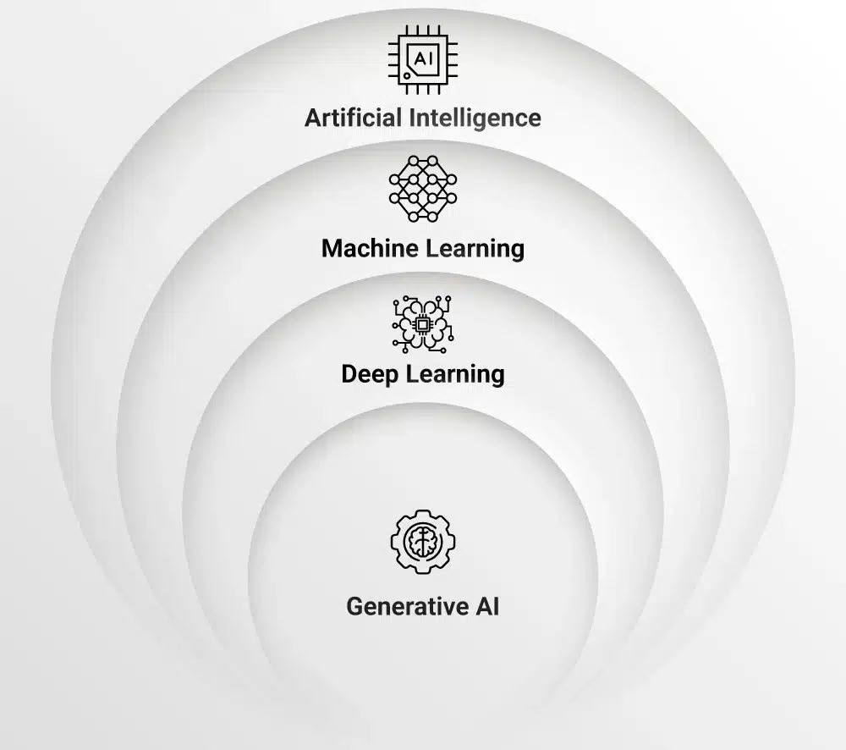
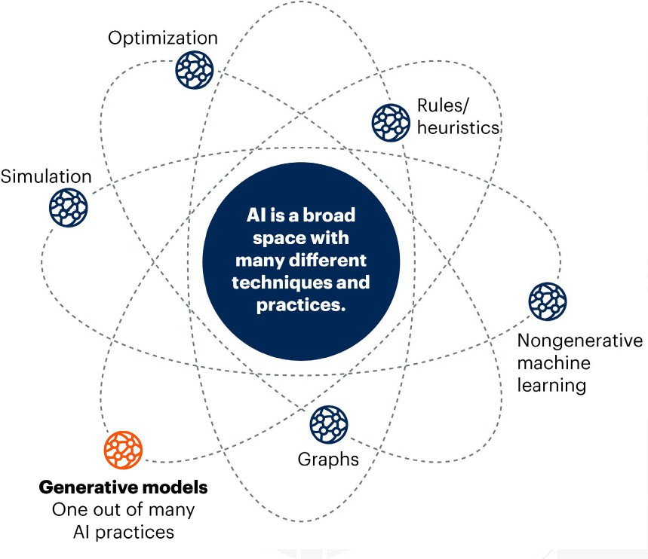
Today’s AI Landscape
Source: Goldman Sachs 2025

Slide 5
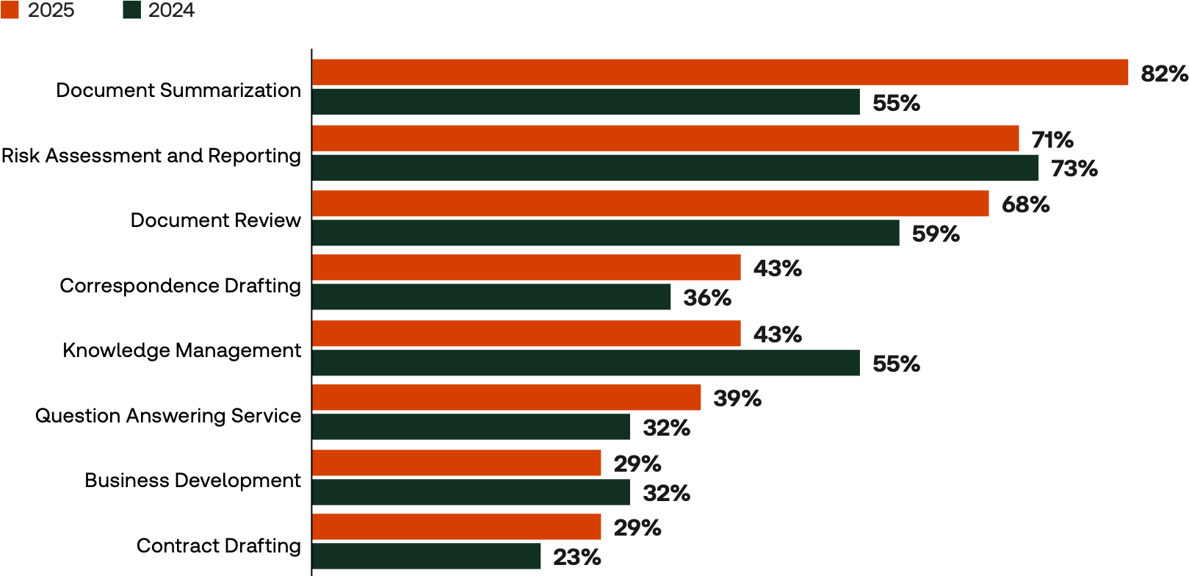
Today’s GenAI Use Cases
Top Use Cases
Source: Thomson Reuters 2025

Slide 6
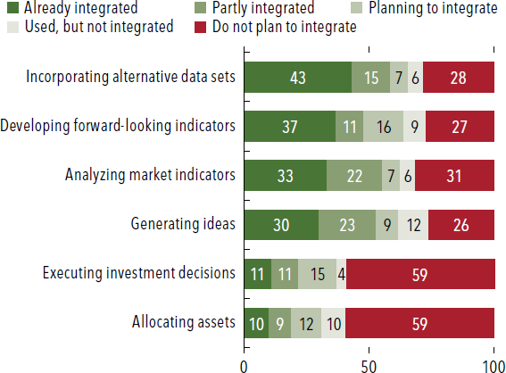
Today’s Use Cases in Finance
Early Adoption in Investment Decision Use Case by Investment Managers
Source: IMF GFSR Oct ‘24

Slide 7
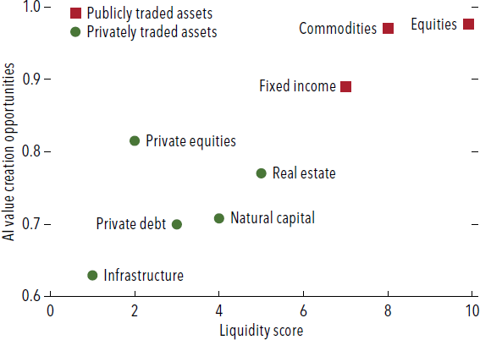
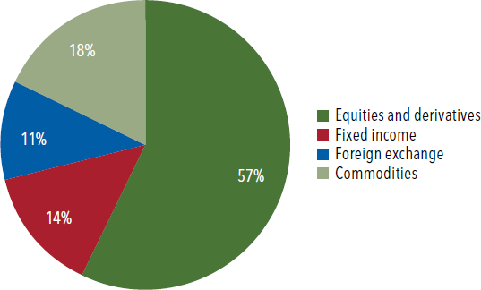
Today’s Use Case Characteristics
Use Cases Correlated with Liquidity
Use Cases by Asset Class
Source: IMF GFSR Oct ‘24

Slide 8
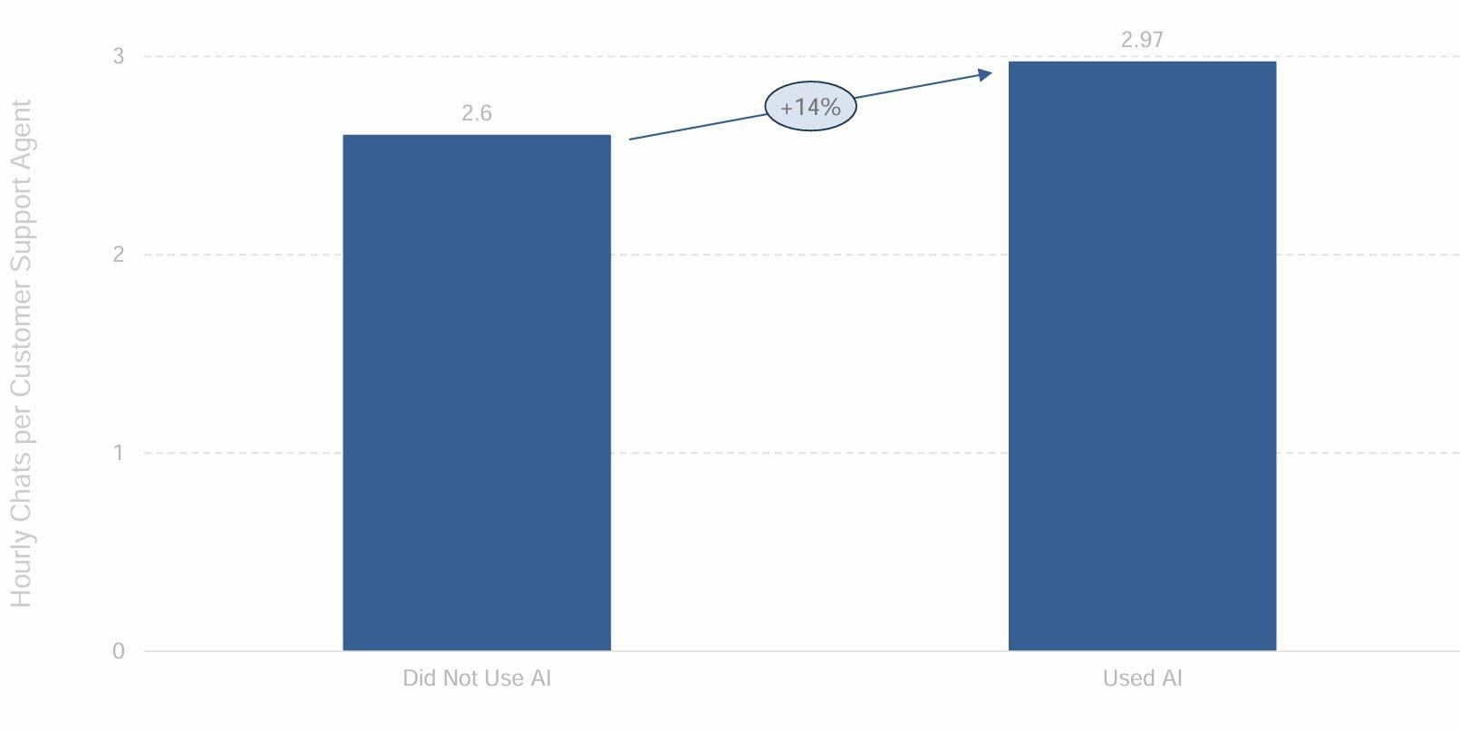
Today’s AI Adoption and Productivity
Top Risk & Fraud GenAI use cases
Source: Stanford AI Index 4/25

Slide 9
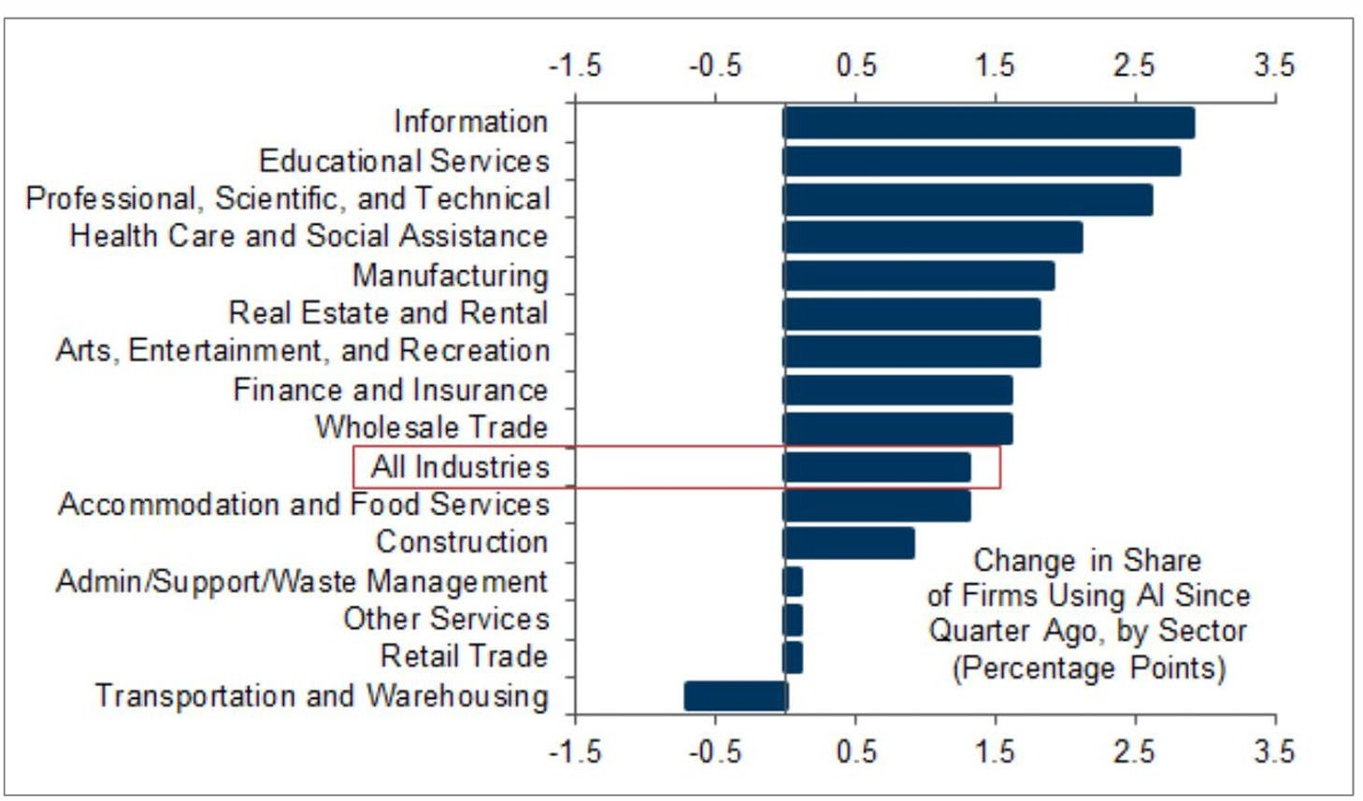
Today’s AI Usage Across Industry
Source: Goldman Sachs 2025

Slide 10
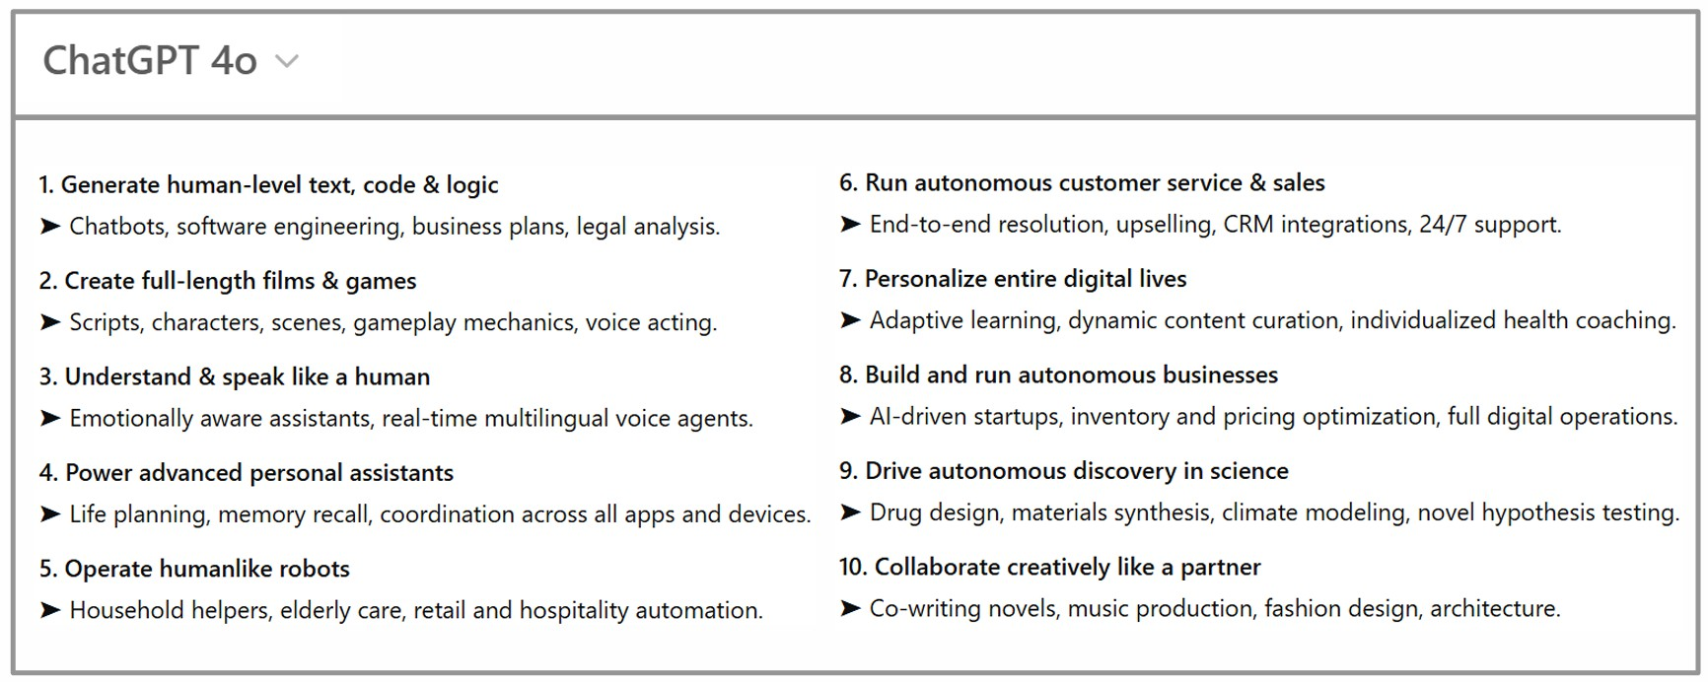
AI Capabilities Forecast in 5 years
Top Risk & Fraud GenAI use cases
Source: Stanford AI Index 4/25

Slide 11
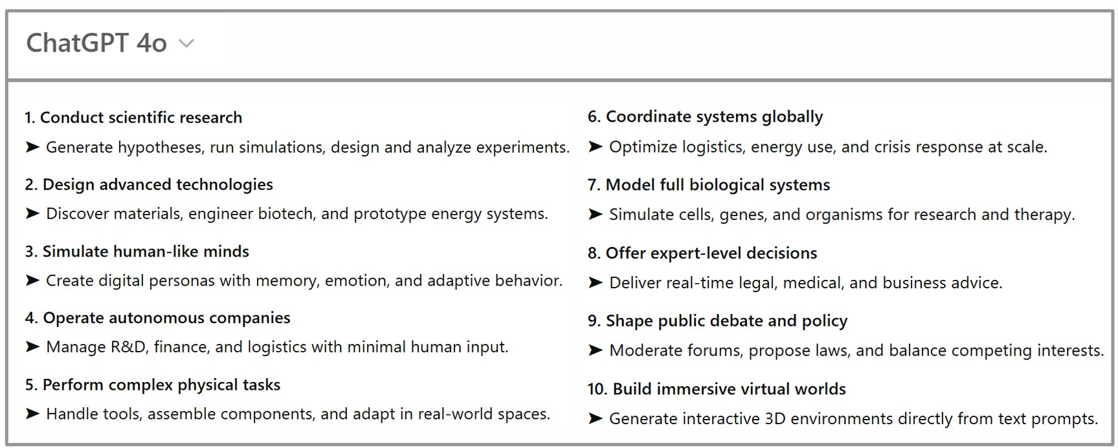
AI Capabilities Forecast in 10 years
Top Risk & Fraud GenAI use cases
Source: Stanford AI Index 4/25

Slide 12


Urgent but Unprepared
98% of companies feel increase in urgency
85% of companies believe less than 18 months to deploy AI strategy
50% of companies have dedicated 10-30% budget to AI
13% of company leadership AI-ready by internal measures
Source: Cisco 2025 AI Readiness Index

Slide 13
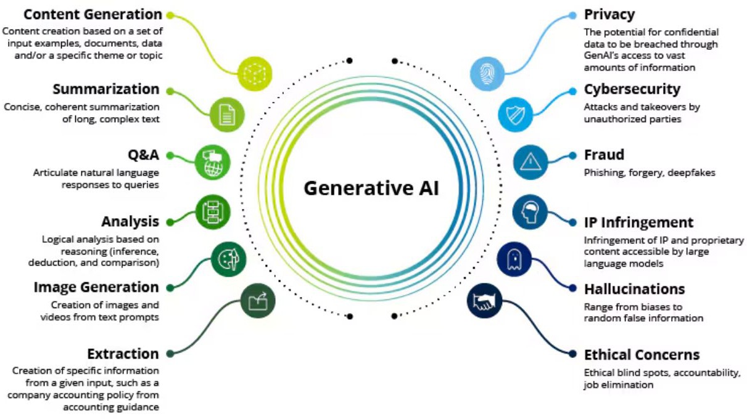
Opportunity for Audit
Value
Risks
Source: Deloitte GenAI for Audit 2025

Slide 14
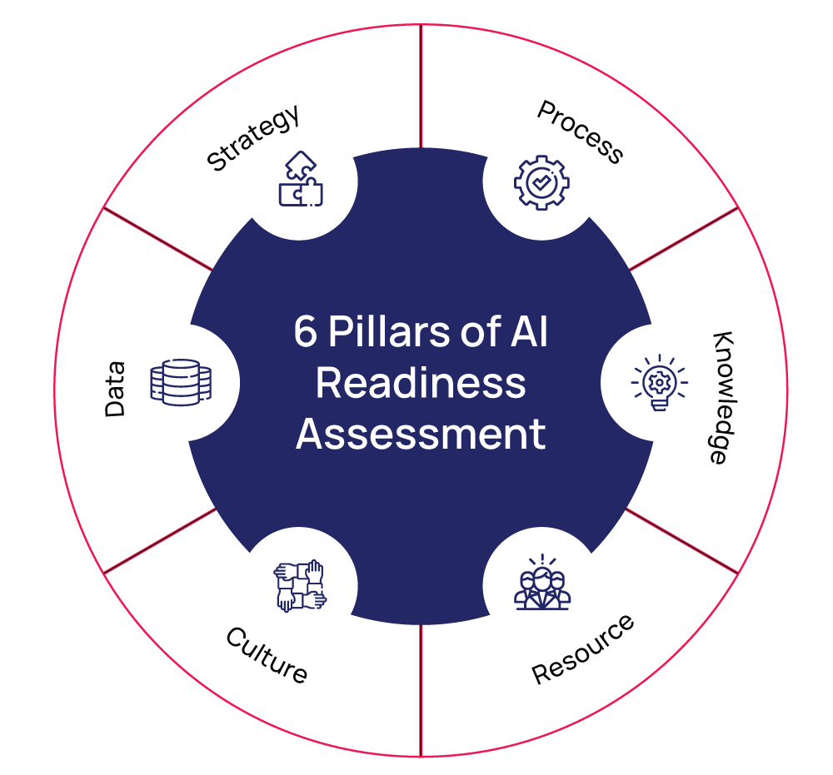
AI Readiness: Alignment Across Pillars
Source: Nuvento

Slide 15
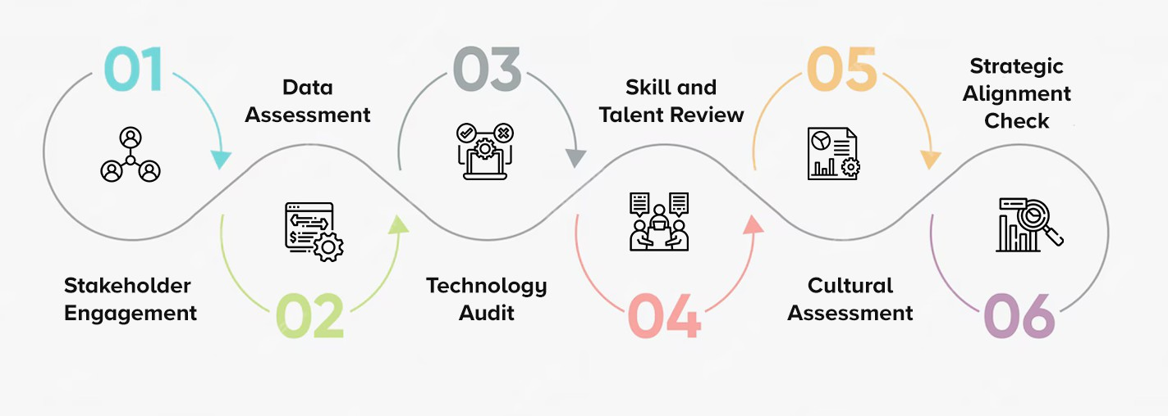
AI Readiness: Practical Next Steps
Source: Matellio Inc.

Slide 16
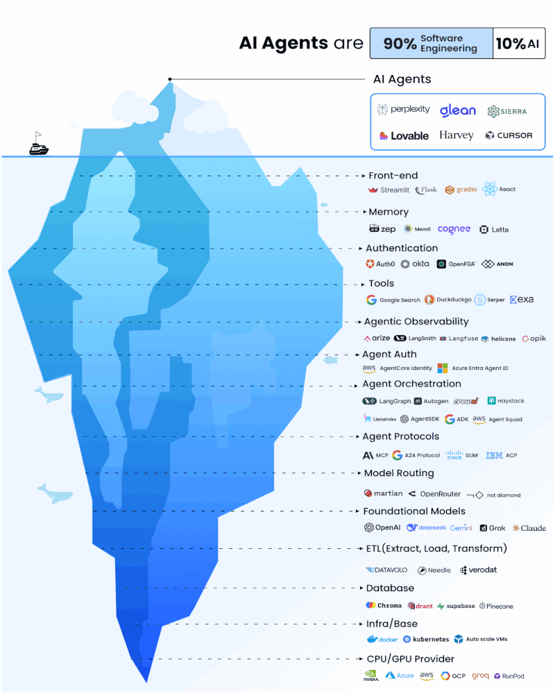
AI Readiness: Practical Next Steps
Source: Matellio Inc.

Slide 17
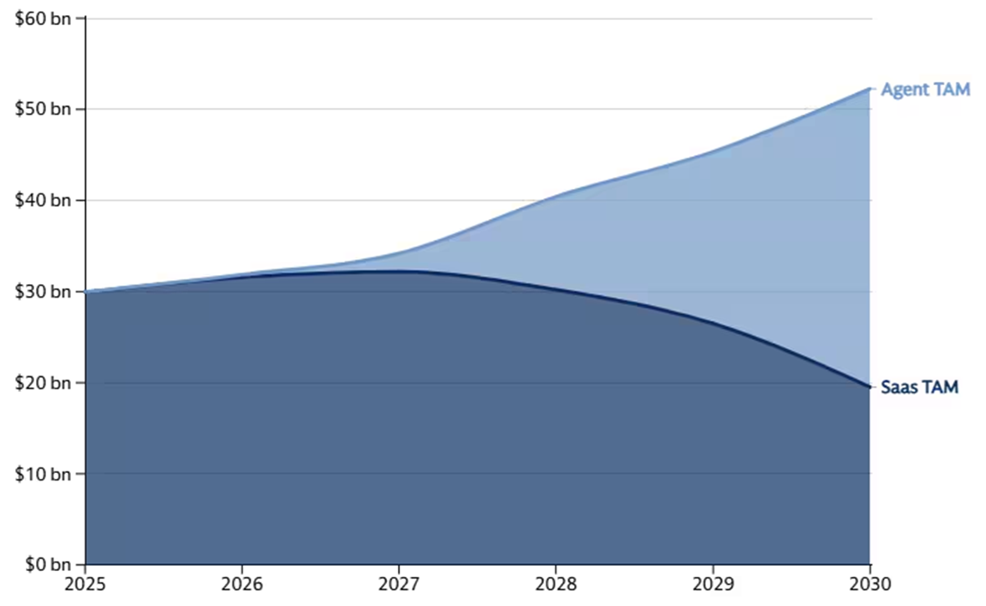

AI Readiness: Practical Next Steps
Profit Pool in software is expected to shift toward AI Agents
Illustrative shift in TAM for SaaS and Agents
Source: Matellio Inc.

Slide 18
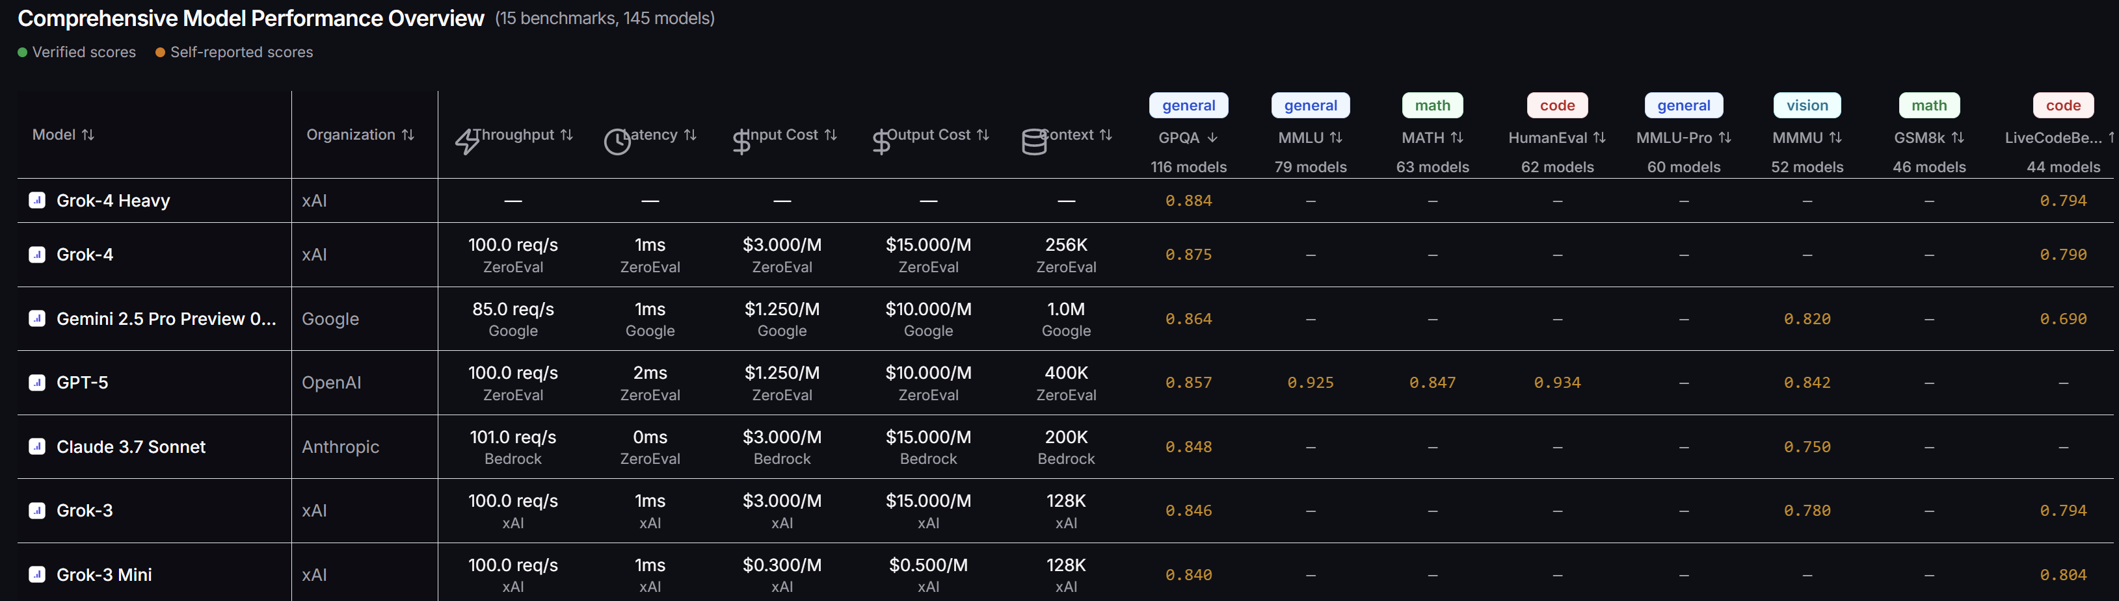
AI Readiness: Practical Next Steps
Source: Matellio Inc.

Slide 19
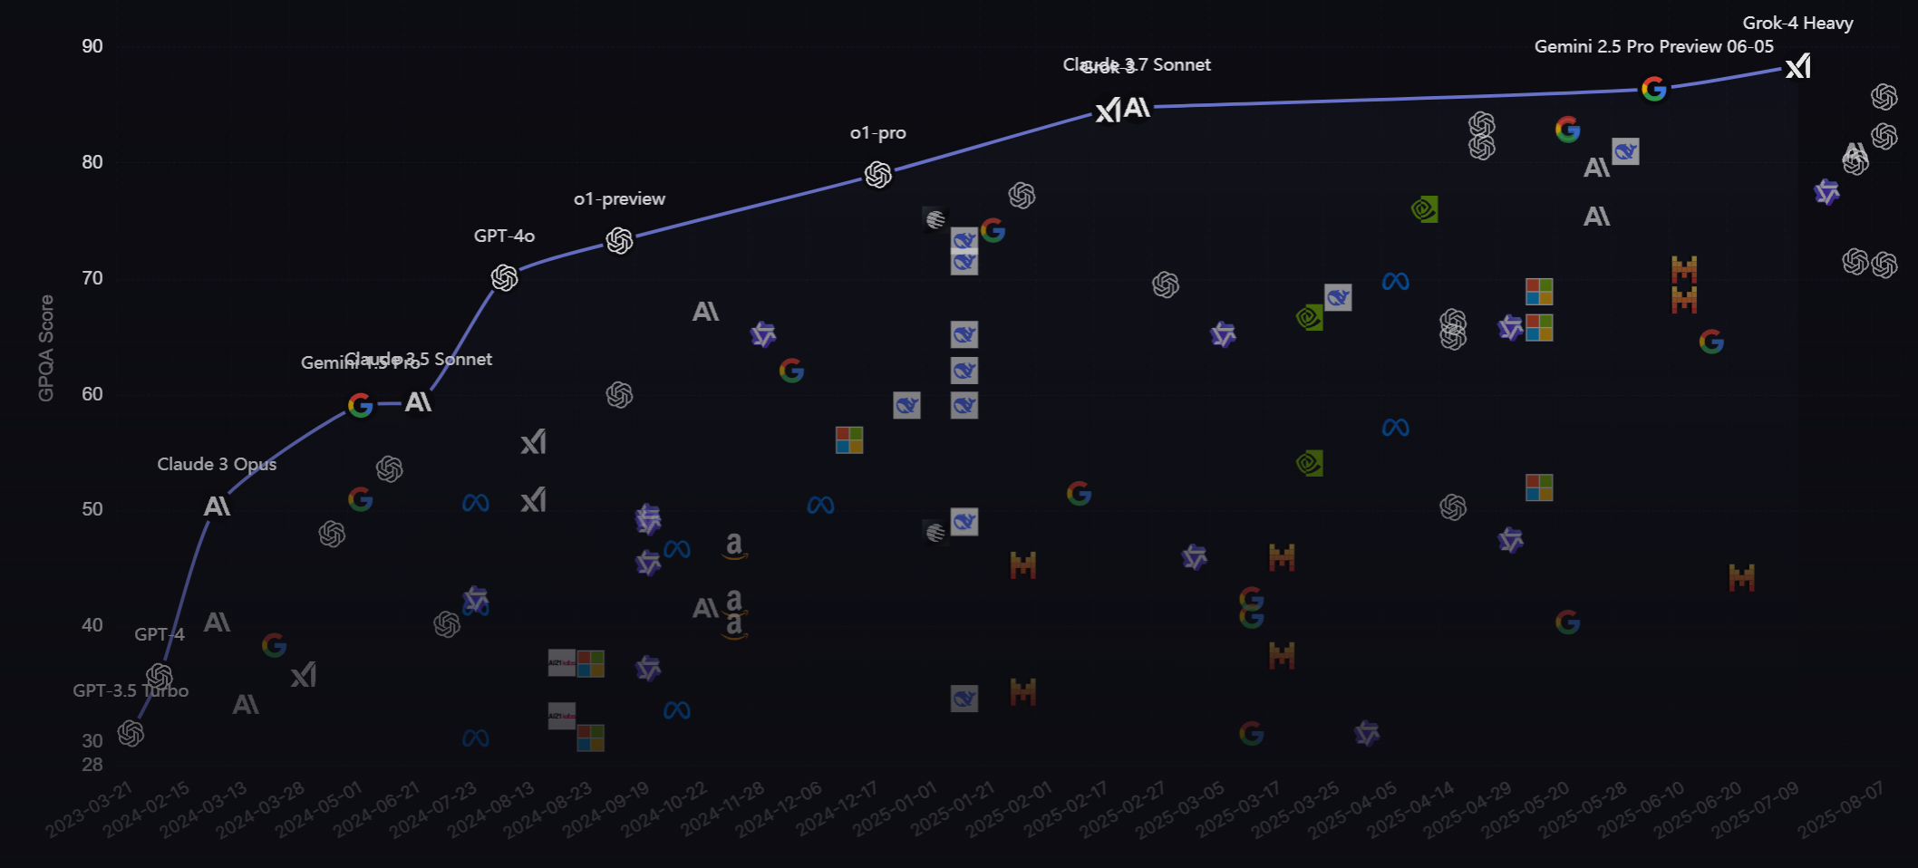
Foundation LLM Leadership Board – GPQA Index
Source: LL-stats

Slide 20
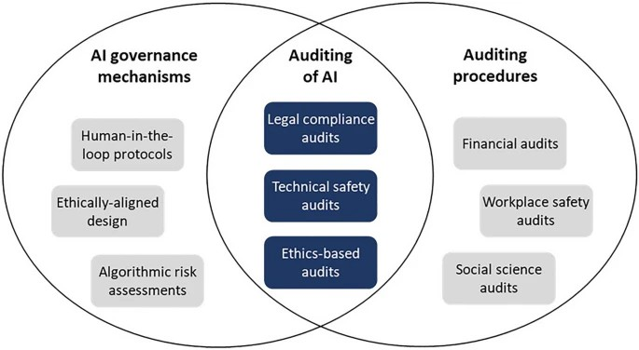
Opportunities for Audit
Source: Mikander, Paper ‘25

Slide 21

AI Readiness:
What Does it Mean?
Ability to adopt, govern, and scale AI responsibly
Combines Trust and Control
  Trust = Accountability + Transparency
  Control = Governance + Risk Management

Slide 22
Executives
Strategic clarity, accountability for outcomes
Audit/Risk
Traceability, explainability, risk alignment
AI Readiness: Personas and Priorities
IT/Security
Systems integration, access control, infrastructure resilience
PMs/Consultants
Safe adoption, vendor vetting, delivery assurance
Developers
MLOps, testing tools

Slide 23



Accountability & Transparency
How do we build trust and ensure AI is explainable and ethical
AI Readiness: Encompassing Themes
Governance & Risk Management
How do we control and scale AI responsibly and securely

Slide 24

Accountability & Transparency
Key Challenges
  Explainability: Are the outputs understandable? (i.e., avoid “black box” situation)
  Validation: Is the model doing what is intended?
  Responsibility: Who is accountable for outcomes?
Technical Solutions
  Model Explainability Tools
  Model Validation
  Model Audit logs

Slide 25

Governance & Risk
AI introduces risks beyond traditional IT
Key Challenges
  Shadow AI: Unapproved usage of AI tools
  Lack of centralization
  Lack of policy enforcement
Technical Solutions
  Shadow AI Detection (e.g., Microsoft Defender)
  Centralized Model Registry (e.g., MLFlow, SageMaker, Vertex AI, Azure ML)
  Integration with Identity and Access Management platforms

Slide 26

Closing the Gaps
Real world consequences from lack of trust and control of AI systems
Readiness impact across functions
  Audit: Traceability
  Risk: Ethics
  IT: Explainability
  Execs: Adoption
  Security: Rigorous Cyber Security

Slide 27
Q&A

Slide 28
Are business and AI goals aligned? Are there success metrics in place?
Strategy
People
Do teams know how to use AI responsibly? Are the necessary roles / training in place?
Ethics
Are the AI systems transparent?
Are there systems in place to mitigate bias?
Infrastructure
Are systems in place to monitor the AI output? Are there workflows to manage model versions?
Data
Is the available data up-to-date and vetted? Are the necessary pipelines in place?
AI Readiness: Discovery Questions

