Slide 1
Triad Healthcare Preparedness Coalition
Quarterly Meeting
November 11th, 2021
2:00 pm

Slide 2
Introductions
Mike Brienza- Healthcare Preparedness Coordinator/Planner
Thomas Gioello- Operations Coordinator/SMAT Team Leader/LTC Coordinator
Ashley McDaniel- Finance/administrative Coordinator
Justin Welborn- Logistics Coordinator
Tiffany Furches- Administrative Assistant/LTC Coordinator

Slide 3
COVID -19
We are closing in on two years of COVID-19 response. With a vaccination available, mAb Clinics as treatment, and booster shots ramping up, COVID-19 may still be a concern, but as statistics are showing, hospitalization among the vaccinated has depleted, mAb clinics are proving to be beneficial with recovery time, and booster shots are extending viability of the initial vaccine. Although we would like to think it’s the beginning of the end, in our positions, we do not have the ability to get comfortable. Planning and training is paramount within every act that we perform.

Slide 4
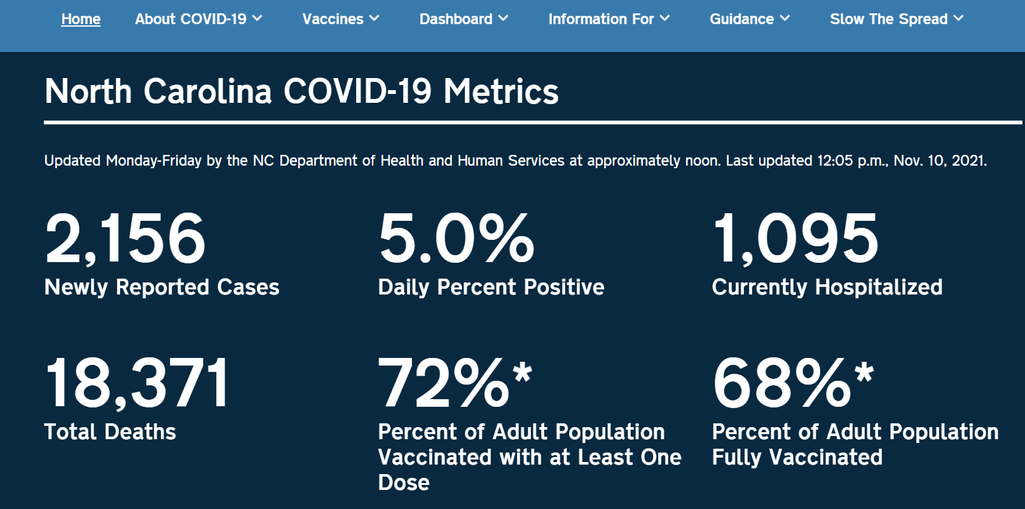
https://covid19.ncdhhs.gov/

Slide 5
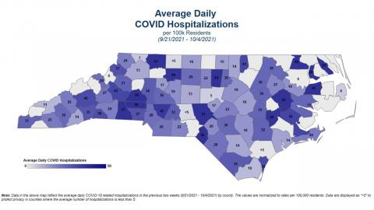
COVID-19 State Hospitalizations
https://covid19.ncdhhs.gov/dashboard/county-transmission-data

Slide 6
As of November 10th, 2021 these are the current numbers for cases and deaths within our region.
County | CASES | DEATH
Alexander | 6,581 | 117
Alleghany | 1,651 | 6
Ashe | 3,491 | 49
Caldwell | 13,672 | 217
Catawba | 28,711 | 430
Davidson | 26,125 | 312
Davie | 6,538 | 80
Forsyth | 52,456 | 572
Guilford | 68,927 | 896
Iredell | 29,272 | 328
Randolph | 22,168 | 203
Rockingham | 12,469 | 203
Rowan | 26,504 | 463
Stokes | 6,407 | 113
Surry | 12,618 | 237
Watauga | 6,760 | 39
Wilkes | 10,718 | 186
Yadkin | 6,098 | 75
Total Regional Cases:
341,166
Total Regional Deaths:
4,526

Slide 7
Work Plan Items
Essential Elements of Information
Hazard Vulnerability Assessment
Training
Burn Annex
SMAT II Bi-Monthly Meeting
Regional Support (Medical/Asset/Documentation)
Regional Participation

Slide 8
Essential Elements of information (EEI)
ASPR requires that the coalition has a created procedure for the use of information sharing techniques within our region. The EEI represents a group of communication capabilities that include phone, email, and text to all medical facilities, county emergency management, county ems, Fire, utilities, among various other entities.
ASPR Guidance: Capability 2.1.2.1- Health Care and Medical Response Coordination
EEI- Important and standard information items needed to make timely and informed decisions. EEIs also provide context and contribute to analysis. EEIs are also included in situation reports
Included Within EEI:
Contact information for various medical and support entities
Entity Reporting: Nature and Scope of Incident
Resource Request Allocation
Patient evacuation and tracking procedures
Bed reporting

Slide 9
Hazard Vulnerability Analysis
Along with ASPR guidance a regional HVA must be completed yearly. With the variety of facilities and entities within the region, we have decided to create three separate hvas to represent three major components within the region:
Long Term Care Facilities
Hospitals
County Emergency Management
In doing this THPC will be able to give particular entities hazard focus, for example, a combative patient would be a hazard for hospitals and ltcs, county emergency management does not have that within their hvas. Ltcs would have a higher focus on elopments, than a hospital. They would have the same issue, but would not be as extensive an issue according the current hvas I have received.
If you have already sent your entities HVA, thank you. If everyone can please send Thomas their most updated HVA, it would be greatly appreciated.

Slide 10
Upcoming Training SMAT 500 Warehouse
ICS 300/400
HSEEP- homeland security exercise and evaluation program
Resource Unit Leader
Planning Section Chief

Slide 11
TERMS Training Opportunities
ICS 300: EE Waddell Community Center- 621 Wall St, Albermarle, November 15-16 0800-1900
https://terms.ncem.gov/TRS/courseDesc.do?sourcePage=courseSearch&cofId=136796
ICS 400: Conover Fire St 1- Catawba- 1225 Conover Blvd East, Conover, Nov 16-17 0800-1700
https://terms.ncem.gov/TRS/courseDesc.do?sourcePage=courseSearch&cofId=137426
ICS 400: Mt Mitchell Fire, 5875 Old Salisbury Concord Rd, Kannapolis, Dec 2, Dec 7, Dec 9, Dec 14
https://terms.ncem.gov/TRS/courseDesc.do?sourcePage=courseSearch&cofId=135509
All Hazards Public Info Officer: Lee County EMS, 204 W Coutland Dr, Sanford, Dec 6-10 0800-1700
https://terms.ncem.gov/TRS/courseDesc.do?sourcePage=courseSearch&cofId=136791
SMAT Bi-Monthly Meeting: 315 Bethel Church Rd, Mocksville, December 7th, 2021- 1900-2200
https://terms.ncem.gov/TRS/courseDesc.do?sourcePage=courseSearch&cofId=135490
Disaster Preparedness for Hospitals and Healthcare Organizations within the Community Infrastructure: 108 McKenzie Rd, Spring Lake Fayetteville Tech, Jan 27-28, 2022 0800-1700
https://terms.ncem.gov/TRS/courseDesc.do?sourcePage=courseSearch&cofId=135195
Jurisdictional Threat and Hazard Identification and Risk Assessment: New Hanover, EOC
203 Government Center Dr, Wilmington Feb 2-3, 2022 0800-1700
https://terms.ncem.gov/TRS/courseDesc.do?sourcePage=courseSearch&cofId=137316
Training Exercise Response Management System
https://terms.ncem.gov/TRS/

Slide 12
Burn Annex
Per ASPR, each coalition must complete a medical response annex for their region. Triad is participating in the creation of a state wide annex. Duke coalition, heading the project, hosts monthly meetings to coordinate information sharing throughout the creation of the document.
Participants for the current burn annex include experienced burn responders. Knowing that the region has many burn personnel, THPC would like to ask if anyone is available to participate in the monthly annex meetings, it would provide information to help guide the process of the document. Having experienced participants would allow the group to gather as much information as possible. Participants could have experience in either burn care and/or wound care. THPC would love to have experience from all aspects involved in this type of care and not just strictly in patient care.

Slide 13
SMAT Bi-mOnthly Meetings
Our Bi-Monthly Meetings consist of Medical and Logistics training. The December meeting will have a holiday dinner provided during a presentation by guest speaker michelle Brock, CEM.
Michelle Brock, CEM – michelleb@cityofws.org
Michelle Brock has been with the Winston-Salem/Forsyth County Office of Emergency Management since October of 2005, and an employee of the City of Winston-Salem since April of 1999. Her career with the City of Winston-Salem began as an Assistant Chemist in the Utilities Department. She is an Executive Level Emergency Manager with the State of North Carolina and in February of 2015, Michelle earned the designation of CEM (Certified Emergency Manager) through the International Association of Emergency Managers. Over the years, Michelle has coordinated many local and regional projects and has been recognized at the local, state and national levels for projects and events that enhance emergency management and preparedness. She also created and manages a regional animal response team (Piedmont Emergency Animal Response Team - PEART), and the Forsyth County Incident Management Team. Currently, Michelle is an administrator of the county-wide Web EOC software and delivers training to Web EOC end users and technical support staff. She is the First Vice President of the North Carolina Emergency Management Association and the Chair of NCEMA’s Training Committee. Michelle also serves on NCEM’s E-Learning Working Group and NC Department of Agriculture & Consumer Services’ Animal Emergency Response Working Group. Michelle has deployed to help other NC emergency managers and communities during Hurricanes Matthew, Florence, and Dorian and during the Party Rock Wildfires.
December 7th, 2021 7:00 PM- 10:00 PM
**PLEASE register in TERMS if you are attending as this will have a limited capacity available**

Slide 14
Deployment Update
*Deployments Listed Last Meeting* *Activities*
Medical Mobile Unit:
Faith Fest- Wilkes Community College: 8/26-8/30/2021 MMU had a successful deployment
Merle Fest- Wilkes Community College: 9/7-9/20/2021 MMU had a successful Deployment
Cheerwine Fest- Salisbury NC: 9/17-9/18/2021 Festival Cancelled
Apple Fest- Wilkes Rescue Squad: 10/1-10/3/2021 Festival Cancelled
Spot Coolers:
Peace Haven family Clinic 9/2-9/12/2021 The clinic was able to complete the maintenance on the facilities HVAC
2 days earlier than expected. The spot coolers
successfully cooled the building with no issues.
Kubota:
Iredell County Fair- Iredell County: 9/2-9/12-2021 Kubota transported patients to their MMU set up
Forts Box:
Wake Forest Baptist Health Flu Campaign: 9/27-11/5/2021
High Point Regional Hospital Demobilized last week.
Wake Forest Baptist Health Winston Campus Extended until May for employee testing requirements

Slide 15
Regional Support
Regional Medical Support
LTV Vents: 24 Kangaroo Feeding Pumps: 4
Monitors: 9 Welch Allyn Vital Sign Machines: 10
Randolph Hospital- Wake Forest Baptist Health Assist- High Flow Oxygen Deliver System
Provided 50 PAPRS to the region for support
PPE Support
mAb Clinic in Wilkes County
Several Long Term Care Facilities
EMS Agencies
Asset Support
Fall Furniture Market: MMU- High Point, Guilford County
Horizons Long Term Care: Spot Coolers x 5 Forsyth County
Tour De Tanglewood: MMU/M8/Generator/Kubota- Forsyth County
Regional Document Support
Adams Farm Living and Rehabilitation

Slide 16
participation
Classes: Planning Section Chief- 10/18-21/2021 Station 42 in Kernersville
Meetings: Initial Burn Annex
Monthly Steering Committee Meetings
Bi-Monthly Meetings: 10/5/2021- Cancelled
LEPC Meetings:
Stokes County
Davidson County
Rowan County
If you are connected with a county emergency management office, please send us your schedule for upcoming meetings
The coalition and SMAT are both involved in several different avenues of training and information sharing. A benefit of having an 18 county region is having the opportunities to be involved with various different exercises and planning events. In order for THPC to provide the best service to our region, it is extremely helpful to be involved with everyone and what you are doing within your area.

Slide 17
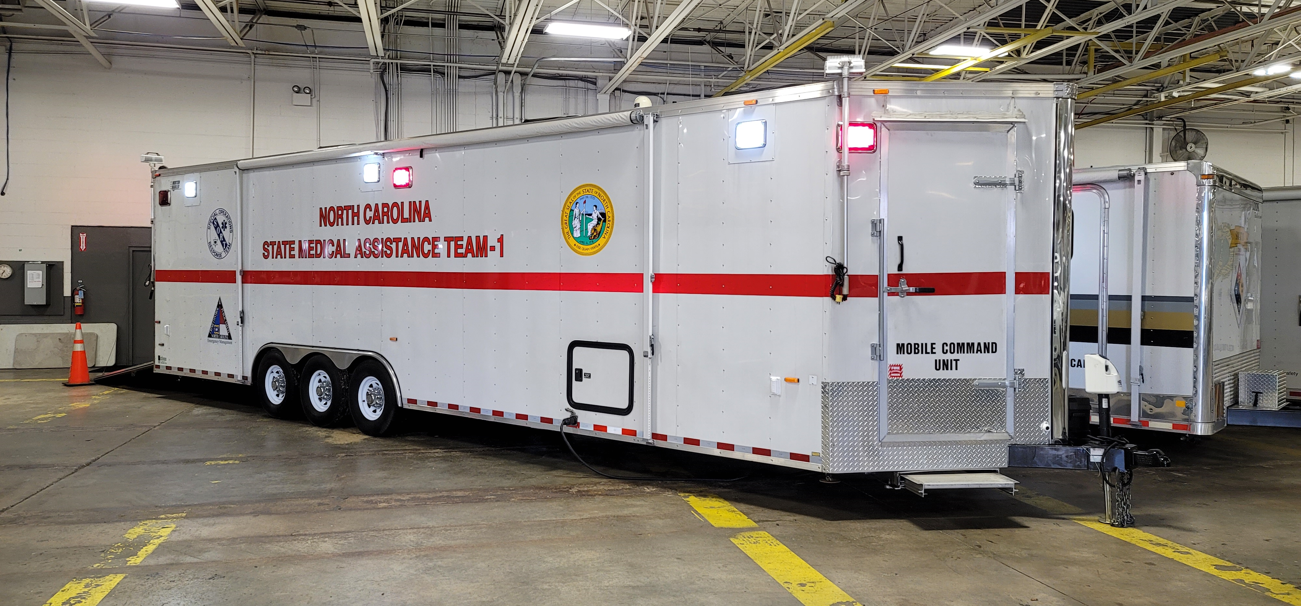
Asset update
The New MMU is complete and ready for deployment. It can assist with planned events and disaster incidents. it has a 6 bed capability along with oxygen and communications capabilities. Time to deploy this with no prior notice would depend on a variety of things but is estimated at 1-2 hours.

Slide 18
Long term care facilities
Having two LTC Coordinators at the coalition, we are continuously contacting and communicating with LTCs to assist with PPE and Staffing needs. Working with the state in this matter, we communicate with facilities to find out current situational statuses. Recording this information, the state coordinates with the given information to assist with facility needs.
Last year LTCs gained assistance from the state with paid volunteers. This year there is a pool of volunteers that are given a stipend. Staffing has been an issue for the majority of the COVID response, but not having the ability to pay each volunteer, this is the solution to the lack of capability.
Tiffany, Administrative Assistant, has taken the last few months to call and communicate with all of the LTCs within the region. Gaining most of their emails, and contact information, we will be able to communicate specifically with LTCs. This will allow the coalition to maintain response levels with LTCs being the main focus.

Slide 19
Long term care facilities
In the upcoming weeks, Thomas and Tiffany will start to schedule calls with all LTC participants within the region. In doing this we will be able to update each facility with state changes, CMS updates, and various other points of information utilized particularly for LTCs.
Coalition Capabilities for LTCs
Emergency Operations Procedure Assistance
CMS Procedural Updates
Crisis PPE Assistance
Phone/Email communication with County Emergency Management/State contacts
Mission Ready Packages
Facility Exercise Observers/Evaluators
Training Room Space for Employee Training

Slide 20
Training Room Opportunities
The Triad Healthcare Coalition has the capability to provide a training room space for classes, training, exercises, and various other actions that facilities need to complete. With this capability, we are happy to provide this space for your facility needs. If requested, a guideline for training room participation will be sent out to the requesting agency listing facility requirements and expectations.
Please feel free to contact Thomas Gioello to schedule any Training Room events.
(336) 528-9625
Tgean@wakehealth.edu

Slide 21
THPC Quarterly MEETINGS
With these quarterly meetings in mind, hoping that they will start to be in person, I would like your feedback on presentations that we could schedule. Any ideas that would include facility gaps or needs would be much appreciated.

Slide 22
Communication/Attendance
TriadHPC.org
Facebook.com/TriadPreparednessCoalition
On-Call Number
336-701-6080
Please email me at tgean@wakehealth.edu, with 08052021 Quarterly Meeting in the subject line. Once I receive your email, I will add you to the attendee list, and send you a certificate of participation.

