Slide 1
Triad Healthcare Preparedness Coalition
Quarterly Meeting
May 6th, 2021
2:00 pm

Slide 2
Introductions
Mike Brienza- Healthcare Preparedness Coordinator/Planner
Thomas Gioello- Operations Coordinator/SMAT Team Leader/LTC Coordinator
Ashley McDaniel- Financial Coordinator
New Employees
Justin Welborn- Logistics Coordinator
Tiffany Furches- Administrative Assistant/LTC Coordinator

Slide 3
Warehouse updates
Training room Painting
Training Room Carpet Replaced
Electrical outlets added and fixed

Slide 4
Asset updates
We have recently switched out our international truck with a 5500 Dodge truck
We will be adding a cache of vital machines to our Mission Ready Packages
Getting warehouse materials and assets together, we are making our 50 bed MRP operational by setting up the assets to pull after receiving the request for the mrp. We will do this will most of our mrps, this way quick response is always available.

Slide 5
Deployments
We have had several requests within the last few months, these included generators, forts boxes, tents, spot coolers, morgue trailers, support items such as tables and chairs
The deployments include
mass vaccination clinics- generators, m8 command center, tables, chairs, forts boxes, tents
Long term care facilities- spot coolers, generators
Hospitals- Morgue Trailers

Slide 6
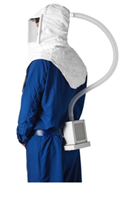
Papr distribution
Power Air Purifying Respirator
At the end of last year, we were given a grant for covid-19 relief. We decided that PAPRS were on high demand due to the pandemic. With this understanding, we purchased 100,000$ worth of paprs and paprs accessories.
Each of our 18 counties received 3 sets of PAPRs
The counties have the ability to decide where the kits go
Each of our 27 hospitals will receive 1 PAPR set
Hospitals choose how they distribute the PAPRs

Slide 7
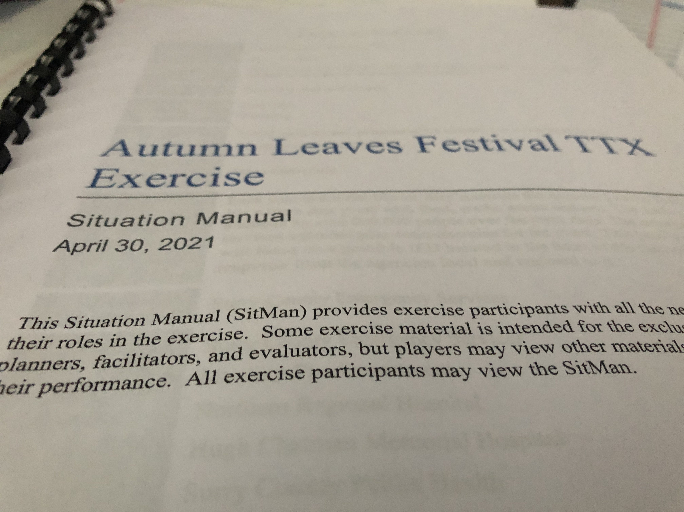
We were able to attend a Dirty Bomb TTX for the Autumn Leaves Festival that is held in Mt. Airy (Surry County) every year.
200,000 people to attend within a four day period
Protests against the festival occurred, with both sides being on scene
2 suspicious packages found
Man with rifle on a roof, group of people dressed in black with guns
Cat 2 hurricane arrived the day before the start of the festival
Bus with 50 people turned over- 15 people ambulatory, 35 people displaced waiting on ride home

Slide 8
Highly infectious disease annex
Duke Coalition was able to obtain a grant to assist with our annex this year.
What this means for the coalition:
This document is set up to assist the region with response to a pandemic
All regional information is gathered and placed so as a coalition we know how hospitals and other agencies will respond to a highly infectious disease. In knowing this, we can assist with the response by planning and operating under the annex.
An example of assistance would be an ambulance strike team, if transfers or patient movement needs to happen and there aren’t enough ambulances available, the coalition can contact other counties in the region to assist with additional ambulances (AST)

Slide 9
Upcoming year
Essential Elements of Information
MYTEP
Hazard Vulnerability Assessment
Mission Ready Packages
Training Classes
Surge annex

Slide 10
Mission Ready Packages
Updated Mission Ready Packages are on our website for viewing.
TriadHPC.org
These packages are set up for users to know what the coalition has available at the warehouse, and what capabilities we possess to assist healthcare entities. Long term care facilities, hospitals, group homes, and various other entities are able to utilize these assets in times of need or during a catastrophic event.

Slide 11
Training Classes
Basic Disaster Life Support
May 26th, 2021
8:00 AM- 5:00 PM
Advanced Disaster Life Support
May 27th-28th, 2021
8:00 AM- 5:00 PM
Bi-Monthly Meeting
June 1st, 2021
7:00 PM- 10:00 PM

Slide 12
June 1st Bi-Monthly Meeting
Two meetings will be available to attend
Medical: Splinting/Musculoskeletal immobilization
Logistics: Inventory of assets

Slide 13
Basic Disaster Life Support
BDLS has an overall concentration in common language used during a disaster, knowledge bas for the clinical and public health management of all ages and populations affected by disasters and public health emergencies

Slide 14
ADVANCED DISASTER LIFE SUPPORT
BDLS is a prerequisite for ADLS
ADLS allows individuals to train for mass casualty scenarios that may happen. Training components include population scenarios, mass casualty triage tabletop and situational training exercises.
The main audience for this course includes physicians, nurses, emergency medical technicians, paramedics, pharmacists, and all who are involved in various healthcare professions.

Slide 15
Communication
TriadHPC.org
Facebook.com/TriadPreparednessCoalition
On-Call Number
336-701-6080
OPEN FOR DISCUSSION

