Slide 1


Triad Healthcare Preparedness Coalition
Quarterly Meeting
August 5th, 2021
2:00 pm

Slide 2
Introductions
Mike Brienza- Healthcare Preparedness Coordinator/Planner
Thomas Gioello- Operations Coordinator/SMAT Team Leader/LTC Coordinator
Ashley McDaniel- Financial Coordinator
Justin Welborn- Logistics Coordinator
Tiffany Furches- Administrative Assistant/LTC Coordinator

Slide 3
COVID -19
With COVID numbers and hospitalizations rising, it seems COVID is making itself known again. Hospitals, federal, and state buildings have kept the mask mandate, while various businesses are choosing for themselves how they want to handle it. We know, through last year’s response from Governor Cooper that mask mandates and business shut downs are an option and may continue to be one.
There are different opinions on COVID as a whole, but being associated with medical disaster response, the Triad Healthcare Preparedness Coalition, is staying in line with what the state is requesting of us. Our affiliate Wake Forest Baptist Health creates our guidance within the THPC/SMAT facility. As we continue on with the year, our ability to meet in person will be governed by what Wake Forest Baptist Health does with their procedures.
Training room use, including trainings and meetings will be updated as we are informed.

Slide 4
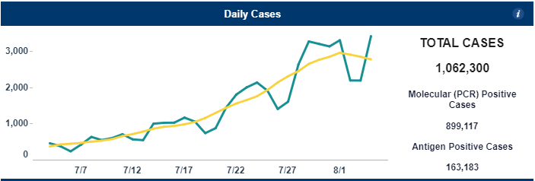
According to NCDHHS Dashboard, over the last month there has been a substantial increase in Daily Reported Cases
July 4- 453 New Cases Reported
August 4- 3,413 New Cases Reported

Slide 5
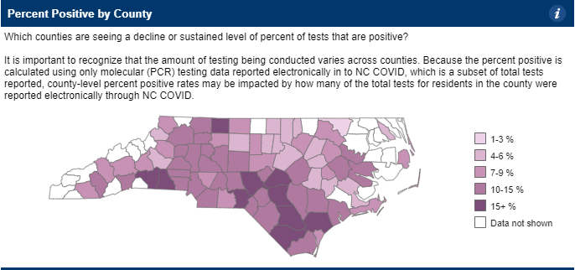
positive percentage regionally
4%-17%
Most counties in the region are between approximately
9%-13%

Slide 6
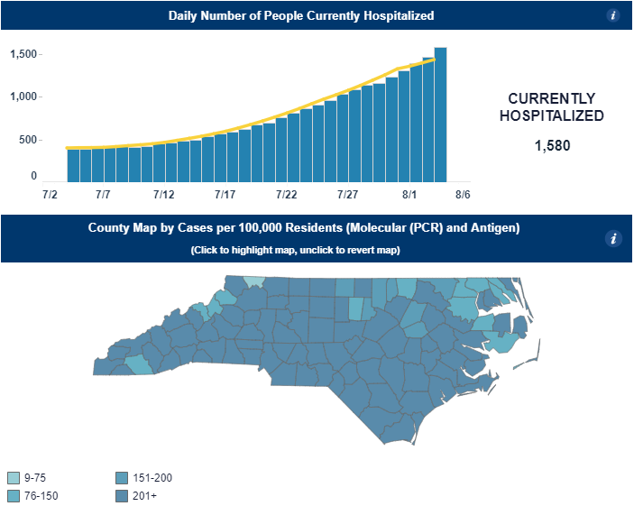
Hospitalizations
July 4 – 388 Hospitalizations Aug 3- 1,580 Hospitalizations
Cases per 100,000 Residents
-16 of 18 Counties are reporting greater than 201 cases per 100,000
*Approximately 60% over the age of 50

Slide 7
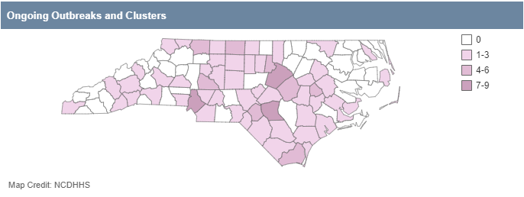
Outbreaks and Clusters
12 of 18 Counties reporting Outbreaks and/or Clusters
Most commonly seen in Congregate Living, Child Care and School Setting
Highest number of reports regionally
-Rockingham
-Surry
-Rowan

Slide 8
RECENT DEPLOYMENTS
Spot coolers
  Appalachian Regional Health System (Charles A Cannon Hospital)
    Deployed to assist with HVAC maintenance updates while their building HVAC was down.
100 Kw GENERATOR
  Deployed to the citadel of Salisbury due to their back up generator breaking down. According to cms (centers for medicare & Medicaid) each long term care facility must have a back up generator at all times.
  https://files.asprtracie.hhs.gov/documents/aspr-tracie-cms-ep-rule-long-term-care.pdf

Slide 9
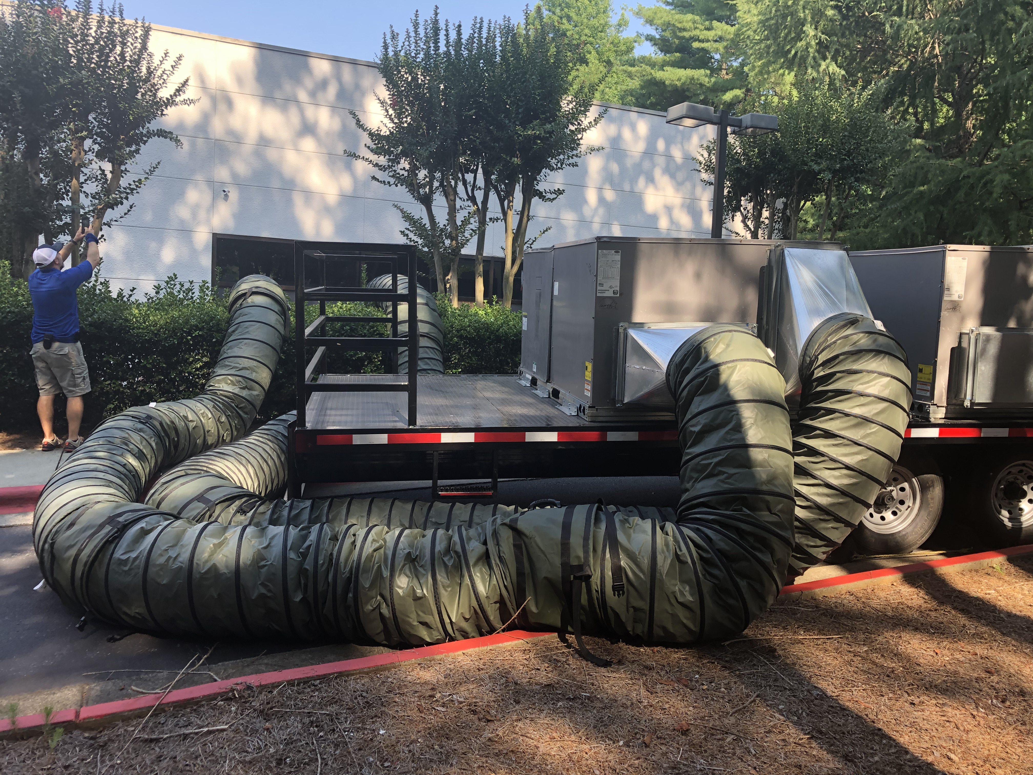
Current Deployments
Old Vineyard Behavioral Hospital, Winston-Salem NC
We deployed our HVAC trailer (Generator, 2x HVAC Units), to Old Vineyard Behavioral Hospital due to their roof unit breaking down. They were using small spot coolers to cool the area, but due to the heat, the spot coolers were not useful. Once our system was in place, they were able to gain the needed support to cool the area. We are currently scheduled to pick up the asset tomorrow, 8/6/2021.

Slide 10
Upcoming deployments
Medical Mobile Unit:
Faith Fest- Wilkes Community College: 8/26-8/30/2021
Merle Fest- Wilkes Community College: 9/7-9/20/2021
Cheerwine Fest- Salisbury NC: 9/17-9/18/2021
Apple Fest- Wilkes Rescue Squad: 10/1-10/3/2021
Spot Coolers:
Peace Haven family Clinic 9/2-9/12/2021
Kubota:
Iredell County Fair- Iredell County: 9/2-9/12-2021
Forts Box:
Wake Forest Baptist Health Flu Campaign: 9/27-11/5/2021
High Point Regional Hospital
Wake Forest Baptist Health Winston Campus

Slide 11
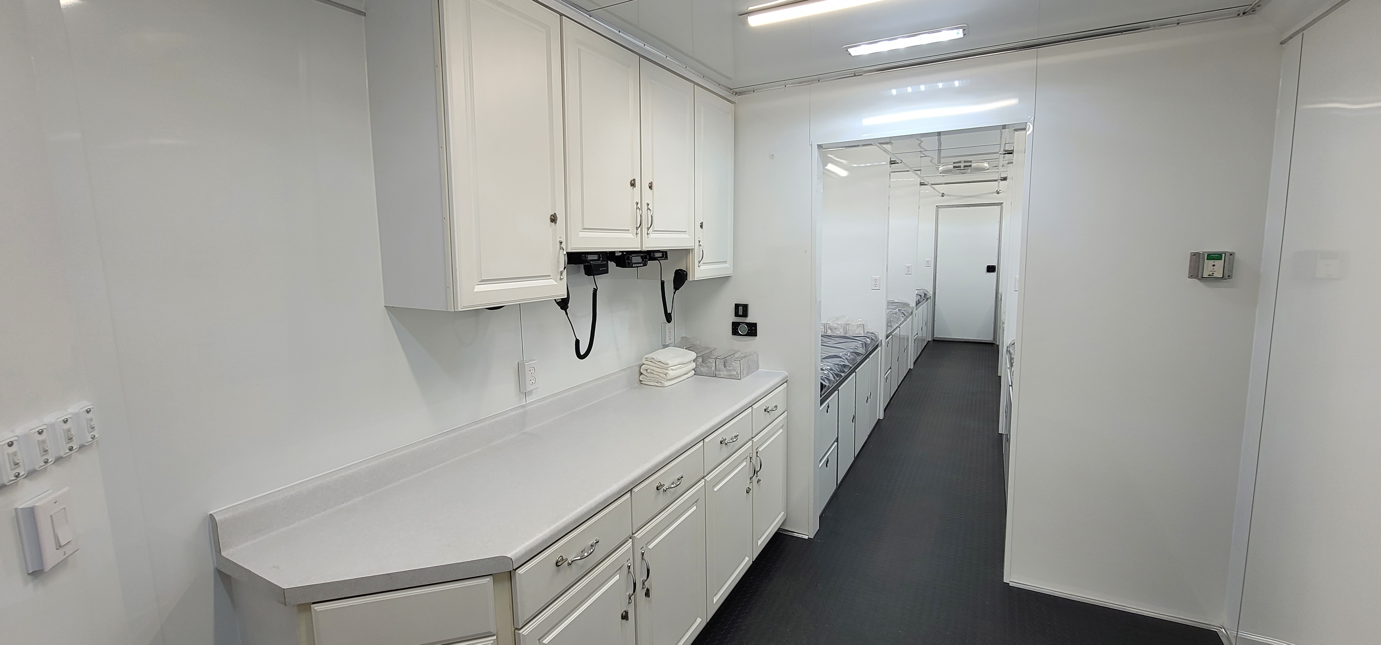
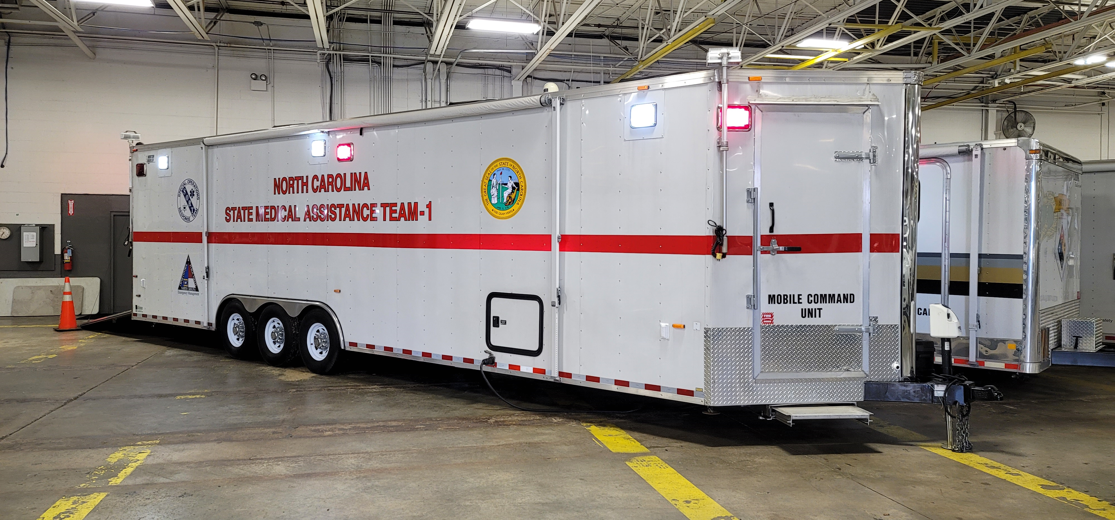
Asset update
One of THPCs Medical Mobile Units (MMU) was updated within the last few months. The MMU was up fitted from a previously used command trailer by Trailers of the East Coast.
It is a 6 bed MMU, that will be deployable starting 9/1/2021.

Slide 12
participation
Classes: ADLS/BDLS May 26th-28th: Both classes were full, Augusta University/NDLS
Meetings: 6/22/2021 System Wide Emergency Management Meeting- Cone Health
Bi-Monthly Meetings: 8/3/2021- 50 Bed Mission Ready Package
LEPC Meetings: Rowan County 7/29/2021
Davidson County 7/14/2021
Rockingham County 7/15/2021
If you are connected with a county emergency management office, please send us your schedule for upcoming meetings
The coalition and SMAT are both involved in several different avenues of training and information sharing. A benefit of having an 18 county region, is that we have the opportunities to be involved with various different exercises, and planning events. In order for us to provide the best service to our region, it is extremely helpful to be involved with all of you and what you are doing within your area.

Slide 13
SMAT Bi-mOnthly Meetings
Our Bi-Monthly SMAT meetings consist of a medical class and a logistics class. Medical can be used for credentialing and logistics allows volunteers to learn how to deploy with the team.
August 3rd, this week, the meeting consisted of looking through and speaking about how to deploy our 50 Bed MRP. This mission ready package was created to set up a 50 bed medical facility. Medical supplies, such as needles, bandages, medications, and oxygen as well as storage, trashcans, linens, diapers, and various other items are included in the package. Volunteers learning what is inside of the package and how to set it up once we get to a destination is extremely helpful when having to deploy at a moments notice.
UPCOMING MEETINGS:
October 5th, 2021 1900
December 7th, 2021 1900

Slide 14
Smat Logistics Work Days
Due to the issues with gatherings for the past year, I have decided to add in an SMAT meeting on the opposite months of our Bi-Monthly Meetings. These meetings will be held for specific logistics training.
September 7th, 2021 1900- Scheduled- Fork Lift Certification Course (Limited to 10 People)
https://terms.ncem.org/TRS/courseDesc.do?sourcePage=courseSearch&cofId=135491
November 2nd, 2021 1900- Scheduled- 50 Bed MRP response and deployment
https://terms.ncem.org/TRS/courseDesc.do?sourcePage=courseSearch&cofId=135492

Slide 15
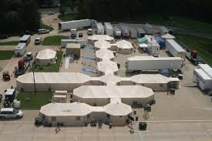
Upcoming year
Essential Elements of Information
Mission Ready Packages
Hazard Vulnerability Assessment
Training Classes

Slide 16
Essential elements of information
Each year the coalition gathers information to update our Essential Elements of Information (EEI). In doing this, we are completing an updated copy of our medical facility contact lists. These facilities include hospitals, long term care facilities, group homes, and other entities.
This is used as a main resource for contacting facilities if a disaster event occurred in that area. We are able to keep up with patient movement, and facility needs through information sharing by having a quick reference guide to groups and individuals.
We gather information such as: Phone numbers, Administrator Names, Addresses, Emails, Facility Coordinates, Sister Facilities, Patient and Staffing Numbers. Some of this information changes often, so going through the time looking up the information, and calling, gives us a better opportunity to speak to facilities within our region and understand their needs.

Slide 17
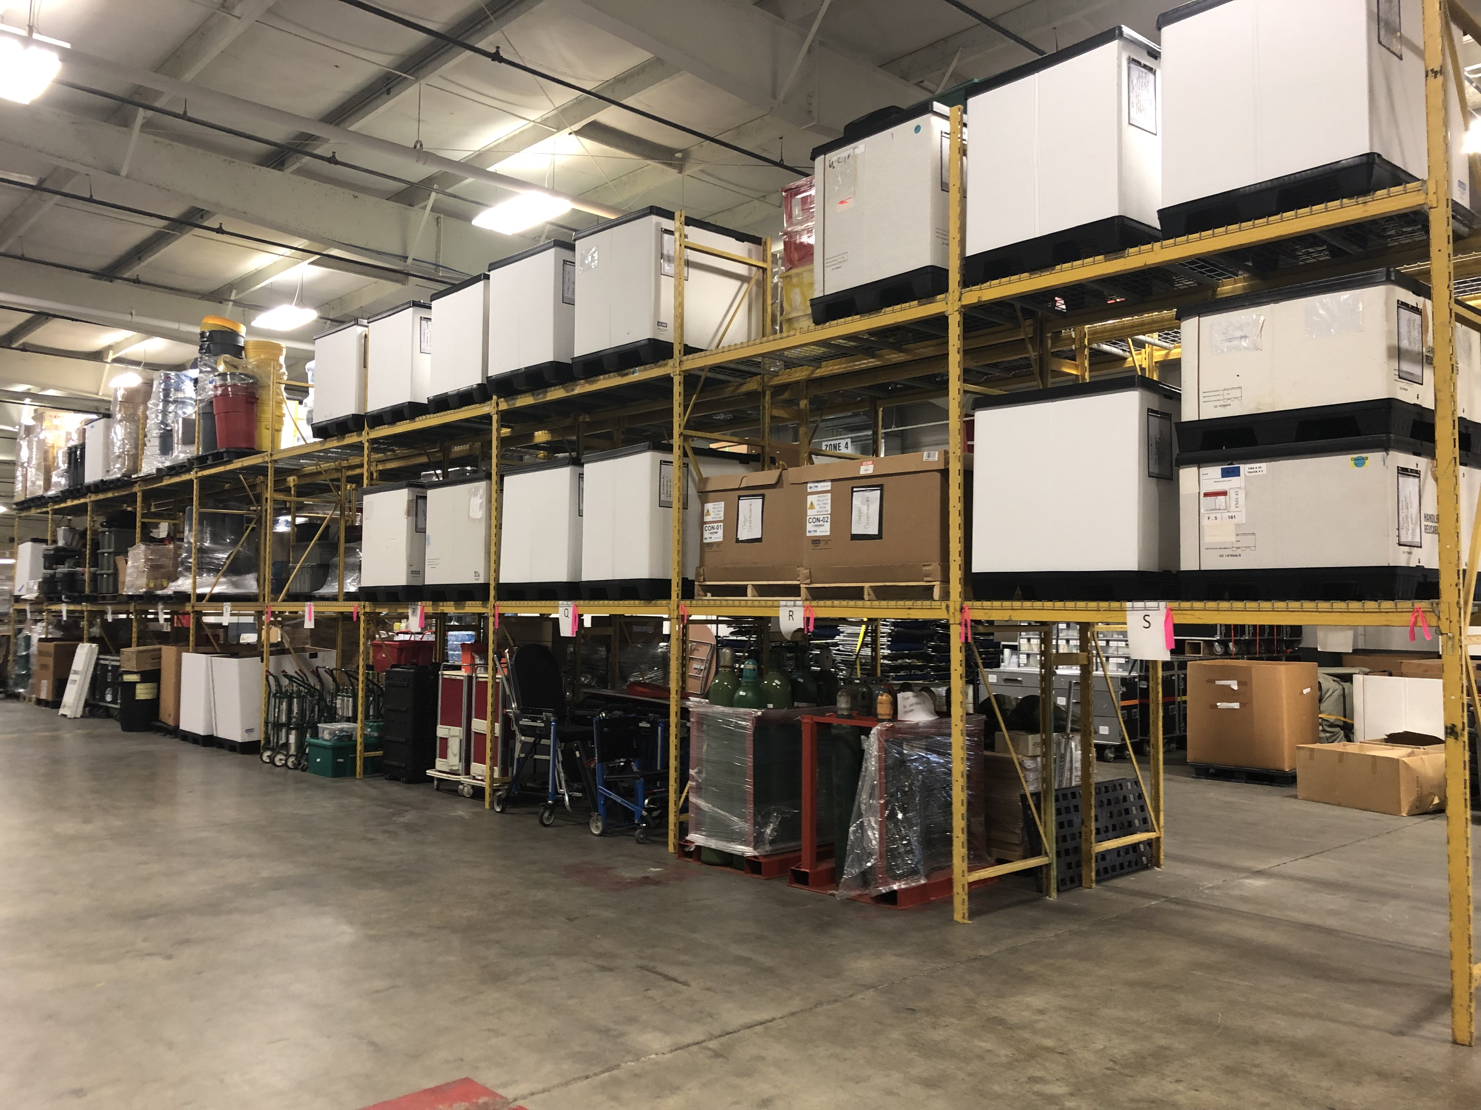
Mission Ready Packages
Updated Mission Ready Packages are on our website for viewing.
TriadHPC.org
Our MRP capability is constantly evolving, becoming more organized, and quicker to deploy. We have taken the last few weeks and focused on our 50 bed mission ready package. Through the use of SMAT Volunteers, and the knowledge of deployments, including lessons learned, we have been able to put together this particular package in a way that would cut the response time down drastically.

Slide 18
Carry over project
Some years coalitions have an option for carry over funding depending on gaps within our capabilities. While organizing and preparing our 50 bed mission ready package, we found that there were a large amount of unused expirables that need to be replaced.
With this possibility, we will be able to start purchasing new items to complete the 50 bed package

Slide 19
Hazard vulnerability assessment
One task that the coalition is responsible for, is the continuation of yearly regional HVAs. In doing this, we can come up with our most concerning hazards. This allows us to understand what may happen within a part of our region, so we can start to write plans for those possibilities.
In order to gather this information, I contact county emergency managers, hospital Administrators, and long term care facility administrators in hopes that they will share their most recent Hazard Vulnerability Assessments.
If you are able, and have access to your areas, or facilities HVA, please send it to me. This will help out greatly.
One consideration for our region, is the fact that we have some mountainous western counties, as well as highly populated counties in the east side of our region. When averaging out numbers and information this is one main thing we take into account.

Slide 20
Highly Infectious Disease Annex Update
In the last meeting, I mentioned that a Highly Infectious Disease Annex was being created. Duke Coalition was able to obtain a grant that allowed them to purchase the vendor “On Target” to complete the annex. After several months of calls and research, On Target completed the document. This annex allows our region to know what capabilities the THPC has when it comes to responding to a highly infectious disease incident.
Below is the link
The annex shows all coalition region capabilities, the Triad Healthcare Preparedness Coalitions information is on page 31 of the document.

Slide 21
Training Classes
After searching for possible classes, the following list will be considered. As always, if there are any ideas for more training opportunities, please let me know.
All Hazards Safety Officer
All Hazards Planning Section Chief
All Hazards Resource Unit Leader
All Hazards Situation Unit Leader
All Hazards Operations Section Chief
All Hazards Logistics Section Chief
ICS 300
ICS 400

Slide 22
Long term care facilities
Last year, THCP was responsible for assisting LTCs within the region to find staffing and Personal Protective Equipment (PPE). Due to numbers going back up, we are setting in to do the same thing in the coming months.
I would like to create a power point for all of the LTCs in the region, so I can send it out and use another avenue to inform these regional facilities.
If you are a part of an LTC or have information pertaining to them, please send me an email with what you think should be included in a presentation.

Slide 23
THPC Quarterly MEETINGS
November 4th, 2021: 2:00 PM- 3:00 PM
February 3rd, 2022: 2:00 PM- 3:00 PM
May 5th, 2022: 2:00 PM- 3:00 PM
With these quarterly meetings in mind, hoping that they will start to be in person, I would like your feedback on presentations that we could schedule. Any ideas that would include facility gaps or needs would be much appreciated.

Slide 24
Communication/Attendance
TriadHPC.org
Facebook.com/TriadPreparednessCoalition
On-Call Number
336-701-6080
Please email me at tgean@wakehealth.edu, with 08052021 Quarterly Meeting in the subject line. Once I receive your email, I will add you to the attendee list, and send you a certificate of participation.

