Slide 1

Celebrating America’s 250th Anniversary in Frederick County, MD Frederick County U.S. Semiquincentennial Commission

Slide 2
America 250 Initiatives America250.org
America Gives: The largest-ever national service initiative to engage volunteers in their communities
Our American Story: The largest national effort to compile an oral history of the United States
America Innovates: A traveling tech expo and event, displaying some of the nation’s greatest innovations & innovators (first event May 16-18)
America’s Startup: Contest for undergraduate students with early business ideas (deadline is March 31, 2026)
America’s Soundtrack: A nationwide celebration of the music that tells our story (three songs added to their YouTube channel so far)
America Waves: Creating moments for all Americans to come together in their communities to wave their American flags (launches Summer 2026)
July 1-5 National Events: Ball Drop in NYC, Time Capsule in Philly, etc.

Slide 3
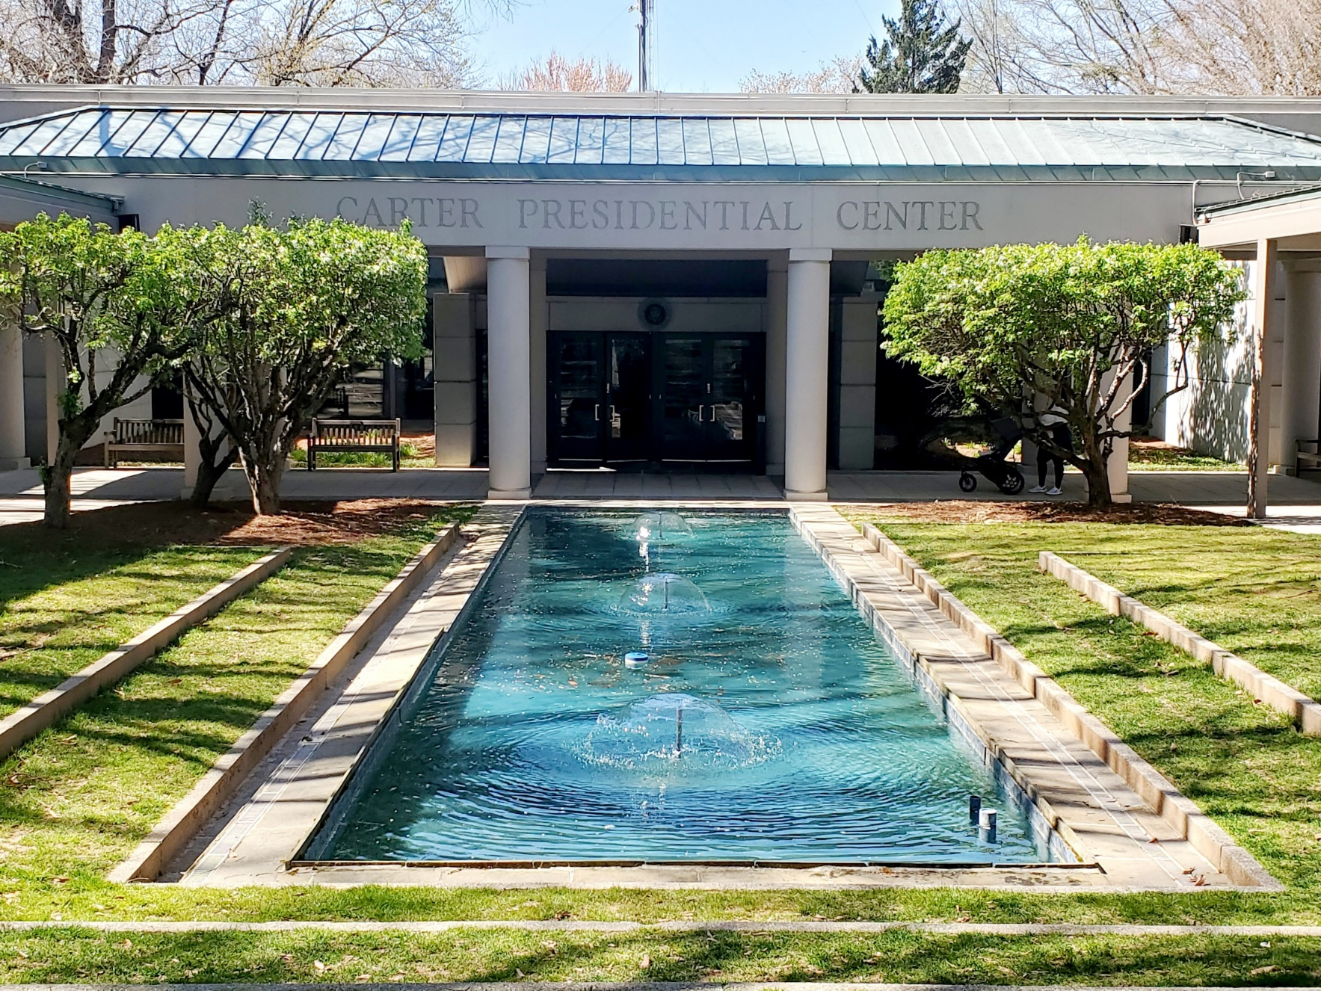
America 250 America’s Field Trip
A nationwide contest inviting students in grades 3-12 to answer the question: “What does America mean to me?”
Round 1: Nine Maryland winners, including one private school student living in Frederick County
Current contest ends March 30 at 5pm.

Slide 4
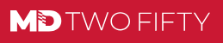
MDTwoFifty.Maryland.gov
America’s History through the eyes and experiences of Marylanders.
In anticipation of America’s 250th anniversary, we’re opening the pages of some of our most iconic accomplishments, from the oyster farms of the Chesapeake Bay to the mountain peaks out west. Beyond the legends we all know well, we’ll explore stories of everyday Marylanders who served our country and helped democracy prosper through civic engagement. We’re honored to commemorate our deep and meaningful contribution to America’s past, present and future by retracing Maryland’s illustrious history.
Nearly every Maryland county has established a 250 Commission.
Maryland’s Story is America’s Story

Slide 5
Citizen Academy Small Grant Program: Town of Myersville
Inclusive History Grants: City of Frederick (Sites of Enslavement)
Maryland Two Fifty Fellows: Heart of the Civil War
Freedom of the Press Project
Miles for Maryland (Hike 250 miles in state parks)
Revolutionary Baseball: June 20 in Frederick!
Other Projects and Programs
Also: America’s Potluck on July 5
Also: Sharing the Spirit of America on July 8
State of Maryland Initiatives

Slide 6
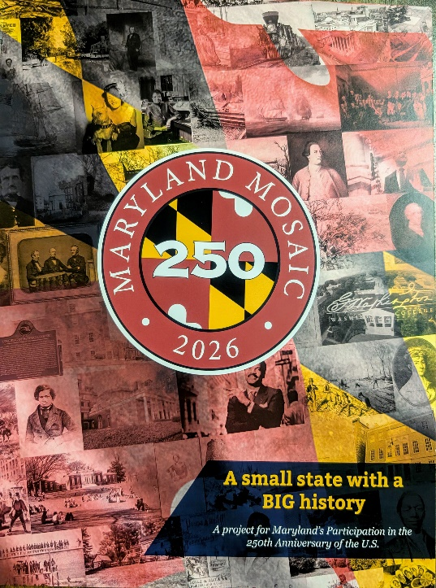
Maryland Mosaic (150+ national firsts)
11 Frederick County “Firsts”
Theophilus Thompson
Genetic Genealogy
Elizabeth Seton
Claire McCardell
Military Intelligence Center
Hospital #1
Battle of Monocacy
Battle of Front Royal
Roger B. Taney
Gov. Thomas Holliday Hicks
John Hanson

Slide 7
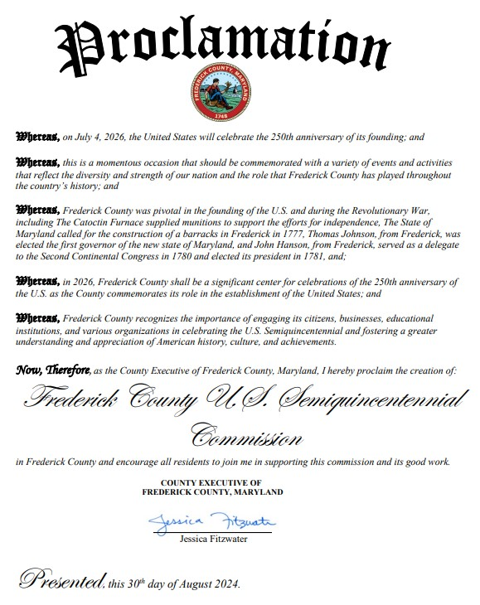

Slide 8
Frederick County US Semiquincentennial Commission
Goals and Duties
Developing a plan for the commemoration of the U.S. Semiquinentennial in Frederick County, outline specific events, programs and initiatives that align with the county’s historical significance and cultural heritage; and
Identifying and securing funding for the celebrations by seeking grants, sponsorships and donations while also exploring partnerships with county, state and federal agencies dedicated to the U.S. Semiquincentennial; and
Coordinating with local, county, and state agencies to ensure the smooth operation of the celebrations; and
Creating and submitting a report to the County Executive three months after the final event, at which time the commission shall dissolve; the report will evaluate the celebrations' success and make recommendations for future celebrations in Frederick County.

Slide 9
Frederick County U.S. 250 Commission Priorities:
Who is the audience for the events?
Students, county citizens and visitors alike, minority groups and people of all races and backgrounds.
What does success look like?
Grow membership of historic organizations, increase volunteer base for historical groups or non-profits, increased tourism, successful event attendance, representation captures the diverse history of all that make up Frederick
Goals of the Commission
Tell the stories of all different groups in the community, programs that embrace our full history, include all of the areas of the county, have the events be fun.

Slide 10
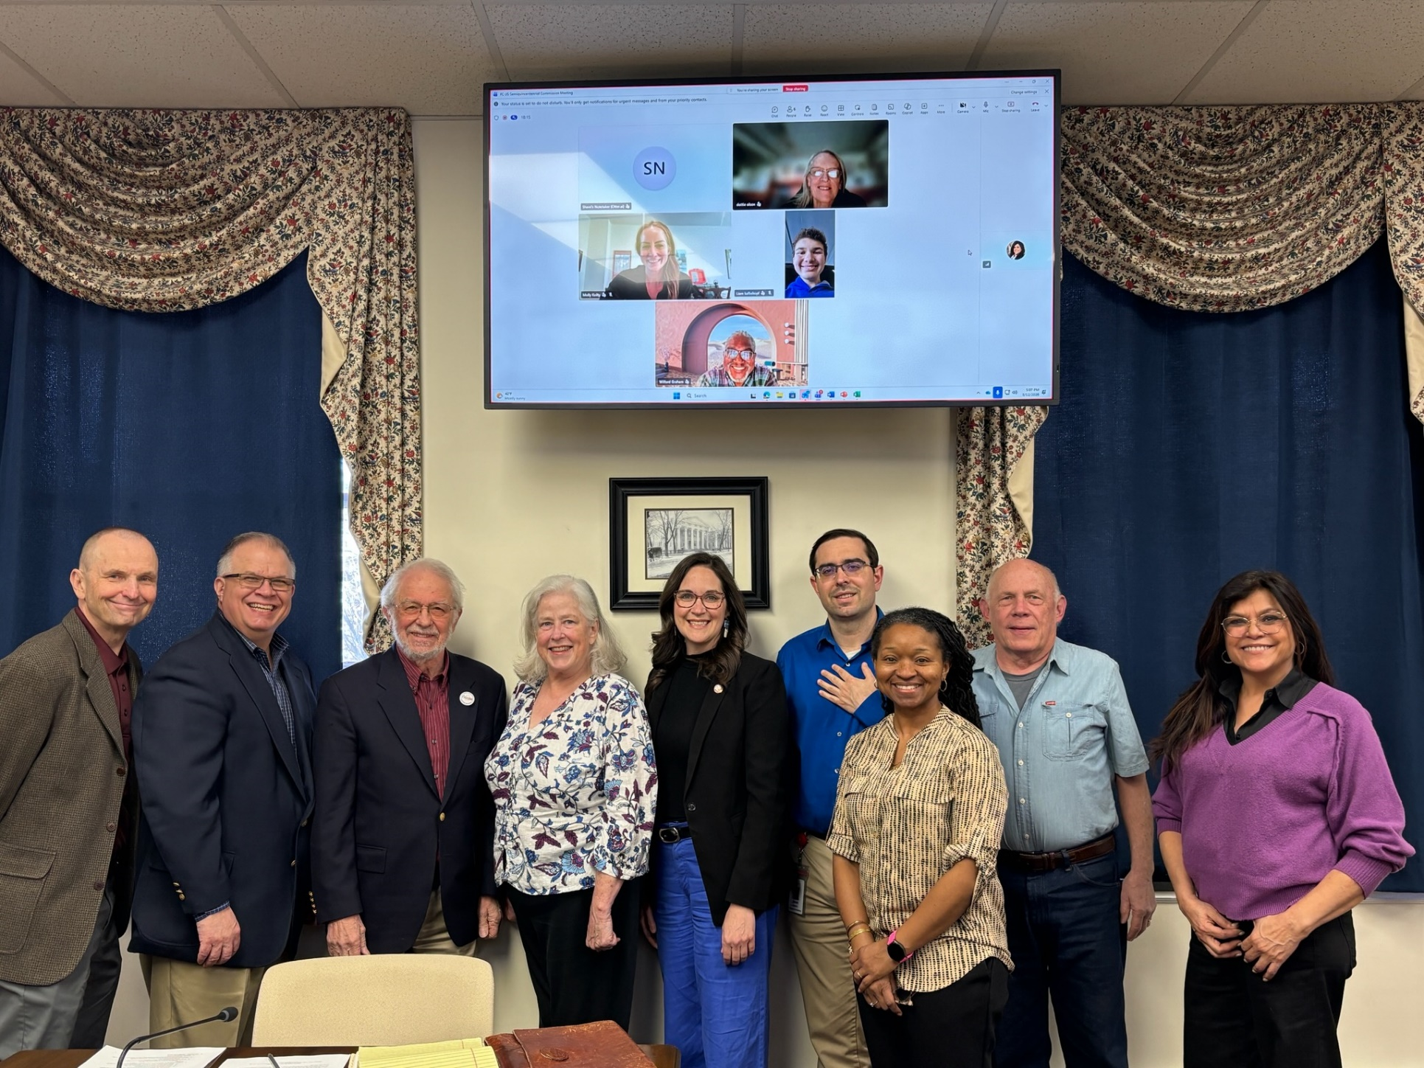
Frederick’s U.S. Semiquincentennial Commission:
Co-Chaired by Ysela Bravo and Shuan Butcher
12 Organizational Representatives & 3 At-Large Members:
Frederick County Government
Sons of the American Revolution
Daughters of the American Revolution
Heart of the Civil War Heritage Area
Historic Sites Consortium
Visit Frederick
Heritage Frederick
AARCH Society
Frederick Chamber of Commerce
Youth Advisory Council
Frederick County Public Schools
Frederick Equity Coalition
A Local Municipality
Frederick County Farm Bureau

Slide 11
Visit Frederick TRIPP Grants:
Catoctin Mountain Furnace - Catoctin Furnace Living History Festival
National Museum of Civil War Medicine - Schematic and design phase of -Museum upgrade
Weinberg Center for the Arts -
Delaplaine Visual Arts Center - Creekside Garden enhancements
Heart of the Civil War Heritage Area – Geocache Trail
Main Street Middletown - Promoting our Main Street via interpretive panels
Rose Hill Manor - In search of Freedom Exhibit
Downtown Frederick Partnership - 7th Street Fountain Park
Frederick Health - We the People- Greenmount Cemetery

Slide 12
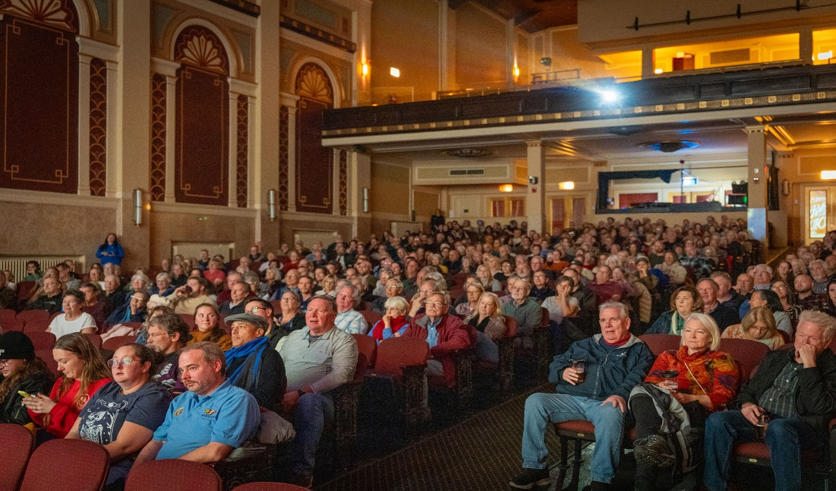
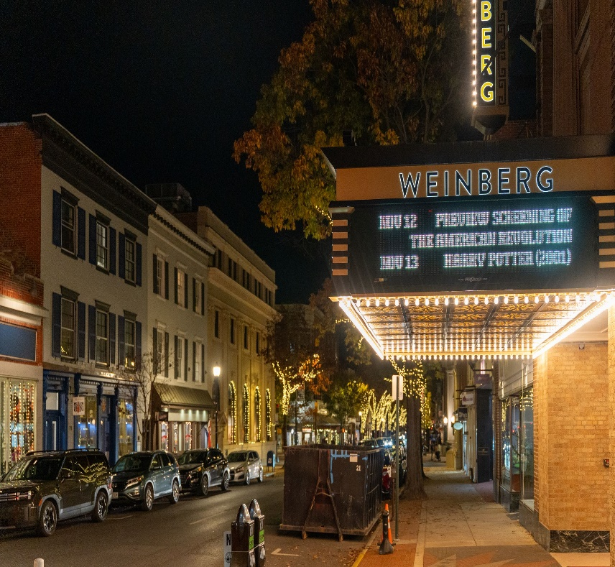
PBS Screening of the American revolution, November 12, 2025 at the weinberg

Slide 13
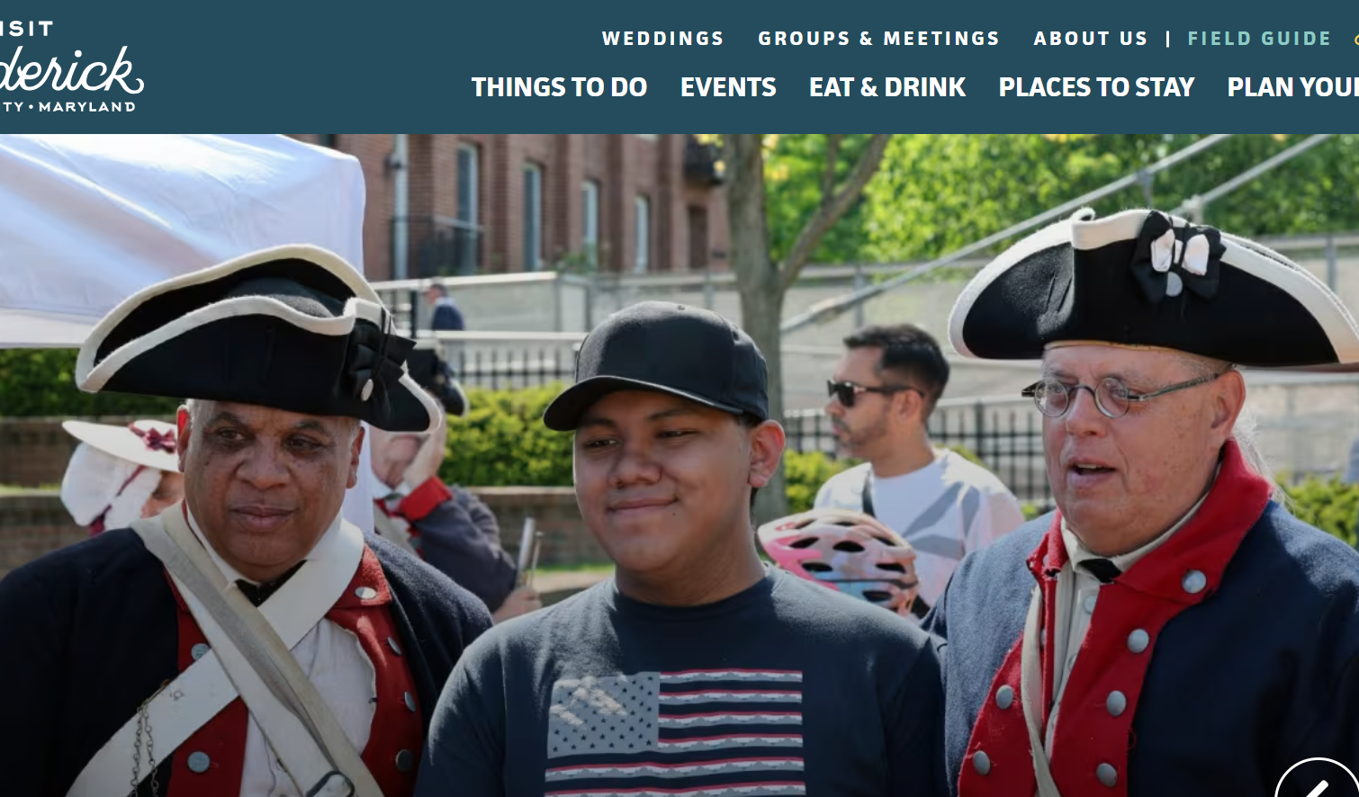
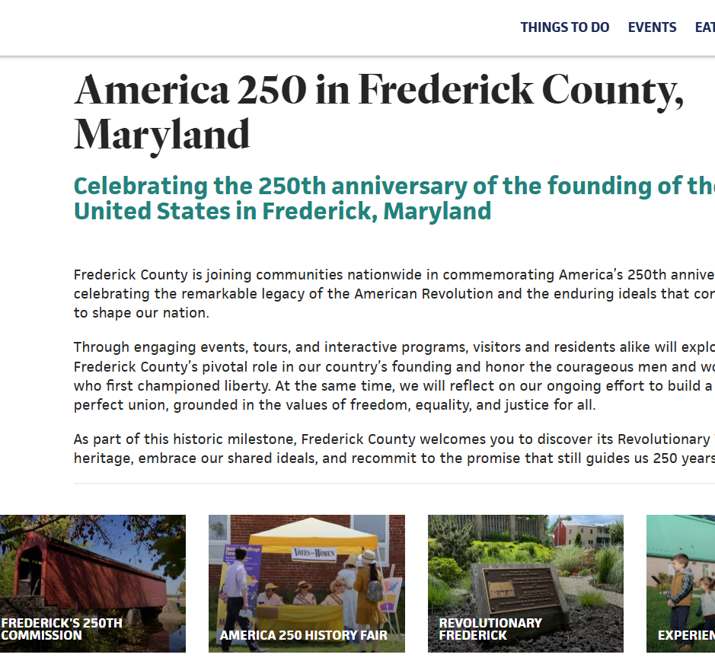
VisitFrederick.org/America250

Slide 14
Frederick County US Semiquincentennial Commission
Signature Events
Music of the Regiment
1776
A Revolutionary Christmas
Music of the Regiment’s program “Equal to any Band in this Country…” combines dramatic readings with the marches and opera arrangements that formed the soundtrack of American, French, and British forces serving during the American Revolution. Free concert is on April 12 at the ERUCC.
This popular American musical is an insightful, vibrant and humorous take on our founding fathers’ determination to do the right thing for their fledgling nation. Performances to be held July 10 – 12 at New Spire Arts.
Based around the local history of German soldiers and Maryland farmers in 1781, this play explores immigration, belonging in a new American nation, and the holiday spirit. December 4-6 at Catoctin Furnace (Frederick performance TBD).

Slide 15
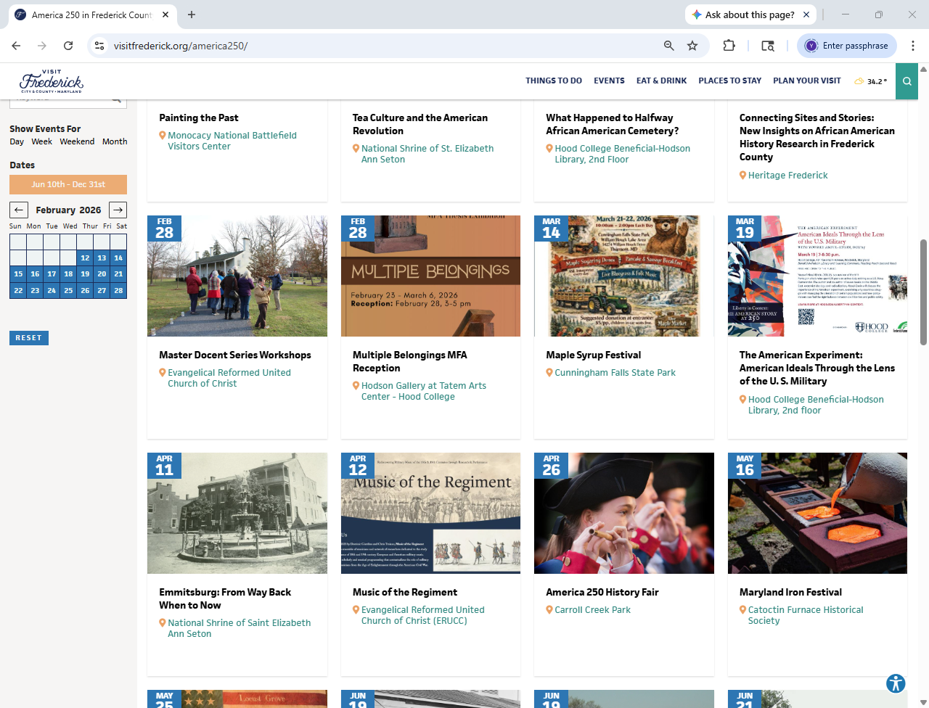
Upcoming Activities

Slide 16
City of Brunswick: The Independence Fireworks Display will take place on July 3 around 9 pm near the Brunswick Middle School Complex/ball fields
City of Frederick: Frederick’s 4th is largest Independence Day celebration in Frederick County with two stages of entertainment alongside family-friendly rides, activities, food, and fireworks from noon to dusk.
Mount Airy: On July 1, the town will host a Spirit Parade and on July 3 will have an Independence Day Fireworks & 250 Candlelight Display.
Middletown: TBD
Thurmont: TBD
Emmitsburg: TBD
Myersville: TBD
Walkersville: Walkersville Volunteer Fire Company Carnival, June 29-July 4 (fireworks July 2nd)
Woodsboro: TBD
New Market/Burkittsville/Rosemont: No plans
Local Independence Day Celebrations

Slide 17
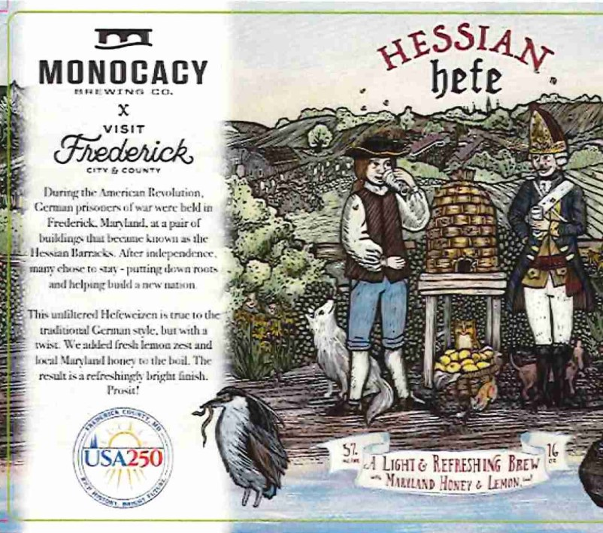
Visit Frederick Beer Collaboration with Monocacy Brewing Co.

Slide 18
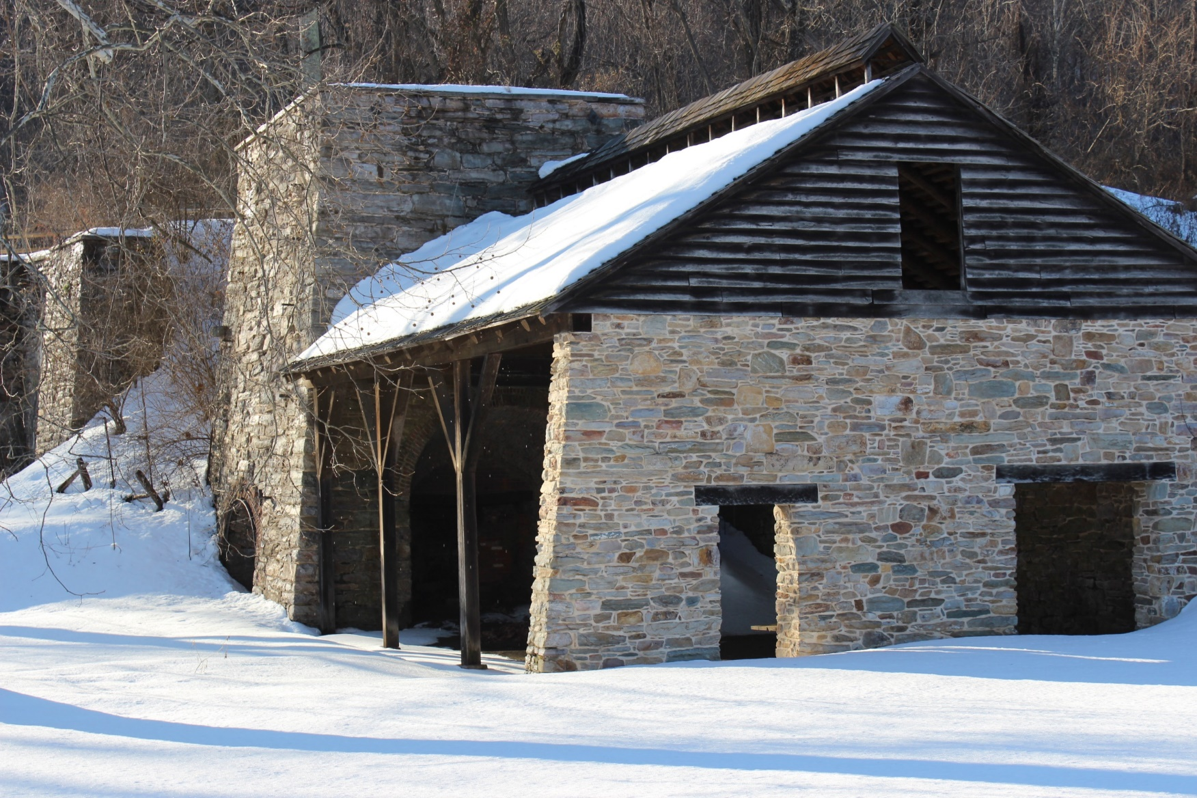
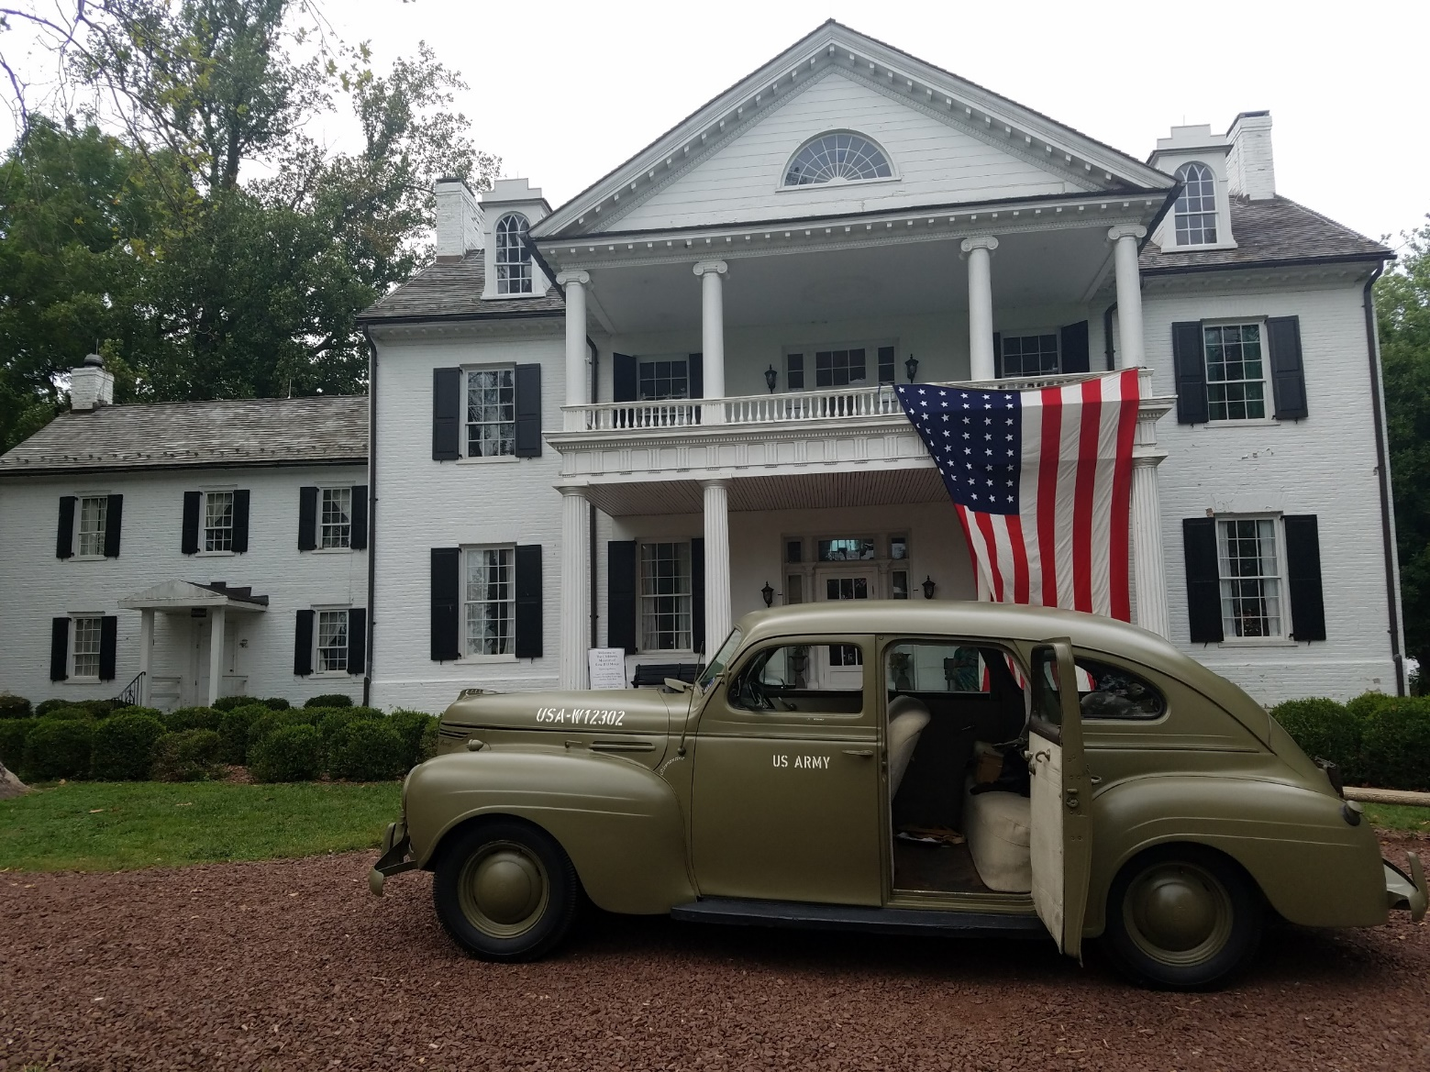
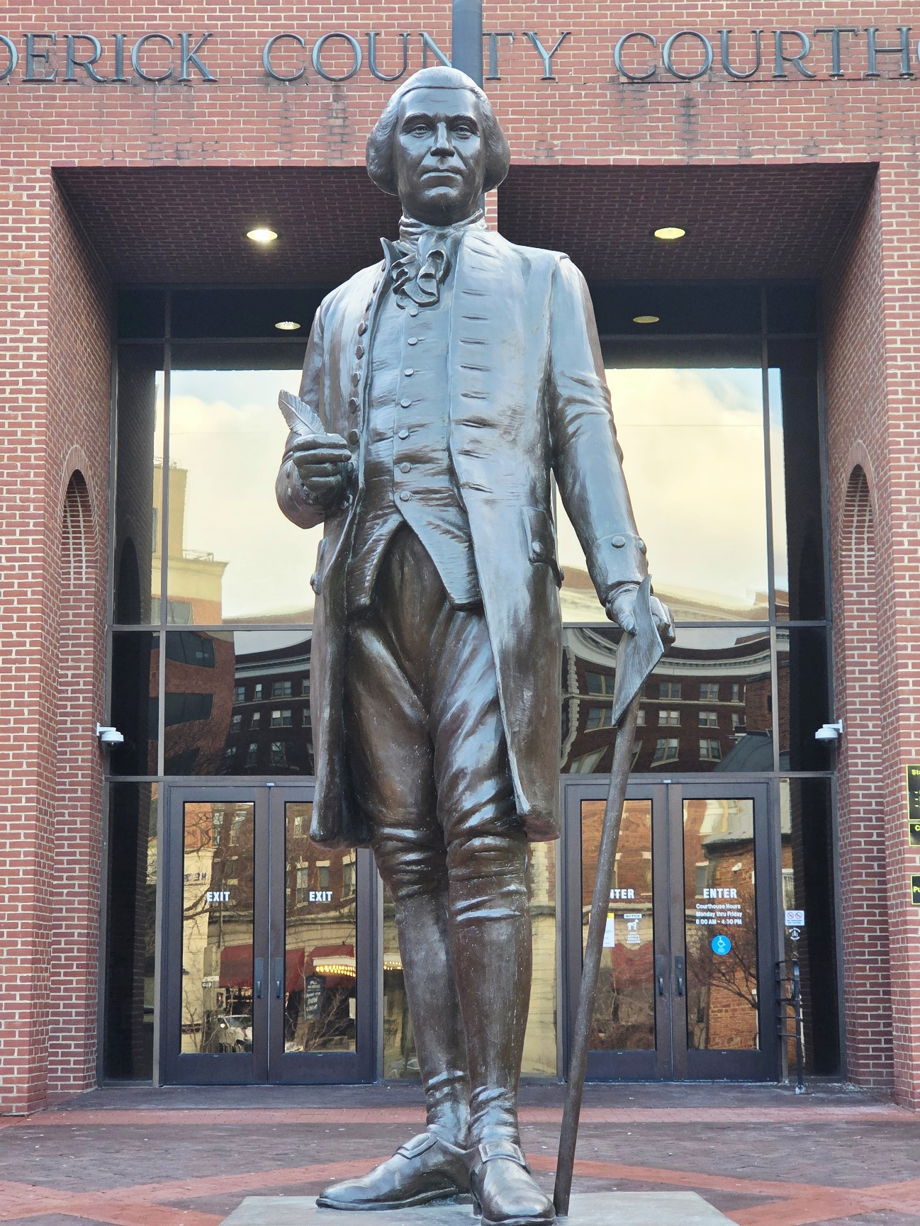
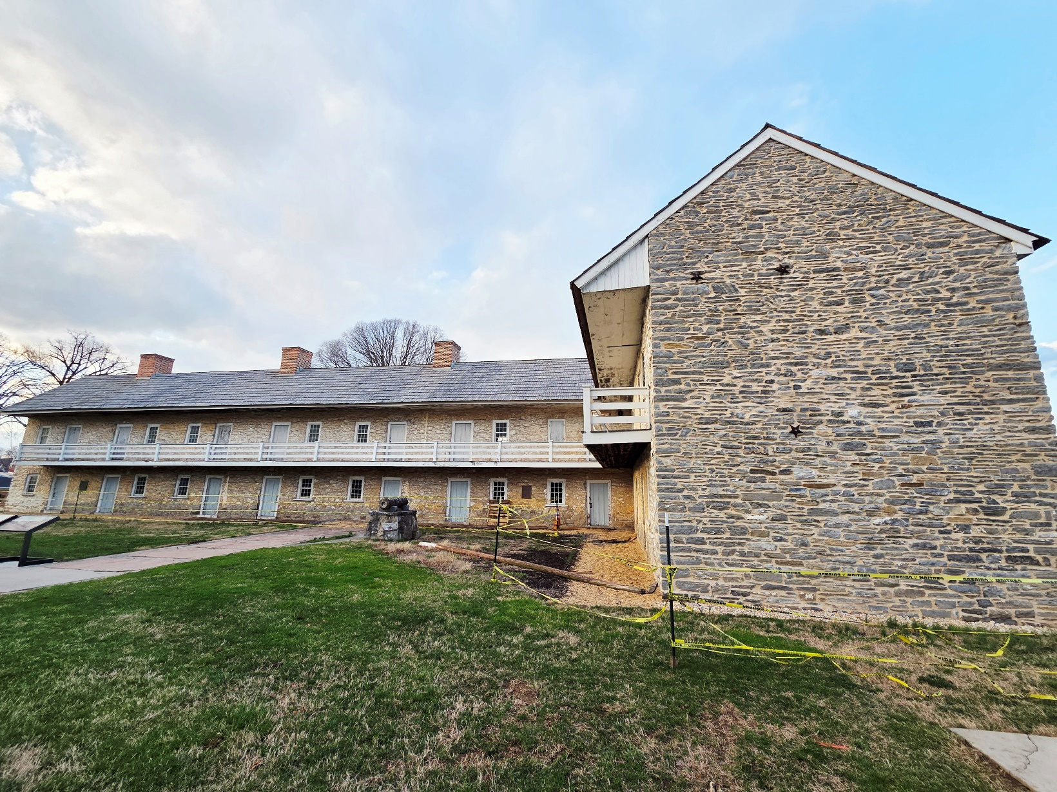
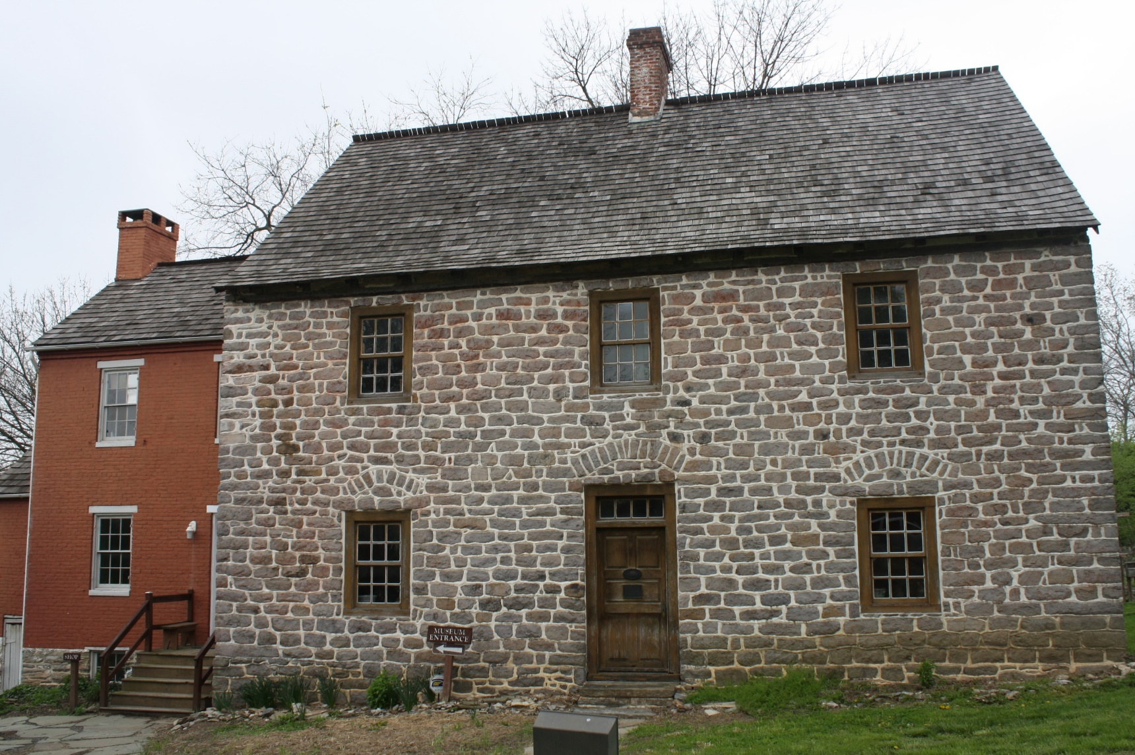
Frederick County
Witness Sites

Slide 19
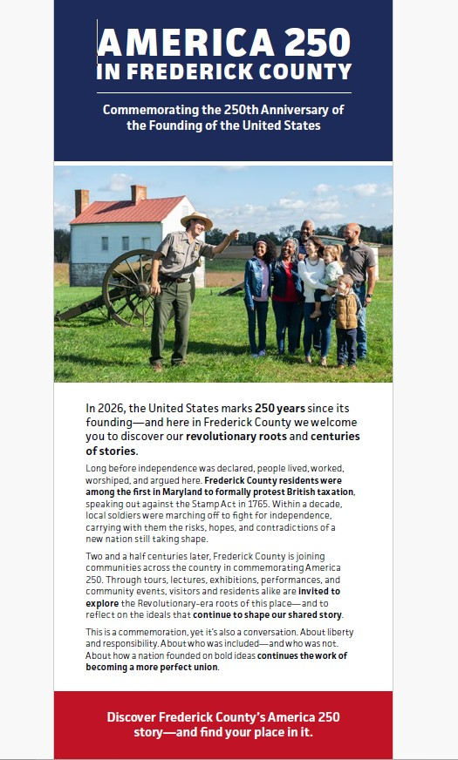
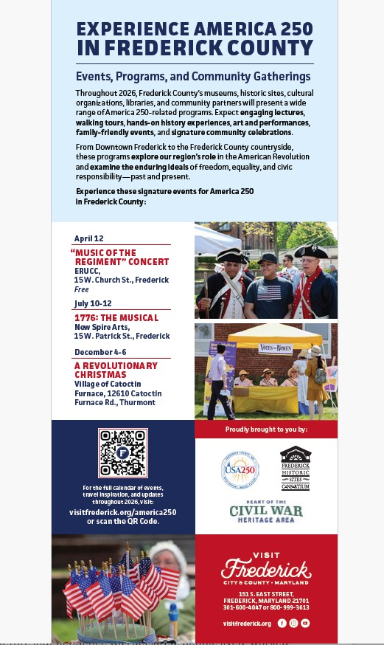


Slide 20
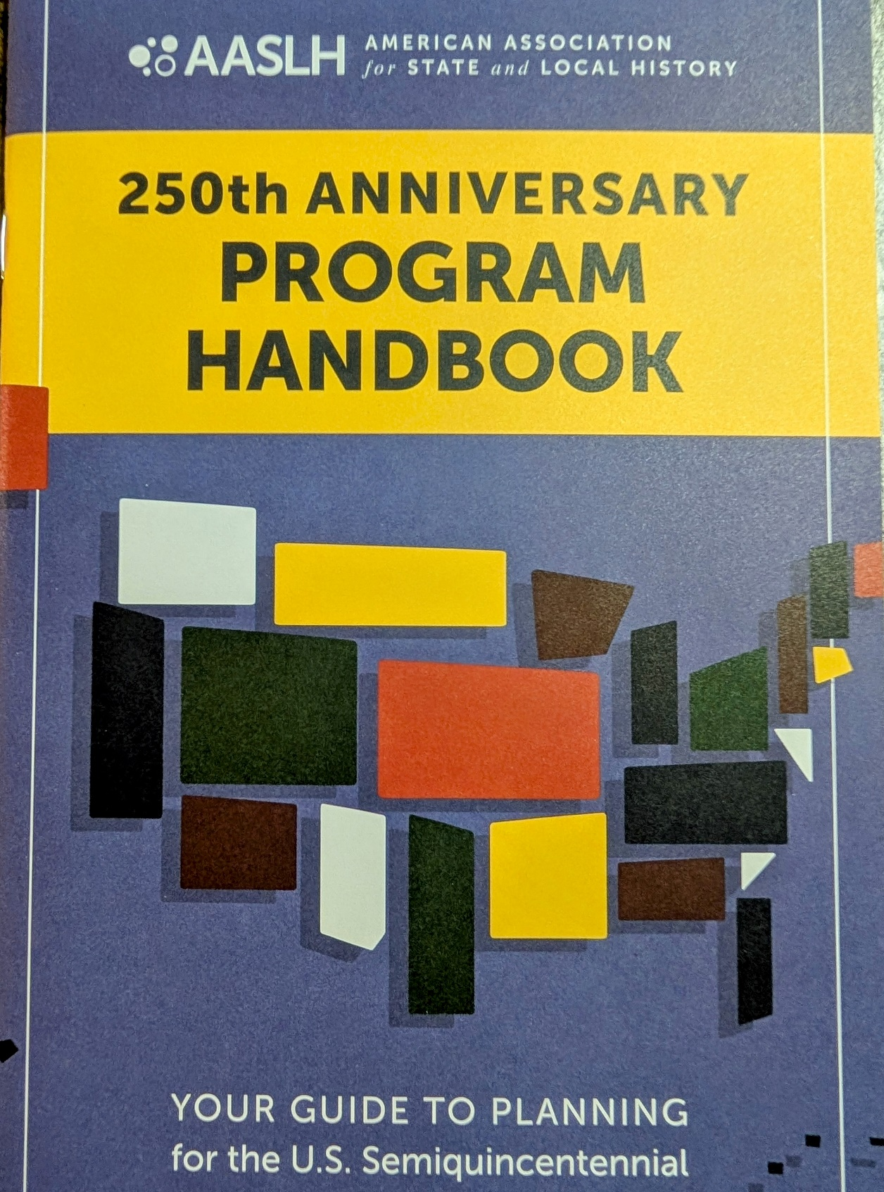
Guide to Planning for the U.S. Semiquincentennial:
Unfinished Revolutions
Power of Place
We the People
American Experiment
Doing History

Slide 21
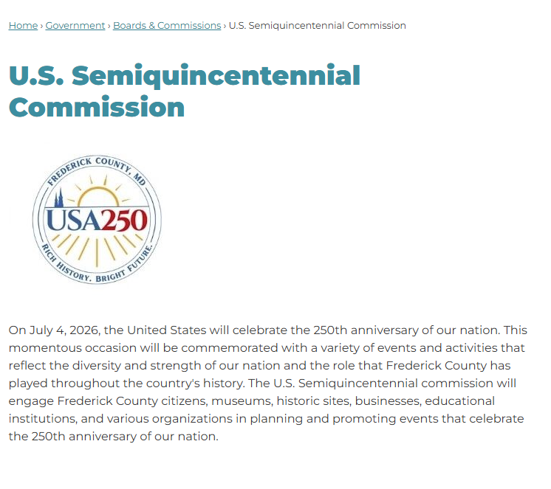
Join our Commission meetings held the second Thursday every month from 5:00 to 6:00pm at Winchester Hall in the City of Frederick
Questions or comments?
Ysela Bravo
ybravo@frederickcountymd.gov
Shuan Butcher
butcher21701@comcast.net
Frederickcountymd.gov/8819/US-Semiquincentennial-Commission

