Slide 1
TKB Youth Corner
Kick Off Meeting
Oct 2nd, 2022

Slide 2
Always remember these 3 R’s

Slide 3
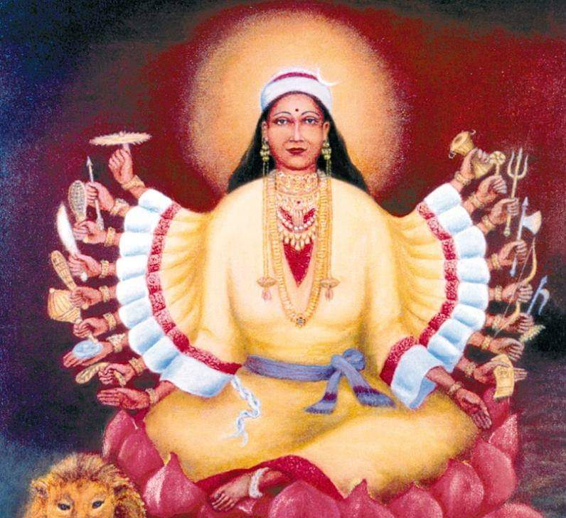
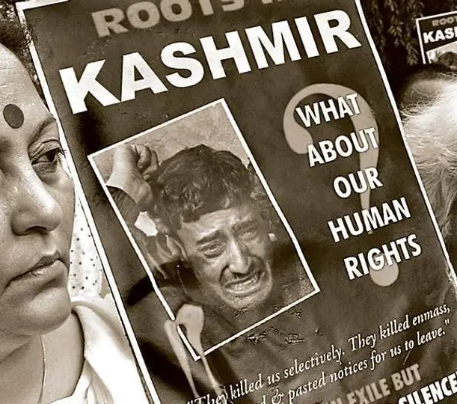
3 R’s
Remember and Reconnect
Right to Justice
Return and Rehabilitation

Slide 4
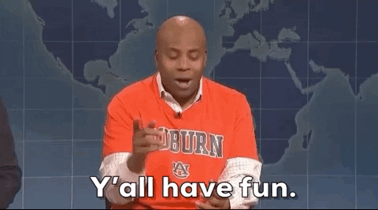
And the most important one…

