Slide 1


A Colloquial Mosquito ID Guide
VMCA
Kylie Wey

Slide 2


City of Norfolk Vector Control
2800 Tarrant Street, Norfolk, VA 23509
Kylie Wey
Penelope Smelser
Kylie.Lakin@norfolk.gov
Kylie.Lakin@VDH. Virginia.gov
KeLakin13@gmail.com
Angelo DelParto
& Team

Slide 3
Current Methods to IDing
Dichotomous Keys
WRBU & Other Websites
Conferences
1 on 1 Training
Experience
Flashcards

Slide 4
Problems to be Addressed
I
II
III
IV
V
VI
Non-centralized
Understanding the Language
Time Consuming
Non-centralized
Helping ALL levels of experience
Pictures

Slide 5


And Now…

Slide 6
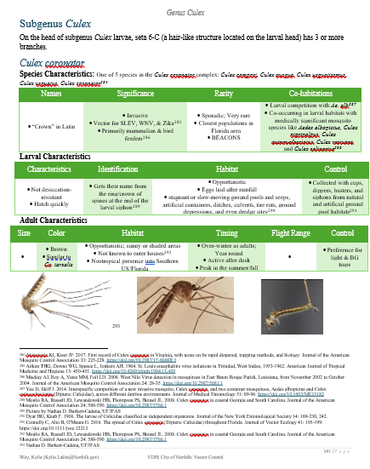
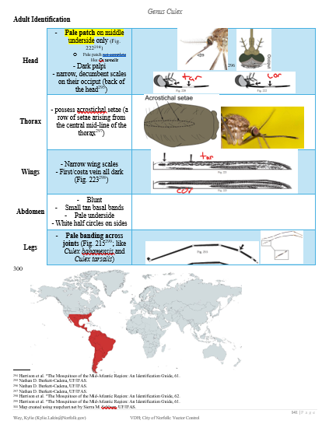
Contents of this template
You can delete this slide when you’re done editing the presentation
Fonts | To view this template correctly in PowerPoint, download and install the fonts we used
Used and alternative resources | An assortment of graphic resources that are suitable for use in this presentation
Thanks slide | You must keep it so that proper credits for our design are given
Colors | All the colors used in this presentation
Icons and infographic resources | These can be used in the template, and their size and color can be edited
Editable presentation theme | You can edit the master slides easily. For more info, click here
For more info: Slidesgo | Blog | FAQs
You can visit our sister projects: Freepik | Flaticon | Storyset | Wepik | Videvo

Slide 7
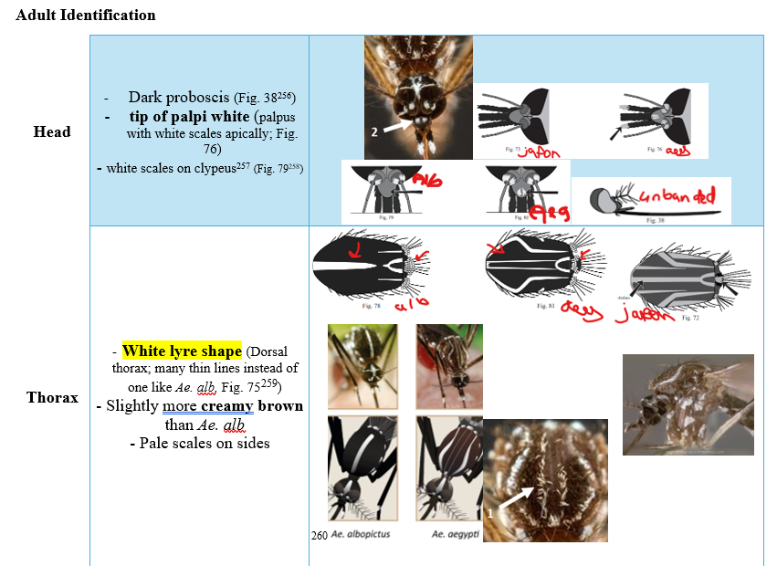

From molecules to life
Mercury is the closest planet to the Sun and the smallest one in the entire Solar System. Contrary to popular belief, this planet's name has nothing to do with the liquid metal. Mercury was, instead, named after the famous Roman messenger god Mercurius
Mercury takes a little more than 58 days to complete its rotation, so try to imagine how long days must be there! Since the temperatures are so extreme, albeit not as extreme as on Venus, Mercury has been deemed to be non-habitable for humans

Slide 8
However…
Does NOT REPLACE a Dichotomous Key
Still in Progress

Slide 9
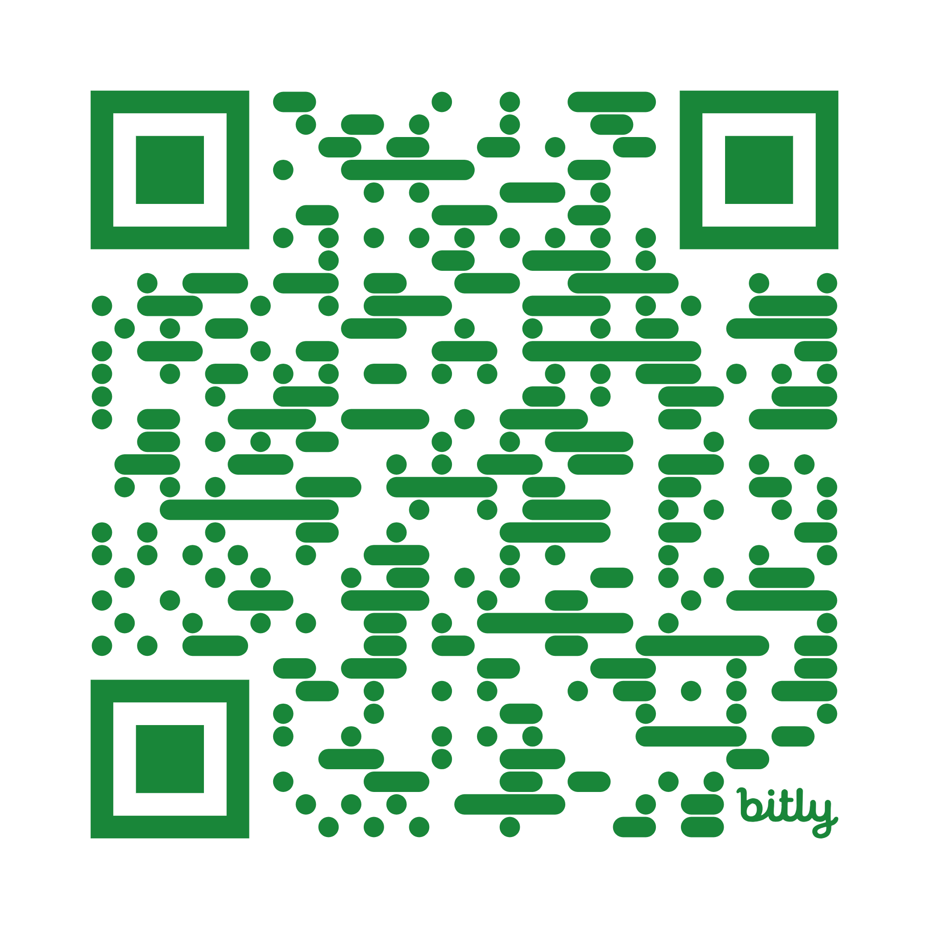
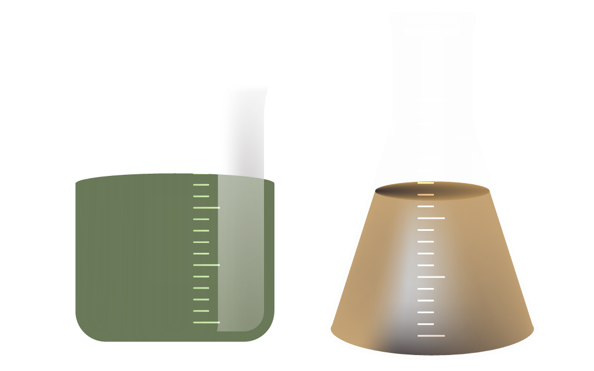
Access
https://bit.ly/KWIDGuide
Open Guide on Word!
Thank you!
Questions are Welcomed & Appreciated
Kylie.Lakin@Norfolk.Gov

