Slide 1
Small/Minor Genera
Toxorhynchites
(2)
Toxorhynchites rutilus
Wyeomyia
Wyeomyia
(3)
Mansonia
Mansonia
(5)
Uranotaenia
(7)
Uranotaenia sapphirina
Culiseta
(8)
Culiseta melanura
Coquillettidia
(10)
Coquillettidia perturbans
Orthopodomyia
(10)
Orthopodomyia signifera

Slide 2
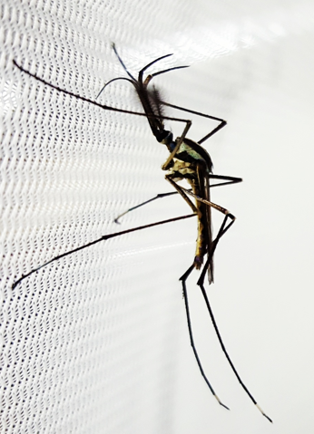
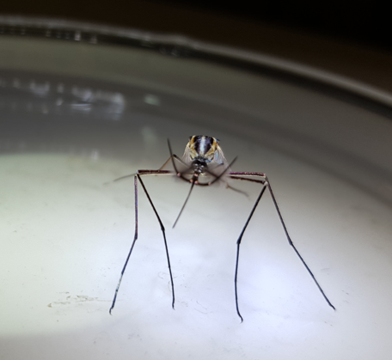
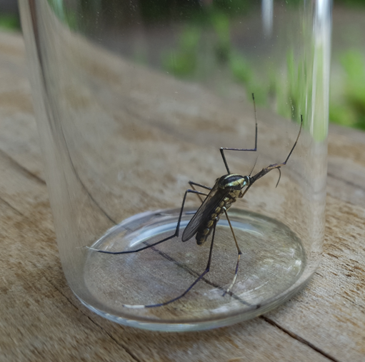
Toxorhynchites rutilus
Biology
Largest mosquito in Virginia
Only female mosquito in our area that doesn’t bite
Gets the protein for her eggs by eating other mosquito larva in the larval stage
Found natural and artificial containers
Identifying
Largest mosquito you will ID
Shiny blue, purple and gold scales
Proboscis strongly bent downward
Palps about half the length of the proboscis
~Couplet 2 Hint~
Is it really large and colorful?

Slide 3
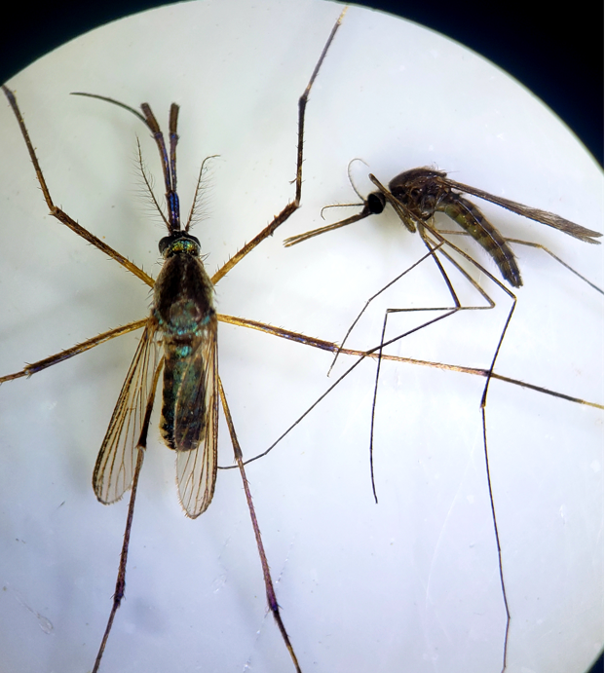
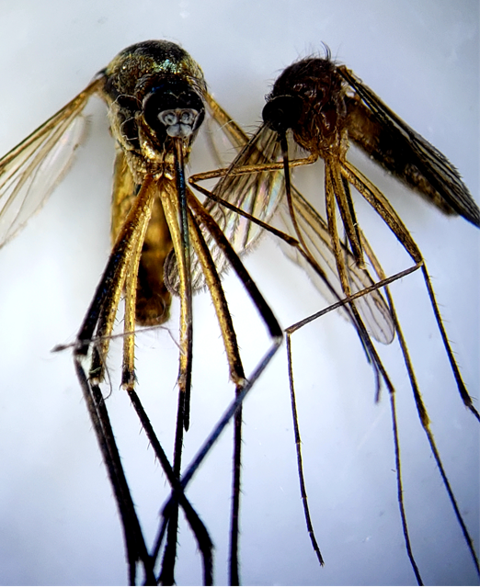
Comparison
Anopheles
Melanura
Palps almost as long as the proboscis
Proboscis looks bent, but overall smaller, duller, and more “hairy”
Anopheles and Melanura are smaller and duller in color

Slide 4
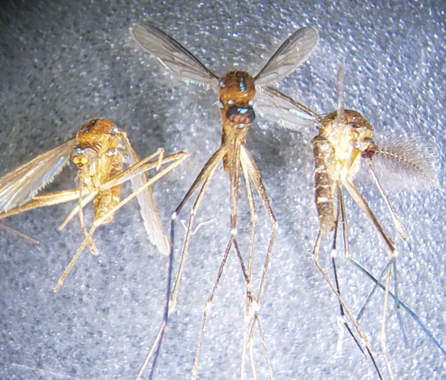
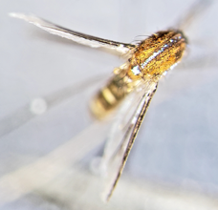
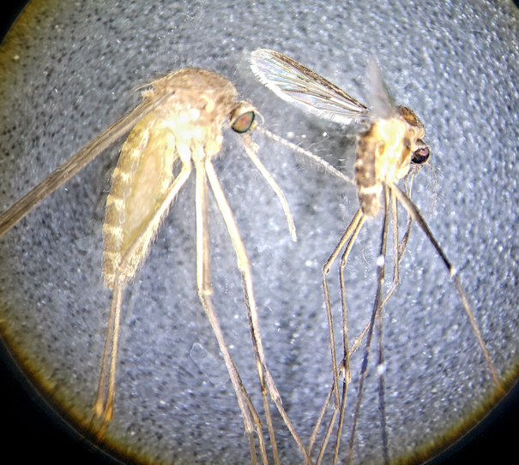
Uranotenia sapphirina
Biology
One of the smallest mosquitoes in our area
Feed on reptiles and amphibians
Found in permeant bodies of water with floating and/or rooted vegetation
Identifying
Small light brown mosquito
Iridescent blue scales
Proboscis is fatter at the tip
From other Ur. species
Ur. sapphirina have a line of blue scales down the scutum
~Couplet 7 Hint~
Blue scales present?
Cx. pipiens vs Ur. sapphirina

Slide 5
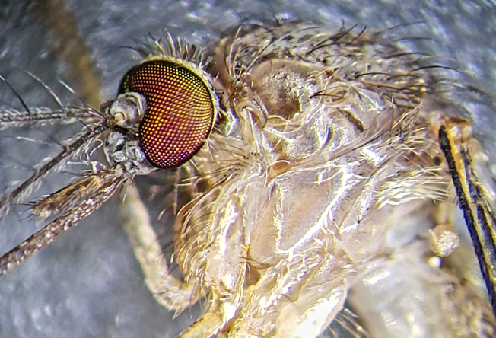
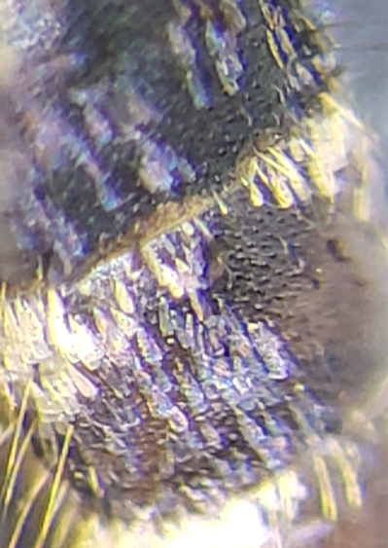
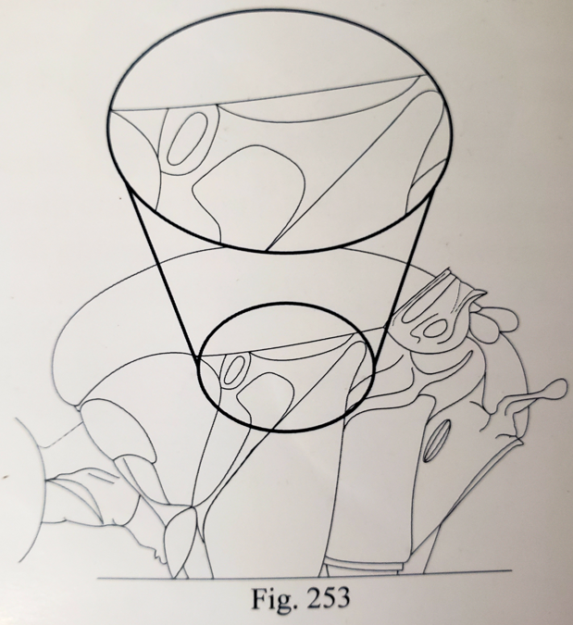
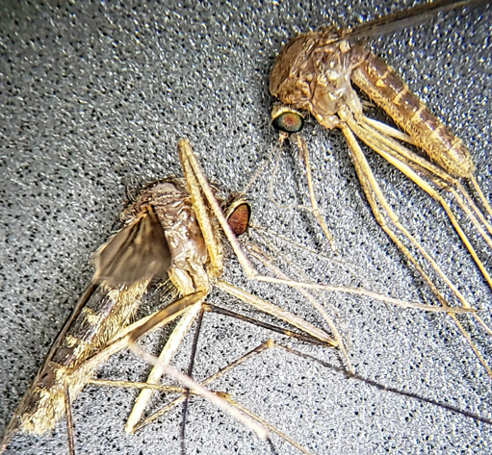
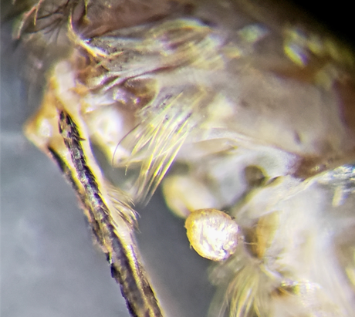
Culiseta melanura
Biology
Prevalent on the Southside
Primarily a bird biter
Comes from freshwater hardwood swamps and tree crypts
Identifying
Dark brown, slightly larger than an average mosquito, and might notice a purple sheen
Armpit hair, hairy chest, long black setae on scutum
Long proboscis that tends to bend downward
From other Cs. species
No scales on paratergite and usually postspiracular area
~Couplet 8 Hint~
Armpit hair?
Cs. melanura vs Cx. salinarius

Slide 6
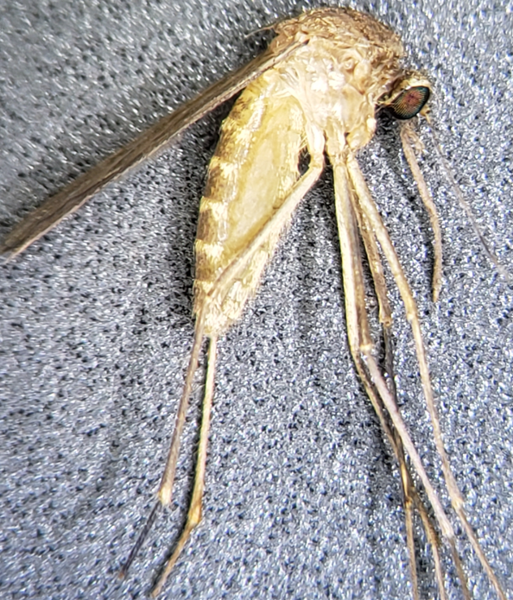
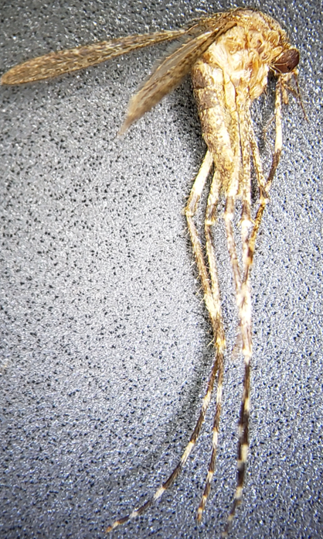
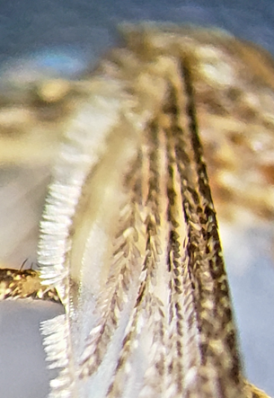
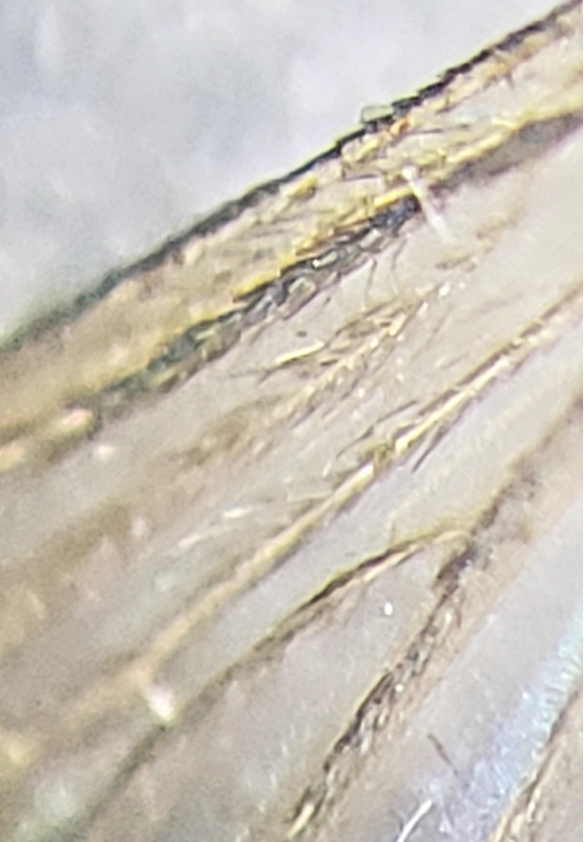
Couplet 9
Going to Couplet 10
Coquillettidia or Orthopodomyia
Culex
Narrow wing scales, all dark
Bland brown mosquito
Broad wing scales, with dark and light scales
Banding on legs
Speckly mosquito

Slide 7
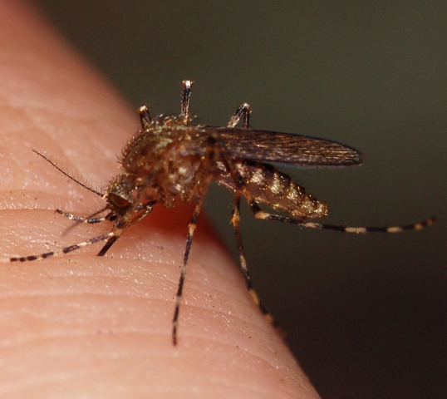
Coquillettidia perturbans
Biology
Cattail mosquito
Larva and pupa are typically attached to cattails or other rooted aquatic vegetation in permanent freshwater areas
Identifying
Overall, a very speckly mosquito
Wings have broad light and dark scales
Legs have broad, distinct banding
Median pale band 1st tarsal segment
Banded proboscis

Slide 8
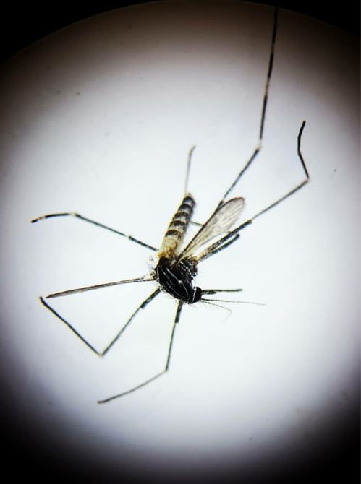
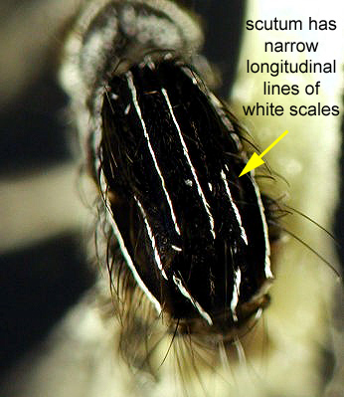
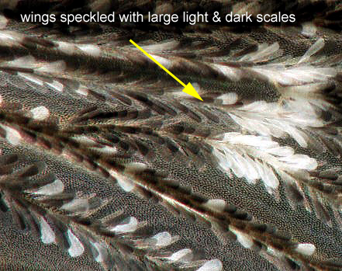
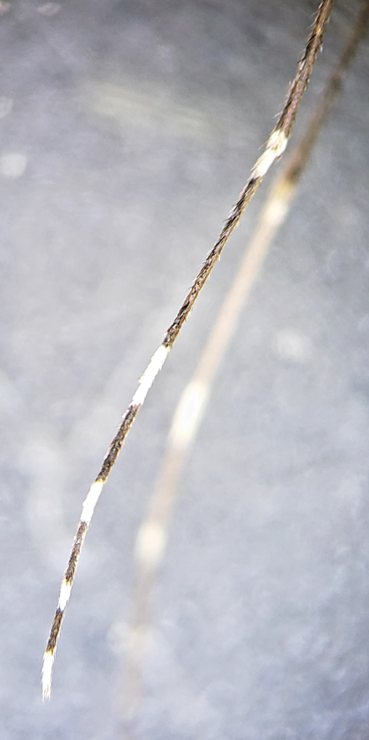
Orthopodomyia signifera
Biology
Larva found in treeholes typically
Identifying
“Salt and pepper” mosquito
Wings have broad white and black scales
Distinct pattern on the scutum
Legs have white apical and basal bands
From other Or. Species
Missing top patch of white wing scales

Slide 9
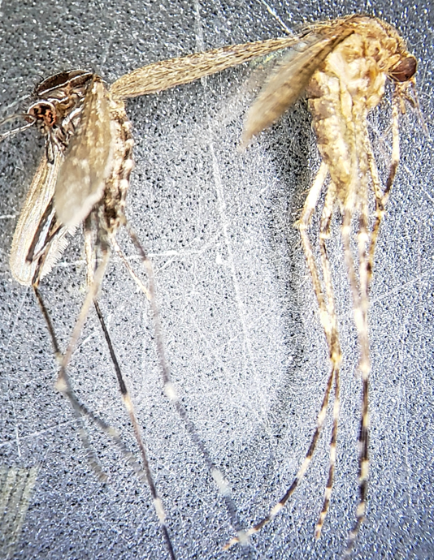
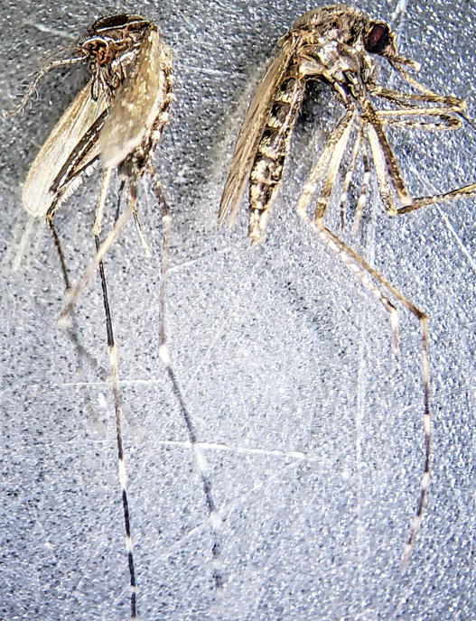
Comparison
Cq. perturbans
Ps. columbiae
Brown with light scales
Banded proboscis with no distinct scutum pattern
Or. signifera is black and white, distinct scutum pattern, and no banding on the proboscis

Slide 10
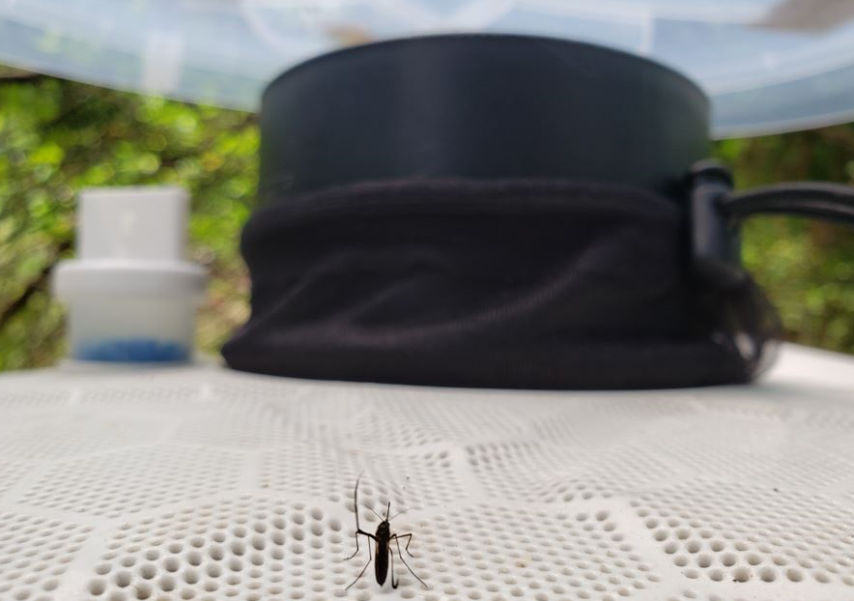
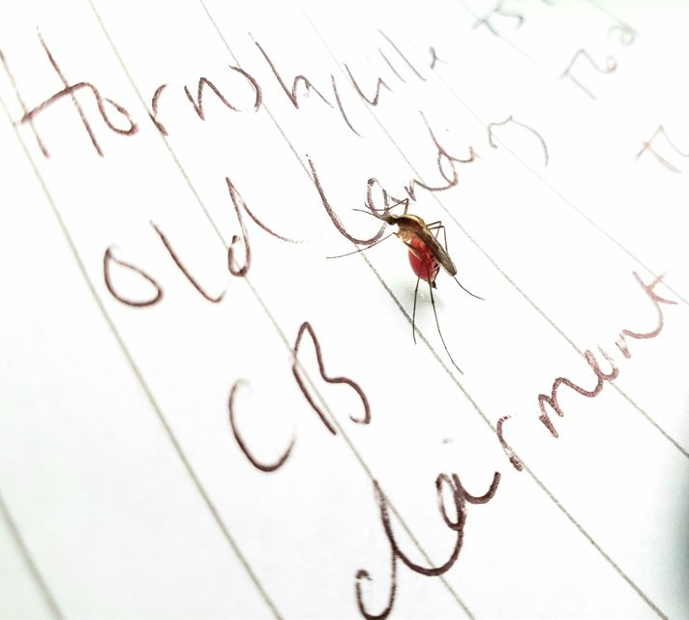
Thank you

