Slide 1
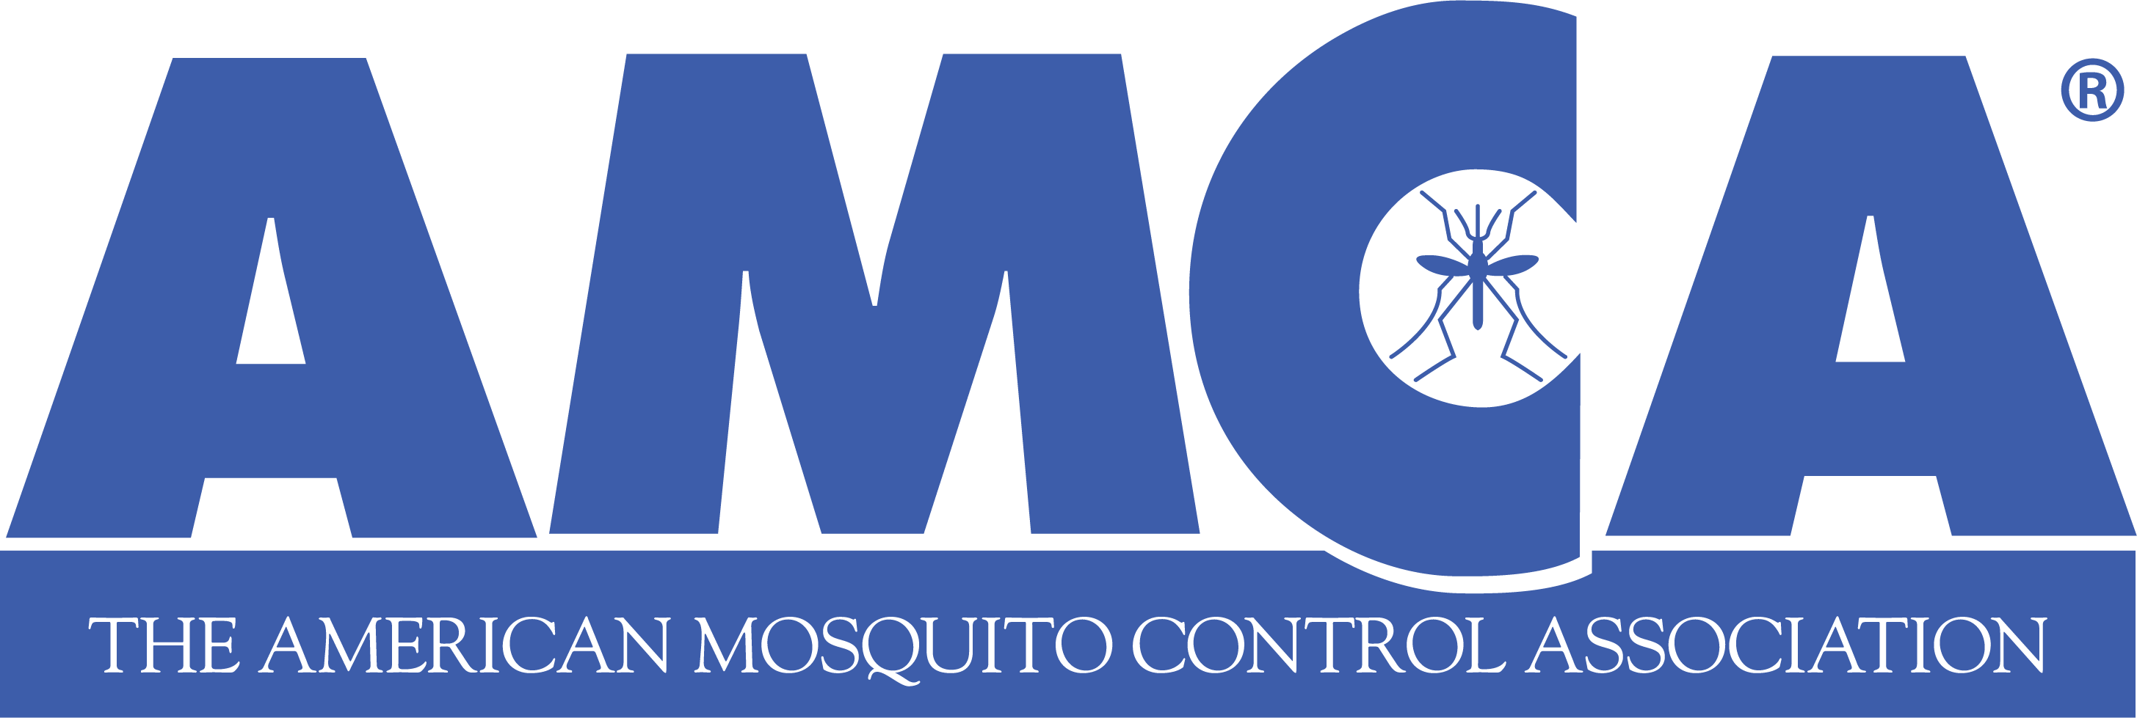
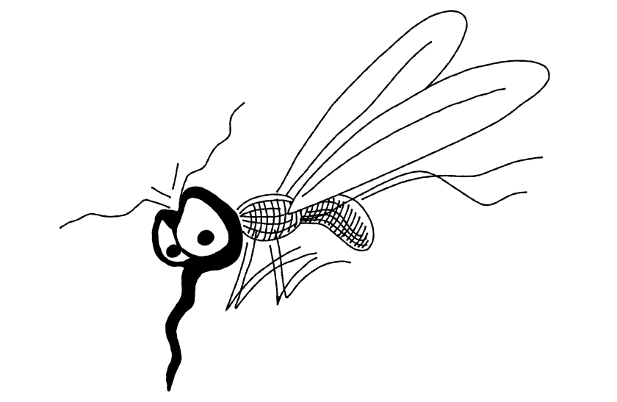

American Mosquito Control Association:
2025 Update
Daniel Markowski, PhD
Technical Advisor, AMCA
Fall 2025
Notes:
Change to your name and title as appropriate.
(there are almost certainly more slides here than you need. Pick and choose the content that you think is best suited to your audience and your level of comfort in discussion. And by all means, never hesitate to just give Dan’s email if you want to bring a topic up; but not go into detail about it)

Slide 2
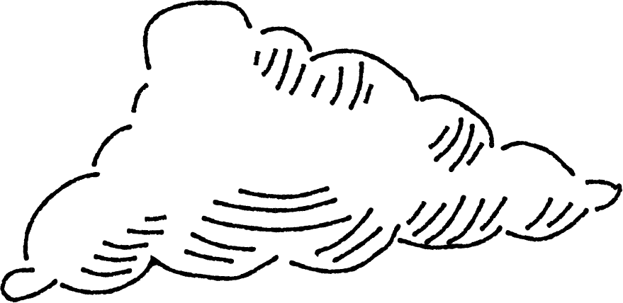
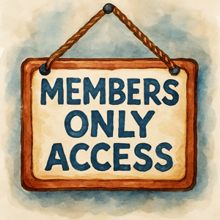

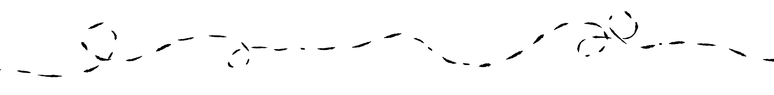

AMCA Membership
It’s the thing to do.
We are your National Voice; Your Membership supports us all.
Training materials, expertise, access to the latest research in JAMCA, UAS Program.
You can properly harass your Regional Director!
2
Notes:
Membership is a steal! Members have access to AMCA sponsored webinars, Training Materials, and the AMCA Journal and Wing Beats. We advocate on your behalf with the Federal regulators that control our operations - EPA, FWS, NMFS, CDC. Your membership supports all our activities. Who is your Regional Director? They can help you find local experts that are experiencing similar problems. i.e. ESA mitigations, how to handle no spray groups, surveillance data, etc.

Slide 3
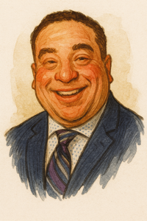
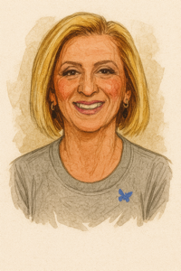
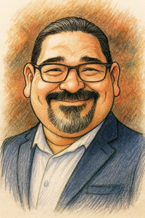
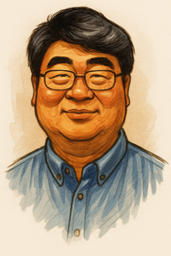
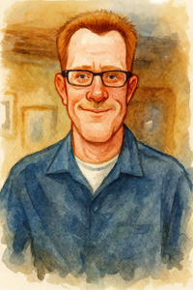
AMCA’s Board of Directors
Herff Jones
AMCA President
Isik Unlu
President-Elect
Joel Buettner
Vice President
Rui-De Xue, PhD
Past President
Gary Goodman
Treasurer
Executive Board Members
3
Notes:
Get to know the Board… Pictured here the Executive Board Members for your viewing pleasure. (I broke the Board pics up onto 2 slides, because its hard to get all the pics on 1 slide). This is a good opportunity to introduce how the Board works and encourage folks to join.

Slide 4
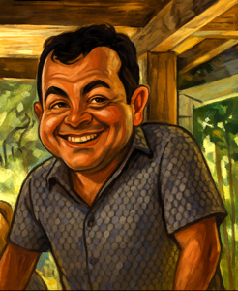
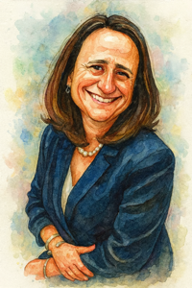
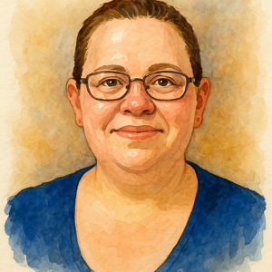
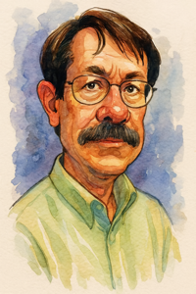
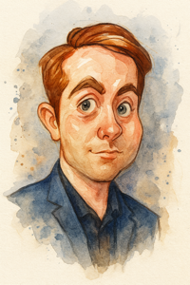
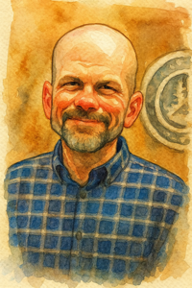
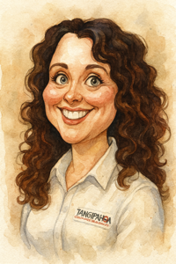
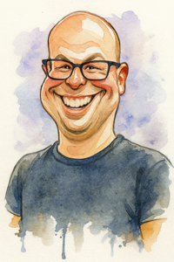
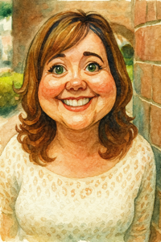
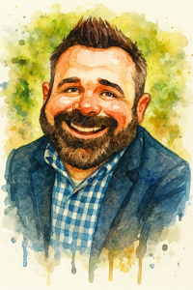
AMCA’s Board of Directors
Grifith Liz’arranga
International Director
Broox Boze, PhD
Industry Director
Priscilla Matton
North Atlantic Director
Michael Doyle
Mid-Atlantic Director
Robert Cartner
South Atlantic Director
Carl Doud
North Central
Director
Colby Colona
South Central Director
Scott Bradshaw
West Central Director
Angela Beehler
North Pacific Director
Peter Bonkrude
South Pacific Director
4
Notes:
Get to know the Board… AND your Regional Director is your best and quickest way to get information about AMCA and get involved. Highlight any specific concerns you’ve helped address. Encourage members to get involved and take over for you when your tenure ends.

Slide 5
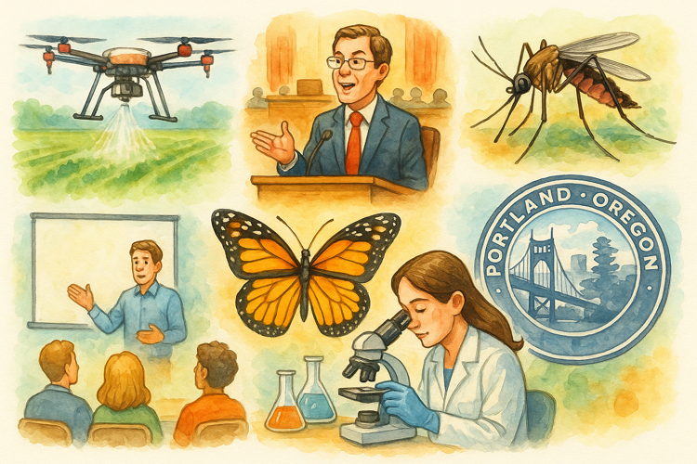
AMCA’s Activities
Legislative Advocacy
UAS Program
ESA Mitigations
Training Programs
AMCA Research Fund
Oropouche Projects
Just to name a few…
5
Notes:
(Think of this as the introductory/overview of what will be presented within the presentation. We may not have to time to talk about everything, but that’s only because we’ve been doing so much for our members.)
The Association has been working hard to provide services and support to mosquito control programs throughout the country. We’ve continued the evaluation of drift models that dictate the fate of ULV applied adulticides. We’ve added to our online Virtual Training program by adding training to coincide with our Emergency Response BMP update. We’ve also gotten new CDC funding for the evaluation of control methods and training on Oropouche Vectors. Of course we continue to work with EPA and the Services and pollinator groups to educate them on our activities and determine appropriate ESA Mitigation measures we can all live with, We’ve stepped up our efforts to advocate in congress for the SMASH act and the Kay Hagan TICK act, funding CDC and other initiatives important to your program. And we’re still working with FAA to streamline paperwork for members with UAS. Do you read the journal!? So much more. I can’t even tell you how awesome we are.

Slide 6
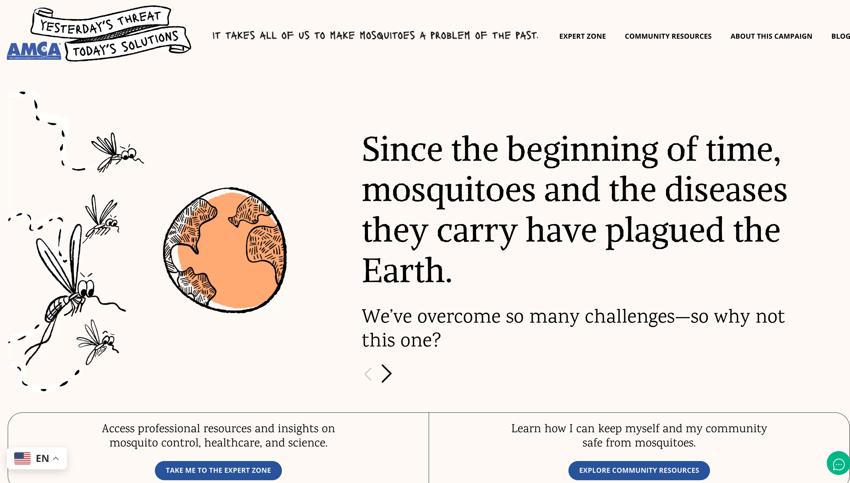
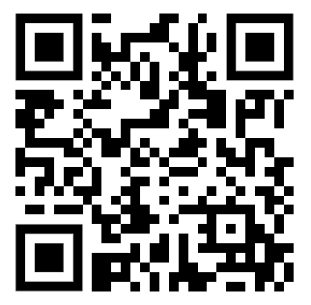
AMCA’s Public Facing Outreach Campaign
Yesterday’s Threats – Today’s Solutions
6
Notes:
As you can see on all these slides, AMCA has developed a new campaign: Yesterday's Threat, Today's Solutions. This concept compares the ways life today has become more accessible and contrasts that with the problem mosquitoes still pose. Mosquito control professionals know how to do this, but we, as the American public, need to invest (individually and collectively) in making it happen at scale. We can win this fight if we come together to do so. Yesterday’s Threat, Today’s Solutions uses humorous anecdotes from across time and history to make our point, then quickly directs people to go deeper and take action. I think its important to stress that the campaign is designed to promote the overall need for Mosquito Control in the US; not individual control tactics like wearing repellent.

Slide 7

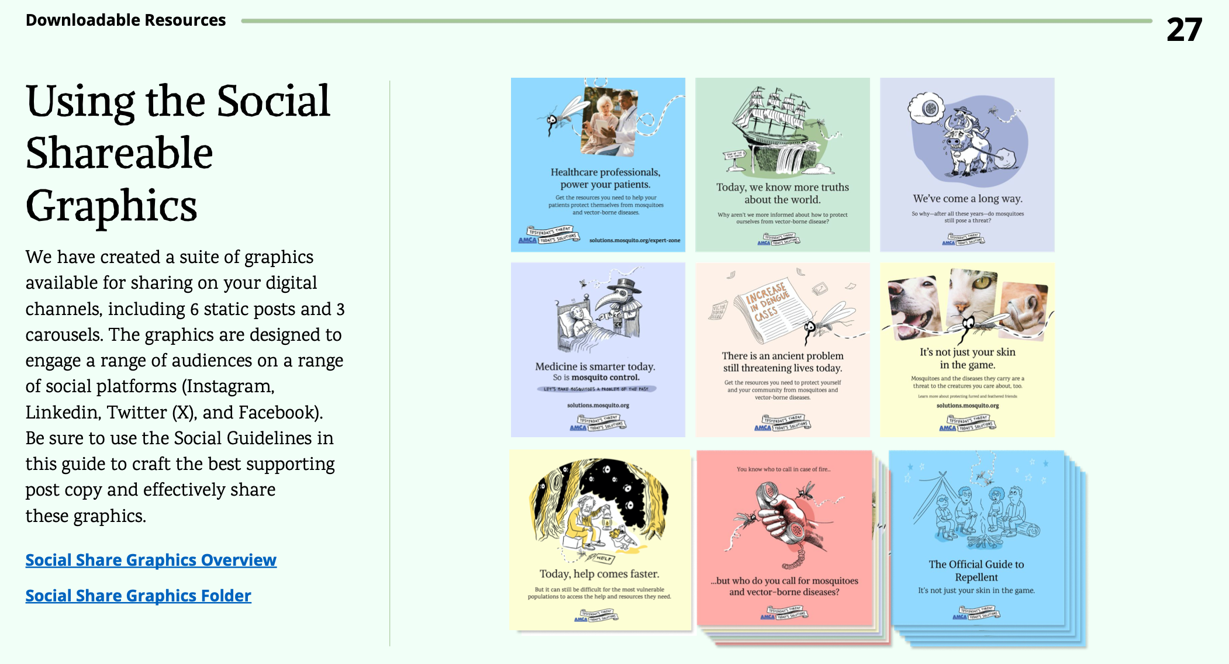
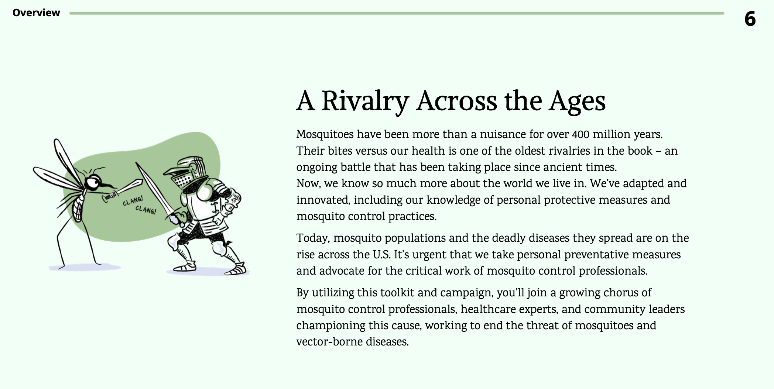
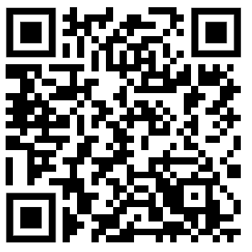
Downloadable PR Toolkit
Download it now.
7
Notes:
For this campaign to be effective, we need you. AMCA’s PR committee can't just do this alone. How can you help? By downloading the public relations toolkit on the Mosquito Solutions website. You can see some images of it here. This is a great resource to help you develop professional, nationally branded content. This is an important part of the campaign that allows you to develop your own shareable graphics, your own message; but maintain a look and feel that other programs across the country are using as well. It provides templates that allow for a unified voice and talking points for mosquito control. And it's all for free.
So I strongly urge you to go here and download it now.

Slide 8
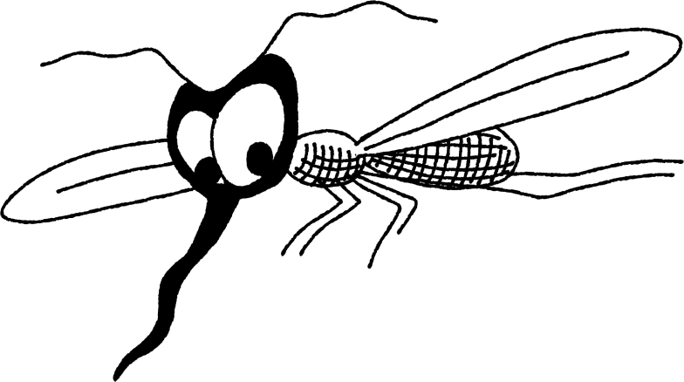
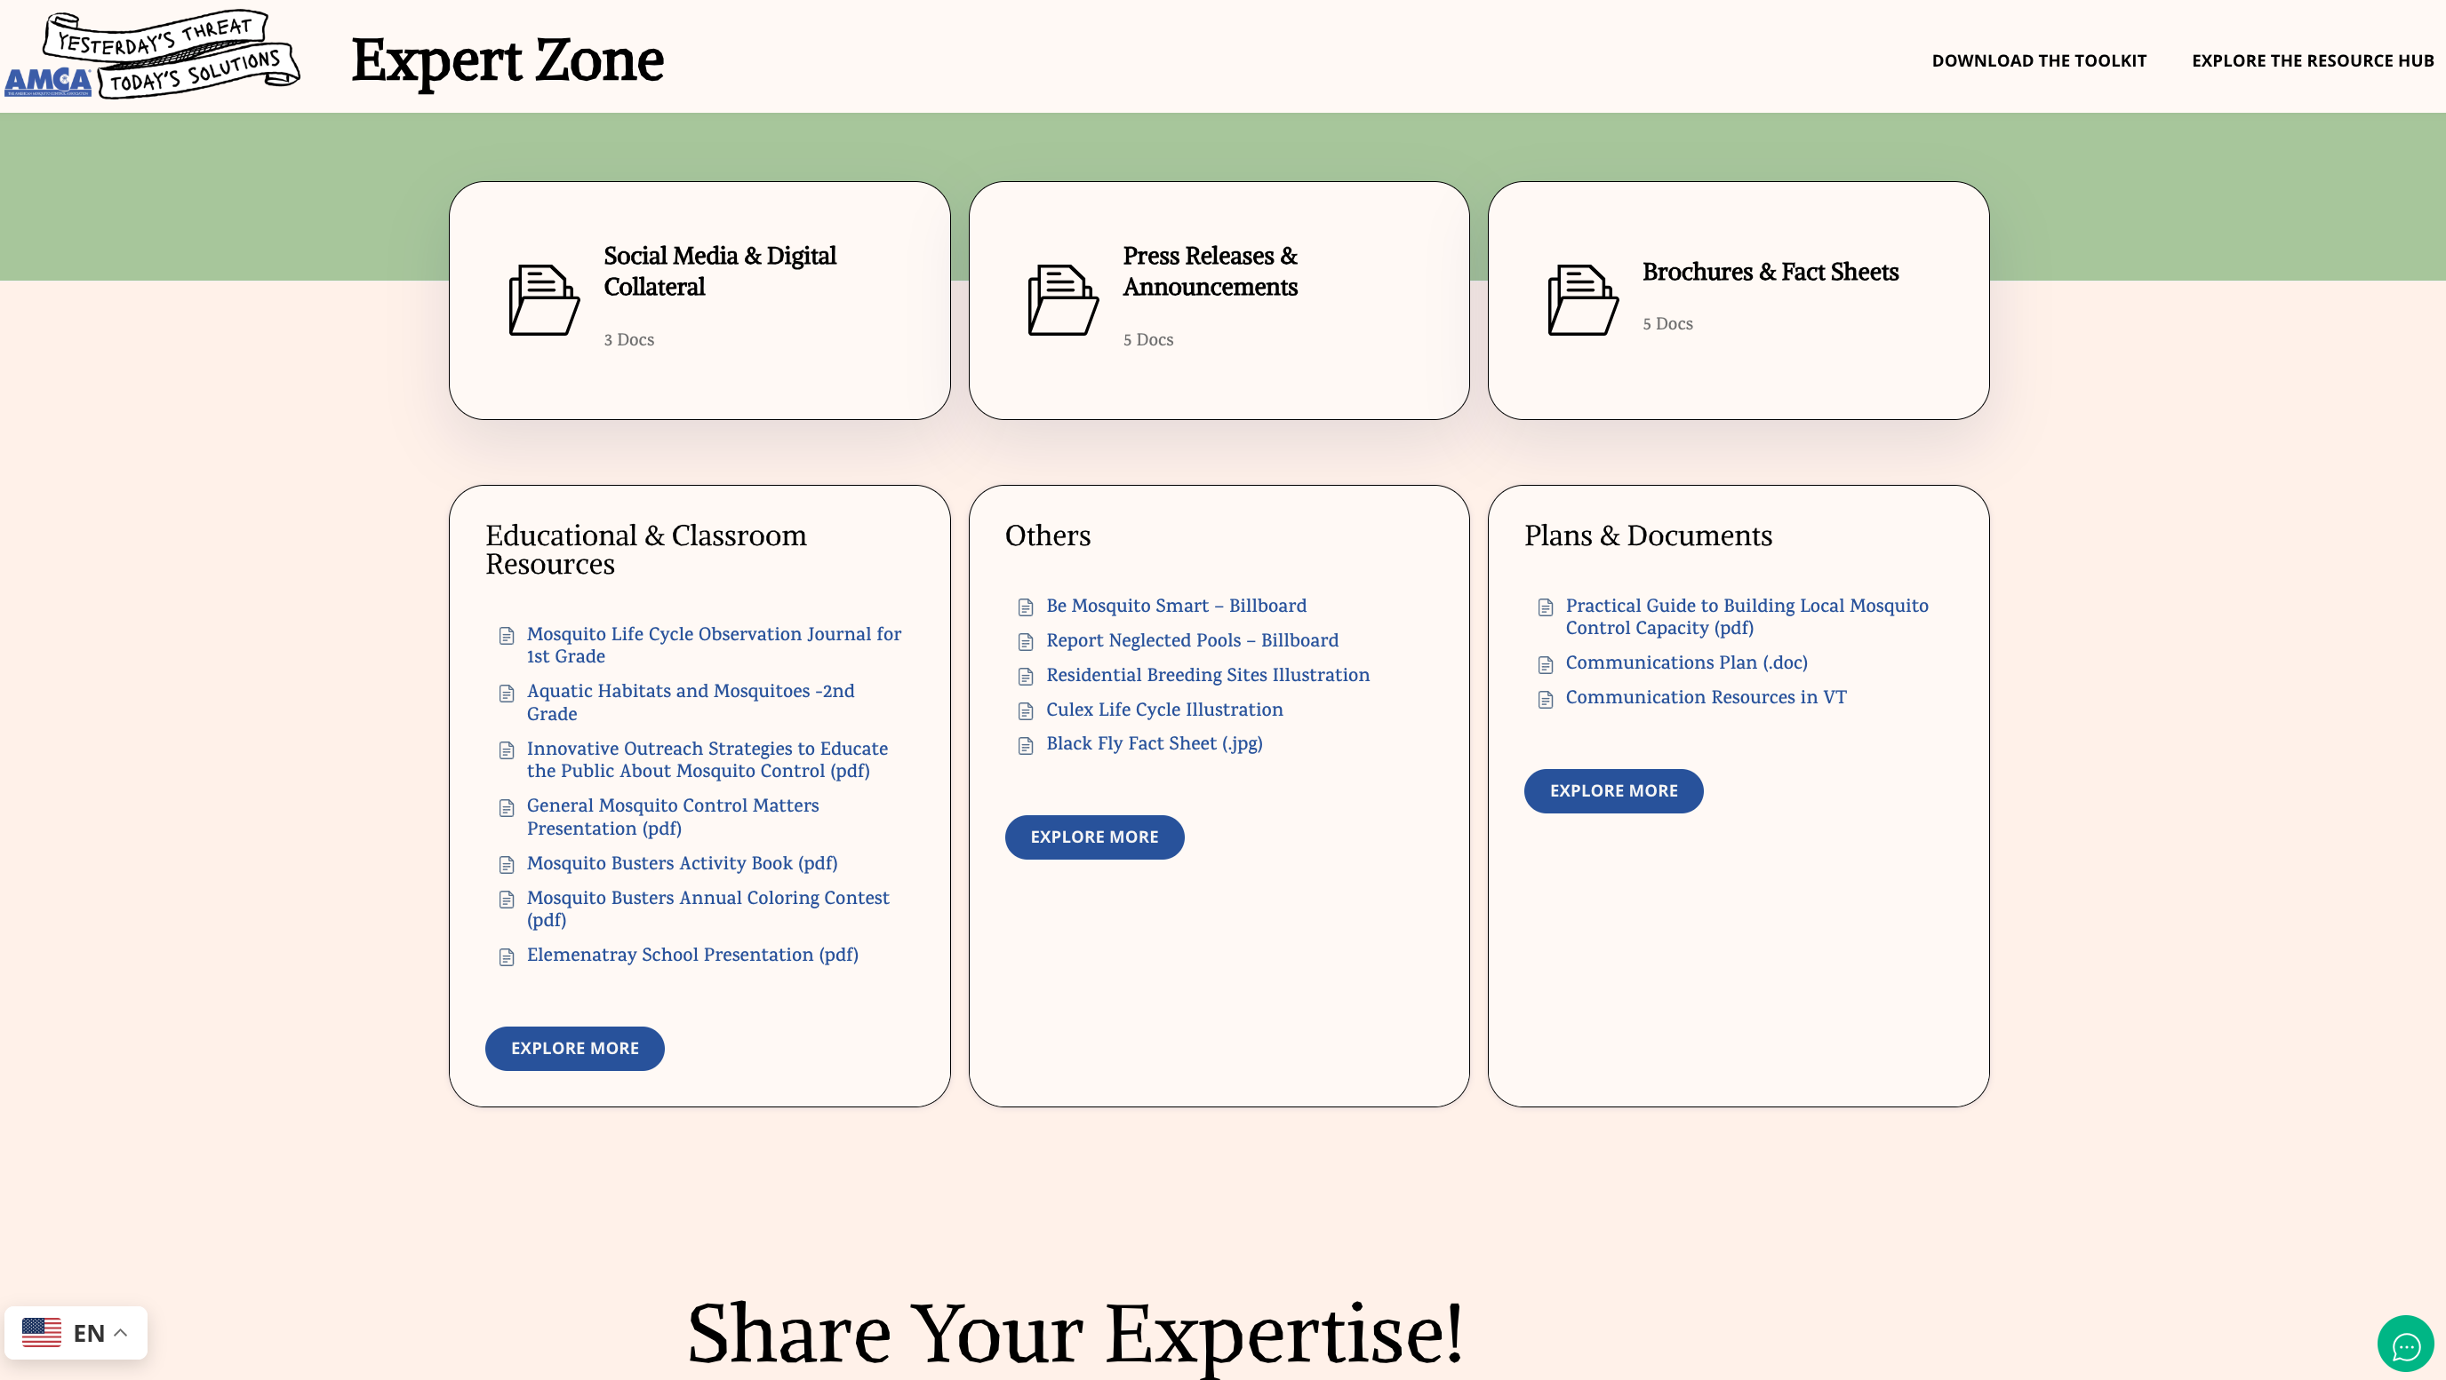
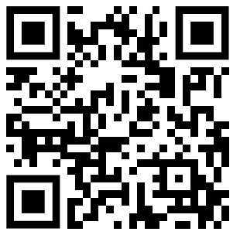
Online Resource Hub
Find
Resources here.
8
Notes:
Another big part of the program is the online Resource Hub. We're asking for agencies all across the US to donate materials and content. We can post it here.
That way other programs can see it, you can share it, you can use it. It’s a great way to get ideas, as well as great content developed by the many great programs around the country. So it will hopefully give programs ideas on graphics that they can develop on educational materials that they need but don't have the resources to develop on their own. With your support and contributions, this site can become a true resource for our industry to share and proliferate good information about the work that we all do.

Slide 9
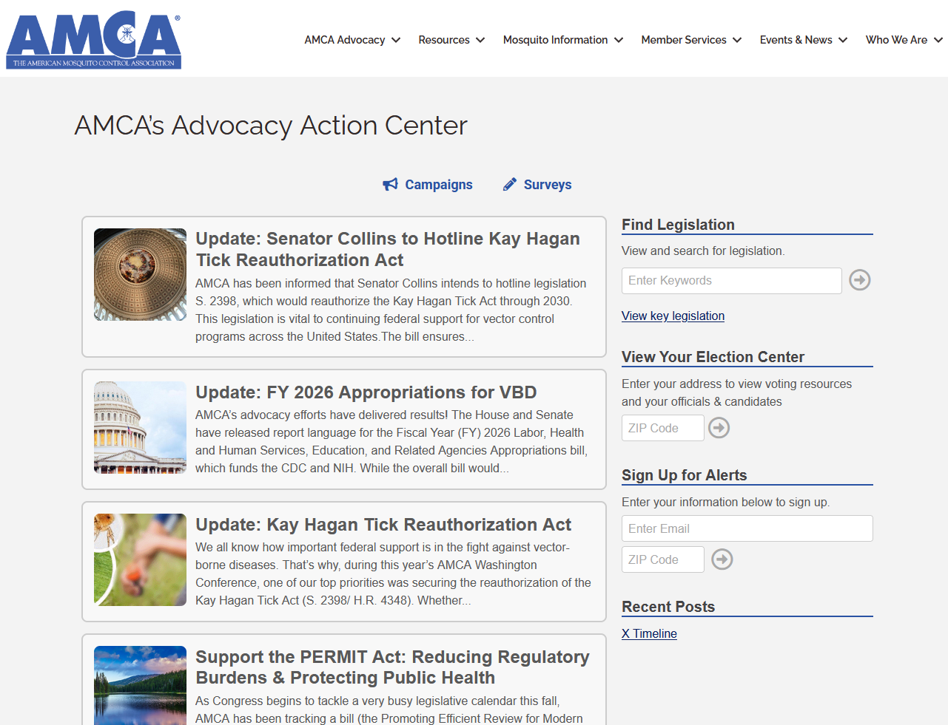
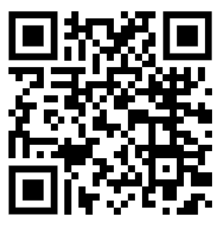
AMCA’s Legislative Advocacy
Use AMCA’s Advocacy Action Center
Where you find all our relevant Advocacy Campaigns.
We’ve made it easy! The Action Center tracks key legislation, has talking points and draft messages that you can send directly to your elected officials.
Don’t forget to sign up for alerts!
Find us here:
https://www.mosquito.org/action-center
9
Notes:
One of the most important things AMCA does is legislative advocacy. Now you may ask… why is this so important?
And that's because, as you've all seen locally, every day we're under attack by people that think what we do is detrimental to the environment and detrimental to their family’s health - when the exact opposite is true. The problem is, if we're not advocating for our profession, congressional leaders are only hearing from the opposition. I kn ow many members say… but I’m a public employee – I can’t lobby. Yes.. our membership consists of many public employees who have lobbying restrictions under state and federal laws. However, non-profit organizations or local government employees are NOT prohibited from aiding in advocacy. So don’t let Congress only hear about how everything you do is bad, about how you don't need to be funded, you don't need to be doing the things you're doing every day. It's up to us to advocate for our profession, to advocate for laws and regulations that allow us to do our jobs more effectively.

Slide 10
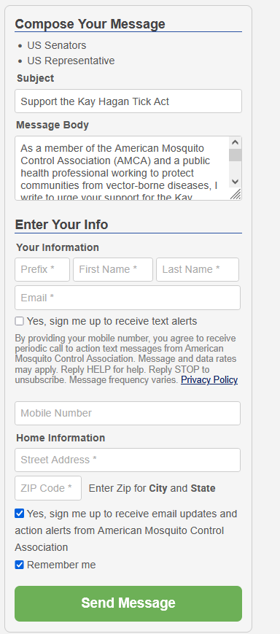
Powered by VoterVoice
Get Involved!
You can REGISTER with YOUR PERSONAL CONTACT INFO; not your work email. Based on your home address, it automatically sends emails to your legislators.
Messages are prewritten, but can be edited for your specific State, goals or message.
If you prefer to send emails directly, you can copy the message and edit it as needed.
Click it!
Before it’s too late.
10
Notes:
Advocating is not lobbying! Advocacy is any action that speaks in favor of, recommends, argues for a cause, supports or defends, or pleads on behalf of others. It includes public education, regulatory work, litigation, work before administrative bodies, lobbying, nonpartisan voter education, and more. Remember, you're an advocate. You're not a lobbyist. We're asking you to advocate on your behalf. Advocate.
If you have concerns about using your work email or work address as an advocate on congressional matters, you can easily go to our Voter Voice Action center and register with your personal contact information, not your work information. That means you personally are advocating for your profession, not you professionally. And, and that's a huge difference for a lot of folks. It's very easy to do. Register and let your voice be heard.

Slide 11
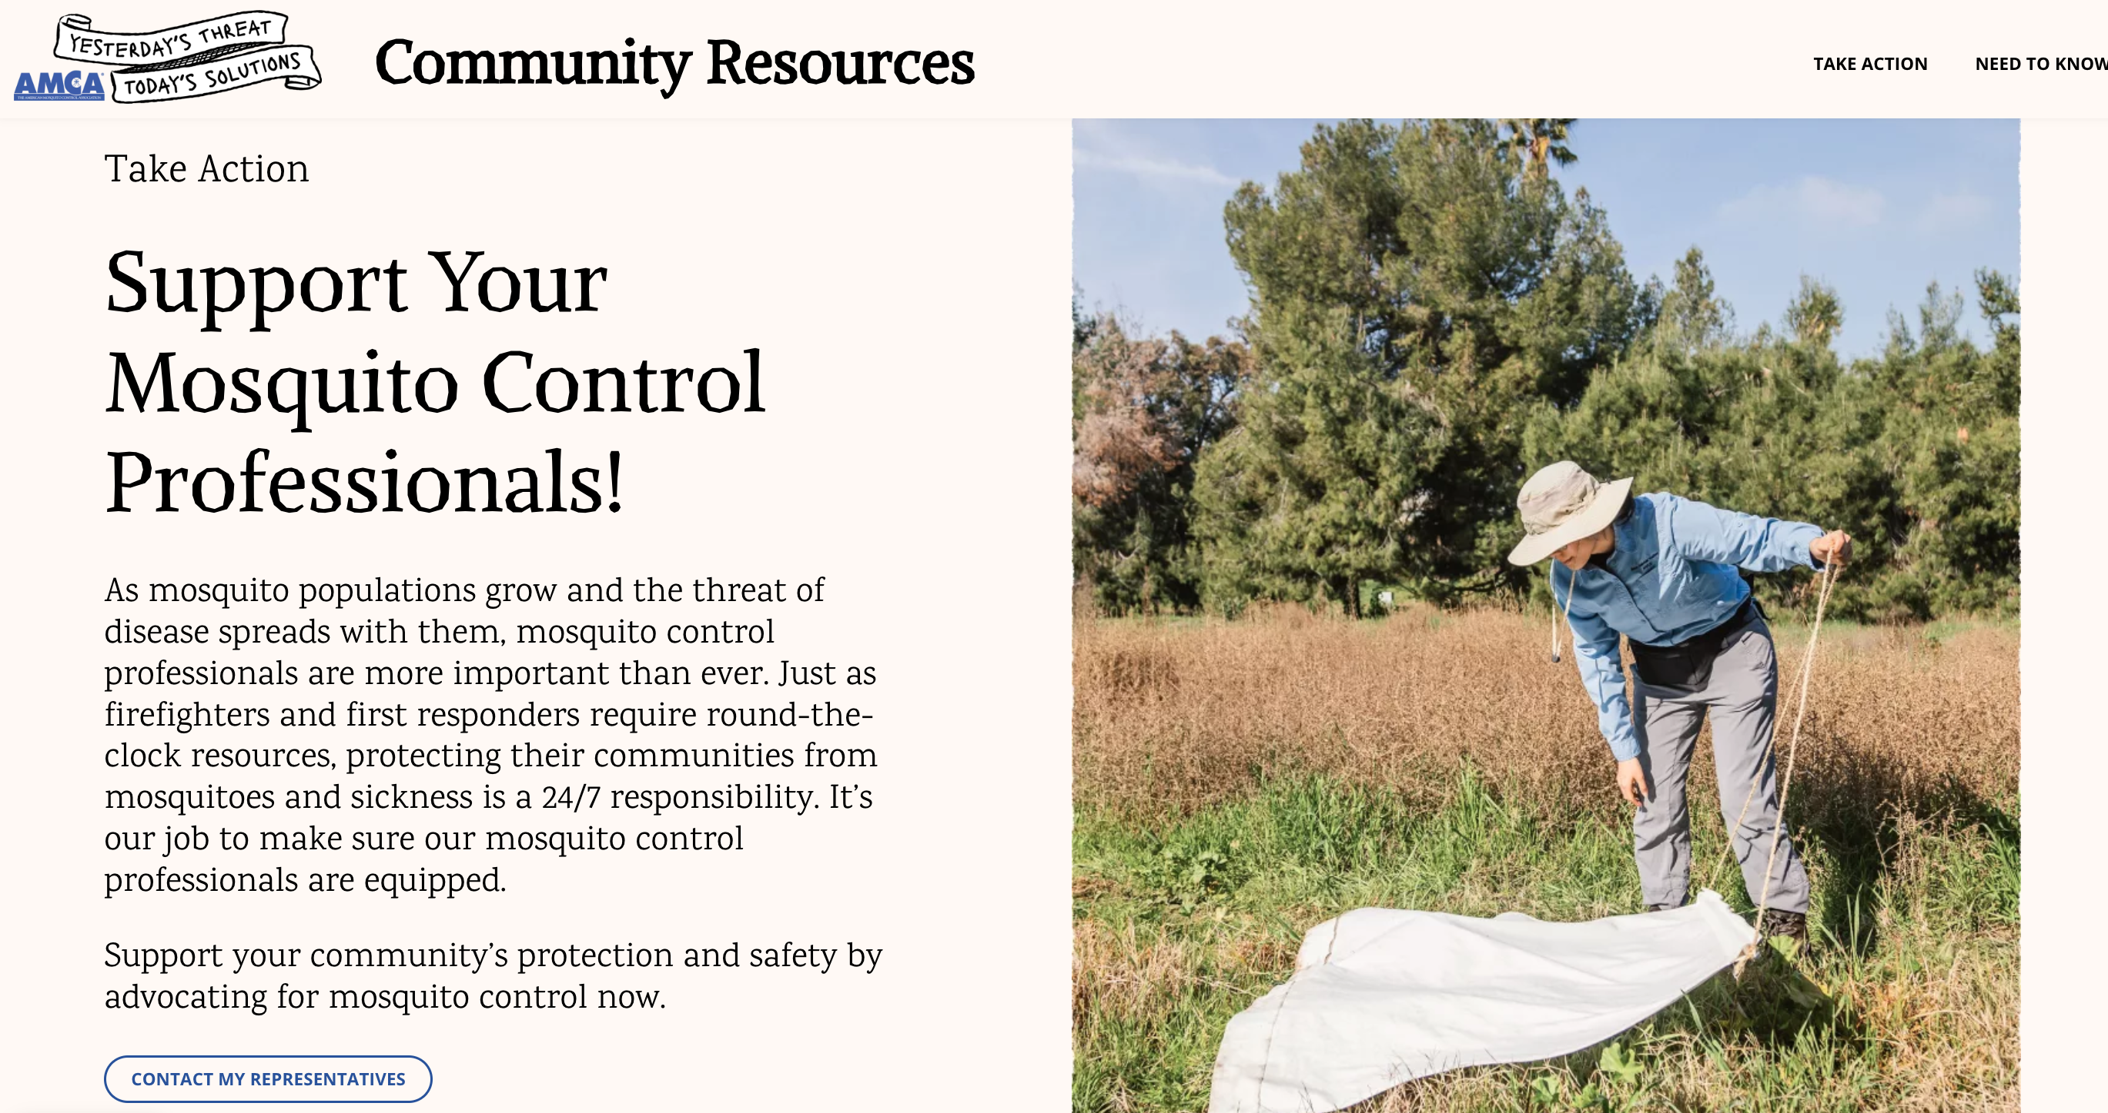
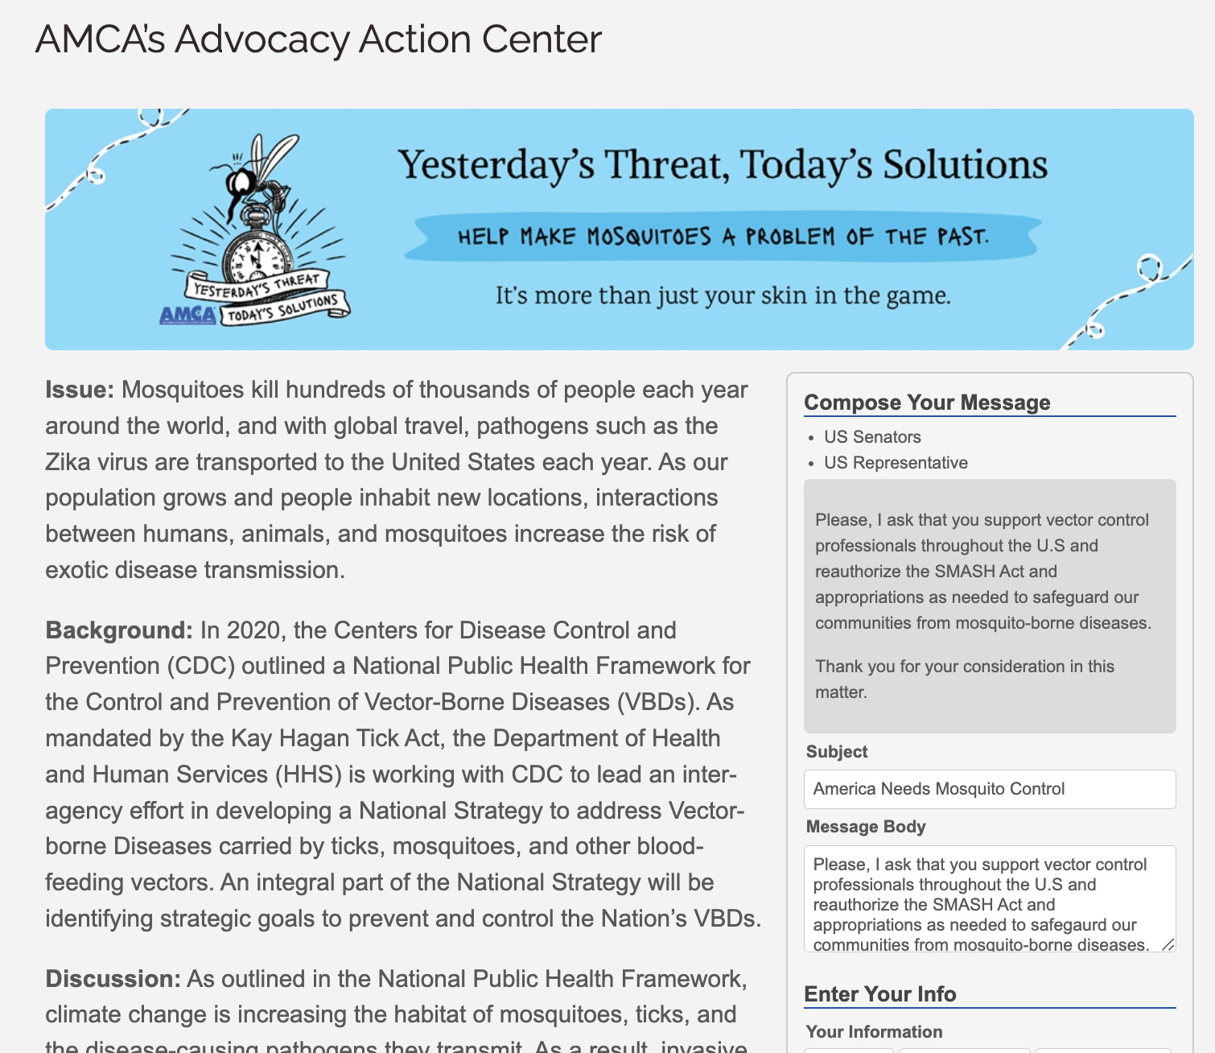
Our Public Campaign can direct the Public to Campaigns Supporting Mosquito Control
11
Notes:
Another large picture kinda thing thing we're trying to do is combine the public-faced campaign that we talked about with this advocacy so we can supply content that directs the general public to advocate for our activities, something just as simple as “support your mosquito control professionals”. They don't have to promote a specific bill, they don't have to promote specific funding. But just having someone from the general public state that mosquito control is an important profession and it should be supported by Congress…. That's extremely powerful and extremely useful. So our ultimate goal with the public relations campaign and our action center will be to combine the two so that we can get the general public supporting what we do as much as we can hopefully get our membership to support what we do.

Slide 12
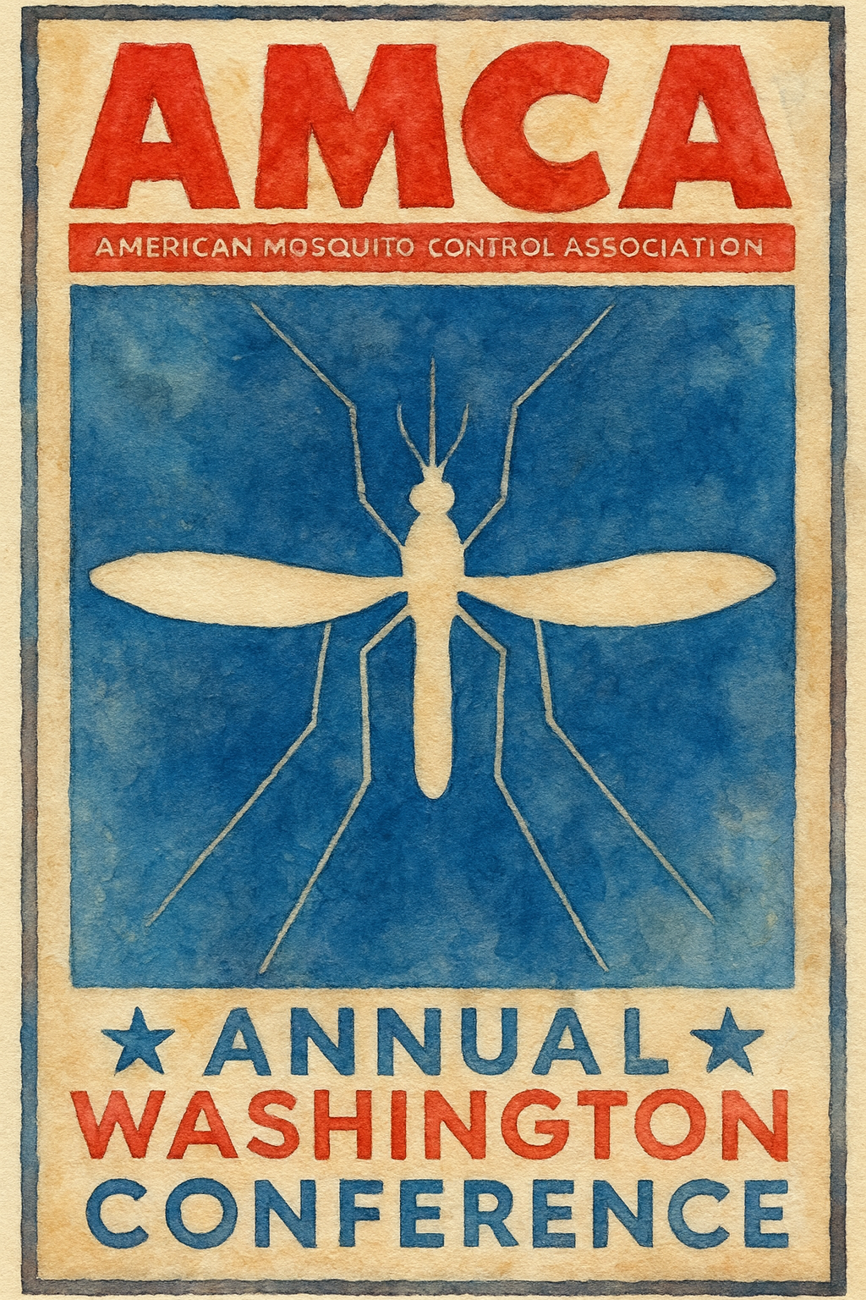
Annual Washington
Conference
Planned for May 12-13, 2026
What issues matter to you? Make them matter to Congress!
Will build on this past year’s successful advocacy.
Call/email Dan Markowski or Keira Lucas for more information.
12
Notes:
Participate! Make a difference! As you’ve seen, our voice is being heard. You have a right to speak to your congressional representatives about issues that affect your life. Mosquito Control is one of those issues. I hope to see everyone this year. It more important than ever to let our voices be heard.

Slide 13
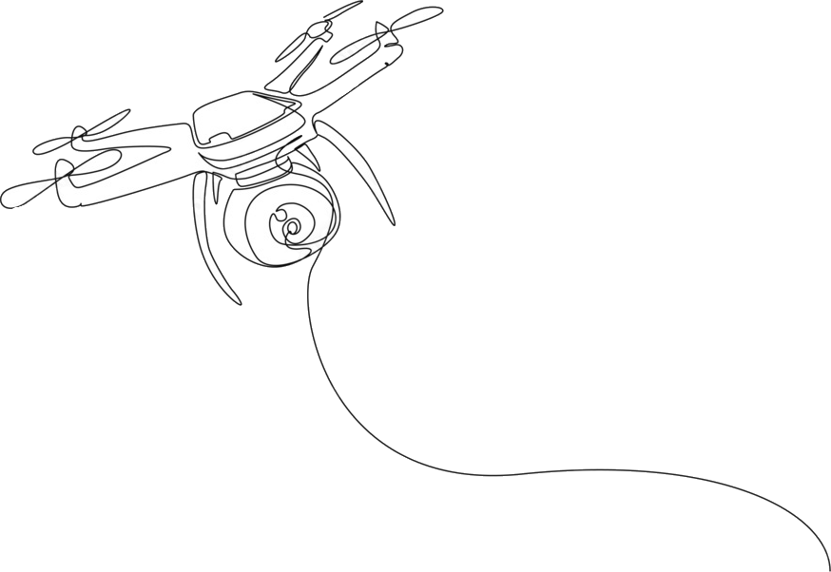
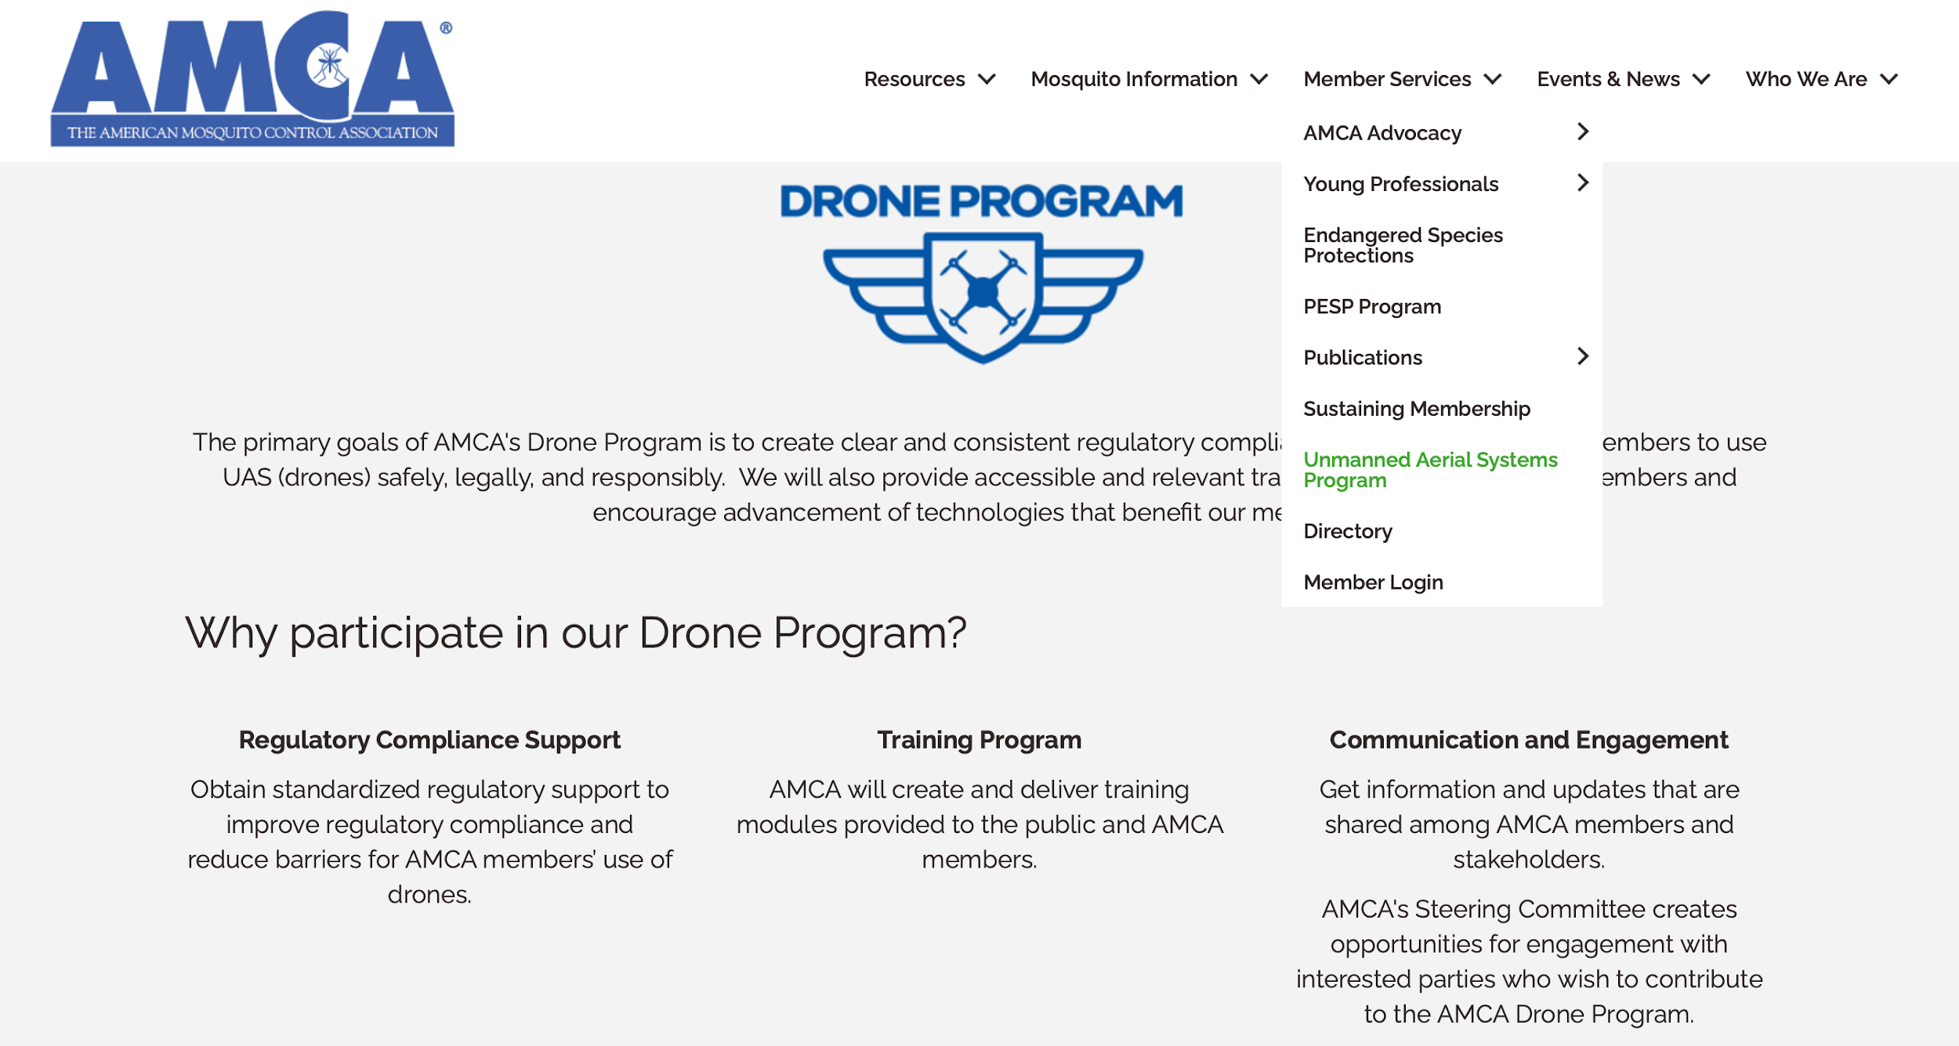
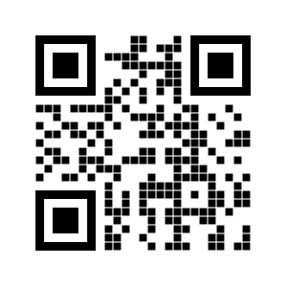
AMCA’s UAS Program
GOALS:
Create clear and consistent regulatory compliance processes for AMCA members to use UAS safely, legally, and responsibly.
Provide accessible and relevant training resources for AMCA members
Encourage advancement of technologies that benefit AMCA members.
Find us here:
https://www.mosquito.org/uas
13
Notes:
Our UAS program will take the uncertainty out of FAA permits, COAs (certificates of authorization), FAA rules, etc. AMCA has done the legwork and will provide easy access to part 137 operating certificates, UAS exemptions for flying above 55lbs, beyond visual line of sight, and more for members in good standing that have completed approved training courses. Here you can see 3 very clear goals of our UAS program. So far the program has been extremely valuable. We only have a few members that have taken advantage of it. I strongly urge everyone that's not in the UAS Program, and considering using drones in their mosquito control operations, to join the program this winter. It’s much easier than it sounds; AND it will ensure you’re in compliance with all FAA rules and regulations well into the future.

Slide 14
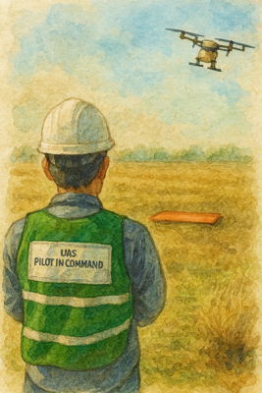
UAS Regulatory Compliance Support
AMCA has partnered with the FAA to Provide standardized regulatory support to improve compliance and reduce barriers for AMCA member’s use of drones.
55lbs +: FAA-2024-0168_AMCA_Exemption No. 23208
<55lbs: FAA-2023-2308_ AMCA_Exemption No. 23177
14
Notes:
We made good progress in 2025. This past year we received both of our exemptions from the FAA. Allowing members that want to fly under 55 pounds as well as over 55 pound drones. You now can do that with a 137 operating certificate which is extremely helpful to your operations. Having a 137 operating certificate over flying under a Public COA has many benefits. Not the least of which… FAA is considering not allowing any more drone applications with a public COA. This all is a huge accomplishment because this allows AMCA to be the leader in aerial drone applications, and ensuring that our members are the class of the industry.

Slide 15
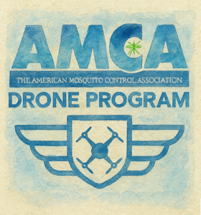
Requirements for use of AMCA’s Exemptions
File Letter of Intent (LOI) with FAA
AMCA must sign LOI to certify operator as an AMCA member in good standing.
Operator must include Part 137 operating permit number.
Use LOI Template & post to docket per instruction in exemption.
LOI is good for the term of the existing exemptions
15
Notes:
Of course, there are requirements to use these exemptions. You'll have to do a number of things once you enter the program. If you go on our website, you'll see the requirements needed to join the program. For example, you have to watch a few training videos, an orientation video. Probably the most important thing you'll need to do is apply for your 137 operating certificate. And even that’s been streamlined after many hours of meetings with the FAA. Essentially, you’ll be filling out a piece of paperwork and sending that to the FAA, but it can take anywhere from several weeks to a month and a half to get that paperwork back. So it's a great thing to do now in the off season, get your paperwork started now. Ultimately, when that paperwork is all in order, you simply file a letter of intent with the FAA stating you want to operate under our exemptions. And, of course, we have that template for you. At that point you're cleared and you're legally able to fly under our permits.

Slide 16

ESA Mitigations and the
Monarch
USFWS & AMCA Partnership:
In 2024, UFWS HQ, Region 3 biologists and AMCA created a working group to leverage the AMCA BMPs into a tangible product
Recognition that applicators can be good stewards and want to protect species and habitat
Provide proactive guidance to practitioners to have on-hand when spraying areas where monarchs are present
16
Notes:
Another important benefit we've been working on are ironing out the Endangered Species Act (ESA) mitigations that mosquito control operators across the country are going to have to adhere to in the near future. We've also been working at length with Fish and Wildlife Services on these mitigations and how they may help with their goal of Monarch Preservation. This is extremely important because as you know, the monarch may be listed in the near future. As you know, most every county in the country has at least one endangered species, and if monarchs are listed it will get even more complex for applicators.
So we've been working with EPA and Fish and Wildlife Service on developing mitigations that are protective of species; yet allow us to do our job.
This has been an extremely in depth but important endeavor that the L&R subcommittees and the technical advisor have been involved with.

Slide 17
Future ESA Mitigation Requirements?
Coordination with local USFWS Field Offices
Local USFWS biologists (ESFOs) can help public health officials determine how to best avoid or minimize impacts to non-target plants and animals
Develop an agreed upon process for technical assistance coordination
  Recommend Annually – prior to mosquito season
Stay in Communication!
  Newly listed species or critical habitat
  Coordination of applications/emerging public health threats
  Proactively address concerns with the process
17
Notes:
As you all probably have heard us talk about in the past, our primary ESA mitigation currently is to avoid applications if necessary.
If you can't avoid them, you have to coordinate your applications with the local US Fish and Wildlife Service offices, ESFOs or Ecological Service Field Office.
So what does that look like? What does that mean? This is where AMCA is going to help and we’re able to walk MEMBERS through this process. I can’t stress enough that nonmembers are going to get left behind. The TA doesn’t have time to help every nozzle head out there. So sign up! If you're a member, you'll have templates, you’ll have an “approved” integrated mosquito management plan that we can walk you through.
We can and will take you through this entire process of what a coordination looks like.

Slide 18
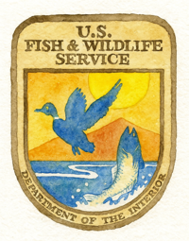
Looking Forward…
Working Together
Creating a written guidance to provide to mosquito control districts/applications and ESFO staff
Collaborating with each other through trainings and meetings
Reaching out this winter to Mosquito Control Programs and ESFOs for collaboration and feedback
18
Notes:
Along that line, we've been working directly hand in hand with Fish and Wildlife Service to prepare a written guidance document not only for mosquito control programs to follow. But also a document that they can then provide their staff; so they know what questions to ask you. They also know what to expect from you. So hopefully it will ease this communication process going forward and allow each agency to work together more effectively and consistently across the country. AMCA is going to continue to collaborate with U.S. fish and Wildlife Service throughout the winter. We hope to develop trainings, have more meetings with them and make sure that their local offices are on board with what our local offices are doing and develop ways we can all work together.
We'll be working this winter, hopefully with multiple programs, to “test” this written guidance document with local mosquito control districts and local FWS offices to ensure its thorough and informative. Currently our guidance document is awaiting final approval from FWS headquarters. At that time, they, and AMCA will sign a letter of coordination demonstrating our need to protect species AND to perform mosquito control operations.

Slide 19
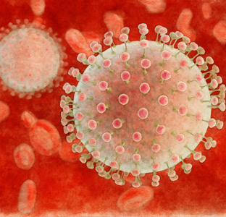
What is AMCA Doing about
OROV?
AMCA received supplemental funds to assist in the development of an OROV Surveillance and Management Guidance document
Coordinating and providing equipment to programs to gather abundance data throughout the U.S.
Funding 7 projects to evaluate all aspects of Culicoides management.
  Repellent efficacy
  Larvicide and Adulticide efficacy
  Age Structure Assessments
Guidance document to be developed based on these projects
All this and more presented at AMCA meeting in Portland, 2026.
19
Notes:
AMCA has an ongoing partnership with CDC to develop training and educations materials for vector-borne diseases. This partnership was strengthened with the additional of supplemental funds to help the nation respond to OROV. Our intention has been to work with member mosquito control programs, and members that are academic researchers to develop clear management guidelines for Oropouche and the vectors that may transmit it. We’re pretty good with mosquito control BMPs. But, what about biting midges? Who does midge control? How many species are in your state? Will ULV applications be as effective? Which repellents work best? Can you identify Culicoides? How will you communicate OROV protective measures to the public? These are many of the questions, we’re working with with 7 different project teams and will provide clear guidance next year in the form of an official guidance document to help you respond to biting midge concerns within your jurisdiction.

Slide 20
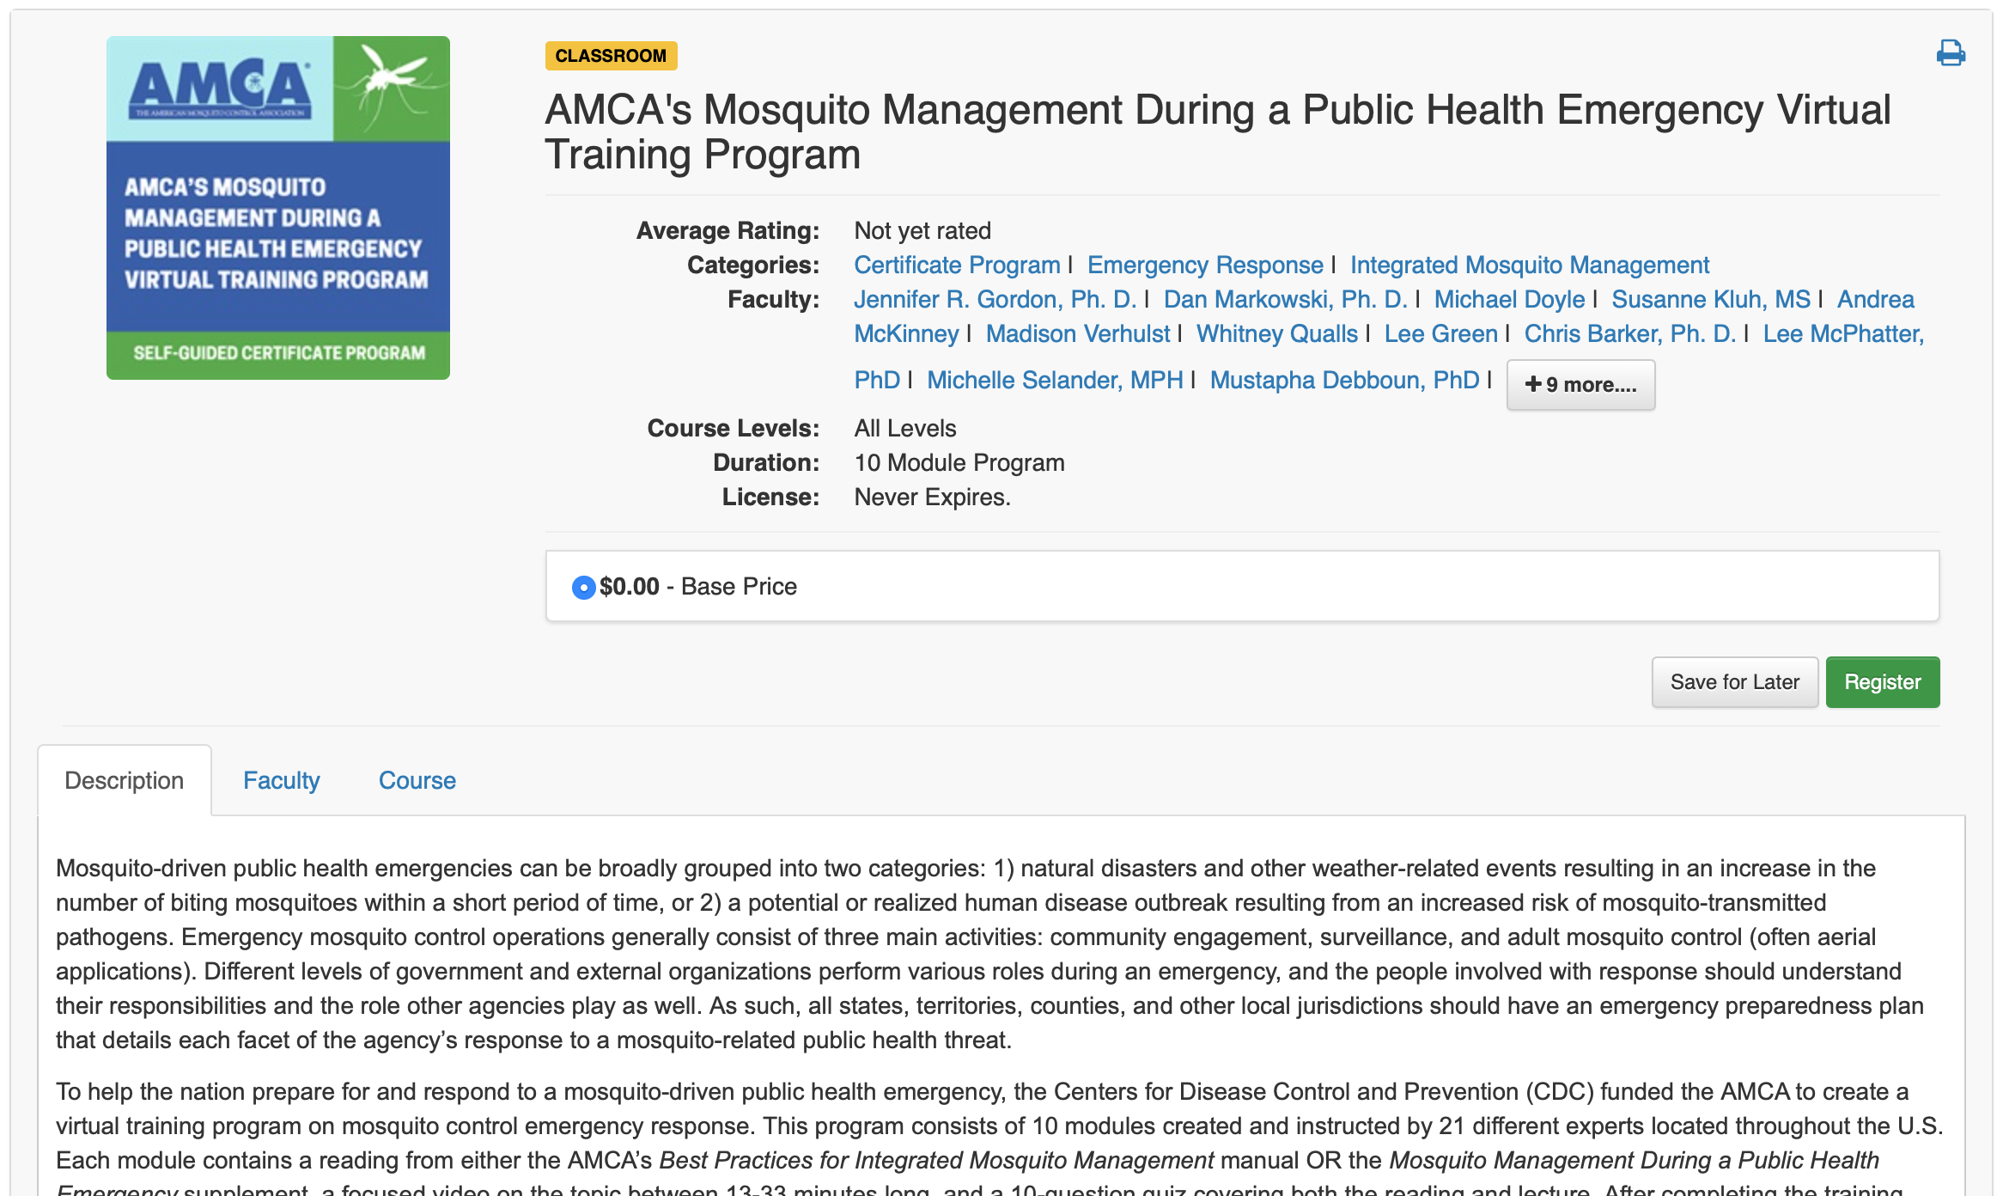
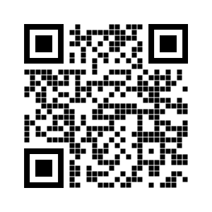
Don’t Forget…
AMCA’s Virtual Training Program
Excellent source for onboarding new staff
Detailed plans for responding to Emergency Outbreaks
Just check it out!
Found at AMCA’s Training Center:
https://www.mosquito.org/webinars-training/
20
Notes:
Hopefully, you’ve all seen the program we’ve developed? Well, we’ve added a virtual training series to accompany our “Mosquito Management During a Public Health Emergency” BMP Supplement. This program is also designed to compliment the BMPs that we’ve produced. Who’s downloaded the BMP updates? The training project is a nationwide collaborative effort designed to train program managers and administrators in all things needed to properly respond to a weather-related or disease outbreak public health emergency. Each model is 20-30 minutes in length with a 10 question quiz to ensure you watched it. This makes it verifiable training that can be used in a variety of ways. The training is asynchronous… so people can take it at their own pace.
The entire program has a simple easy to use interface; that will provide tracking of your progress and provide a certificate upon completion. If you want to watch/use just one or two of the modules, you can. So the training program can be customized to your program’s needs and staff requirements. However, a certificate of completion is only provided if all modules are completed. But all progress is tracked and users receive updates and reminders of the the next module. Additional reading materials and references are included as links with the video. The program was developed with funds provided by the CDC, so the content is FREE for all to use and we hope you find it useful. If you think new/different videos or material would useful, let the TA know. We can develop it and continue to expand the usefulness for all.

Slide 21
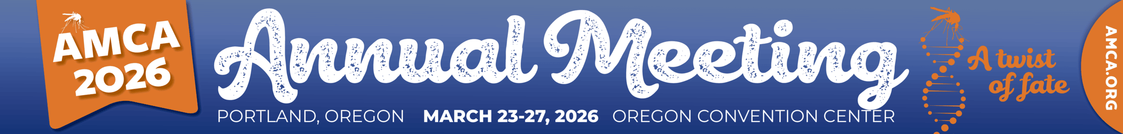
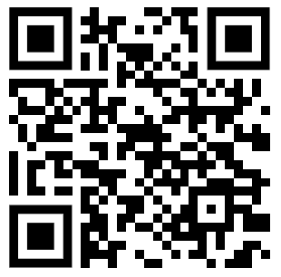
March 23 – 27, 2026
Portland, Oregon
Network from Colleagues from around the world
Dan will buy you a drink.
Learn Stuff! Have Fun!
Register Here
21
Notes:
Hope everyone attends!

Slide 22
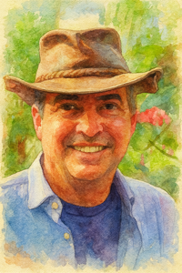
Thank you
Dan Markowski amca.ta@mosquito.org
22
Notes:
Change name and contact info as appropriate.

