Slide 1
Anopheles spp. Adult Mosquitoes ID Course
Lisa Wagenbrenner
Director, Chesapeake Mosquito Control Commission

Slide 2
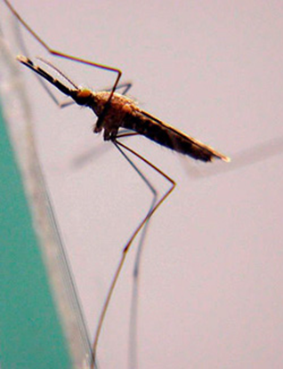
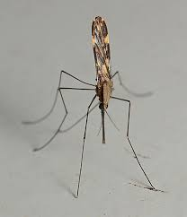
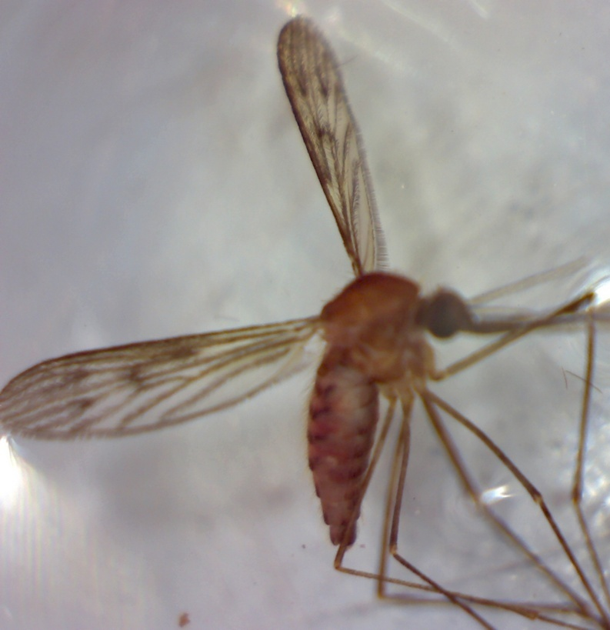
Common Regional Anopheles Species of Mosquitoes
An. crucians complex
An. punctipennis
An. quadrimaculatus group

Slide 3
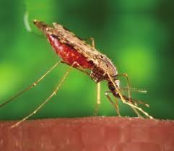
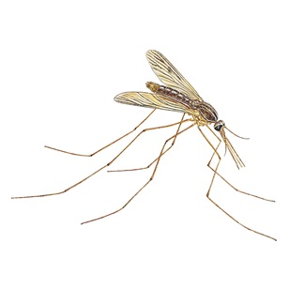
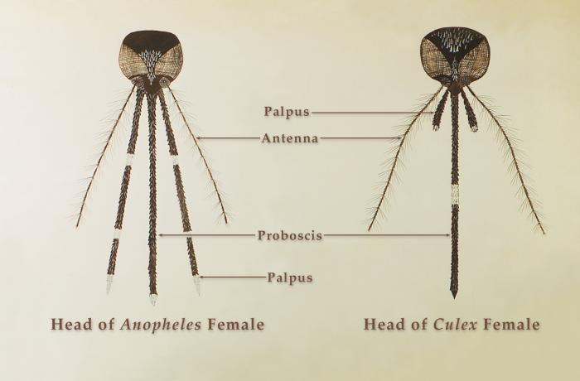
Common Morphological Characteristics Anopheles spp.
Easily distinguished by:
Long palps – just as long as proboscis
Anopheles Long “Phel”-ers
Posture when feeding/resting – head, thorax, & abdomen at an angle to surface
Rounded Abdomen
Size: Medium – Large

Slide 4
The genus of Anopheles Behavioral Characteristics
Feeding:
Mostly on mammals including humans
Occasionally bites birds & reptiles
Female activity:
Mostly active at night or dusk
Daytime: resting in cool, damp places
Winter Season:
Hibernating-like state over winter
Often resting in sheltered environments
Potential Vectors for:
Plasmodium spp. – parasite that causes malaria in humans
Dirofilaria immitis – parasite that causes heartworm disease in dogs & cats
e.g. Attics, outbuildings

Slide 5
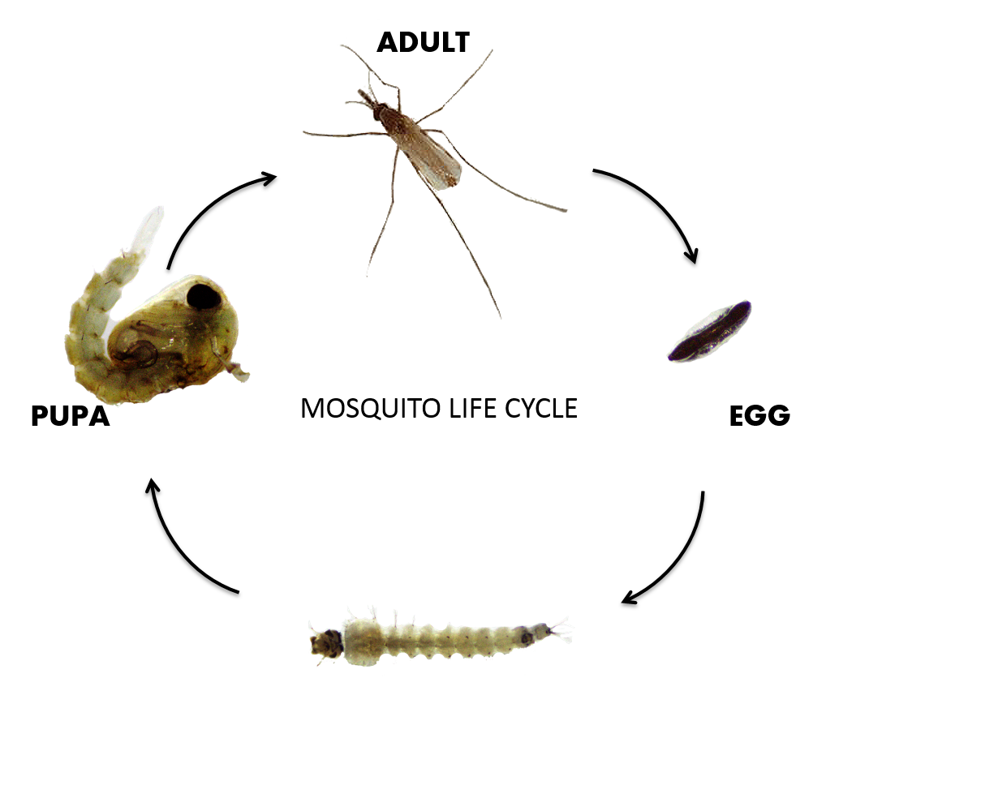
Anopheles spp. – Immature Stages of Life Cycle

Slide 6
Anopheles Eggs – laid singly on water, with floats
Eggs of the Anopheles quadrimaculatus

Slide 7
Anopheles Larva & Pupa
Anopheles larvae:
No siphon- have spiracular apparatus
Rest parallel to water surface
Anopheles quadrimaculatus larva (left) & pupa (right)

Slide 8
Adult Stage of Life Cycle
The species of Anopheles found in Virginia

Slide 9
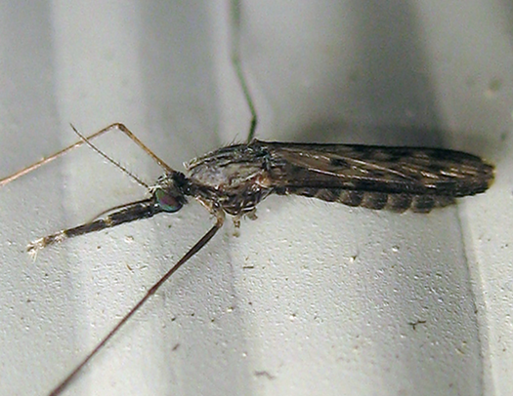
Anopheles crucians complex – Common
Anopheles crucians complex – a group of ≥ 7 species
Some can be identified as larvae, most cannot be differentiated
Similar biology
Nearly indistinguishable as adults
Anopheles crucians complex made up of:
An. bradleyi
An. crucians
An. georgianus
At least 4 other species that have not formally been distinguished
Species within the complex are typically grouped together
Breeding Habitats:
Freshwater swamps, marshes, ponds & woodland pools – An. crucians & An. georgianus
Salt marshes & brackish, coastal pools – An. bradleyi

Slide 10
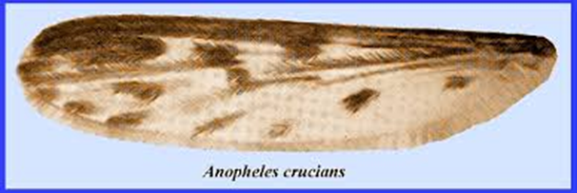
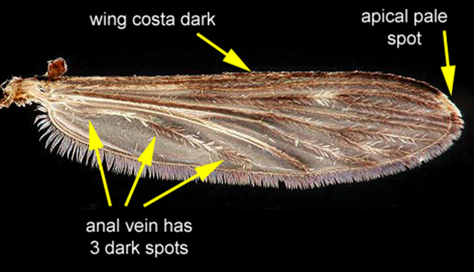
Anopheles crucians complex – Common
Identifying Characteristics
Banded palpi
Dark palps ringed with pale scales
Wings:
Solid dark costa with pale scales at outer tip
Spotted appearance – alternating patches of dark & light scales along veins
Specifically – anal vein has 3 dark spots

Slide 11
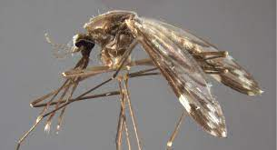
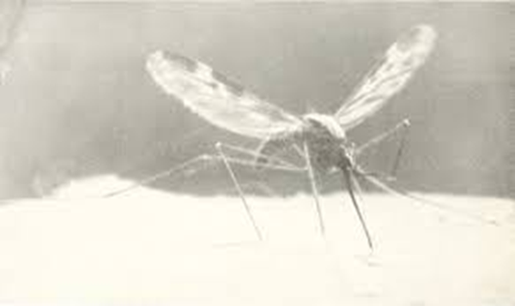
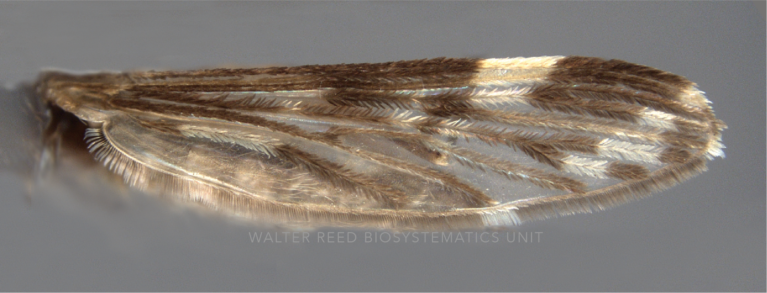
Anopheles punctipennis - Common
“Punks”
Breeding Habitats:
Slow-moving streams, puddles, ponds & pooled pockets of water within streams
Man-made containers:
Esp. rain-filled barrels & watering troughs
Identifying Characteristics:
Palpi unbanded
Scutum (of thorax) – gray median stripe bordered by brown
Mohawk
Wings:
Costa is dark with two patches of pale scales:
One patch – breaks up the dark edge
Other patch – at outer tip (like An. crucians)
Anal vein has 2 dark spots

Slide 12
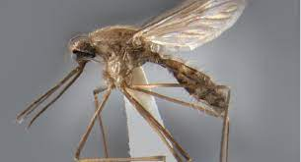
Anopheles quadrimaculatus group – Common
“Quads”
Previously considered a single species → now ≥ 5 species – all close resemblance
Can only be distinguished by slight differences in number + coloration of bodily scales & setae
Anopheles quadrimaculatus group made up of:
An. quadrimaculatus
An. smaragdinus
An. diluvialis
An. inundatus
An. maverlius
These species are treated as one group
Most important mosquito species in the southeastern United States involved with the transmission of malaria (prior to disease eradication)
Breeding Habitats:
Permanent bodies of water with aquatic vegetation

Slide 13
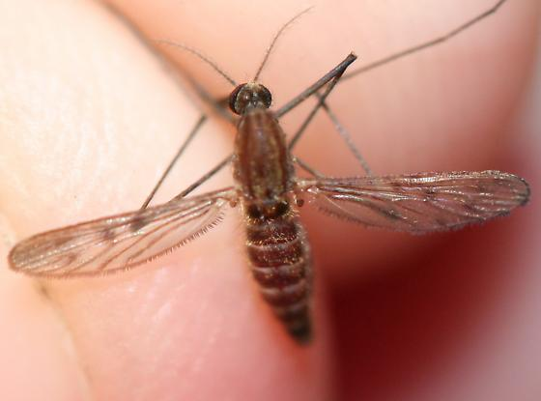
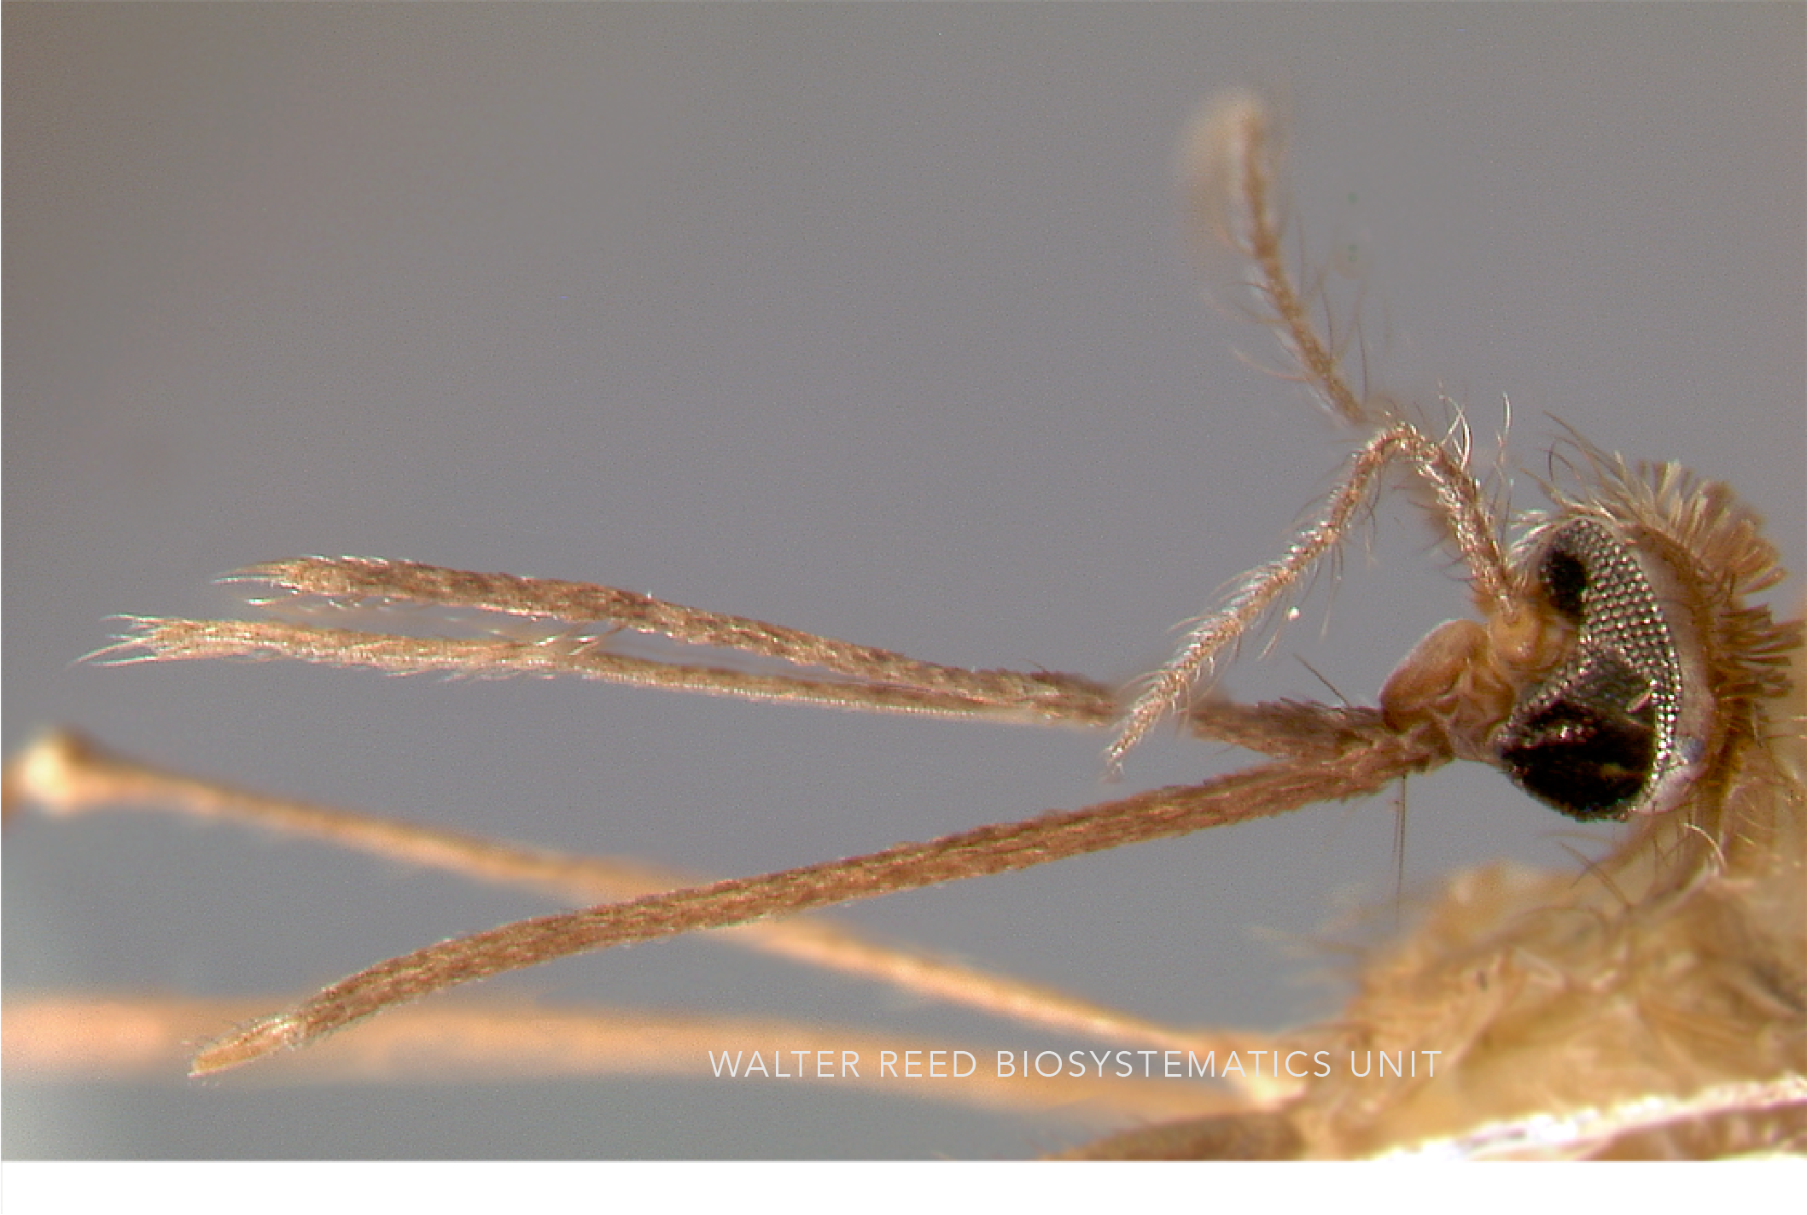
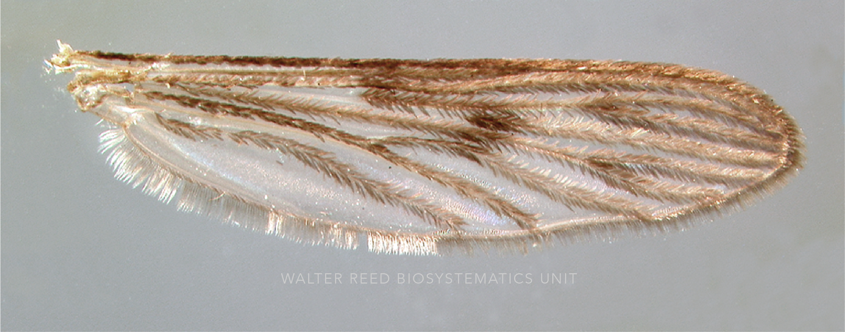
Anopheles quadrimaculatus group – Common
Identifying Characteristics
Palpi – only dark scales
Darker body – more brown than black
Wings:
No patches of pale white scales
Four distinct patches of dark scales
Located at junctures of veins

Slide 14
Uncommon Regional Anopheles Species of Mosquitoes
An. atropos
“Salt-marsh Anopheles”
Identifying Characteristics:
Palpi unbanded
Dark halteres
Wings entirely dark scaled, 4 indistinct dark spots
An. barberi
“Barber’s treehole Anopheles”
Identifying Characteristics:
Small, grayish-brown mosquitoes
Pale scales around eyes
Wing scales dark, but lack dark spots
An. perplexens
Breeding Habitats: Limestone springs Freshwater swamps
Identifying Characteristics:
Palpi unbanded
Wings similar pattern to An. punctipennis
An. perpl. – Frontal pale patch is very small
Recent studies: sizes of pale spots vary for both species → hard to differentiate; distinct differences in eggs → more reliable way to identify
An. walkeri
Breeding Habitat: Freshwater swamps
Identifying Characteristics:
Banded palpi
Pale halters
Wing scales dark, with 4 dark spots (similar to An. atropos & An. quadrimaculatus group )

Slide 15
Thank you!
Lisa Wagenbrenner
Director
Chesapeake Mosquito Control Commission
lwagenbrenner@cityofchesapeake.com

Slide 16
References
Slide 2:
1. ©2022 Official City of Jacksonville and Duval County Government Website Mosquito Control Anopheles crucians Complex https://www.coj.net/departments/neighborhoods/mosquito-control/anopheles-crucians-complex.aspx
2. Copyright © 2019 Barbara Thurlow Temple Hills, Maryland https://bugguide.net/node/view/1743123/bgimage
3. © Lee Elliott, some rights reserved (CC BY-NC-SA), uploaded by Lee Elliott https://www.inaturalist.org/guide_taxa/645745
Slide 3:
1. https://www.pesterminators.com.mv/pest-library/
2. CDC PHIL/Dr. Richard Darsie Illustrator: Chester J. Stojanovich
3. Pictorial identification key of important disease vectors in the WHO South-East Asia Region 2020
Slide 5:
1. Anopheles Genus – Life cycle http://vectorinfo.icmr.org.in/Mosquito/An_lcycle.aspx
Slide 6 & 7:
1. Featured Creatures Entomology & Nematology FDACS/DPI EDIS University of Florida Photograph by C. Roxanne Connelly, University of Florida. https://entnemdept.ufl.edu/creatures/aquatic/Anopheles_quadrimaculatus.htm
2. Globe Observer Know your Mosquito! Institute for Global Environmental Strategies p. 2 https://observer.globe.gov/documents/19589576/dfd06be6-2a7b-49f8-99f4-fc03498c8aee
3. Featured Creatures Entomology & Nematology FDACS/DPI EDIS University of Florida Photograph by James M. Newman, University of Florida.
https://entnemdept.ufl.edu/creatures/aquatic/Anopheles_quadrimaculatus.htm
Slide 9:
1. Copyright © 2009 John R. Maxwell Marlton, NJ, USA http://bugguide.net/node/view/272672/bgpage
Slide 10:
1. Florida Medical Entomology Laboratory
https://fmel.ifas.ufl.edu/mosquito-guide/mosquito-genera-and-species/genus-anopheles/anopheles-crucians/
Slide 11:
1. Walter Reed Biosystematics Unit (2021). Anopheles punctipennis species page. Walter Reed Biosystematics Unit Website, http://wrbu.si.edu/vectorspecies/mosquitoes/punctipennis, accessed on [25 April 2022].
2. https://en.wikipedia.org/wiki/Anopheles_punctipennis
Slide 12:
1. Walter Reed Biosystematics Unit (2021). Anopheles quadrimaculatus species page. Walter Reed Biosystematics Unit Website, http://wrbu.si.edu/vectorspecies/mosquitoes/quadrimaculatus, accessed on [25 April 2022].
Slide 13:
1. Walter Reed Biosystematics Unit (2021). Anopheles quadrimaculatus species page. Walter Reed Biosystematics Unit Website, http://wrbu.si.edu/vectorspecies/mosquitoes/quadrimaculatus, accessed on [25 April 2022].
2. Copyright © 2007 Graham Montgomery https://bugguide.net/node/view/114760

