Slide 1
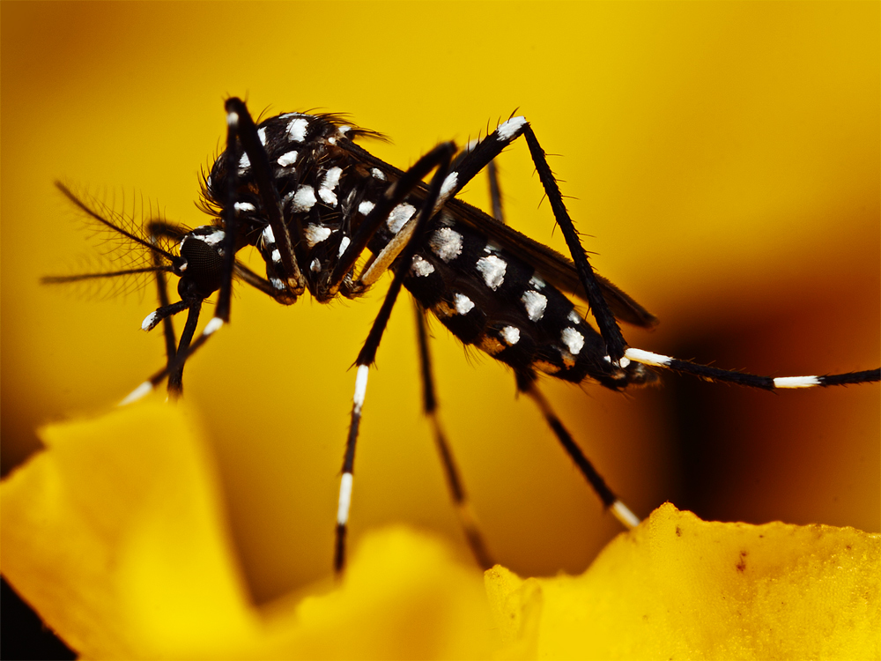
Mosquitoes

Slide 2
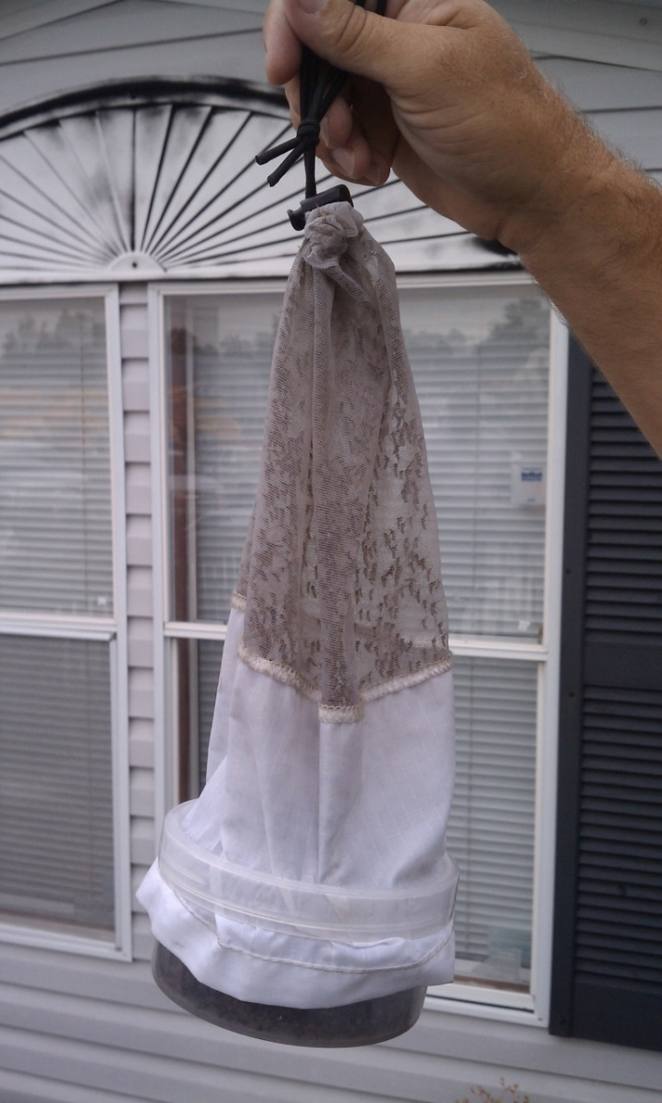
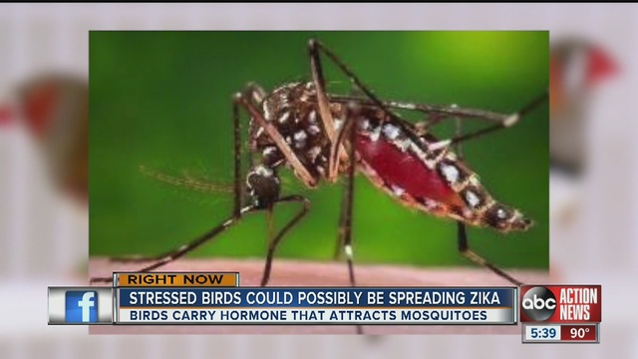
Why Mosquito Control???
Disease Potential
Nuisance Problems

Slide 3
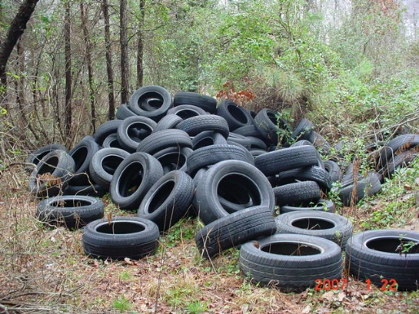
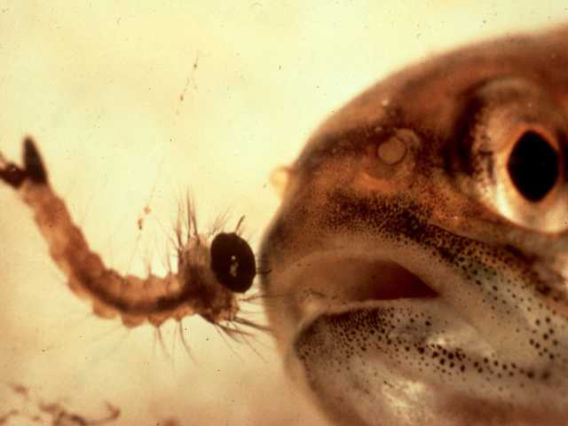
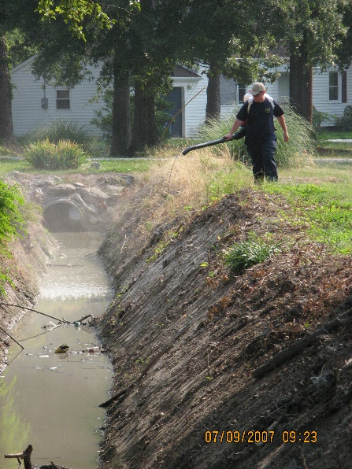
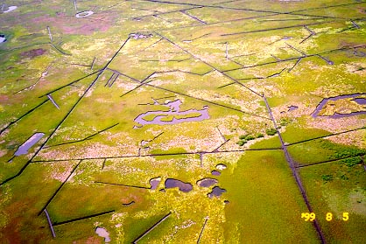
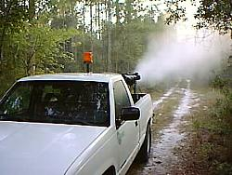
Integrated Pest Management
Outreach and Education
Surveillance
Source Reduction
Larvaciding
Adulticiding

Slide 4
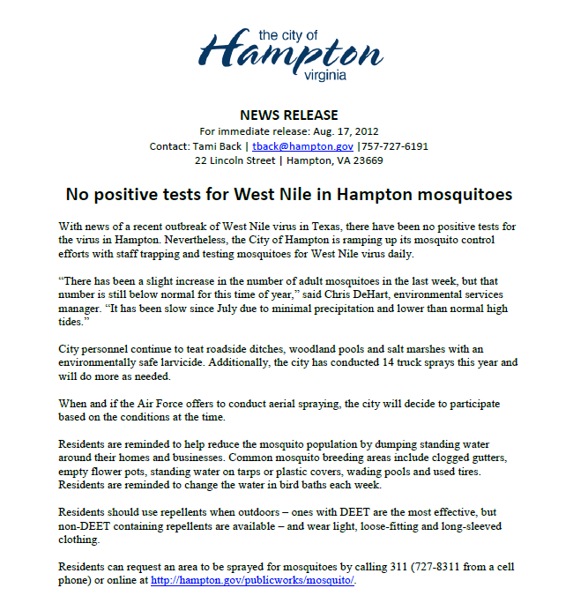
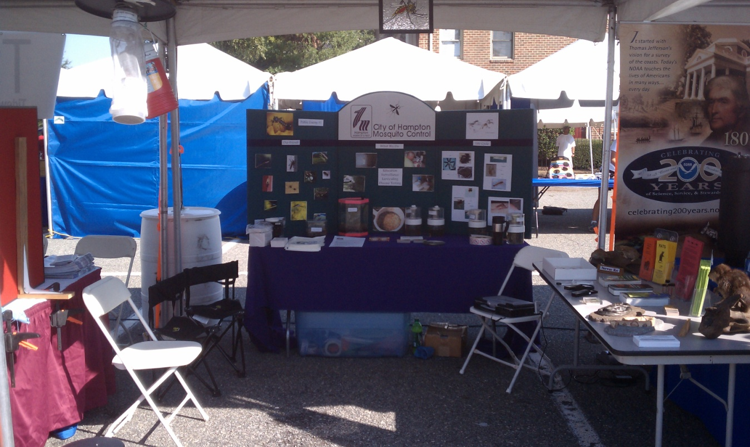
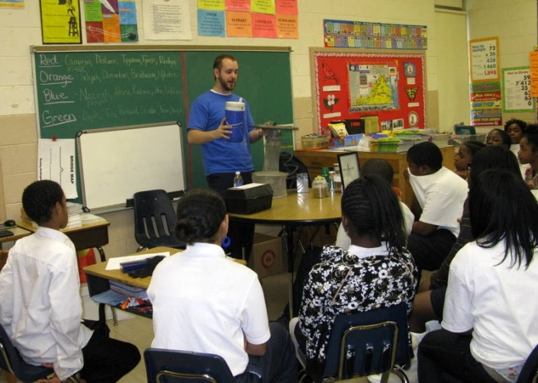
Outreach and Education
Community Outreach Programs
School Classes & Career Days
Local News Interviews
Press Releases
Notes:
The first piece of our program has to be Outreach and Education. This element focuses on getting information out to the public about what we do, who we are, and the services that they can expect from our program. In recent years, we have really stepped up on getting the message out utilizing the marketing company that is currently used by the City of Hampton. This company sends out regular emails to include routine scheduling of what we have planned, friendly reminders after heavy rain events, or any special announcements we want to get out to the public. In 2012, we put out 6 announcements trying to engage the public about spraying operations, the start of the asian tiger season, and rain event information. We also were in touch with the media twice early on in the season, and had our own Environmental Services Manager, Chris DeHart on the local program ‘Round Robin’ talking about the upcoming season. Other educational programs that we take part in is the local festivals such as Hampton Bay Days, and assisting in programs such as the Hampton Roads Public Works Academy where we talk to High School students about what we do. Another outreach program is the Beekeeper Program, which will be discussed later in the presentation.

Slide 5
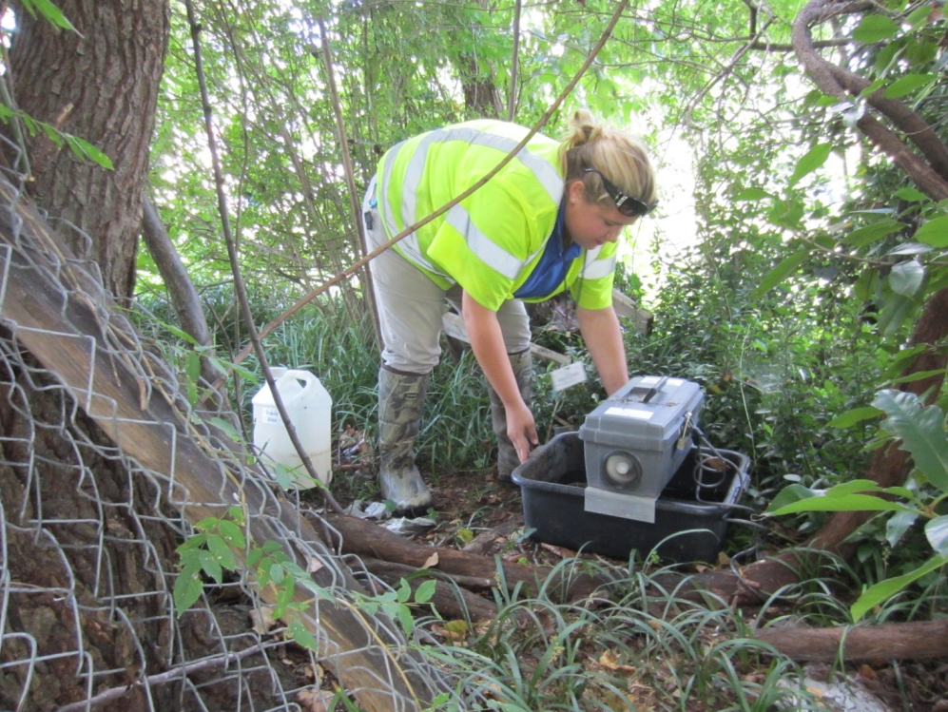
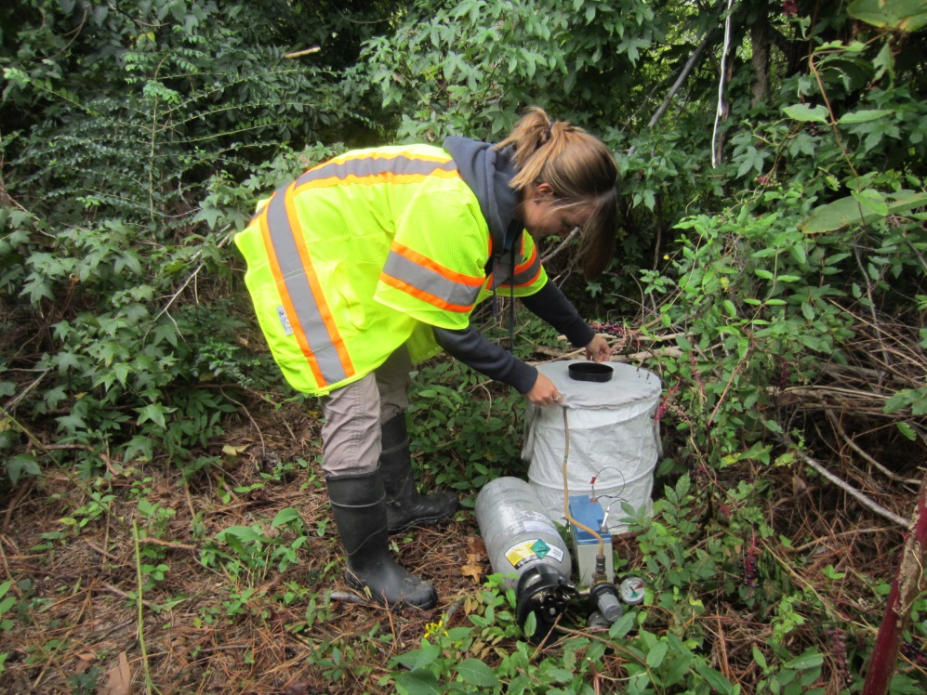
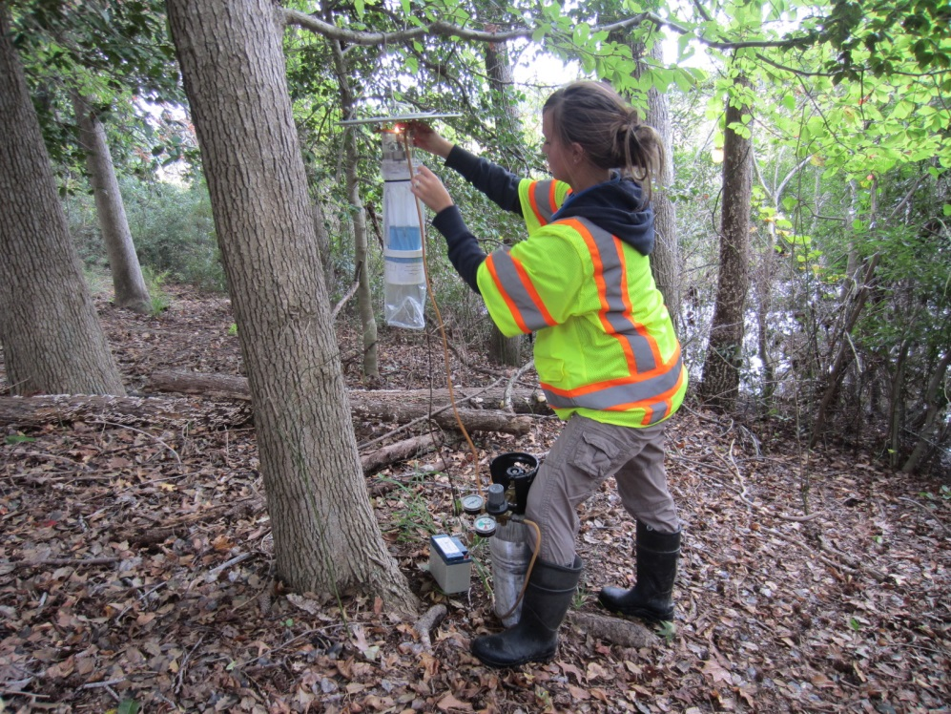
Surveillance
Trap Types
CDC Light Trap w/ CO2
- Set in wooded area
- Catches most species
Gravid Trap
- Set in urban area
- Specializes in catching WNV
carrying mosquitoes
BG Sentinel Trap
- Set in urban or suburban areas
- Specializes in catching Asian Tiger
or other peri-domestic mosquitoes
BG Sentinel Trap w/ Lures
CDC Light Trap w/ CO2
Gravid Trap

Slide 6
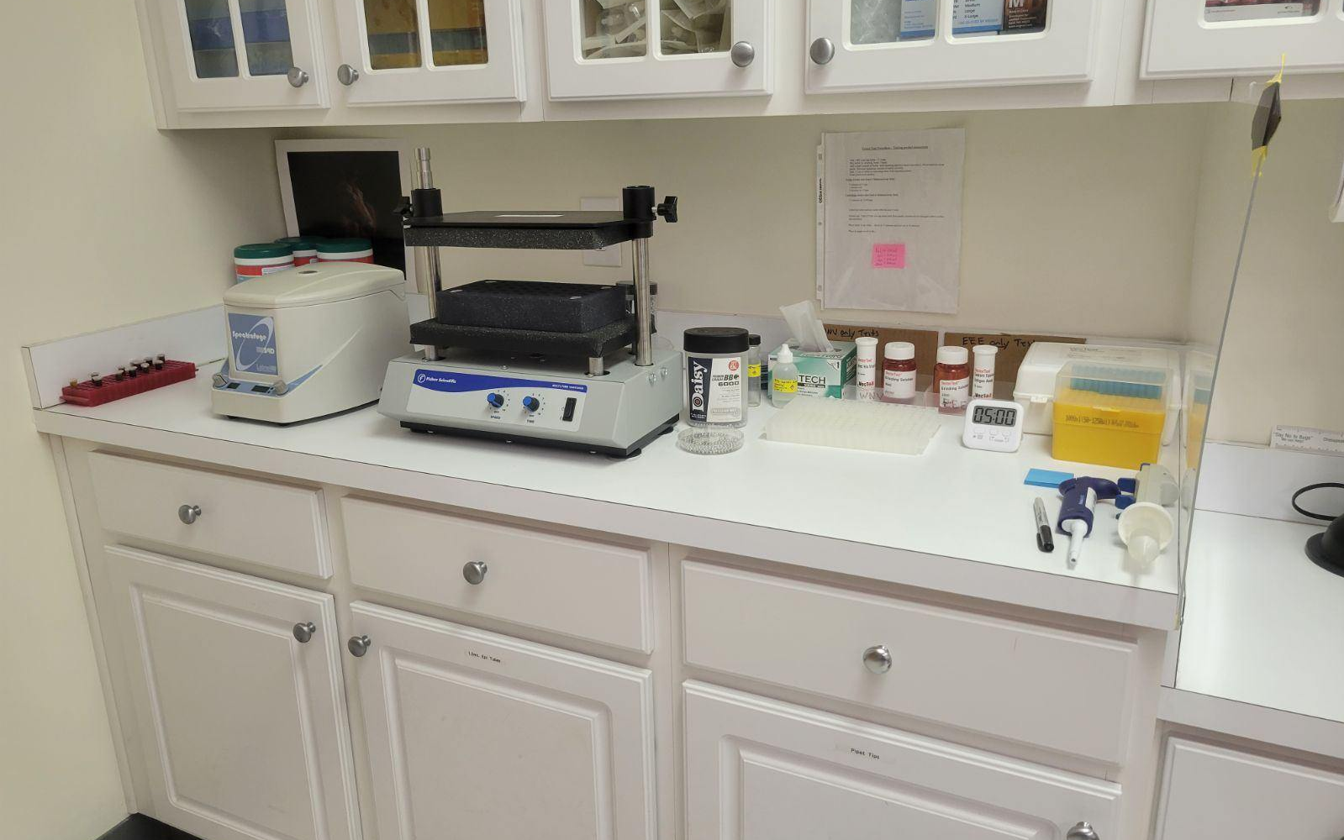
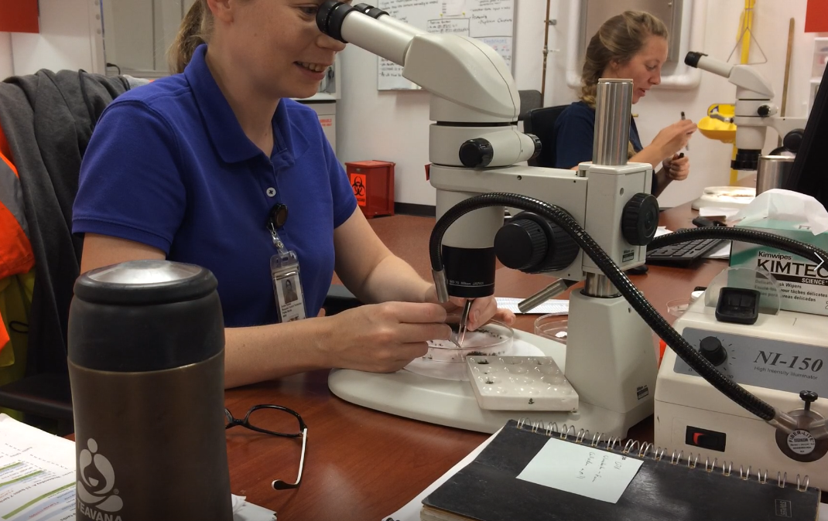
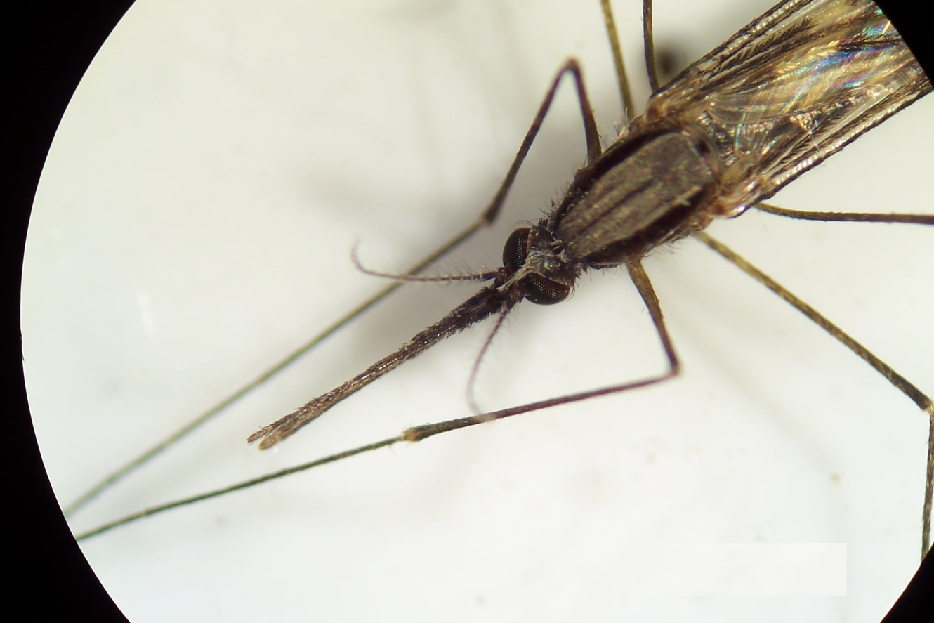
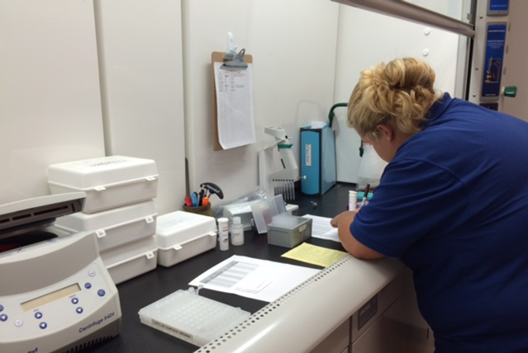
Surveillance

Slide 7
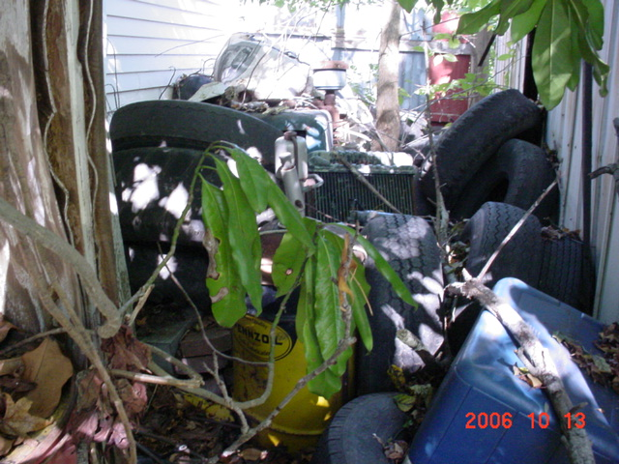
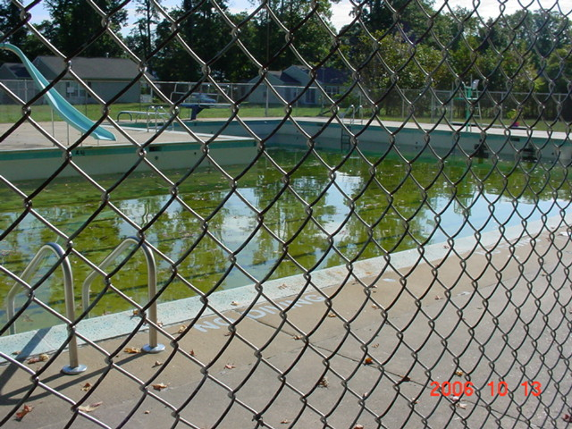
Source Reduction
Notes:
Source Reduction may be very labor intensive, but stopping the problem before it starts is always the best way to control a pest. Back Yard Inspections are common in our line of work, and finding one home in a neighborhood of very clean yards like this can cause an entire neighborhood to call for help. Assisting homeowners in realizing that their backyard can not only be a nuisance for visual issues, but also public health can be a giant leap in reducing a neighborhood wide problem. We can also work closely with Codes and Compliance in certain cities to help an area if a homeowner is being obstinate. (next picture) Tire piles can cause a big problem for us in the field, and can be just as difficult to stop as a citizen not willing to clean their property up. Some businesses may not want to pay the tire disposal fee and instead dump a load of tires off in the nearby wooded area out of sight. This may cause a bad mosquito problem, and finding the culprits may not be easy. (next picture) There are also sometimes public entities no longer able to run the neighborhood pool, and this issue may arise. While this can be hit or miss with mosquitoes due to the depth of the water, this can be an issue if left untreated or undrained. All these pictures show different circumstances that can all be boiled down to source reduction. Getting rid of the mosquito habitat before it becomes a problem.

Slide 8
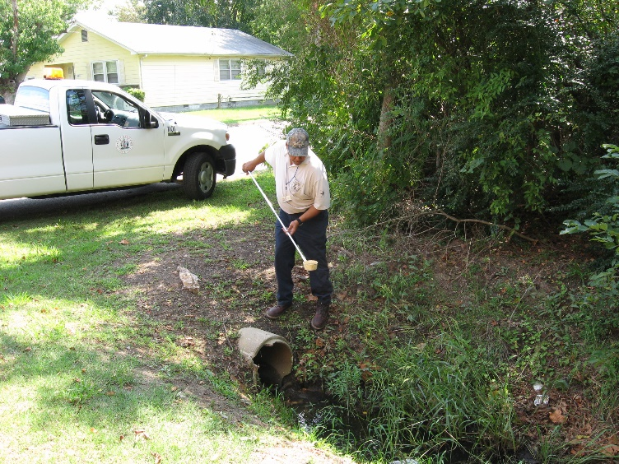
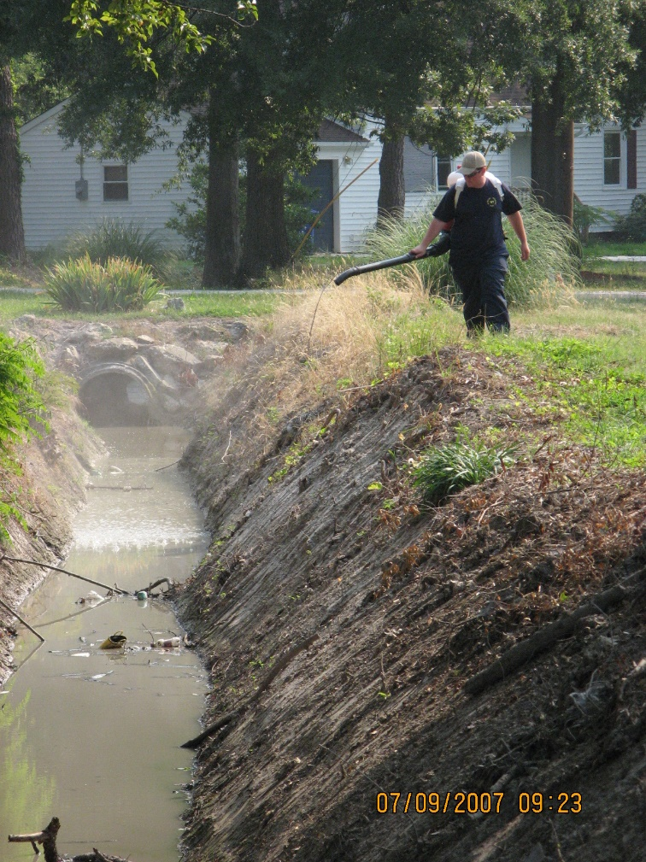
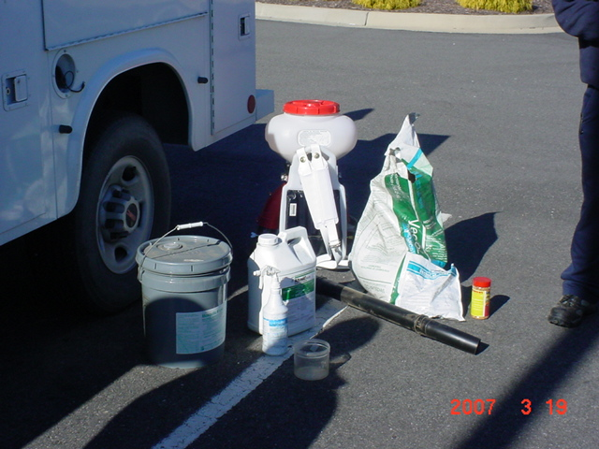
Larval Control with Pesticides
Notes:
While there are many different methods of application, and various pesticides out there that eliminate mosquito breeding, it also is important for the pest control operator to know which pesticides are best for the problem. Some pesticides allow the mosquito to develop late in the larval stage, but not mature into flying adults, while others act as a surfactant on the surface of the water, not allowing them to breathe. Others still can be eaten, with the result of an exploding gutwall, eliminating any mosquito that partakes. All pesticides though, should only be used after the pest control technician is certified and trained in order to reduce any possibility of harming the environment or other beneficial insects.

Slide 9
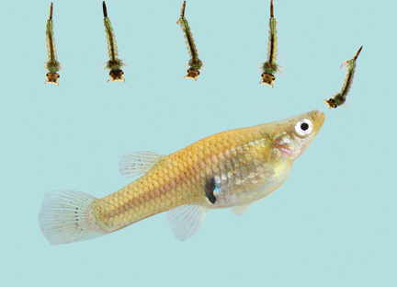
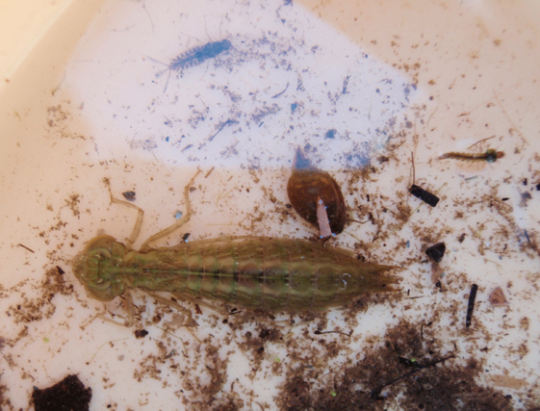
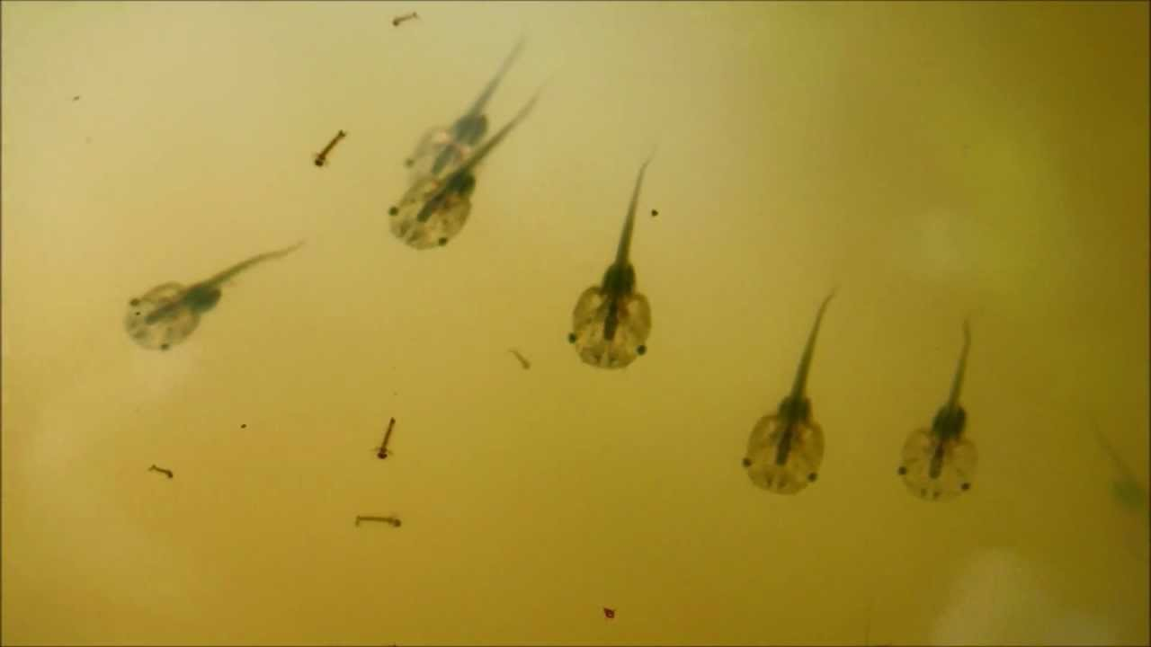
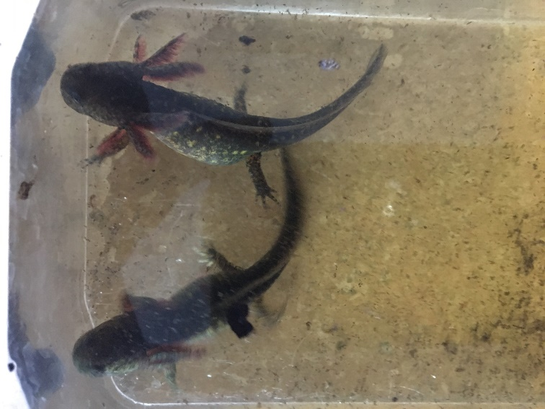
Biological Control
Notes:
There are many natural predators of mosquitoes out there such as bats, purple martins, dragonflies, etc. One method of larval control that is rarely used due to the time and effort into building the program, is using these natural predators to control mosquitoes at the larval stage. Dragonfly nymphs are extremely good at reducing larval numbers, and also eventually become adult dragonflies which also picks up mosquito larvae for food on a regular basis. Tadpoles are another great example of an efficient mosquito killer that can be found in the smallest mudpuddle, to the biggest ditch. Finding a mudpuddle that is drying up, and seeing hundreds of tadpoles can be looked at as free mosquito larvacide in the right eyes. Transferring those dying tadpoles to a larger body of water with mosquito larvae will not only help the future frogs, but also kill mosquitoes as well. And finally, mosquito fish are all the craze, and the easiest program to set up. They are very efficient at eliminating or reducing mosquito populations, and can be found outside of a fish farm, just about everywhere.

Slide 10
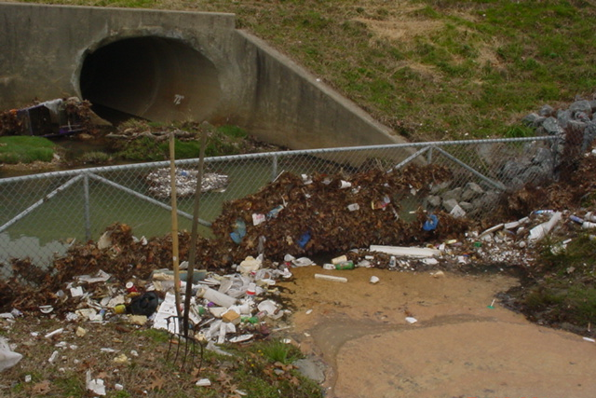
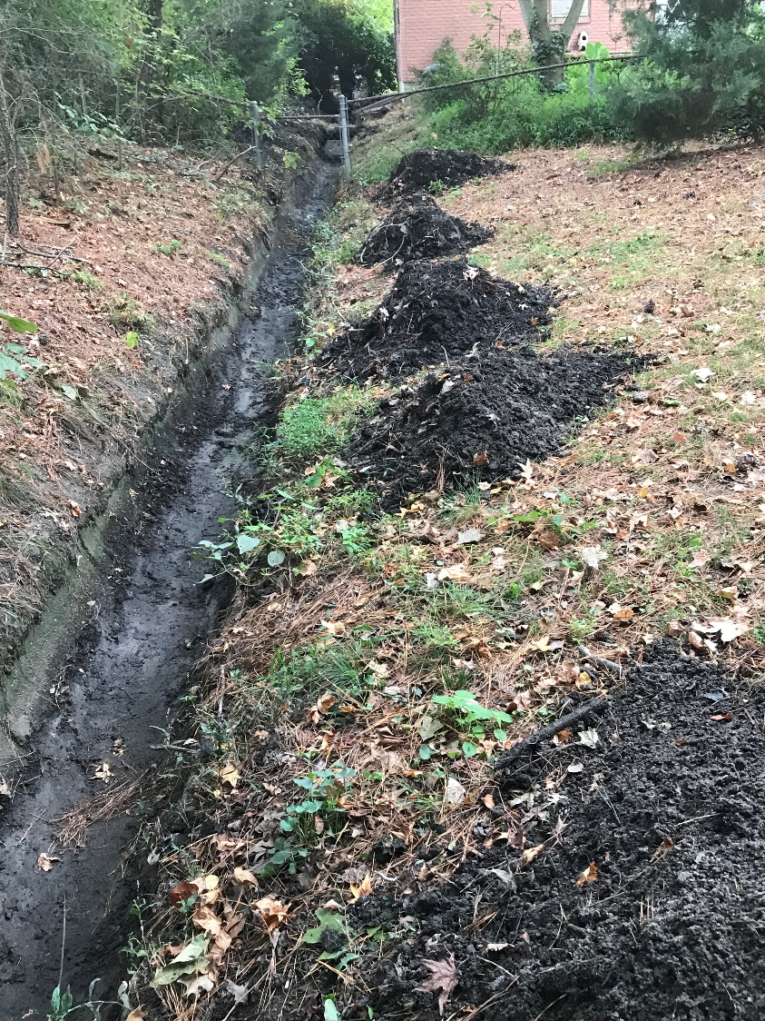
Mechanical Control
Notes:
Mechanical Control of mosquitoes is actually fairly common, and mostly involves removing debris from ditches that have standing water. Mostly, this task falls on the stormwater division of the city, which works closely with mosquito control at times. Other methods can be very complex and may involve heavy machinery such as the open marsh management pictured in the bottom right. This method involves large machinery to cut straight ditch lines through the open marsh to assist in getting tides in and out without leaving perfect mosquito habitats along the way. Fountains in ponds pictured in the bottom left assist in reducing algae and promote water flow creating a more inviting habitat for mosquito predators such as fish and drangonfly larvae.

Slide 11
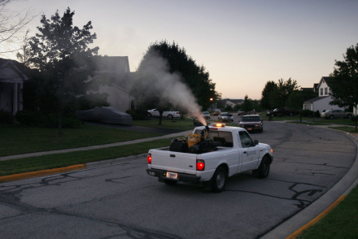
Adult Control with Pesticides
Notes:
What the public see’s more than anything in our job is actually our last measure to control mosquitoes before a major problem exists. Spraying from trucks in the evening, using helicopters or aircraft to put out pesticide to reduce mosquito populations are only reserved to help us when all other measures have been used. While most counties only have truck mounted sprayers that go out occasionally throughout the year, you may have seen an aircraft doing the same, to control a larger section of area for mosquito control.

Slide 12
Basic
Mosquito
Biology

Slide 13
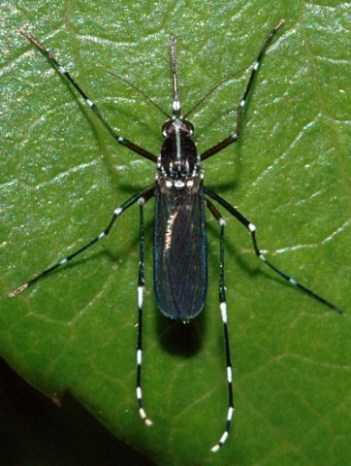
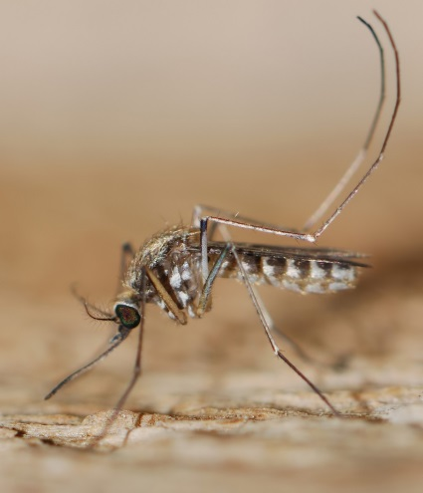
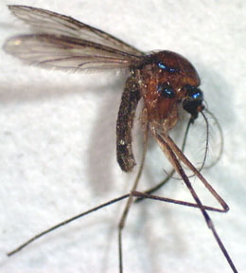
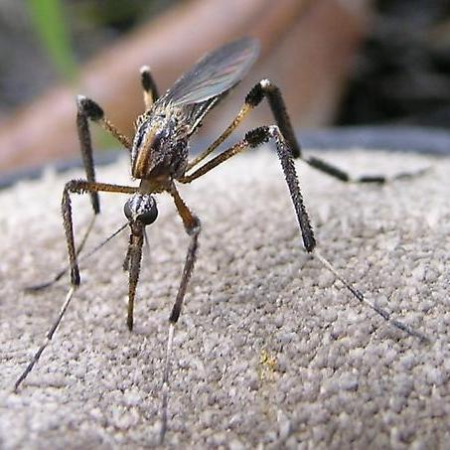
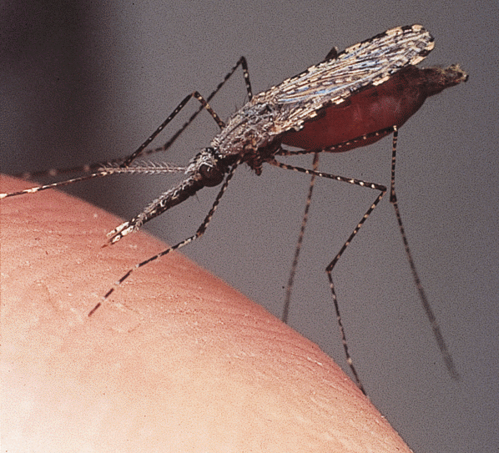
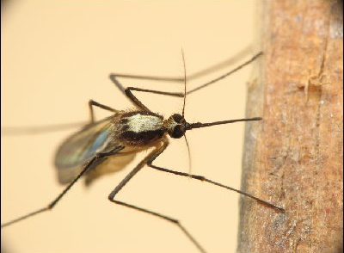
Mosquito Species
How many species of mosquito are there world-wide?
Over 1,500
Over 100
Over 3,000
Over 15,000

Slide 14
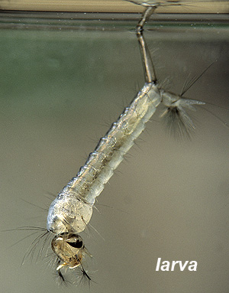
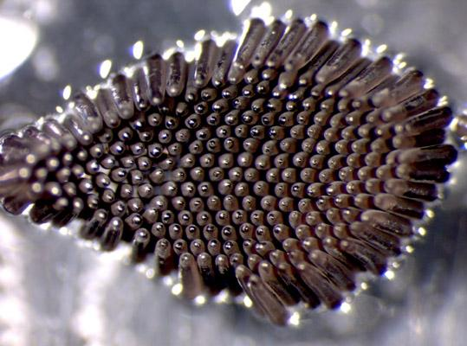
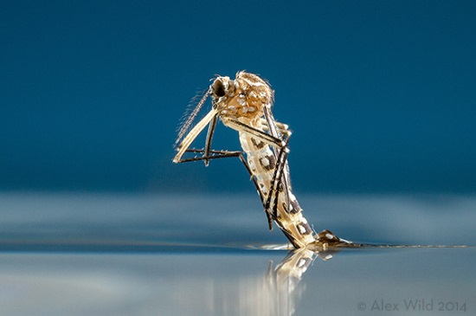
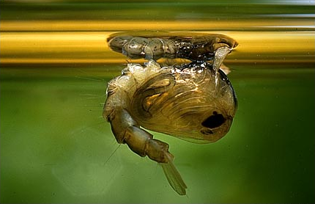
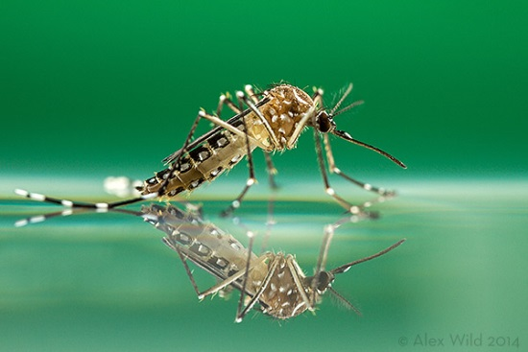
Mosquito Life Cycle

Slide 15
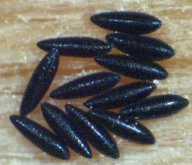
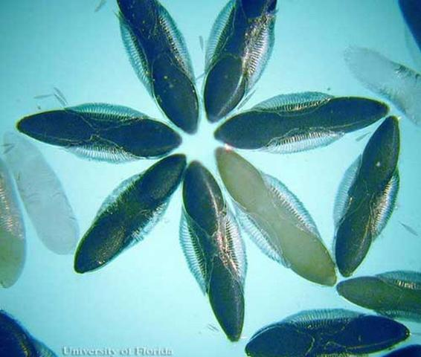
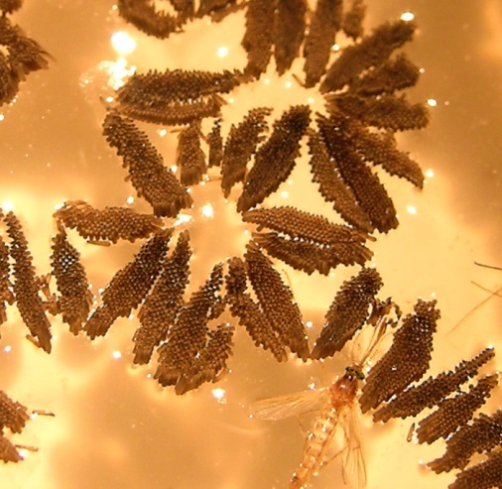
Mosquito Life Cycle
Eggs - Larva - Pupa - Adult
Aedes
Anopheles
Culex

Slide 16
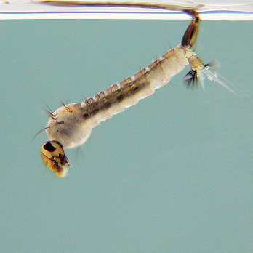
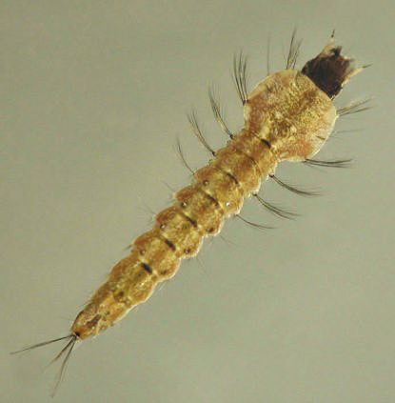
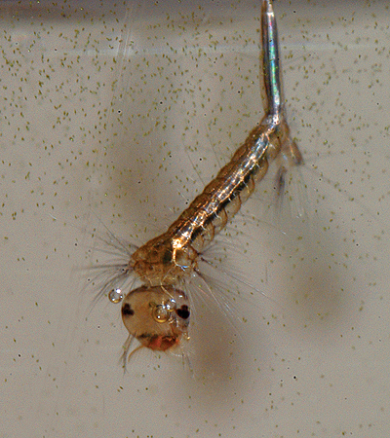
Mosquito Life Cycle
Eggs - Larva - Pupa - Adult
Aedes
Anopheles
Culex

Slide 17
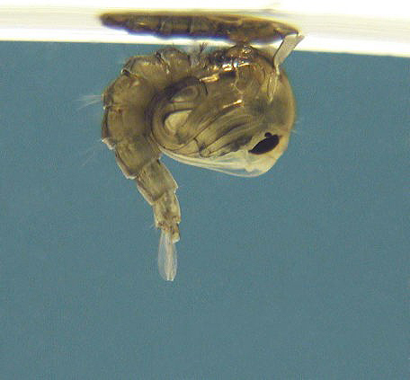
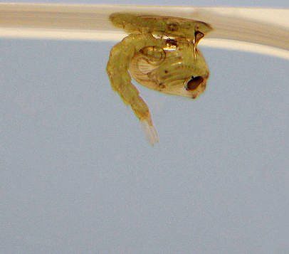
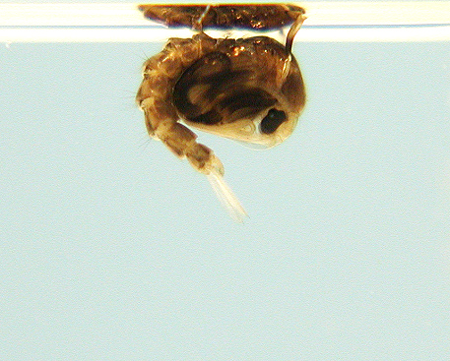
Mosquito Life Cycle
Eggs - Larva - Pupa - Adult
Aedes
Anopheles
Culex

Slide 18
Mosquito Life Cycle
Eggs - Larva - Pupa - Adult
Aedes
Anopheles
Culex

Slide 19
Morphological Features
Proboscis
Long palps &
“Fuzzy” Antennae
Maxillary palp
Antenna
Head
Thorax
Wings
Abdomen
Haltere
(8 segments)
6 Legs
Smaller

Slide 20
Identifying Characteristics Head – Palpi Length

Slide 21
Identifying Characteristics Head – Banding

Slide 22
Identifying Characteristics Thorax
Setae
Scales

Slide 23
Identifying Characteristics Thorax - Wings

Slide 24
Identifying Characteristics Thorax - Legs
Basal – Towards the Body
Apical – Away - Towards the Outside
Basal – Below
Apical – Above

Slide 25
Identifying Characteristics Abdomen - Banding

Slide 26
Identifying Characteristics Abdomen - Shape
Anopheles
Culex
Culiseta
Coquillitedia
Orthopodomyia
Uranitaenia
Psorophora
Aedes
Long “Phel”-ers
Rounded Letters
Equal
Rounded Abdomens
Pointed Abdomens

Slide 27
Mosquito Borne Diseases

Slide 28
Threats Posed
• Nuisance Levels
• Disease Potential
- West Nile Virus
- Eastern Equine Encephalitis
- Dog Heartworm
- LaCrosse Encephalitis
- St. Louis Encephalitis
- Chikungunya
- Malaria
- Dengue Fever
- Yellow Fever
ZIKA!!!

Slide 29
Transmission Cycle

Slide 30
West Nile Virus
• 70-80% people non-symptomatic
• 20-30% people have fever, mild flu
• Less than 1% have severe symptoms
• Can affect Horses if not vaccinated
• Symptoms: stumbling, impaired coordination, weak limbs
extremely high fever with quick onset.
Eastern Equine Encephalitis
• Mainly affects Horses
• Horse Vaccines are readily available
• Symptoms: stumbling, impaired coordination, weak limbs,
no fever.
• If humans are infected, 33% chance of having encephalitis

Slide 31
Dog Heartworm
• Endemic in the area
• Medication readily available to prevent heartworm
• Can infect Felines with no treatment available

Slide 32
ZIKA Virus
• Human to Human transmission cycle
• Primary vector habitat in close proximity
• Virus on-set vs. Transmission cycle
• Other modes of transmission

Slide 33
Questions???

