Slide 1
Genus: Psorophora
Penelope Smelser, Environmental Health Specialist
Norfolk Department of Public Health
757-683-8662
Penelope.Smelser@Norfolk.gov

Slide 2
Species
Psorophora ciliata
Psorophora howardii
Psorophora ferox
Psorophora columbiae

Slide 3
Habitat
Woodland Pools
Floodwater
Brackish Water

Slide 4
Behavior
Voracious Biters
Mostly Confined to Wooded Areas
Long Flight Ranges
Low Disease Transmittal Rates
Collected Mainly in CDC Light Traps and BG Sentinel Traps

Slide 5
Characteristics
Pointed Abdomen
Apical Banding on the Abdomen
Above Average Size
Accelerated Life Cycle
Eggs can withstand long periods of dessication

Slide 6
Psorophora ciliata
Very Large
Gold Stripe on Top of Thorax
Gold Scales on the Proboscis
Shaggy/Feathery Dark Leg Scales

Slide 7
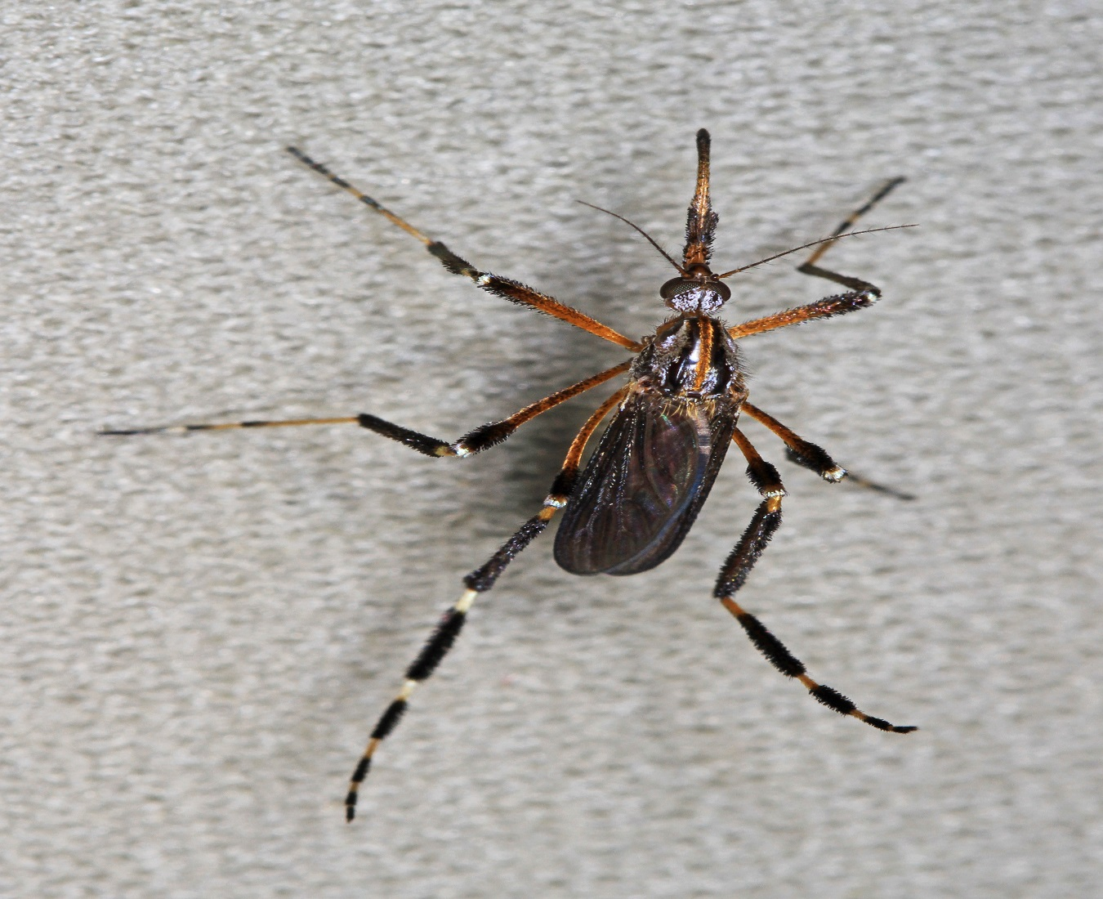
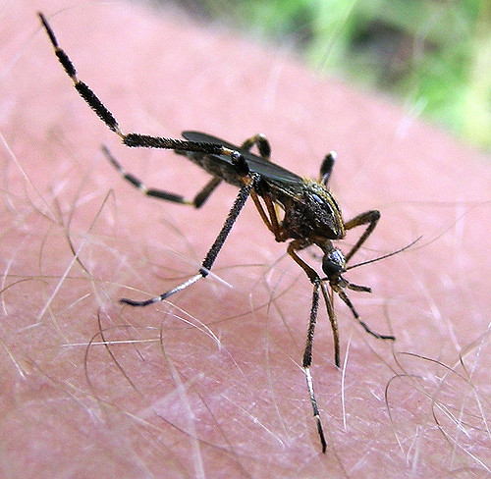
Long Shaggy Leg Scales
Gold Stripe

Slide 8
Psorophora howardii
Very Large
NO Gold Stripe on Top of Thorax
Proboscis uniformly dark
Dark Leg Scales but NOT Shaggy

Slide 9
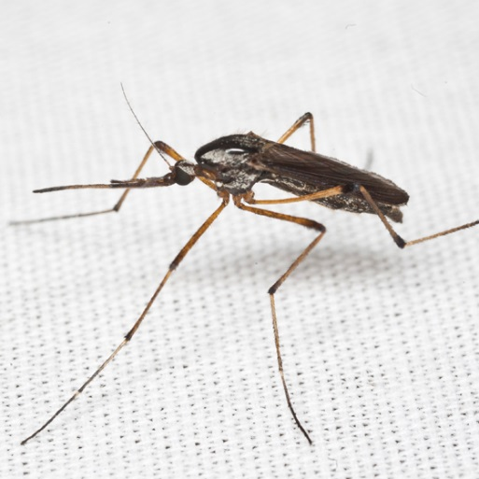
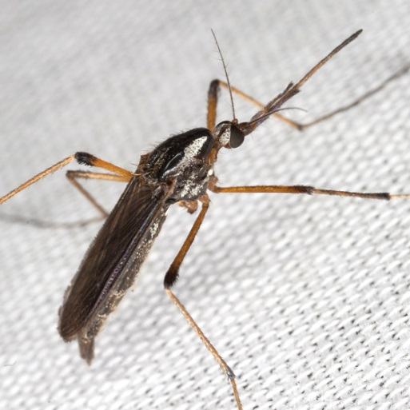
No Gold Stripe
No Gold Band
Leg Scales Less Shaggy

Slide 10
Psorophora ferox
Pointed Abdomen with Gold Apical Banding
Scutum speckled with brown and gold scales
Overall Purple Coloring
“Rainbow” Eyes
White “socks”

Slide 11
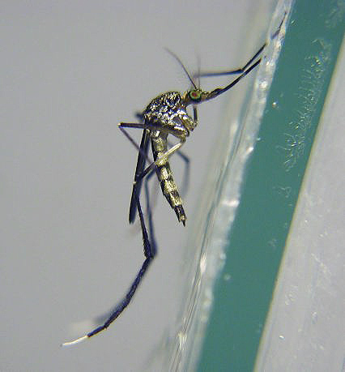
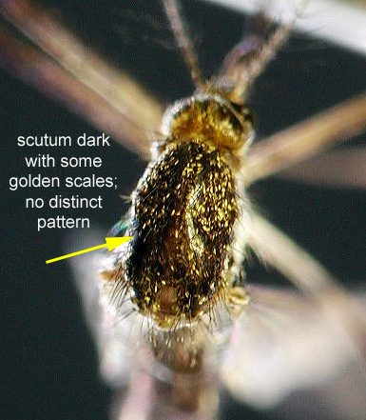
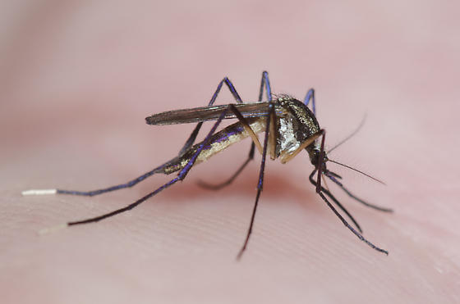
White “Socks”

Slide 12
Psorophora columbiae
White and Black Wing Scales
Pale Band on Proboscis
White Tips on Palps
Banded Legs
Dark Brown/Black
Incomplete white apical bands on abdomen

Slide 13
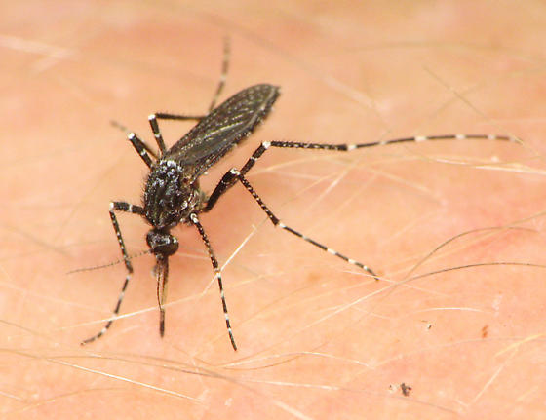
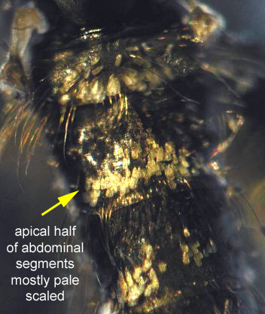
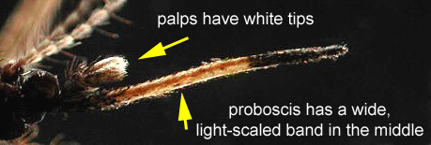
Dark and Light Wing Scales

