Slide 1
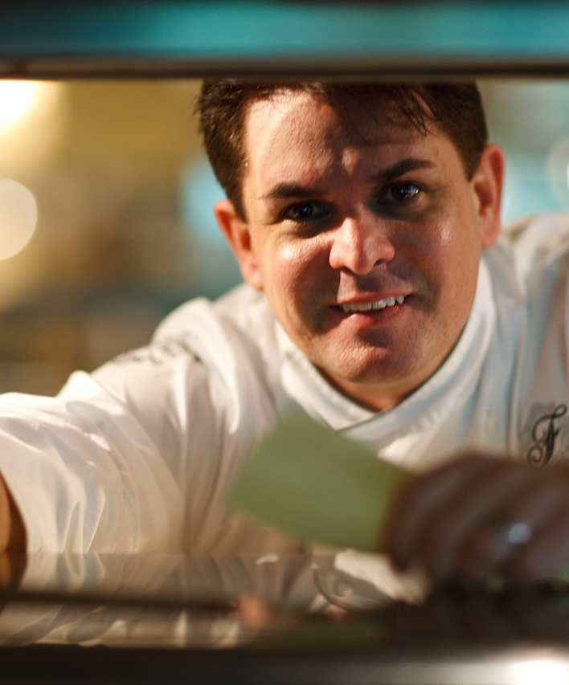

CHEF
PATRICK DUFF
CULINARY LEADERSHIP PORTFOLIO
Executive Chef / Director of Culinary
From dishwasher to international luxury hotel leader.
Phuket, Thailand
Notes:
Core sources: user-supplied Culinary Leadership Portfolio, Chef CVs, GM/RM CVs, Patrick Duff BIO 2026, testimonials, hospitality archive and the Ultra-Luxury Culinary Leadership evaluation framework. Photographs are embedded from user-supplied files only. Career and performance statements are candidate-supplied and have not been independently audited. Portrait: image1.jpg extracted from the user-supplied source PPTX. PD monogram extracted from the attached Patrick Duff BIO 2026 PDF.

Slide 2
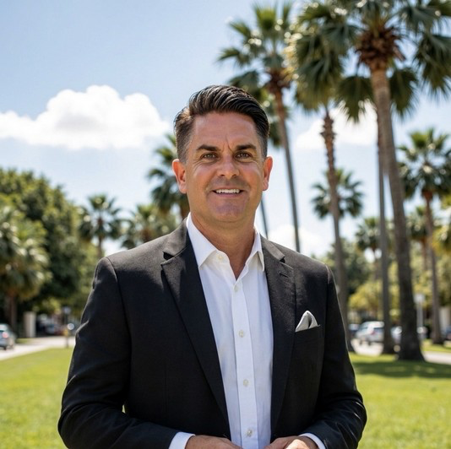
EXECUTIVE PROPOSITION
A chef who understands the whole hotel
A rare progression: kitchen craft to hotel-wide leadership.
From Executive Chef and F&B Director to Resort Manager, Hotel Manager and General Manager assignments, Patrick brings culinary credibility together with full-hotel operating judgment. The result: guest experience, team capability and commercial performance considered as one agenda.
13
7
50+
20+
COUNTRIES
HOTEL PRE-OPENINGS
AWARDS AND MEDALS
YEARS IN LUXURY HOSPITALITY
MAY 2026 - PRESENT
Director of Culinary, in Charge of Food & Beverage
CHEF PATRICK DUFF
02
Notes:
Core sources: user-supplied Culinary Leadership Portfolio, Chef CVs, GM/RM CVs, Patrick Duff BIO 2026, testimonials, hospitality archive and the Ultra-Luxury Culinary Leadership evaluation framework. Photographs are embedded from user-supplied files only. Career and performance statements are candidate-supplied and have not been independently audited. Current confidential international luxury resort pre-opening appointment and May 2026 start were confirmed by the user. Property and ownership remain intentionally withheld.

Slide 3
LEADERSHIP FOUNDATION
From dishwasher to hotel executive
A career built from the kitchen floor upward—and broadened across the hotel.
01
02
03
04
05
Kitchen foundation
Formal training
Executive Chef
Culinary and F&B
Hotel leadership
Dishwasher and early kitchen roles
Culinary Institute of America, AOS
Multi-outlet luxury hotels and resorts
Director-level commercial responsibility
Hotel Manager, Resort Manager and GM assignments
CIA credentials
Dean's List, GPA 3.8, perfect attendance and class graduation speaker.
Conversational Thai
CHEF PATRICK DUFF
03
Notes:
Core sources: user-supplied Culinary Leadership Portfolio, Chef CVs, GM/RM CVs, Patrick Duff BIO 2026, testimonials, hospitality archive and the Ultra-Luxury Culinary Leadership evaluation framework. Photographs are embedded from user-supplied files only. Career and performance statements are candidate-supplied and have not been independently audited.

Slide 4
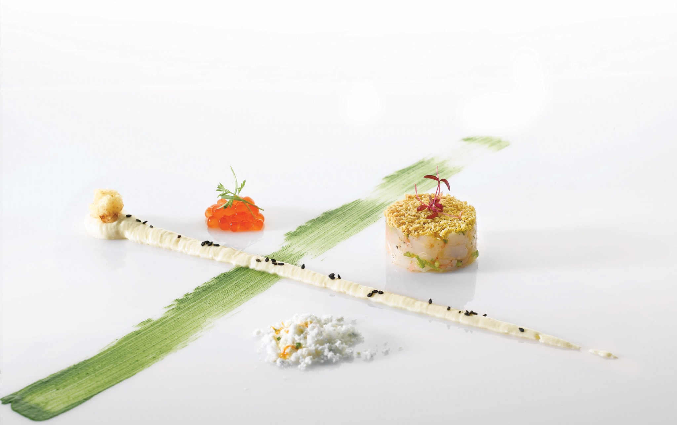
CULINARY CRAFT
Precision before ornament
Shrimp and salsify
Composition, texture and controlled color. The plate is disciplined, readable and designed for the guest, not the photograph.
Culinary creation by Chef Patrick Duff
CHEF PATRICK DUFF
04
Notes:
Core sources: user-supplied Culinary Leadership Portfolio, Chef CVs, GM/RM CVs, Patrick Duff BIO 2026, testimonials, hospitality archive and the Ultra-Luxury Culinary Leadership evaluation framework. Photographs are embedded from user-supplied files only. Career and performance statements are candidate-supplied and have not been independently audited.

Slide 5
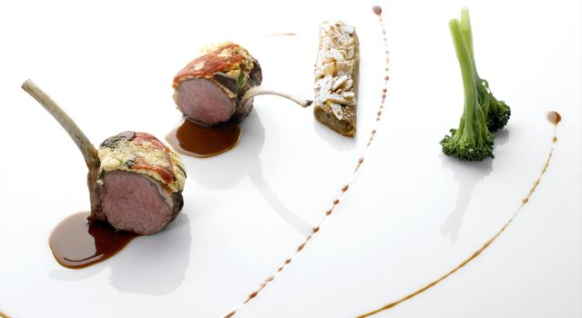
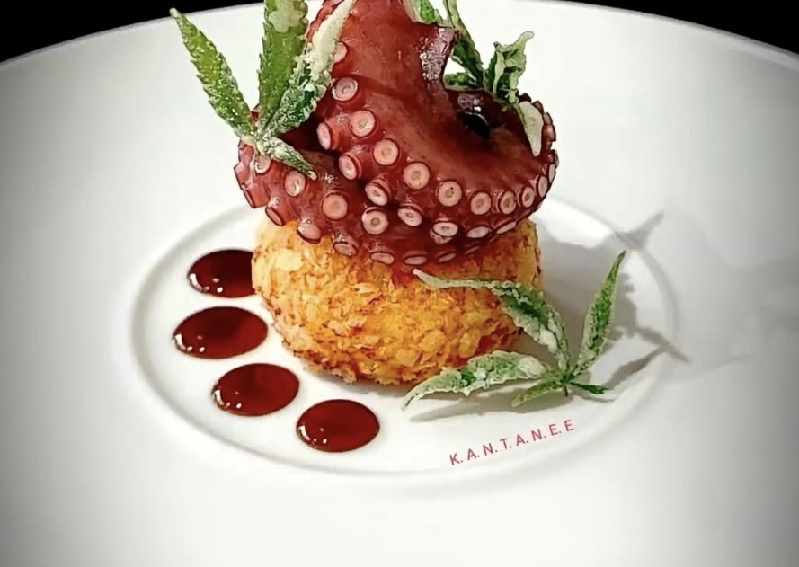
SELECTED CULINARY WORK
Classical technique, individual expression
Octopus
Original culinary work by Chef Patrick Duff
Moroccan-spiced rack of lamb
Feta crust, potato and eggplant bistilla, pomegranate molasses
CHEF PATRICK DUFF
05
Notes:
Core sources: user-supplied Culinary Leadership Portfolio, Chef CVs, GM/RM CVs, Patrick Duff BIO 2026, testimonials, hospitality archive and the Ultra-Luxury Culinary Leadership evaluation framework. Photographs are embedded from user-supplied files only. Career and performance statements are candidate-supplied and have not been independently audited.

Slide 6
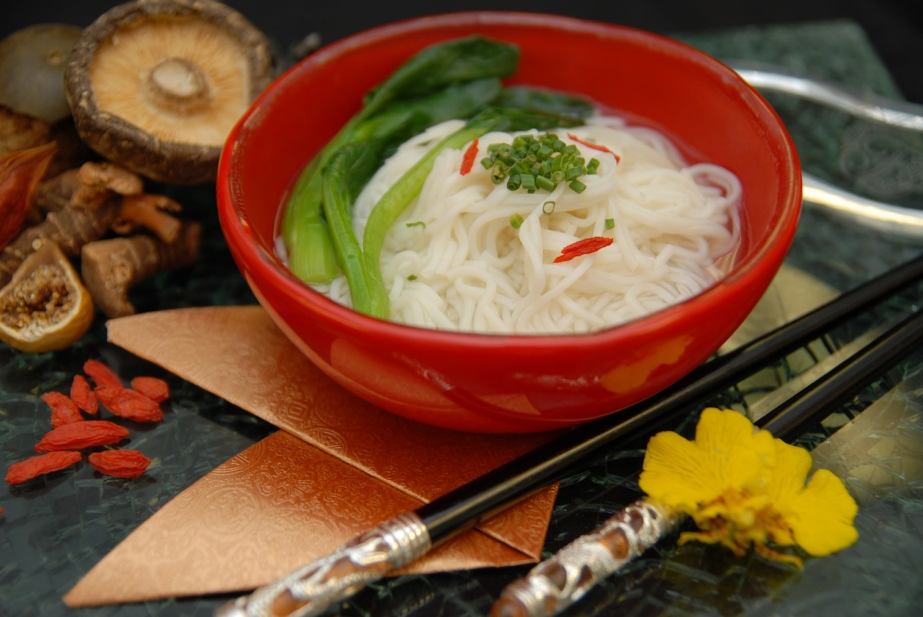
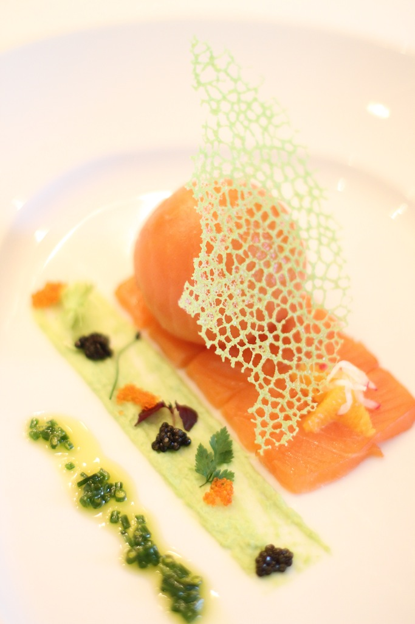
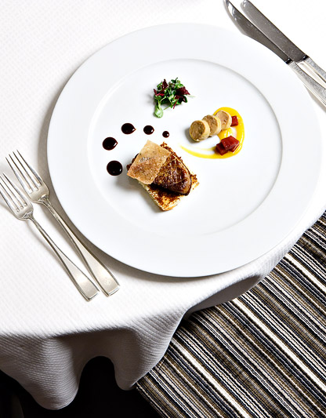
SELECTED CULINARY WORK
Range without losing the standard
Asian noodle presentation
Salmon bomb
Foie Steak House
Contrasting cuisines and service styles, using Patrick's original food photography.
CHEF PATRICK DUFF
06
Notes:
Core sources: user-supplied Culinary Leadership Portfolio, Chef CVs, GM/RM CVs, Patrick Duff BIO 2026, testimonials, hospitality archive and the Ultra-Luxury Culinary Leadership evaluation framework. Photographs are embedded from user-supplied files only. Career and performance statements are candidate-supplied and have not been independently audited.

Slide 7
COMMERCIAL PERFORMANCE
Commercial results built on quality and execution
+22%
38% → 46%
F&B REVENUE | FAIRMONT DUBAI
F&B GOP | W TAIPEI
12 restaurants · 500+ colleagues · approximately 47% average F&B GOP over three years
Beverage sales +20% through venue strategy, cost discipline and commercial partnerships
33% → 42%
37% → 40%
HOTEL GOP | SWISSÔTEL NAI LERT PARK
F&B GOP | MAKATI SHANGRI-LA
Rooms upgrades, incentives and growth in restaurant, banquet and local corporate business
F&B revenue +12% in the first three months through new streams, retail and targeted marketing
Selected results from distinct senior roles; figures are candidate-supplied and retain their original property context.
CHEF PATRICK DUFF
07
Notes:
Core sources: user-supplied Culinary Leadership Portfolio, Chef CVs, GM/RM CVs, Patrick Duff BIO 2026, testimonials, hospitality archive and the Ultra-Luxury Culinary Leadership evaluation framework. Photographs are embedded from user-supplied files only. Career and performance statements are candidate-supplied and have not been independently audited. Results and property contexts are transcribed from the supplied Executive CVs. Fairmont Dubai F&B revenue growth exceeded 22%; average GOP was approximately 47% over three years. W Taipei F&B GOP increased from 38% to 46% and beverage sales by 20%. Swissôtel Nai Lert Park hotel GOP rose from 33% to 42%. Makati Shangri-La F&B GOP rose from 37% to 40%, with F&B revenue up 12% in the first three months.

Slide 8
PLANNING THROUGH OPENING
Seven openings: from construction to first service
4
3
Selected project evidence
PROJECTS LED
ADDITIONAL OPENINGS SUPPORTED
01
Fairmont Beijing
Led culinary opening readiness for Fairmont’s first hotel in China.
02
NAAMA Beach Villas
44-villa pre-opening: recruited leaders, built SOPs and led trials through construction delays.
03
Regent Hong Kong
Five-outlet transition: established concepts and menus through operating handover.
“His passion for food & the industry was like no other.”
Graham Kruse, Sous Chef, Fairmont Beijing pre-opening
CHEF PATRICK DUFF
08
Notes:
Core sources: user-supplied Culinary Leadership Portfolio, Chef CVs, GM/RM CVs, Patrick Duff BIO 2026, testimonials, hospitality archive and the Ultra-Luxury Culinary Leadership evaluation framework. Photographs are embedded from user-supplied files only. Career and performance statements are candidate-supplied and have not been independently audited. Seven projects, including four led and three supported, were confirmed by the user. Exact excerpt from Graham Kruse testimonial in Chef Duff Testamonials(1).pdf, describing the Fairmont Beijing pre-opening.

Slide 9
SELECTED TESTIMONIALS
Senior references: people, business and guest impact
“Patrick Duff exemplifies everything you want in a top Executive Chef today.”
“The Latin-Asian food concept was well accepted by guests and patrons alike.”
Ricardo Acevedo, General Manager
Philip M. Barnes
Four Seasons Hotel Mexico
Vice President & General Manager, Fairmont Pacific Rim
LEADERSHIP JUDGMENT
PEOPLE & CULTURE
“Patrick knows when he needs to be flexible and when he needs to take a stand for the business.”
“Chef Duff virtually re-built the culinary department from scratch.”
Tim Steckbeck, Vice President
Martin Büchele, Chef de Cuisine, Spectrum on One, Fairmont Dubai
Historical testimonials supplied by the candidate. Titles are reproduced as stated in the source documents.
CHEF PATRICK DUFF
09
Notes:
Core sources: user-supplied Culinary Leadership Portfolio, Chef CVs, GM/RM CVs, Patrick Duff BIO 2026, testimonials, hospitality archive and the Ultra-Luxury Culinary Leadership evaluation framework. Photographs are embedded from user-supplied files only. Career and performance statements are candidate-supplied and have not been independently audited. Four selected references. Philip M. Barnes, Ricardo Acevedo, and Martin Büchele excerpts come from Chef Duff Testamonials(1).pdf. Ricardo Acevedo, Four Seasons Hotel Mexico, provides the Four Seasons concept testimonial. The source uses the title Director General; the slide renders this as General Manager at the user’s direction. Martin Büchele is the author of the Fairmont Dubai testimonial on department rebuilding. The Tim Steckbeck quote is exact from Reference 2 - Patrick Duff 2(3).pdf; public attribution is Tim Steckbeck, Vice President, with no company listed.

Slide 10
SELECTED REFERENCES
Tim Steckbeck’s reference
“Absolutely! I enthusiastically recommend Patrick.”
PEOPLE LEADERSHIP
“Good at attracting and developing talent”; led by example and motivated others.
EXECUTIVE RELATIONSHIPS
Strong relationships with sous-chefs and Executive Committee colleagues.
Tim Steckbeck
FINANCIAL CONTROL
Vice President
“Usually would know his costs before the Controller posted.”
Reference dated 24 April 2013
BUSINESS JUDGMENT
“Knows when he needs to be flexible” and when to stand firm for the business.
PEOPLE LEADERSHIP
FIVE-DIAMOND STANDARD
“Able to motivate and inspire others.”
The reference states the hotel moved from four to five diamonds during their tenure.
CHEF PATRICK DUFF
10
Notes:
Core sources: user-supplied Culinary Leadership Portfolio, Chef CVs, GM/RM CVs, Patrick Duff BIO 2026, testimonials, hospitality archive and the Ultra-Luxury Culinary Leadership evaluation framework. Photographs are embedded from user-supplied files only. Career and performance statements are candidate-supplied and have not been independently audited. Reference 2 - Patrick Duff 2(3).pdf is dated 24 April 2013. Public attribution is shown as requested: Tim Steckbeck, Vice President, with no company listed. Reference details are paraphrased or quoted faithfully. The four-to-five-diamond statement is attributed to the reference period and does not claim sole causation.

Slide 11
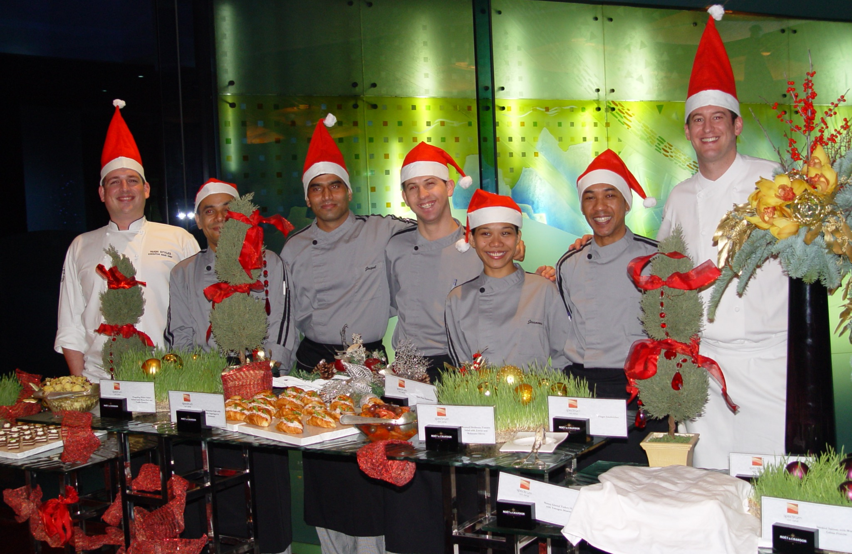
PEOPLE DEVELOPMENT
Build teams that perform—and advance
The strongest measure of leadership is who advances next.
FAIRMONT DUBAI
20+ managers, chefs and colleagues promoted
A reference reports 70% of leaders internally promoted
One-year entry-level culinary program; five Thai colleagues later progressed to international roles
Regular in-house “Iron Chef” sessions turned standards into practical coaching
“One of the main reasons why I am inspired to work every day is because of Chef Duff.”
Fairmont Dubai culinary colleague, quoted in Girlie Datar-Abellana’s testimonial
CHEF PATRICK DUFF
11
Notes:
Core sources: user-supplied Culinary Leadership Portfolio, Chef CVs, GM/RM CVs, Patrick Duff BIO 2026, testimonials, hospitality archive and the Ultra-Luxury Culinary Leadership evaluation framework. Photographs are embedded from user-supplied files only. Career and performance statements are candidate-supplied and have not been independently audited. Team photograph extracted from the user-supplied source PPTX. Exact frontline-colleague quote reproduced within Girlie Datar-Abellana’s testimonial in Chef Duff Testimonials (1).pdf. The testimonial states that 70% of leaders had been internally promoted; the CV reports more than 20 managers, chefs and colleagues promoted. Five Thai colleagues progressing to international roles and the one-year program were confirmed by the user. In-house Iron Chef sessions are described in Philip M. Barnes’s testimonial. The photo is not labeled as the Presidential Award team.

Slide 12
STRUCTURED LEARNING
Training designed to outlast the individual chef
ONE-YEAR ENTRY-LEVEL CULINARY PROGRAM
Created in Dubai to build practical skill, confidence and accountability through structured learning.
0-90 DAYS
SKILL ROTATION
SUPERVISORY DEPTH
COMPETITION READY
Induction, shadowing, clear objectives and practical assessment
Core techniques, outlet exposure and cross-training
Coaching, feedback and first leadership responsibility
Internal challenges and sanctioned competition preparation
5
Thai colleagues later progressed to international roles with different companies.
The team also received Presidential Award recognition.
CHEF PATRICK DUFF
12
Notes:
Core sources: user-supplied Culinary Leadership Portfolio, Chef CVs, GM/RM CVs, Patrick Duff BIO 2026, testimonials, hospitality archive and the Ultra-Luxury Culinary Leadership evaluation framework. Photographs are embedded from user-supplied files only. Career and performance statements are candidate-supplied and have not been independently audited. The one-year Dubai program and its structure are candidate-supplied. The user confirmed five international progressions with different companies and Presidential Award recognition. No award-team photograph is available in the supplied files.

Slide 13
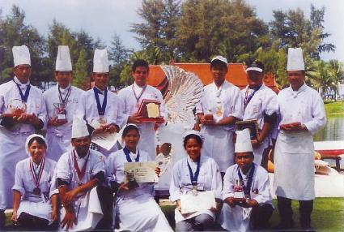
AWARDS AND CREDENTIALS
Professional standing backed by documented work
50+
SELECTED DOCUMENTED RECOGNITION
American Culinary Federation
Certified Executive Chef
1995 Ice Carving Competition
First place
1996 Annual Ice Carving Competition
Winner
“Best Chef in St. Maarten”
Caribbean Culinary Association
International culinary competition judge
awards and medals with teams and individually
15
solo medals
Competition team, medals and ice-carving display
Competition work served as a practical development platform for the culinary team.
CHEF PATRICK DUFF
13
Notes:
Core sources: user-supplied Culinary Leadership Portfolio, Chef CVs, GM/RM CVs, Patrick Duff BIO 2026, testimonials, hospitality archive and the Ultra-Luxury Culinary Leadership evaluation framework. Photographs are embedded from user-supplied files only. Career and performance statements are candidate-supplied and have not been independently audited. Conservative 50+ total follows the supplied bio and Chef CV credential section; source files contain conflicting 40+, 50+ and 60+ totals. The 15 solo-medal count is consistent. The 1995 and 1996 ice-carving wins and Best Chef in St. Maarten are stated in Chef Duff Hospitality(6).PDF, page 22. Competition photograph extracted from the user-supplied Phuket Group Chefs(9).pdf; the visible awards and ice sculpture are shown without claiming a specific event or year.

Slide 14
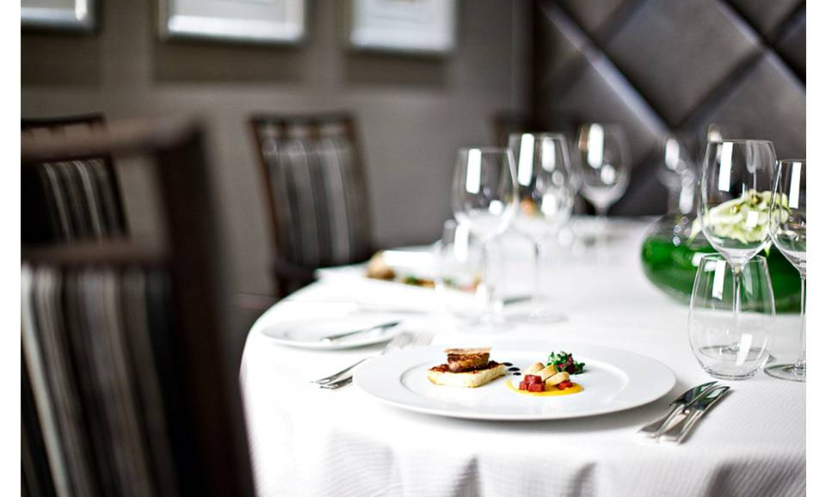
GUEST RELATIONSHIPS
The plate and the complete dining experience
The guest experiences the entire sequence, not only the dish.
Recognize returning guests, VIP expectations and the occasion behind the meal.
Handle allergies, dietary restrictions and religious requirements with precision.
Create bespoke dining experiences, then take personal ownership when recovery is needed.
Luxury becomes credible through memory, consistency and recovery.
CHEF PATRICK DUFF
14
Notes:
Core sources: user-supplied Culinary Leadership Portfolio, Chef CVs, GM/RM CVs, Patrick Duff BIO 2026, testimonials, hospitality archive and the Ultra-Luxury Culinary Leadership evaluation framework. Photographs are embedded from user-supplied files only. Career and performance statements are candidate-supplied and have not been independently audited.

Slide 15
OPERATING DISCIPLINE
How standards become daily performance
01
Define
02
Verify
03
Act
Recipes, specifications, tasting standards, SOPs and clear ownership.
Tasting, HACCP, allergens, supplier checks, traceability and outlet review.
Coach quickly, correct root causes and prepare for equipment or service disruption.
WHAT THE GENERAL MANAGER SHOULD RECEIVE
Consistent dining standards, safe kitchens, credible forecasts, planned capital priorities and practical crisis readiness.
“...the business results the Hotel enjoys as a result of his fiscal focus.”
Philip M. Barnes testimonial
Junior colleagues should be able to stop service and report a safety concern without hesitation.
CHEF PATRICK DUFF
15
Notes:
Core sources: user-supplied Culinary Leadership Portfolio, Chef CVs, GM/RM CVs, Patrick Duff BIO 2026, testimonials, hospitality archive and the Ultra-Luxury Culinary Leadership evaluation framework. Photographs are embedded from user-supplied files only. Career and performance statements are candidate-supplied and have not been independently audited. Exact testimonial fragment from Philip M. Barnes in Chef Duff Testamonials(1).pdf. Safety and crisis-readiness expectations reflect the attached Ultra-Luxury Culinary Leadership evaluation framework.

Slide 16
EXECUTIVE OPERATING EVIDENCE
Hotel-wide leadership, with measurable outcomes
TRIBE PHUKET
THE SALIL RIVERSIDE
VAKKARU MALDIVES
Stabilize and grow
Deliver the year
Protect the guest promise
4.3 → 4.8
46%
>40%
TripAdvisor rating
GOP margin
repeat-guest mix
High-season occupancy moved from below 20% to above 90%; ADR rose from THB 1,100 to more than THB 3,000.
230 rooms · 500+ colleagues · approximately US$13.3M revenue. F&B revenue +15%; 77% occupancy.
TripAdvisor rose from 4.2 to 4.8; reduced colleague turnover and completed villa and pool upgrades before high season.
Different assignments, same executive discipline: improve the guest experience while owning the operating result.
CHEF PATRICK DUFF
16
Notes:
Core sources: user-supplied Culinary Leadership Portfolio, Chef CVs, GM/RM CVs, Patrick Duff BIO 2026, testimonials, hospitality archive and the Ultra-Luxury Culinary Leadership evaluation framework. Photographs are embedded from user-supplied files only. Career and performance statements are candidate-supplied and have not been independently audited. TRIBE, Salil and Vakkaru metrics are from the supplied 2026 Executive CV and ATS CV. TRIBE Phuket: TripAdvisor 4.3 to 4.8, high-season occupancy from below 20% to above 90%, ADR THB 1,100 to above THB 3,000. The Salil Hotel Riverside: approximately US$13.3M revenue, 46% GOP, 77% occupancy, F&B revenue +15%. Vakkaru Maldives: TripAdvisor 4.2 to 4.8, repeat-guest mix above 40%, reduced turnover, and villa/pool upgrade program completed before high season.

Slide 17
SELECTED ASSIGNMENTS
Culinary leadership with hotel-wide judgment
MAY 2026 - PRESENT
Director of Culinary, in Charge of Food & Beverage
Confidential international luxury resort pre-opening
2025-2026
TRIBE Phuket
2023
Pullman Arcadia Karon Beach
Hotel Manager / F&B Expert
Task-Force Director of Culinary, in Charge of F&B
2024-2025
The Salil Hotel Riverside Bangkok
General Manager
FEB-SEP 2022
Mondrian Doha
Task-Force Director of Culinary, in Charge of F&B
2023-2024
Vakkaru Maldives
Resort Manager
Earlier brands include One&Only, Shangri-La, W Hotels, Fairmont, Four Seasons, The Sukhothai, Regent and The Ritz-Carlton.
CHEF PATRICK DUFF
17
Notes:
Core sources: user-supplied Culinary Leadership Portfolio, Chef CVs, GM/RM CVs, Patrick Duff BIO 2026, testimonials, hospitality archive and the Ultra-Luxury Culinary Leadership evaluation framework. Photographs are embedded from user-supplied files only. Career and performance statements are candidate-supplied and have not been independently audited.

Slide 18
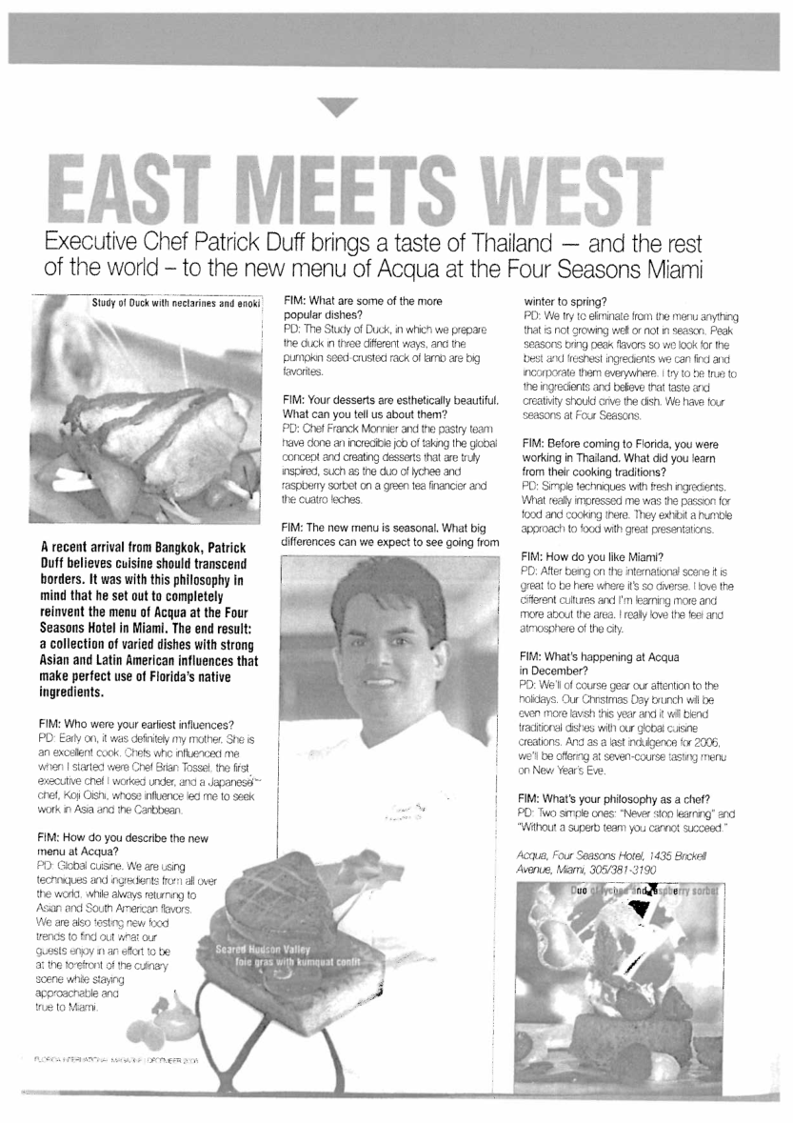
SELECTED EVIDENCE / CONCEPT DEVELOPMENT
Four Seasons Miami: concept and growth
Acqua: Italian to Latin-Asian
THE ASSIGNMENT
Executive Chef for three outlets and banqueting in a 221-room hotel with approximately US$14M annual F&B revenue.
THE LEADERSHIP MOVE
Led the transition to a Latin-Asian direction, rebuilt the culinary team, introduced menus and developed skills through training and culinary competitions.
+10%
OUTLET & BANQUET REVENUE
Guest satisfaction improved
CHEF PATRICK DUFF
18
Notes:
Core sources: user-supplied Culinary Leadership Portfolio, Chef CVs, GM/RM CVs, Patrick Duff BIO 2026, testimonials, hospitality archive and the Ultra-Luxury Culinary Leadership evaluation framework. Photographs are embedded from user-supplied files only. Career and performance statements are candidate-supplied and have not been independently audited. The 221-room property, three outlets, transition from Italian to Latin-Asian menus, revenue increase of 10% and guest-satisfaction improvement are from the supplied Executive Chef CV. Ricardo Acevedo reference is presented on the selected testimonials slide. Supporting media scan from Chef Duff Hospitality(6).PDF, page 4.

Slide 19
SELECTED EVIDENCE / LEADERSHIP APPROACH
Responsible operations without empty claims
Protect quality while reducing avoidable waste.
THAILAND
The Sukhothai Bangkok
Phuket resort experience
Conversational Thai
Long-term commitment to local talent
The discipline
Forecast demand, measure waste, control yield, store correctly and improve production planning before waste reaches the bin.
The local context
Respect regional ingredients, culinary traditions, ethical sourcing and local chef development in concepts and guest experiences.
No quantified sustainability result is claimed without supporting evidence.
CHEF PATRICK DUFF
19
Notes:
Core sources: user-supplied Culinary Leadership Portfolio, Chef CVs, GM/RM CVs, Patrick Duff BIO 2026, testimonials, hospitality archive and the Ultra-Luxury Culinary Leadership evaluation framework. Photographs are embedded from user-supplied files only. Career and performance statements are candidate-supplied and have not been independently audited. These statements describe operating priorities and leadership approach. No unverified quantified sustainability, sourcing or retention result is claimed.

Slide 20
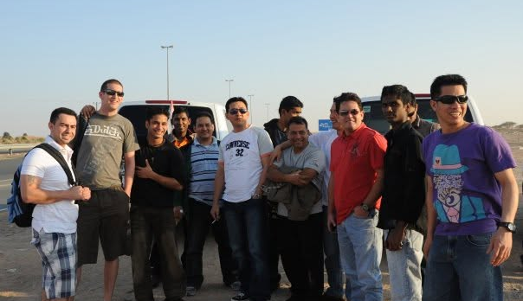
SELECTED EVIDENCE / TEAM CULTURE
Relationships outside service strengthen the brigade
Time outside the operation builds trust across backgrounds.
That trust improves communication when service becomes demanding.
Original team-outing photograph supplied by Patrick Duff.
CHEF PATRICK DUFF
20
Notes:
Core sources: user-supplied Culinary Leadership Portfolio, Chef CVs, GM/RM CVs, Patrick Duff BIO 2026, testimonials, hospitality archive and the Ultra-Luxury Culinary Leadership evaluation framework. Photographs are embedded from user-supplied files only. Career and performance statements are candidate-supplied and have not been independently audited. The newly supplied team-outing photograph replaces the earlier outing photo. One image from this outing appears in the deck.

Slide 21
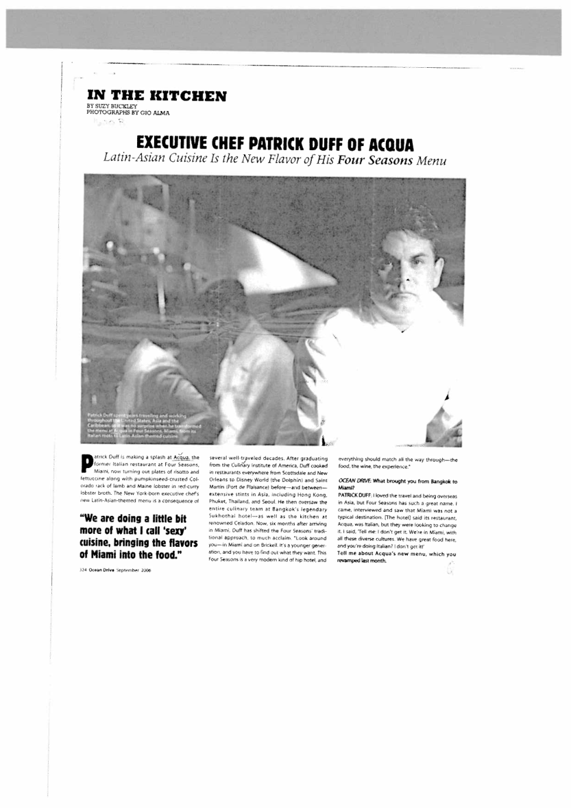
SELECTED EVIDENCE / MEDIA AND INDUSTRY
Published culinary coverage
“In the Kitchen”
Ocean Drive, September 2006
The feature profiles the Latin-Asian direction at Acqua, Four Seasons Miami, and the international culinary experience behind the menu.
The historical hospitality archive also records television appearances and culinary competition work.
CHEF PATRICK DUFF
21
Notes:
Core sources: user-supplied Culinary Leadership Portfolio, Chef CVs, GM/RM CVs, Patrick Duff BIO 2026, testimonials, hospitality archive and the Ultra-Luxury Culinary Leadership evaluation framework. Photographs are embedded from user-supplied files only. Career and performance statements are candidate-supplied and have not been independently audited. Original article scan from Chef Duff Hospitality(6).PDF, page 1: In the Kitchen, Ocean Drive, September 2006, page 324, by Suzy Buckley, photographs by Gio Alma. Historical media evidence only.

Slide 22
CHEF PATRICK DUFF
Executive Chef / Director of Culinary
Build capable chefs. Create distinctive dining experiences. Take ownership of standards and performance.
Phuket, Thailand / +66 94 807 3223 / chefduff@hotmail.com
Notes:
Core sources: user-supplied Culinary Leadership Portfolio, Chef CVs, GM/RM CVs, Patrick Duff BIO 2026, testimonials, hospitality archive and the Ultra-Luxury Culinary Leadership evaluation framework. Photographs are embedded from user-supplied files only. Career and performance statements are candidate-supplied and have not been independently audited. Contact details from the supplied Chef CV. PD monogram from the attached bio.

