Slide 1

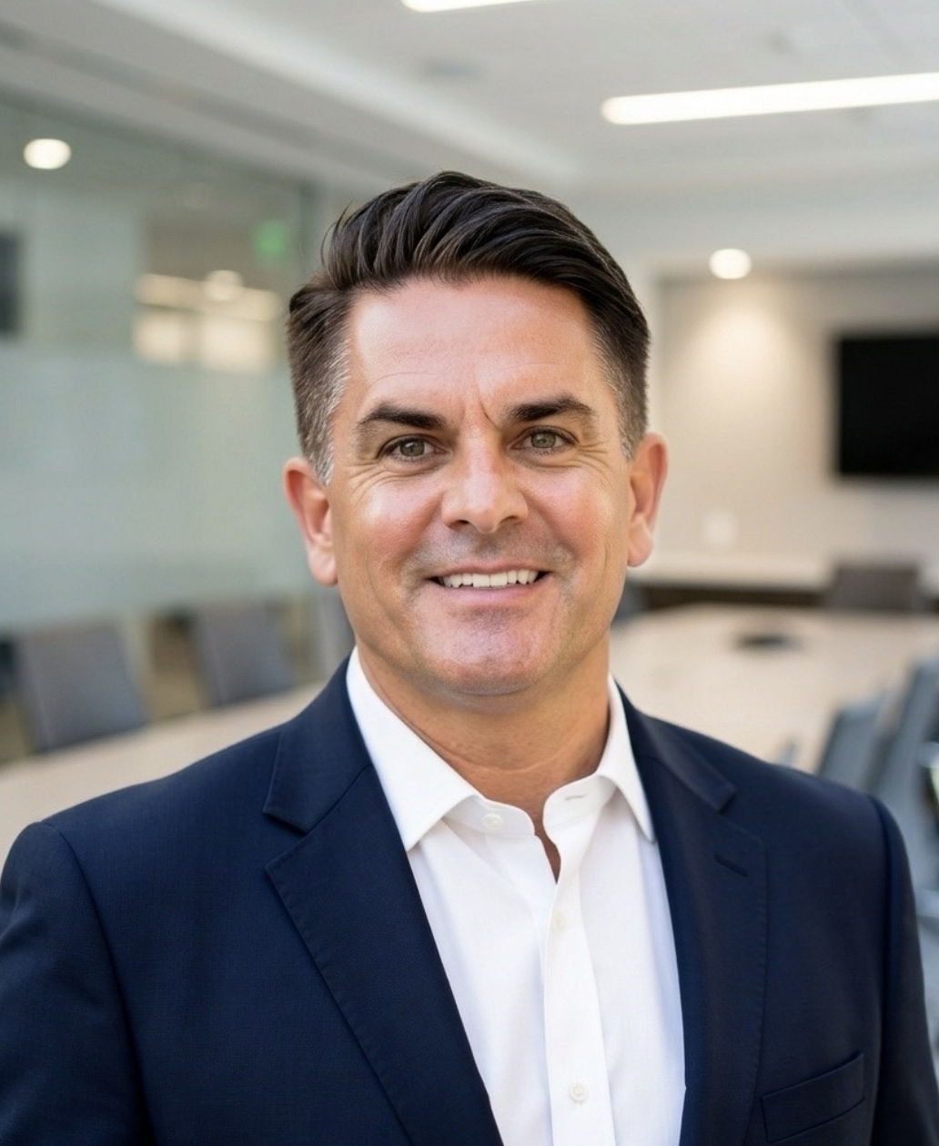
PATRICK
DUFF
RESORT MANAGER • HOTEL MANAGER
DIRECTOR OF OPERATIONS • BOUTIQUE GM
International luxury hospitality leadership across hotels, resorts, and private-island destinations.
Phuket, Thailand
+66 94 807 3223 • patrickduff@outlook.co.th
linkedin.com/in/Patrick-duff-5182012
20+ YEARS • 13 COUNTRIES
Luxury hotels • Island resorts • Openings • Turnarounds
Notes:
[Sources]
- Patrick_Duff_2026_RM-HM_Executive_Final.docx
- User-provided portrait: 6AC2FD9B-9C7-4FB8-947F-9F2B8FF33403.jpeg

Slide 2


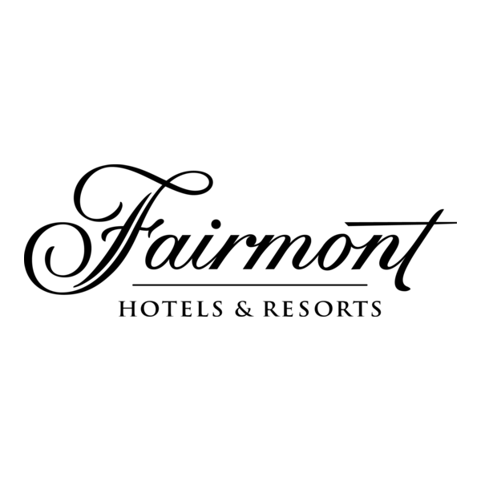





EXECUTIVE SNAPSHOT
Leadership at scale
20+
13
US$140M
years of international leadership
countries across five regions
annual property revenue scale
1,200+
500+
10
rooms at the largest property
colleagues led at scale
fixed-term mandates
REGENT
HONG KONG
PATRICK DUFF • EXECUTIVE HOSPITALITY PORTFOLIO
02
Notes:
[Sources]
- Patrick_Duff_2026_RM-HM_Executive_Final.docx
- User-provided brand marks listed in build/source-notes.txt
- Regent Hong Kong shown without dates by user instruction

Slide 3
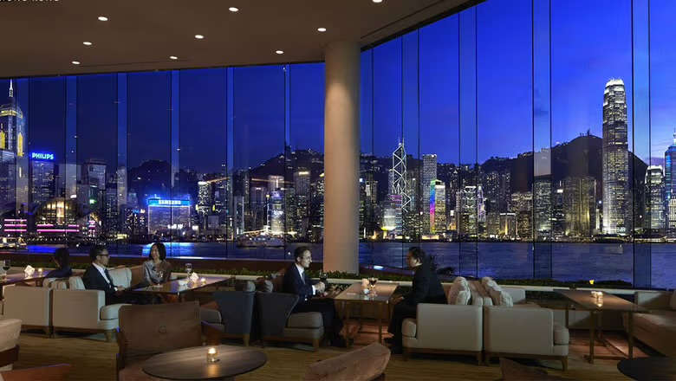
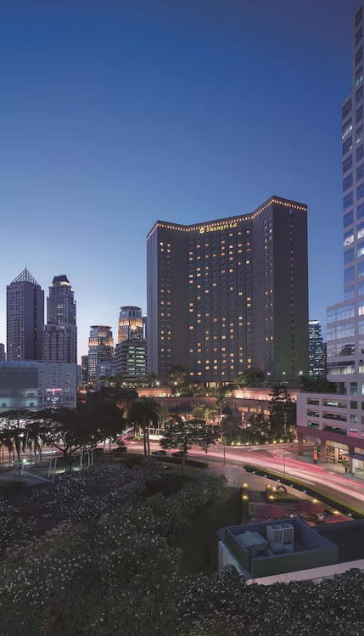
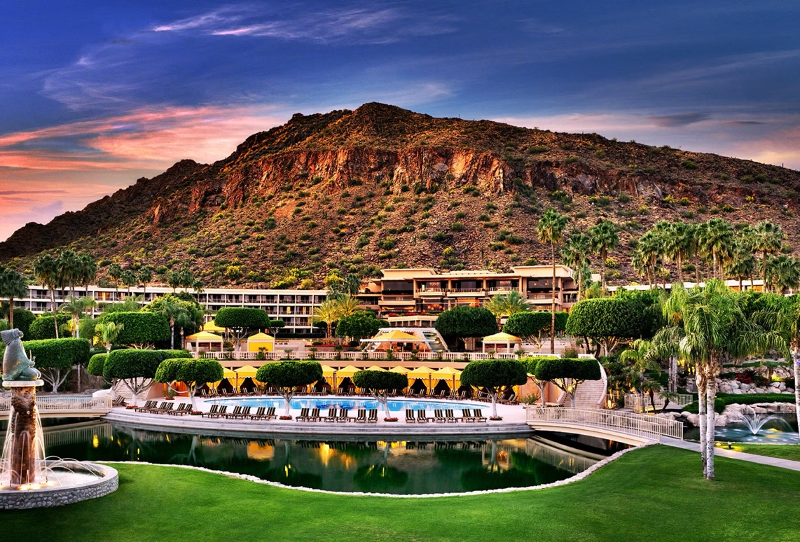
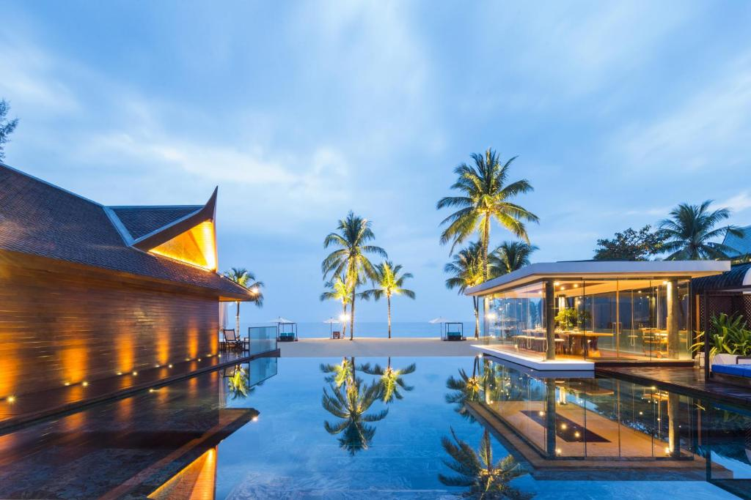
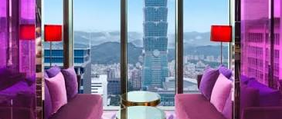
SELECTED PORTFOLIO
Luxury depth across cities, resorts, and islands
The Phoenician • US$140M scale
InterContinental Hong Kong
W Taipei • Director of Food & Beverage
Makati Shangri-La
LUXURY RESORT EXPERIENCE
PATRICK DUFF • EXECUTIVE HOSPITALITY PORTFOLIO
03
Notes:
[Sources]
- Patrick_Duff_2026_RM-HM_Executive_Final.docx
- User-provided property images: InterContinental Hong Kong, Makati Shangri-La and The Phoenician
- User-provided W Taipei image: 01355023-A86C-42F2-B6CE-3CB79CE09BB6.jpeg
- User-provided Iniala Beach House image: D9605180-C7BF-48AE-9014-FE065A577FBF.jpeg

Slide 4
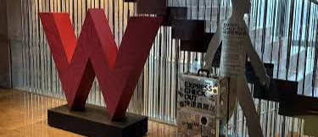
COMMERCIAL PERFORMANCE
Disciplined operations built stronger margins
33% → 42%
Hotel GOP
Swissôtel Nai Lert Park Bangkok
+22%
F&B revenue
Fairmont Dubai
+12%
F&B revenue in three months
38% → 46%
Makati Shangri-La
F&B GOP • W TAIPEI
4.2 → 4.8
TripAdvisor score at Vakkaru
+20% beverage sales through mixology, partnerships, and venue activation
Vakkaru Maldives
Results are shown with their exact operational scope—hotel, F&B, or guest experience—so the claims remain defensible.
PATRICK DUFF • EXECUTIVE HOSPITALITY PORTFOLIO
04
Notes:
[Sources]
- Patrick_Duff_2026_RM-HM_Executive_Final.docx
- User-provided W Taipei image: 647A8151-E27E-49CD-B172-A41B5335D47B.jpeg

Slide 5
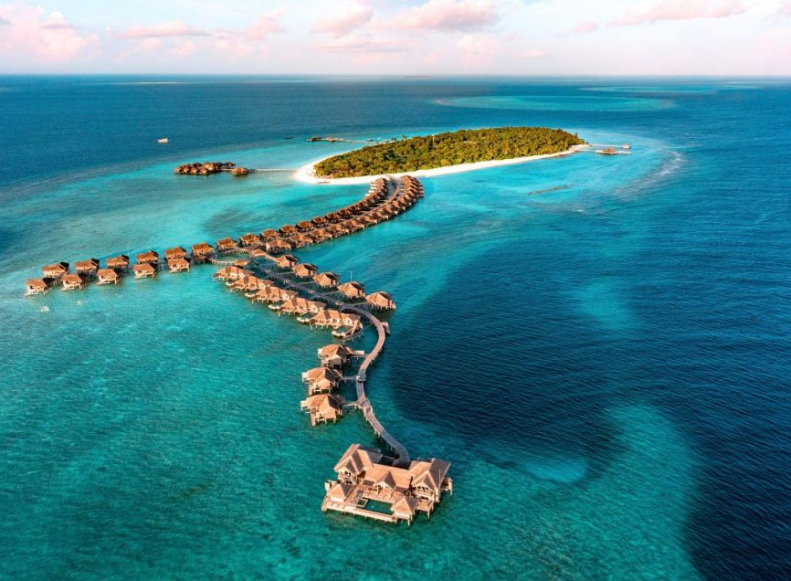
PRIVATE-ISLAND CASE STUDY
Vakkaru: loyalty through live construction
500+
colleagues and casuals
TripAdvisor 4.2 → 4.8
improved during the assignment
At least 40% repeat guests
Directed phased construction of two additional villas and full-size pool conversions while closing only the affected island sections.
RESORT MANAGER / ACTING GENERAL MANAGER • 133 VILLAS
Proof point: guest experience, team morale, and asset enhancement managed together.
PATRICK DUFF • EXECUTIVE HOSPITALITY PORTFOLIO
05
Notes:
[Sources]
- Patrick_Duff_2026_RM-HM_Executive_Final.docx
- Patrick Duff Reference Vakkaru Iain(2).jpeg
- User-provided Vakkaru aerial: 8224A8F6-8831-4C38-8D99-E762E5606D3E.jpeg

Slide 6
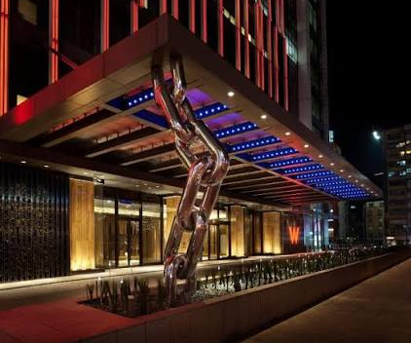
LIFESTYLE-HOTEL CASE STUDY
W Taipei: brand energy, stronger margins
DIRECTOR OF FOOD & BEVERAGE
405 rooms • 5 venues
Events for up to 2,000 guests
Approx. US$60M hotel revenue
38% → 46%
F&B GOP
+20% beverage sales
The flagship hotel was recognized with 80+ travel-industry awards by 2016.
Venue strategy • Cost discipline • Partnerships
PATRICK DUFF • EXECUTIVE HOSPITALITY PORTFOLIO
06
Notes:
[Sources]
- Patrick_Duff_2026_RM-HM_Executive_Final.docx
- Recommendation Letter - Patrick.pdf — Cary M. Gray, General Manager, W Taipei
- User-provided W Taipei image: CF35829B-5B3D-4E1D-AF7A-D272CC1BE713.jpeg

Slide 7
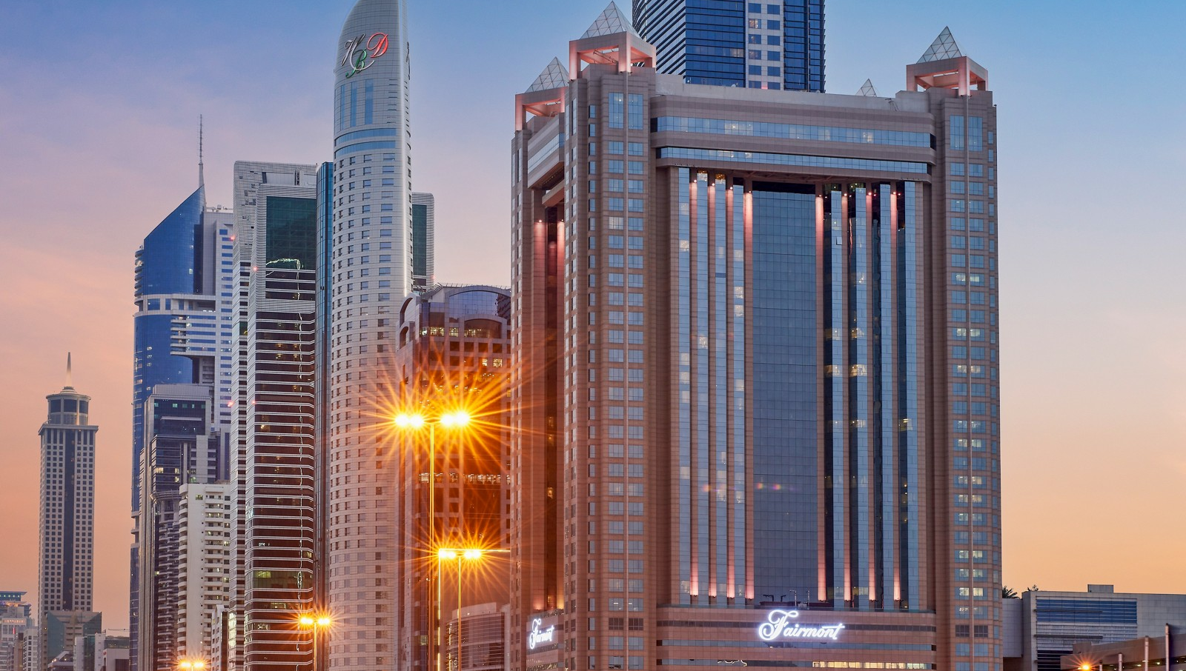
MULTI-PROPERTY PROGRESSION
Fairmont & Swissôtel: scale and succession
SWISSÔTEL NAI LERT PARK BANGKOK
33% → 42%
Hotel GOP • 350+ colleagues and casuals across a 300-room hotel
FAIRMONT DUBAI
FAIRMONT DUBAI • SCALE, TALENT & PERFORMANCE
+22% F&B revenue
Led 500+ colleagues across 12 restaurants, grew F&B revenue by 22% and sustained approximately 47% average GOP over three years. Contributed to Fairmont’s 2010 Global Hotel of the Year recognition.
12 restaurants • 500+ colleagues • 20+ promotions
Part of Fairmont’s 2010 Global Hotel of the Year team
PATRICK DUFF • EXECUTIVE HOSPITALITY PORTFOLIO
07
Notes:
[Sources]
- Patrick_Duff_2026_RM-HM_Executive_Final.docx
- Patrick Duff the Fairmont Dubai (3).pdf — Philip M. Barnes
- Official Fairmont Dubai exterior image: https://m.ahstatic.com/is/image/accorhotels/aja_p_6302-41:4by3
- User confirmation, 7 August 2026 — page 7 changed from Fairmont Beijing to Fairmont Dubai

Slide 8
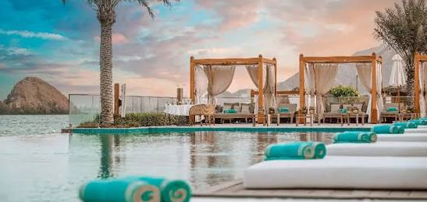
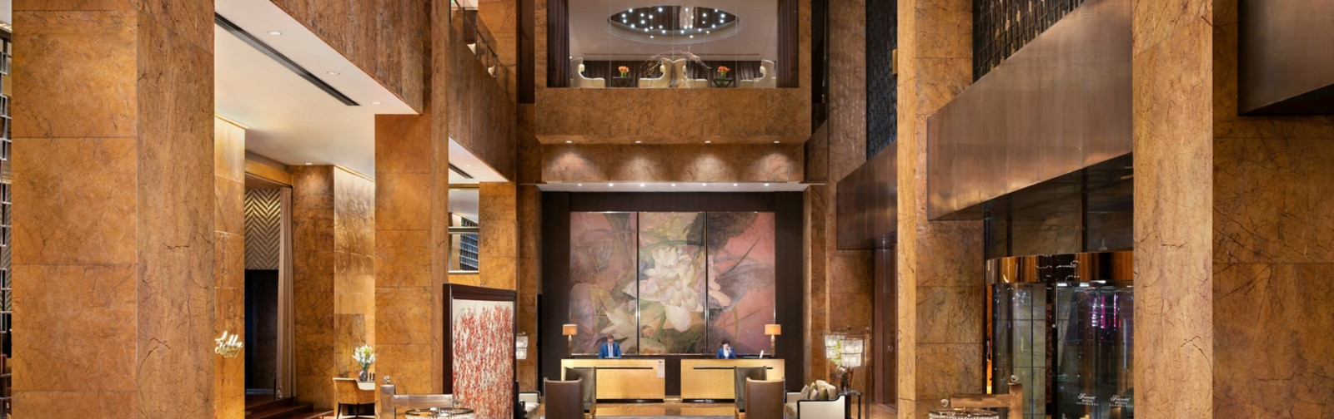
SELECTED MANDATES
Four assignments, one repeatable model
4
selected case
studies
01
The Ritz-Carlton
Full opening at Rose Hall, Jamaica; opening task-force assignments in Philadelphia and New York.
02
Fairmont Beijing
Concepts, construction priorities, equipment, and phased readiness for the brand's first hotel in China.
03
NAÄMA Beach Villas & Spa
44-villa pre-opening: SOPs, department-head recruitment, trial operations, training, and villa setup.
04
TRIBE Phuket + Pullman conversion
180-room post-opening stabilization at TRIBE Phuket, plus senior operating support for a 660-room conversion to Pullman.
PRE-OPENING • CONVERSION • STABILIZATION
PATRICK DUFF • EXECUTIVE HOSPITALITY PORTFOLIO
08
Notes:
[Sources]
- Patrick_Duff_2026_RM-HM_Executive_Final.docx
- Reference Letter Khun Patrick 2.pdf — TRIBE Phuket task-force reference
- User-provided NAAMA image: 2C002F6C-AE9C-48A8-B3DF-3C39E44669E1.jpeg
- User-provided Fairmont Beijing lobby reference: 2BFD53AD-15F0-4B91-ACC2-7775C39F7330.jpeg
- Official Fairmont Beijing lobby image: https://m.ahstatic.com/is/image/accorhotels/aja_p_5804-68:4by3
- User confirmation, 7 August 2026 — Ritz-Carlton openings in Rose Hall, Philadelphia and New York
- Former Hilton name intentionally omitted by user instruction

Slide 9
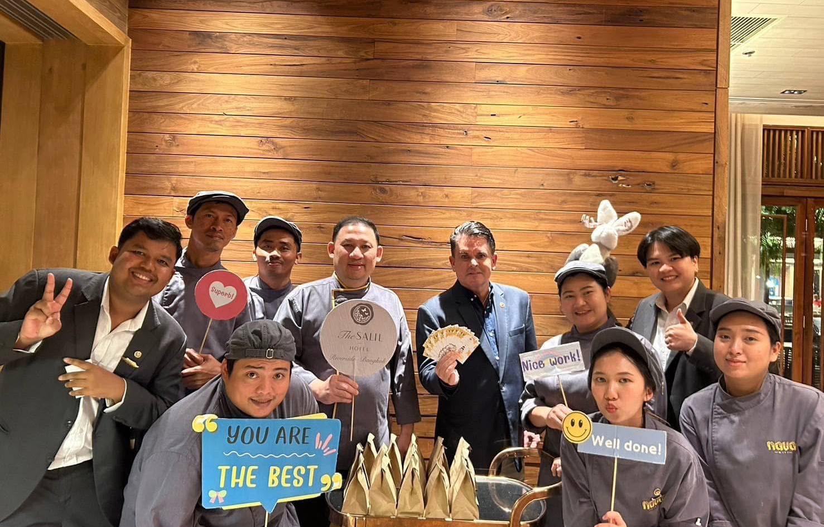
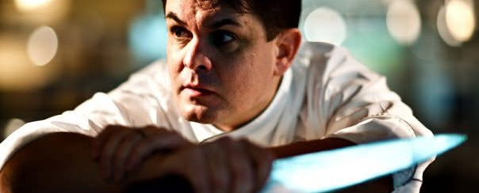
PEOPLE LEADERSHIP
People Development and Succession
20+
managers, chefs, and colleagues promoted at Fairmont Dubai
10+
department heads and managers recruited for NAAMA pre-opening
CULINARY FOUNDATION FOR HOTEL-WIDE LEADERSHIP
Certified Executive Chef with experience across F&B, hotel operations, Resort Manager and General Manager roles.
VISIBLE LEADERSHIP • ACCOUNTABILITY • RECOGNITION
Culinary training links food quality, cost control, team development and guest experience.
Thailand focus: visible, hands-on leadership with respect for local culture and deliberate development of Thai talent.
PATRICK DUFF • EXECUTIVE HOSPITALITY PORTFOLIO
09
Notes:
[Sources]
- Patrick_Duff_2026_RM-HM_Executive_Final.docx
- Executive Chef of the Year - Patrick Duff.pdf
- User-provided team-recognition and culinary photographs

Slide 10
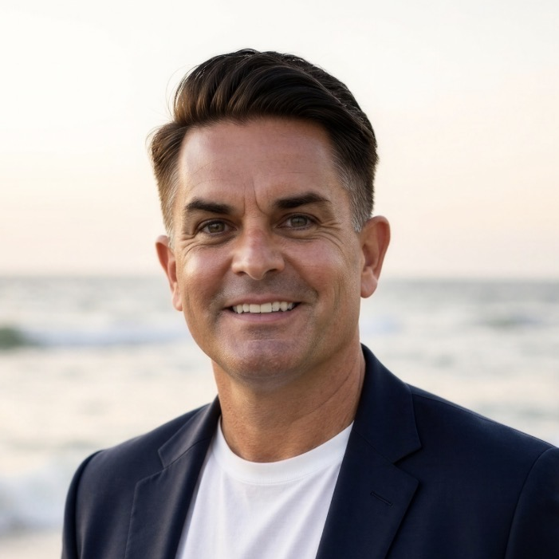
INDEPENDENT VALIDATION
Trusted by leaders who saw the work up close
“Patrick immediately made a significant impact on our operations.”
IAIN McCORMACK • GENERAL MANAGER, VAKKARU MALDIVES
“Patrick is a creative and focused leader who produced excellent results.”
CARY M. GRAY • GENERAL MANAGER, W TAIPEI
“His focus on quality, costs and motivating the team were terrific.”
Commercial discipline.
Visible leadership.
Owner confidence.
Stronger teams.
PHILIP M. BARNES • REGIONAL VICE PRESIDENT & GENERAL MANAGER
Phuket, Thailand • +66 94 807 3223 • patrickduff@outlook.co.th • linkedin.com/in/Patrick-duff-5182012
PATRICK DUFF • EXECUTIVE HOSPITALITY PORTFOLIO
10
Notes:
[Sources]
- Patrick Duff Reference Vakkaru Iain(2).jpeg — Iain McCormack
- Recommendation Letter - Patrick.pdf — Cary M. Gray
- Patrick Duff the Fairmont Dubai (3).pdf — Philip M. Barnes
- User-provided portrait: E8E9F3CF-19E0-4A74-833D-7AF1A7BDDF26.jpeg

