Slide 1
The Early Earth
Ms. Larsh

Slide 2
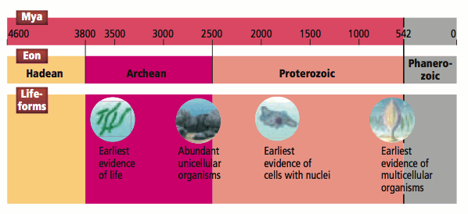
The Precambrian
Spans almost 90% of Earth’s history.
First 700 mya are not well understood as no rocks exist from this time. Earth was hot, volcanically active and no continents existed. (Hadean Eon)
Oldest existing rocks are from the Archean Eon as well as the earliest signs of life; simple and unicellular.

Slide 3
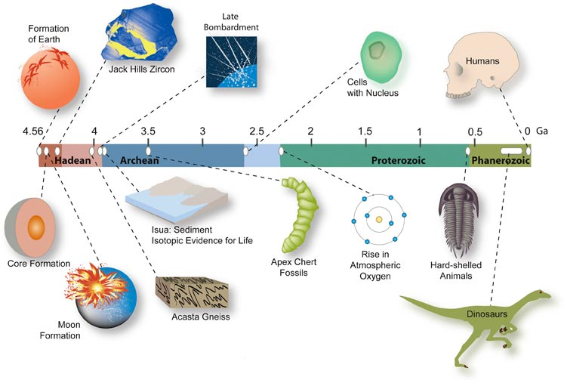
How Do We Know?
If no rocks exist from the birth of our planet, how can we know it’s age?
Crustal Rock Evidence
  Zircon minerals found in 3.96 bya rock are remnants of older rocks.
  The zircon is at least 4.4 bya and, therefore, the Earth must be at least this old.

Slide 4
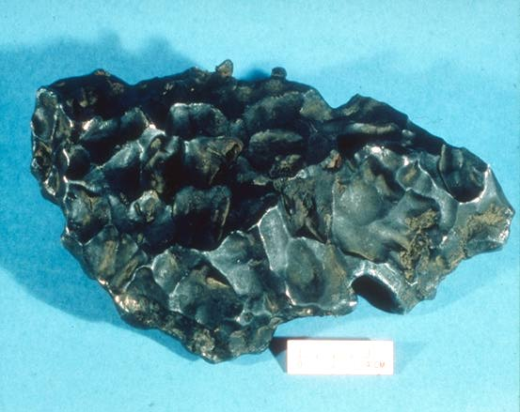
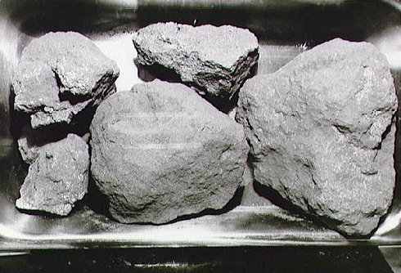
Solar system evidence
  Meteorites, small fragments of orbiting bodies that have fallen to Earth, have been dated at between 4.7 to 4.5 bya.
  Assumed that parts of the solar system formed at the same time and, therefore, Earth and the meteorites are approximately the same age.
  Also, Moon rocks have been dated at 4.45 bya and the Moon was formed very early in Earth’s history.

Slide 5
Early Earth’s Heat
The Earth was extremely hot after it formed due to three sources:
  Gravitational contraction
  Radioactivity
  Heavy Bombardment (asteroids, meteorites, etc.)

Slide 6
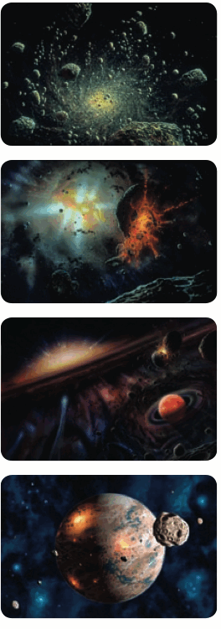
Gravitational Contraction
Earth formed by the gradual accumulation of small, rocky bodies in orbit around the sun.
As it grew, the increased mass lead to increased gravity.
The Earth’s centre was squeezed together with so much forces that the pressure raised the planet’s internal temperature.

Slide 7
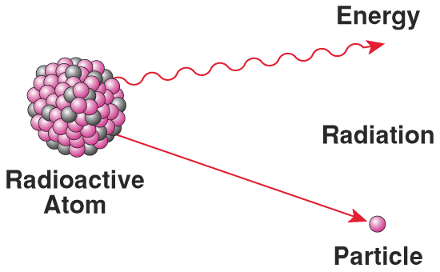
Radioactivity
Certain radioisotopes were more abundant in the past.
The short-lived ones decayed quickly and released heat which lead to a planet that was much warmer than present day.

Slide 8
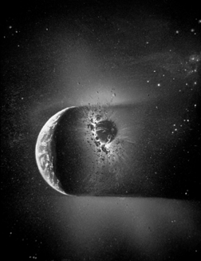
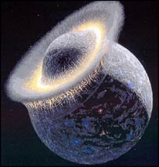
Heavy Bombardment
The first 500 – 700 mya saw many more asteroids throughout the solar system compared to present day.
This increased the chance of collision with Earth.
These impacts generated a tremendous amount of heat.
The massive collision that likely formed the Moon generated so much heat that much of the Earth melted.

Slide 9
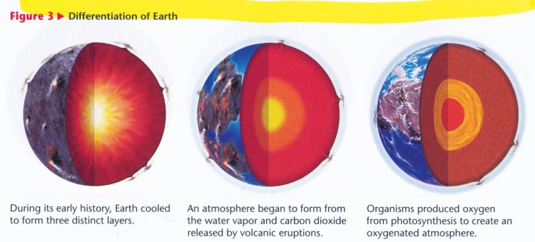
Cooling
Eventually Earth cooled but we are still uncertain as to how long it took.
Evidence suggests that within the first 200 mya it cooled enough for liquid water to form.
Cooling of the Earth continues today.

Slide 10
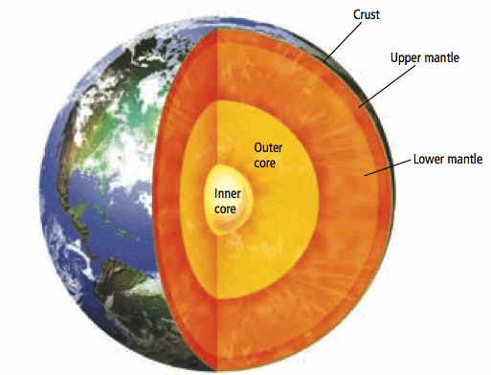
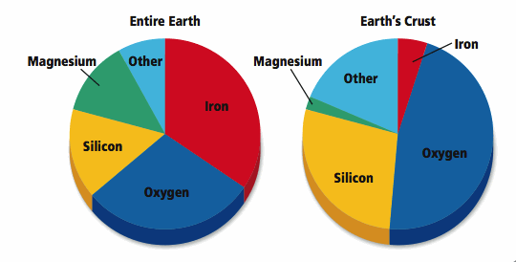
Crust and Continent Formation
Differentiation
  lighter elements (ex. Silicon and oxygen) remained close to the surface while heavier ones (ex. Iron) sank to the centre.
  Micro-continents formed during the Archean Eon.

Slide 11
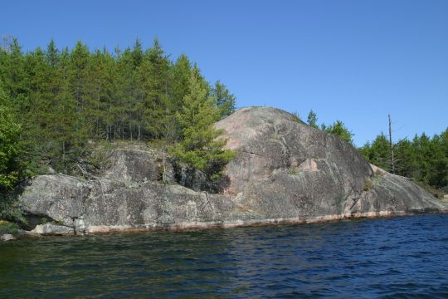
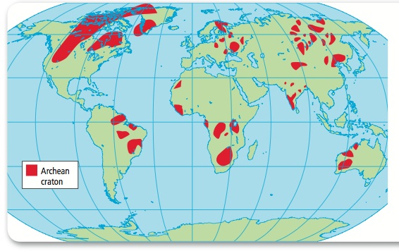
Precambrian Shields
Oldest parts of continents that are exposed.
  Ex. Canadian Shield - 3.8 bya

Slide 12
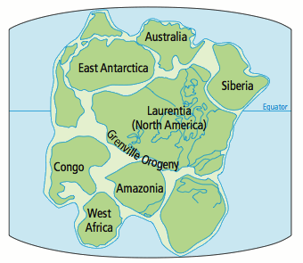
Mountain Building
During the Proterozoic Eon, the microcontinents collided with each other which resulted in massive mountains.
Ex. Laurentia
  Largest Proterozoic landmass.
  Ancient continent of N. America
  Many different mountain building events (orogenies) occurred

Slide 13
The Early Atmosphere
Vapourized water from asteroid and meteorite impacts.
Ammonia and methane dominated at first but the Sun’s intense UV radiation broke them down.
Outgassing, addition of gases to the atmosphere from volcanic eruptions, released CO₂, water vapour and other gases.
Little O₂ for the first 3 bya.
Ancient cyanobacteria, using photosynthesis, converted CO₂ into O₂

Slide 14
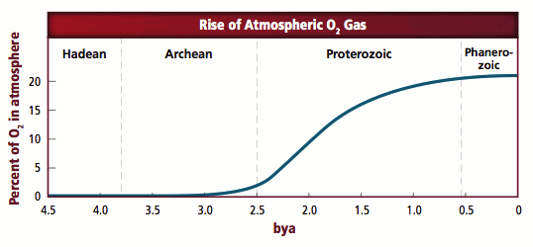
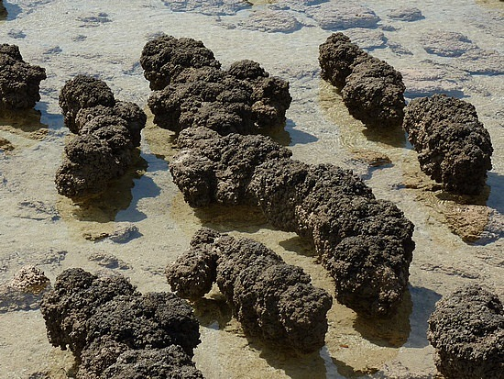
By the early Proterozoic, large, coral reef-like mounds of cyanobacteria called stromatolites dominated the oceans that covered most of Earth’s continents.
Billions of cyanobacteria colonies that trap and bind sediments together. This is an image of present-day stromatolites.

Slide 15
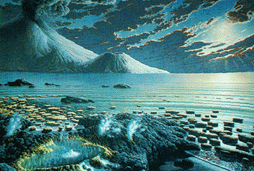
The Formation of the Oceans
Reached their current size fairly early.
Water came from: volcanic outgassing and extraterrestrial origins (asteroids, comets, etc.)

Slide 16
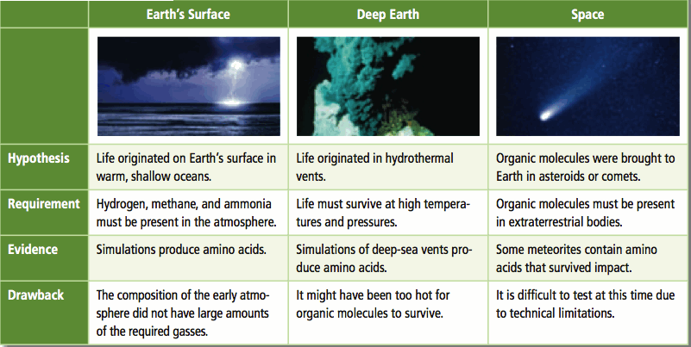
Early Life
Probably as early as 3.9 bya.
Possible scenarios as to how:

Slide 17
Mass Extinction
The planet has been plagued by a number of mass extinction events.
There were at least two during the Precambrian.
First:
  Occurred at least 750 mya
  A period of severe glaciation (may have spread to the equator; the oceans may have froze)
  Most of all life was wiped out
Second:
  Occurred near the end of the Ediacaran period (~540 mya)
  Many soft-bodied organisms died out suddenly; little more is known

