Slide 1
SITE NAME
Training Director: Heidi Putney, Ph.D.
Practicum Directors
NAMES
Contact Information:
Website/Brochure:
Application requirements
Application Deadline:
Monday, January 5th, 2026
MISSION
Site
population
*This program follows the PTC notification date. We will not offer our positions until this date. The 2026-2027 training season notification date will be:
Monday, February 9th, 2026
PROGRAM EXPERIENCE

Slide 2
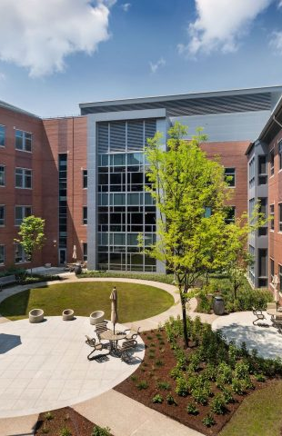
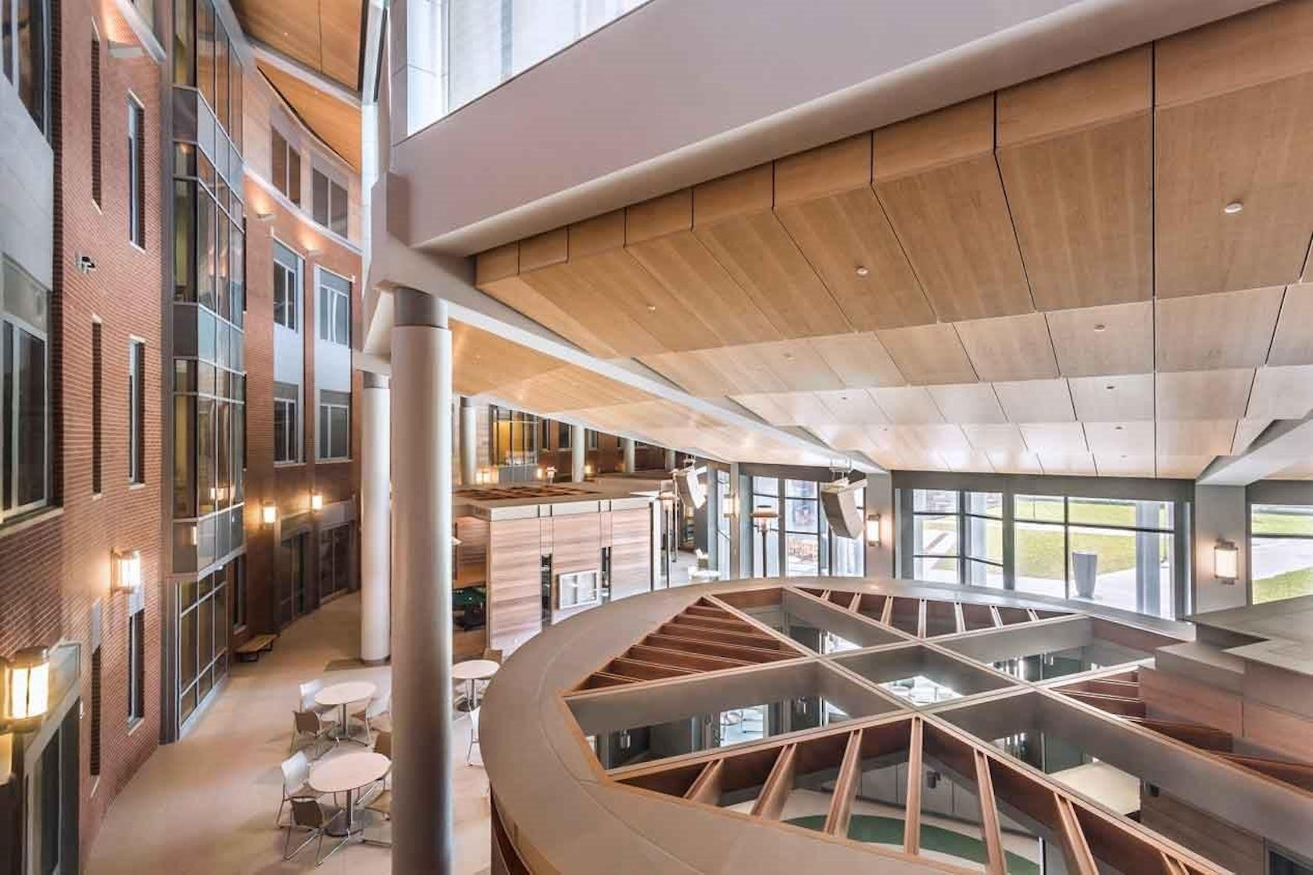
UMass Chan / Worcester Recovery Center and Hospital (WRCH)
Training Director: Heidi Putney, Ph.D.
Practicum Directors
Ariel Ingber, Psy.D. & Faith Therrien, Psy.D.
Contact Information: Ariel.Ingber2@mass.gov
Website/Brochure: https://www.umassmed.edu/psychiatry/education/psychology_programs/advanced-practicum-in-adult-clinical-psychology/
Application requirements
Cover letter, detailing your relevant experiences
Curriculum Vita
Unofficial Transcript
Three letters of reference, at least one from a field training supervisor
Fully redacted case formulation, including a biopsychosocial history and mental status exam
If available, a fully redacted, psychological or neuro testing report
Application Deadline:
Monday, January 5th, 2026
MISSION
Our practicum is designed to provide clinical training in treatment, assessment, and consultation with adults with serious and persistent mental illness, many of whom are also legally involved and present with a wide range of co-occurring psychological and medical disorders. The delivery of our professional psychological services occur within a recovery-oriented, person-centered culture of care in a public service context.
*This program follows the PTC notification date. We will not offer our positions until this date. The 2026-2027 training season notification date will be:
Monday, February 9th, 2026
PROGRAM EXPERIENCE
Site
population
24 hours per week
On –site at WRCH in Worcester, MA
$4,000-$6,000 stipend + educational stipend
Tuesdays are mandatory
Mix of individual, group treatment, and admission assessments
Weekly didactics
One (1) integrated battery
Training year begins early July
The inpatient recovery center is composed of two adult court evaluation units; ten adult continuing care units including units with specialized services such as those serving medically compromised individuals and Deaf/hard-of-hearing adults and; two adolescent units.

