Slide 1








Proposal
QBE Contact Center Experience
Feb. 16, 2023

Slide 2
Proposal Contents
Who We Are
Our Understanding
Proposed Approach
Timelines
Proposed Team
Outcomes and Deliverables
Dependencies
Commercials
Next Steps
Appendix

Slide 3
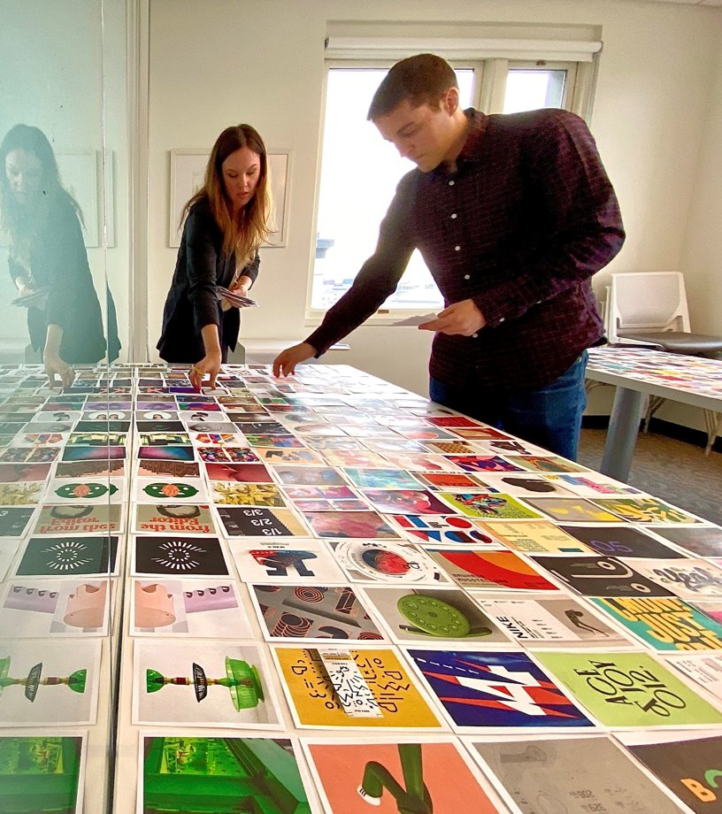
Who We Are - Mphasis
2000
Founded in Seattle
8 Locations
Across USA, UK, Europe
150+
Research, stratedgy and design experts
90%
Long-term partnerships

Slide 4
Who We Are - Mphasis
Rigorous Evidence
Radical Collaboration
Proactive problem-solving
Long-tem partnerships
Contagious passion
Good Humans
Why our clients choose us

Slide 5
Our Understanding of QBE’s Contact Center Requirements
A summary of QBE Contact Center’s requirements which pans across technical, operational, and experience requirements and impacts all users, including customers and internal QBE LoB users in the Contact Center, Inside Sales, and more
Drive Transformation
Customer and Employee Experience
Improved contact center technology and integration
Scalable across geographies, with multi-lingual support
Better process and technology automation
Timely and quality service to high-profile customers
Improved first call resolution and next best actions
Need for feedback close-loop mechanism
CSAT survey available after each call or interaction
Workforce Optimization
Quality Management
Effectively manage queues, agent performance metrics and utilize AI tools to aid in quality assurance management and provide analytic dashboards for team managers.
Define Quality Management goals and objectives
Establish Quality Control processes
Knowledge Management
Workforce Planning & Management
Uniformity and standardization of knowledge articles
Ease of access and findability of knowledge articles
Effectively manage workload, bandwidth and volumes
Improve operational efficiencies

Slide 6
Our Proposed Approach
We propose two streams working in tandem to achieve short-term and long-term goals to address and solution
Tactical, focused on resolving current critical issues
Technical due diligence to assess current state and recommend what should continue
A Design Thinking led approach for strategizing, ideation, and to bring all; business, operational, and technical minds together, and define the long-term technical, operations, and experience solution
Stream 1
Short-Term - Review, fix, and Recommend
Review existing issues, fix, and test
Learn what works for QBE currently
Recommend what may continue to work long-term
Stream 2
Long-Term - Business Driven, User-Centered, Optimal Technology Solution
Align with QBE’s business strategy and goals, and define key performance indicators
Take a Design Thinking led, user-centered, service design approach to solutioning
Evaluate technology options best tailored for QBE’s long-term needs
Recommend the best-in-breed, optimal solution

Slide 7

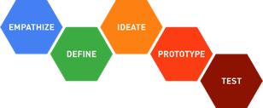
With an optimized execution for both streams across 6 calendar weeks
The two streams will work in parallel, focused on addressing short-term goals, and strategizing and solutioning for the long-term goals
Week 1
Week 2
Week 3
Week 4
Week 5
Week 6
Stream 1 – Short-Term - Review, fix, and Recommend
DT Workshop
Stream 2 – Long-Term Business Driven, User-Centered, Optimal Technology Solution
Report with Strategy,
Technology Solution,
Execution Roadmap
Learnings from Stream 1 will feed into Stream 2 activities, and aid in decision-making for future technology choices
The outcome from Stream 2 will define the scope of the proposed solution, execution, and timelines for Phase 2

Slide 8









Stream 2: Technical Assessment, Design Thinking, exploring best-fit options for QBE
These are indicative key activities; a detailed plan will be created at the start of the 6-week engagement
Weeks
Week 1
UNDERSTANDING
Weeks 2-3-4
DESIGN THINKING AND STRATEGIZING
Weeks 5-6
RECOMMENDATIONS
Key Activities
Application Understanding Workshops to understand app configurations
Provide Recommendations and Develop Implementation Roadmap for Target State
Application Inventory, functional and non-functional requirements and other related docs
Review existing IT documents, QBE strategy and roadmap
Review & Finalize Target State Architecture
Review & Finalize Contact Center Blueprint
Analyze functional and non-functional application requirements, gaps, external/internal integrations, customer pain points and define solution
Interviews and workshops with QBE’s leadership and LOB heads to understand business goals, and define key performance indicators
Design Thinking activities – user research, interviews, shadowing of specialists, detailed activity mapping, brainstorming workshop
Conduct Test the flows with users and improvise
Collect volumetrics e.g., AHT, SLAs, downtimes, FCR, ASA, etc.
Dependencies, integrations, reporting & analytics needs
Analysis of As-Is architecture. Evaluation of technology options for various architecture and data components
Implementation Roadmap with Investment, Timeline details
Deliverables
Interim Documents
None
Interim Documents
4-5 primary internal user archetypes and journey maps
Customer archetype and journey map
Improved experience design screens 1-2 key flows
Deliverables
Final Report with Recommendations for
Target CCaaS Solution and Architecture
Roadmap and Execution Plan

Slide 9
Proposed Mphasis Team
Stream 1
Salesforce SME
Amazon Connect SMEs
Network Engineer
Governance
Stream 2
Design Thinking Experts
Enterprise Solution Architect
Visual Designer
Contact Center Business Process Expert

Slide 10
Outcomes and Deliverables
Stream 1
Salesforce Service Cloud Voice
Review salesforce installed packages, versioning and configurations.
Outcome à Identify & mitigate issues and stabilize operational use of the solution.
AWS & Amazon Connect
Review salesforce-Amazon Connect installed packages, versioning, call flows and configurations.
Review AWS configurations, Carrier trunk capacity to QBE.
Replace audio greetings with new / improved audio greetings and modify as needed.
Outcome à Identify & mitigate Amazon Connect issues, enable or fix features that aren’t present today or not working as expected. Resolve Call quality issues, and improve quality of Audio greetings to customers calling in.
Network & IP Telephony Assessment
Mphasis to review Layer 2 / Layer 3 Network devices which are used in sending/receiving data for Salesforce Service Cloud and Amazon Connect. This may include Routers, Switches, Firewalls and internal SIP trunks.
Outcome à Identify & mitigate AWS outages and performance issues - and Amazon Connect by extension.

Slide 11
Outcomes and Deliverables
Stream 2
1. Final Report
Consolidated User Research Analysis
Personas
Existing and Desired Journey Maps
Technical Assessment, Recommendations, and Strategy
Optimized Contact Center Operations Recommendations with Roadmap
2. Experience Design Prototype for User Testing with Contact Center Specialists

Slide 12
Dependencies on QBE
Asks from QBE team
Participation required for the Design Thinking workshop
Dependencies from QBE stakeholders
Availability of Function (e.g. L&D) Manager, SMEs
Current process documents, SOPs and process manuals (ideally before the blueprint)
Volumetric information including 12 months productivity, quality performance, if available
Opportunity for Mphasis consultants to listen to live calls / operations (SME / agents time – about 30 to 45 mins per call / process)
Provide systems architecture and insights on proposed changes
Preparation for the Design Thinking Workshop - Access to different participants:
QBE project sponsors for one-on-one interviews to understand vision and business goals for the Contact Center (max 3-4 stakeholders, 45-60 mins each)
QBE cross-functional specialists to understand existing technology landscape and existing documentation, with walk-throughs as necessary
QBE Line of Business stakeholders and Customer Center staff for one-on-one interviews (max 5-6 stakeholders, 45-60 mins each)
Post Workshop
1-2 sessions with QBE stakeholders for clickable prototype design, report reviews, feedback and finalization
Access to QBE customers in US and France for one-on-one testing of the clickable prototype of the new experience (max 18-20 customers, 45-60 mins each)
Remote Design Thinking Workshop Day –
8-10 stakeholders
(3-4 dedicated hours from each participant)
QBE stakeholders for Download Center
Project Sponsors and Stakeholders
Technology Specialists
Line of Business Representation
Mphasis Team Participation
Design Thinking Experts
Technology Experts
Visual Designer
Technology Architect
Contact Center Business Process Expert

Slide 13
Different Stakeholder groups time requested across the 6 weeks
Stakeholder groups | Week 1 | Week 2 | Week 3 | Week 4 (4-6 hours for Design Thinking Workshop) | Week 5 | Week 6
QBE Program Sponsors | 1 | 3-4 hours Program Sponsor Interviews, 45 minutes each | 0 | 4-6 hours / person | 2-4 hours Review sessions for clickable prototype | 1-2 hours Presentation Read out
QBE Operations Manager and Technology Lead | 4-8 for overall planning, access, + walkthrough | 2-3 hours Interviews+ walkthrough + group session | 2-3 hours Interviews+ walkthrough | 4-6 hours / person | 2-4 hours Review sessions for clickable prototype | 1-2 hours Presentation Read out
QBE Customer Care Specialists and Inside Sales Agents | 0 | 2-3 hours Interviews + group session | 2-3 hours Interviews, 45 minutes each | 4-6 hours / person (2-3 people) | 2-4 hours Review sessions for clickable prototype | 0
Mix of other related teams, as advised by Program Sponsors Technology | 0 | 2-4 hours 1 group session | 0 | 4-6 hours / person (2-3 people) | 0 | 0
Note: Given stakeholder roles and time requested are indicative and based on similar engagements. Exact roles and times will be discussed and finalized during Week 1.

Slide 14
Commercials

Slide 15
Next Steps
For QBE
Your feedback on Mphasis proposal
Define start date
Identify LoBs and respective stakeholders
For Mphasis
Submit SOW
Mutual agreement to start date
Identify team

Slide 16
Thank You!

Slide 17
Appendix
Stream 1: Short-term - Fix, Review, and Recommend
Stream 2: Long-term – Business Driven, User-Centered, Operations Technology Solution
Industry Trends

Slide 18
Appendix
Stream 1: Short-term - Fix, Review, and Recommend
Stream 2: Long-term – Business Driven, User-Centered, Operations Technology Solution
Industry Trends

Slide 19
Stream 1: Short-term - Fix, Review, and Recommend
These are indicative short-term fixes, which will/may change based on a complete understanding of all challenges prioritized in Stream 1.
Some of these fixes will also be relevant to continue and be recommended for the long-term solution.
Salesforce Service Cloud
Confirm which Salesforce “package” QBE has deployed
  (Essentials, Professional, Enterprise, Unlimited).
Review Salesforce configurations: Ensure Salesforce core application and all 3rd party apps and “installed packages” (i.e., Amazon Connect CTI Connector) are up to date, deployed & configured correctly.
Ensure data is being synchronized across data source(s) within Salesforce, and opportunities to reduce redundant data entry.
Work with LOBs to identify desired configuration changes in visual look & feel of Salesforce widgets, how & where widgets are laid out, “real-estate space” of case note windows, and improve readability for agents/specialists.
Work with LOBs to identify “custom” items (i.e., button to initiate a new case); which items can be achieved in short vs. long term.
Note: Evaluate opportunities for additional customer interaction channels, and options for better integration between channels.
  (Evaluation would be applied toward longer-term SOW).
Amazon Connect portion of Salesforce SCV
Review Amazon Connect configurations within Salesforce SCV, as well as directly via Amazon Connect.
Ensure application is up to date, installed & deployed correctly and using latest CTI Connector version.
Identify specific list of features / functionality that Customer Care wants which may be available but not deployed or implemented in call flows correctly.
Update or create new Amazon Connect IVR Flows.
Review revised call flows with QBE, deploy in dev-env, perform user testing for acceptance, deploy in production.
Explore other options for Salesforce interaction for Sales Agents
Zingtree: Supports native integration with Salesforce SCV and Zoom.
Enables Sales agents and Customer Care specialists to use next-best action solution that pulls relevant information from Salesforce in an easily displayed window.
Dynamically update information from Agents / Specialists into SCV.
Training: Greatly reduces training cycles.
Knowledge Management: Zingtree can be used as an internal knowledge management solution.
Self-Service: Can provide customers with a self-service portal via website, tablet or cell phone.
Network / IP Telephony Architectural Evaluation
Review network setup (architecture /configurations / capacity) at QBE and path that voice traverses out to AWS Pop.
Note: Even if initial configurations for QBE were done correctly, increase in agent and call volume may have outstripped bandwidth and capacity allowances, resulting in various issues including dropped calls, “busy errors”, routing conflicts, and data timeout issues.

Slide 20
Stream 1: Some known problems we will address (not limited to this list)
Problem 1
Problem 2
Problem 3
Calls not displaying in Salesforce Omni-Channel even though customer(s) had called.
Call transfers being dropped and call routing to a specific team based on logic (route to nearest service center)
Improvement is needed in the sound quality of prompts.
Problem 4
Problem 5
Problem 6
Investigate and analyze current contact flows (+ Lambda code) based on best practices which may be causing some frequent errors.
Zoom Integration – Zoom Phone, Contact Center
Issues for multiple time zones when calling for a call back (entered time)

Slide 21

Stream 1 – Suggested activities for Amazon Connect
Audit
Assess
Identify Issues
Provide Recommendations
Review Changes with Stakeholder
Apply change in Dev env.
Post Change review
Deploy changes in Prod. Env.
service cloud voice
amazon connect
Review Amazon Connect configurations within Salesforce SCV, as well as directly via Amazon Connect.
Confirm which CTI Connectors for Amazon Connect are deployed and versions (are these correct? Are any additional connectors/adaptors required?)
Ensure application is up to date, installed & deployed correctly and using latest CTI Connector version.
Identify specific list of features / functionality that Customer Care wants which may be available but not deployed or implemented in call flows correctly.
Update or create new Amazon Connect IVR Flows.
Update or create new Amazon Connect IVR Flows.
Review revised call flows with QBE & Stakeholders
Deploy in QA/Dev-environment
Perform User Acceptance Testing,
Deploy in production.
Post deployment monitoring

Slide 22
Stream 1 – Suggestions for addressing Zoom Integration Challenges
Zoom Phone Integration
Zoom supports limited integration between Zoom One (Zoom Phone) and Salesforce Lightning today, but NOT Service Cloud.
Note: This capability is expected by end of Q123.
Zoom Phone Integration
Mphasis has direct engagement with Zoom, and can work with their engineering to identify as soon as integration with SCV is available, test and deploy at QBE
Zoom Contact Center
Mphasis can assist QBE in Zoom discussions for contact center / Salesforce integration and manage such a solution deployment for QBE.
Review current / future feature availability of Zoom’s Contact Center solution, and deployment of future desired capabilities due throughout 2023.
Zoom CC integration with SCV still TBD, expected Q3 | Q4.
Note: This would contribute to a longer-term engagement as the features are not yet available.
Zoom Contact Center
Mphasis is working to identify target GA dates for Zoom / SCV integration, and similar to above, can test, configure and deploy at QBE and manage feature / config updates.
Once GA roll-out and feature roadmaps are identified, Mphasis can add to long term project plans for QBE.
Note: This assume QBE plans to continue to move towards a Zoom Contact Center roll-out. Mphasis is also able to offer alternative contact center solutions that fully integrate with Zoom Phone and Salesforce Service Cloud today.
Zoom in Non-Support GEOs
Zoom One / Phone is not directly available in some locations QBE operates out of such as Saudi Arabia.
Zoom Contact center is not currently available outside of North America, UK or Ireland.
Zoom in Non-Support GEOs
Mphasis is exploring ability to leverage Zoom cloud-peering partners to enable connectivity between Zoom & QBE in non-Zoom countries. Similar to the approach used with Zoom phone, though differences in how this deploys may exist.

Slide 23
Understanding of Challenges – Short term
Salesforce SCV - Usability
Agents & Specialists have difficulty finding relevant customer data quickly.
Must work through many screens / clicks or can’t find relevant data when needed.
Real-estate” space is very limited, making it unwieldly to edit & view case notes.
“Provides an “inconsistent experience view” depending on who’s logged in.
Customer Journey: Lack of visibility or what “stage’ customers are at. Data points don’t appear to move along with the customer.
Lack of customer journey info prior to CTI screen pop to agent.
Impact:
Directly affect AHT during call, and post wrap up time after call.
Agents may become frustrated or un-focused on customer needs while trying to navigate through Salesforce.
Data entry / process may be inconsistent or incomplete
Salesforce SCV – Data Synchronization
Case information is entered multiple times; manually linked together (i.e., VIN #s). Repetitive, time consuming & acts against Specialist’s Post Call Time activities.
No “Button” to initiate a new case.
Lack of case management awareness (Other agents who may be actively engaged).
Mobile app & website don’t rely on same data source or applications for customer account setup, nor synchronize data.
Impact:
Affects AHT during call. Agents & specialists spend more time inputting data.
Lack of Workflow automation, data may be both redundant and inconsistent.
Increased opportunity for data entry errors, missing data, outdated info in different data sources.

Slide 24
Understanding of your Challenges – Short Term
Salesforce SCV with Amazon Connect:
Features not available or not working as expected with Amazon Connect.
Features that *should* be available like call transcription, sentiment analysis, journey analytics – not deployed or not functioning.
Audio issues, dropped calls, etc.
Lack of IT staff SMEs knowledgeable with Amazon Connect, deploying & managing updates.
Impact:
Frustrating experience for agents using the solution & LOBs / supervisors trying to leverage solution for teams.
New features / capabilities / bug fixes and patches may not be deployed
Outages / dropped calls may be more frequent & longer in duration.
Work Force Management (WFM) - Missing
There is not WFM process in place.
Staffing and queue allocation are done manually every morning.
Agents are aware of what their activities will be until each morning.
As team sizes increase, this will become more difficult / impossible to effectively manage.
May result in staffing allocation challenges – especially if agents are assigned to specific interaction channels.
Impact:
WFM can help control labor expenses & increase productivity ,correct staffing inefficiencies an enable a proactive rather than re-active approach to staffing.
This is neither a scalable nor efficient approach.

Slide 25
Understanding of Challenges
Salesforce SCV - Zoom One (Phone):
No integration between Salesforce & Zoom Phone.
No ability to remotely monitor agent calls, barge or whisper tone.
Routing: Calls could be from anywhere in the U.S. & reach any agent.
IVRs are siloed, non-interconnected experience.
Authentication: Agents have to ask for customer details every call.
Video Calls with customers not available.
Lack of channel separation: Agents handle calls, emails, SMS all at once.
Account Setup for new customers takes 25–45min.
Impact:
Critical functions necessary for contact center agents is missing.
Agents have to transfer calls to other teams which impacts hold times in queue (inflates call load).
Missing important interaction channels impacts customer/agent experience and may result in longer AHT (25-45 min).
Salesforce SCV – Inconsistent Experience
Agents can’t directly enter case notes in Salesforce while on zoom call.
Must email another team to enter customer notes.
Customers have a “different experience” depending on how they access QBE (PC, Tablet, mobile). Difficult for agents to guide customers resulting in LONG call times.
Impact:
Difficult to train effectively
Inefficientt workflow experience
Lack of cohesion & consistency, doesn’t project brand confidence

Slide 26
Understanding of Challenges – Long Term
Training:
Training materials are out of date.
LOBs have not had time or resources to maintain process changes.
Salesforce has a “voice-box” widget which agents aren’t familiar with.
Initial onboarding for Customer Care is 3-5 days but requires lots of mock calls / role-playing.
Impact:
As materials become further out of date, process & time to train staff will take increaser, and introduce inconsistencies in how customers are handled.
What happens when processes change for already trained/on-boarded agents | specialists?
Knowledge Management:
Knowledge Articles, FAQs, training materials, exist in a variety of repositories, Confluence, manuals, & file shares.
Team members often must rely on one another to obtain knowledge or materials.
Impact:
As QBE grows, this will become further fragmented. Lack of version control & increase in artifacts will create additional delay and inaccuracies.
Self-Service Portal:
QBE has a test-drive scheduling option on website, but most customers aren’t aware of it, even though its prominently displayed on QBE’s home page.
How to provide self-service options for customers to aid in reducing call volume and still offer an excellent/engaging experience for customers?
Impact:
Self-Service tools aren’t well utilized or effectively advertised to customers. Limited self-service capabilities beyond self-scheduling test drives.
Self-Service portals are an effective way to drive voice deflection wile empowering customers and maintaining high customer satisfaction.

Slide 27
Appendix
Stream 1: Short-term - Fix, Review, and Recommend
Stream 2: Long-term – Business Driven, User-Centered, Operations Technology Solution
Industry Trends

Slide 28
Our Understanding of QBE and the Contact Center
QBE has 4K employees globally operating in the following countries:
North America (US & Canada)
Europe (Switzerland, Germany, Netherlands)
Middle East: (KSA (Govt. and Non-Govt.)
APAC: China
Primary LOBs:
Sales 16 Agents
Customer Care 16 Specialists
Others
Applications used by Contact Center Specialists:
Salesforce
QBE Garage: where they can see status of the car and send commands to it
Confluence
Urgently - Roadside assistance app
LYFT - Sometimes
Status of Technology Environment for LOBs
QBE uses Salesforce Service Cloud Voice (SCV) as it’s primary CRM and source of truth.
Customer Care relies on Amazon Connect integrated with SCV for their Contact Center solution.
Inside Sales relies on Zoom phone (non-contact center solution) which does not presently integrate with SCV

Slide 29










Challenges we heard so far
Call Center
INTERACTIONS
New or Potential
Customer
Support Existing
Customers
Schedule Delivery
of Vehicle
Visits Customers
Core LOB Challenges
Inside Agents take & receive calls via Zoom One (Zoom Phone). Doesn’t integrated with SCV.
Results in lack of visibility, access to necessary information, laborious work and some one else to update Salesforce accordingly.
Calls TFN
Sales Agents
SMS
1
Customer Care
Email
2
Delivery
Customer Care: Utilize Amazon Connect integrated with Salesforce, but there are issues with the way it integrates, making for a less than ideal experience for agents, and sometimes customers.
3
Web
Field Services
Tablet|
Mobile
4
CRM
All teams who utilize Salesforce wish it was setup more in-line with their needs. Widgets, usable window space, or even how / where to find relevant information is often not well laid out or difficult to find.
Contact Center
Amazon
Connect
Unified Voice
(Non-CC)

Slide 30
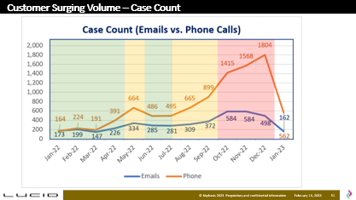
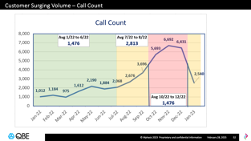
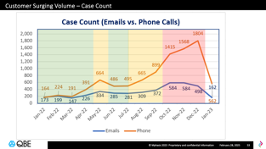
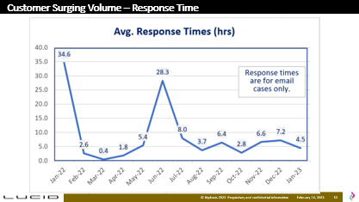
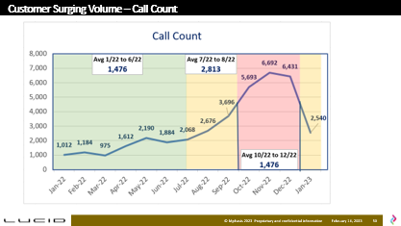
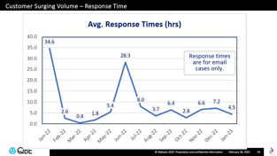
Impact of Surging Customer Volume
Call Volume Surging
Call volumes during Q1|Q2 of 2022 were on avg. 1,476 per month. Calls increased 91% during Q3, and 123% again during Q4.
Case Volumes (Email vs. Phone Calls)
Case volumes via phone calls during Q1|Q2, were on avg. 353 per month. Volumes increased 94% during Q3; & 132% during Q4.
Emails also showed surging, but less dramatic than that of phone calls. An avg. of 227 emails per Q1|Q2, an increase of 41% during Q3, and another increase of 73% during Q4.
Text Messages: No data was provided re: SMS/TXT Volumes
Average Response Times
There were 2 very high anomalies for Jan and June. We discounted the peak volume to provide a more leveled view.
From Feb through May, avg RT was 2.5hrs. That increased 105% to 5.25hrs in June through Oct, and again 17% to 6.1hrs in Q4.
There are no effective way to track email responses, and generating RT reports is very laborious. Every time a field is updated, the response times seem to change.
Effects of Surging Volume
QBE advised plan to increase staffing. Staffing challenges, AHT and cost will continue to increase if technology stack challenges, integration and workflow automation are not soon resolved.

Slide 31
Stream 2 - Long Term Priorities
Explore other options for Salesforce interaction for Sales Agents.
Zingtree: Supports native integration with Salesforce SCV and Zoom.
Enables Sales agents and Customer Care specialists to use next-best action solution that pulls relevant information from Salesforce in an easily displayed window.
Dynamically update information from Agents / Specialists into SCV.
Training: Greatly reduces training cycles.
Knowledge Management: Zingtree can be used as an internal knowledge management solution.
Self-Service: Can provide customers with a self-service portal via website, tablet or mobile phone.
Note: Some aspects of solution could be deployed short term, others would be scoped out for longer term engagement.
Explore other options for Contact Center Solution
Evaluate and recommend alternative to Zoom Contact Center.
Integrated support for Salesforce SCV and Zoom Phone.
Robust features for how QBE works today and going forward.
Explore additional customer interaction channels (Chat, Co-Browse, Video, etc.)
    What can be deployed in short term
    What can be deployed as part of longer-term solution.

Slide 32
















Stream 2: Design Thinking led– Operations and Technology Solution to address business goals and users needs
QBE’s Users
Their Existing Journeys
Their Desired Experiences
….it takes me time to identify the customer in the Salesforce portal. I am often moving between many tabs to find all client details, which can be tough at times… the customer ends up waiting….
The system should give me information about the client and context as soon as I get the call, so that I am better prepared, can find the right Knowledge Article, and can respond correctly and fast…
Felicity
Customer Care Specialist
Mphasis will propose an Optimal Technology, Infrastructure, and Operations Solution to empower QBE’s employees to service customers faster and better
….I do not get accurate and timely information from the portal and sometimes need to ask the customer for information which leads to worse customer experience....
I want a Portal which can give me accurate client details. I would also like to have separation of calls by region and channels, a chatbot and access to analytics such as answer rate, call duration etc.…
David
Contact Center Agent
…. Everyday I have to ensure steady state while monitoring the team, and handling escalations… I have the tools but they are not modern and well-integrated and hence I have to do multiple tasks manually...”
I Agents Specialists want ‘smart’ tools to enable me to control and better manage the day-to-day allocations, escalations, reporting, and team management. The tools should be integrated such that information is accessible without manual efforts….
Sandra
Team Manager

Slide 33

Sample Archetype of Felicity, Specialist in QBE’s Customer Care LoB
“I want tools which make me efficient – recognizing the customer, accessing his record quickly, …” – Felicity, Specialist
Challenges I typically face while attending a customer’s call
The current customer overview page we see when attending a call is very cluttered and contains irrelevant information
Our systems are not synched- so there is lot of manual input of information repeatedly, at varying levels of details, in different places.
It is hard to navigate to a section that I need to see
It can take a long time to provide information to a customer, s/he may be needing critical information and needs it quickly. This sometimes leads to customers’ frustration as they need to wait.
There is a lot less usage of templates or auto-filling of cases
After every call, I have to perform after-call work and manually update my notes for that customer’s records. This can take up time.
Customer advocates need to go over our notes/ transcripts to identify issues. They rely upon our notes to manually extract information and insights, and pass on to the different product owner teams in QBE, which focuses on improvements for the vehicle/experience. This is tedious because they need to go through blocks of text and extract line items to understand the main issues of the customer.
I am part of a 24x7 team and we work in shifts for customers in NA
Customers who have ordered / bought QBE vehicles in NA call us irrespective of where they live
I get assigned to work on calls or emails for the day and I focus on that area
Needs
It would be good to have certain fields be automatically synched across the customer journey.
It would help to have readymade templates

Slide 34



\
Felicity’s Current Journey and Challenges
Start of Day
Daily Activities
Triage
Our team leader assigns us to work queues for either calls or emails or texts
Before 8 AM we can handle all channels together but after 8 AM the volume increases so each of us gets assigned to one channel
I get assigned to voice calls
We are available 24x7 and work for US and Canada based customers only
Attend Calls/ Respond to text/emails
Attend Calls/ Respond to text/emails
Attend Calls/ Respond to text/emails
Set status to available to begin taking calls
I receive a call from a customer
I need to create a case for them in Salesforce Omni Supervisor since it does not get created automatically based on their call.
After creating the case I need to attach it to this voice call record manually
The Reasons field (dropdown), the Description field (free text) in the Call Notes section do not automatically populate to the case. The case creation already has Reason and Sub-reason fields that I populate while creating the case.
I use a single monitor to keep switching between my applications throughout my day
I use
  Salesforce
  QBE Garage: where we can send commands to the car, see the status of the car
  Confluence
  Urgent.ly
  Lyft
For texts I use Salesforce Amazon Connect
I use Salesforce Omni Supervisor for all my work
I spend 5-15 minutes on After-call work after I finish each call
FELICITY’S ACTIONS
For emails I use Salesforce
Respond to Emails
\
Manual distribution of work
Software is very far from being intuitive; it does not show all the information that I need in one page.
There is no button that says NEW CASE. Current case creation flow is not at all intuitive.
Every case needs a VIN to be attached to it (an asset) but it is not automatically attached, you must attach it manually.
After creating the case, it is not attached automatically to the voice call record it is related to.
Call Notes section (Reason and Description) needs to be filled manually. Case and Voice call record are not synched automatically. Case and work order are not synched. Case creation allows for lot more detailed notes on the reasons than the Voice call record does.
The layout needs improvement to get more screen real estate.
Widgets are not conveniently placed or sized
After call work needs to be reduced
FELICITY’S PAIN POINTS

Slide 35
David – Agent Archetype for Emily’s Team (Inside Sales)
“My main goal is to ensure customers get satisfied with the responses to their queries, in a quick manner…” – David, Contact Center Agent
How my team works
We attend calls that come from anywhere within US
We also handle cases i.e. emails that come to sales@QBE.com
I would love to have calls routed by region
I would like to have separate roles for addressing inbound and outbound calls
I would like to have dual monitors instead of the current single one
It would be great to have better integration between Zoom and Salesforce
I have to rely on lot of manual processes, need to increase automation
Logging text needs to be simpler, currently we wait to log text until there is a conversation thread in order to reduce effort (?)
If we have a chat feature, my call load would be more manageable, and I can provide better service
I would like to have a feature where I can log calls as soon as it begins

Slide 36
\
Inside Sales team member journey – Current
I need to ask the customer about their stage in the journey sometimes as I myself cannot see it
As I attend calls, I try to take notes and add logs
Start of Day ?
Daily Activities
I route calls to Delivery team if it is about a delivery related issue
I pull up customer details in Salesforce, what stage of their journey the customer is in
We try to answer as much as we can
Calls come in from anywhere in US
We route the call to the appropriate agent for their region
We also handle cases (e.g. emails for sales@QBE.com)
6:30 AM – 5:30 PM
We get calls about new potential customers, Order status, Scheduling test drives, Delivery Status and final stage
Attend Calls/ Respond to text/emails
Attend Calls/ Respond to text/emails
Attend Calls/ Respond to text/emails
OSCAR’S ACTIONS
Respond to Emails
\
Customer Call Volume has greatly increased
Calls are not routed by region
We handle both inbound and outbound calls
Handling texts, calls, emails – all channels at the same time
Lack of skill based routing
Customers use different browsers/devices to access their accounts, we cannot see what they see which makes it hard to navigate them.
We don’t have ability to do video calls with customers
Not sure if QBE mobile app can be used for creating a new account
Mobile app account and account created online are separate which results in creation of two accounts for the customer. (The mobile app account is created at the time of delivery)
Seeing a customer’s entire journey is difficult
Logging texts is difficult
Single monitor setup
Taking notes while on call is difficult
The analytics are not visible to all teams, different teams see different set of analytics
Lack of chat feature
OSCAR’S PAIN POINTS

Slide 37
\
Inside Sales team member journey – Desired
Chat feature makes it more convenient for me and the customer to communicate while troubleshooting/taking notes or logs
Start of Day ?
Daily Activities
Our calls are routed by market region
Outbound calls and inbound calls are handled by different teams
Each channel is handled by a different team
Dual monitor setup
Attend Calls/ Respond to text/emails
Attend Calls/ Respond to text/emails
Attend Calls/ Respond to text/emails
I can ‘masquerade’ into a user’s profile to see their view of the account and I can help the user more effectively
Video calls with customers help me communicate better
I help the customers in creating the user account which can be used for logging in to the mobile app
I see a clear snapshot of customer’s journey and their place in it as soon as I receive a call or text from them in my Salesforce
By using templates and auto-fills I can take notes more easily while attending calls
We have access to comprehensive analytics and KPIs which help us to improve our services continuously
OSCAR’S ACTIONS
Respond to Emails
\
INTERVENTIONS

Slide 38
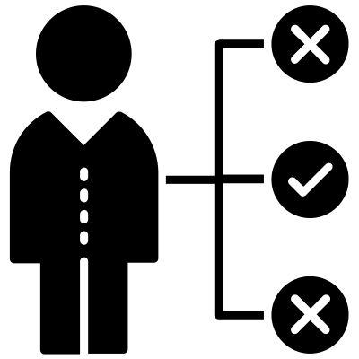






















Stream 2: Outcomes - An illustration of Key Insights around personas’ challenges and pain-points
Insights
Challenges derived during the sessions
Insights
Challenges derived during the sessions
Currently no program for Quality (QC)
Feedback - close loop - currently no mechanism
Integration with SNOW system
API functionality to be extended to update shipping status. Not happening currently, so users do not know order status.
Better integration between Calls and Chats and TeleOpti
Challenges related to Quality (QC)
Application Integration / API
Volume of calls
Escalations - agent needs to go offline, and call customer back
Calls by type are not as accurate
Need for improved first call resolution
Need for skill-based routing
Calls by type are not as accurate
Currently, there is no skill-based routing
Lack of Call / Case Context or Status
Currently not aware of the context or status
Ideally a prop-up that helps set the context on what the user is asking would be helpful
Need for automation
No automation. Still many manual processes.
Automation remains key
Emails are a big black box
Inability to classify, filter and direct emails
Need for improved alerts and notifications
Alerts are displayed at the top - in no order (Chronological order)
Historical information is not being tracked
Need for contextual knowledge
All knowledge base articles are different for different clients which complicates stuff
Need uniformity, standardization for knowledge articles
No historical information is currently available to Agents
Lack of Next Best Actions (NBAs)
Need for improved RPA / Bots
Need for Call elimination with intelligent Bot capabilities (earlier bot failed).
Verification of device identification etc. frustrated the end user, it was not very intelligent. Was a bot - similar to Johnny. Not a chatbot, but an automation bot.
Needs right directions to prevent caller frustration
Equipped to be able to provide an improved first call resolution
Search and easy access to Knowledge
Newer agents may struggle with the terminologies
Volume of Knowledge Articles is very high and client specific
Need for Systematically logging in chats and all the other details.
Chat Conversations are not all getting recorded on SNOW
Clients know chat interactions are not logged into the portal.
It is copy-paste and manual effort
Agents have to go through extra work to assigning further to business etc.

Slide 39


Long Term CCaaS Strategy for QBE – How we view QBE’s future state CC Ecosystem
360 Complete
Conversational AI
CRM
Voice Calls
Enterprise Collaboration
Chat
App Integration
CCaaS
CCaaS Widget
Messaging
WFO / WFM
Customers
Online Digital
RPA & Bot Automation
Real Time Analytics

Slide 40






Future State - 360 Complete Contact Center
Conversational AI
NLU / NLP Voice Gateway
Self-Service
Virtual Agents
Voice Calls
Voice Calls
Enterprise Collaboration
Tech Interventions
Voice ID
Conversational AI
Visual IVR
Self-Service
Cognitive KM Search
Chatbot
Virtual Agents (NLU/NLP)
Optimized Mobile Experience
Next Best Action (Agents)
AI Quality Control Tools
Predictive Outbound Dialer
IVR
Elevate To
CRM
Touch Tone (DTMF)
Voice Recog.
Deflect Call to Chat
NLU/NLP
Voice
Call Backs
Voicemail
Chat
Chat
Real Time
Video
Chat Bots
Elevate To
Transcription
Call / Screen Recording
Chat
Simple Chat (Visual IVR)
Sentiment Analysis
Dashboards
App
Integration
Intelligent Chat (NLU/NLP)
Knowledge
Query - KMS
Next Best Action
Tickets & Case Mgmt.
Customers
Messaging
WFO
(Agent Monitoring)
WFM
(Omni Channel Forecasting
Messaging
Text Messaging (SMS / RMS)
Sales & Marketing
Messaging History
Interaction History
Web Analytics
Messaging Apps (WhatsApp)
ERP Tools
Digital
Email
DBs
Digital Online
Webforms
Digital History
Social Media
RPA | Bots
Workflow Automation
Data lake
Online Forums

Slide 41

Stream 2: Outcomes - An illustration of “Intelligent” Capabilities to what can address QBE’s needs: Core Interventions
Based on the users’ specific needs, Mphasis will define the core interventions, which will determine the technology stack
Intelligent Capabilities for a ‘Smarter’ Contact Center
IVR & Interaction Channels
Workforce Management & Optimization
Salesforce Integration*
Unleash Amazon Connect’s Potential
Look & Listen
Learn
Assist
Analytics Engine WFO & WFM
Collect
Organize & Understand
Adherence Monitoring
Predict, Forecast & Schedule
Building Better Integrations
Salesforce Service Cloud
Amazon Connect
Zoom where/if applicable
Professional & clear Announcements
KB Knowledge Search
Queued Call Backs
Real-time Call Transcriptions
Real-time Sentiment Analysis
Use with Voice, Chat – future channels available as needed
Voice-ID Authentication
Adherence / Quality Monitoring
Call Monitoring / Barge
Coaching & Whisper Tones
Customer Journey Optimization
Wallboard data for agents and supervisors
Interaction & Sentiment Analytics
Real-Time Experience Reporting & Analytics
Correct Integration issues between Amazon Connect & Salesforce Service Cloud Voice
Improved queue routing and transfers
Assess & engage Skill Based Routing
Agent Specialist Team Manager
Aimed at empowering QBE’s customers with choices of how they want to engage, while equipping agents with tools and technology to turn them into rock stars!

Slide 42
Appendix
Stream 1: Short-term - Fix, Review, and Recommend
Stream 2: Long-term – Business Driven, User-Centered, Operations Technology Solution
Industry Trends

Slide 43


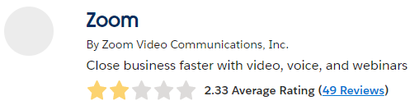

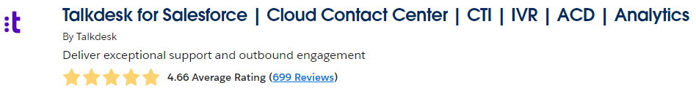
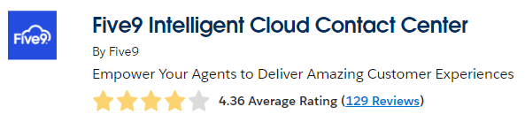
Long Term CCaaS Strategy for QBE
Magic Quadrant for CCaaS 2022
Challengers
Leaders
Genesys
Integration Reviews on Salesforce AppExchange
NICE
Five9
Content Guru
Talkdesk
Cisco
Amazon Connect
8x8
Vonage
Ability to Execute
Niche Players
Visionaries
Completeness of Vision
August 2022
Top 3 Leaders in CCaaS Space
Genesys – NICE – Talkdesk
Top Challenger: Five9
  Top Visionary: Amazon Connect

Slide 44
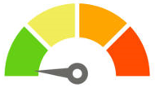

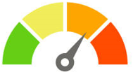



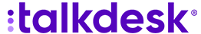
Long Term CCaaS Strategy – Understanding the Risks
Already deployed in environment
Resolving Current Issues is
Shortest path to stabilizing environment
Minimal disruption to Customer Care
Deployed Correctly – Addresses all defined LOB needs
Amazon Connect
RISK
Zoom CC not currently deployed in environment
Limited feature set – feature parity expected later this year
Integration with Salesforce SCV not supported yet
  (ETA soon - end of Q1-23)
Not currently available outside North America, UK, Ireland
  3rd party Carrier peering ETA Q3/Q4-23
Contact Center
RISK
Other CCaaS solution not deployed in environment
Talkdesk & Five9 are among top CCaaS best-in-class.
Full feature stack – supports business defined needs
Supports strong integration with Salesforce SCV
Supports integration with Zoom Phone
RISK
Note: None of these providers support local DIDs in KSA

Slide 45
Long Term CCaaS Strategy – Aligning Risks with Course of Action
Lowest Risk Factor
Already in place
Assess & Address issues, fix in Dev/QA – deploy in prod
Quickest turn around time of all options.
Minimal disruption to LOBs
Option to determine if QBE wants to keep long term & expand to other LOBs
1
Amazon Connect
RISK
Demo both solutions, addressing all LOB use cases for each solution.
Price quotes and time to deploy for both solutions
QBE to choose solution of preference or another solution of interest
Deploy in QA/Dev
  Ensure testing & training in place before cutting over in prod.
2
RISK
If not satisfied with other solutions presented OR, after Amazon Connect deployment has been normalized
Review POC once Zoom CC for Salesforce SCV becomes GA
Review feature schedule to ensure feature availability is in line with LOB needs
Deploy in QA/Dev
  Ensure testing & training in place before cutting over in prod – North America Only until BYOC is availability in Q3 | Q4.
3
Contact Center
RISK

Slide 46
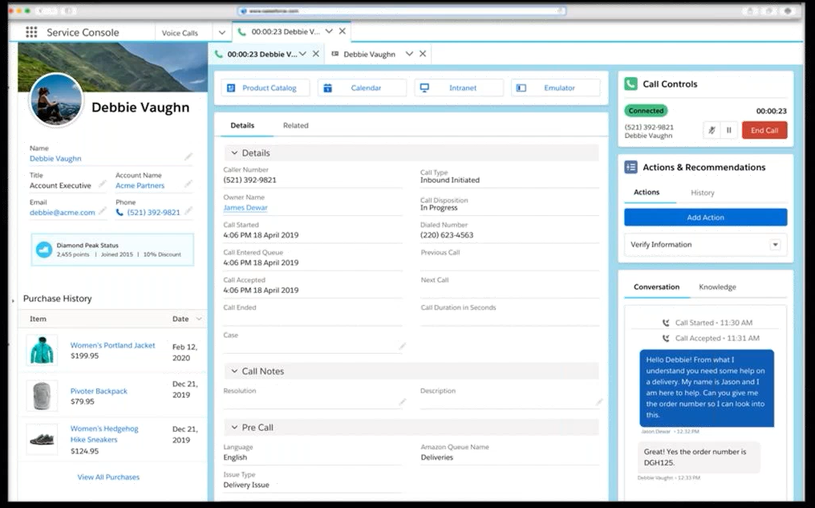
Salesforce Service Cloud Voice (SCV) – with Amazon Connect
Customer 360 Data
Connect data across systems for a 360-degree view of the customer on the call
  An example of how Amazon Connect could integrate with Salesforce SCV, utilizing relevant features
Customer History
Full context into customer’s purchase history

Slide 47
Salesforce Service Cloud Voice (SCV) – with Amazon Connect
Amazon Connect Embedded
AI/Process Automation
Launch Einstein intelligence during the call.
Real-Time Call Transcription
Capture conversation attached to a case
Next-Best Action based on transcription
Sentiment Analysis

Slide 48
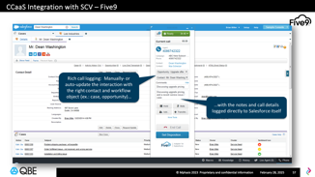
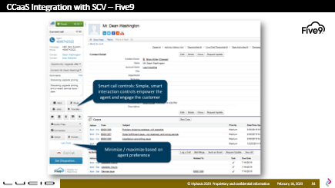
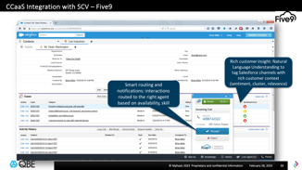
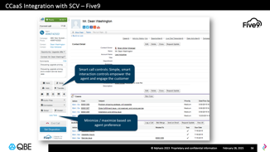
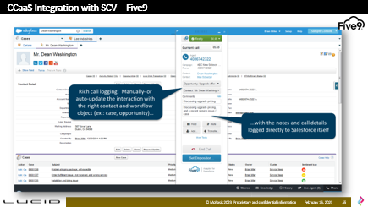
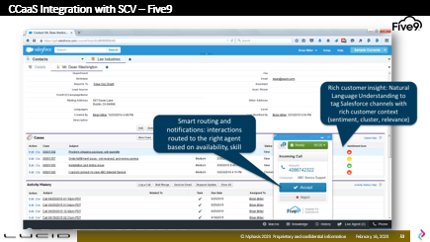
Salesforce Service Cloud Voice (SCV) – with Amazon Connect
*Available via Salesforce AppExchange
Utilize core call controls blended within Salesforce’s Omnichannel solution.
Receive inbound screen pops (CTI) with ability to search for previous interactions
Access call logging information for full context to previous interactions helping personalize customer experience.
Support and ticket management data is shared across systems helping to reduce friction for the agent and the customer.
Screen Pop, Smart Routing & notifications. Skill Based Routing
Natural Language Understanding (NLU) with Customer content from Salesforce including Sentiment & Relevance
Smart Call Controls for easier agent-customer call mgmt.
Optimize Controls view for better agent experience.
Rich Call Logging: Manual or auto-update interactions.
Work-Flow with notes & call details logged directly into Salesforce

Slide 49
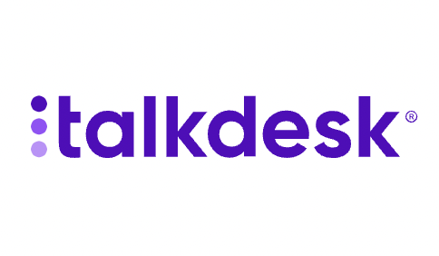
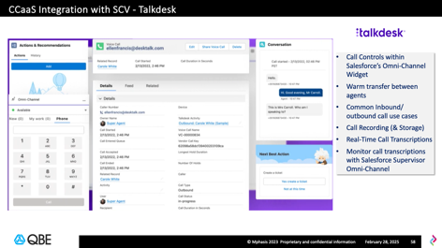
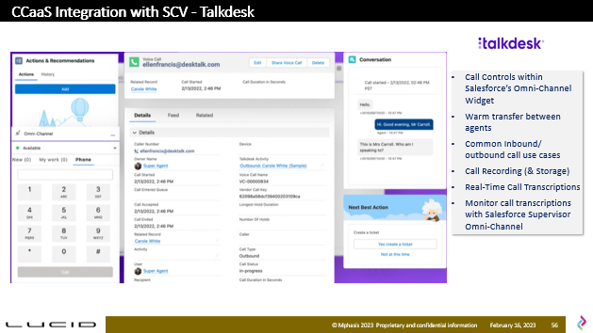
Salesforce Service Cloud Voice (SCV) – with Talkdesk
*Available via Salesforce AppExchange
Call Controls within Salesforce’s Omni-Channel Widget
Warm transfer between agents
Common Inbound/ outbound call use cases
Call Recording (& Storage)
Real-Time Call Transcriptions
Monitor call transcriptions with Salesforce Supervisor Omni-Channel

Slide 50
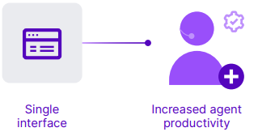
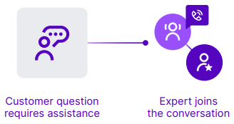
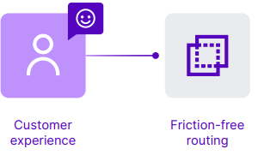
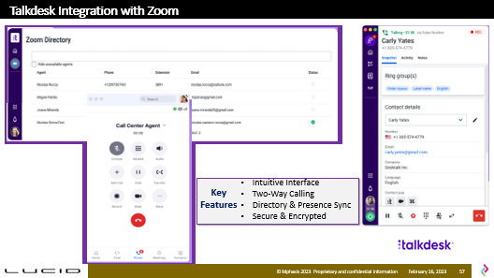
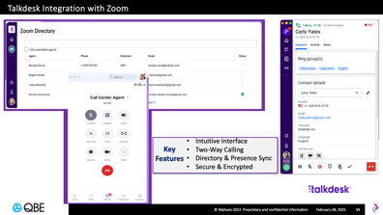
TalkDesk Integration with Zoom
*Available via Zoom App Marketplace
Enhance Agent Productivity
Key Features
Intuitive Interface
Two-Way Calling
Directory & Presence Sync
Secure & Encrypted
Eliminate application switching (swivel chair). Agents can quickly find & collaborate with experts in your organization using a single interface.
Real-time collaboration
Agents can quickly engage a subject matter expert to join the conversation and resolve the issue then and there.
Seamless Routing
Provide friction-free routing between Zoom Phone and Talkdesk without disrupting the customer experience.

Slide 51


Thank You
THANK YOU
Sumit Saxena
Sales Account Executive, Hi-Tech
Sumit.Saxena@mphasis.com
+1 (469) 543 9300

Slide 52
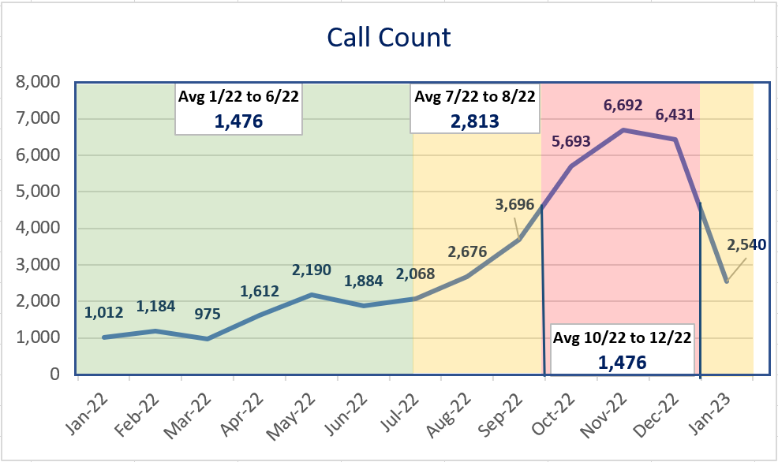
Customer Surging Volume – Call Count

Slide 53
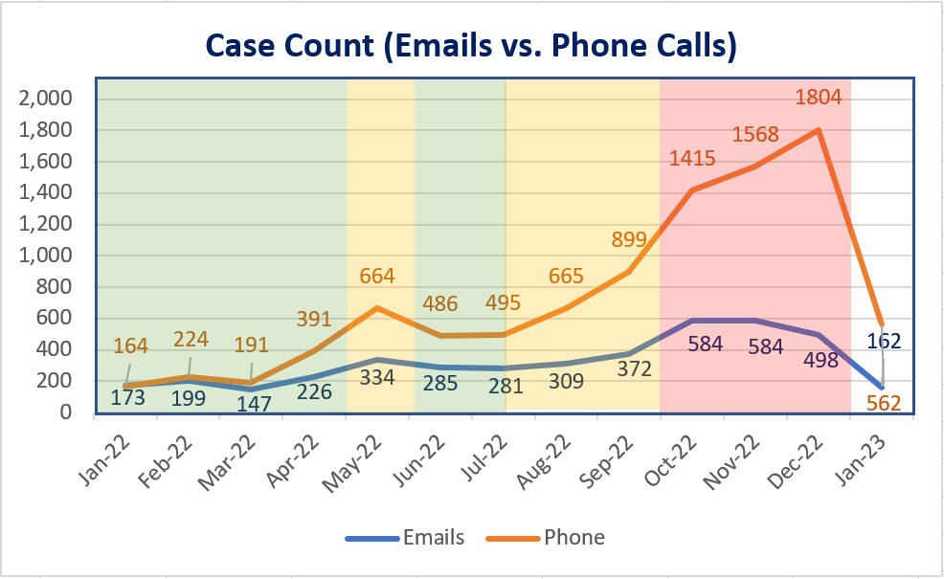
Customer Surging Volume – Case Count

Slide 54
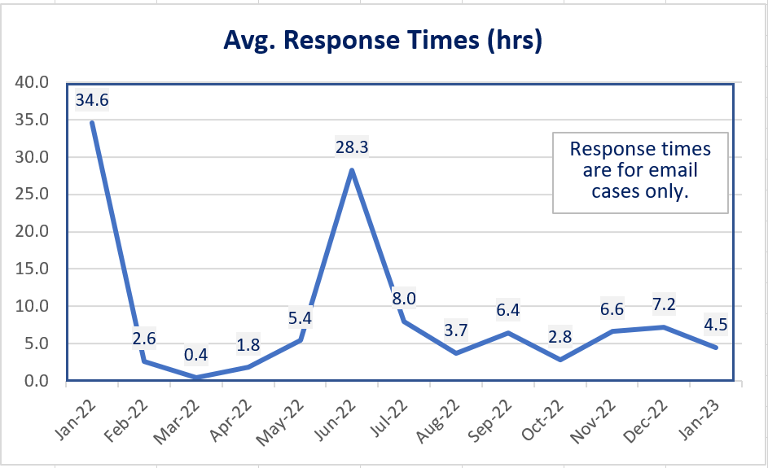
Customer Surging Volume – Response Time

Slide 55

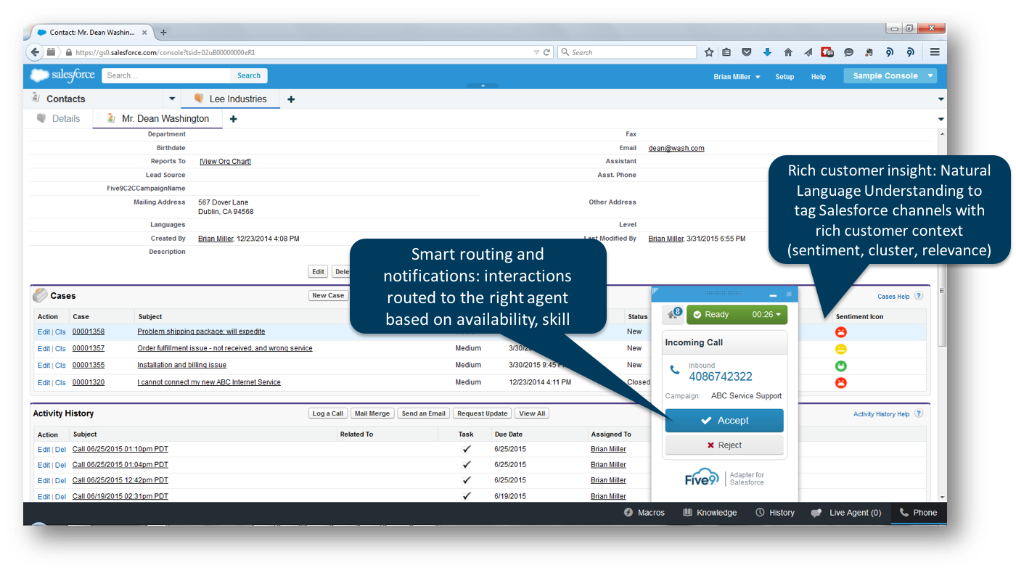
CCaaS Integration with SCV – Five9

Slide 56
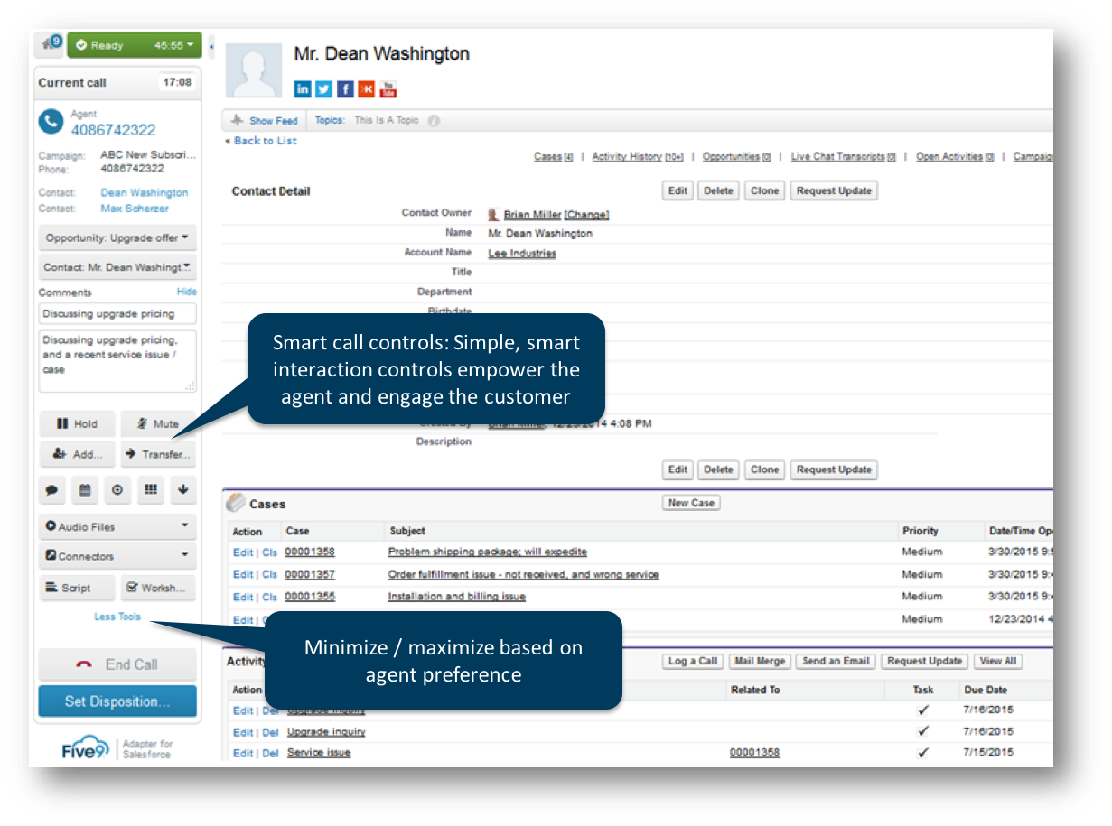
CCaaS Integration with SCV – Five9

Slide 57
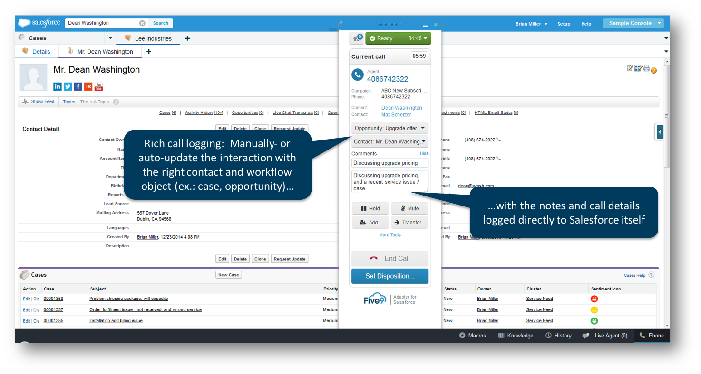
CCaaS Integration with SCV – Five9

Slide 58
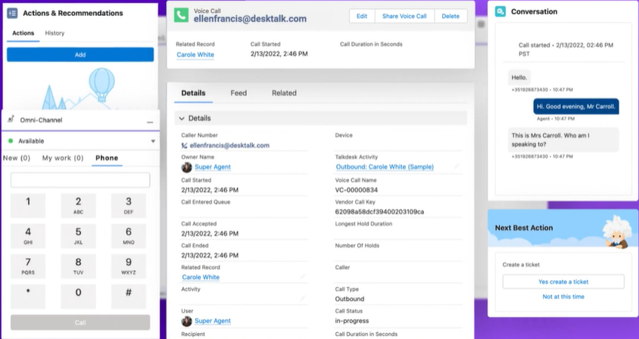
CCaaS Integration with SCV - Talkdesk
Call Controls within Salesforce’s Omni-Channel Widget
Warm transfer between agents
Common Inbound/ outbound call use cases
Call Recording (& Storage)
Real-Time Call Transcriptions
Monitor call transcriptions with Salesforce Supervisor Omni-Channel

Slide 59
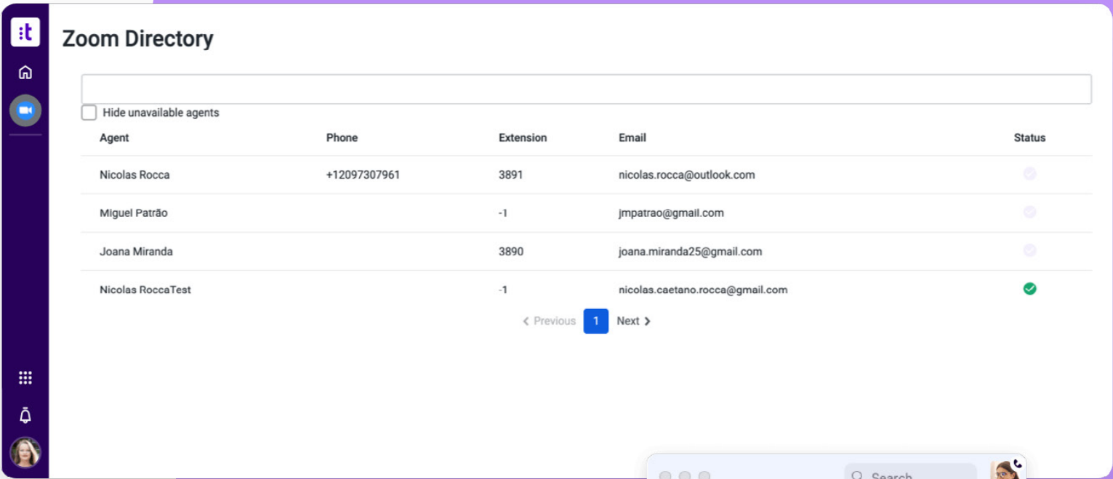
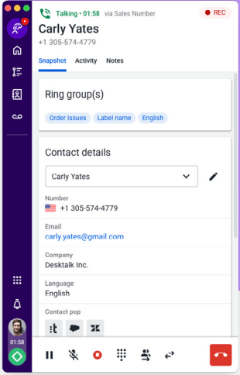
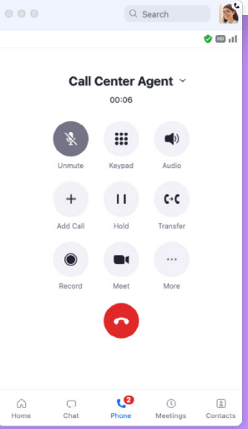

Talkdesk Integration with Zoom
Intuitive Interface
Two-Way Calling
Directory & Presence Sync
Secure & Encrypted
Key Features

Slide 60
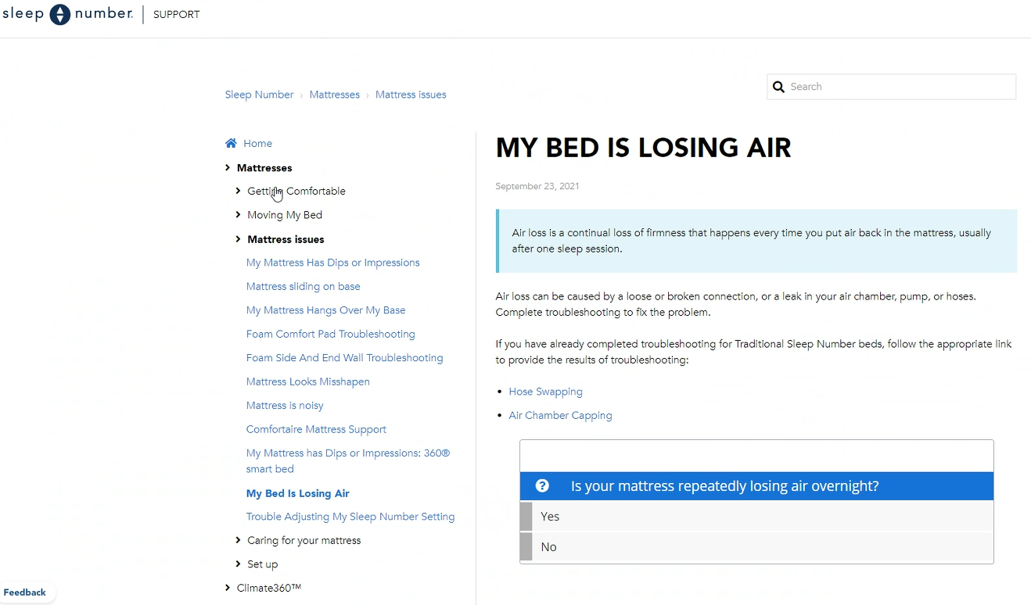
Zingtree – Customer Facing Knowledge Base

Slide 61
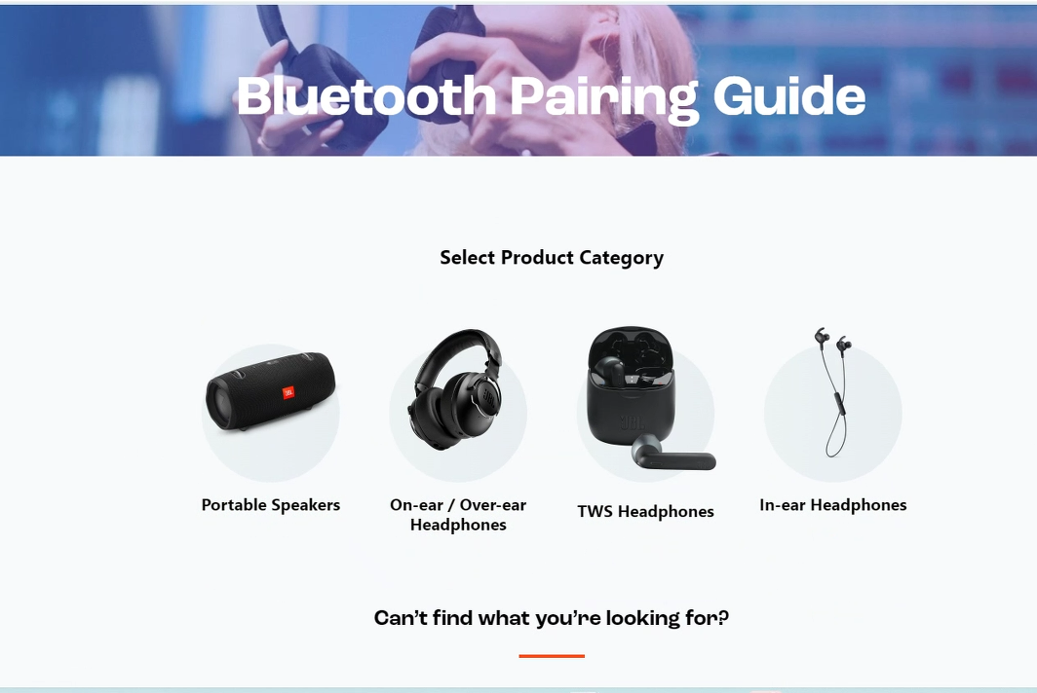
Zingtree – Customer Facing Self-Service Portal

Slide 62
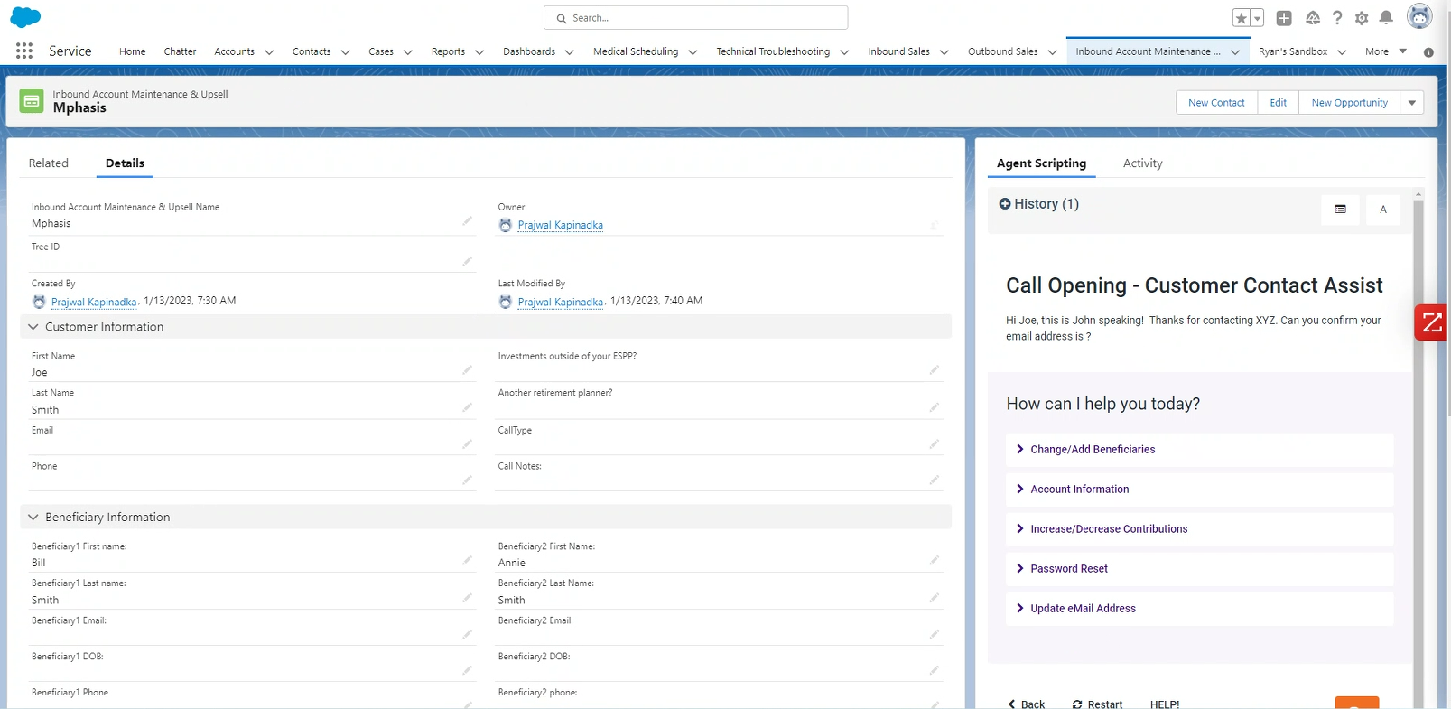
Zingtree – Sample of Salesforce SCV Embedded

