Slide 1


East Kaweah GSA
GSP Revisions Update
July 20, 2022 TAC
Presented by: Matt Klinchuch, PE

Slide 2
Reminder of Process
DWR Released GSP Incomplete Determination for Kaweah Subbasin on January 28, 2022.
Three deficiencies the Kaweah Subbasin needs to address within 180 days:
  SMC for lowering groundwater levels not set in the manner required by SGMA Regs.
  SMC for Subsidence not set in the manner required by SGMA Regs.
  GSPs do not consistently identify interconnected surface water or set their SMC in the manner required by SGMA Regs.
GSP modification & response due July 27, 2022
Provost & Pritchard Consulting Group

Slide 3
Deficiency 1: Chronic lower of groundwater levels

Slide 4
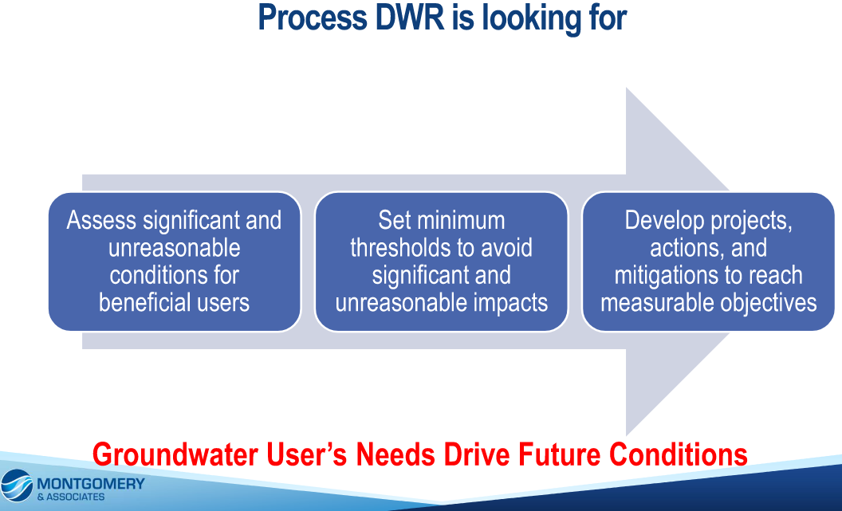
Def. 1: SMC for Lowering Groundwater Levels
Provost & Pritchard Consulting Group

Slide 5
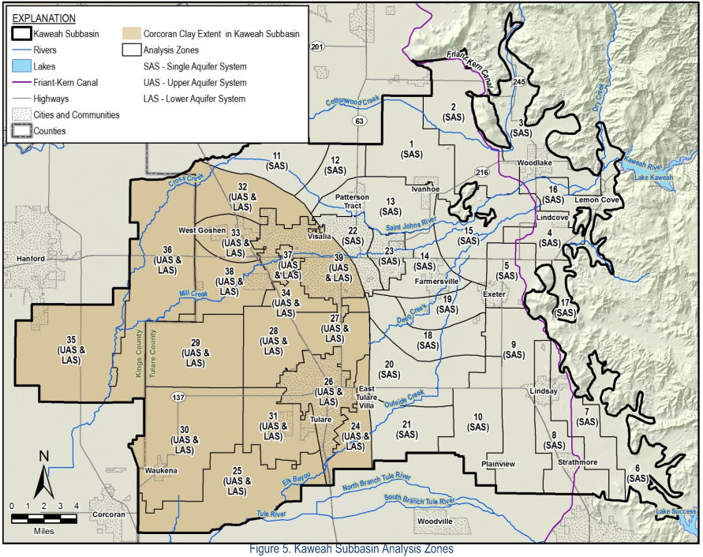
SMC for Lowering Groundwater Levels
Identifying Beneficial Uses/Users:
  Ag
  DAC
  Domestic
  Municipal
  Small Systems
Subbasin coordinated to select groundwater levels protective of the 90th percentile of completed depths for all beneficial use/user type wells since 2002.
Evaluated across 39 zones

Slide 6
SMC for Lowering Groundwater Levels
After reviewing the completed depth for 90th percentile completion depths of all beneficial use/user type wells in a zone found that all 10 EKGSA Threshold Region MTs were more protective (i.e., higher elevation).
Incorporated into the methodology that GSA would not allow for a greater rate of groundwater level decline than that historically experienced (2020 GSP trend analysis), leading the GSA to be more protective – going to deeper MTs would be undesirable to the EKGSA
Results of analysis are that the EKGSA Groundwater Level MTs are not changing
The Subbasin GSAs has been evaluating the MT contour across the Subbasin to understand the “smoothing” of the contours.

Slide 7
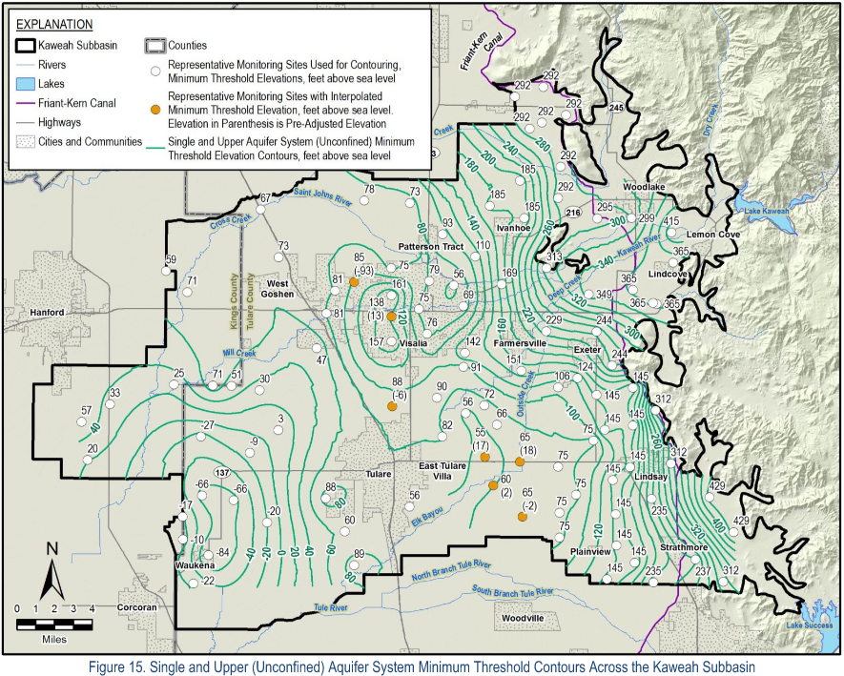
SMC for Lowering Groundwater Levels

Slide 8
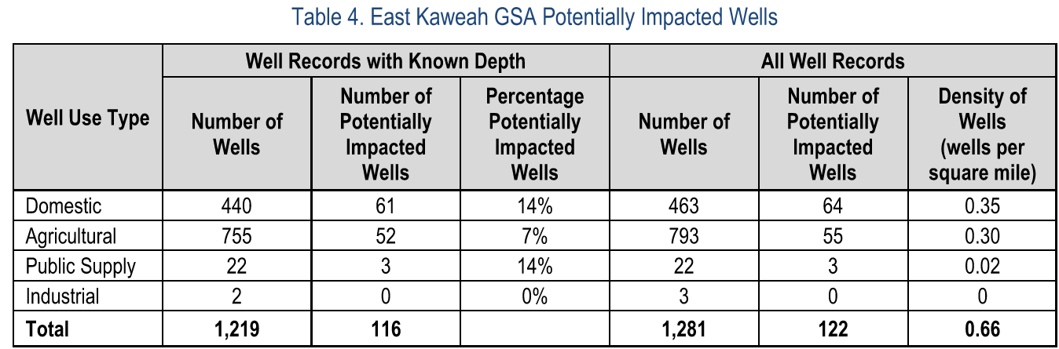
SMC for Lowering Groundwater Levels
The Subbasin understands there are wells that will be impacted prior to the MT elevations and is committing to further develop a Mitigation Plan
A framework for the mitigation plan is going into the GSP revisions. The Mitigation Plans and corresponding funding are still to be coordinated and developed across the Subbasin.
Preliminary analysis approximates the following number of wells could be impacted if water levels reach MT. More investigation to fill gaps and gain more detail will be an on-going effort.

Slide 9
SMC for Lowering Groundwater Levels
A draft framework for triggering conditions that may guide the mitigation program.
Trigger | Conditions | Investigation/ Qualifications | Outreach | Mitigation | GW Management
Green | Groundwater conditions are stable at or above established MO. No Issues are anticipated | Typical monitoring schedule and GSP Management | Annual Monitoring Report | None expected | Continue GSP Planning at objective management
Yellow | Groundwater conditions below established MO and above 50% of established MT by Threshold Region. | Monitoring Network indicating some areas may need further investigation. Initiation of investigation and vetting of specific conditions. Evaluate monitoring frequency. | Annual Monitoring Report; Visual representation of impacted area on GSA map | Following investigation/ qualification - GSA implementing applicable mitigation method for the specific issue | GSA to evaluate annual allocation amount in next allocation period
Orange | Groundwater conditions below 50% of operational range and above the established MT by Threshold Region | Monitoring Network indicating areas need further investigation. Initiation of investigation and vetting of specifc conditions. Evaluate monitoring frequency. | Annual Monitoring Report; Visual representation of impacted area on GSA map; Increased communications | Following investigation/ qualification - GSA implementing applicable mitigation method for the specific issue | GSA to evaluate localized groundwater pumping limits or actions
Red | Groundwater conditions at or below established MTs by Threshold Region | Monitoring indicating many areas need further investigation. Initiation investigation and vetting of specific conditions. Monitoring frequency increased. | Annual Monitoring Report; Visual representation of impacted area on GSA map; Increased communications; Working with local agencies | Following investigation/ qualification - GSA implementing applicable mitigation method for the specific issue. Looking into larger, long-term solutions to address significant impacts | GSA to evaluate broader groundwater pumping limits or actions

Slide 10
Deficiency 2: subsidence

Slide 11
Def. 2: SMC for Subsidence
The Friant-Kern Canal is listed as critical infrastructure for both the East and Greater Kaweah GSPs – Coordination to the 9.5-inch estimate for 10% capacity impact.
Greater & Mid coordinating to a total subsidence MT of a 9 feet
In some locations the subsidence MT may govern over groundwater levels, which means management actions related to reducing groundwater pumping may be triggered by subsidence.
Mitigation related to subsidence impacts is to be developed, but details not as well understood as groundwater levels (wells dry).

Slide 12
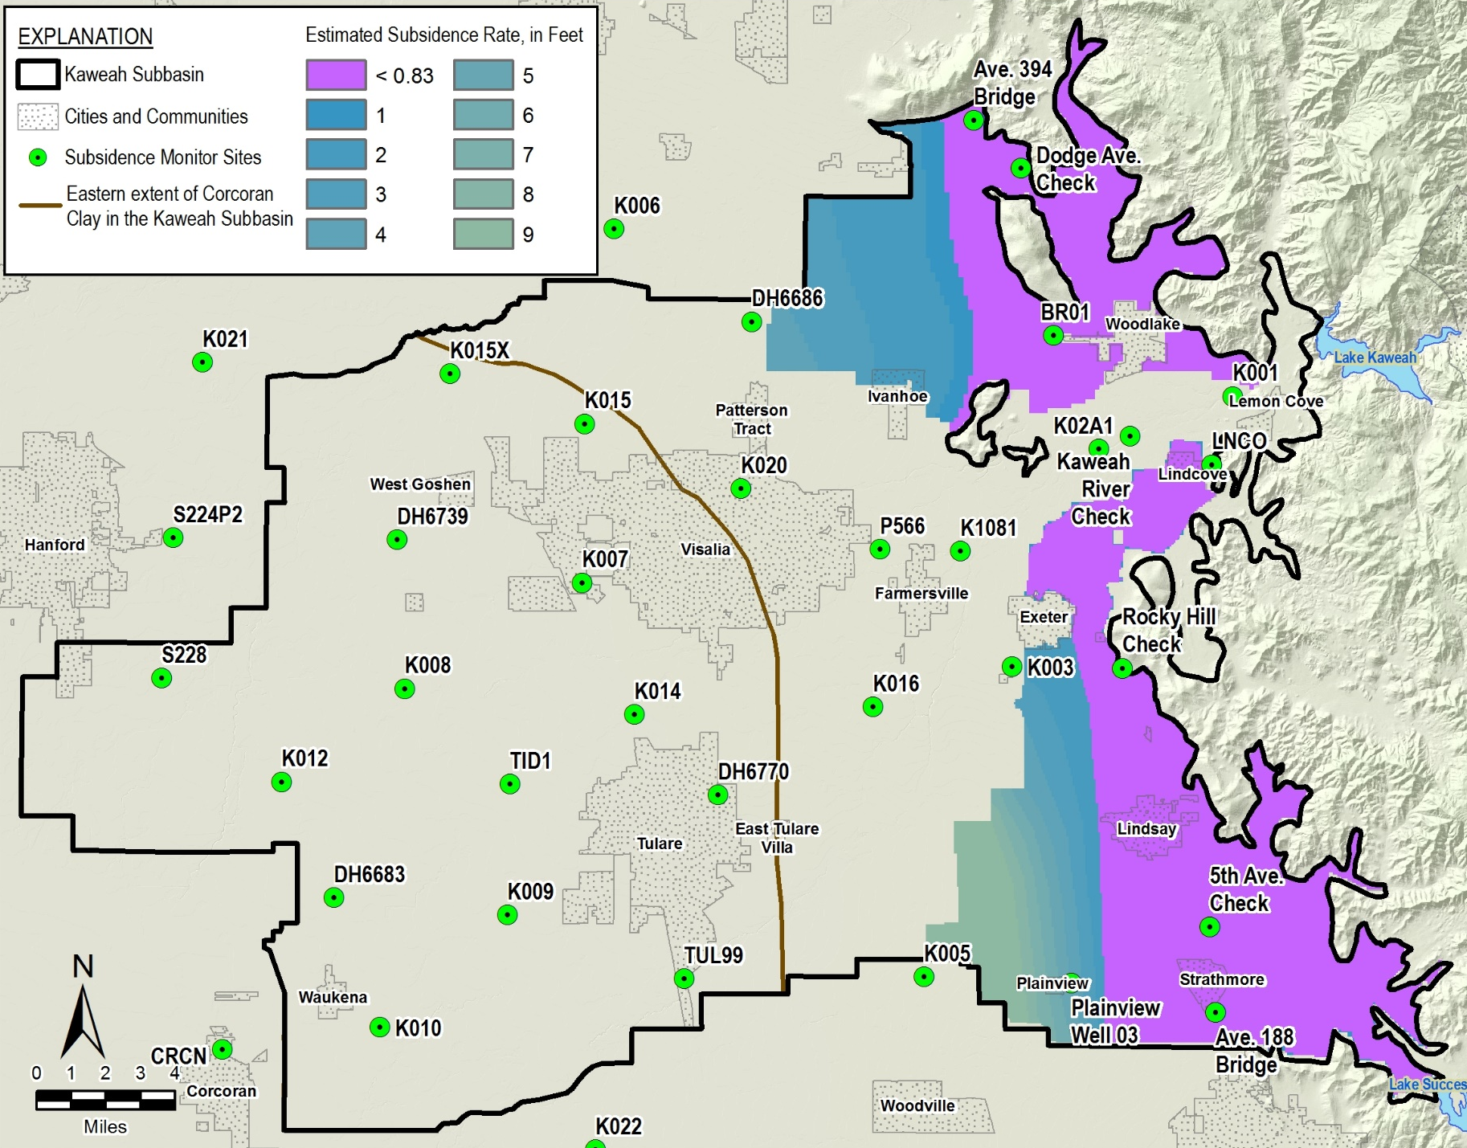
Def. 2: SMC for Subsidence

Slide 13
Deficiency 3: interconnected surface water (ISW)

Slide 14
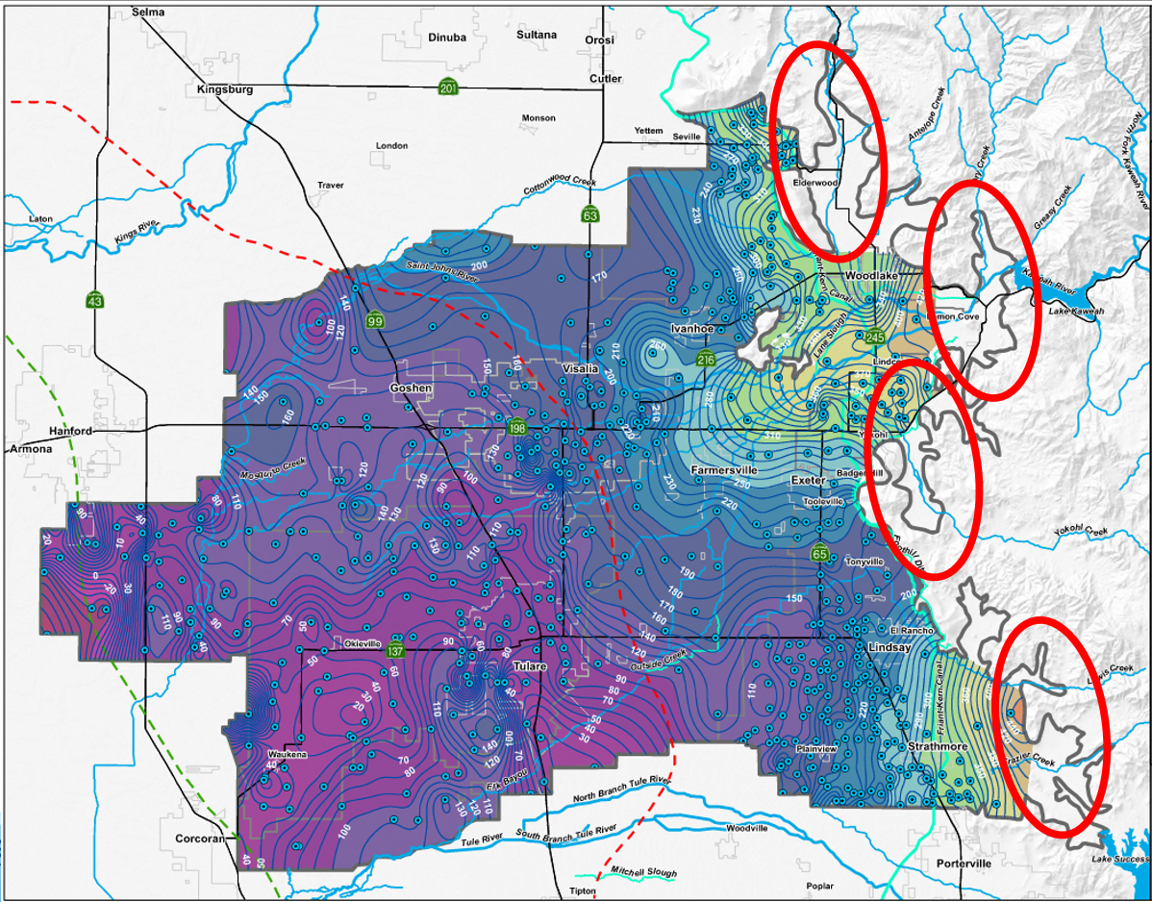
SMC for ISW
Significant gaps exist in potential locations – closer to the watersheds in the foothills
GSAs working to fill groundwater level monitoring data gaps
Most waterways are ephemeral and lack flow for many years
Groundwater pumping in or around this areas unknown

Slide 15
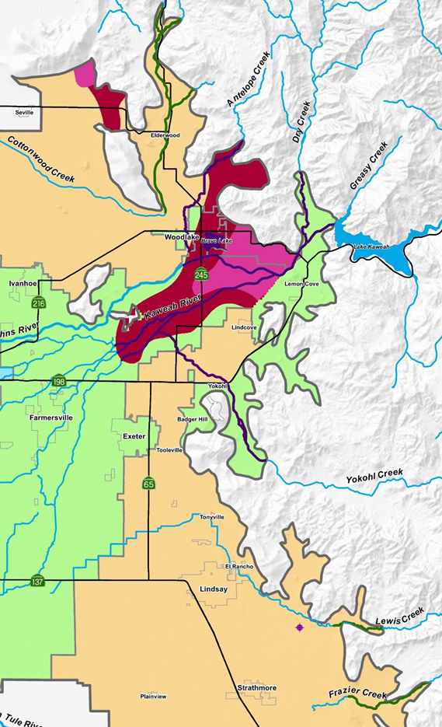
SMC for ISW
Study area to in areas where groundwater level has been within 30 feet of ground surface since SGMA was enacted OR where no groundwater level data currently is available
Evaluating Spring 2015 (dry year) and Spring 2017 (wet year) for the range of downstream limits
Waterways in the EKGSA are:
  Cottonwood Creek
  Antelope Creek
  Kaweah River
  Yokohl Creek
  Lewis Creek
  Frazier Creek

Slide 16
SMC for ISW
Proposing preliminary SMC on channels Losses: MT at 50% losses; MO at 30% losses
Using 1970 Tulare County Flood Master Plan for 25-Year Storm on channels with little flow data

Slide 17
SMC Summary
Sustainability Indicator | GW Elevation | GW Storage | SW-GW Connection | GW Quality | Land Subsidence
Undesirable Result | Unreasonable lowering of groundwater levels resulting in significant impacts to supply wells | Unreasonable reduction in groundwater storage | Unreasonable depletion of interconnected surface waterways, where present | Unreasonable long-term changes of water quality concentrations from baseline conditions to significantly impact users of groundwater | Loss of the functionality of a structure or a facility to the point that, due to subsidence, the structure or facility cannot reasonably operate without either significant repair or replacement
Measurement Methodology | Groundwater Levels | Groundwater Levels (Proxy) | Surface water depletion rate | Sampling for 3 COCs at Ag wells in Monitoring Network; Utilize public system Title 22 quality monitoring | Annual survey of set Mile Posts along the FKC and InSAR data when available and Plainview well point
Minimum Threshold | The most protective groundwater level in a threshold region based on protective level of the approximate 90th percentile of all water supply wells and not allowing a rate of groundwater decline greater than the historical groundwater decline experienced between 1997-2017 | The most protective groundwater level in a threshold region based on protective level of the approximate 90th percentile of all water supply wells and not allowing a rate of groundwater decline greater than the historical groundwater decline experienced between 1997-2017 | More than 50% losses in interconnected surface waterways when water is present | No long-term (10-yr. running average) increase in concentration beyond recognized Ag or Urban standards for those wells under the threshold. For those wells over the recognized Ag or Urban standards, no long-term increases by 20% in concentration | 9.5" of subsidence in a year and cumulative (relate to no more than 10% capacity reduction in current capacity of the FKC)
Measurable Objective | Spring 2017 groundwater levels | Spring 2017 groundwater levels | Equal to or less than 30% losses in interconnected surface waterways when water is present | No unreasonable increase in concentration caused by groundwater pumping and recharge efforts | No subsidence throughout the GSA
Interim Milestones | Proportionate to % of overdraft to be corrected in 5-year intervals through implementation period | Proportionate to % of overdraft to be corrected in 5-year intervals through implementation period | Proportionate to % of overdraft to be corrected in 5-year intervals through implementation period | No change from current Objective (re-evaluate at the 5-year milestone pending data collection) | No change from current Objective

Slide 18
End
Provost & Pritchard Consulting Group

