Slide 1
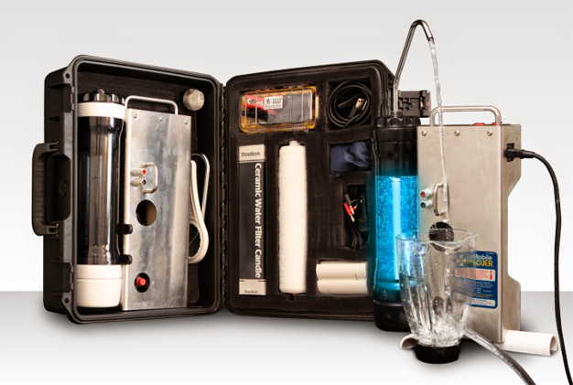
AIR MOBILE RESCUER
“Powerful… Portable… Efficient… Simple!”

Slide 2
CLEAN WATER IS AN ABSOLUTE "NON-NEGOTIABLE".
The lack of clean water will wipe out whole populations / stop armies / and, if left unchecked completely wipe out man-kind.
We have developed a HIGHLY PORTABLE MACHINE that will take the most contaminated water and make it pure on less electricity than a light bulb.
You are about to learn about the "near miraculous" Air Mobile Rescuer water purifier.

Slide 3
PORTABLE
26 LBS / FITS INTO OVERHEAD BIN ON COMMERCIAL AIRLINER
EFFICIENT
DELIVERS 20-25 GALLONS PER HOUR ON 54 WATTS! (AC 120/60 240/50 - 12 VOLTS)
POWERFUL
OZONE /UV 35,000 TIMES MORE POWERFUL THAN CHLORINE
SIMPLE
SETS UP IN 1 MINUTE
THE RESCUER

Slide 4
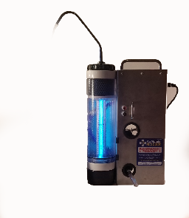
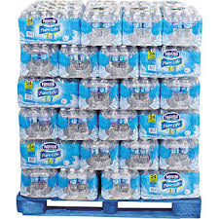

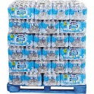
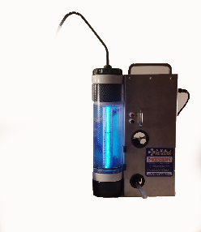
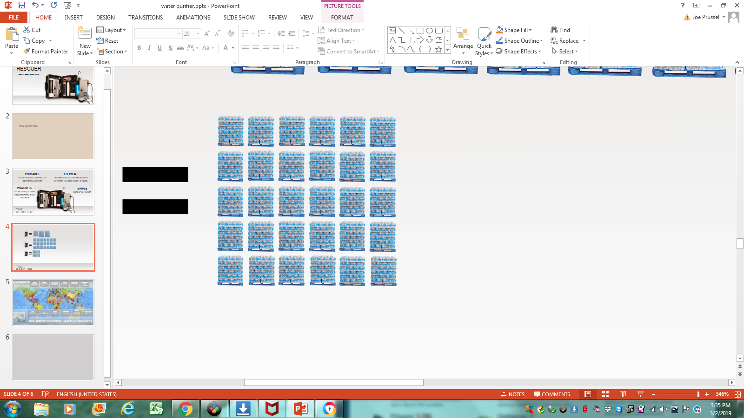
3 Pallets in one day
4,800 Lbs.
21 Pallets in one week
33,600 Lbs.
1,095 Pallets in one year!
1,725,000 Lbs.
THE RESCUER

Slide 5
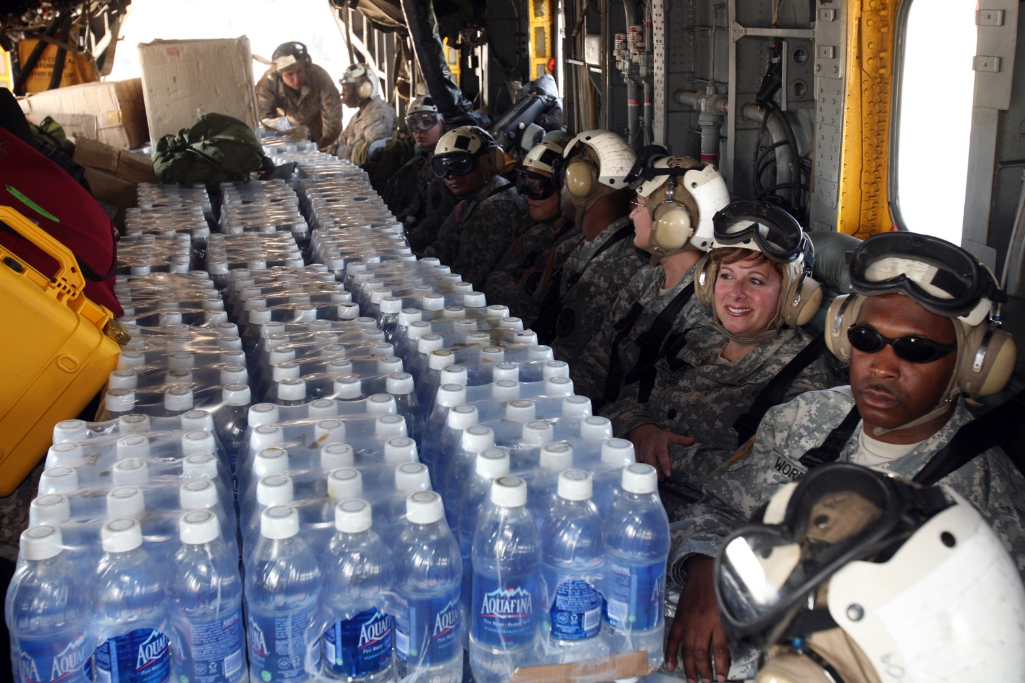

Slide 6
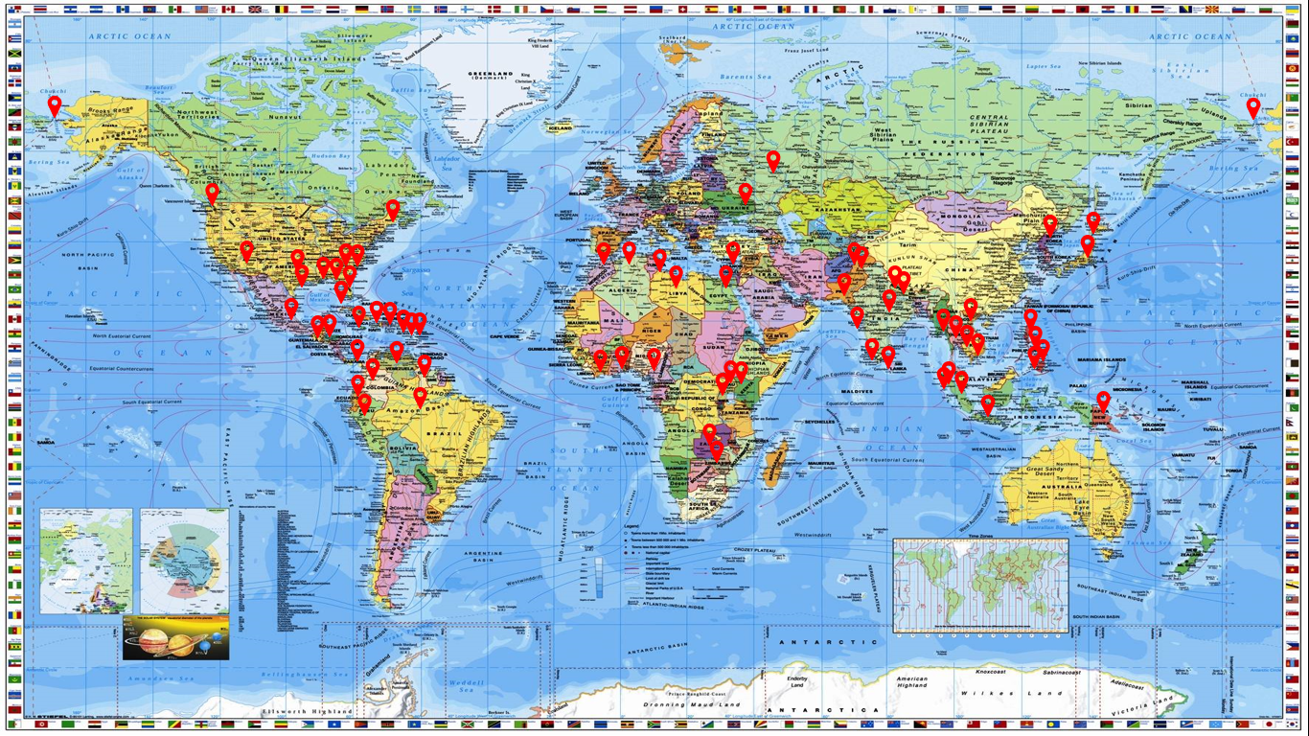
URBAN NEW ORLEANS, INDIA, PAKISTAN (KARACHI)
COLD JAPAN, NEPAL, PAKISTAN, ALASKA
JUNGLE SOUTH AMERIC, INDONESIA INDIA
RAIN FOREST SOUTH AMERICA, SOUTHEAST ASIA
HIGH ALTITUDE NEPAL, PAKISTAN
DESERT NORTH AFRICA
REFUGEE CAMPS SOUTH SUDAN, UGANDA, SYRIA
MAJOR DISASTERS TSUNAMIS EARTHQUAKES HURRICANES CYCLONES TYPHOONS FLOODING FAMINE WAR etc.
HOSTILE SOUTH SUDAN, SYRIA, PAKISTAN, NORTH KOREA
RADIATION (FUKUSHIMA)
HOT INDIA (125 DEGREES)
HUMID AMAZON, SOUTHEAST ASIA
1300+ UNITS IN 47 COUNTRIES - MULTIPLE ENVIRONMENTS

Slide 7
International Red Cross
Samaritans Purse
UN World Food Program
Operation Blessing
Christian Broadcasting Network
Christian Television Network
Reach Out To Haiti
World Compassion
ABC
Love A Child
International Mission Board
UNICEF
Doctors Without Borders
YWAM
East Coast Christian Center
New Life
Mission Aviation Fellowship
USAID
Remote Area Medical
The Great Outdoors
Water For The World
Scores Of Individual Mission Organizations
Scores Of Individuals Who Fund Units For Free Deployments
Wycliffe
LDS
Food For The Poor
Harris Rosen
Calvary Chapel
South American Mission (SAM)
PUMA (Pennsylvania United Medical Association
Philippine Air Force
OFNAC - Haiti
Luka - Thailand
Peruvian Air Force
Ecuador Air Force
Arica
Team Rubicon
H.E.R.O.
PARTIAL CLIENT LIST

Slide 8
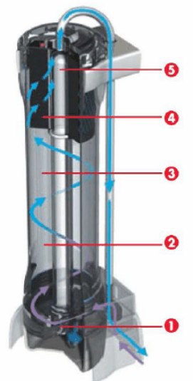
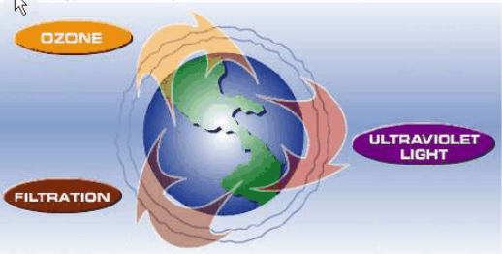
BASICS OF A UV/OZONE VESSEL
5-Way Purification

Slide 9

Organisms | Energy dosage of ultraviolet radiation in µW/cm need to kill factor
Bacteria | 90% | 100%
Bacillus anthracis-Anthrax | 4520 | 8700
Bacillus anthracis spores-Anthrax spors | 24,320 | 46,200
Bacillus magaterium sp. (spors) | 2730 | 5200
Bacillus magaterium sp. (veg.) | 1300 | 2500
Bacillus paratyphusus | 3200 | 6100
Bacillus subtilis spores | 11,600 | 22,000
Bacillus subtilis | 5800 | 11,000
Clostridium Tetani | 13,000 | 22,000
Corynebacterium Diphtheriae | 3370 | 6510
Ebertelia typhosa | 2140 | 4100
Escherichia coli | 3000 | 6600
Legionella bozemanil | 3500 | 7000
Legionella dumoffii | 5500 | 11,000
Legionella gormanii | 4900 | 9800
Legionella micdadei | 3100 | 3100
Legionella longbeachee | 2900 | 5800
Legionella pneumophila | 3800 | 7600
Leptospiracanicola-Infectious Jaundice | 3150 | 6000
The following is a UV industrial standard table showing the kill factor of the UV germicidal lamp contained in the Air Mobile rescuer emits a 40,000 energy dose.
TECHNICAL DATA SHEET
According to this table the lamp kills 100% 53 known bacteria, viruses, protozoa, yeast, and molds.
(System specification, operating characteristics, and claims)

Slide 10
Microccocus candidus | 6050 | 12,300
Microccocus sphaeroides | 1000 | 15,400
Mycobacterium tuberculosis | 6200 | 10,000
Neisseria catarrhalis | 4400 | 8500
Phytomonas tumefaciens | 4400 | 8000
Proteus vulgaris | 3000 | 6600
Pseudomonas aeruginosa | 5500 | 10,500
Pseudomonas Fluorescens | 3500 | 6600
Salmonella enteritdis | 4000 | 7600
Salmonella paratyphi – Enteric Fever | 3200 | 6100
Salmonella typhosa- Typhoid Fever | 2150 | 4100
Salmonella typhimurium | 8000 | 15,200
Sarcina Lutea | 19,700 | 26,400
Serratia Marcesens | 2420 | 6160
Shigella Dyseteriae-Dysentery | 2200 | 4200
Shigella flexneri- Dysentery | 1700 | 3400
Shigella paradysenteriae | 1680 | 3400
Spirillum rubrum | 4400 | 6160
Staphylococcus Albus | 1840 | 5720
Staphylococcus Aerius | 2600 | 6600
Staphylococcus Hemolyticus | 2160 | 5500
Staphylococcus Lactis | 6150 | 8800
Staphylococcus Viridans | 2000 | 3800
Vibrio Comma - Cholera | 3375 | 6500
Molds | 90% | 100%
Aspergillius Flavus | 60,000 | 99,000
Aspergillius Glaucus | 44,000 | 88,000
Aspergillius niger | 132,000 | 330,000
TECHNICAL DATA SHEET
(System specification, operating characteristics, and claims)

Slide 11
Mucor racemosus A | 17,000 | 35,200
Mucor racemosus B | 17,000 | 35,200
Oospora lactis | 5000 | 11,000
Penicillium Expansum | 13,000 | 22,000
Penicillium Roqueforti | 13,000 | 26,400
Penicillium Digitatum | 44,000 | 88,000
Rhisopus Nigricans | 111,000 | 220,000
Protozoa | 90% | 100%
Chlorella Vulgaris | 13,000 | 22,000
Nematode Eggs | 4,000 | 92,000
Paramecium | 11,000 | 20,000
Virus | 90% | 100%
Bacteriopfage-E.Coli | 2600 | 6600
Infectious Hepatitis | 5800 | 8000
Influenza | 3400 | 6600
Polivirus – Poliomyelitis | 3150 | 6600
Tobacco Mosaic | 240000 | 440000
Yeast | 90% | 100%
Brewers Yeast | 3300 | 6600
Common Yeast Cake | 6000 | 13200
Saccharomyces Carevisiae | 6000 | 13200
Saccharomyces Ellipsoideus | 6000 | 13200
Saccharomyces spores | 8000 | 17600
TECHNICAL DATA SHEET
(System specification, operating characteristics, and claims)

Slide 12
American, British and Hong Kong laboratories have tested the Dalton Sterasyl Cartridge (Stage 2 Function) with the following results….
NSF 42 – exceeds 85% particle 0.05 through 1.0 Micron reduction
NSF 53- meets 99.5% cysts and 1.0 NTU turbidity reduction
Bacteria Reduction – 99.99%
Removed 100% Shigella Dypenteriae, Salmonella Typhi, and Vibrio Cholerae
Heavy Metals Reduction 99.5% – 99.9%
Visit the Doulton Water Filter website at www.DoultonUSA.com for additional technical information and claims.
TECHNICAL DATA SHEET
(System specification, operating characteristics, and claims)

Slide 13
DATA SHEET
POWER REQUIREMENT | 12V Or 110-240V
POWER DRAW | 54w
WATER PRODUCTION | 20-25 Gph
DUTY CYCLE | 8 Hours Recommended
LIFE CYCLE OF UV | 10,000 On /Off Cycles
UV INTENSITY | 40,000 Microwatt Ssc
WEIGHT | 26 Lbs Or 11.8 Kg
DIMENTIONS | 19.2” X 15.2” X 7.3

Slide 14
COMPONENT SERVICING
SUCTION SCREEN | SERVICE NOT NEEDED
SUCTION FILTER | 1000 GAL DEPENDING WATER QUALITY/PARTICULATE
CERAMIC PER-FILTER | CLEANABLE
PURIFICATION LAMP | 10,000 ON/OFF CYCLES
PURIFICATION LAMP | 10,000 GAL +

Slide 15
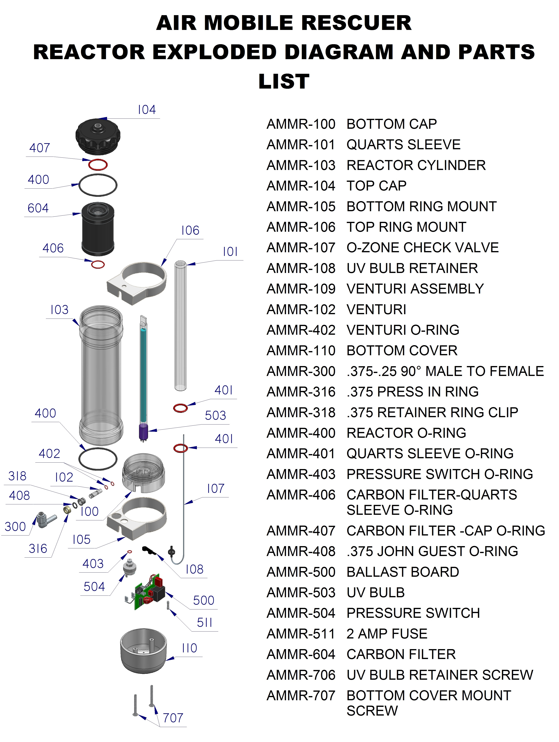
DIAGRAM

Slide 16
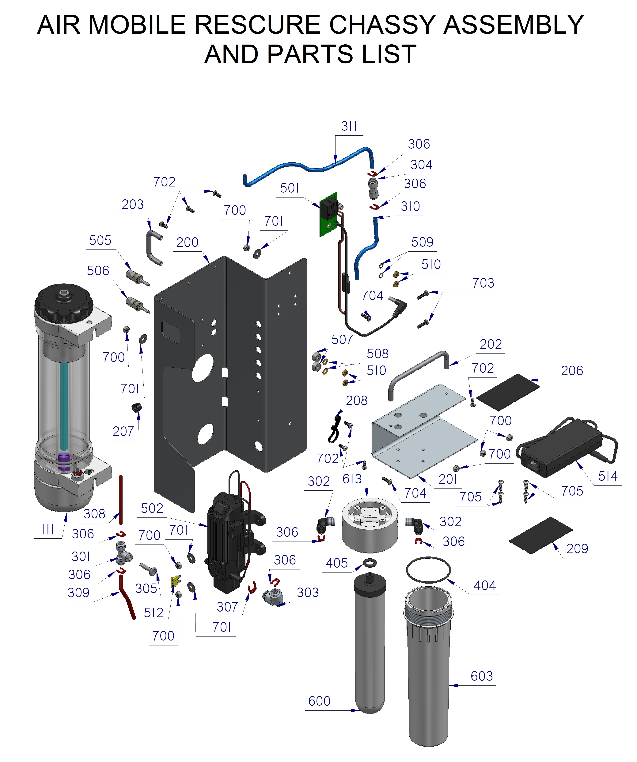
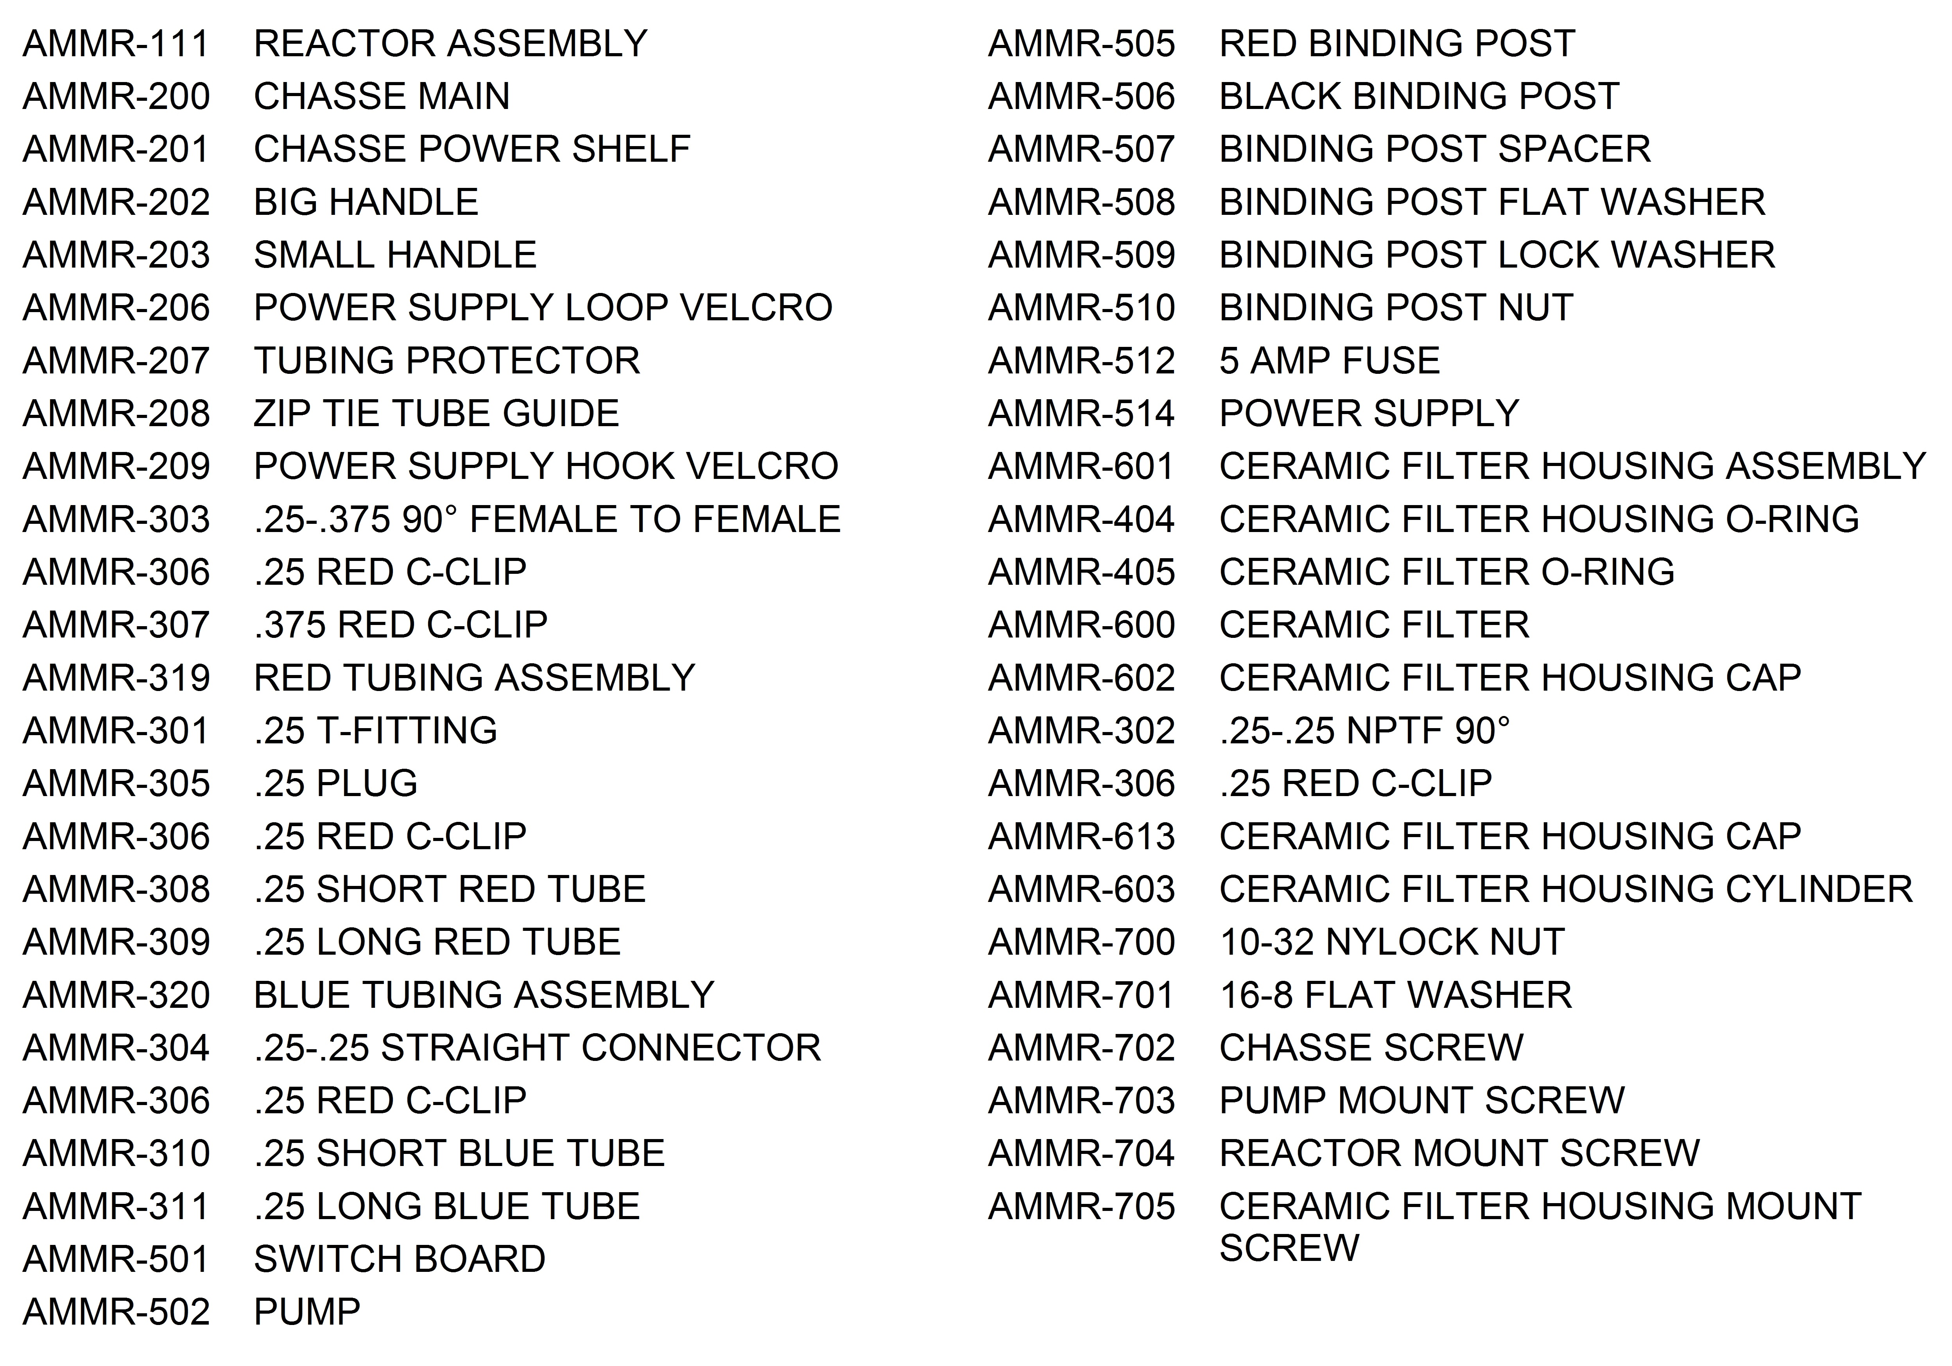
DIAGRAM

Slide 17
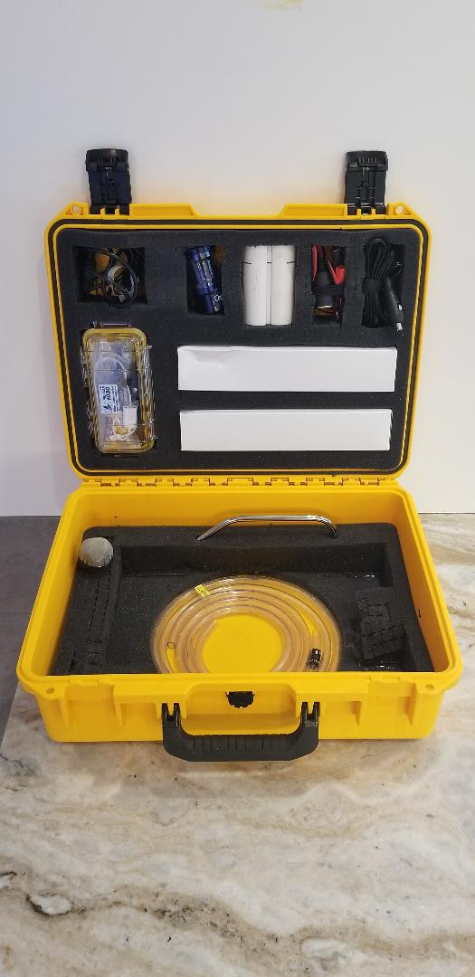
IN THE CASE
International plug kit
3 Stabilizing Feet
Male 12v power plug
Female 12v power plug
Standard 110v plug
Gloves and scotch bright pad
Mushroom mesh filter
“Magic” tool kit
Ditch filter
Spare Ceramic Filter
2, 5’ 3/8” Tubing (standard & silver impregnated)
Spout
Strap wrench
Manual

Slide 18
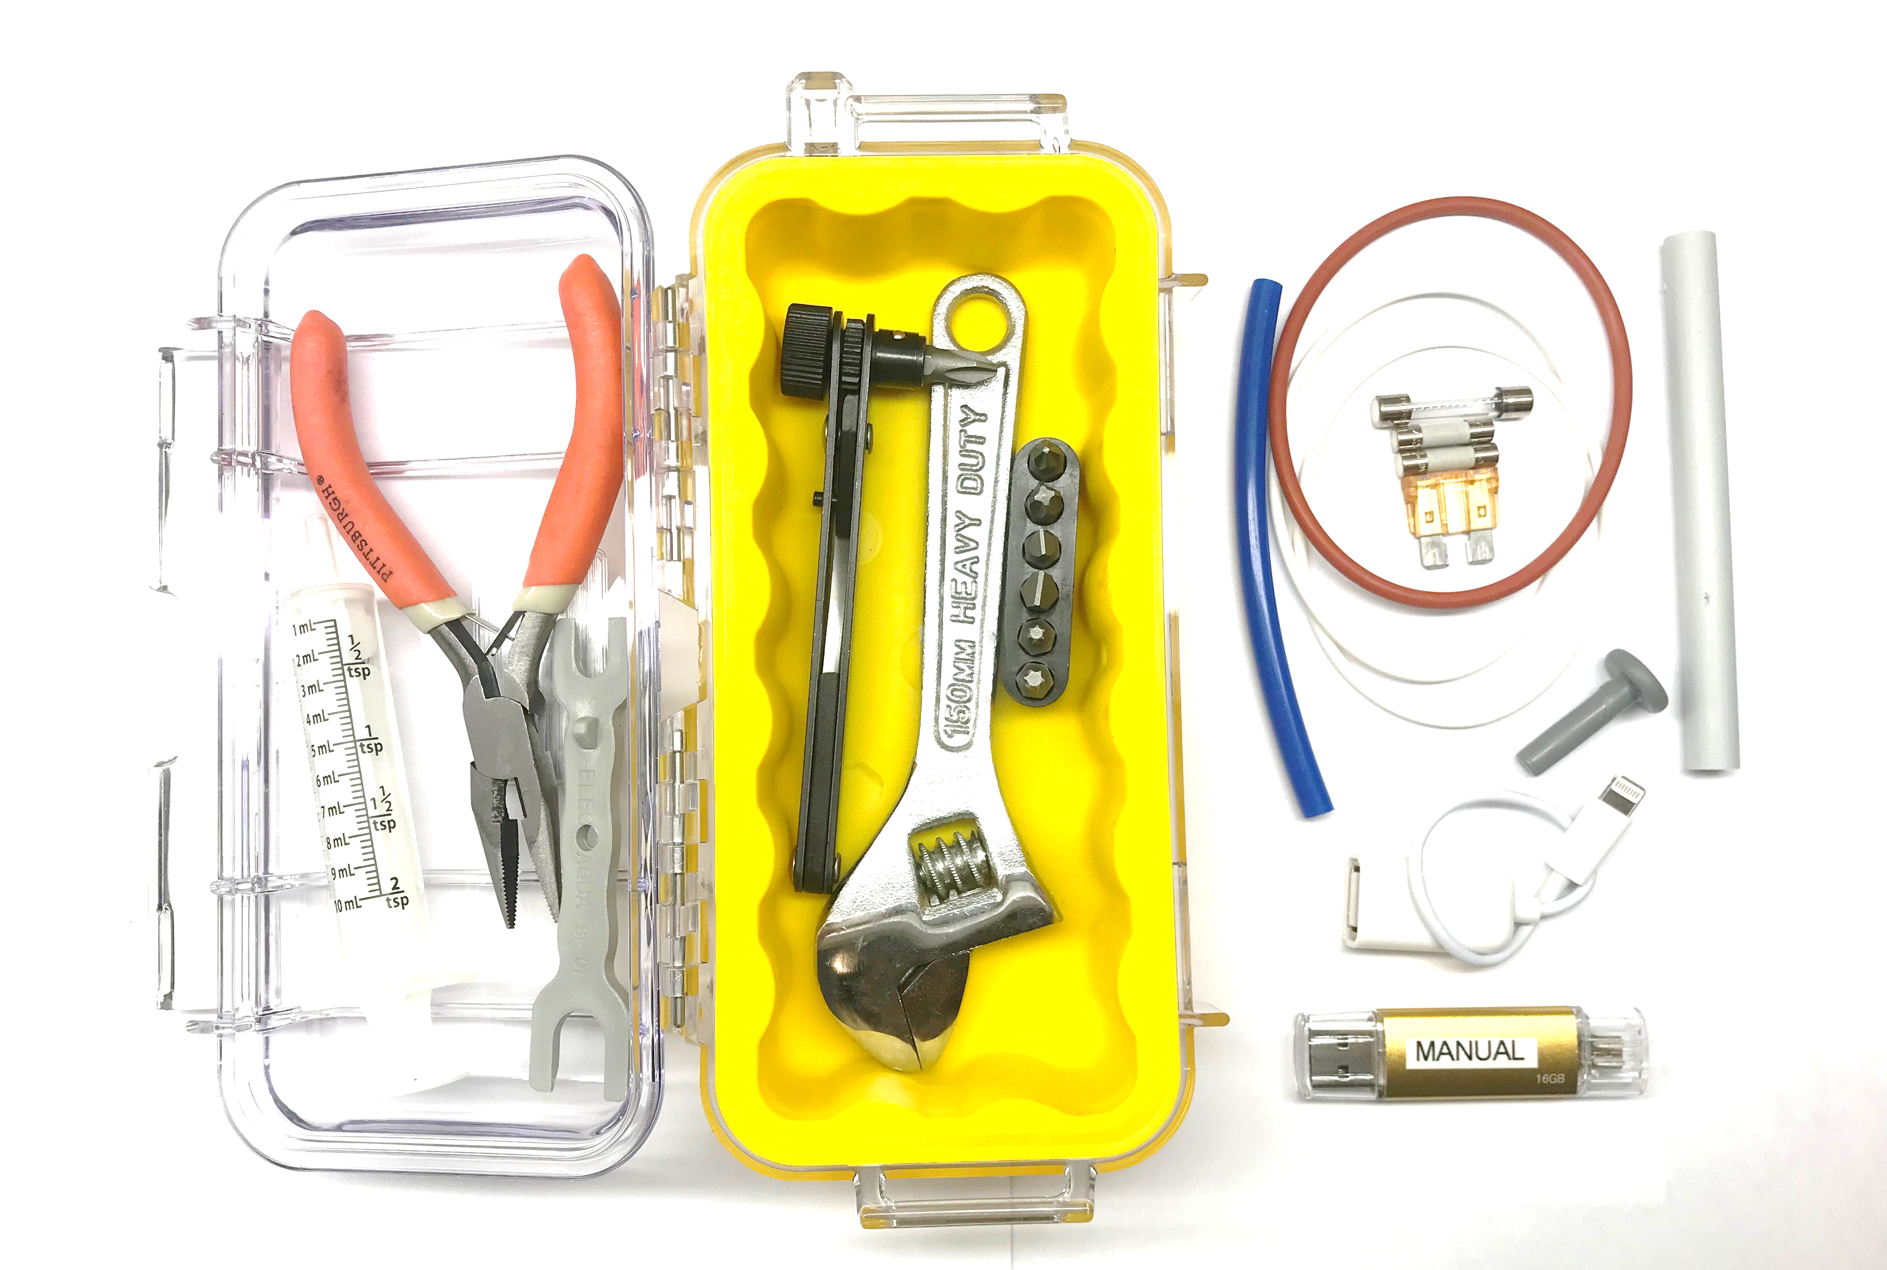
IN THE “MAGIC BOX” TOOL KIT
Within every “magic box” tool kit there is…
  O-rings- 2 ceramic filter, 1 main seal, 1 small carbon
  filter seal
  John Guest Plug
  Blue Cleaning tube
  Clear tubing extension tube
  John Guest tool
  Fuses- 2 2amp, 1 10amp, 1 5amp,
  Tools- crescent wrench, screwdriver, pliers, syringe,
  USB- USB with manual and videos, USB adapters

Slide 19
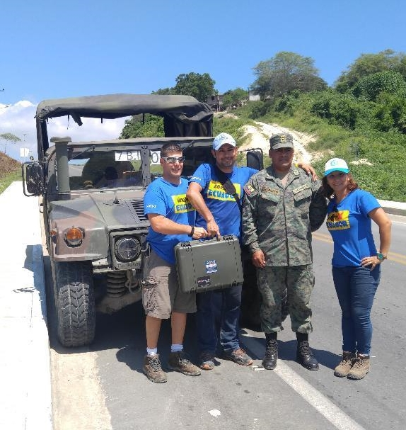
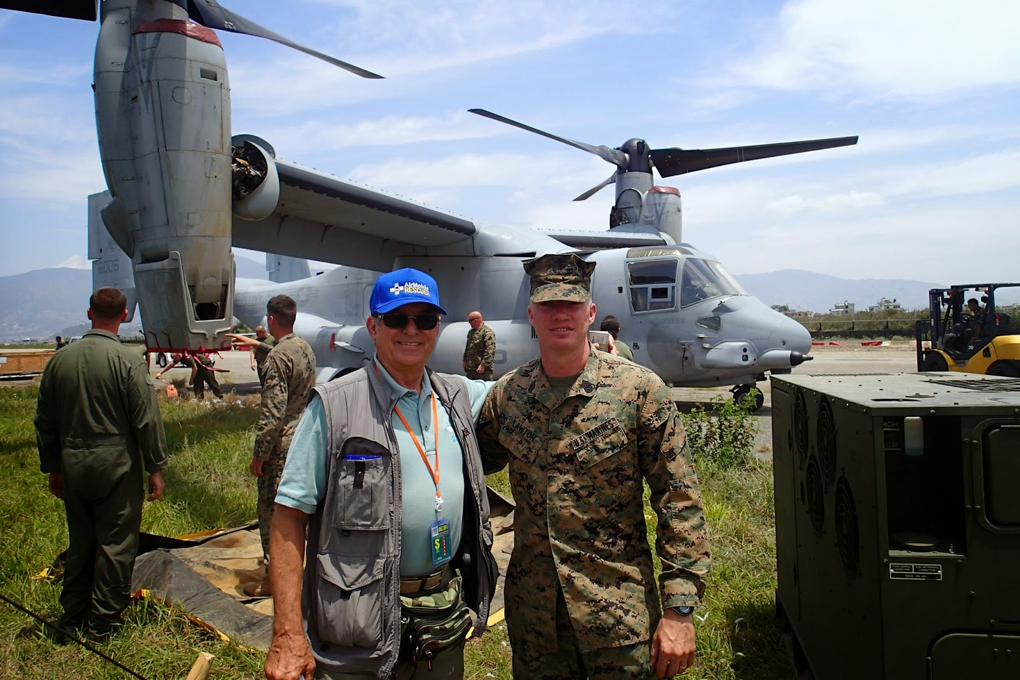
THANK YOU

