Slide 1
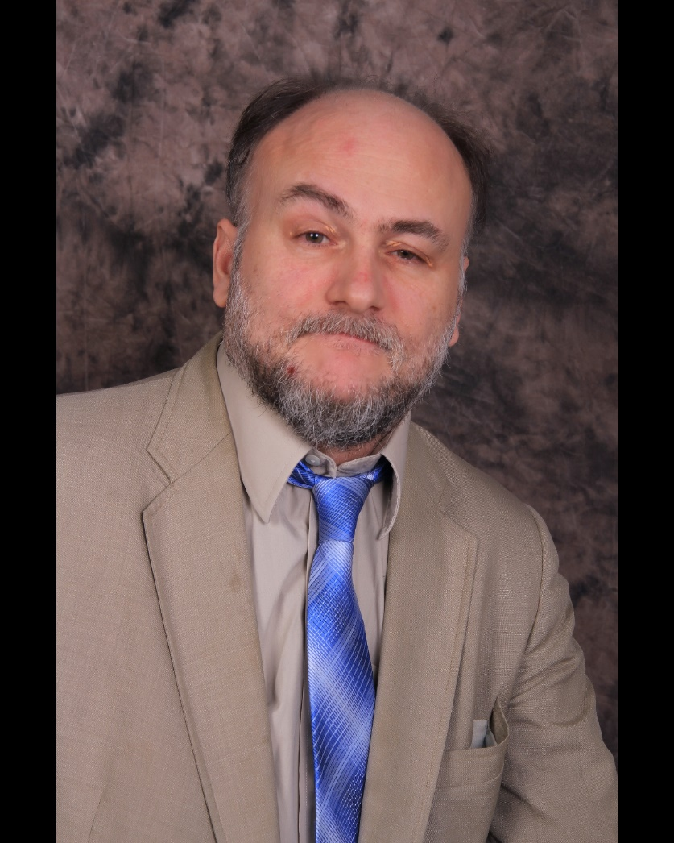
Our President and Founder
Paul D.C. Amara

Slide 2
Contents
A BIOGRAPHY
A WORD ABOUT OUR PRESIDENT AND FOUNDER
A WORD ABOUT PAULDCAMARA&ASSOCIATESHYPNOTHERAPY
A WORD ABOUT PAULDCAMARA.COM
A WORD ABOUT HYPNOTHERAPY AND HOW WE WORK
A WORD ABOUT OUR GOALS
A WORD ABOUT SUCCESS
WHAT YOU CAN EXPECT
SURPRISES

Slide 3
A Biography
Professed Secular Franciscan St Joseph’s Church
Boston, Mass
Undergraduate College University of Massachusetts
Boston, Mass (Sociology, Psychology, Law)
Graduate School Cambridge College
Cambridge, Mass (Masters in Education)
Schools of Specialization Stratford University
Falls Church, Virginia (Relaxation Therapy)
School of Specialization HMI Nationally Accredited College of Hypnotherapy
Tarzana, California (Hypnotherapy)
Certifications: Handwriting Analysis, Advanced Handwriting Analysis, Therapeutic Imagery Facilitator, Smoking Cessation, Sports Performance,
Other areas of concentration Dream Therapy , Stage Hypnosis, Rapid & Instant Iductions,

Slide 4
A WORD ABOUT OUR PRESIDENT AND FOUNDER
Mr. Amara’s interest in the field of cognitive sciences began when he first used the principles on himself, later on family members, friends, and his colleagues and later throughout his career in education.
Mr. Amara has taught all ages and lead many groups in both Church and secular organizations throughout his lifetime. Through his faith life, he has always held a close relationship to God and a strong desire to lead through his service to those in his life in every venue.
Mr. Amara first learned the art of Relaxation through the works of Fredrick Lens (Relaxation Therapist) and Dr. David Illig (Hypnotherapist). This lead Mr. Amara to Stratford University where he received his Relaxation degree and later IMI America’s Nationally Accredited School of Hypnotherapy
where he received his Hypnotherapy degree and other specializations.
Mr. Amara learned philosophies of success, leadership skills, and business through some of the most well known experts including but not limited to James Rohn, American entrepreneur, author, and motivational speaker, Darren Hardy, American author, keynote speaker, advisor, and founding editor of Success Magazine, Napoleon Hill, Norman Vincent Peale and George Clason.

Slide 5
A WORD ABOUT
PAULDCAMARA&ASSOCIATESHYPNOTHERAPY
Mr. Amara like his grandfather John Joseph Amara of John J. Amara and Sons Construction (1926) believes in leading the community through service.
As John F. Kennedy said “Ask not what your country can do for you, ask what you can do for your country.
Our company is founded upon these principles.
Special note:
As Mr. Amara is a Secular Franciscan he wishes to point out that it is not him or his hypnotherapist team that is the uppermost in charge of what happens in our offices and facilities rather it is by and through the will of God if change should take place and if so the extent to which such a change takes place.
His main principle here as in life is
“Jesus, I trust in You.”
(Thank you Sr. Faustina)
Let’s place our faith in Him and in each other!

Slide 6
A WORD ABOUT PAULDCAMARA.COM
Our company started this site in order to reach out and serve as many people as possible to help them reach their goals and desires in life.
We invite you to realize that with the simple click of your mouse or keypad you may find yourself becoming much more successful in life.
Which is your level of success?

Slide 7
A WORD ABOUT HYPNOTHERAPY & HOW WE WORK
We work with both adults and children.
Among our clients issues are:
Improvement in health
Improvement in relationships
Attaining and maintaining financial prosperity
Attaining and maintaining a good meaningful career
Attaining and maintain a nice place to live
Getting rid of bad habits of thought and action and replacing them with good healthy habits of thought and action
Dealing with major changes in one’s life
Attaining and maintaining practices for self improvement
Unless otherwise specified hypnotherapists are not medical doctors. Hypnotherapy is a service provided to help our clients achieve avocational and self-improvement goals. We also work under referral of doctors, dentists, psychologists and other medical professionals.

Slide 8
A WORD ABOUT OUR GOALS
Together, as a team we may see changes that otherwise may never have happened or maybe may never have been dreamt of.
As your , therapist consider me the coach and yourself as the athlete.
And our goal is for you to become a gold medalist.
What we will achieve depends on the level your subconscious will take you to.
Remember, “The only failure that is truly tragic is not to try and fail but to fail to try.

Slide 9
WHAT YOU CAN EXPECT
A caring and listening ear
A professional therapist
A life coach and teacher
The script to a possible new life
A chance to achieve your goals and desires

Slide 10
Surprises
          What the subconscious has in store
          Where the subconscious will lead
          What level of success we will achieve

