Slide 1
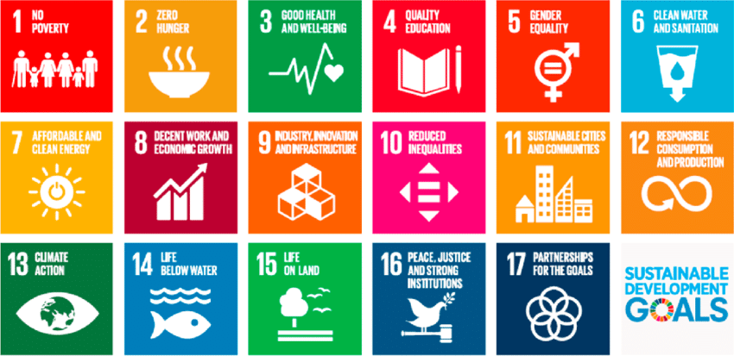
HNWI and Tax Compliance Capacity Building Engagement with KRA’s Premier Tax Office
Dr. Lyla Latif
UNDP Technical Expert, Tax and SDGs
Notes:
Notes
Tax for SDGs requires aligning tax policy making and tax administrative capacity to facilitate the achievement of SDGs.
Tax administration plays a crucial role in implementing tax policies that can advance the SDGs.
Tax administrators, therefore, need to be more invested in the interconnectedness between taxation and the SDGs.
COURSE STRUCTURE is in 5 PARTS:
Part 1 – we start off with a discussion on taxation (tax, tax system, tax principles, social contract, tax types, classification etc) justifying the need to align tax to financing and achieveing SDGs. We also discuss the tax system of the misión country (eswatini examples here)
Part 2 – discuss SDGs – what are they, their interconnectedness, the key cross cutting SDGs, demonstrating how tax policy can be linked to SDGs
Part 3 – country focus –extent to which SDGs achieved, where the problems/challenges are, what is being done, how the country has interconnected tax with SDGs
Part 4 - challenges in achieving SDGs (can be tweaked to discuss key aspects example Sri Lanka asked for a discusión on identifying and curbing IFFs and an understanding of corporate vehicles in creating opaque entities making it difficult to trace financial flows)
Part 5 – a focsued discusión on the role of tax admin and policy makers

Slide 2
WEALTH TAX
A wealth tax is a levy on the net worth of an individual or entity. Net worth is typically calculated as the total value of assets minus liabilities.
Wealth taxes can generally be divided into two main categories:
Net wealth taxes. These are levied on an individual's net assets, either on a regular basis (e.g., annually) or occasionally (e.g., one-time, event triggered, like capital gains).
Transfer taxes. These apply to the movement of wealth and can be classified as either originating from the giver (e.g., stamp duty, estate or gift taxes) or from the recipient (e.g., CGT, inheritance or accessions taxes).

Slide 3
IMF FRAMEWORK FOR TAXING WEALTH
Capital income taxes to target the returns generated by wealth, such as dividends, interest, and capital gains.
Direct wealth taxes levied on the stock of wealth itself, typically calculated as the total value of assets minus liabilities.
Wealth transfer taxes, including inheritance and gift taxes, focus on the movement of wealth between individuals, often across generations.

Slide 4
TAXING POINTS FOR WEALTH
As it generates returns
As it accumulates
As it is transferred

Slide 5
COMMON APPROACHES TO TAXING FORMS OF WEALTH
Property taxes
Capital Gains Tax
Inheritance/Estate taxes
Gift taxes
Financial transactions taxes
Luxury taxes

Slide 6
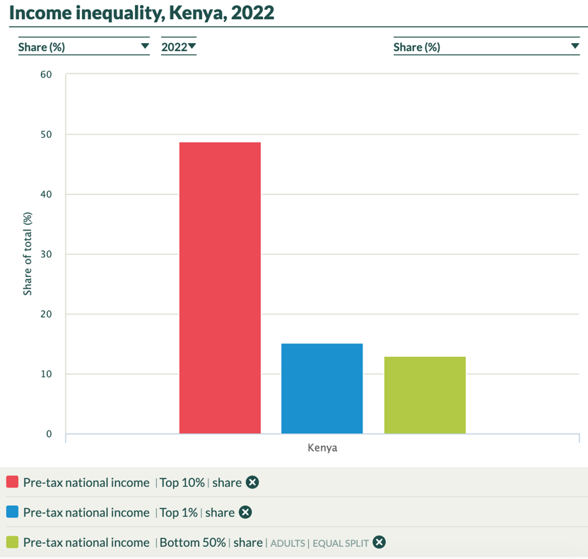
INCOME INEQUALITY
The top 10% of the population earns more than 3.5 times what the bottom 50% earns collectively.
The share of income held by the top 1% is greater than that of the bottom 50%, despite representing a much smaller portion of the population.
There's a large gap between the top 10% and the top 1%, suggesting significant inequality even within the upper income brackets.

Slide 7
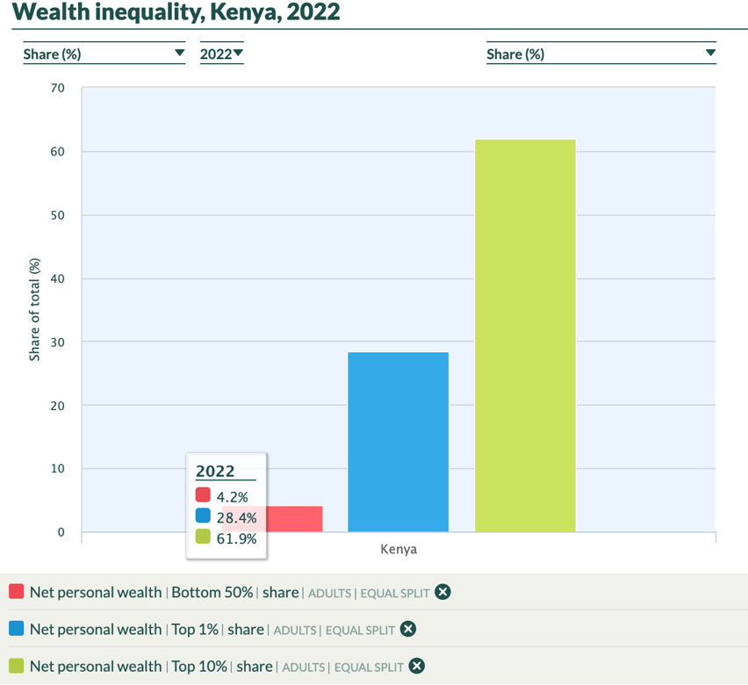
WEALTH INEQUALITY
Data from the World Inequality Database for Kenya (2022) shows significant wealth concentration in Kenya, with the top 10% owning 61.9% of net personal wealth, while the bottom 50% owns just 4.2%.

Slide 8
HUGE GAP

Slide 9
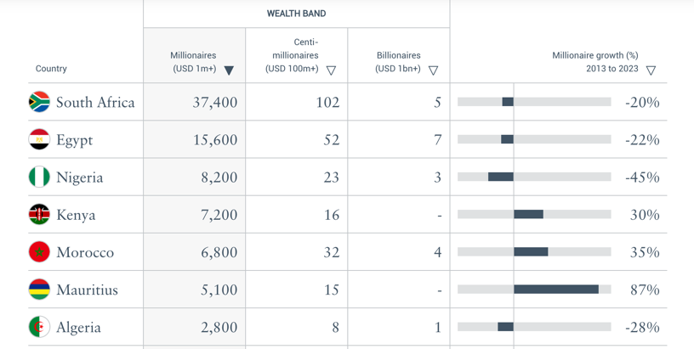
HNWI IN KENYA
Number of HNWI in Kenya: The Africa Wealth Report 2024 estimated that there are 7,200 high-net-worth individuals (HNWIs) in Kenya. A targeted wealth tax on 7,200 HNWI could generate substantial revenue.

Slide 10
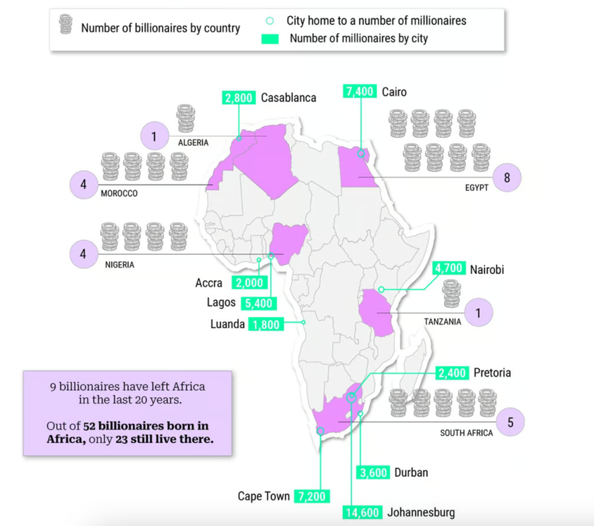
HNWI IN NAIROBI

Slide 11
REVENUE POTENTIAL OF A WEALTH TAX
Wealth Bracket | Proposed Tax Rate | Estimated Number of Individuals | Assumed Average Wealth | Estimated Tax Revenue
$1M - $3M | 1.5% | 5,700 | $2M | $171M
3M - $100M | 3% | 1,500 | $10M | $450M
>$100M | 5% | 16 | $200M | $160M
Total |  | 7,216 | $781M
Estimates: a progressive tax system can have the potential to yield around $781 million annually based on a proposed structure of 3 tiers to taxing the wealth of HNWI.

Slide 12
PTO COLLECTION
USD 21.26M

Slide 13
PTO NO OF HNWI

Slide 14
PROJECTED COLLECTION BY PTO OF 6386 HNWI
Tax per HNWI = KES 2.7bn ÷ 814 HNWI = 3,316,955.71 KES per HNWI
Estimate tax from 6,386 HNWI: 3,316,955.71 × 6,386= KES 21.18bn
Approximately USD 156.89mn

Slide 15
CONSTITUTIONAL BASIS
Article 201: Principles of Public Finance
(b)(i): "The public finance system shall promote an equitable society..."
(b)(ii): "The burden of taxation shall be shared fairly."
Article 210: Imposition of Tax
(1): "No tax or licensing fee may be imposed, waived or varied except as provided by legislation."
Fourth Schedule: Distribution of Functions Between National and County Governments
Part 1(28): Lists "taxation and revenue raising" as a function of the national government.

Slide 16
WEALTH TAX LEGISLATION
Kenya does not have a wealth tax law.

Slide 17
CHALLENGES WITH HNWI
Limited capture of accumulated wealth:
Income tax primarily targets flows (income) rather than stocks (accumulated wealth).
This means large fortunes can remain largely untaxed if not actively generating income.
2. Challenges in taxing non-productive assets:
Assets like vacant land or unused properties, which don't generate income, may escape taxation.
This can lead to inefficient use of resources in the economy.
3. Difficulty in tracking wealth accumulation:
Without regular wealth reporting requirements, it's challenging for tax authorities to track how wealth is accumulating and changing hands.

Slide 18
LEBANESE EXPERIENCE WITH HNWI
Real Estate Investment
Tactic: Purchase high-value properties and leave them unoccupied
Tax Advantage:
No tax on idle real estate
Avoid rental income tax
Potential for untaxed capital gains upon future sale
Gold Investments
Tactic: High imports and purchases of gold
Tax Advantage:
No wealth tax on gold holdings
Easy to store and transport without declaration
Potential for tax-free gains if sold unofficially

Slide 19
LEBANESE EXPERIENCE WITH HNWI
Luxury Items
Tactic: Invest in high-end watches, art, jewelry, etc.
Tax Advantage:
No luxury goods tax or wealth tax on these items
Can be easily transported or gifted without tax implications
Use of Cyprus as a Tax Haven
Tactics: a) Establish residency or citizenship in Cyprus b) Open bank accounts or establish companies in Cyprus
Tax Advantages:
Lower personal and corporate tax rates
No tax on worldwide income for non-domiciled residents
Strong banking secrecy laws
Within EU, allowing easy access to European markets

Slide 20
LESSONS FOR KENYA
Enhance Asset Registration and Valuation
Create a centralised registry for high-value assets
Develop advanced valuation methods for non-financial assets
Implement regular reporting requirements for luxury goods ownership
Monitor Real Estate and Luxury Markets
Implement a vacancy tax on unused high-value properties
Require registration of luxury goods purchases above a certain threshold
Collaborate with real estate agencies and luxury goods dealers for reporting

Slide 21
LESSONS FOR KENYA
Understand the Gold Market in Kenya
Monitor gold import/export trends
Track local gold production and artisanal mining
Analyse gold prices and trading volumes in local markets
Create a centralized registry for significant gold holdings
Require declaration of gold assets above a certain threshold
Implement a system to track the chain of custody for large gold transactions

Slide 22
ZIMBABWEAN EXPERIENCE
Current System
1% tax on second homes valued over $250,000 USD
Excludes primary residence
Aimed at targeting wealthy property owners
Key Challenges
1. Property Identification
Difficulty in identifying second homes
Lack of comprehensive property ownership database
2. Inter-Agency Coordination
Poor information sharing between relevant government bodies
Siloed data across different departments
3. Local Government Issues
Responsibility for taxing land and buildings lies with local authorities
Local governments struggle with property valuation and tax collection
4. Compliance and Enforcement
Low voluntary compliance due to weak enforcement mechanisms
Difficulties in verifying property values and ownership
5. Threshold Implementation
Challenges in accurately determining property values to apply the $250,000 threshold
Currency fluctuations complicating valuation in USD

Slide 23
LESSONS FOR KENYA
Create a joint task committee with the Ministry of Lands and county governments to develop and maintain a unified, national property ownership database. This database should:
Include all properties, their current market values, and ownership details.
Be regularly updated with new transactions and valuations.
Be accessible to PTO tax officials for HNWI compliance checks.
Cross-reference property data with other wealth indicators.

Slide 24
STRATEGY FOR HNWI UNIT: Developed risk profiles, based on:
Income sources
Asset ownership
International connections
Compliance history
Industry specific factors
Lifestyle indicators
Political exposure

Slide 25
HNWI UNIT: Risk Profile for Income Sources
Multiple sources of income (e.g., business, investments, rentals)
Income from high-risk sectors (e.g., mining, real estate, import/export)
Significant changes in income year-to-year

Slide 26
HNWI UNIT: Risk Profile for Asset Ownership
High-value property holdings
Ownership of luxury assets (e.g., vehicles, aircraft)
Investments in multiple businesses

Slide 27
HNWI UNIT: Risk Profile for International Connections
Foreign bank accounts or investments
Frequent international travel
Business ties with tax haven countries

Slide 28
HNWI UNIT: Risk Profile for Compliance History
Past audit results
History of late filings or payments
Frequent amendments to tax returns

Slide 29
HNWI UNIT: Risk Profile for Industry Specific Factors
Involvement in sectors with complex tax considerations (e.g., mining, oil & gas)
Participation in rapidly growing or volatile business sectors (e.g., mobile money services, app development companies, digital marketing)

Slide 30
HNWI UNIT: Risk Profile for Lifestyle Indicators
High expenditure patterns inconsistent with declared income
Children in expensive international schools
Luxury home locations

Slide 31
HNWI UNIT: Risk Profile for Political Exposure
Politically Exposed Persons (PEPs) or their close associates
Sudden wealth accumulation coinciding with political appointments

Slide 32
SECTORS IN KENYA THAT ARE HIGHER RISK FOR TAX COMPLIANCE
Renewable Energy:
Solar power installation and distribution
Wind farm projects
Crypto mining operations
Fintech:
Mobile lending apps
Digital insurance providers
Online investment platforms
App-based transportation networks
Food delivery platforms
Online Education and Ed-tech:
Virtual tutoring services
E-learning platforms
Educational technology developers
Betting and Gaming Industry

Slide 33
PTO STRATEGIC APPROACH
PTO should establish an information exchange system with the Registrar of Business Registration Service where the latter shares data on businesses registered that have keywords related to the risk sectors in the company descriptions
Search for news articles about startups and growing companies in these sectors
Collaborate with the central bank for lists of licensed fintech operators
Work with securities regulators for information on online investment platforms
Liaise with energy regulatory bodies for lists of renewable energy projects
Collaborate with major payment gateways to identify high-volume merchants in these sectors

Slide 34
TAXING FORMS OF WEALTH IN KENYA
Resident Individual Income Tax Rates (Second Schedule)
Progressive tax rates up to 35% for income over KES 9.6M per year
Capital Gains Tax (Eighth Schedule)
Rate: 15% (as of 2023) on gains from sale of property and securities
Rental Income Tax (Section 6A)
Applicable to residential rental income
Rate: 10% of gross rental receipts
Dividend Income (Section 34)
Withholding tax on dividends: 15% for residents, 20% for non-residents
Taxes returns on share ownership

Slide 35
TAXING FORMS OF WEALTH IN KENYA
Interest Income (Section 35)
Withholding tax on interest: 15% for residents, 20% for non-residents
Deemed Interest Provisions (Section 16(2))
Imputes interest on interest-free loans provided by non-resident persons
Aims to prevent tax avoidance through related-party transactions
Taxation of Trusts (Section 25)
Provides for taxation of income of trusts, often used by HNWIs for wealth management
Digital Service Tax (Section 12E)
1.5% on gross transaction value of digital services
Targets modern forms of wealth creation in the digital economy

Slide 36
KRA REFLECTIVE EXERCISE
Sarah Kamau is the founder and CEO of GreenSun Energy, a rapidly growing solar power company in Kenya. The company was founded 3 years ago and has expanded quickly, now operating in 5 counties. Public records show that GreenSun Energy received a $10 million investment from a foreign venture capital firm last year.
Recently, there have been media reports about Sarah purchasing a luxurious home in an upscale Nairobi neighborhood for Ksh 150 million. She's also known to drive high-end vehicles and frequently travels abroad for 'business meetings.'
GreenSun Energy's tax returns show a modest profit, with Sarah's declared income being Ksh 5 million per year for the past two years. The company claims significant expenses for 'research and development' and 'international consultancy fees.’
As a tax administrator in the Premium Tax Office, what steps would you take to assess Sarah Kamau's tax compliance?
Question for the group:
Outline the top 5 actions you would take to investigate this case, explaining your rationale for each action. Consider aspects such as:
- Information gathering
- Risk assessment
- Potential areas of concern
- Interagency cooperation
- Any specific tax issues (e.g., transfer pricing, capital gains

Slide 37
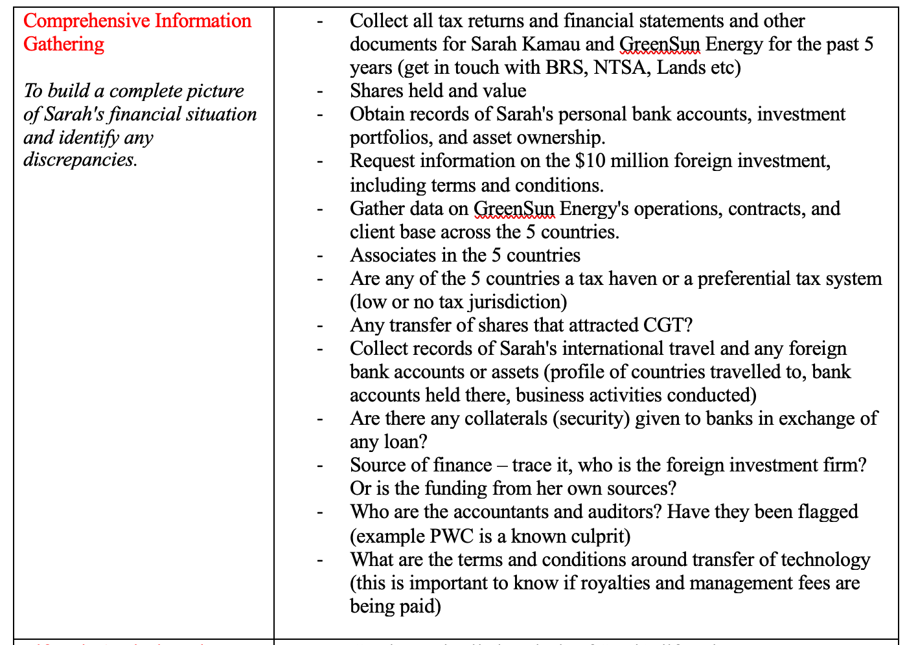
CHECKLIST

Slide 38
CHECKLIST

Slide 39
CHECKLIST

Slide 40
CHECKLIST

Slide 41
CHECKLIST

Slide 42
KRA REFLECTIVE EXERCISE
Draft a basic risk profile template for HNWIs in the large-scale commercial agriculture sector. What are the top 5 factors you would include in this risk profile? For each factor, briefly explain why it's important.

