Slide 1
DEBT, AUSTERITY AND IFFS
“Where water is the boss, there the land must obey”
African Proverb
@LylaALatif

Slide 2
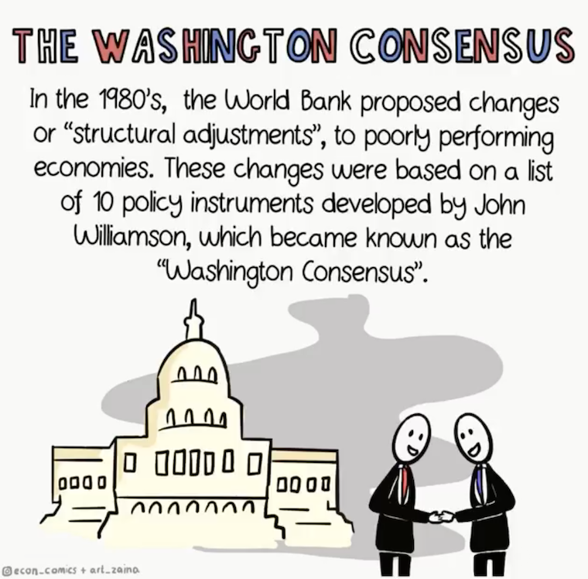
WASHINGTON CONSENSUS
Financial liberalisation
Adoption of a single competitive exchange rate
Trade liberalisation
Elimination of barriers to FDI
Privatisation of SOE
Deregulation of market entry Competition
Security of property rights

Slide 3
WHEN A STATE IS UNABLE TO FINANCE ITS DEVELOPMENT AND RECURRENT EXPENDITURE DUE TO FISCAL DEFICITS, IT RESORTS TO BORROWING
BORROWING HAS IMPLICATIONS…..

Slide 4
WHAT ARE THESE IMPLICATIONS?
DRAINING DEVELOPMENT AND ILLICIT FINANCIAL FLOWS
CAN DEBT UNDERMINE DEVELOPMENT?
DEBT CONDITIONS
FISCAL ADJUSTMENTS THAT ARE LINKED TO AUSTERITY
THE PROBLEM OF DEBT RELATED IFFS
CAN DEBT SUPPORT DEVELOPMENT?
IT SUPPORTS THE BORROWING STATE TO MEET ITS BUDGET DEFICITS
IT PROVIDES ACCESS TO FINANCE THAT IS NEEDED TO SUPPORT DEVELOPMENT NEEDS (DOES IT?)

Slide 5
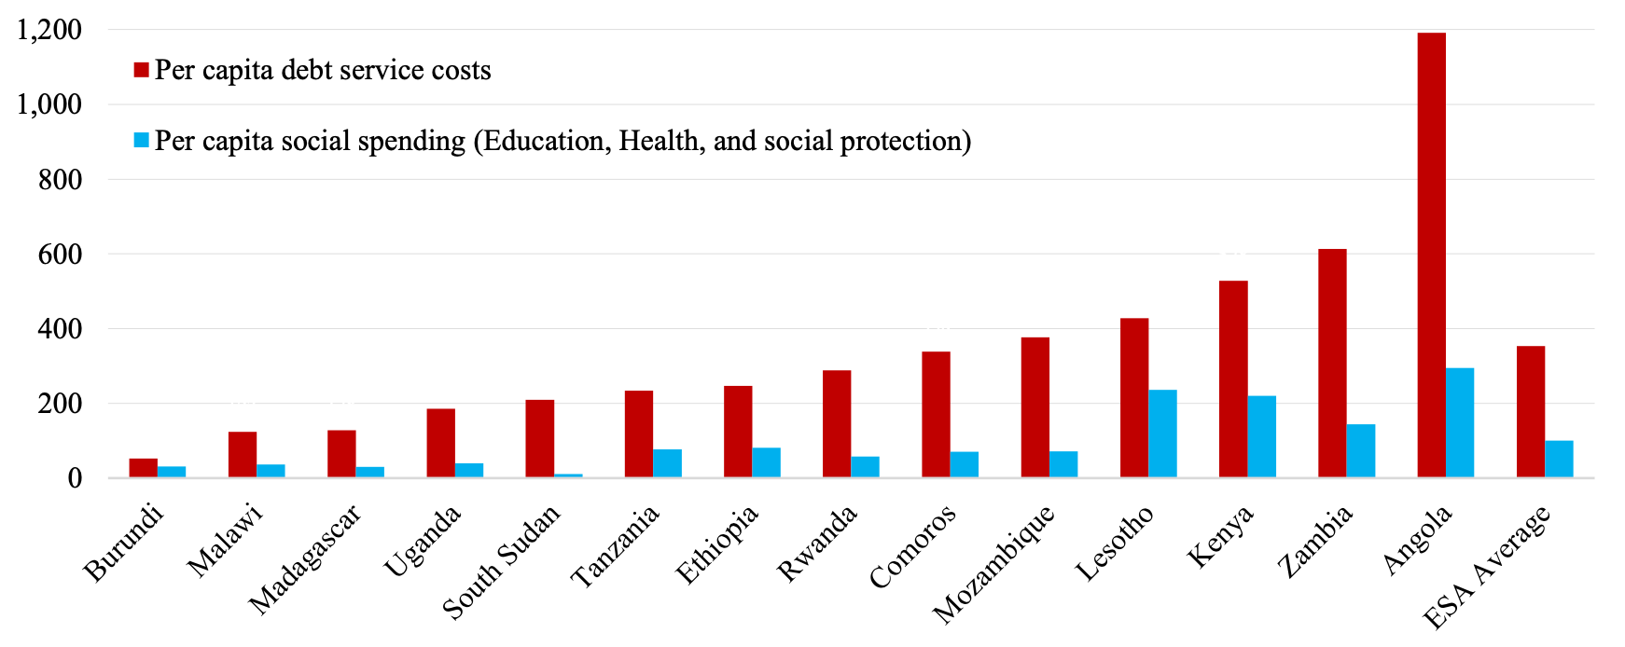
Does it really?
Let’s look at the facts
Zambia 2021 budget - more money allocated to debt servicing than to education, health, water and sanitation. 88% of Zambians live on less than $6p/d. Zambia spending 4 times more on debt payments.
Angola - spending 44% of government revenue on repaying external debt, only 6% spent on public health while the country has the highest child mortality.
Debt Service in ESA countries 2010 and 2019 (as a % of total revenue)
World Bank, International Debt Statistics, 2021

Slide 6
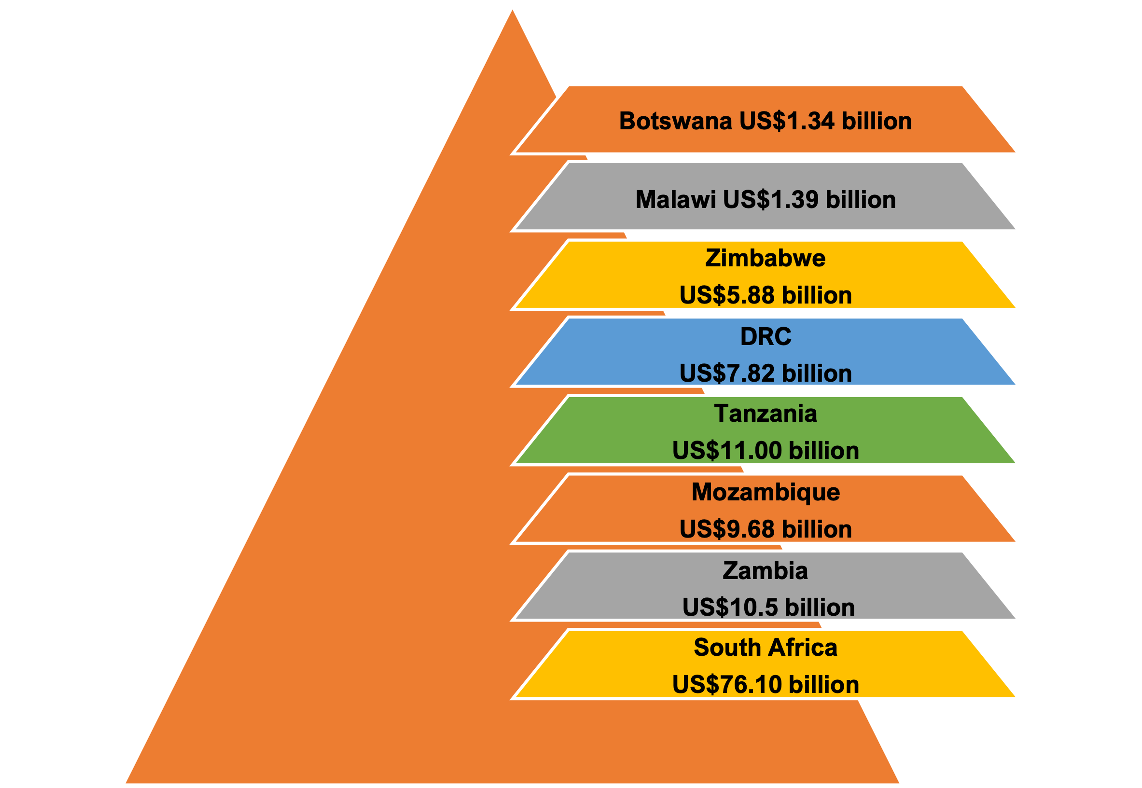
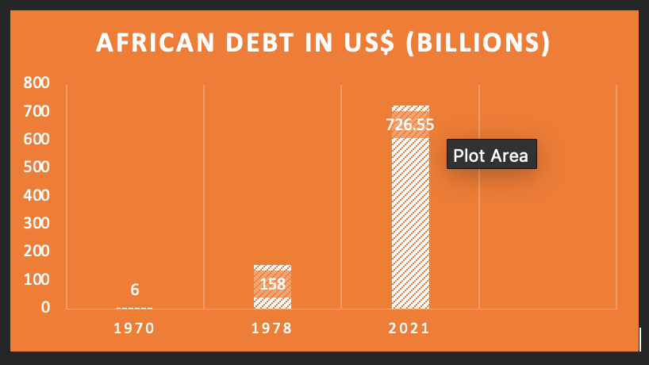
SADC’s debt - $123.71billion (2019 World Bank)

Slide 7
How did we come to accumulate so much debt?

Slide 8
Austerity
Previous debt obligations and the added Covid 19 fiscal shocks
Budget cuts expected in 159 countries in 2022 - to continue to 2025 (IMF)
Austerity projected to affect 6.6 billion people or 85% of the world population in 2022
4/5 persons will still continue to live under austerity in 2025.

Slide 9
Solutions
Identify if your government is reducing expenditure or planning to in the near future (e.g., wage bill cuts, reducing subsidies, revising minimum wage downwards, increasing consumption taxes)
If yes, articulate alternative demands for post-pandemic recovery and moving out of debt distress

Slide 10
Alternative Demands?
Exercise the right to unilateral repudiation of odious, illegal and illegitimate sovereign debt as a human rights defence (Principle 1 UNGA Res 69/319 - Basic Principles on Sovereign Debt Restructuring Process)
For debt that is unsustainable, suspend payment
Postova Banka AS and Istrokapital SE v Greece ICSID Award (9 April 2015)
Sovereign debt cannot be equated to private indebtedness or corporate debt. Issues of immunity apply, therefore unilateral measures acceptable

Slide 11
Unilateral insolvency
Repudiation or non-enforcement of arbitral awards on public policy grounds (article V(2)(b) of the 1958 New York Convention on the Recognition and Enforcement of Foreign Arbitral Awards)
Denunciation on grounds of executive necessity and/or the right to fiscal/tax sovereignty (rejection of stabilisation clauses eg Article 6(5)(a) Chapter 17 of the EU-Singapore FTA)
Direct unilateral repudiation on the basis of reports by national debt audit committees (eg Brazil, audit led to creation of Commission of Public Inquiry, which helped reduce Brazil’s debt balance in terms of interest and cost at a rate of 50%)
Repudiation of contracts when the creditor violates human rights and of unconscionable concession contracts
Renegotiation of bilateral investment treaties and concessions (Botswana demanded renegotiation of its Debswama concession with De Beers in 1973/1974, Zambia cancelled all mineral development agreements through its Mines and Minerals Act, 2008. Ghana and Tanzania renegotiated royalty rate with mining companies)

Slide 12
“You have little power over what’s not yours”
Zimbabwean Proverb
“When the roots of a tree begin to decay, it spreads death to the branches”
Nigerian Proverb
‘When you show the moon to a child, it only sees your finger”
Zambian Proverb

Slide 13
IFFS out of SADC Countries -$542.4billion
UNCTAD EDAR 2020
GENERAL ESTIMATES $88.6BILLION
1970-2018
Boyce & Ndikumana

Slide 14
Lost in IFF
Owing

Slide 15
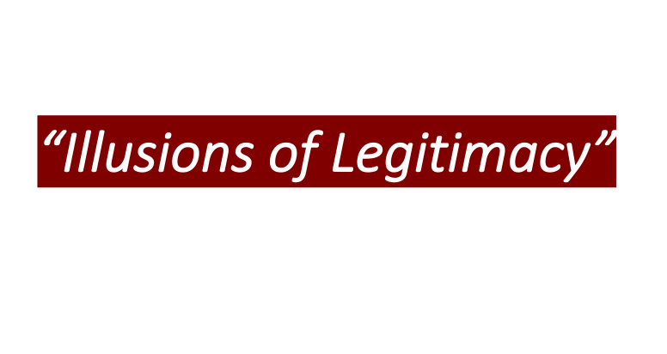

Slide 16
HOW?
LOSING REVENUE THROUGH DEBT RELATED IFFS

Slide 17
Vulture fund
Private commercial entities that acquire, either by purchase or assignment or some other form of transaction, defaulted or distressed debt with the aim of achieving a high return.
Aquire non performing debt of countries in financial difficulties on the secondary market at a price significantly less than its face value, refuse to participate in debt restructuring and attempt through litigation to sue for full amount plus interest, penalties and costs.
Track the debt relief process, buy debt of countries about to receive multilateral debt relief and then sue the countries concerned once their fiscal capacity has increased.
Case: VF bought Zambian debt valued at £3m, sued for $55m and was awarded $15.5m

Slide 18
Debt to Equity Swap
Debt to equity swap - instead of the debt being repaid, the creditor is given shares in the company. Let's think outside the box on this type of arrangement.
SCENARIO 1. Z registered in a tax haven and is involved in Illehal Unreported Unregulated fishing in Africa. Loans money to B a sugar production company. Later enters into a D-E swap. Now it has shares in B. As a shareholder in B, Z can advise B to limit its tax liability by paying dubious offshore claims for IP, management fees or consultancies.
SCENARIO 2. Z loans money to B. Asks for D-E swap. Then argues before RA that the money received constitutes capital gain rather than investment income, which results in lower rate of tax. In the US this wouldn't work, laws against it. Check your jurisdiction to see if the income tax act, cgt act has provisions against this type of arrangement.

Slide 19
SOLUTIONS
VULTURE FUNDS
WB to buy back outstanding debt from debtor state to get at-risk debts out of public domain so as to prevent vulture activities
African states to enact laws to make vulture funds profiteering illegal
Sovereign immunity from hedge fund litigation
DEBT TO EQUITY SWAPS
Safe harbour rules

Slide 20
Other forms of debt related IFFs?

