Slide 1
OECD PILLAR 1 : Sourcing for additional revenue for African countries
Lyla latif
Advocate. Commissioner for oaths. Notary public
chief executive lai’latif & co

Slide 2
Background
Digital companies undertaxed
Tax law playing catch up to digitalising economy
Problem with bilateral treaties

Slide 3
OECD Pillar 1
The rise of the digital economy does not necessarily mean more government revenue
This will be pegged on the OECD Pillar 1’s outcome (Amount A) – as it determines the amount of a MNE’s profits that will then be partially redistributed to market jurisdictions, which are expected to be largely developing countries

Slide 4
Key Highlights: Amount A
Reallocates the profits of about 100 of the world’s largest and most profitable MNEs to market jurisdictions
Establishes new nexus and profit allocation rules that expand the taxing rights of market jurisdictions – regardless of physical presence
Uses revenue sourcing rules to determine whether revenue derives from a market jurisdiction and profit allocation rules to allocate profits to market jurisdictions

Slide 5
Of importance to African countries is the possibility of sourcing additional revenue under Pillar 1
To tax – certain conditions must be met
  Global revenue exceeding EUR20 billion and a profit to revenue ratio of >10%
  Nexus with jurisdiction that seeks to tax – should derive at least EUR1 million in revenue from that market jurisdiction / Smaller jurisdictions with a GDP lower than EUR40 billion, the nexus is set at EUR250,000

Slide 6
Looking for additional revenue: taxing digital companies
Kenya
Uganda
Tanzania
India
Taiwan
Turkey
China
Unilateral measures
OECD IF’s Task Force on Digital Economy on Amount A: Regulated Financial Services Exclusion – removes financial institutions such as banks, insurance companies and asset managers from the scope of the tax – Amount A

Slide 7

UN Model Tax Convention – Article 12B
Eliminates the physical presence requirement
Expands the taxing rights of market economies for the income from ADS
Income from ADS – taxed on gross basis via WHT – net also possible
Capped at 3-4 per cent

Slide 8
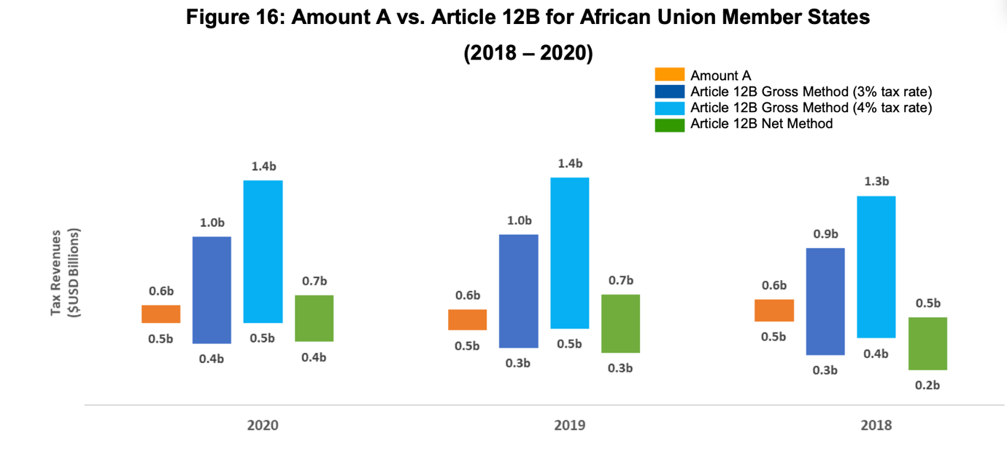

Slide 9
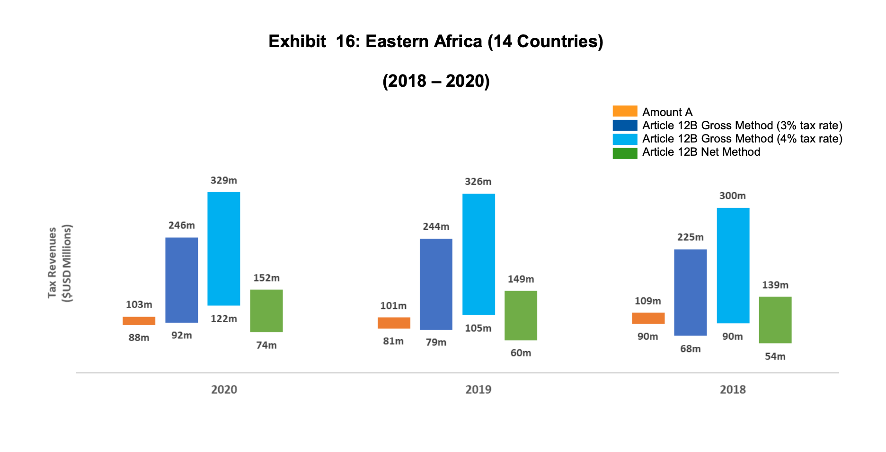

Slide 10
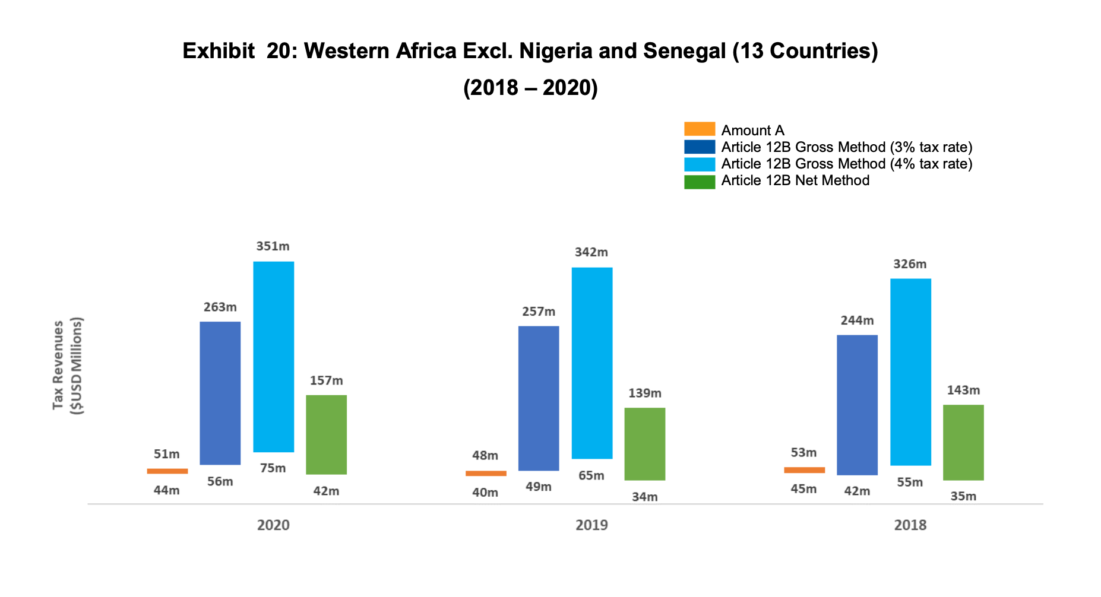

Slide 11
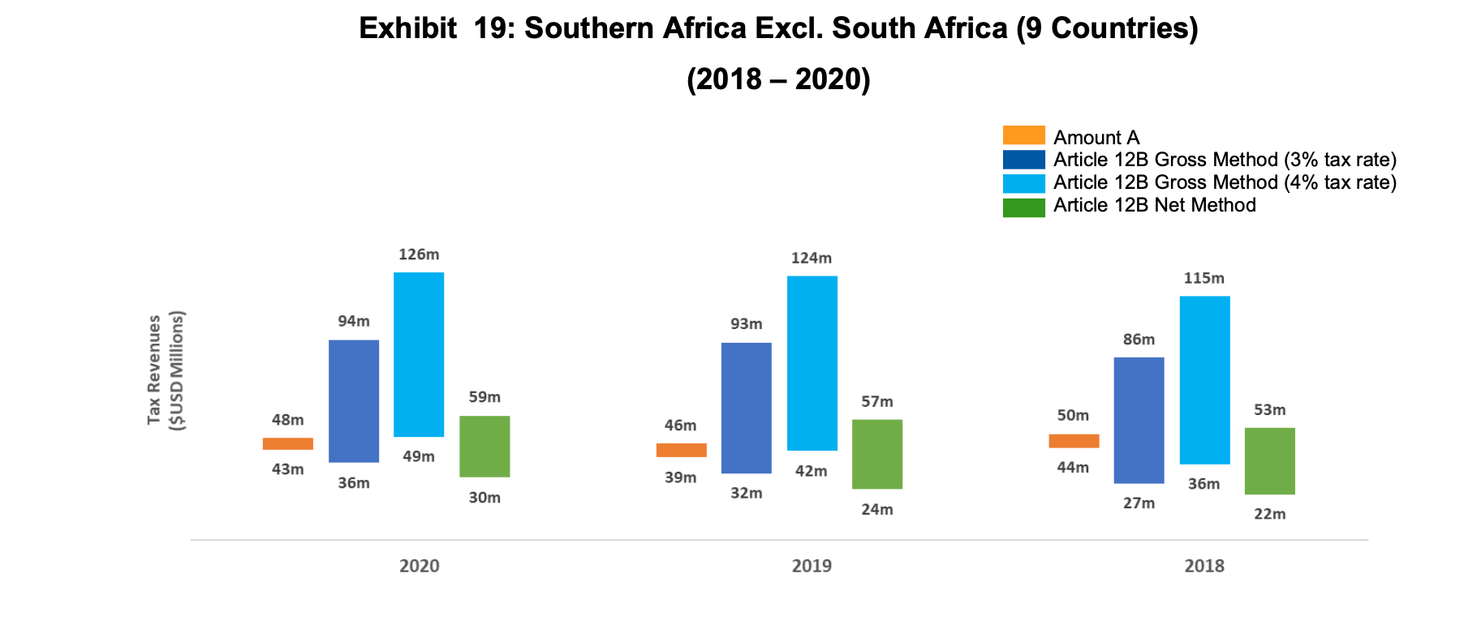

Slide 12
Do developing countries need to implement Pillar 1, or are they better off implementing unilateral measures?

