Slide 1
‘If you are building a house and a nail breaks, do you stop building or do you change the nail’
A Rwandan proverb

Slide 2
“Tell me and I forget, teach me and I may remember, involve me and I learn.”
― Benjamin Franklin
“Spoon feeding in the long run teaches us nothing but the shape of the spoon.”
― E.M. Forster
“I cannot teach anybody anything. I can only make them think”
― Socrates

Slide 3
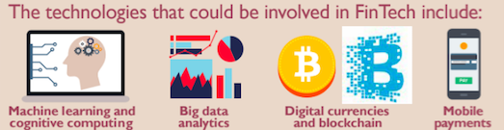

FINANCING DEVELOPMENT
Certificate Program on
7-11 October 2019. University of Nairobi

Slide 4
Let’s start with some Throwback Quescussions
What is development?
  Micro level
  Macro level
How do you understand financing development?
How does one prioritise one development need over another?

Slide 5
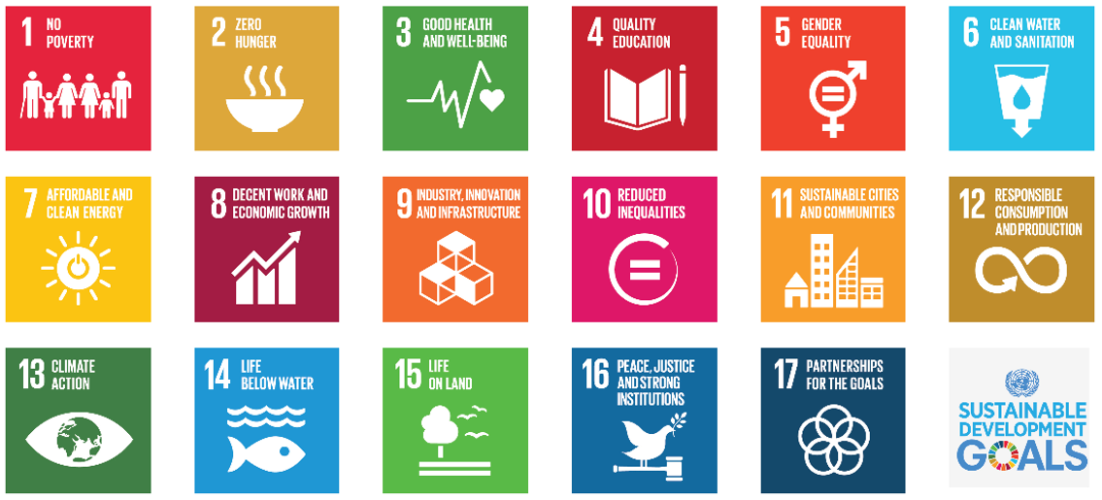

Slide 6
The 2030 Agenda for Sustainable Development
Shared blueprint for peace and prosperity for people and planet now and in the future
Interrelated – ending poverty and other deprivations must go hand in hand with strategies that improve health and education, reduce inequality and spur economic growth- all the while tackling climate change and working to preserve our oceans and forests
Goals and indicators
Based on global partnership

Slide 7
How it all began
1992
Earth Summit adopted Agenda 21 (global partnership for SD to improve human lives and protect the environment)
2000
Millennium Declaration and MDGs (to reduce extreme poverty by 2015)
2002
Johannesburg Declaration on SD and the Plan of Implementation (commitment to poverty eradication and the environment and emphasized on multilateral partnerships
2012
UN Conference on SD (Rio +20) - outcome document ‘The Future We Want’ – to develop a set of SDGs to build upon the MDGs
2013
OWG to develop proposal on SDGs
2015
UNGA began negotiation process on the post 2015 development agenda and adoption of 2030 Agenda for SD

Slide 8
Rooted in finance
Monterrey Consensus of the International Conference on FfD (2002)
  Mobilise domestic financial resources for development
  Mobilise international resources for development: FDI and other private flows
  International trade as an engine for development
  Increasing international financial and technical cooperation for development
  External debt
Doha Declaration on FfD (2008) – follow up to MC
  Same as for MC
Addis Ababa Action Agenda of the Third International Conference on FfD
  Domestic public resources
  Domestic and international private business and finance
  International development cooperation
  International trade as an engine for growth
  Debt and debt sustainability
  Science, technology, innovation and capacity building

Slide 9
Rooted in principles
Universal
Rules based
Open
Transparent
Predictable
Inclusive
Non discriminatory
Equitable
Importance of:
National ownership of development strategies
Inclusive financial sector
Enabling environment
Expand the reach of private flows to a greater number of developing countries
Fully maintaining ODA commitments by donors
Exploring innovative sources of finance
Debt restructuring

Slide 10

The Financing Challenge
Estimates of the amounts needed to finance the 2030 Agenda are in the range of “trillions, not billions”, to cover global financing gaps of between USD 1.5 trillion per year to USD 2.5 trillion or more. While this amounts to 2 to 3 percent of global gross national income (GNI), the costs of implementing the 2030 Agenda in proportion to the GNI of developing countries (low- and middle income) are far higher.
The magnitude of financing requirements at the national level can be illustrated by looking at a subset of the goals related to social protection as defined by each country. Kenya – health shortfall of 242billion. Climate finance, shortfall of 120billion, currently, in debt of a trillion dollars.

Slide 11
Short Debate
Is development all about finance?
Yes
No
Putting in place the development needs requires infrastructure, capacity building, training
It is about expenditure
It also concerns putting in place the necessary legislation and regulatory framework
It requires inclusivity so that no one is left behind
It is about securing the minimum core content on human rights

Slide 12
Financing development in a broader context
Vision
Technology and Digital Economy
Work and people
Business models and digial technologies
Globalisation, global digital cooperation and FinTech

Slide 13
Features
Mobile phones/Internet – sharing economy
AI, machine learning and big data
Blockchain or distributed ledger technology
Cloud computing

Slide 14
Contextualising FD in Africa
SDGs
Digitalisation
AU Agenda 2063
OECD BEPS
Addis Tax Initiative
Addis Ababa Action Agenda
Local Visions and Agendas (Kenya Vision 2030 and Big Four Agenda)
DRM

Slide 15
All that would require an enabling framework
Laws to be in place (e.g., FDI capture through NIFC)
Regulations to define the parameters (e.g., StAR, FATF AML)
Judicial system to be seen to be effective (e.g., Matthew Okwanda Case)
Political will
Budgetary measures
Sustainable fiscal contract

Slide 16
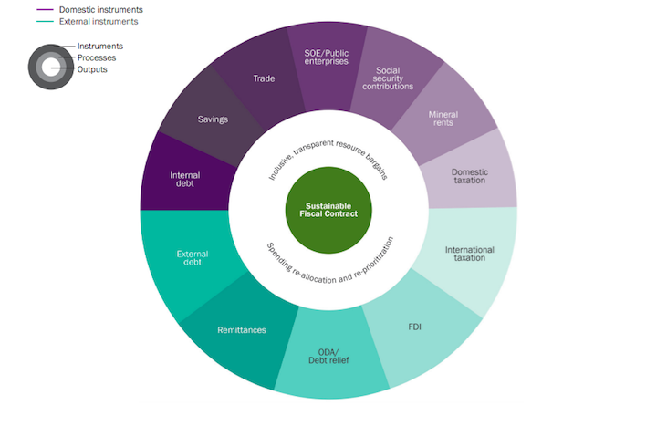
The crux of it all: the Sustainable Fiscal Contract

Slide 17
SFC must be attached to a DRM policy
DRM concerns mobilising sources of revenue through:
  Broadening the tax base
  Identifying additional tax/revenue streams
  Combatting corruption and IFF
  Closing tax loopholes
  Caving in on (aggressive) tax avoidance and evasion
  Strengthening tax compliance and administration
  Re-appraising the efficacy of tax incentives and exemptions
  (Re)negotiating tax treaties

Slide 18
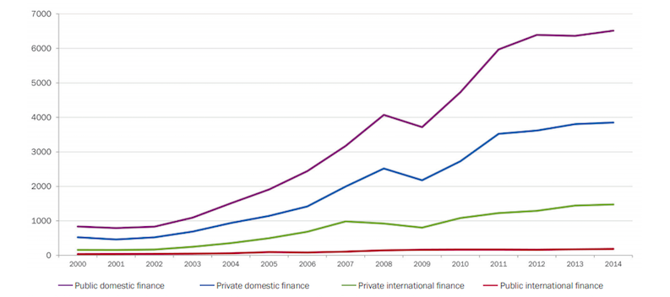
Financing Trends in Developing Countries (2000-2014)

Slide 19
DRM priority? (reducing health budget)
Source: Lyla Latif (2018)

Slide 20
Domestic Resource Mobilisation
Public
Private
Taxes
Duties
Levies
Service Charges
National insurance
Private insurance
Out of pocket payments
Community based financing

Slide 21
International Resource Mobilisation
Public
Private
Grants
ODA
Donor Aid
Innovative financing schemes

Slide 22
Group Task
Between the two; DRM and IRM, which is the better and more effective?
Tips to think and reflect on:
  What kind of challenges and opportunities does each provide?
  Which of the two is more sustainable?
  Which of the two can effectively target transformative change?
  Which has the potential for impacting positively on institution building and accountability?
  Which is more effective for stabilizing the economy?

Slide 23
Public Domestic Resources
Generally speaking, public domestic resources
  have various social, economic and political benefits if compared to private or external funds. Among these are their linkages with domestic policy making and policy space, their potential for impacting positively on institution building and accountability, their ability to redistribute income and stabilize the economy, and their capacity to make production and consumption more sustainable in environmental, economic and social terms.
  are more likely than external resources to trigger transformative structural change of the economy and redistribution, leading to higher equality, inclusion and social protection, in particular in the case of taxation and social contributions. This relates to the links with social policy, democratization and rights that emerge from revenue bargains between citizens and states.

Slide 24
50:50 on DRM or IRM dependence on economic/fiscal capacity of a state
For most countries, tax income is the most important national revenue source, accounting for 85 percent of government revenues in high-income countries of the Organisation for Economic Co-operation and Development (OECD), and around 70 percent in developing countries.
However, for a number of countries, in particular LDCs, other revenues such as ODA are equally or even more important, with aid exceeding tax revenue in countries such as Liberia and Malawi

Slide 25
Leave No One Behind Principle
To advance the required policy reforms which will “leave no one behind”, countries will need to design their own financing strategies according to their economic and political structures and specific needs.
  This means that the combination of sources and instruments—external and domestic, public and private—as well as their weights in the overall financing mix will differ between countries.
  Some will be able to attract greater amounts of private investment (such as upper middle income countries/UMICs), others will rely more on aid transfers, foreign debt, resource rents and remittances (least developed countries/LDCs and lower middle-income countries/LMICs), and others—mostly middle-income countries (MICs) and high-income countries (HICs)—will be able to finance a larger part of their budgets with proceeds from domestic tax systems and national capital markets.

Slide 26
Challenges 1/3
Wealth and property are forms of DRM, what is the poverty level? Who are buying properties? What kind of properties? Should affordable housing be subject to the tax next? High net, what is high net in a country that does not have the earning power as the OECD, should high net have a different criteria? Anyone earning over 3000?
What constraints can you identify with regard to DRM in your country? (insufficient growth performance, informality and unemployment, tax losses due to tax optimization, low national savings rate, lack of accessible and affordable banking systems and underdeveloped capital markets, financial crises, per capita income level, sector specific economy, MNC tax avoidance, IFF- Rwanda 2008-2012, IFF outflows 20.4% of country’s GDP)
Increase tax base – export taxes?

Slide 27
Challenges 2/3
How can countries increase DRM? (fair tax system? Progressive tax system? Anti trust legislation – breaking up monopolies, remove tax exemptions) – Uganda, tax system relies heavily on a small number of taxpayers, mostly MNCs with around 35 top taxpayers accounting for 50% of revenues collected by URA (73) -divest natural resource rents out of the hands of the politicians – decentralisation/devolution of revenue – Kenya county level fiscal autonomy
Think of DRM – environmental taxes, PPP, global funds – implementation has been either slow or fraught with problems
Do political factors influence resource mobilisation?

Slide 28
Challenges 3/3
DRM require financial resources that are sustainable in economic, social, environmental and political terms
Mandate – tax bargain- fiscal contract
Negotiation between tax payer and government where the former agree to comply with tax obligations in exchange for the effective provision of public services.

Slide 30
Designing the DRM Strategy – ‘Trading Services for Revenue’
Important so as to avert a regressive tax system in which poorer people and women spend a higher share of their income on consumption goods (VAT)
DRM – purpose to finance planned expenditures while honouring debt obligations
Ensuring solvency in the medium to long term
Not only about mobilising the necessary quantity of resources or safeguarding financial stability

Slide 31
Design continued
Quality of revenue, measured in terms of their transformative impact on production and employment, redistribution, gender equality, sustainable use of natural resources and inclusion
Suggests that financing and expenditure policies need to be designed in an integrated way, based on principles of efficiency, equity, fairness, social justice and human rights while ensuring political processes related to financial issues are inclusive and participatory.
Ensure institutional capacity to deliver services and transfers
Control deviation of resources through corruption, clientelism or rent seeking practices or bottlenecks, bureaucracy

Slide 32
Design continued
Look at the economic strategies and economic crises – result in low growth, increase in inequalities and low employment creation
Most countries need to mobilize more resources to cover spending gaps; this leads to the question of how to increase the quantity of revenues. The quality of revenues in terms of their potential to trigger transformative change toward greater economic, social, political and environmental sustainability differs, and the question is how to increase revenue quality in this broad sense.

Slide 33
PUBLIC RESOURCE MOBILISATION
Smarter use of ODA to catalyse other finance resources
Revision or elimination of subsidies
Improving public expenditure and financial accountability
Recovery of Stolen Assets
Raise voice against corruption
Combat IFF
Fiscal autonomy and engagement of local governments
Tax revenue and tax administration

Slide 34
PRIVATE RESOURCE MOBILISATION
Local Savings
Pension Funds
Public Private Partnerships
Sovereign Wealth Funds
Asset Managers
Institutional Investors
FDI
Capital Markets

Slide 35
Write down 5 key words/themes/nouns that you have picked out from our discussions
Write a poem using your 5 ☺ or a drawing representing the 5

Slide 36
DRM and problem areas challenging financial sustainability
Challenges faced in:
mobilising revenue (can’t identify, can’t trace)
securing revenue (corruption, public financial management loopholes)
earmarking the revenue (priorities)
Challenges can be countered through:
implementing sustainable economic policies aligned with the mobilisation and use of public resources (SFC)
sound public financial management
UK and the Pattiserie Vallerie case/ UK homelessness case
corporate accountability within the SDG framework
CMC Di Ravenna (hydropower and drinking water projects in Nakuru & Elgeyo Marakwet)
Green Arava Ltd (Galana and Kulalu irrigation scheme in Kenya)

Slide 37
Sound public financial management – the how of it…
With respect to what? The budget? The revenue collection? The DTAs?
Salient features will be to:
set up (reinforcement) of audit controls, anti-fraud and anti corruption measures
implement sound tax administration and country by country reporting to increase financial transparency
pay attention to climate adaptation and mitigation strategies
combat IFF

Slide 39
Practices of sound financial management

Slide 40
Interrelated practices
budget management – managing the sources of funding and expenditure, and allocating those resources in line with organisational priorities and expected financial performance;
financial controls – the rules, processes, and procedures that address risks and ensure that financial resources are being recorded and used in the right way, for the right purpose, and at the right time;
value management – measuring, prioritising, and allocating financial resources based on the expected cost-effectiveness or value for money (VFM) to be derived (sometimes termed "performance management"); and
governance and accountability – roles, responsibilities, delegations, and structures for making decisions, through which strong financial management can be introduced, practised, reported, and evaluated.

Slide 41
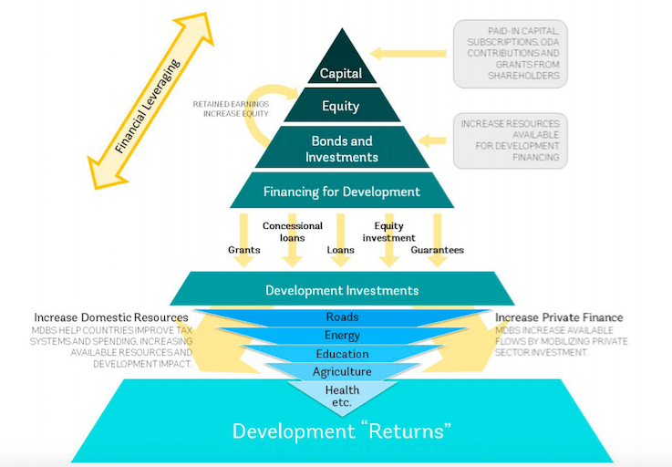

Slide 42

position statements

Slide 43
IFF
Illegal sources earned, used or transferred illegally
Illegal sources earned, used or transferred legally
Legal sources illegally used or transferred
Funds with criminal origin, such as proceeds of crime
Funds with a criminal destination, such as bribery, terrorist financing or conflict financing
Funds associated with tax evasion
Transfers to, by, or for, entities subject to financial sanctions
Transfers which seek to evade anti money laundering/counter terrorist financing measures or other legal requirements (such as transparency or capital controls)

Slide 44
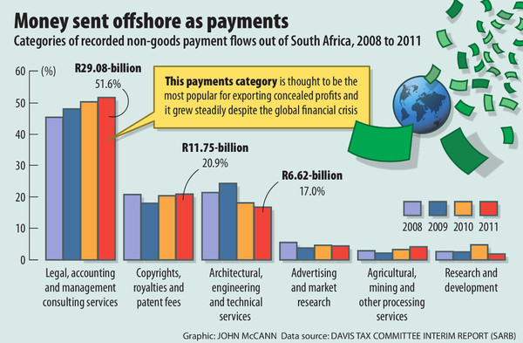

Slide 45
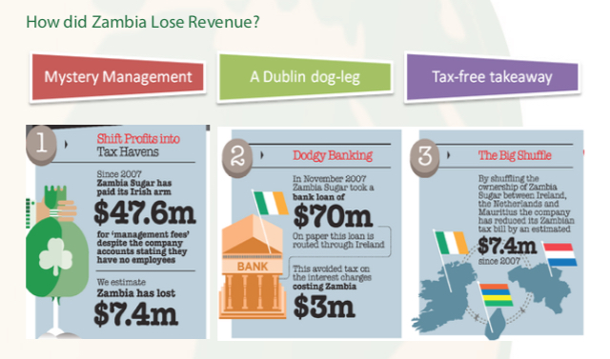
The case of Associated British Foods – Zambia Sugar PLC

Slide 46
Illegal money used/transferred legally

Slide 49
IFF at value chains creation stages
Award of contracts and licences
Sale of concession
Business related human rights abuses and corruption
Exploration stage and samples
Value addition and royalties

Slide 50
Further examples
Trade misinvoicing
Transfer mispricing
Debt shifting
hawala
Round tripping

Slide 51
Transfer mispricing
TP is legal
TMP or abusive TP is illegal
TP – what is it?
TP is the general term for the pricing of cross border, intra firm transactions between related parties. It refers to the setting of prices for transactions between associated enterprises involving the transfer of property or services (UN Practical Manual Para 1.1.6)

Slide 52
Example
  Company A manufactures cars in Japan to be sold to customers in Germany
  Cars are sold by Co A to Co B (distribution subsidiary) in Germany
  Co B resells the cars to independent dealers
  Cars cost $10,000 per unit to develop and build
  Customer pays $20,000 for the car
  Independent dealer earns gross profit of 15% of the end sale price ($3000) per car - (buying at $17,000 from Co B per unit)
  That leaves $7,000 (20000-3000-10000) to cover freight, selling/marketing costs, overheads, R&D and profit for Co A and Co B

Slide 53
TMP
How much should Co A charge Co B for the cars?
  Related companies
  Cross border
ALP
  Profit margin of other manufacturers
  Co B’s distribution costs
  Per unit freight costs from Japan to Germany
  Retail prices charged by competing companies for their cars
  Prices charged selling similar cars to unrelated dealers in Japan
  Co A’s total investment in manufacturing plant and equipment
  Whether Co A uses the same brand in Japan and Germany

Slide 54
IFF losses
Organisations | Tax Loss Estimates per year
AfDB | >USD 1trillion in corporate tax losses since 1980 from Africa
TJN | USD 500billion in corporate tax losses globally
IMF Fiscal Affairs Department | USD 200billion in corporate tax losses globally
HLP Report | USD 50billion in IFF from Africa
ECA | USD 100billion through mis-invoicing from Africa
AU | USD 67billion in IFF from Africa – of which 5% lost through corruption

Slide 55
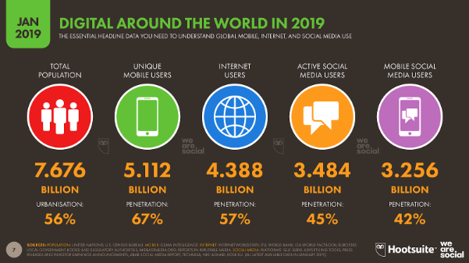
FfD using DE

Slide 56
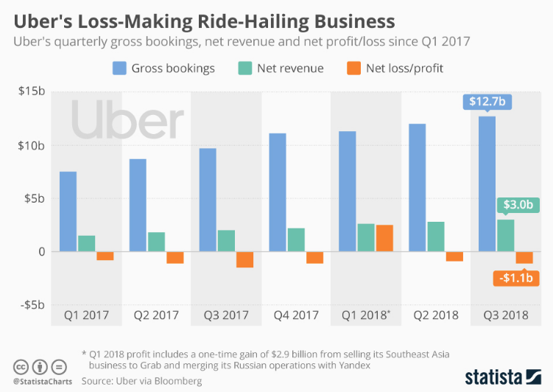

Slide 57
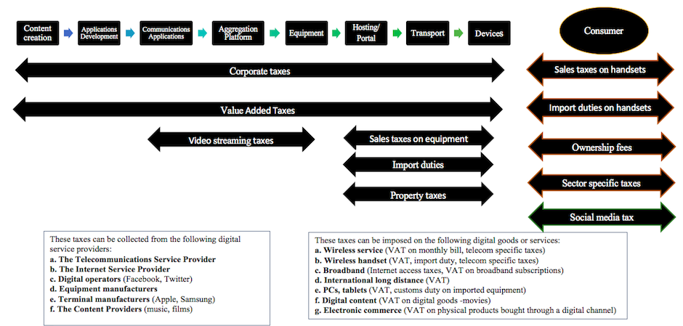
DRM from DE

Slide 58
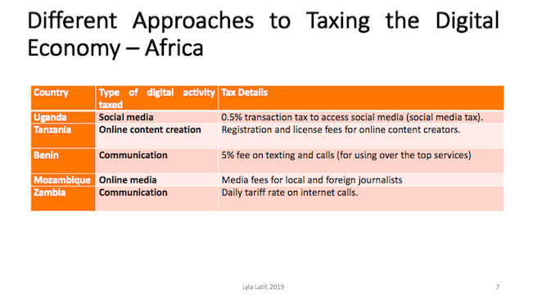

Slide 59
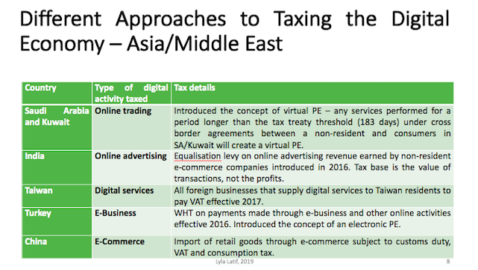

Slide 60
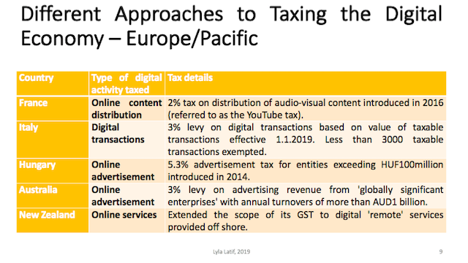

Slide 61
Innovative financing for development – express your ideas using art/drawings
  Kilimo Salama
  Sukuk
  Blended finance
  As Sadaqa for SMEs
  Digital platform – kiva crowd funding, pay as you go e-learning (allowing vulnerable or remote populations to access educational content digitally and affordably – see: Eneza Foundation mobile education platform
  Diaspora bonds – bonds issued by a country to its own diaspora to tap in their wealth offshore

Slide 62
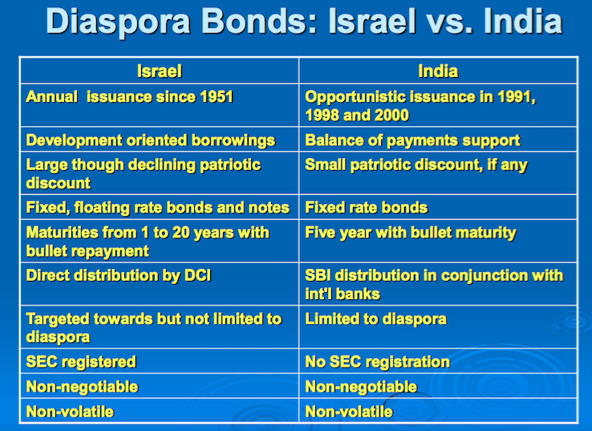
Lump sum repayment at maturity
Securities & Exchange Commission

Slide 63
DEVELOPING A TOOLKIT FOR CHECKING PROGRESS ON FINANCING FOR DEVELOPMENT
Operational principles
Regulatory architecture
Development goal
Existing revenue streams
Use of private sector and communities
Protection of financial resources

Slide 64
What principles would you develop to guide financing for development in a country? (Think of national ownership, integration across public sector, incentive frameworks)
What barriers and opportunities exist for financing for development? (Think of our discussions on climate finance for ideas)
What needs financing? (Pick a SDG)

Slide 65
What would be the priority and specific concern under (the SDG picked) that requires financing?
What financing mechanisms already exist? (Go back to the Day 1 lectures)
Are these financing mechanisms adequate? (Reflect on our discussions on innovative financing)

Slide 66
Are there other alternatives to mobilise additional financing?
Are there any incentives to get the private sector involved? (Consider Kilimo Salama)
What information needs to be made public to help investors make informed investment decisions?

Slide 67
What steps would you take to mitigate risks involved in financing for development? (Pick a SDG and assess its impact and implications)
How would you increase transparency, track and compare financial sustainability? (Think of our case studies on CMC Di Ravenna and Green Arava)
How would you ensure reporting on financing for development?

Slide 68
What steps would you take to help the public understand how to hold their governments accountable for financing for development?

Slide 69

DEBATE SESSION

Slide 70
See Training Manual (Case Study, p.18)
Will the 6 SDGs lead to development?
Are the investment needs of country X justified?
What are your arguments on country X’s approach to securing financing for development?
How would you address its financing gaps?
What key factors would you consider in preparing an enabling environment to secure innovative financing for development?

