Slide 1


Fiscal Activism: Operational Dimensions of the Shift Towards the Islamic Wealth Tax for Financing SDGs
Lyla latif
University of Warwick, UK

Slide 2
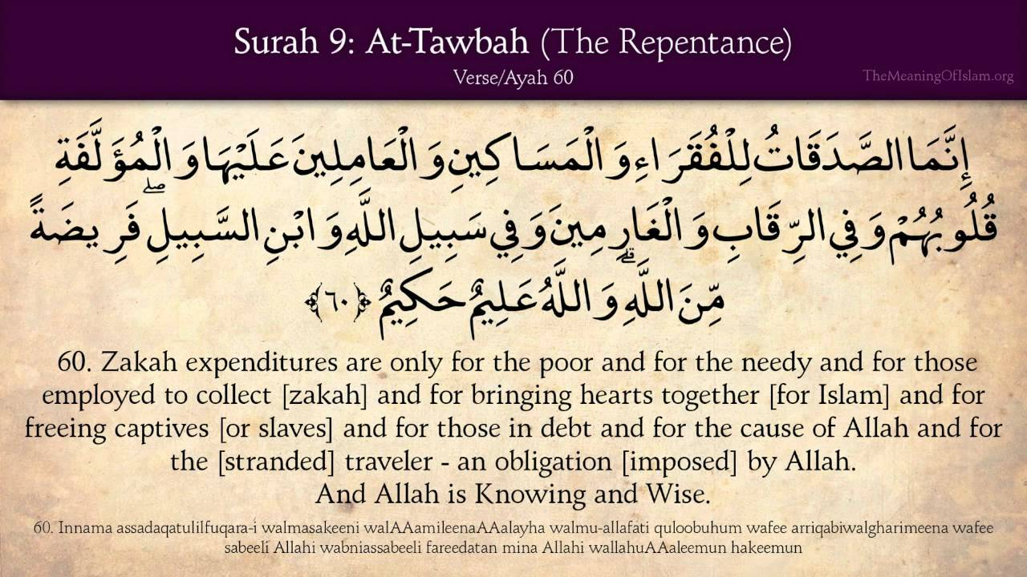

Slide 3

Zakat
2.5% savings, shares, investments
2.5% gold, silver
5-10% land
Camel | Sheep/Goats | Cows
5-9 camels – value of 1 ram/goat | 40-120 sheep – value of 1 ram/sheep/goat | 30-39 cows – value of a 2-year-old calf
10-14 camels – value of 2 rams/goats | 120-200 sheep – value of 2 sheep | 40-59 cows – value of a 3-year-old calf

Slide 4
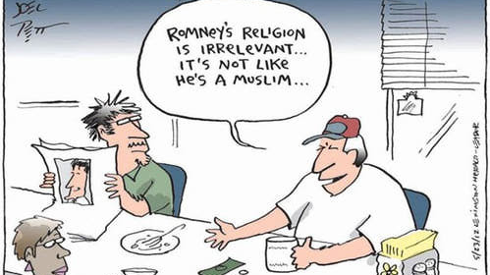

Slide 5
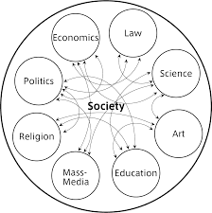
Luhman’s Theory of Autopoietic Legal Systems

Slide 6
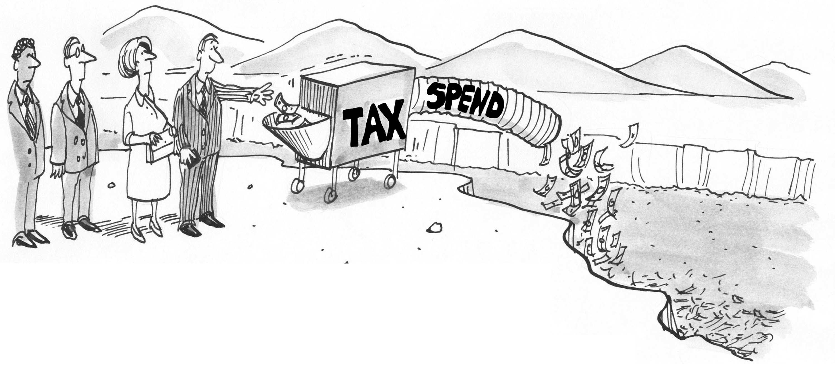

Slide 7

Can fiscal activism to expand the government's domestic revenue mobilisation policy based on zakat be supported by the Kenyan legal system?
Can religious funds be included as part of development finance?
Would operational challenges arise from a Law/Religion interface to finance development needs?

Slide 8



Slide 9
In development finance, redistributive tax arrangements are critical to progress towards achieving sustainable development.
Under the Islamic fiscal system such nexus is pegged on the collective redistributive action of zakat payers.
When probing the definition of finance, it then becomes significant to construe the term from the human rights principle of maximum available resources to ask whether human rights law permits its doctrine to intersect with religious norms in designing a development finance model.

Slide 10

Applying HR principles to bring together independent and separate autopoetic fiscal systems under a common purpose allows fiscal activism to gain ground in a legal system that separates law from religion.

Slide 11
Finally,
The idea of looking into Muslim money/zakat by the Kenyan state for example or any other non-Islamic state allows the government to broaden its revenue base and that is what we should be thinking about if we want have an inclusive approach to development finance.
@LylaALatif
Lyla.Latif@warwick.ac.uk

