Slide 1
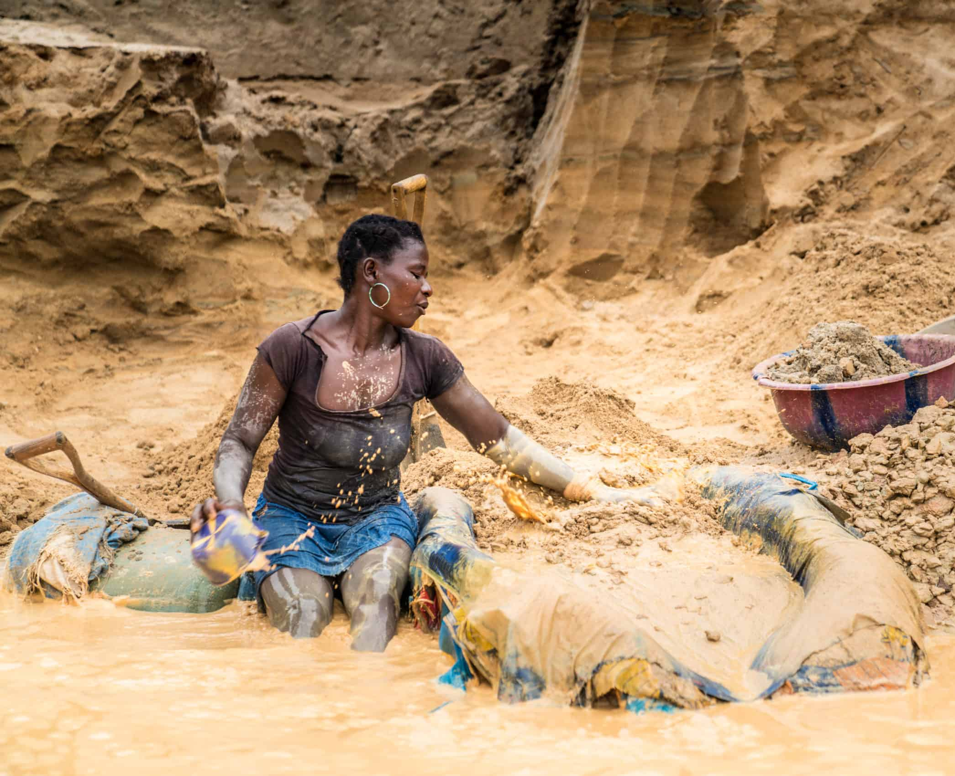
GENDER JUSTICE IN THE MINING SECTOR: GOVERNANCE & REDISTRIBUTION
Female Parliamentarians Training Seminar on Debt and Gender
15 November
Lusaka, Zambia
@LylaALatif

Slide 2
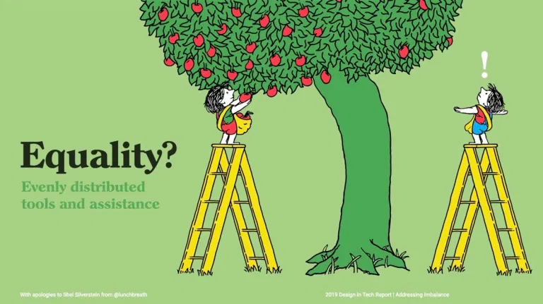
GOVERNANCE
GOVERNANCE
Process through which the state and society participates in directing and controlling how a particular sector should function for their benefit.
Process that allows the structures and institutions laid down by government to foster state building and permit society to be involved in decision making at all levels of governance
Determined by the states legal system and the criteria it seeks to meet
DRM
Inclusivity. Non- discrimination. Accountability. Transparency. Distributive justice. Sustainable development. Responsibility

Slide 3
Mining Governance
1
Rules, regulations, procedures and systems put in place that influence how the sector is managed
2
Part of such management concerns linking the sector with supporting the state’s public finance regime
3
And promoting redistribution and gender inclusivity

Slide 4
Mining Governance linked to DRM
The state’s approach to the governance of the sector
Reliance on external debt and its impact on the sector
Improving the efficiency of public spending out of revenue generated from the mining sector towards achieving gender justice

Slide 5
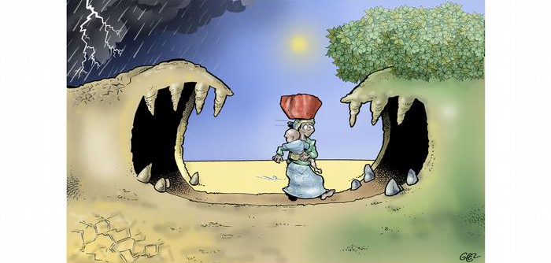
1. MINING GOVERNANCE, WOMEN AND DRM

Slide 6
DRM
The fiscal capacity of the state to identify and mobilise domestic sources of revenue with which to finance state building and sustainable development.
Link between governance of the mining sector and its potential towards generating DRM is based on the extent to which fiscal transparency and accountability feature as part of and along the industry’s value chain – from how extraction rights are awarded to how revenues are managed and allocated by government.
Along this chain, the role of women and their agency (decision making) is usually neglected or underprioritized.

Slide 7
Mining industry’s value chain
IVC approach to governance of the mining sector seems to foster an enabling environment that results in DRM but to what extent does this approach ensure gender inclusivity in mining led DRM redistribution?
Does it allow women to have a say in how the mining sector is to be governed? Role of female parliamentarians at each stage of IVC?
Stages at which women are allowed to participate in the state’s fiscal policy towards utilizing the sector’s tax contributions towards gender inclusive social and economic spending?

Slide 8
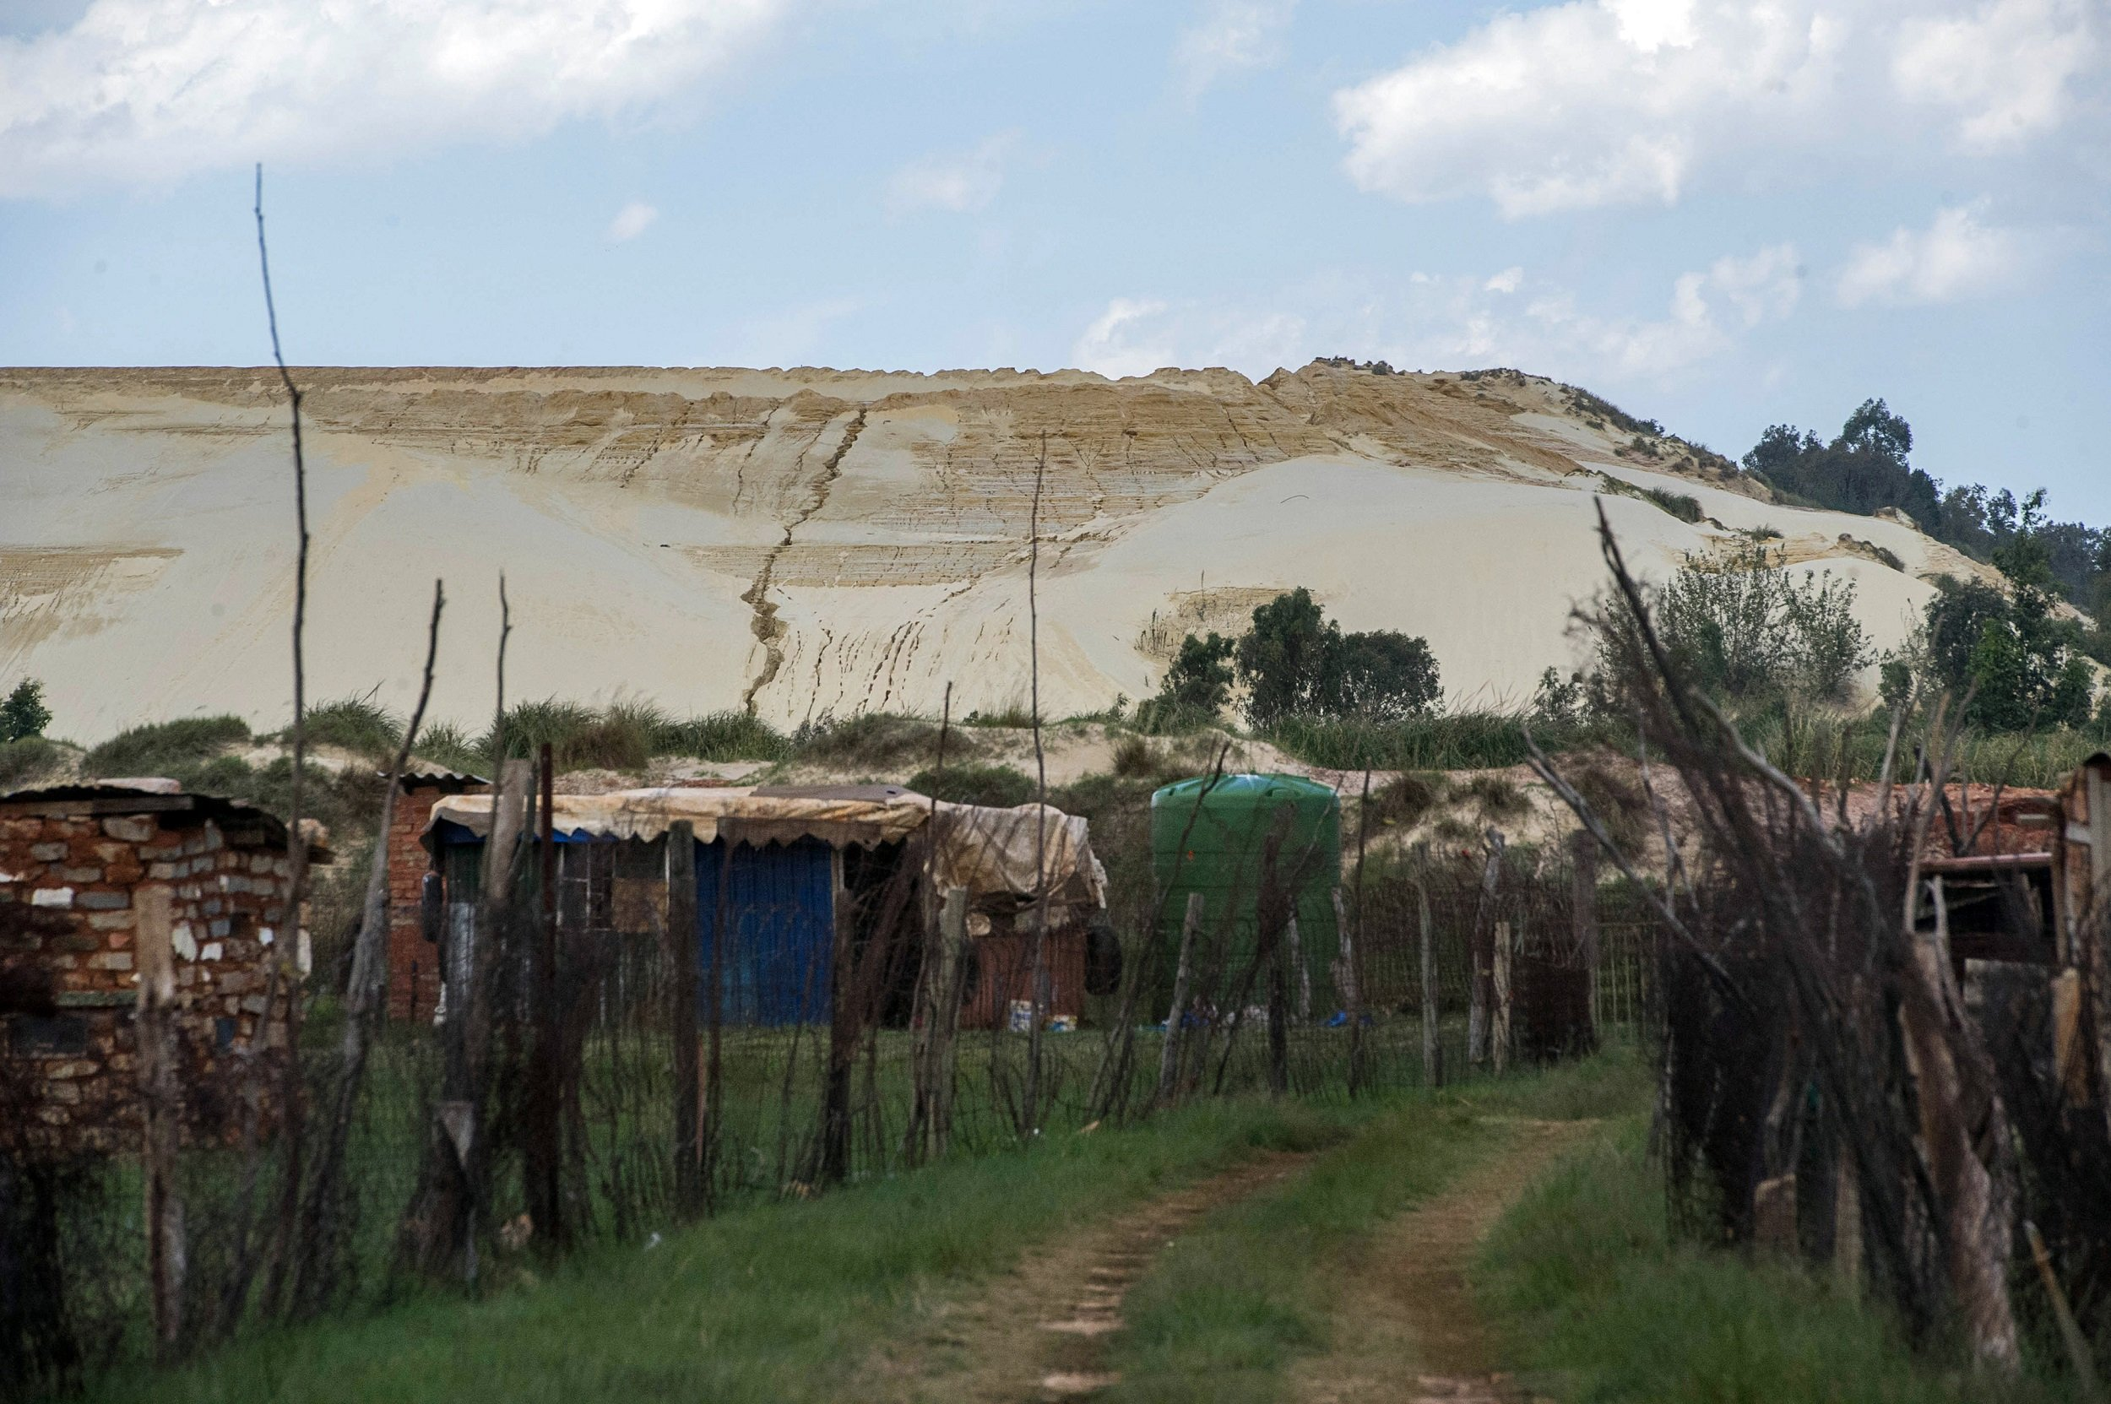
NATURAL RESOURCES
Local communities living along mining areas – land tenure/property rights challenges
Government negotiates with mining companies to compensate communities to relocate to other areas
Communities that remain - have HR adversely affected
2 problems for women
Snake Park, Jo’burg– impoverished suburb on the fringe of Soweto’s biggest mine dump

Slide 9
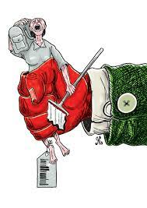
Problem 1: Compensation schemes usually involve government officers, mining company representatives and male community leaders. Women are ruled out of decision making either because of community patriarchal standards or the state’s preference for vertical decision making, that is taking to account only representatives rather than ensuring full public participation.
Problem 2: The lack of tenure in land ownership or where land is held under trusteeship or is part of ancestral land, usually ownership is seen to be vested in the male person. When negotiating compensation or relocation, title to land is also then conferred on the male person who will hold the title on behalf of all other community members. Customary law that prevents women from owning land effectively removes women from participating in compensation or relocation negotiations.
Gender bias = lack of land ownership rights, forced into labour as ASM – contribute to VAT – removal from decision making during compensation or relocation negotiations is not commensurate with their taxpayers rights

Slide 10
But… there is hope
Articles 10 and 201, Constitution of Kenya
AWEIK
Voice of Africa Women
GROOTS Kenya

Slide 11
CONTRACTS AND LICENCES
MNCS – large scale mining, procurement process, tax contribution but also IFF
Women – ASSM, subject to contract/licenses/permits, but process is challenging

Slide 12
Taita Taveta County in Kenya is ranked 28th among the poorest counties in Kenya. The region has a poverty rate of 54.0%, which is higher than the national average of 36.1%. Women making up the majority of the labour force have joined the ASM sector for job opportunities to support their economic welfare. If they have to bribe middlemen to procure mining permits, it only goes towards fostering an enabling environment for corruption related IFFs. Middlemen are used because the government offices are not located within proximity to where the women reside. To curb this, field offices of the government body offering the ASM mining licenses should be established near the mine sites so that women can access them.
The money lost by women to bribe middlemen does not go towards supporting the county’s DRM capacity. Having to bribe in order to procure a mining permit indicates the failure of the legal system to fairly apply the mining laws. The fee paid towards procuring the mining permit ordinarily should be redistributed towards the provision of public goods the use of which would benefit women. But does the county provide financial data to show the total amount in fees received from ASM licence application? Is the data disaggregated so that its apparent how much women have paid? Tax data is usually not disaggregated. So, we cannot tell for certain the extent to which mining licence fees earned by the county go towards social spending.
Reference: Mugo et al 2021

Slide 13
PRODUCTION
Mineral exploration
Extraction of the gemstone
Separation and sorting
Washing
Shining by glycerin
Packaging - sale to brokers
Women who work in the ASM sector when engaged along the value chain make it difficult to determine the market value of the minerals. How much are they paid for the gemstones they transact with? In terms of quantity, how many gemstones are the women extracting? Since ASM is viewed as part of the informal sector, loosely regulated, it makes it difficult for government to negotiate mining contracts with large scale mineral producers, thereby affecting its tax base. Women in ASM should offer for sale their minerals in the open market so true value can be determined and so that they can price their gemstones for fair value, apply VAT and hold government accountable towards redistribution targeted towards a gender inclusive economy.

Slide 14
Ghana is recognised as one of Africa’s best governed countries and a model of best practice in resource governance. Ghana is among Africa’s largest gold producers. Gold represents up to 49% of the country’s exports having contributed approximately $8.35billion to Ghana’s $59 billion GDP in 2019. Is this lucrative source of revenue available to women? In Ghana whether women can fairly or equitably access comparable income from gold is subject to how they bargain for power and also how their roles at the mining sites facilitate their participation in decision making over gold governance and their potential to earn. Numerous forms of cultural marginalisation keep women at the less productive margins of the industry. Cultural customs, superstitious beliefs and social taboos encourage such gendered dimensions toward women in mining. This results in women engaging in lower level supporting roles compared to managerial roles and ultimately ownership of mine sites. Their role is reduced to carrying mineralised sand in pans and sometimes providing water to wash the mineralised sand. They are rarely seen inside the mine shafts and underground mine pits where extraction occurs. Digging, use of hand tools and mineral processing are reserved for men following local cultural customs and taboos that bar women from working in underground pits. This impacts the ability of women to earn commensurate with the male persons.
Reference: Arthur-Holmes & Busia (2021)
In Ghana, women are also involved in illegal ASM activities, locally referred to as galamsey. The challenge they face here is breach of their casual labour relationship by their employer who fails to pay them their wages. No legal action can be taken since the labour results out of an illegality. This problem has to be tackled as part of mining governance. Penalising employers involved in illegal ASM activities.

Slide 15
REVENUE COLLECTION
Effective and efficient institutions with clear mandates
ASSM as part of (1) informal sector removes it from the revenue generation cycle of the state (2) restricts state from collecting revenue from women and having them as their tax base

Slide 16
Sources of Revenue?
Royalties,
corporate tax
employment tax
withholding tax
custom duties
city service levy

Slide 17
Examples
Royalties contribute over 25 percent of total payments in all sub-Saharan African countries except Liberia and Mali (around 15 percent).
Corporate taxes represent over 15 percent of total payments. The only exceptions are Liberia and Sierra Leone which are both below 5 per- cent
Taxes on mining company goods and trade (excises, customs duties, and export taxes) are contributing materially to total payments. In Burkina Faso, Guinea, Mali, and Zambia, these represent over 15 percent of total payments. In Ghana, Niger, Liberia, Sierra Leone, and Tanzania, however, these payments were less than 15 percent.
The source of remaining payments varies. Ghana for example received around 38 percent of payments from state participation dividends while, in contrast, Sierra Leone received around 18 percent of payments from license fees.

Slide 18
Tanzania
Introducing a 1 percent inspection fee on the gross value of all minerals exported out of the country is one such measure.

Slide 19
Despite a broadened tax base…
New IMF (2021) led research indicates African countries are losing between $470 million and $730 million per year in corporate income tax on average from MNE tax avoidance.
Women ASSM?
Role of female parliamentarians?

Slide 20
REVENUE ALLOCATION/SOCIAL – ECONOMIC SPENDING
Reflective Question: Revenue that is sourced from the mining sector is used towards what purpose? Is it redistributed towards social spending?

Slide 21
Zambia
Between 2011-2014 - mounting mining revenues for Zambia. Spending on health increased.
However, a significant part of the health expenditure was financed by external resources and out of pocket expenses.
Despite this the free primary health care policy of the government significantly increased the utilisation of public health care facilities, especially by disadvantaged social categories, constituting a step towards universal health coverage.
But equity issues in the provision of health care persist in Zambia. There is an urban bias in the territorial distribution of financial and human resources. Barriers remain to poor people’s access to secondary- and tertiary-level hospitals, while supply deficiencies are still appreciable at the rural primary level. Disparities in per capita public health care spending are quite substantial between provinces, with rural provinces less favoured. These provinces are in fact experiencing worse outcomes for some health indicators (child mortality and child stunting). The allocation of human resources is even more unbalanced, with rural areas having half as many health workers per 1,000 people as urban areas; half of the doctors are concentrated in the province of Lusaka. The estimated health personnel deficit has been reduced overall (from 69 per cent in 2005 to 43 per cent in 2016), but it is still very high in most rural and remote areas.
During the period of increase in mining revenue, recruitment of health workers increased and there were wage increases as well (recurrent expenditure) but infrastructure development, medical equipment and the acquisition of drugs, vaccines and other health supplies decreased. To what extent did mining revenue contribute towards health sector spending? What has the Zambian government established in terms of which revenue allocation goes to fund what priority and what systems have been put in place to monitor budgetary allocations are utilised for intended purposes? Does the Zambian mining revenue contribute towards women’s development?

Slide 22
2. EXTERNAL DEBT, DRM AND THE MINING SECTOR

Slide 23
Debt tests the fiscal capacity of states
When a state is running on borrowed money – it has to become fiscally active. The state must seek to continually identify and mobilise domestic sources of revenue to repay the debt on maturity and at the same time to have sufficient finances remaining to redistribute towards social and economic needs of the state and its citizens.
Usually, states end up spending more revenue sources servicing the debt at the expense of redistribution towards social needs. For example, Angola spends 44% of government revenue repaying its external debt. The country has the highest child mortality, yet the government only spends about 6% on public health. Zambia on the other hand spends 4 times more servicing its debt while 88% of Zambians are living on less than $6 a day.

Slide 24
When a state relies on borrowed funds its decision making is captured by external creditors, powers, institutions and markets
The state then compromises between repaying the debt with its interest or spending its revenue on social needs. The latter often gets neglected.
For debt not to undermine the fiscal capacity of a state pushing its towards austerity for example, the government has to plan out its short-, medium- and long-term growth priorities supported by what it can access locally in terms of revenue.
The government should also develop a debt repayment strategy through which it is able to prudently evaluate its domestic revenue mobilisation capacity and future projections and allocate specific industries, tax bases towards debt repayment and social spending in an equitable manner.

Slide 25
The debt should not be utilised toward supporting recurrent expenditure
but should be directed towards development expenditure and creation of employment opportunities alongside investments in education and health care.
The mining sector provides the state with an opportunity to strengthen its fiscal capacity and its ability to generate sources of revenue.
Understanding how the mining sector is governed is crucial to determine its capacity to generate revenue for the state.
Focusing on women as economic players whether through the formal or informal markets within the mining sector and its governance is equally important, if the state is to properly benefit from a broadened revenue base supported by the taxation of women.

Slide 26
Reflective Exercise: Managing debt using Africa’s mining sector
Resource backed loans can undermine a state’s future fiscal capacity if not prudently negotiated. RBLs can force a state to handover the management of the natural resource to its creditor on default. RBLs also allow a state to seek funds on the strength of its natural resources as collateral with repayment often spread out over many years after maturity. Does access to RBLs aid sustainable social and economic growth for Africa? How can RBLs be managed so as not to risk losing the sector to foreign control or ownership?

Slide 27
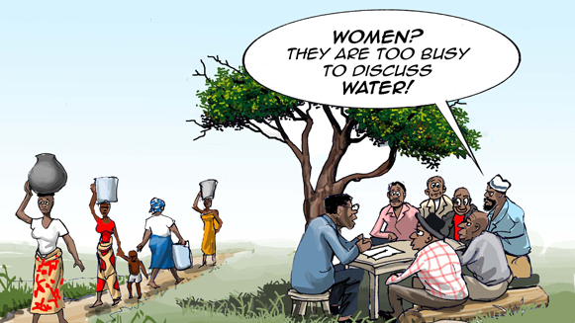
MINING GOVERNANCE, WOMEN AND DRM
EXTERNAL DEBT, DRM AND THE MINING SECTOR
3. EXTRACTIVE FISCAL ACTIVISM AND THE ROLE OF WOMEN

Slide 28
Key considerations
When RBLs are taken out by governments, do women access any distributive effects of the debt?
Being part of the ASSM sector, do women get to make decisions or participate in the decision-making process on what priority areas will be financed by the debt?
Do they get to influence what priorities are to be identified for debt finance?
What structures is debt financing creating for women to access and become economic agents? How will the debt service conditions impact women?

Slide 29
Key step
Women, often relegated to the boundaries of economic structures and markets should push towards extractive fiscal activism. Knowing their rights as taxpayers is an important starting point. Only then can they challenge all institutions and systems within the mining sector that trumps their right to demand for fiscal transparency, public accountability and to promote a rights based, gender inclusive approach to revenue redistribution.

Slide 30
WHAT CAN FEMALE PARLIAMENTARIANS DO?
What is to be done at the policy level to amplify the role of women in mining?
How can you influence change as a parliamentarian?
What will be your key priorities to address in supporting women in mining?
How can law be used to foster gender inclusivity in the governance of the mining sector?
What legal measures can you think of proposing?
What institutions are key towards promoting gender inclusivity in the mining sector, are they working as intended?
Can you think of ways to improve DRM out of the mining sector?
What are the key challenges towards strengthening mining sourced DRM?
What sort of leakages contribute toward your country's mining tax base erosion?
Can you think of ways in which the mining sector and mining revenue can contribute to debt reduction?

