Slide 1


Understanding the linkages between corruption, taxation and illicit financial flows
@LylaALatif
SUMMER SCHOOL 2018, MANGOCHI
Raising the Voice against IFF, Corruption and Inequality in Africa. Existing and New Challenges
AFRODAD
Notes:
Why is it important to understand the linkage between the three – income inequality, sustainable development, dependency on aid and borrowing, reduction in spending on ESCR, structural transformation, burden on poor and middle classes and SMEs and infant industries, distorts competition, erosion of tax base

Slide 2
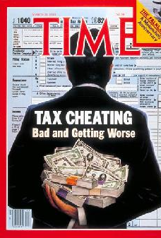
Objectives
If Africa fails to stop corruption, corruption is most likely going to stop Africa
Understanding the link between corruption, taxation and IFF and what it entails
Identifying the political and economic factors exacerbating this link
Unpacking the secret nature of corruption and IFF in the value addition process
Tracing the nodes through which information is restricted so as to facilitate corruption and IFF
Due diligence methods on detection of IFF in the value chain process
Thinking of solutions to weaken the corruption and IFF link
Using a toolkit to assess a country’s approach and stand on fighting against corruption and IFF
Protecting the domestic resource base of African economies
Notes:
To help you identify the legal, regulatory and administrative loopholes on the one hand and on the other the socio-economic and political factors that exacerbate corruption, IFF
Our focus shall be on the extractives sector
The session is divided into 4 parts: First, introducing the terms and their scope. Second, demonstrating the linkages thru GVC and GWC. Third, case studies scenarios to help us put this linkages in perspective and finally, using a toolkit to spot C and IFF in our country setting so that we can get started on targeting the loopholes that facilitate C and IFF and put an end to it.

Slide 3
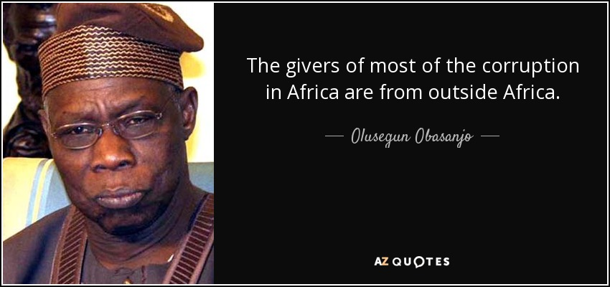
INTRODUCTION
1330hrs – 1400hrs

Slide 4
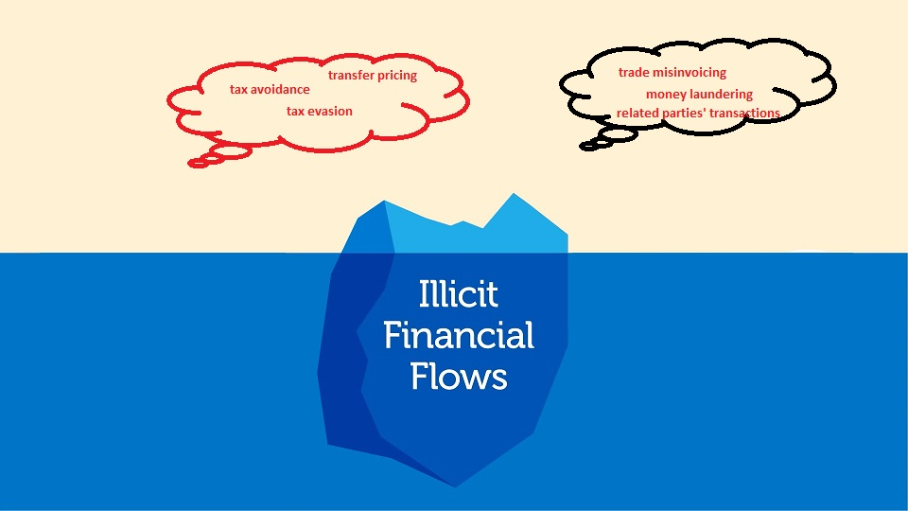
Corruption
Corruption?
Secretive nature and lack of accurate estimates – 5% of $67billion lost from Africa through IFF
Transnational Features
  Public/private to public/private to private – demand and supply side
  Institutions
  Sectors
Corruption
Notes:
Not just public sector issue or a domestic concern
Key stages: actors, institutions and sectors

Slide 5
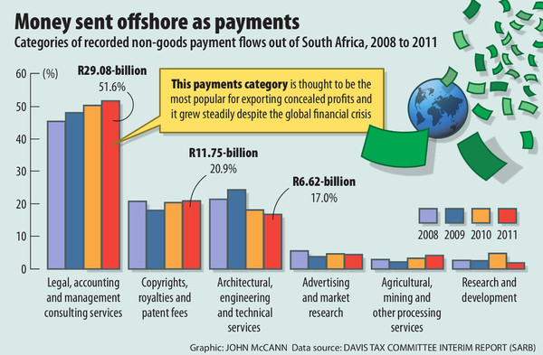
Taxation
Double Taxation Agreements (DTAs)
Taxation
Income tax
VAT
Custom/Excise
Royalties
Corporate tax
Dividends/Excess Profit Taxes
Notes:
Extractives is subject to DTAs
Language that is deliberately ambiguous and technical and clouded with secrecy – liberal theory implications – government to be hands off.
SA – NL DTA

Slide 6
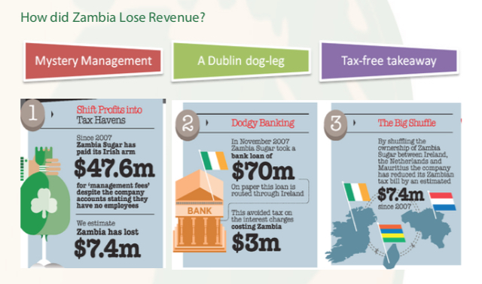
The case of Associated British Foods – Zambia Sugar PLC

Slide 7
Illicit Financial Flows
Illegal sources earned, used or transferred illegally
Illegal sources earned, used or transferred legally
Legal sources illegally used or transferred
Funds with criminal origin, such as proceeds of crime
Funds with a criminal destination, such as bribery, terrorist financing or conflict financing
Funds associated with tax evasion
Transfers to, by, or for, entities subject to financial sanctions
Transfers which seek to evade anti money laundering/counter terrorist financing measures or other legal requirements (such as transparency or capital controls)
Notes:
Legal source (profits) illegally used/transferred (tax evasion – trade misinvoicing, profit shifting, debt shifting)
Bribery/drugs/trafficking – real estate, mobile transfers, digital currencies
Profits thru value addition/sample sales – tax havens (what makes it illegal is that it evades AML laws)

Slide 8
Framework for understanding sources of income and their tax implication (p.19 training module)
Trade misinvoicing
Transfer pricing
Debt shifting
hawala
Round tripping

Slide 9
Causal effect of corruption, taxation and IFF link
high
Corruption
low
Taxes
Corruption
Illicit financial flows
IFF
Taxation
Corruption
IFF
Diminished tax base
Lesser DRM
Reduced tax collection
Notes:
Erosion of the tax base

Slide 10
Contributing factors
Weak legal framework (old tax laws, laws on extractives ambiguous, weak procurement process)
Political accountability
FDI conditions
DTAs
Lack of transparency and accountability (no automatic exchange of information)
Porous borders
Beneficial ownerships and no public registers
Complicit professionals and third parties
Capacity (human resource, training)
Institutions
Infrastructure (technology)
Tax havens
Global value and wealth chains

Slide 11
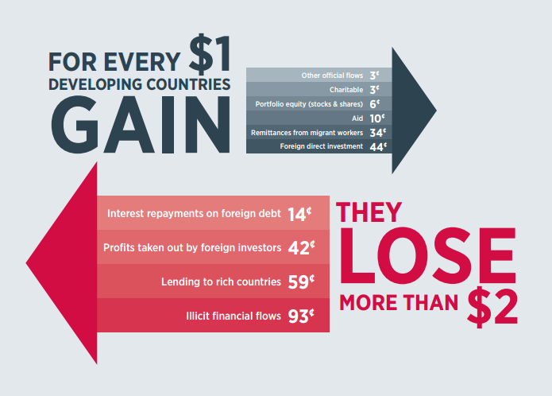
Global and continental responses towards curbing corruption and IFF
Section 1.3. at pages 22-27 of the training manual
Notes:
UN Convention against Corruption
OECD Convention on combatting corruption
FATF
StAR
OECD BEPS
SDGS 16.4
AUCPCC
ATAF
UNECA
NEPAD
ARPM
Regional initiatives SADC ECOWAS COMESA EAC protocols on combating corruption

Slide 12
Reflective exercises at page 13 and 15 of the training manual

Slide 13
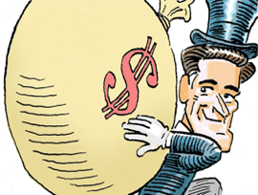
Understanding the linkages between corruption, taxation and IFF
1400hrs – 1430hrs

Slide 14
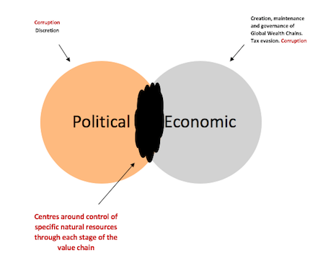
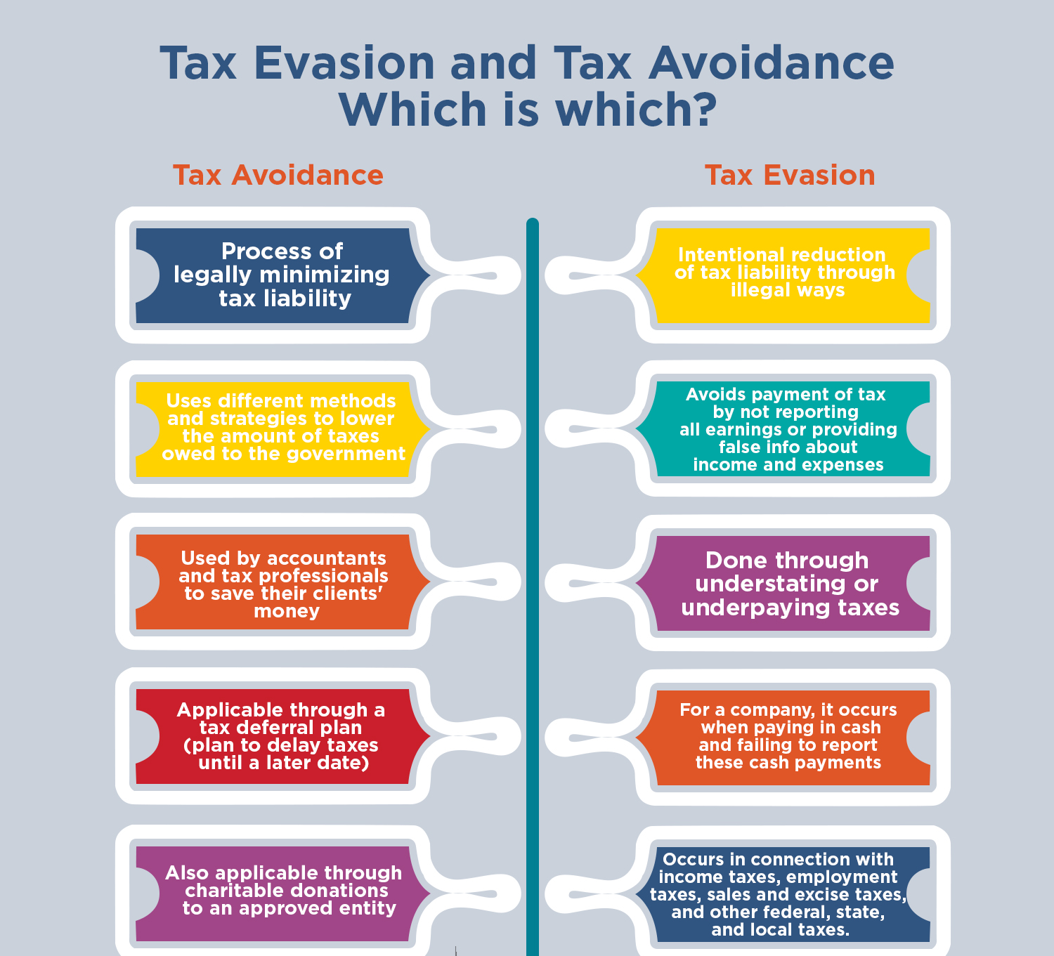
Factors that drive the corruption, taxation and IFF link

Slide 15
Value chains creation stages
Award of contracts and licences
Sale of concession
Business related human rights abuses and corruption
Exploration stage and samples
Value addition and royalties

Slide 16
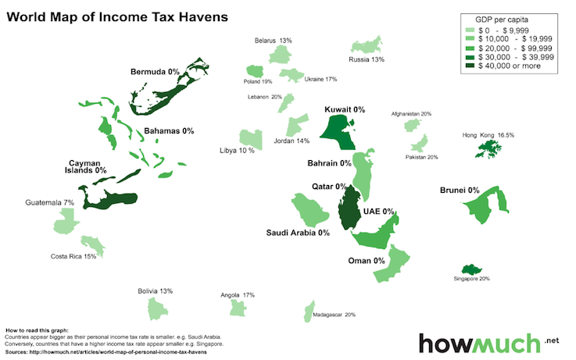
Nodes that strengthen the corruption, IFF linkage
Notes:
Professionals
One side: cross border lawful activities (lawyers and accountants make it possible)
Next side: global tax architecture

Slide 17
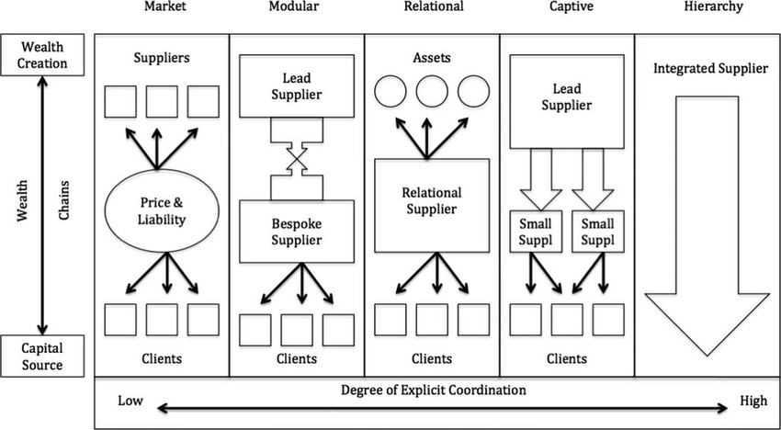
Global Wealth Chains: Linking corruption, taxation and IFF
Regulator
Notes:
Hiding identity

Slide 18
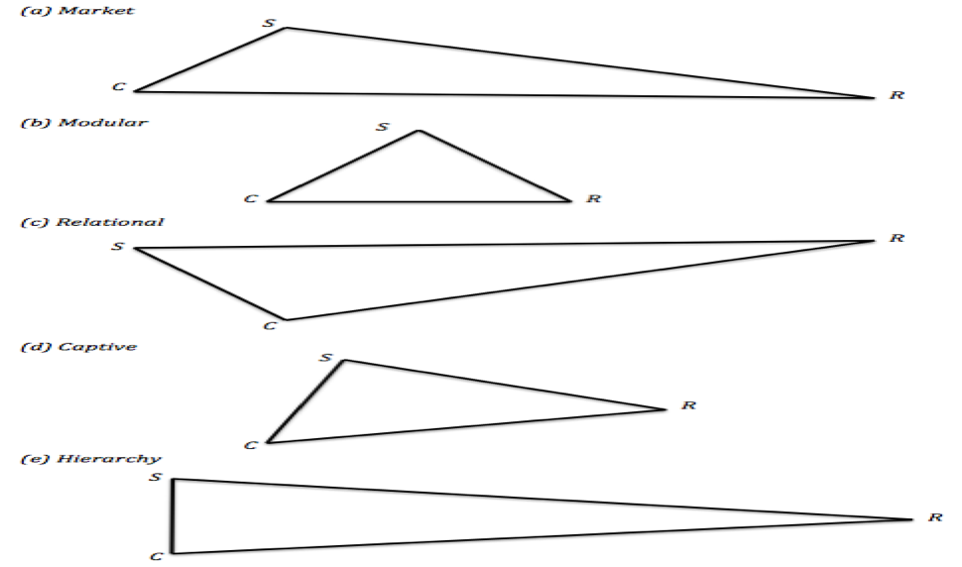
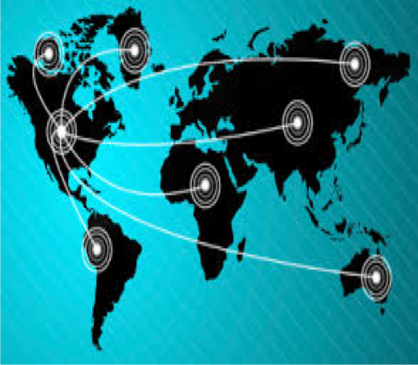
GWC- how it works (information asymmetry)

Slide 19
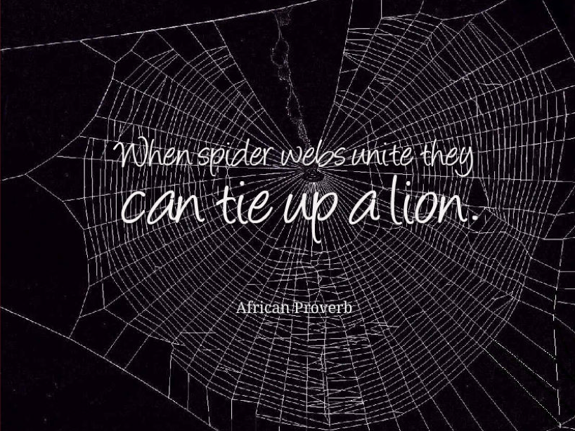
Group Task
Reflective exercise on page 32 of the training manual 1430hrs – 1445hrs
Discussion 1445hrs - 1500hrs

Slide 20

Case Studies
1500hrs - 1510hrs

Slide 21
Salient features
Insufficient contract transparency
External agents
Transfer of title without legitimate foundations/land use conflicts
Lack of legitimate justice system
Lack of public participation

Slide 22
Specific examples
Private gain
Unequal contracts and concessions
IFF
Lost CGT and under pricing
Tax holidays
Notes:
Reflect

Slide 23
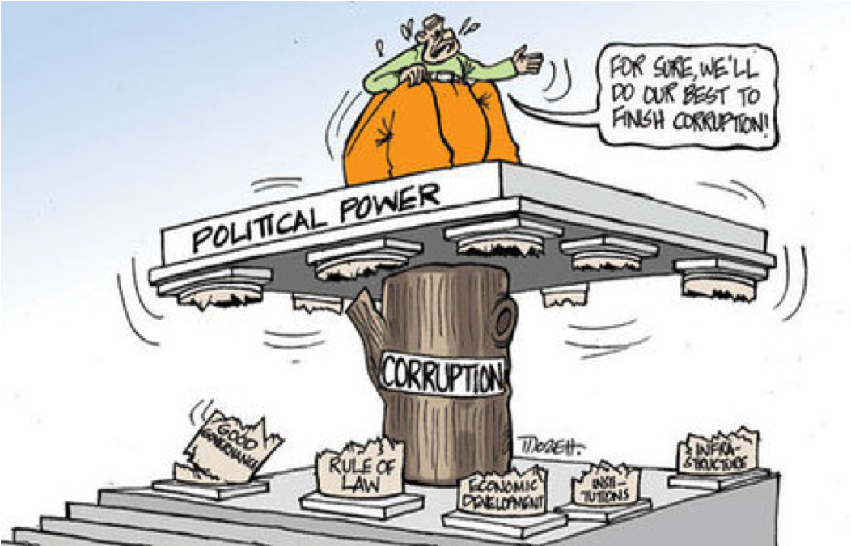
Reflection exercises and discussion- at page 36 of the training manual 1510hrs – 1530hrs

Slide 24
Tea Break
1530hrs - 1545hrs

Slide 25
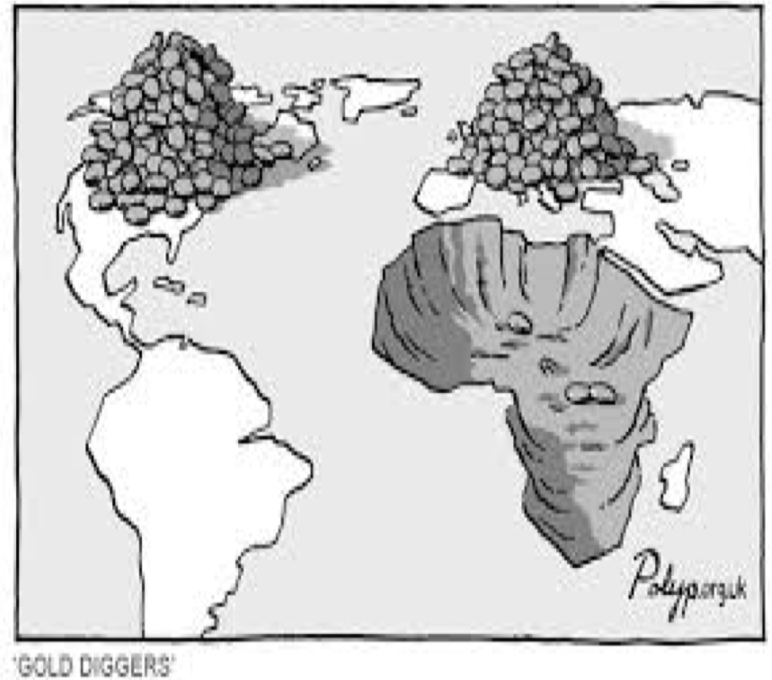
Identifying, pre-empting and redirecting policy change in curbing corruption, taxation and IFF
1545hrs – 1615hrs

Slide 26
Strategic approach
Due diligence/ background check on MNC
Cap on the renewal of exploration licence
DTA review
Cap on samples being taken out for testing
Expert report on sample's identification of value addition
Legal redress for unpaid royalties on value addition
Public register on beneficial ownership of MNCs
Corporate structure and shareholders information to be regularly updated

Slide 27
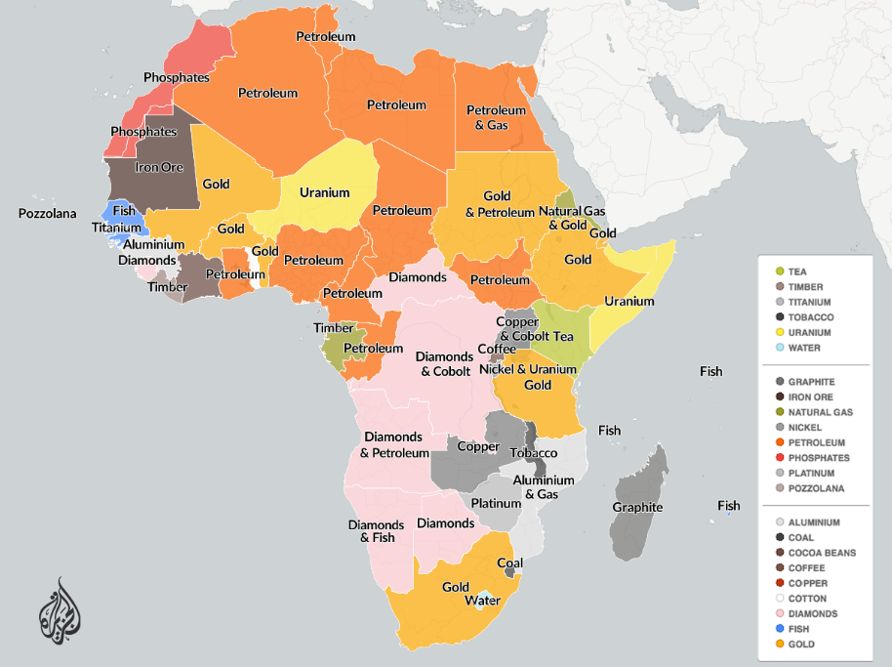
Working with the toolkit
1615hrs – 1630hrs

Slide 28
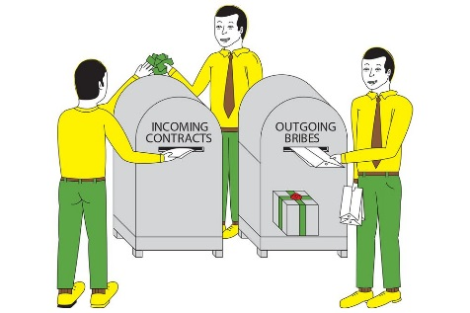
Recommendations
Improve the tools to measure IFF
Develop greater integration across interventions at country level
Explore lessons from StAR and their relevance for recovering other IFFs
Build capacity in critical areas for reducing IFF
Strengthen global coalitions to reduce IFF
AUCPCC
ATAF and NEPAD – training professionals
APRM – due diligence
Political will – Angola, Kenya and Mozambique
Transparency and freedom of information

Slide 29
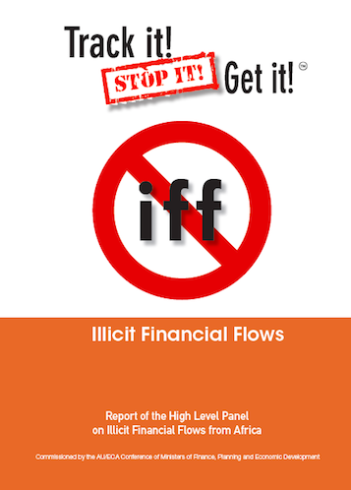
Questions, Way Forward latif@uonbi.ac.ke latif.lyla@gmail.com
@LylaALatif

