Slide 1
Understanding the Digital Economy
Lyla Latif

Slide 2
Approach
What is it?
Online activities? Offline activities? Mobile money based system? FinTech?
How does it function/operate?
Internet, ICT, digitalisation, digital business models, payment/lending system, AI, machine learning, blockchains, big data, mobile networks, sensors, WiFi
Who/how is it controlled?
Governments, private companies, individuals, data centers
Legal issues
Data privacy, data theft, human rights concerns, informed consent, tax

Slide 3

Prompt Questions
‘Economy’ what does it mean?
What is the ‘digital economy’?
How is the digital economy different from traditional economy?
Can you identify specific features of the digital economy?

Slide 4
Further Queries
LAW
LANGUAGE
EARNINGS
TAX

Slide 5
DST - Kenya
DST will be paid by the digital service provider or the digital marketplace provider or the tax representative of a non-resident person.
DST is applicable on the provision of digital services and digital marketplace. Digital services provided by residents and non-residents on which DST will apply are as follows:
  downloadable digital content including downloadable mobile applications, e-books and films;
  over-the-top services including streaming television shows, films, music, podcasts and any form of digital content;
  sale of, licensing of, or any other form of monetizing data collected about Kenyan users which has been generated from the users’ activities on a digital marketplace;
  provision of a digital marketplace;
  online distance training through pre-recorded media or e-learning including online courses and training; and
  any other service provided through a digital marketplace.

Slide 6
DST – Kenya non resident
A non-resident company providing a digital service to a user located in Kenya shall be subject to DST where:
  the user receives the digital service from a terminal (computer, tablet or mobile phone) located in Kenya;
  the payment for the service is made using a debit or credit facility provided by a Kenyan financial institution or Kenyan company;
  the digital service is acquired through an internet protocol address registered in Kenya or an international mobile phone country code assigned to Kenya; or
  the user has a business, residential or billing address in Kenya.

Slide 7
Some Definitions of the Digital Economy

Slide 8
IMF
The digitalisation of the economic activity can be broadly defined as the incorporation of data and the Internet into production processes and products, new forms of household and government consumption, fixed capital formation, cross-border flows, and finance.
Narrow definition: online platforms, and activities that owe their existence to such platforms
Broad definition: all activities that use digitised data are part of the digital economy
Notes:
Why do we understand definitions? Because through them we understand how to frame the law and apply it. We get to engage at international policy making from a definitional point of view. If you don’t agree on definition, you will not agree on principles and on the application of the law.

Slide 9
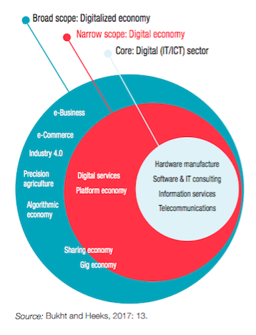
Notes:
Are you deriving a tax base from breaking down this definitional analysis? Are you looking to tax hence the need to break down definition? What is your purpose and target. Who or what is your target?

Slide 10
UNCTAD
That part of economic output derived solely or primarily from digital technologies with a business model based on digital goods or services.

Slide 11
UNECA
The global flow of goods, services and finance through the means of digital computing technologies that are unbound by national borders.

Slide 12
OECD
As part of an economy that enables and conducts the trade of goods and services through electronic commerce on the Internet.

Slide 13
My preferred working definition
The global network of economic and social activities that are enabled by platforms such as the Internet, mobile and sensor networks

Slide 14
There are no agreed definitions on the digital economy!

Slide 15
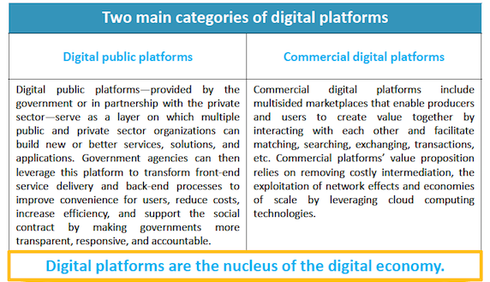

Slide 16
FinTech
How do you earn from FinTech as a commercial digital platform?
Is FinTech taxed in Africa?
If yes, how is it taxed?
And is its taxation earmarked for development finance?

Slide 17
OECD digital tax – DRM potential
The OECD/G20 Inclusive Framework on Base Erosion and Profit Shifting (IF) has agreed a two-pillar solution to address the tax challenges arising from the digitalisation of the economy.
Tax base: MNEs with global turnover above 20 billion euros and profitability above 10% (i.e. profit before tax/revenue) with the turnover threshold to be reduced to 10 billion euros, contingent on successful implementation including of tax certainty on Amount A
Nexus: There will be a new special purpose nexus rule permitting allocation of Amount A to a market jurisdiction when the in-scope MNE derives at least 1 million euros in revenue from that jurisdiction. For smaller jurisdictions with GDP lower than 40 billion euros, the nexus will be set at 250 000 euros.

Slide 18
What is this Amount A?
A three-step process will be required to calculate the quantum of Amount A taxable in each eligible market jurisdiction.
by either using absolute amounts of profit (the “profit-based approach”) or, alternatively, profit ratios (the “profit margin-based approach”).

Slide 19
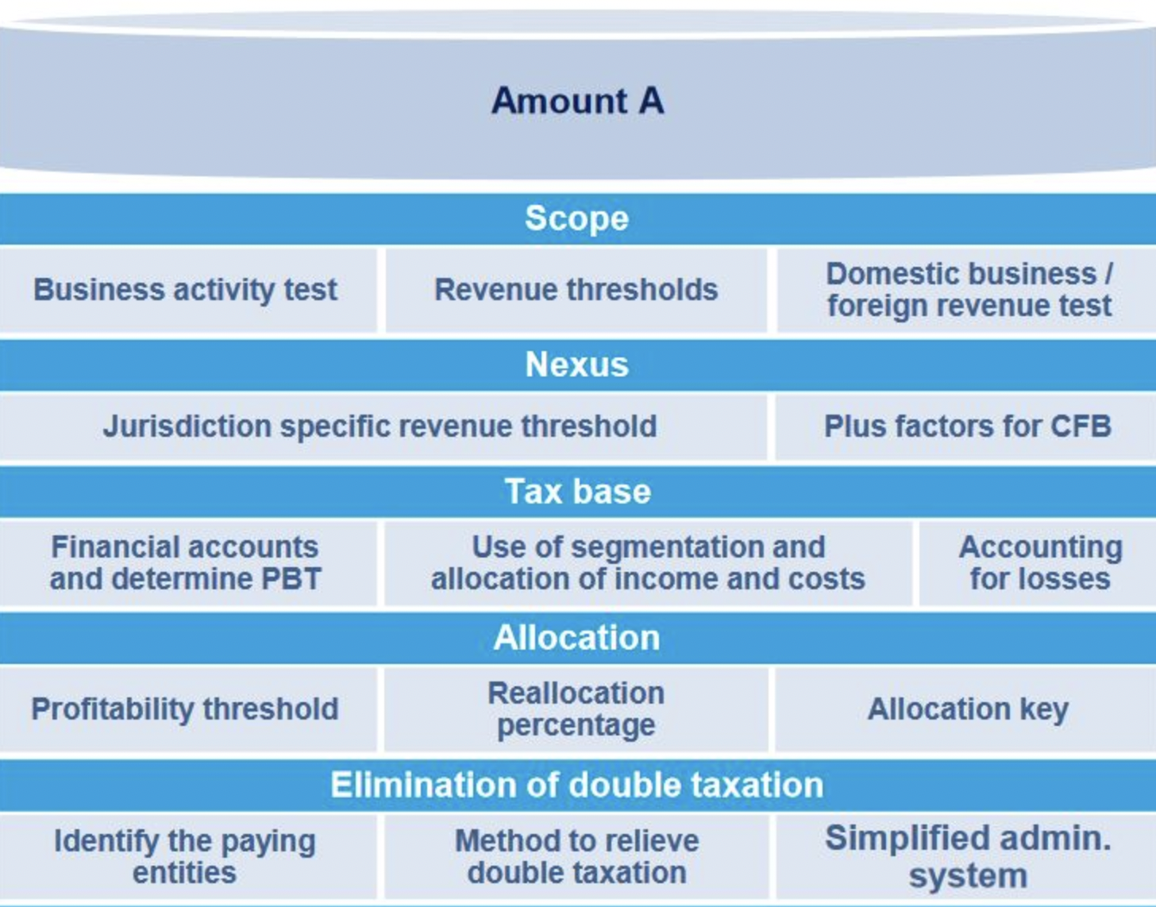

Slide 20
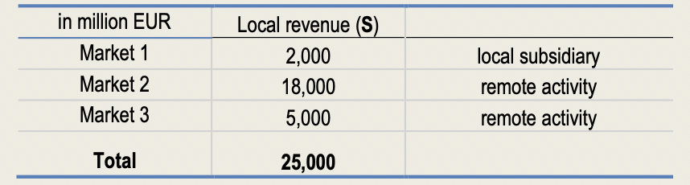
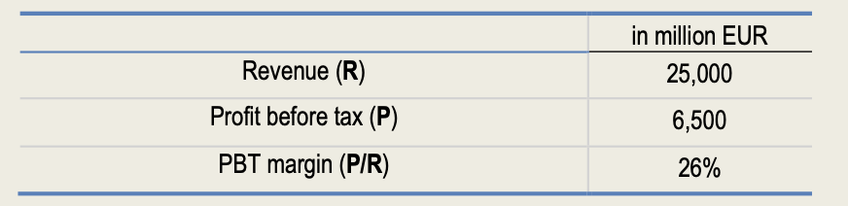
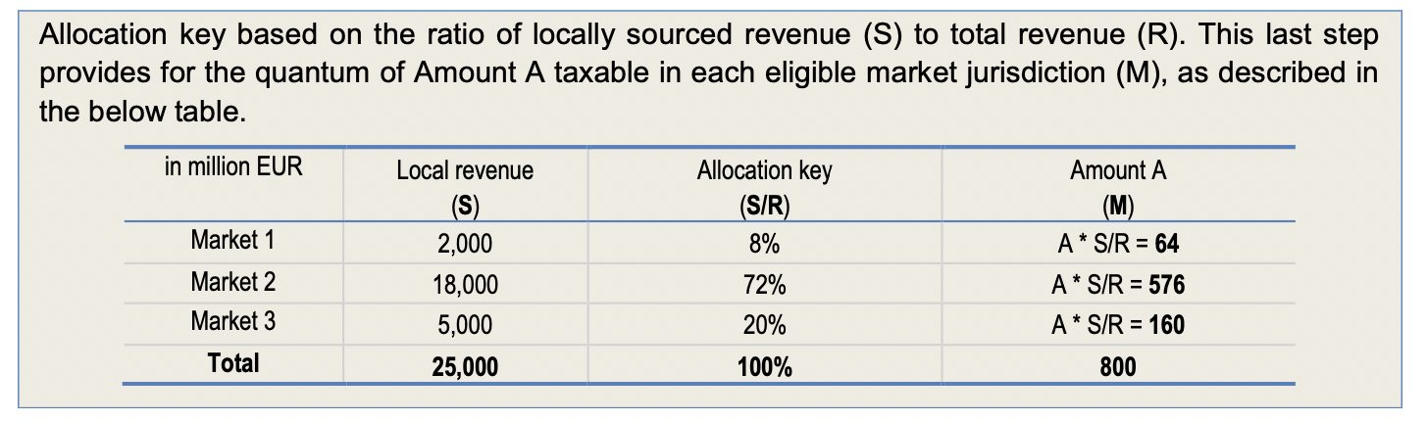
Profit based approach

Slide 21
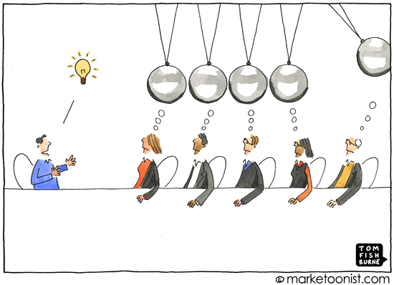
Audience,
It’s your turn now
Sector - Think of a sector in your country that has been disrupted by digitalisation.
Digital impact - How has digitalisation affected/impacted that sector?
Legal response - How has the state responded to this disruption?
Market response - What is the market response?
What are the legal issues, tax challenges? Is the digital aspect inclusive – can everyone access, infrastructure readiness, digital literacy level?

Slide 22
An Example of How the Digital Economy Works

Slide 23


Slide 24
Digital business models
Subscription model
Advertisement model
Access model
B2C
B2B
P2P
FinTech

Slide 25
Who/How is the Digital Economy Controlled?
Government
Executive
Legislature
Judiciary
Digital companies
FinTech
E-commerce
Individuals
Cybersecurity
Dark web
Notes:
FATF Recommendations on AML and TF
OECD BEPS
WAEMU
Individual states

Slide 26
Emerging Legal Issues

Slide 27
DATA PRIVACY ISSUES
Notes:
What are the legal issues related to data privacy?
Whose data? Terms and service that you accept have conditions – use of your data, so when does ownership of data shift? Can you exercise control over such data? Unsubscribe?
What happens when data is sold to a third party without your knowledge, but you get targeted adverts on your social profile?
What of protection of copyright material? Information you share online and publicly? IP around these concerns.

Slide 28
DIGITAL IDENTITY
Notes:
The law of contract and digital identity. Initially problematic but laws have been enacted to recognise electronic identities. What of issues of defamation? Look at the identity spectrum and assess how a nexus is to be identified. Paypal payment, risk mitigation – storing of passwords online and remembrance feature for passwords activated, if phone stolen and system used, think of the chain of events necessary to recover payment.

Slide 29
Data Theft
The case of Garmin SA.
Estimated loss to African businesses from cyber crime at US$3.5bn. Nigeria was the hardest hit with losses of US$649m, followed by Kenya with US$210m and Tanzania with US$99m.
Notes:
This then is the domain of regulation and infrastructure capacity.

Slide 30
Human Rights Concerns
Notes:
Social media posts and hate crime, arrests? FB pulls down the post. Consequence?
Spying on HR activists allegedly by Rwanda?
Denial of employment as a result of vetting of one’s social media?
What other HR implications can you think of?

Slide 31
Informed Consent/digital consent
Agreeing to terms of service? Do we read? Sharing with third party
No access without agreeing to terms of service
So how does one give consent?
Notes:
Part of HR but important to discuss separately as well.

Slide 32


Slide 33
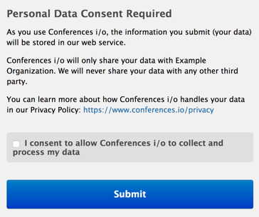

Slide 34
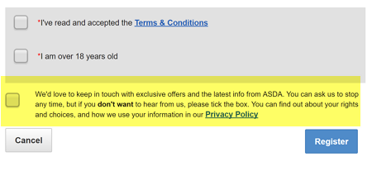

Slide 35

Data Protection Models
Comprehensive
Co-regulatory
Sectoral
Self regulatory

Slide 36
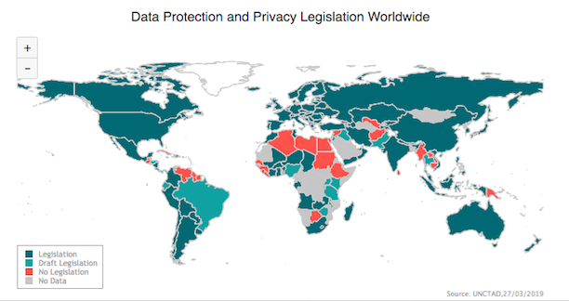
Notes:
Kenya has now enacted its Data Protection Law.

Slide 37
Tax
What to tax?
How to tax?
Who to tax?
When to tax?
Why tax?
Where to tax?

Slide 38
Taxation of e-commerce is problematic due to anonymity, difficulty to determine the amount of tax, lack of paper trail, tax havens, companies incurring liability in multiple countries, tax administration’s lack of capacity to identify companies and manage VAT

Slide 39
Tax Challenges Arise From
Nexus: The possibility to conduct business without physical presence thanks to technological advancements.
Data: The difficulty to attribute value to data generated by using personal information of end-users.
Characterisation: The creation of new products and new ways of delivery, which make the characterisation of payments uncertain in new digital business models, such as cloud computing, which facilitates storage of data and programmes at external services, and thus saves space on the consumer’s own computer.

Slide 40
Value Creation
Value is created by subscription fees paid by users. Advertisement fees generated by users and access fees paid by third parties to take hold of user’s data in digital business models
So how do you capture it?

Slide 41
The End
To continue this discussion, please write to me either through
Twitter: @LylaALatif or
Email: latif@uonbi.ac.ke

