Slide 1
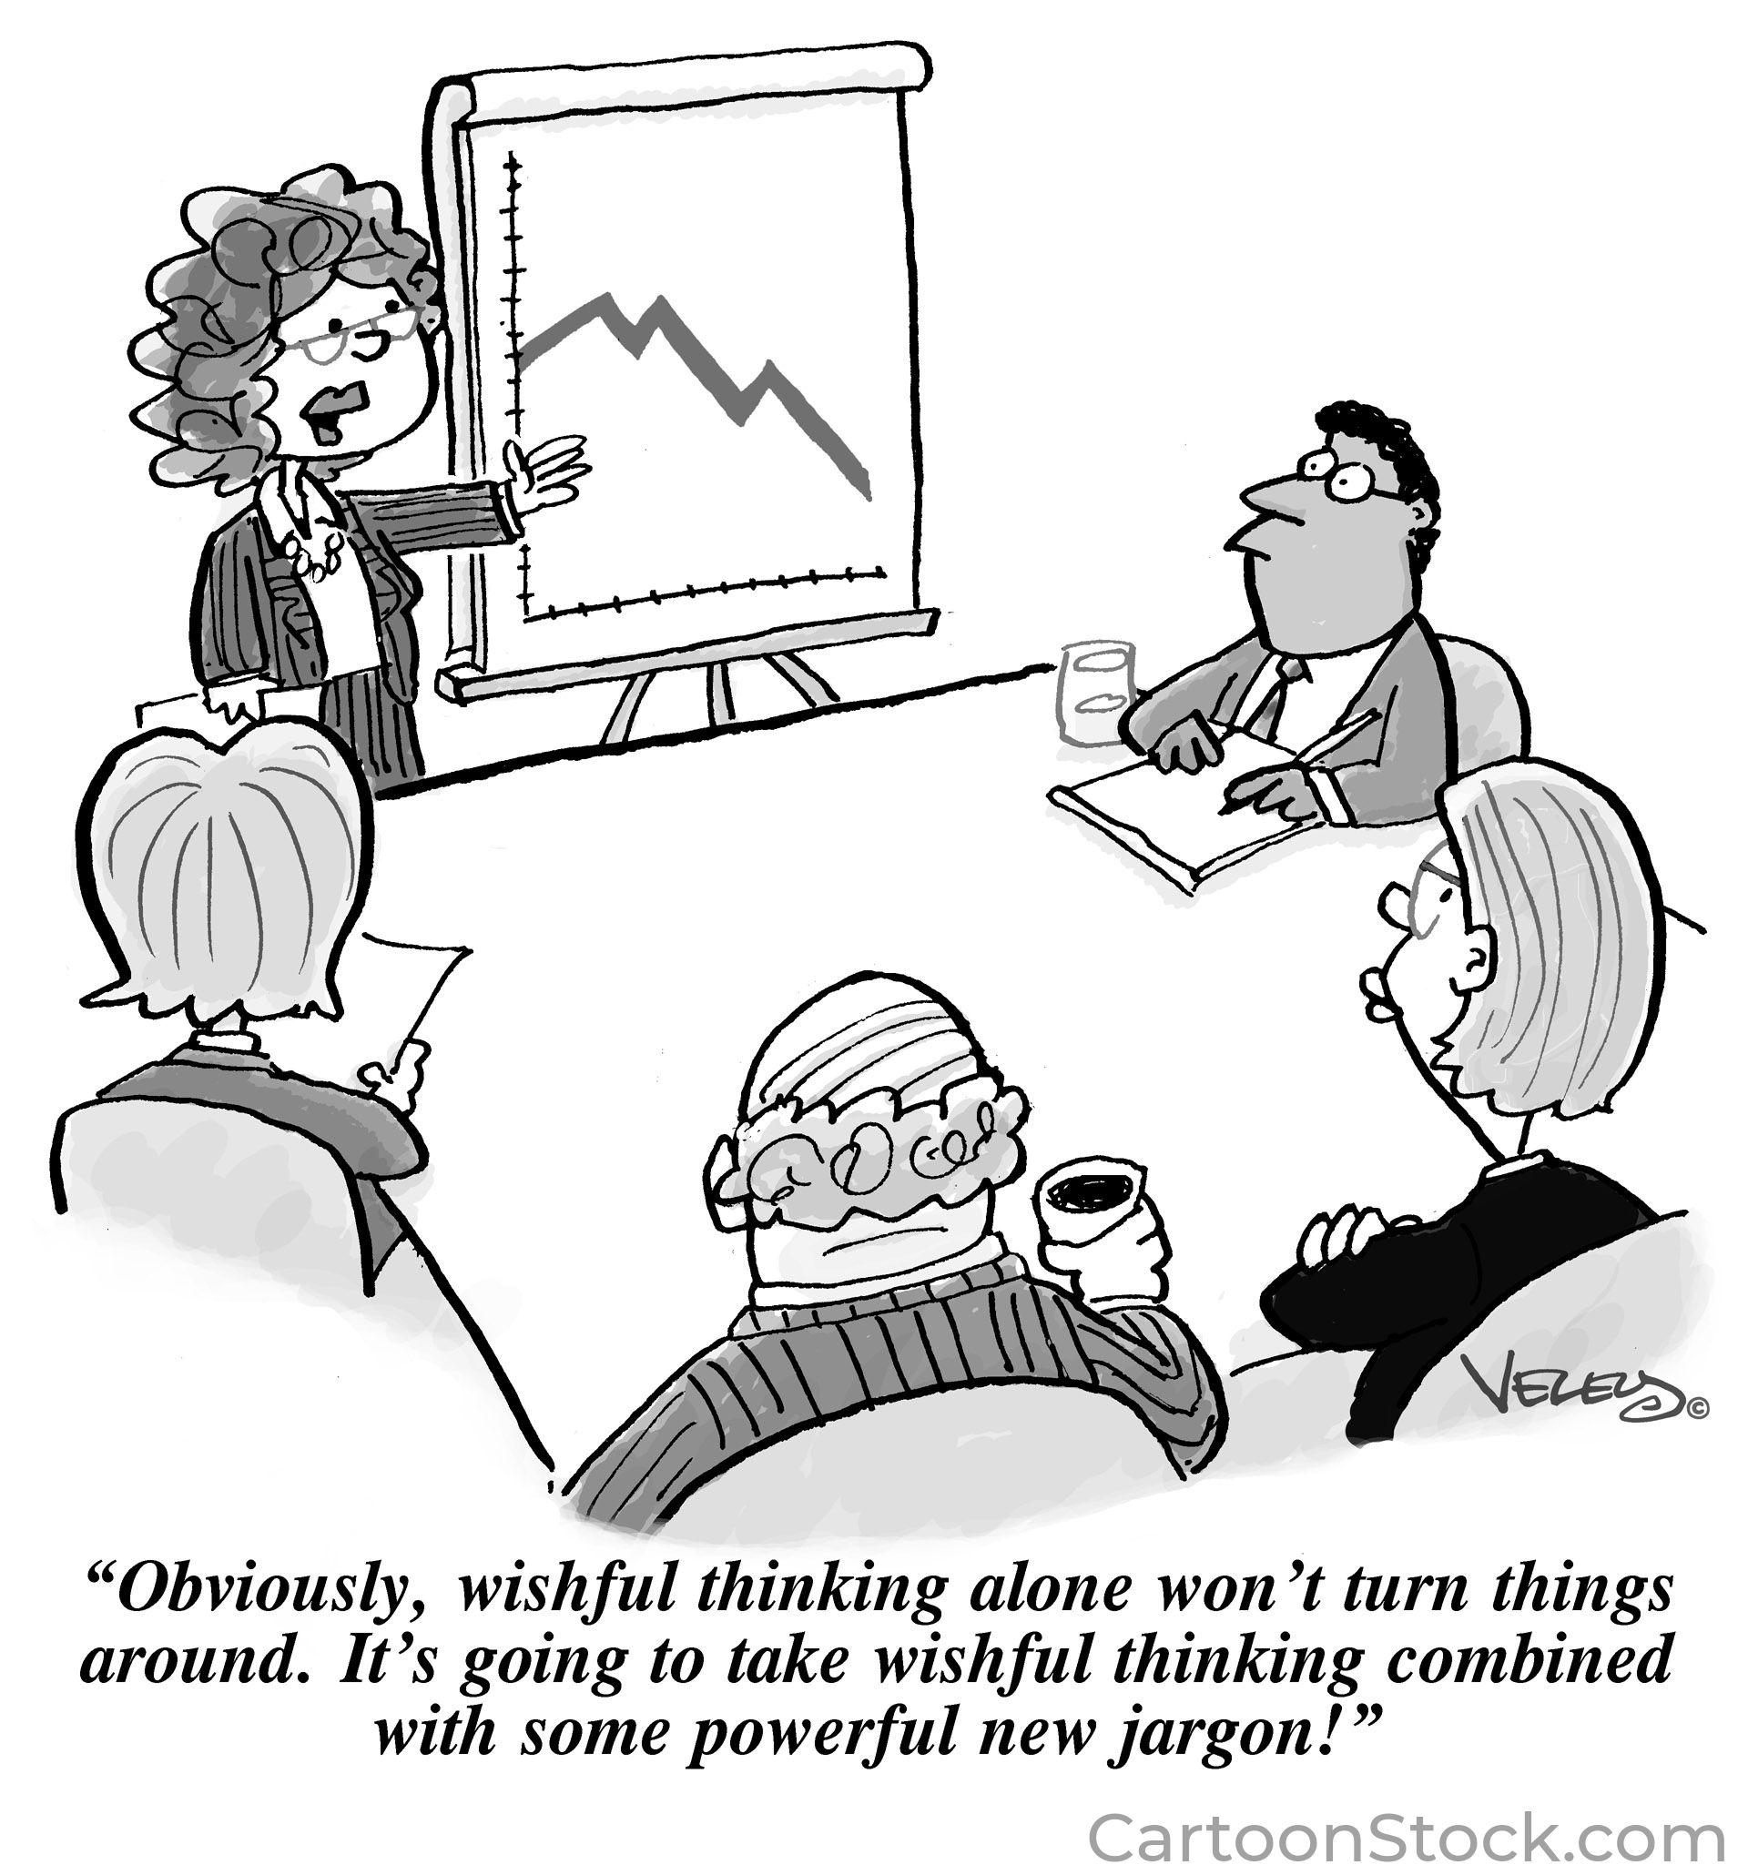
Draft Text of the UNFCITC
Language as Distributive Choice
Lyla Latif (PhD)
Committee on Fiscal Studies, Faculty of Law, University of Nairobi
www.lai-latif.com
18th GREIT Lisbon Summer Course,
University of Lisbon, Portugal
19 June 2026

Slide 2
Treaty language is a distributive choice
It is the substantive agreement.
The choice between
  ‘shall adopt’ and ‘shall explore’,
  between ‘develop and implement effective measures’ and ‘take such measures as are necessary’,
  between a precise threshold and an open-ended qualifier, is the choice between
    an obligation that binds and
    a recitation that does not.

Slide 3
The good-faith floor — Vienna Convention on the Law of Treaties
ARTICLE 26 — VERBATIM TEXT
‘Every treaty in force is binding upon the parties to it and must be performed by them in good faith.’
ARTICLE 31(1) — VERBATIM TEXT
‘A treaty shall be interpreted in good faith in accordance with the ordinary meaning to be given to the terms of the treaty in their context and in the light of its object and purpose.’

Slide 4
ICJ jurisprudence on modal verbs and obligation
LaGrand (Germany v. United States), ICJ Reports 2001, p. 466. The Court held (paras 99–102) that the word ‘shall’ in Article 41 of the ICJ Statute creates a juridical obligation of performance — provisional measures are binding. The Court reached this result by direct application of VCLT Article 31, treating ‘shall’ as the ordinary-meaning indicator of a duty.
Pulp Mills (Argentina v. Uruguay), ICJ Reports 2010, p. 14. Paragraph 197 supplies the canonical formulation of the conduct/result distinction. An obligation requiring a State ‘to use all the means at its disposal in order to avoid activities which take place in its territory, or in any area under its jurisdiction, causing significant damage’ is an obligation of conduct (due diligence), not of result. The threshold for breach is failure of effort, not failure to produce a guaranteed outcome.
Whaling in the Antarctic (Australia v. Japan: NZ intervening), ICJ Reports 2014, p. 226. The Court parsed the textual standard ‘for purposes of scientific research’ under ICRW Article VIII and held that even discretionary treaty language is reviewable on an objective reasonableness test. Young and Sullivan (16 Melbourne JIL 311, 2015) read the judgment as the ICJ moving from deference to discretion-claims toward objective review of even apparently discretionary language. The implication: a State cannot escape obligation simply because the textual standard appears soft.

Slide 5
Common language appearing as treaty modal verbs
MODAL FORM
JURIDICAL CONTENT
COMPLIANCE THRESHOLD
PRECEDENT
shall
Obligation of performance
Duty to act; failure is breach.
LaGrand (2001)
shall (with ‘to the extent possible’)
Obligation rendered discretionary
Self-judging; effectively none.
—
may
Faculty or right
No duty; no compliance question arises.
—
should
Recommendation
Good-faith departure permitted on reasoned ground.
UNFCCC Art. 3
shall endeavour / shall pursue
Obligation of conduct toward a stated aim
Due diligence; effort required, result not guaranteed.
Pulp Mills (2010)
shall explore / shall consider
Obligation of effort
Procedural; consideration suffices.
—

Slide 6
Obligations of conduct and obligations of result
OBLIGATION OF CONDUCT
OBLIGATION OF RESULT
Requires the party to use all the means at its disposal — due diligence — to attempt a specified outcome. Breach is failure of effort, not failure to produce the outcome itself. Capabilities and circumstances are taken into account. The canonical formulation is in Pulp Mills (ICJ 2010) para. 197.
Requires the party to produce the specified outcome. The obligation is breached if the outcome is not produced, regardless of effort. Examples in tax treaty practice include withholding tax collection at a specified rate; in environmental law, the achievement of a stated reduction target.

Slide 7
VCLT Articles 30 and 59 — the prevailing-effect question
ARTICLE 30(2) — VERBATIM TEXT
‘When a treaty specifies that it is subject to, or that it is not to be considered as incompatible with, an earlier or later treaty, the provisions of that other treaty prevail.’
ARTICLE 59(1) — VERBATIM TEXT (IN SUMMARY)
‘A treaty shall be considered as terminated if all the parties to it conclude a later treaty relating to the same subject-matter and: (a) it appears from the later treaty or is otherwise established that the parties intended that the matter should be governed by that treaty; or (b) the provisions of the later treaty are so far incompatible with those of the earlier one that the two treaties are not capable of being applied at the same time.’
DOCTRINAL CONSEQUENCE FOR THE CONVENTION?

Slide 8
Article 8 — Harmful tax practices: the substance requirement deleted
OCTOBER 2025 DRAFT · ARTICLE 8(2)
‘The States Parties agree that any tax incentives provided by States Parties should be substance-based, linked to investment or performance, and not merely profit-based.’
JANUARY 2026 CO-LEADS' TEMPLATE · ARTICLE 8(2)
[entire paragraph deleted]
REPLACEMENT PROVISION IN THE JANUARY 2026 TEMPLATE · ARTICLE 8(2)
‘The States Parties shall develop, enhance and implement effective tools to address harmful tax practices including tools that provide for: (a) enhanced transparency; (b) monitoring and identifying emerging harmful tax practices; and (c) the effective taxation of economic activities that benefit from harmful tax practices.’

Slide 9
Article 8 — Three linguistic shifts, three substantive losses
SHIFT 1 — FROM OBLIGATION OF RESULT TO OBLIGATION OF EFFORT
The October 2025 substantive criterion (‘substance-based, linked to investment or performance, and not merely profit-based’) was an obligation of result: it required that tax incentives meet specified content.
The January 2026 process obligation (‘shall develop, enhance and implement effective tools’) is an obligation of effort of the weakest available form.
SHIFT 2 — FROM EXTERNAL NORMATIVE STANDARD TO SELF-REFERENCE
The October draft characterised harmful tax practices as those that ‘undermine the ability of all countries to tax income fairly.’ The January Template substitutes ‘undermine the ability of all countries to tax income in accordance with their domestic laws and policies.’ The replacement of ‘fairly’ with deference to domestic law is doctrinally consequential.
The October formulation invoked an external standard against which a practice could be measured. The January formulation defers entirely to the domestic law of the affected State. If a State's domestic law is itself the instrument of the harmful practice (as in jurisdictions operating IP regimes that permit minimal-substance profit recognition), the provision becomes self-defeating.
SHIFT 3 — FROM DEFINED TO UNDEFINED OPERATIVE CONCEPT
Neither draft defines ‘harmful tax practices.’ The OECD's BEPS Action 5 framework identifies four constitutive factors (no or nominal taxation; ring-fencing; lack of transparency; lack of effective information exchange). The Convention adopts none of these criteria.
The consequence is that, absent a definition in the operative text, the term will be supplied with content from the body of OECD doctrine that the Convention was convened to displace — or with divergent domestic interpretations. The cumulative juridical assessment: the January 2026 draft of Article 8 has been weakened along three dimensions simultaneously — from outcome to process, from external criterion to self-reference, from defined to undefined operative concept. The change is not stylistic; it is substantive regression.

Slide 10
Article 8 — Proposed redrafting
‘Tax incentives and preferential regimes shall be substance-based and linked to genuine economic activity and investment in the jurisdiction providing the preference. States Parties shall not provide preferential tax treatment based solely on legal form, intellectual property ownership, or other factors unconnected to substantial business operations in the jurisdiction.’
COMPANION DEFINITION (TO BE INSERTED IN ARTICLE 3)
‘Harmful tax practices include regimes offering effective tax rates below fifteen per cent without requiring substantial economic activity, regimes ring-fenced to apply only to non-residents or foreign-source income, regimes lacking transparency regarding beneficiaries and amounts of preferential treatment, and regimes facilitating base erosion through artificial separation of income from the activities generating it.’

Slide 11
Article 6 — HNWIs: from ‘agree to adopt’ to ‘shall explore’
OCTOBER 2025 DRAFT · ARTICLE 5(3) [RENUMBERED]
‘The States Parties agree to adopt coordinated approaches to ensuring effective taxation of high-net worth individuals.’
JANUARY 2026 TEMPLATE · ARTICLE 6(3)
‘The States Parties shall explore coordinated approaches to ensuring effective taxation of high-net worth individuals.’
The replacement of ‘agree to adopt’ with ‘shall explore’ is the most concentrated example of linguistic regression in the negotiating record.
‘Adopt’ is an obligation of result: the State Party must put into effect the coordinated approach.
‘Explore’ is an obligation of effort at its weakest; the State Party need only consider the possibility. A State that convenes a single inter-agency working group has, on a strict reading, complied with the obligation to explore, regardless of whether any coordinated approach emerges.
The good-faith floor under VCLT Article 26 imposes some constraint on the latter — a State that systematically refused even to consider the question would be acting in bad faith — but the substantive constraint on actual taxing practice has been removed. The linguistic shift converts a substantive commitment into a procedural courtesy.

Slide 12
Article 6 — Two further linguistic weaknesses
PARAGRAPH 1 — THE PROCESS VERB ‘DEVELOP’
Article 6(1) requires States to ‘develop and implement measures’ to detect, deter and prevent tax avoidance by high-net-worth individuals. ‘Develop’ is, again, a process verb. A State that establishes a working group ‘to develop measures’ but never implements them has, on a strict reading, complied with the development obligation. The provision contains no timeline by which implementation must follow development. The companion to Article 6(3)'s ‘shall explore’, Article 6(1)'s ‘shall develop’ produces a regime in which the substance of the obligation may be perpetually deferred.
THE DEFINITIONAL VOID — WHAT IS A ‘HIGH-NET-WORTH INDIVIDUAL’?
Article 6 contains no threshold definition. In the absence of a specified income, asset or wealth threshold, States may apply divergent definitions and produce divergent practices. A jurisdiction that applies a threshold of USD 100 million treats only the very wealthy as in scope; a jurisdiction that applies a USD 1 million threshold captures a far broader population. The Convention does not specify which is intended. Without definitional discipline, the operative reach of Article 6 will be fragmented from inception.
PROPOSED DEFINITION
‘High-net-worth individuals means individuals with annual income exceeding one million United States dollars or net assets exceeding five million dollars, with States Parties permitted to apply lower thresholds reflecting their national circumstances.’

Slide 13
Article 7 — Illicit financial flows: process without outcome
JANUARY 2026 TEMPLATE · ARTICLE 7
‘The States Parties shall develop and implement measures to combat tax-related illicit financial flows…’
THREE STRUCTURAL GAPS
(1) No definition. ‘Tax-related illicit financial flows’ is nowhere defined. The category may, on a broad reading, encompass aggressive tax avoidance that is technically legal but violates the spirit of the rules; on a narrow reading, it may be confined to clearly illegal evasion. The Convention specifies no choice between these readings, and States will interpret narrowly to minimise compliance costs.
(2) No timeline. When must measures be in place? What is the cycle of review and reporting? The provision is temporally vague. The Convention has no analogue to the Common Reporting Standard's specification that financial institutions must collect information annually and jurisdictions must exchange information by 30 September of the year following the relevant calendar year.
(3) No measurable standard. What constitutes ‘effective combat’ against IFFs? The provision specifies no measurable standard against which a State's compliance can be assessed. The contrast with the FATF Recommendations is instructive: ‘Countries should criminalise money laundering’ and ‘Financial institutions should be required to maintain records’ are outcome obligations. The Convention's Article 7 permits perpetual development without implementation.

Slide 14
Article 12 — Capacity-building: the discretionary clause
JANUARY 2026 TEMPLATE · ARTICLE 12 (KEY FORMULATION)
‘…shall make concrete efforts to the extent possible.’
THE CONTRADICTION
The provision combines binding language (‘shall’) with an escape clause (‘to the extent possible’) and produces a legal contradiction.
Either the States are obligated to provide assistance or they are not.
The phrase ‘to the extent possible’ permits each State to determine unilaterally what is possible for it. The obligation becomes entirely discretionary.
The pattern recurs across the January 2026 Template: ‘to the extent possible’, ‘as appropriate’, ‘where feasible’ and ‘taking into account different capacities’ are deployed as escape qualifiers that convert obligations into discretion without operationalising the differentiation they purport to express.

Slide 15
Five textual problems of the present draft — overview
PROCESS VERBS IN PLACE OF OUTCOME VERBS
‘Develop’, ‘explore’, ‘enhance’, ‘consider’ in place of ‘adopt’, ‘implement’, ‘achieve’, ‘ensure’. Recurrent in Articles 6, 7, 8, 12. Converts obligations of result into obligations of effort.
DEFINITIONAL VOIDS
‘Harmful tax practices’, ‘high-net-worth individuals’, ‘tax-related illicit financial flows’, ‘fair allocation’ undefined in operative text. Permits divergent State interpretation; supplies content from OECD interpretive tradition by default.
ESCAPE CLAUSES WITHOUT OPERATIONALISATION
‘To the extent possible’, ‘as appropriate’, ‘where feasible’, ‘taking into account different capacities’. Not paired with reporting, justification or peer review. Converts obligation into self-judging discretion.
BRACKETED TEXT
Unresolved fundamental disagreements carried into operative text (e.g., Art. 10(1): ‘[may be][is foreseeably] relevant’). Treaties are typically adopted with all bracketed choices resolved.
ABSENCE OF ENFORCEMENT ARCHITECTURE
Substantive obligations not paired with reporting, peer review, technical assistance triggers, or graduated consequences. The single most consequential lacuna because it determines whether the Convention alters behaviour or remains aspiration.

Slide 16
2
Drafting principle 1 — replace process verbs with outcome verbs
THE PRINCIPLE
Each ‘shall develop’, ‘shall explore’ and ‘shall consider’ in the operative provisions should be replaced with ‘shall adopt and implement’, accompanied by a specification of the outcome to be achieved. Where the conduct/result disaggregation is appropriate, the Paris Agreement Article 4(2) model should be deployed: hard procedural duties (prepare, communicate, maintain) plus a softer obligation of conduct (pursue, with the aim of) toward a specified objective.
THREE CONCRETE REDLINES
Article 6(3) — restore the October 2025 wording: ‘The States Parties agree to adopt coordinated approaches to ensuring effective taxation of high-net-worth individuals, with mandatory implementation timelines set by the Conference of States Parties.’
Article 8(2) — reinstate the substance requirement: ‘Tax incentives and preferential regimes shall be substance-based and linked to genuine economic activity and investment in the jurisdiction providing the preference.’
Article 7 — convert process to result: ‘States Parties shall adopt and enforce measures including [specified measures] to combat tax-related illicit financial flows, and shall report biennially to the Conference of States Parties on the operation of those measures.’

Slide 17
Drafting principle 2 — define operative concepts in the treaty text
THE PRINCIPLE
Each operative concept identified in Section 5 (‘harmful tax practices’, ‘high-net-worth individuals’, ‘tax-related illicit financial flows’, ‘fair allocation’) should be defined in Article 3 of the Convention itself, not left to subsequent Commentary or COP decisions. The doctrinal advantage is that definitions in operative text acquire the full Article 31(1) interpretive weight; definitions in subsequent Commentary acquire only Article 32 supplementary status.
THREE DEFINITIONS TO BE INSERTED IN ARTICLE 3
Harmful tax practices include regimes offering effective tax rates below fifteen per cent without substantial economic activity, regimes ring-fenced to non-residents or foreign-source income, regimes lacking transparency regarding beneficiaries, and regimes facilitating base erosion through artificial separation of income from generating activities.
High-net-worth individuals means individuals with annual income exceeding USD 1 million or net assets exceeding USD 5 million, with States Parties permitted to apply lower thresholds reflecting national circumstances.
Tax-related illicit financial flows means cross-border movement of money or value that is illegally earned, transferred, or utilised, including proceeds from tax evasion; income or profits artificially shifted to avoid taxation through trade misinvoicing, transfer mispricing, treaty abuse, or other techniques; and amounts subject to taxation that are concealed from tax authorities through beneficial-ownership opacity or other means.

Slide 18
Drafting principle 3 — operationalise escape clauses
THE PRINCIPLE
Sensitivity to capacity differentials is a constitutive feature of any multilateral instrument that includes parties at different levels of development. The pathology arises only where the differentiation is delivered through self-judging qualifiers (‘to the extent possible’, ‘as appropriate’) rather than through identified obligated parties, specified outcomes and operational reporting. Each escape clause should be replaced with an operationalised differentiation rule.
THREE OPERATIONALISATION DEVICES
(1) Identified obligated parties. Following Paris Agreement Art 9(1), specify which States bear which obligation. ‘Developed country Parties shall provide…’ is operationally precise; ‘Parties shall, to the extent possible…’ is not.
(2) Specified timelines. Following the Montreal Protocol, specify the date by which the obligation must be met. Differentiated timelines for States at different levels of development are permitted; indefinite postponement is not. Reporting should be triggered by the timeline.
(3) Capacity-building triggered by documented constraints. Following the FCTC reporting model (Art 21), require States to document capacity constraints in periodic reports and pair the documentation with mandatory technical assistance offers from the Secretariat or designated States Parties.

Slide 19


The End
Time to Discuss ☺
Faculty of Law
Parklands Campus, Nairobi
Kenya
Website: cfs.uonbi.ac.ke
Email: latif@uonbi.ac.ke

