Slide 1

Re-politicizing Africa’s Food Sovereignty Struggles Convening | 27 April 2026, Addis Ababa
Chakula ni Uhuru
A Decolonial Feminist Intervention on Tax, Maize,
and the Right to Eat on Our Own Terms
Lyla Latif (PhD)
GLOBAL TAX AND TECHNOLOGY GOVERNANCE SPECIALIST
BEGIN →

Slide 2
WHY · THE STARTING POINT
Why Chakula is Uhuru.
Food is freedom because:
Food is not just nutrition. It is power over our bodies, our land, and our labour.
When we choose what we grow and eat, we choose how we live.
When we control our seeds, we control our future.
When our own taxes finance our own food systems, we are free.
When women’s work in food is seen and valued, the whole system holds together.
So food freedom is tax freedom, land freedom, and gender freedom all at once.
⌂ HOME
← TITLE
THE NODES →

Slide 3
THE SEVEN NODES · FROM SEED TO PLATE
The journey of the maize kernel
How has tax muddled this? What does feminism see, and what does it propose? How do we decolonise this node?
Tap a node to open it.
01
02
03
04
05
06
07
Mbegu
Ardhi
Shamba
Mavuno
Kusindika
Soko
Sahani
SEED
LAND
FARM
HARVEST
PROCESSING
MARKET
PLATE
⌂ HOME
← WHY
MBEGU →

Slide 4
NODE 01 · OF · 07
Mbegu · The Seed
Three questions:
HOW TAX HAS MUDDLED THIS
WHAT FEMINISM SEES & PROPOSES
HOW WE DECOLONISE IT
Multinationals like Bayer get tax holidays to bring in GM seeds
‘Royalty-free’ deals hook farmers onto patented systems
Public research on our own seeds is underfunded
Seed-saving can become a crime under patent law
Women have always been the keepers of indigenous seed
Patents turn seed-saving women into potential criminals
Fund women-led community seed banks with public money
Protect women's right to save, share, and exchange seed
Reject seeds as corporate property
Fund public research on locally adapted varieties
Refuse tax incentives for patented seed
Treat indigenous seed as national heritage
⌂ HOME
← HUB
NEXT →

Slide 5

NODE 02 · OF · 07
Ardhi · The Land
Three questions:
HOW TAX HAS MUDDLED THIS
WHAT FEMINISM SEES & PROPOSES
HOW WE DECOLONISE IT
Colonial hut taxes made women’s farming invisible
Modern land tax still favours formal (male) ownership
Women farm the land but cannot use it for credit
Customary land rights are rarely recognised in tax law
Women are 60 to 80 per cent of Africa's farmers
The productivity gap is about denied resources, not ability
Titling reform that recognises women's land rights
Credit guarantees tied to women's real farming work
Reform land tax to reflect customary systems
Recognise women's farming as ownership, not just labour
Treat land reform as a food security policy
End the colonial split of paid and unpaid labour
⌂ HOME
← PREV
NEXT →

Slide 6
NODE 03 · OF · 07
Shamba · The Farm
Three questions:
HOW TAX HAS MUDDLED THIS
WHAT FEMINISM SEES & PROPOSES
HOW WE DECOLONISE IT
Duties on seed, fertiliser, and tools hit smallholders hardest
VAT refunds reward big agribusiness with lawyers
Tax exemptions go to multinationals, not the mama mkulima
Public money funds input subsidies, not agroecology
Women farm with a jembe while men access tractor hire
Subsidy registers ignore women's labour patterns
Redesign subsidies around women's real farming lives
Invest in rural infrastructure that eases the care burden
End duty exemptions that favour corporate farming
Redirect subsidies to agroecological transition
Deliver extension services directly to women farmers
Fund water, energy, and childcare in rural areas
⌂ HOME
← PREV
NEXT →

Slide 7
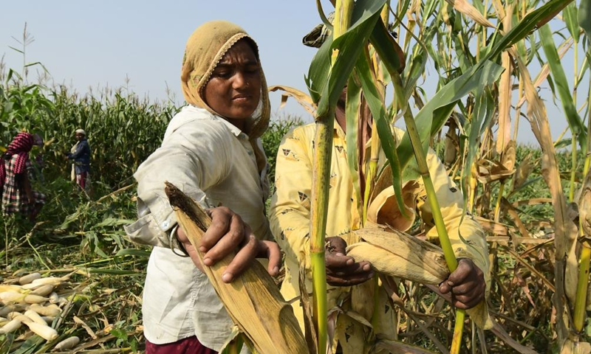
NODE 04 · OF · 07
Mavuno · The Harvest
Three questions:
HOW TAX HAS MUDDLED THIS
WHAT FEMINISM SEES & PROPOSES
HOW WE DECOLONISE IT
A handful of buyers set the price for smallholders
Transfer pricing lets multinationals shift profits offshore
Nigeria’s 2025 Tax Act gives new agribusiness a 5-year holiday
Kenyan farmers earn US$100 to 120 per hectare; multinationals pay no tax
Post-harvest losses fall hardest on women without storage
Women hold no pricing power in the fiscal bargain
Invest in community-scale storage, not only commercial
Enforce transfer pricing rules to protect welfare budgets
Enforce transfer pricing rules against grain traders
Build community-owned storage cooperatives
Set minimum tax rates to end the race to the bottom
Redirect corporate tax revenue to rural welfare
⌂ HOME
← PREV
NEXT →

Slide 8
NODE 05 · OF · 07
Kusindika · Processing
Three questions:
HOW TAX HAS MUDDLED THIS
WHAT FEMINISM SEES & PROPOSES
HOW WE DECOLONISE IT
Four firms control 70 to 90 per cent of global grain trade
They shift profits through offshore subsidiaries to avoid tax
African governments give them ‘investment’ privileges
Public revenue drains that could fund food security
Small-scale women processors face costly compliance burdens
VAT and licensing rules are designed for big corporations
Simplify tax for small-scale women processors
Invest in community-owned milling cooperatives
Break the ABCD monopoly through tax transparency
Fund community milling and regional trading
Tighten transfer pricing rules on multinational grain firms
End fiscal privileges for foreign agribusiness
⌂ HOME
← PREV
NEXT →

Slide 9
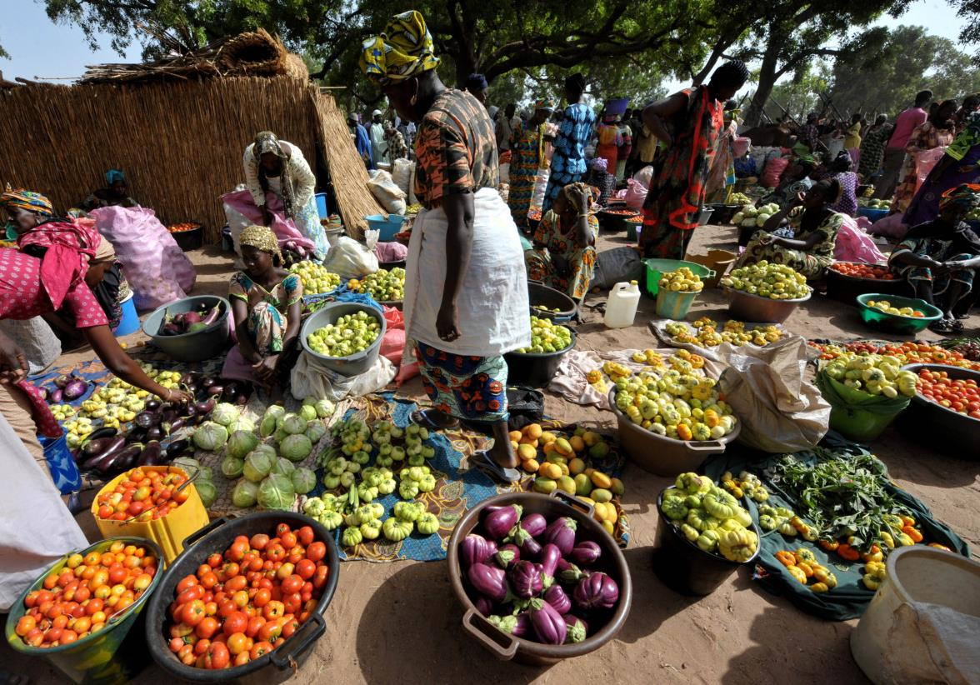
NODE 06 · OF · 07
Soko · The Market
Three questions:
HOW TAX HAS MUDDLED THIS
WHAT FEMINISM SEES & PROPOSES
HOW WE DECOLONISE IT
VAT on staple foods raises revenue from the poor
Kenya’s 2024 Finance Bill tried 16 per cent VAT on bread
KRA lost KES 119.9bn in VAT refunds in 2022 on bread and milk
Consumption taxes hit those least able to bear them
Women spend most of household income on food
They manage food budgets, so VAT hits them twice
End VAT on staple foods
Tax corporate profits, not consumers, to replace the revenue
Reject the ‘consumption tax equals modern tax’ dogma
Assess every food VAT through a gender lens
Enforce corporate tax to replace consumption tax revenue
Support mama mboga traders with favourable treatment
⌂ HOME
← PREV
NEXT →

Slide 10
NODE 07 · OF · 07
Sahani · The Plate
Three questions:
HOW TAX HAS MUDDLED THIS
WHAT FEMINISM SEES & PROPOSES
HOW WE DECOLONISE IT
The plate carries every upstream tax choice
Africa imports US$60bn in food annually
Food prices reflect corporate incentives, not citizens' needs
Nutritious food becomes unaffordable when staples are taxed
Unpaid cooking, cleaning, and childcare feeds every plate
This invisible labour is the real infrastructure of the food system
Gender-responsive budgeting that values women’s unpaid work
Public investment in water, energy, and childcare
Make women’s unpaid food work visible in national accounts
Measure food security by nutrition, not only trade balance
Restore food sovereignty as a fiscal priority
End the fiscal capture of our plates by corporate supply chains
⌂ HOME
← PREV
FINISH →

Slide 11
CLOSING · ONE
The right to eat on our own terms.
What does this right actually mean?
Choosing what we grow and what we eat, not what corporate markets dictate.
Women keeping their place as seed custodians and farmers, not as licensees.
Public revenue financing our own food systems, not corporate rents and royalties.
Indigenous knowledge valued as seriously as scientific research.
African governments setting their own tax priorities. This is fiscal sovereignty.
Women’s unpaid work in kitchens and fields counted as an economic foundation.
Food prices shaped by public interest, not by multinational strategy.
⌂ HOME
← SAHANI
PROTECT →

Slide 12
CLOSING · TWO
How do we protect this?
Seven practical steps, available now, within the tax system we already have.
Review every agribusiness tax incentive and publish what it costs us.
Redirect recovered revenue to agroecology and community food systems.
Assess every staple-food tax through a gender lens before it passes.
Count intellectual property rents as fiscal extraction, because that is what they are.
Make women’s unpaid kazi visible through gender-responsive budgeting.
Use the UN Framework Convention on International Tax Cooperation to rebalance the rules.
Hold our Parliaments accountable for every tax break given to multinationals.
⌂ HOME
← BACK
FINISH →

Slide 13
Chakula ni uhuru.
FOOD · IS · FREEDOM
Freedom begins with fiscal self-determination. Reclaiming our uhuru wa chakula means reclaiming our fiscal sovereignty.
Lyla Latif (PhD)
Global Tax and Technology Governance Specialist
Managing Partner, Lai’Latif & Co Advocates
Chair, Committee on Fiscal Studies, Faculty of Law, University of Nairobi
latif@lai-latif.com · www.lai-latif.com
← RETURN TO HUB

