Slide 1


Regional Technical Discussion on Taxation of the Digital Economy
WATAF 8th High Level Panel Dialogues & 23rd General Assembly
Dr. Lyla Latif, Global Tax, Public Finance and Technology Governance Specialist
PhD| LLM| MA| LLB| Dip.Law
www.lai-latif.com

Slide 2





What you call the digital economy depends on where you stand
THE PUBLIC
THE TAX ADMINISTRATOR
THE TECHNOLOGIST
THE DIGITAL CORPORATION
THE ACADEMIC
“It is my phone: chatting, banking, shopping, streaming.”
“It is a stream of taxable events I can only partly see.”
“It is a stack: hardware, protocols, code and data.”
“It is a market without borders.”
“It is a mode of accumulation.”
Sees convenience. Never sees the machinery, or who profits from it.
Consumption at home, visible. Profit abroad, obscured. Data, invisible.
A machine that copies and distributes value at zero marginal cost.
Users are assets, data is free raw material, jurisdiction is a choice to be optimised.
Value extracted from everyday life, concentrated by network effects, priced nowhere it is produced.
Five definitions, one legal problem: before the law can tax a thing, it must decide what the thing is.

Slide 3
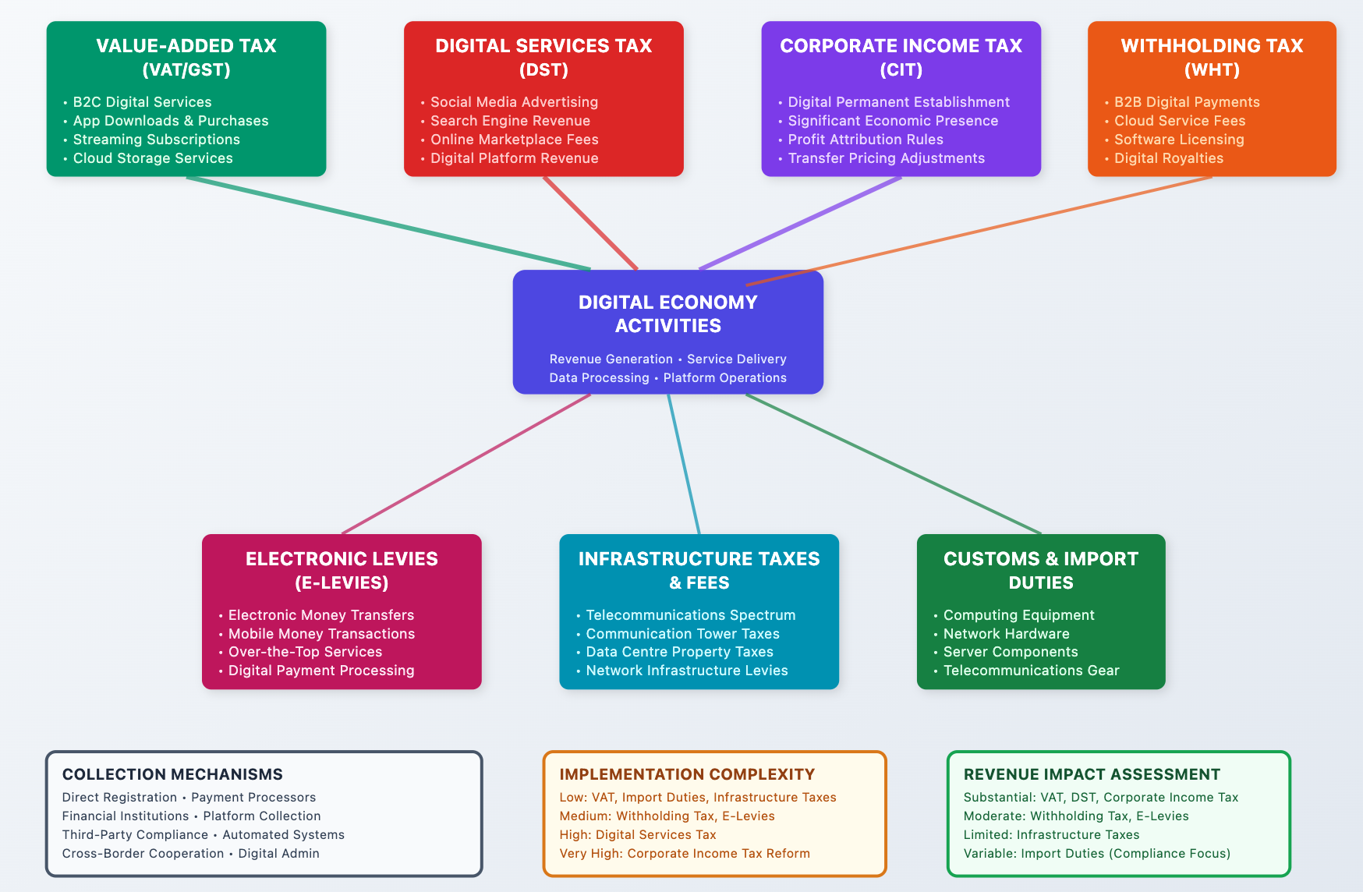

Slide 4
The pyramid of the digital economy
WHERE TAX ATTACHES TODAY
almost nothing attaches
WHAT IT
PRODUCES
data, intelligence, profit, power
VAT on digital services; DST and SEP on turnover
WHAT MOVES ACROSS IT
transactions, services,
content, payments
WHAT CONNECTS IT
networks, platforms, interfaces, APIs
excise on connectivity; VAT on telecoms
WHAT MAKES IT WORK
devices, hardware, software, protocols
import duties and VAT at the border; licences
INFRASTRUCTURE
cables, data centres, towers, spectrum, power
customs duties, property rates, licence fees, PAYE
Read it as a lawyer: the wider and heavier the layer, the more tax it bears. The apex, where the value is, bears almost none.

Slide 5

Tax law attaches to four anchors. Find them, or there is no tax.
PERSON
someone identifiable,
within your reach
THE LEGAL DISCIPLINE OF THE DAY
Where all four anchors hold, the digital economy is already taxed: equipment at the border, data centres on the rates roll, VAT at checkout.
Where even one is missing, tax fails: data (no valuation), free services (no event), the foreign platform's profit (no person within reach).
Every gap we meet today is a missing anchor. Every proposal is an attempt to forge one.
A LAWFUL
TAX
VALUATION
EVENT
a defensible
price
a moment the law
can name
BASE
a quantum a rate
can apply to

Slide 6

Example: Adama buys design software
Adama, a freelance designer in Lagos, subscribes to a design platform incorporated abroad: US$120 for the year.
At checkout the platform adds VAT at 7.5 per cent. Adama pays US$129. Her receipt shows US$9 of tax, collected and remitted to the FIRS.
The platform has no office in Nigeria, no staff, no agent, no server. Its entire presence is an app and a website.
So: tax was collected on this transaction. Whose money was it? And did the platform itself pay any tax at all?

Slide 7
TAX COLLECTED
This is how the digital economy works, and tax is collected
Adama
Lagos
PLATFORM
CHECKOUT
FIRS
US$120 + US$9 VAT
US$9 VAT remitted
pays US$129
adds 7.5% VAT
receives US$9
VAT on the subscription: collected by the platform under Nigeria's non resident registration regime and remitted.
Excise already paid on the data bundle she used to buy it; import duty and VAT already paid on her phone.
The system works. But notice: every naira of tax in this picture came out of Adama's pocket.

Slide 8
NO TAX COLLECTED
The same US$120 again: profit is made, and no tax is collected
Adama
MERCHANT
OF RECORD
Dublin
royalty strips margin
IP HOLDER
low tax
jurisdiction
taxed elsewhere,
lightly or not at all
PROFIT
~US$40
US$120
Adama’s usage data flows back to improve the product sold to her. Price paid for it: zero.
No permanent establishment in Nigeria, so no corporate income tax on the profit under the standard treaty rule.
The margin is moved by intra group royalty and cost sharing charges to wherever the group prefers.
Profit was made from Nigeria. Nigeria taxed none of it. The consumer bore every tax in the story.

Slide 9
WHAT THE TWO PICTURES TELL US
VAT taxed the consumption. Adama bore it.
The platform's profit, a third of what she paid, left untouched.
Her data, which improves the product sold back to her, was priced at zero.
And every step of it was lawful.

Slide 10



Your last digital purchase
Take the last digital purchase you personally made: a subscription, an app, cloud storage, a ride, an advert you boosted.
List what your administration saw of it: which taxes attached, at what point, and who bore each one.
Then name what escaped: the profit, the data, the fees. Where did each go, and which anchor was missing?

Slide 11
Where the fisc already TAXES, and where it DOESN’T TAX
WHAT
IT
PRODUCES
UNTAXED
NOTICE THE PATTERN
Everything marked taxed is tangible, registered or resident: the four anchors all present.
The partial middle is taxed through the consumer's wallet: VAT, excise, turnover levies.
The apex is where the value concentrates, and where every anchor fails at once.
We tax the wallet with ease; the profit with difficulty; the data not at all.
WHAT MOVES ACROSS IT
PARTIAL
WHAT CONNECTS IT
PARTIAL
WHAT MAKES IT WORK
TAXED
INFRASTRUCTURE
TAXED

Slide 12






Where tax cannot yet see, and which anchor is missing
Cross border data flows Your citizens’ data leaves daily, trains foreign models, returns as a priced service.
NO ANCHOR AT ALL
Undersea cables in international waters Laid and operated under high seas freedoms; no rent accrues to the states whose economies they carry.
NO NEXUS
Algorithms deployed internally A model replaces five hundred clerks. No transaction occurs; payroll and PAYE simply shrink.
NO EVENT
The most valuable flows are the least visible.
Services paid for in attention and data Free platforms extract value without a monetary price, so VAT and income tax find nothing to measure.
NO VALUATION
Orbital and offshore infrastructure Traffic routed above and beyond every territorial register.
NO JURISDICTION

Slide 13

What digital economy lies under the high seas?
CABLE SHIP AT WORK
TWO EXTRACTIVE ECONOMIES SHARE ONE SEABED
Beyond 200 nautical miles: no state’s territory. Freedom to lay cables (UNCLOS arts 87, 112); the minerals below are the 'common heritage of mankind' (Part XI).
A mineral economy, about to begin, already assigned a revenue sharing regime before a single commercial tonne is lifted.
A data economy, decades old, moving trillions in value through the cable, assigned nothing.
Both cross the same ocean floor.
SUBSEA DATA CENTRE PODS
THE SUBMARINE CABLE: ~99% OF TRAFFIC
POLYMETALLIC NODULES: CHIP MINERALS

Slide 14
WHAT THE SEABED TEACHES
TANGIBLE
EXTRACTION
INTANGIBLE
EXTRACTION
Visible: ships, licences, tonnage
Measurable: production value
Locatable: block coordinates
Rent obligations follow,
even in a global commons
Invisible: light in glass
Unmeasured: no state meters its data exports
Unlocated: routed, mirrored, cached
No obligations,
anywhere, yet
The entire digital taxation debate is the struggle to give intangible extraction
the legal visibility that tangible extraction has had for a century.

Slide 15

The Earners: Digital Business Models and Virtual Service Providers
These are the entities that earn the revenue and book the profit. The question is whether our instruments, VAT, excise, income tax, reach them at all.

Slide 16
Six ways digital firms earn
Subscription: recurring fees for continued access (Netflix, Microsoft 365, ChatGPT Plus).
Advertising: user attention packaged and sold to brands (Meta, TikTok, Google Search).
Commission: a take rate on every intermediated transaction (Jumia, Uber, app stores).
Freemium: free tiers converting to paid (LinkedIn, Canva, Spotify).
Data monetisation: free service in, behavioural data out, priced at zero on the way in.
Usage based cloud and API: metered compute, storage and model calls (AWS, OpenAI API).
Most large platforms blend several, and shift profit toward whichever stream is hardest to tax.
SUBSCRIPTION
USAGE / API
ADVERTISING
DIGITAL
REVENUE
DATA
COMMISSION
FREEMIUM

Slide 17




Who earns, and where the earning legally happens
THE USER
THE INTERFACE
THE CONTRACTING ENTITY
THE IP HOLDER
THE INFRASTRUCTURE
Accra, Lagos, Dakar: pays money, attention and data
An app, a browser: the only part that visits your country
Dublin, Amsterdam: books the sale, the 'merchant of record'
Delaware, Zug, Cayman: owns the model; collects royalties
Global cloud regions: runs the service from wherever is cheapest
THE LEGAL QUESTION Virtual service providers deliver into your market with no local footprint at all: revenue is legally realised where contracts and IP sit, not where customers sit. Of the five circles above, how many can your administration currently serve with an assessment? For most members, one: the user.

Slide 18
The instruments that attach today in West Africa
VAT on cross border digital services
Nigeria (7.5%), Ghana (15%), Senegal (18%), Cote d’Ivoire (18%), among others, now require non resident suppliers to register and remit
Reaches consumption in the market state
Excise on connectivity and money
Duties on airtime, data and mobile money across the region; Ghana repealed its electronic transfer levy in 2025 after sustained pushback
Reaches usage by the local consumer
Digital services and SEP taxes
Nigeria’s SEP rules assess non residents on deemed profits; Sierra Leone applies a DST; Kenya, as comparator, runs a SEP tax at an effective 3% of turnover
Reaches turnover or deemed profit of the non resident
Corporate income tax
Applies only where a permanent establishment or SEP style nexus exists; the ordinary treaty answer is that it does not
Reaches net profit, if nexus can be found

Slide 19
What these instruments reach, and what they miss
VAT
EXCISE
DST / SEP
CIT
REACHES
The consumption spend of your residents
MISSES
The provider's profit entirely; the burden sits on your consumer
REACHES
Usage, simple to collect at the operator
MISSES
Taxes access itself: regressive and politically brittle, as Uganda's social media tax and Ghana's e-levy showed
REACHES
Turnover of non residents, no treaty PE needed
MISSES
Gross basis ignores margins; invites disputes and retaliation; treaty compatibility contested
REACHES
Net profit, the base we say we want
MISSES
Almost everything: without physical presence there is no PE, and without a PE, article 7 gives you nothing
The pattern of the last decade: we tax the African consumer’s wallet with ease, and the foreign provider's profit with difficulty.

Slide 20
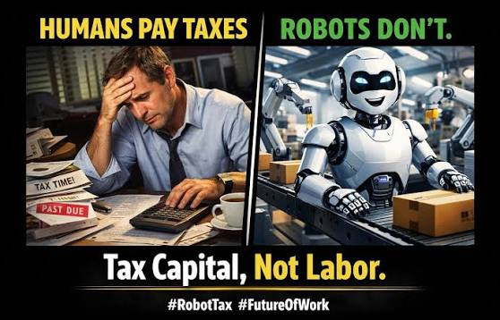
The Global Digital MNC: Are OpenAI and Anthropic Taxed?
The companies of the AI era collect revenue from every jurisdiction on earth. How is it apportioned so that each state can tax its share? It is not. Why, and what would it take?

Slide 21
How Anthropic makes money: every node from which income flows
DIRECT SALES: CUSTOMER PAYS ANTHROPIC
Capital inflows that fund the model (not income, but they shape where profit lands)
Equity from Amazon (about USD 8bn), Google (over USD 3bn), Microsoft and Nvidia (up to USD 15bn), plus Series H at a reported USD 965bn valuation (May 2026). Much of it returns to the investors as compute purchases: Azure (USD 30bn), Google TPUs, AWS Trainium.
CHANNEL AND LICENCE INCOME
API usage, pay per token
Developers and enterprises pay per million input and output tokens, with premiums for long context, batch and caching. Largest single stream.
Cloud marketplace resale
AWS Bedrock, Google Vertex AI and Microsoft Foundry resell Claude. The hyperscaler invoices the customer; Anthropic receives a licence share, royalty like in substance.
Consumer subscriptions
Claude Free, Pro (about USD 20 a month) and Max (USD 100 to 200) billed by card, worldwide, from the US parent.
Consulting and platform alliances
Accenture, Deloitte, PwC, Salesforce, Snowflake and Palantir embed Claude and route enterprise spend, taking a margin on top.
ANTHROPIC, PBC
Delaware public benefit corporation, San Francisco. The legal seller on every Claude invoice worldwide; Dublin and London subsidiaries are operational only.
Team and Enterprise contracts
Per seat plans and negotiated enterprise agreements with volume commitments, admin controls and data terms.
Government and defence
Claude for government and defence contracts, chiefly US federal; concessionary pricing buys adoption and lock in.
SCALE, AS REPORTED IN 2026
Annualised revenue reported at about USD 65bn by July 2026; first quarterly operating profit reported for Q2 2026. Analyst estimates put API and enterprise contracts at roughly four fifths of revenue, consumer subscriptions near a tenth. Cloud channel sales are booked gross, so end customer spend on Bedrock and Vertex counts as Anthropic revenue.
Claude Code and agent products
Developer agent billed on tokens or seats; reported above USD 2.5bn annualised by early 2026, over half from enterprises.
Education and beneficial deployment
Subsidised or donated access (Rwanda and ALX learning companion, 2026; Kenya talks) that seeds future paid demand and data.
Every arrow ends in one Delaware company. Whatever an African user, developer, bank or ministry pays, by card, by API meter or through a cloud bill, is booked as the income of a US resident with no permanent establishment on the continent. Figures are company disclosures and analyst estimates (Sacra; company statements), not audited accounts; Anthropic is private.

Slide 22
What is taxed on Anthropic, where, and what escapes entirely
TAXED ON ANTHROPIC (RESIDENCE)
TAXED ON THE CUSTOMER (MARKET)
NOT TAXED AT ALL
US federal corporate income tax, 21%
On worldwide profit of Anthropic, PBC. But cumulative losses reported at USD 10 to 15bn since 2021 and full expensing of research and compute mean little cash tax falls due even as profit begins.
VAT and GST through non resident schemes
Registered through Stripe Tax as a non resident supplier in the EU (OSS), UK, Switzerland, Japan, Australia, Canada, Singapore, Norway and New Zealand. The consumer pays; Anthropic remits.
Profit from African consumption
No office, server or staff in Africa means no permanent establishment, so no corporate income tax anywhere on the continent.
California and other state taxes
Franchise tax on apportioned income; sales tax on software in the states that tax SaaS.
Reverse charge for business buyers
A business customer with a VAT number pays 0% at invoice and self accounts, then recovers the input tax: net revenue to the treasury is close to nil.
The model licence inside the cloud bill
Anthropic's share of Bedrock and Vertex revenue flows from Seattle and Mountain View to San Francisco: no African withholding touches it.
Ireland (12.5%) and UK (25%)
Anthropic Ireland Ltd and Anthropic Ltd are cost plus service entities: they earn a routine markup on staff costs, not the model's profit.
Cloud channel VAT
Bedrock and Vertex bills carry VAT charged by AWS or Google entities (Luxembourg, Ireland, South Africa). The tax is on the cloud bill, not on Anthropic.
Training data and language
African text, code and speech scraped for training carry no royalty and no tax; annotation labour in Nairobi or Lagos is taxed as wages, the value it creates is not.
Where the profit sits
Model IP, contracts and pricing power are held by the US parent. Residual profit, and the tax on it, stay in the United States.
Withholding, only where law and enforcement meet
Nigeria's SEP rules and Kenya's SEP tax can reach turnover; whether Anthropic is assessed under them is not public.
Card spend that no scheme sees
Subscriptions and API top ups paid on cards from countries where Anthropic holds no VAT registration, and any use routed through foreign cards or VPNs, are invisible to the market state.

Slide 23
Where West Africa loses the tax on Anthropic, and where it could tax
1 Consumer buys Claude Pro
Card payment, Lagos or Accra, seller: Anthropic PBC (US)
2 Fintech buys API tokens
Developer meter, paid in dollars to the US parent
3 Bank buys via Bedrock or Vertex
Invoice from AWS or Google, licence share flows to Anthropic
4 Ministry signs an MoU
Subsidised deployment, data access, exemptions in the small print
5 Profit lands in the US
No PE, no treaty, no African assessment
WHERE IT LEAKS
VAT depends on the seller registering itself. Nigeria, Ghana, Senegal and Cote d'Ivoire all require non resident registration, yet Anthropic's published registrations cover Europe, Asia Pacific and North America only. Unregistered spend is untaxed consumption.
The fee is a service paid abroad: no withholding is applied at the card or bank, and the developer rarely self assesses. Nigeria's SEP Order reaches this turnover on paper; assessment needs data the administration does not hold.
The bill reads as cloud hosting from a Luxembourg or Irish entity, not as a licence of a model. Withholding on royalties is never triggered and Anthropic's embedded share leaves without a trace.
Deals are signed by digital or education ministries, not by revenue authorities. Free access today builds paid dependence tomorrow, and MoUs can carry duty and tax concessions no parliament debated.
Article 7 of every model treaty gives business profits to residence absent a PE. Yet no WATAF member has a tax treaty in force with the United States, so the limit here is capacity and design, not treaty law.
WHERE IT COULD BE TAXED
Register or be blocked: appoint card acquirers, payment gateways and telcos as VAT collection agents (Nigeria's FIRS bank appointments; Kenya's electronic marketplace regulations), so tax is withheld at the rail, not at the seller's discretion.
Apply SEP and deemed profit rules to AI providers by name, with turnover thresholds set by users and revenue; require banks reporting foreign currency payments to named AI vendors. UN Article 12B style withholding once treaties are opened.
Characterise the model component of cloud bills as a royalty or technical fee subject to withholding; demand hyperscaler transparency on the Anthropic share; treat resale margins as a domestic taxable event.
Route every AI MoU through the revenue authority; refuse blanket exemptions; value donated access and data rights as consideration, and secure data localisation that creates a future nexus.
Negotiate as a bloc: fractional apportionment by users and data volume in the UNFCITC services protocol; coordinated SEP definitions across WATAF; a shared registry of AI vendor spend.

Slide 24
The proposals on the table in 2026
OECD PILLAR ONE,
AMOUNT A
Reallocates a quarter of residual profit above a 10 per cent margin of the very largest MNEs to market states by a revenue formula.
Stalled: the convention remains unsigned and United States support was withdrawn in 2025.
UN MODEL ARTICLE 12B
A withholding tax on gross fees for automated digital services, agreed bilaterally, collected at source without needing a PE.
Live: simple to administer, but gross basis and bilateral, one treaty at a time.
SEP AND DEEMED PRESENCE
Domestic law manufactures nexus: significant economic presence defined by revenue or users, with profit deemed as a fraction of turnover.
Live: Nigeria operates SEP rules; Kenya's SEP tax runs at an effective 3 per cent of turnover.
UNILATERAL DSTs
Turnover taxes on defined digital revenue streams.
Live but exposed: retaliation risk, gross basis, designed as a bargaining chip as much as a tax.
UN FRAMEWORK CONVENTION (UNFCITC)
The negotiating arena in which allocation itself, including fractional and formulary approaches and taxation of cross border services, is being reopened with every state at the table.
The live multilateral track: negotiations run toward 2027, with an early protocol on cross border services.

Slide 25
A head of administration’s comparison
ROUTE
BASE
WHO DECIDES
ADMINISTRABILITY FOR YOU
TIME HORIZON
Pillar One
Net residual profit
OECD Inclusive Framework
Complex: formulary computation on data you may never see
Uncertain at best
Article 12B
Gross service fees
You, bilaterally
High: withholding is your oldest competence
Each renegotiation
SEP rules
Deemed profit on turnover
Your parliament
Moderate: identification and enforcement burdens are real
Immediate
DST
Gross turnover
Your parliament
Moderate: definitional and retaliation management
Immediate but fragile
UNFCITC protocol
To be negotiated
All states, one vote each
Designed with administrability as an African demand
Toward 2027 and beyond
The strategy: run SEP and VAT now, negotiate 12B style withholding where treaties open, and shape the UNFCITC protocol as a bloc.

Slide 26

What is a defensible apportionment key?
USERS
Count active users in your market
Easy to evidence; but are ten million free users 'value' without revenue?
LOCAL REVENUE
Share of global sales sourced to your market
Cleanest legally; but zero priced services generate no 'revenue' to count
DATA VOLUME
Data originated in your jurisdiction
Captures the true contribution; measurement and audit are unsolved
FORMULARY
Weighted sales, assets, payroll
A century of US state practice behind it; Africa loses on assets and payroll, wins on sales and users

Slide 27

Data: Holding It, Sharing It, Earning Nothing From It
If I only hold data and never monetise it, should there be tax? If I share it for nothing, is that a transaction? If I have earned nothing, can tax still bite? Let us unpack this properly.

Slide 28
How data becomes wealth: the tributaries
a message
a search
TRAINED
MODEL
PRODUCT
& REVENUE
a purchase
the aggregated dataset
a voice note in Twi
a location ping
Watch where the value crystallises: not at the moment of contribution, but three steps later, after aggregation, in a different legal entity, in a different jurisdiction. By the time value is measurable, your taxpayer and your nexus are both gone.

Slide 29


What is data in law? Four awkward facts
It is not property
It is non rivalrous
Its value is emergent
Its location is fluid
Most legal systems recognise no ownership in data as such. Data protection law confers rights over personal data, but a right to object is not a title to sell.
Copying does not deplete it. A 'transfer' leaves the transferor holding exactly what it held before, which unsettles every analogy to sale.
A single record is worth nearly nothing; a billion records train a model worth billions. Value lives in aggregation, not in the datum.
Mirrored, cached, sharded across continents in seconds. Situs rules built for ships and warehouses have nothing to grip.
Consequence: the classic tax categories, asset, supply, income, each fit data awkwardly. The contest over taxing data is really a contest over which imperfect analogy the law will adopt.

Slide 30
So how could data be taxed? Four families, four designs
Data export levy
Per record or per gigabyte charge on outbound flows, collected at gateways or on declared volumes
Volume is a poor proxy for value; WTO moratorium engaged
EXCISE FAMILY
Data holding levy
Annual charge on large scale data inventories above a threshold, akin to rates on land
Valuation convention needed; carve outs for public interest holders
WEALTH FAMILY
Barter VAT
Tax the service for data exchange at open market value of the service supplied
Requires valuing zero priced supplies; strongest doctrinal footing
VAT FAMILY
Data as allocation key
No separate tax: data volume becomes a factor apportioning MNE profits to market states
Depends on multilateral adoption: the UNFCITC arena
INCOME FAMILY

Slide 31

THE INVISIBLE WORKFORCE
Algorithms: Asset, Worker, Trader
Trillions of economic decisions a day are taken by software that pays no income tax, no social contribution, and appears on no payroll. Is there a tax here? Can there be?

Slide 32
One loop, three legal identities
A CAPITAL ASSET
INPUTS
An intangible on the balance sheet: developed, amortised, licensed, sold. Tax already sees it through CIT, CGT and transfer pricing.
PROFIT
MODEL
A WORKER
It performs labour that salaried humans performed yesterday, but draws no wage, pays no PAYE, makes no pension contribution.
OUTCOME
DECISION
A TRADER
Increasingly it transacts autonomously: quoting, contracting, settling. Whose acts are those in law, and where do they occur?
data in, decisions out, profit captured, model improved: the loop never clocks off
Each identity implies a different tax treatment. The law has only ever legislated for the first.

Slide 33


Where money changes hands, tax can see
Licensing and API access
Model sales and acquisitions
Algorithmic trading
IP migration
Per token and per call pricing is a price for algorithmic labour. Every API invoice is a taxable supply and, often, a withholdable technical service fee.
Model weights and the companies holding them are bought outright; acquihires price the algorithm inside the payroll. Capital gains and stamp regimes apply.
Firms whose entire profit is generated by algorithms executing trades: fully taxable today wherever the firm is resident, which is rarely West Africa.
Algorithms relocate to low tax jurisdictions by contract, like any intangible. Exit taxes and transfer pricing are the existing counterweights.
Where the algorithm is sold, licensed or metered, your existing instruments apply: VAT, withholding on royalties and technical fees, CIT, transfer pricing. The gap is elsewhere.

Slide 34
Where tax sees the algorithm, and where it cannot
VISIBLE: THE TRANSACTED ALGORITHM
INVISIBLE: THE DEPLOYED ALGORITHM
API and licence fees: VAT and withholding attach
Royalties on embedded models: treaty article 12 territory
Sales of models or model companies: CGT
Cross border migration of model IP: transfer pricing and exit charges
A bank deploys a model that replaces five hundred clerks: no transaction occurs at all
PAYE and social contributions simply evaporate from the base
The productivity gain accrues as profit, taxed, if at all, at CIT rates far below labour's effective burden
No invoice, no supply, no event: the four anchors all missing at once

Slide 35
Conclusion
ORBIT
LEO constellations, in orbit relays
No jurisdictional hook yet
INTELLIGENCE
Models, algorithms, agents
Taxed only when transacted; silent when deployed
PLATFORMS AND SERVICES
Subscriptions, ads, marketplaces, APIs
VAT and SEP reach turnover; profit escapes
DATA AND ATTENTION
Flows, datasets, engagement
No event, no valuation: the contested base
COMPUTE AND CLOUD
Data centres, cloud regions
Rates, duties and PAYE where located; location is elective
PHYSICAL INFRASTRUCTURE
Cables, towers, spectrum, devices
Fully taxed: the anchors all present
THE SEABED
Cables pay nothing; minerals will pay humanity rent
Two regimes, one ocean floor: the lesson of the day
Green: taxed. Amber: partially taxed. Red: untaxed.

Slide 36


https://research-under.hfw-project-terra.org/

Slide 37
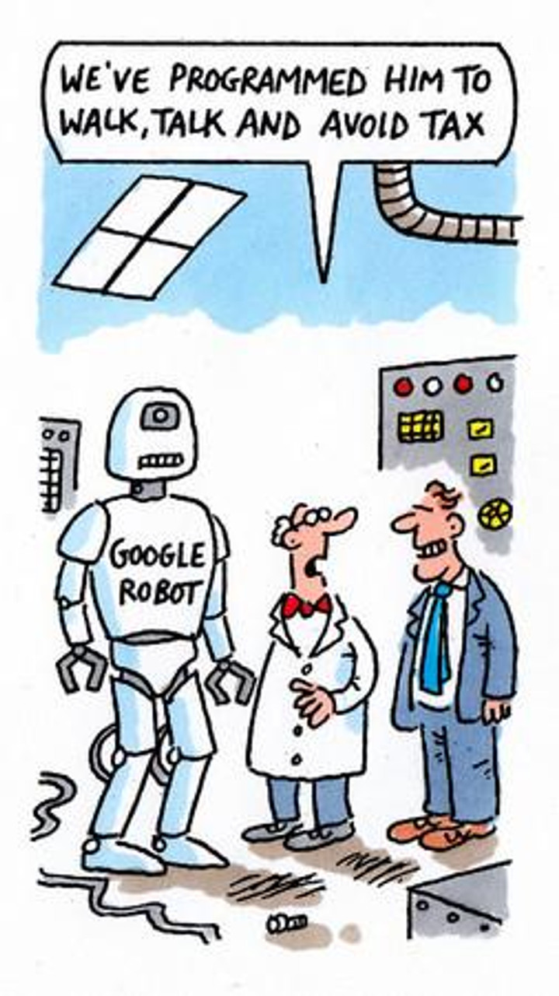
THANK YOU FOR COMING AND ENGAGING

