Slide 1
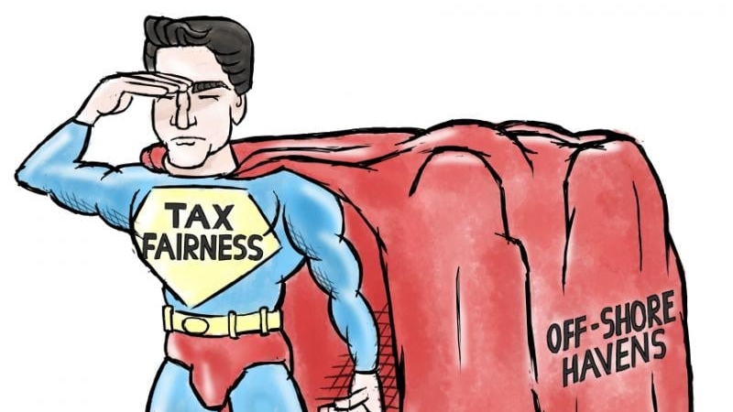
Transforming the International Tax Architecture: UNFCITC
Lyla Latif
Tunis, 24 June 2024
Regional Workshop on the Role of African Countries in Defining New Global Tax Rules

Slide 2
3 Questions
What
Why
How

Slide 3
What?
1. Taxing rights
Existing asymmetries and correcting them
Identification of new sourcing rights and claiming them
2. Decision making rights
Rule of majority
3. International cooperation
Ending the enabling environment for tax related IFFs, tax base erosion and tax minimisation strategies
Addressing the misalignment between legality and ethical responsibility by redefining corporate local responsibility to include fair tax practices

Slide 4
Why?
Judicial capture
Subject to Tax Rule (STTR)
AI and Data

Slide 5
Judicial capture
The OECD deliberately undermining judicial independence by influencing the Court of Justice of the European Union to use terms very similar to those in its BEPS project when ruling on tax avoidance cases.
This curtails judicial independence, forcing the judiciary to implement OECD's political ideas rather than upholding their duty to deliver impartial justice.
Is this not a direct assault on the integrity of the judicial process, compromising the Court's ability to make independent rulings in international tax matters.

Slide 6
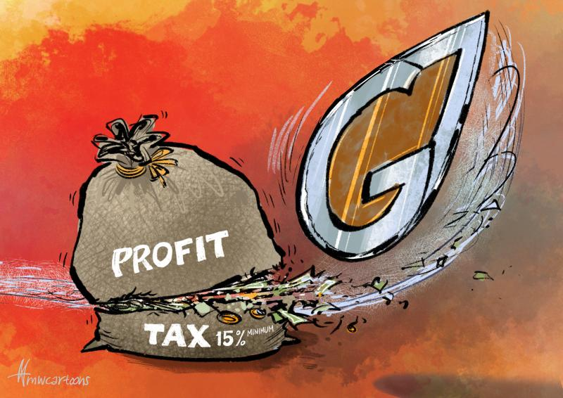
STTR
STTR is a Pillar Two global minimum tax package - as a measure to benefit developing countries by allowing them to impose a top-up tax on certain payments made to related entities in other jurisdictions.
The commitment by developed countries to include the STTR in treaties is informal and non-binding.
The STTR only applies if specifically requested by a developing country and agreed to by the treaty partner.
The STTR can be suspended if a country's economic status changes to high-income for five consecutive years.

Slide 7
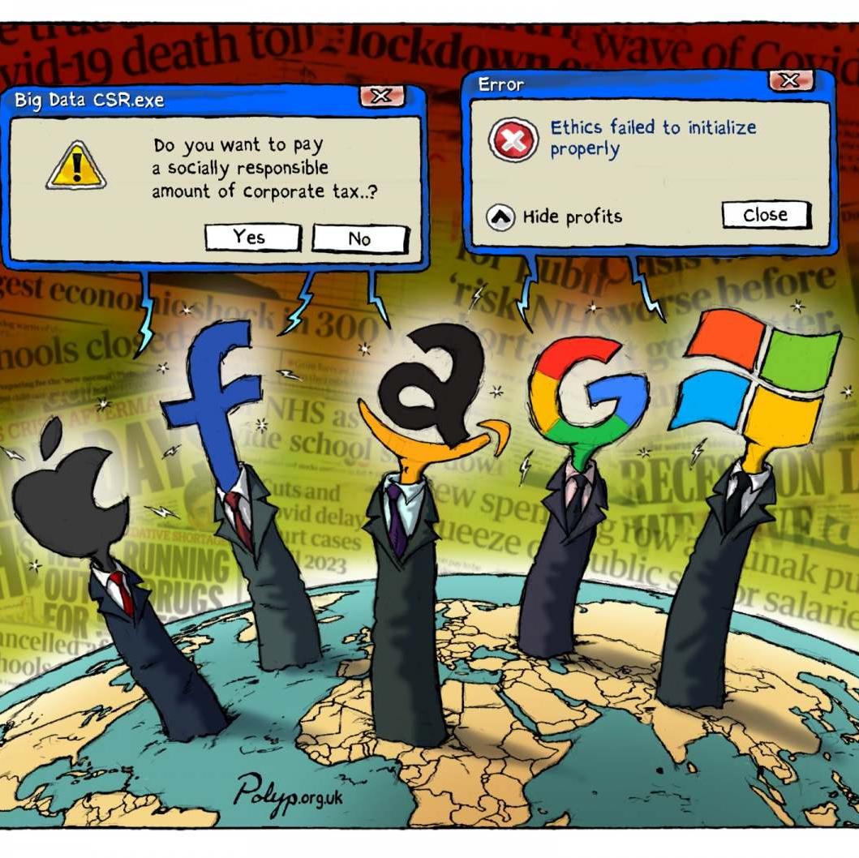
AI
AI value chain is incredibly complex and fragmented across multiple jurisdictions.
Research might happen in one country, data processing in another, and algorithm deployment in a third. This makes it extremely difficult to determine where value is actually created and how profits should be fairly allocated for tax purposes.
Large tech companies, predominantly from the Global North, are extracting valuable data and insights from the Global South.
These companies are concentrating immense wealth and intellectual property in low-tax jurisdictions, while the countries providing the raw material - the data - see little benefit.
There’s a concentration of AI-related intellectual property in the hands of a few powerful actors. This skews the distribution of profits and makes it incredibly difficult for countries in the Global South to capture a fair share of the value created within their borders.

Slide 8
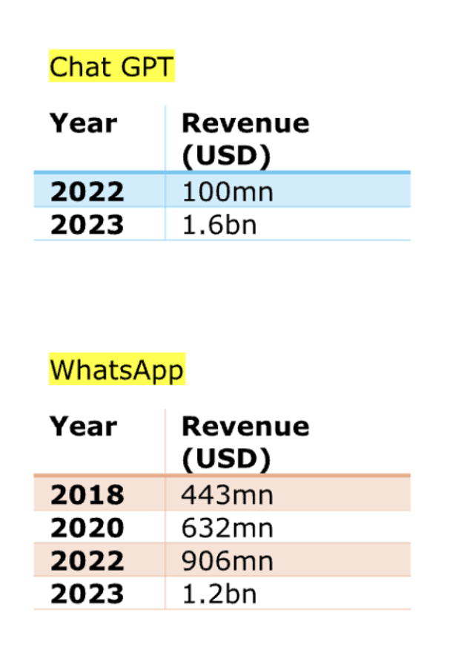
Tunisia
9.96 million internet users in Tunisia
7.10 million Tunisians on Facebook
Year | Revenue ($ bn) | Profit ($ bn)
2010 | 1.97 | 0.37
2015 | 17.92 | 3.66
2020 | 85.96 | 29.16
2023 | 134.9 | 39

Slide 9
How?
Practical
Normative

Slide 10
New Rules: Tax adjudication
Prohibit the use of language or concepts from any single organisation (like the OECD) as definitive in judicial interpretation

Slide 11
New Rules: Taxing Norms
Meaningful minimum tax
Tiered minimum tax rate that increases with global revenue
Same principle/different threshold for High-Net-Worth Individuals (HNWI)
Same principle to apply to tech giants
3. Exit tax
Progressive tax | Threshold
15% | Revenue up to $100mn
20% | Revenue up to $500mn
25% | Revenue over $1bn

Slide 12
Exit Tax and the UNFCITC
Define exit taxes clearly
State that they apply to unrealised gains on assets when a taxpayer changes tax residency.
Specify that both individuals and corporations can be subject to these taxes, but with appropriate thresholds to avoid undue burden on smaller taxpayers or those making temporary moves.
A key principle should be the fair valuation of assets at the time of exit.
The convention could provide guidelines for valuation methods, particularly for complex assets like intellectual property or unlisted securities.
It should also address timing issues, specifying when the tax liability is triggered and when payment is due.

Slide 13
New Rules: AI
AI enabled permanent establishment (PE)
Profit attribution based on formula that considers data inputs, user engagement and AI deployment
Develop methods to value data and AI contributions to the value chain
Extend country by country reporting (CbCR) to include data on AI deployment, data collection and processing activities
Consider a global minimum tax specifically for income derived from AI and data driven activities
Create mechanisms for countries to tax the extraction and use of data from their citizens

Slide 14
Links to AI taxation ideas
Youtube Link
Tax Notes Article

Slide 15
Discussion/Questions X: @LylaALatif Email: latif@lai-latif.com

