Slide 1
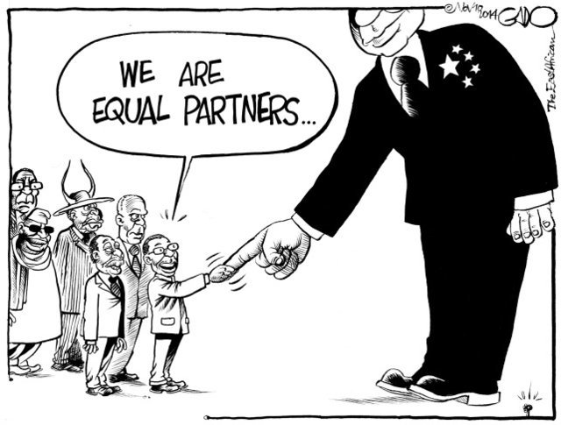
Who Shapes Africa’s Economic Future?
Keynote Address
Pan Africa Conference on Illicit Financial Flows 2026
Lyla Latif (PhD)
Advocate | Commissioner for Oaths | Notary Public
Global Tax, Public Finance and Technology Governance Specialist
www.lai-latif.com
Email: latif@lai-latif.com

Slide 2
The answer is hidden in the question
WHO
Not what Africa should produce.
Not how fast it should grow.
Whose hands are on the levers of production, labour, exchange and the creation of capital, and in whose interest are they pulled?

Slide 3










Who?
Government
Households and informal workers
Corporate power
Courts and legislatures
Civil society
Africa's
economic future
The diaspora
Academia
Regional bodies
Platform operators
IFIs and creditors

Slide 4





And one more entrant: the machine
Production
Labour
Algorithms decide when to plant, what to price, which shipment moves
The human work that feeds the model is sourced where wages are lowest
Large language models, robots, agentic AI and the compute that powers them.
Not a tool the other actors use. An actor in its own right.
Transactions
Capital creation
The platform sits between every buyer and seller, taking a fee and a data trail
Model weights and compute owned by a handful of firms, elsewhere

Slide 5

What did Karl Marx warn?
Capital, Vol. I, ch. 25
Capital, Vol. I, ch. 15
Grundrisse, 'Fragment on Machines'
Accumulation of wealth at one pole is accumulation of misery at the other. The machine creates a reserve army of labour that disciplines wages.
The machine becomes the competitor of the worker. It does not shorten the working day but intensifies it. Skill migrates from the hand into the machine, and so to its owner.
The general intellect, society’s accumulated knowledge, is absorbed into fixed capital. The decisive productive force becomes knowledge embodied in machinery, held as private property.
Notes:
Marx did not write about AI, but he wrote precisely about machinery owned by a few and worked by the many. The mechanism is structure, not villainy.

Slide 6
Does the warning describe Africa today?
Production
Labour
Systems trained and hosted outside Africa now decide planting, pricing and logistics
Kenyan data workers took home US$1.32 to US$2 an hour while the contractor was paid US$12.50 an hour (Time, 2023)
Transactions
Capital creation
The payment platform extracts a fee and a data trail from every exchange. The data is worth more than the fee
Africa holds 0.6% of global data centre capacity. The general intellect is being assembled elsewhere

Slide 7








Where does Africa's economic future sit?
Agriculture
Trade
Labour
Tourism
Extractives
Blue economy
Oil and gas
Critical minerals
Digital economy
Manufacturing
Manufacturing is where the future ought to sit, and where it least does.

Slide 8
What do the numbers say?
15%
7.5%
74%
1.5%
of Africa’s trade is with itself (US$208bn of US$1.4tn, 2024)
of world oil and 5.8% of world gas came from Africa in 2024, mostly exported crude
of the world’s cobalt is mined in the DRC, then refined elsewhere
of global manufacturing value added is African
The sectors have been organised, for a very long time, to supply inputs to production elsewhere.
Sources: Afreximbank 2025; Energy Institute Statistical Review 2025; USGS 2024; UNIDO 2025

Slide 9
Along what pathway has that future been shaped?
Colonial
extraction
Independence
Stagnation
and debt
Adjustment
Liberalisation
Governance era
Platforms
The machine
1
2
3
4
5
6
7
8
Commodities out, labour taxed into wage work
Commodity slumps, oil shocks, Cold War
Privatisation, austerity, hollowed public services
Foreign rails for payments, information and work
Nationalisation, tariff walls, welfare ambition
Lagos Plan 1980 answered by Berg Report 1981
PRSPs, mobile money, Eurobonds
Models, robots, agentic AI, compute
‘The age of the machine has not arrived on neutral ground. It runs along a groove already cut.’
Lyla Latif, Governing the Machine (forthcoming)
Notes:
Rodney, Nkrumah and Amin on the survival of the colonial arrangement. Lagos Plan of Action 1980 versus the Berg Report 1981. My own work on Kenya and Uganda on how the welfare promise was imperilled.

Slide 10


Same groove, new track?
→
The railway
The data centre
Built to carry minerals to the coast
At risk of being built to carry data to the cloud
The physical location has changed. The direction of value has not.
Notes:
Data colonialism literature: Couldry and Mejias 2019; Kwet 2019; Birhane 2020; Crawford 2021.

Slide 11
What has the pathway produced? Five things
16.1%
25
US$88.6bn
Majority
0.6%
Narrow fiscal base
Debt dependence
Value haemorrhage
Informalised labour
Digital dependence
Average tax-to-GDP across 38 African countries, 2023
African countries paid more in interest than on health, 2019 to 2021
Lost each year to illicit financial flows (UNCTAD)
Working outside labour law, social insurance and income tax
Of global data centre capacity. Users and trainers, not owners
Each of these is a fiscal fact before it is anything else. Each reduces the state’s capacity to tax, to act, and so its place among the who.
Sources: OECD/AUC/ATAF Revenue Statistics in Africa 2025; UNCTAD A World of Debt 2024; UNCTAD EDAR 2020; Data Centres in Africa 2026

Slide 12
How narrow is the fiscal base?
A state that collects one sixth of national income cannot fund the education, health and infrastructure that would let it shape rather than be shaped.
Source: OECD, AUC and ATAF, Revenue Statistics in Africa 2025

Slide 13



Seven spaces, one system
Agriculture
Health
Labour
Interrelated
Education
Trade
Science, technology and innovation
Industrialisation

Slide 14
How are the seven spaces connected?
Agriculture
supplies food that sustains labour and raw materials that feed industry
Education and health
produce and sustain labour, deciding whether a population is productive or merely present
Labour
is the input to every other space and the output of education and health
Industrialisation
converts primary output into higher value, where labour becomes skilled and wages rise
Trade
decides whether that output is exchanged on terms that retain value or export it
Science, technology and innovation
sets the technique for all of the above, and whether that technique is owned or rented

Slide 15
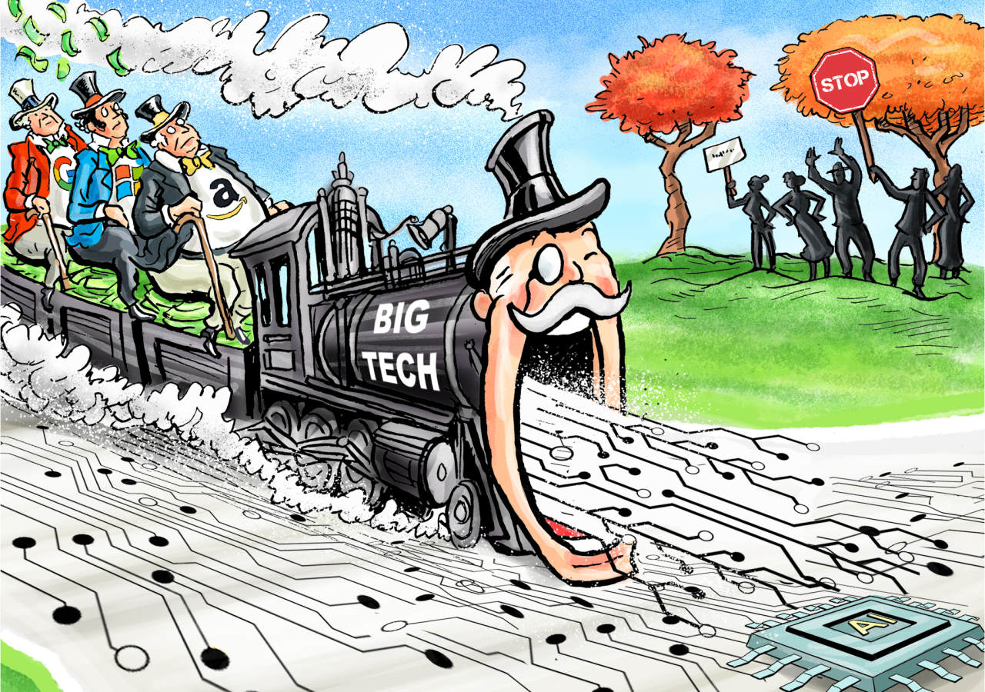
In the long run: whoever owns compute
Compute is the processing capacity that trains and runs the models, hosts the platforms, clears the payments and stores the data.
It is to the age of the machine what the blast furnace was to the age of industry: the means of production.
0.6%
Africa's share of global data centre capacity
1.2 GW
Where compute is built on the continent, it is built by foreign hyperscalers and sovereign funds, under incentives African governments compete to make generous.
projected by 2030, and the gap with the world still does not close

Slide 16




What must tax and tax justice do?
See the machine
Write a SEP rule into the Income Tax Act and apply withholding tax at source on payments for cloud, compute and model access.
Stop subsidising concentration
No tax holiday for a data center without local equity, a skills obligation, BO disclosure and a sunset clause. Publish what each incentive costs in the budget.
Reach the labour of the machine
Require AI outsourcing contracts to be filed with the revenue authority and apply TP rules to the margin between the foreign client’s fee and the local wage bill
Retain, not merely collect
Legislate that recovered IFFs and digital tax revenue go into a dedicated social protection fund, with a published formula, so citizens can see what the tax bought
Restrain the fiscal state
Statutory limits on which data it may pull, judicial authorization for bulk access, data protection oversight and an annual report to parliament
Notes:
Fiscal sociology: the tax system is where the relationship between state and society is written down (Schumpeter 1918). My work: The Evolving Thunder (2020); Why the UN Must Put AI and Data on the Tax Agenda (2024); Digital Tax Surveillance (2025); Transforming Extraction into Protection (2026).

Slide 17
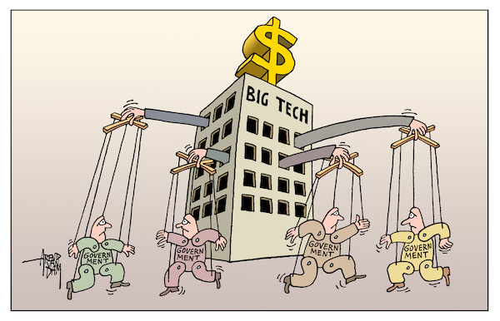
So, who shapes Africa’s economic future?
Today, in order of effective power:
the owners of compute and the platforms on it,
the corporate and financial interests that organise supply chains and credit,
the governments that alternately enable and resist them, and
the scholars and advocates who describe what is happening.
Beneath them all: the farmers, the traders, the nurses, the teachers and the data workers whose labour is the substance of the seven spaces.
Thank you.
Learn more through my Project TERRA -
https://research-under.hfw-project-terra.org/

