Slide 1
Ponthir Sports & Community Club
PSCC
Presentation to Stakeholders October 2022
AGENDA
Presentation
Q&A
Walk around

Slide 2
Participants
Stakeholder | Invitees | Designation
Torfaen CBC | Stephen Vickers David Leech Stewart Lawrence Andrew Peacock Holly Hinchley Dan Morris Cllr Karl Gauden | Chief Executive Chief Officer – Communities Head of Sports Development Sports Development Officer Sports Development Officer Asset Manager Ward councillor
Torfaen Voluntary Alliance | Aimee Morris | Manager/Adviser
Cricket Wales | Mark White | Regional Development Manager
Ponthir Community Council | Cllr Ian Danaher Clare Danaher | Chairman of PCC Clerk to PCC
High Sherriff of Gwent | Malgwyn Davies | High Sherriff
Football Association of Wales ** | Sam Lloyd Bethan Woolley Laura Davies Rachel Holt | Facilities Investment Manager FAW Trust National Girls Football Lead
Welsh Government. ** | Michael O’Shea | Community Facilities Programme Advisor
Welsh Senedd Members ** | Peter Fox Natasha Asghar Laura Anne Jones Delyth Jewell Peredur Owen Griffiths
Stakeholder | Invitees | Designation
PSCC | Richard Alsept Lesley Bateman Paul Buffery Mike Holcombe Norrie MacDonald John Parfitt Tony Pead Sean Ryan | Chairman Director – Events Director – Business Dev’t Director – Grounds Assistant Treasurer Secretary Treasurer Director - House
** Attending a separate session

Slide 3
Overview
Objective is for PSCC to become the key hub for cricket , football and the community.
Significant progress has already been made over the last 2 years
We are seeking significant funding to improve existing and provide multiple new facilities
Improvements will enable
  The club to become a hub for the community , football , cricket and other sports
  Increase in numbers participating in sport from to over 500 with over 50% expected to be juniors
  Expansion into more sports played by disadvantaged and minorities
  Major expansion of Girls and Woman's sporting participation
  Extending the use of the club as a community facility for Ponthir & the surrounding area
Ability to deliver
  There is a strong management board with extensive and relevant experience
  The improvements delivered over the last 2 years prove the team will deliver the project.

Slide 4

Background
Beginnings
  Ponthir Cricket Club first played in 1881
  Move to Oaklands c 1974
  Football section started late 1990’s
2014 to 2017
  Asset Transfer to limited company (PDSC) – 2014
  Harsh reality of maintaining property and grounds ourselves
  Lack of prudent financial management
  Poor relationship between Cricket and Football at committee level
  No common vision or direction within the club
  Lack of engagement with wider community

Slide 5
A new Direction– Mar 2018
Call to Arms
  Net cash reserves including bar float of £700
  New committee including Jerry, John, Tony + + + +
  Worked very hard to pull back from brink
  Doubled bar turnover by encouraging wider community use
  Small business rates relief
“More than a club” – 2019
PANDEMIC
(Double edged sword)

Slide 6

Ponthir Sports and Community Club
#morethanaclub
PDSC
Creating a Vision and Strategy

Slide 7
Strategic review - the 8 key strands of success
Community
Sports
Enterprise
1.Vision - Strategy
4. For the Community
5. Great place / environment
6. Communication
7. Income Generation
2. Leadership
3. Welcoming
Great experiences
8. Getting things done through the right people

Slide 8
What do we want to do?
We must improve our outside facilities. Drainage!!
ACTIVITIES
Cricket
Football
Social Playing
Dog walking
Social events
Games
Socialising
FACILITIES
Fields
Pitches
Training Facilities
Changing
Showers
Lounge
Bar
BENEFITS
Health
Fitness
Wellbeing
Inclusion
Learning
Happiness
Sense of Community
Provide
To enable
To produce
MUGA(s)
New changing rooms
Total refurb
Better promote the club in the community

Slide 9
The need for mutual support
One fails
All fail
The whole is greater than the sum of the parts
Football
Cricket
Community
Vision , Requirements , expectations
Guidance , Support , Resources
Support from Welsh Government , Borough & Community Councils

Slide 10
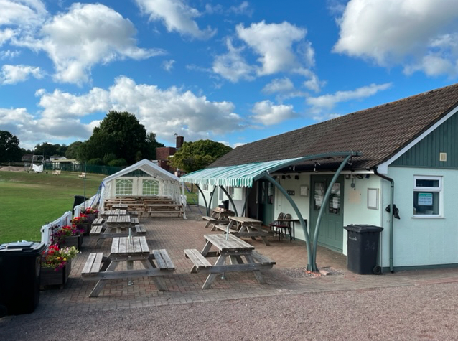
Achievements to Date - The Small Stuff
(largely funded by investing Covid grants)
Made significant improvements to clubhouse
  Exterior and interior heating & lighting
  Exterior and interior decoration
  Facia, soffits and cladding
  New doors
  Canopy
  Picket fence
  Extended patio and new patio furniture
Created a welcoming & friendly environment used by
  Charities
    ACGAS, MNDA, The Samaritans
    St. David’s Hospice Care, Royal British Legion
  NHS (Families’ Day), Private parties
  Foreign language classes (U3A) , Cook stars , Lunch club
  Community café
  Cribbage team , Quiz , Darts teams, Boules teams
LAST BUT NOT LEAST
Club has circa 500 Members
Provided Ponthir School with sports facilities
Significant use by families and juniors for informal recreation , sports and outdoor activities

Slide 11
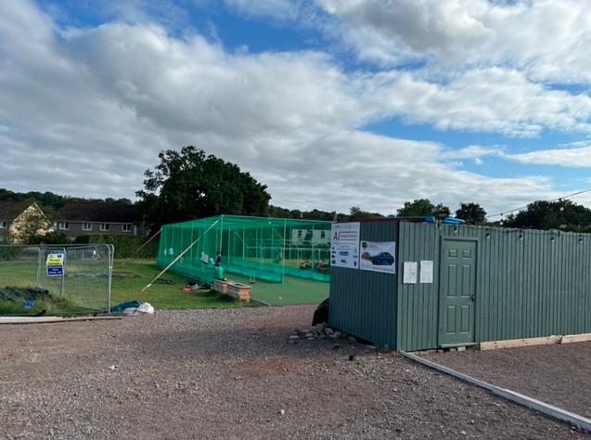
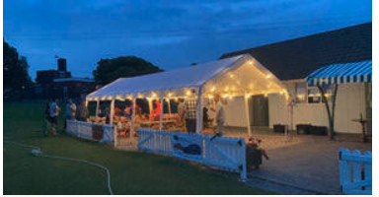
The Big Stuff
largely funded internally but with help from the Ponthir Community Council
Community Amateur Sports Club (CASC)
Boules pistes (soon to have four teams)
New cricket nets
New storage container for small grounds equipment
New garage for large grounds equipment
Grounds mini tractor plus ancillary equipment
Marquees
Expanded events calendar

Slide 12
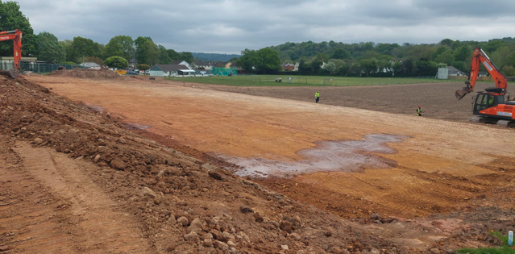
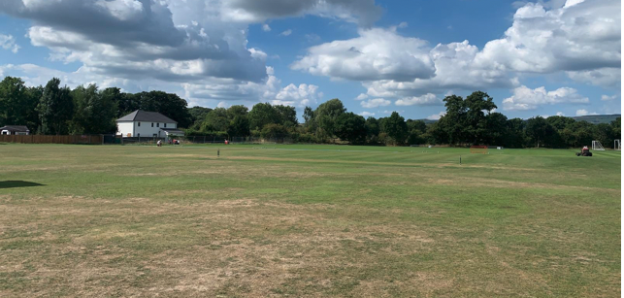
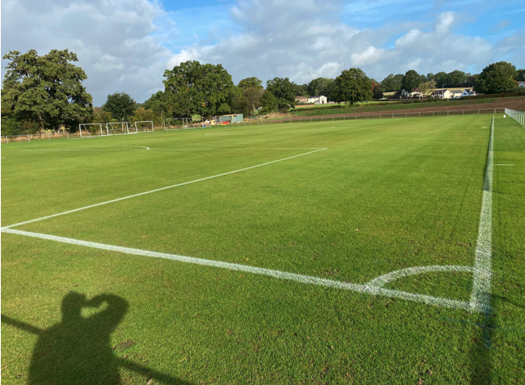
The Very Big Stuff
(50% funded internally)
Removed the blight of electric overhead cables
Graded cricket outfield eliminating a 5 ft slope
Graded, re-laid and fully drained main pitch
Created new pitch on top field – why?
Drained cricket outfield – why?
Created 3rd football pitch on outfield – why?

Slide 13
How have we achieved it?
Committed core of people on the Management Board
Professional approach to governance and management
Enthusiastic and committed band of volunteers involved in every aspect of club life
  coaches, team managers
  cooks, bar people
  event stewards, stage crew
  engineers, ground staff, litter pickers
Grant funders with an open mind and a sympathetic ear – sometimes!

Slide 14
Funding The Very Big Stuff (to date) £ 000’s
Investment | Cost
Power line removal | 39
Main football pitch | 93
Top football pitch | 54
Cricket outfield | 49
South pitch | 15
Total | 250
Funded by | Value
CFW (1) | 43
CFW (2) | 29
FAW | 43
Match Funding | 10
Total External Funding | 125
PSCC Funded | 125
50% of £250K spend funded by PSCC

Slide 15
Future Projects
Complete ground works - £70,000
Stage / Outdoor function area - £20,000
Boules melee area - £25,000
Changing rooms - £400,000
MUGA No 1 - £200,000
MUGA No 2 - £300,000
Clubhouse refurbishment - £200,000
Rewilding - £ 100,000
Total - £1,315,000

Slide 16
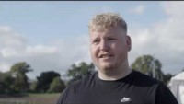
Video

Slide 17
Journey over last 5 years
2017
Actions Taken
Today
Sports Club mainly for adult males
Limited awareness & use by local community
Cricket & Football sections separate
Financially struggling
Only one football pitch & cricket field with poor drainage
New proactive management team with clear vision
Community sports club
Created family friendly facilities
Changed club culture
Financial turnaround
£250K spent on facility improvements with 50 % raised by the club.
Financially solvent
3 Football pitches
Over 100 girls playing football (and 100 more waiting to join)
Improved Cricket field
Attractive outside bar / social
Used by multiple sections of local community
Vibrant friendly atmosphere
Created “Pester Power Premises of Ponthir”!
17

Slide 18
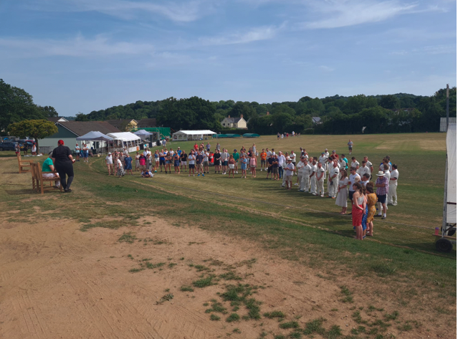
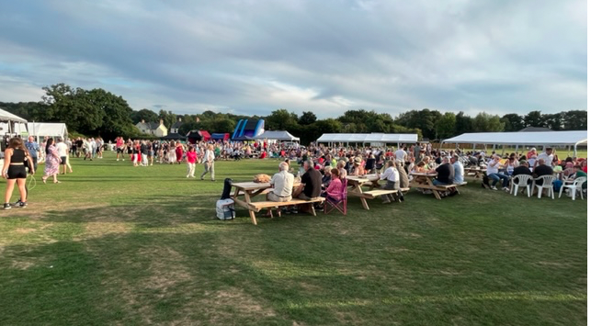
Vision – 2024 / 2025
THE PLACE PEOPLE WANT TO BE
Increased use as community hub for local people
  Active use 7 days a week both day times and evenings
  Green space and open playing areas for the village (children playing informally on the grounds)
  Focus on disadvantaged sections of community (elderly , disabled , youth)
  Key low-cost facility for charities , local clubs and all in the community
  Centre for family activities using clubhouse and playing fields
  Over 30 % of local resident’s using facilities regularly
Multisport Hub
  More than 500 active sporting members with over 40% female and juniors
  – Adults , Juniors , Veterans and Girls / Women's teams,
  Cricket , Football , Petanque and others
  Facilities in use all year round 5 + days per week
  Provide facilities for new sports using proposed MUGA and improved grounds
    Softball , Basketball , Netball etc
Financially self sustaining

Slide 19
FINANCIAL SUSTAINABILITY
> £300K
Surplus £ 000’s excluding major investment / loan repayments etc
C £180 K
Club will generate sufficient income to maintain and continuously improve the facilities.
C £120 K
< £30K
Revenue growth generated from
Increased bar / trading income
More members
Ground / facility hire
  MUGA
  Objective is to keep price of using facilities low for the local community
Use of trading surplus
Loan repayments & major investments £80 - £100 K pa
Maintenance / minor investments £40 = £60K pa

Slide 20
Summary
Planned Investment
 |  | Enables
Improvements in priority order | Estimated cost £ 000’s | Community activities | Sport | Revenue generation
Stage / Outdoor function area | 20
Ground improvements & Boules Melee area | 105
Changing rooms | 400
Clubhouse | 200
MUGA 1 | 200
MUGA 2 | 300
Rewilding | 100
Total | 1315
There is the opportunity to create a 1st class sporting and community hub in Ponthir
Major improvements have been achieved over the last 3 years
We are requesting help and grant funding to support our proposed £1.3M investment
We are confident we can deliver these improvements within 2 years and within budget
The club will be sustainable in financial , social and environmental areas once improvements complete
Can you Help ?

Slide 21
QUESTIONS
WALK OF GROUND & FACILITIES

Slide 22
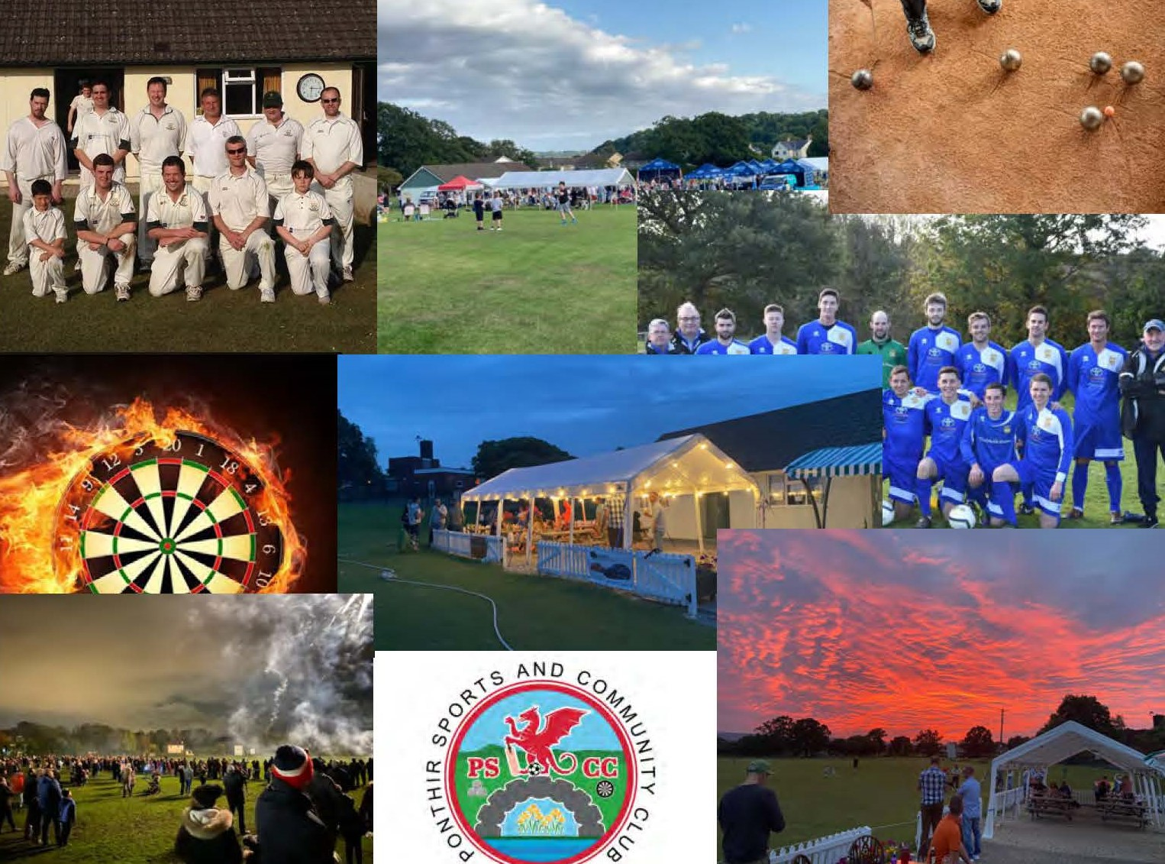
Huddle
All Stars
The whole is greater than the sum of the parts
Vets
9 x Girls
4 x
Junior
Vets
1 x Adult Football
3 x Adult Cricket
Junior
Girls
#morethanaclub
Community
Women’s
Youth
Charities
Schools
WI
Social
PCC
4 x
Boules
2 x Darts
Societies
Lunch Club
Cafe
U3A
Clubs

