Slide 1
Designing LED Circuits for Model Railroaders
Prepared for ARHS
February 2021

Slide 2
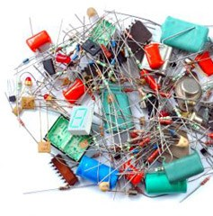
Electronic Symbols—common to model railroad use
Passes current only from Positive to Negative—in the direction of the “arrow” in the symbol.
The direction of installation is important
In practice, from anode (the long leg) to the cathode (which is the short leg).
LED
Same characteristics as a Diode but in addition emits light when passing current in the forward direction.
Stores electricity—like a mini battery. Units are farads, microfarads and picofarads
Direction of installation is not usually important (electrolytics are exception and are marked).
Creates a magnetic field. Units are Henrys.
Direction of installation is not important
Creates resistance—like an orifice in a hose. Units are Ohms
Direction of installation is not important
Source of DC power—usually a battery, but could be a power supply
Units are DC Volts
Source of AC power—usually a power supply
Units are AC Volts
Current only flows this way
Anode
(long leg)
Cathode
(short leg)
An LED is a current device—A resistor must be sized to control the current

Slide 3
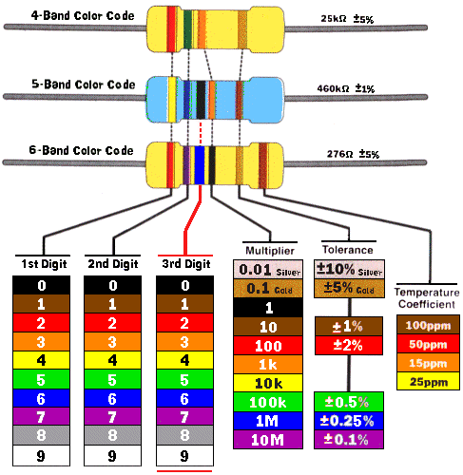
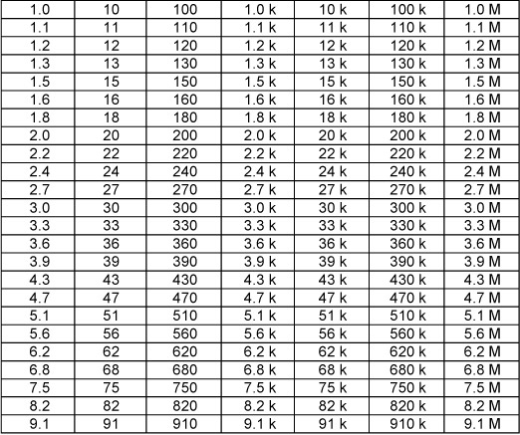
Resistors—those colored bands have a meaning
Standard Resistor Values
Standard Resistor Values are at about a 10% interval.
The tolerance on the value (silver band) is 10%.
Always pick the next higher resistance value to limit current.
Any calculation in electricity within 10% is accurate enough!

Slide 4
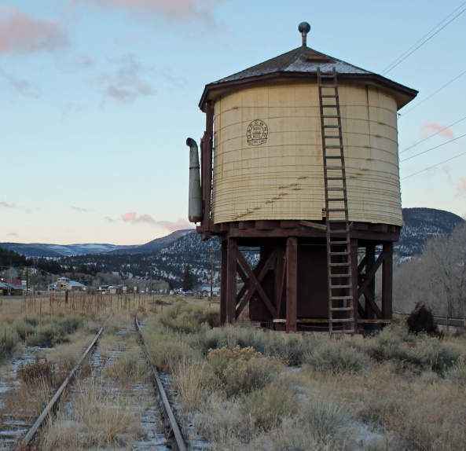
Direct current is like water flowing in pipe
A battery stores energy. The higher the (water level) the higher the voltage.
Water pressure is analogous to Voltage.
O
The flow in the wire is current and is analogous to the volume of water flowing in a pipe.
Water flow in GPM is analogous to current in Amps
Orifice
A resistor is similar to an orifice in a pipe—it restricts the flow.
Check Valve
A diode act like a check valve—current can only flow in one direction.
Ground has zero potential energy. Everything is measured from ground.
This Photo by Unknown Author is licensed under CC BY-SA

Slide 5
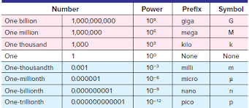
There are only two equations that are needed to calculate a resistor value.
The units for electrical values can be tricky
Resistance (units are Ohms) is calculated from:
V= i * R (Where V is volts, i is Amps and R is Ohms)
Which can be rewritten as
R = V / i
Power (units are watts) is the energy converted to heat in a resistor and is calculated from:
P = V * A or P = V * i
(Where P is watts, V is volts, and I is amps.)
Typical Power ratings for resistors are:
1/8, 1/4, 1/2 , 1 Watt
Some units have a prefix of:
Milli which is x 10 ⁻³ or times .001
So, 20 milliamps is 0.020 Amps
Other prefixes are shown in the chart below: below:

Slide 6
Tricks with Resistors
What is the Equivalent Single Resistor replacing two Resistors in Series?
What is the Equivalent Single Resistor replacing two Resistors in Parallel?
The Equivalent single resistor is a bit more complicated…….
Re = (R1 * R2) / (R1 + R2 )
Multiply the two resistors and divide by the sum of the resistors
A special case is when both resistors are the same value, then
Re = (R * R ) / 2R = R/2
The equivalent of two equal resistors in parallel is one half of the individual resistor value.
If each resistor is a ¼ Watt, the equivalent resistor carries twice the power and is rated at ½ Watt.
A trick here is if you need a ½ Watt resistor but only stock ¼ watts, then double the resistance value and put two in parallel.
Trick question—what is the equivalent resistor if four equal resistors are in parallel? Answer is Re = R / 4 (one fourth of R)
The Equivalent single resistor is the sum of the two individual resistors.
If you need a higher resistance value than any resistor that you stock, then just add small resistors in series until you have the necessary resistance.
The power capability of the equivalent resistor is usually twice the rating of the lowest individual resistor but the power across each resistor should be checked.

Slide 7
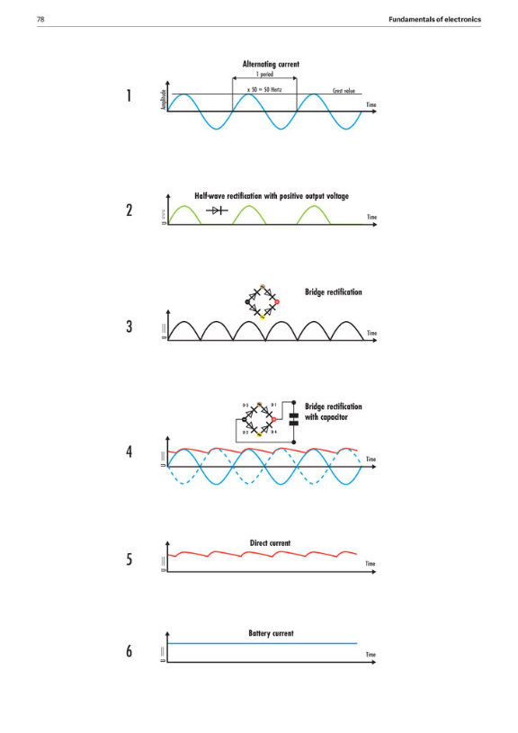
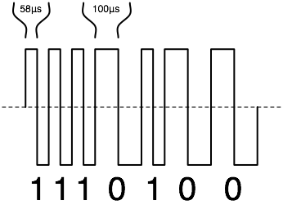
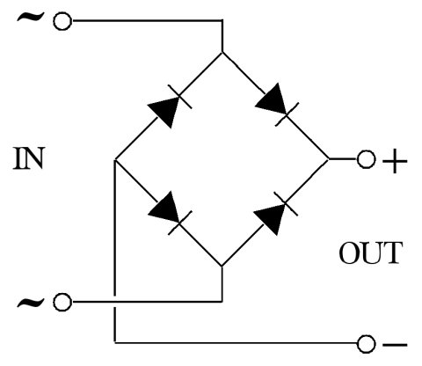
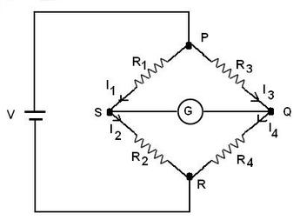
Alternating Current and Direct Current are different
There are variations on the types of current
DCC is a form of AC, but uses a square wave
AC
Half Wave
Full Wave
Full Wave
With Capacitor
Full Wave
With Capacitor
DC
The decoder looks at the width and frequency of the pulses and “decodes” the message being sent.
AC can be converted to DC using a Wheatstone Bridge (also known as a Rectifier)
A capacitor or a battery produces a reasonably constant DC voltage.
Adding a capacitor “smooths” the ripple

Slide 8
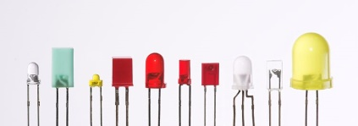
A Resistor is “Sized” by defining TWO Values: Resistance (in Ohms) and Power Rating (in Watts)
This is the simplified circuit you are building.
The circuit has:
A constant voltage source (a power supply or a battery)
A resistor that you must size, and
A LED which has two known characteristics
It’s forward voltage, V_{f}, and
It’s operating current, i_{f}
Redraw this circuit as a simple “stick” diagram where:
V_{S} is the Source (or battery) voltage in Volts
V_{f} is the Forward Voltage of the LED (usually on the LED package) in Volts
”i” is the Forward Current of the LED (Also usually on the LED package) in Amps or if in milliamps then multiply the resistance value by 1000.
O
V_{S}
The equation for the Resistance of the Resistor is:
R = (V_{S} – V_{f}) / i_{f} in Ohms
And, the power dissipated in the Resistor is:
P = (V_{S} – V_{f}) * i_{f} in Watts
i_{f}
i_{f}
V_{f}

Slide 9
Example Problem Using a “Typical” LED
The most important step is to draw the circuit picture!!
The equation for the Resistance Value of the Resistor is:
R = (V_{S} – V_{f}) / i_{f} in Ohms
R = (12 – 2 ) / 0.020
R = 10 / 0.020
R = 10,000 / 20
R= 500 Ohms
And, the power dissipated in the Resistor is:
P = (V_{S} – V_{f}) * i_{f} in Watts
P = (12 – 2) X 0.020
P = 10 X 0.020
P = .2 Watts
All LEDs have peculiar operating characteristics, and you should always use the values associated with that LED.
If you don’t know, then you can use a “typical” LED set of values to ”get in the Ballpark”
For a Typical LED:
V_{f} = 2 Volts
I_{f} = 20 milliamps
Drawing the simple circuit using a 12- volt DC power supply and solving the equations gives:
O
V_{S} = 12V
}
V_{R} = 10V
i_{f}
= _{0.020 A}
O
V = 2V
V_{f} = 2V
The proper size resistor is 500 Ohms rated at ¼ Watt

Slide 10
Now a couple of “What if” Problems
“What if” you have two LEDs in series?
Assume a “standard” LED and a 12 VDC power supply
Draw the circuit:
“What if” you have two in parallel?
Assume a “standard” LED and a 12 VDC power supply
Draw the circuit:
The equation for the Resistance Value of the Resistor is:
R = (V_{S} – V_{f}) / i_{f} in Ohms
R = (12 – 2 – 2 ) / 0.020
R = 8 / 0.020
R = 800 / 20
R= 400 Ohms
And, the power dissipated
in the Resistor is:
P = (V_{S} – V_{f}) * i_{f} in Watts
P = (12 – 2 -2 ) X 0.020
P = 8 X 0.020
P = .16 Watts (Greater than .125 but less than .25)
The equation for the Resistance Value of the Resistor is:
R = (V_{S} – V_{f}) / i_{f} in Ohms
R = (12 – 2) / 0.020
R = 10 / 0.040
R = 1000 / 40
R= 250 Ohms
And, the power dissipated
in the Resistor is:
P = (V_{S} – V_{f}) * i_{f} in Watts
P = (12 – 2) X 0.040
P = 10 X 0.040
P = .4 Watts
O
V_{S} = 12V
O
V_{S} = 12V
I_{R}= _{0.040 A}
V_{R} = 8V
V_{R} = 10V
i_{f} = _{0.020 A}
O
V = 4V
O
V = 2V
O
V_{f} = 2V
O
V = 2V
i_{f} = _{0.020 A}
V_{f} = 2V
V_{f} = 2V
i_{f} = _{0.020 A}
The Proper Resistor is a 400 Ohm, 1/4 Watt
The Proper Resistor is a 250 Ohm, 1/2 Watt

Slide 11
Here are some variations using different power sources
“What if” you are using a 5 Volt Power supply?
Then Vs becomes 5 and the solution follows:
Now, you try it using a 9 Volt Power supply
The equation for the Resistance Value of the Resistor is:
R = (V_{S} – V_{f}) / i_{f} in Ohms
R = (5 – 2 ) / 0.020
R = 3 / 0.020
R = 300 / 20
R= 150 Ohms
And, the power dissipated
in the Resistor is:
P = (V_{S} – V_{f}) * i_{f} in Watts
P = (5 – 2) X 0.020
P = 3 X 0.020
P = .06 Watts
The equation for the Resistance Value of the Resistor is:
R = (V_{S} – V_{f}) / i_{f} in Ohms
R =
R= _______ Ohms
And, the power dissipated in the Resistor is:
P = (V_{S} – V_{f}) * i_{f} in Watts
P = _______Watts
O
O
V_{S} =___
V_{S} = 5V
i_{f} = _{0.020 A}
i_{f} = ____
O
O
O
V = 2V
V_{f} = 2V
V_{f} = ___
The Proper Resistor is a 150 Ohm, 1/8 Watt
The Proper Resistor is a ___ Ohm, ___ Watt

Slide 12
More Examples…..
Does somebody have an LED????
V_{S} = ____
V_{f} = _____
I_{f} = _____
Does somebody have another LED????
V_{S} = ____
V_{f} = _____
I_{f} = _____
The equation for the Value
Resistance of the Resistor is:
R = (V_{S} – V_{f}) / i_{f} in Ohms
R =
R= _______ Ohms
And, the power dissipated
in the Resistor is:
P = (V_{S} – V_{f}) * i_{f} in Watts
P = _______Watts
Resistance:
R= _______ Ohms
Power:
P = _______Watts
O
V_{S} =___
O
V_{S} =___
i_{f}= ____
i_{f} = ____
O
O
V_{f} = ___
V_{f} = ___
The Proper Resistor is a ___ Ohm, ___ Watt
The Proper Resistor is a ___ Ohm, ___ Watt

