Slide 1
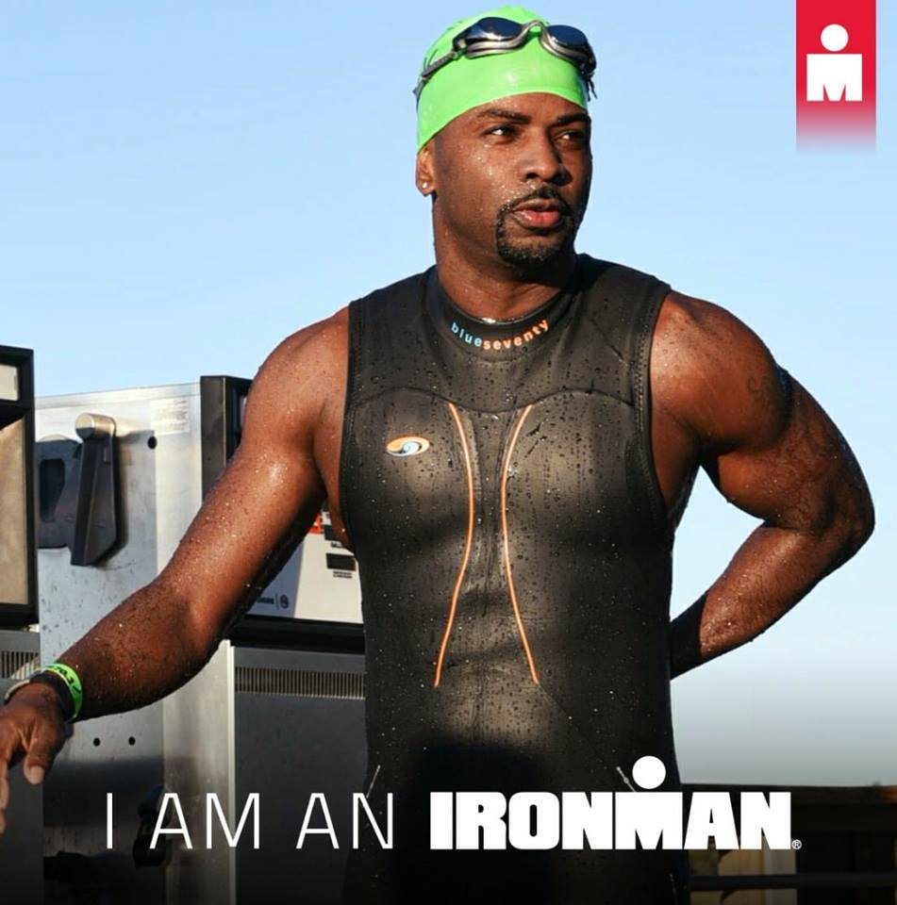
But first, a father, a son, a brother, a friend, God fearer, life liver. And in all things fitness and life
M. Kendrick Miles

Slide 2
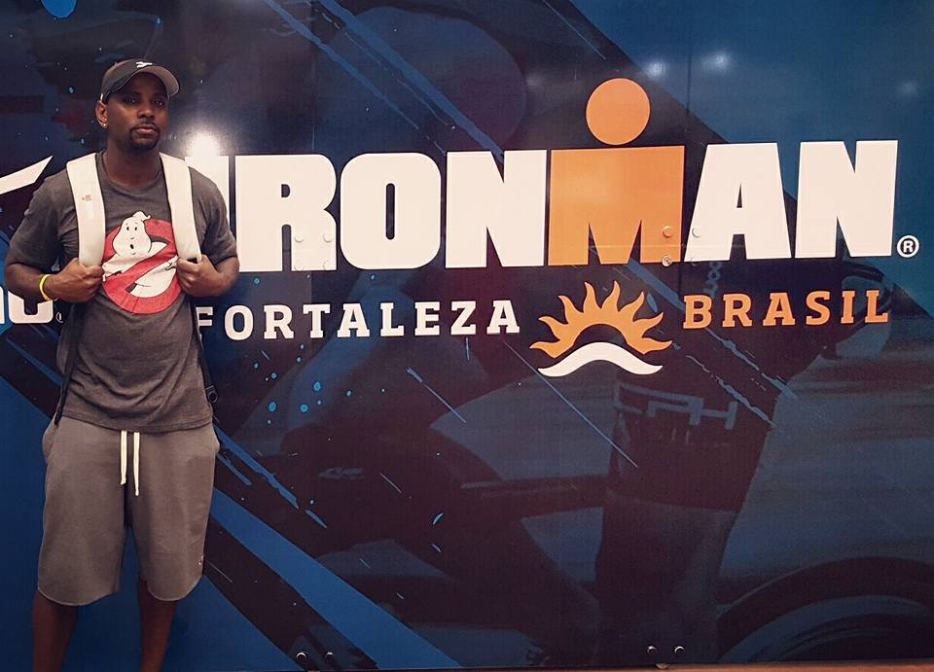

Slide 3
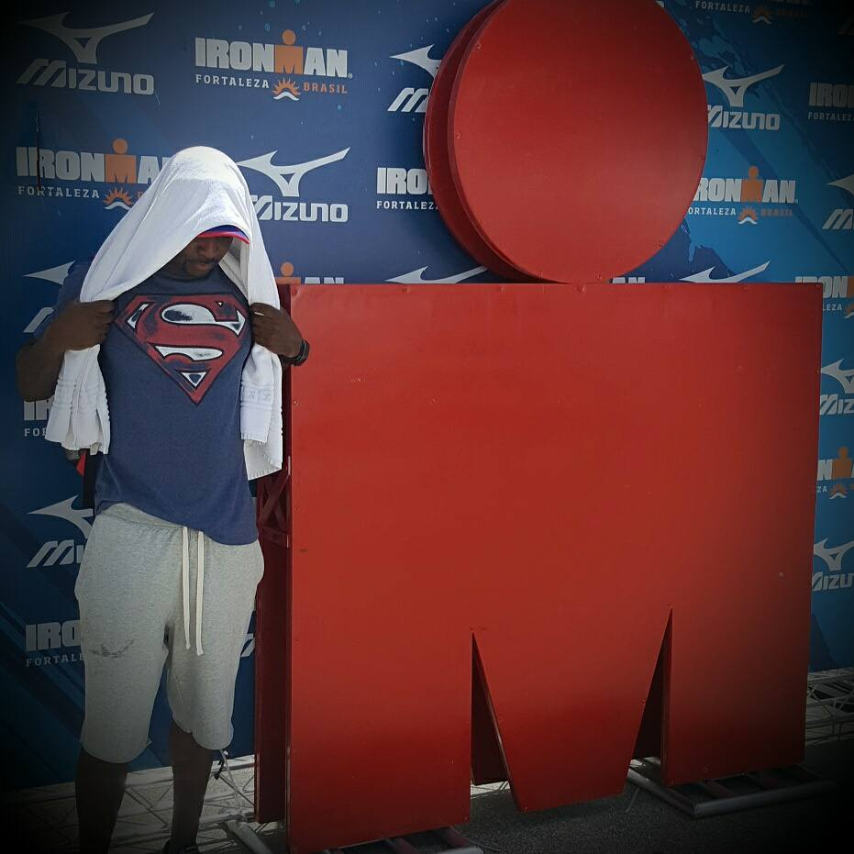

Slide 4
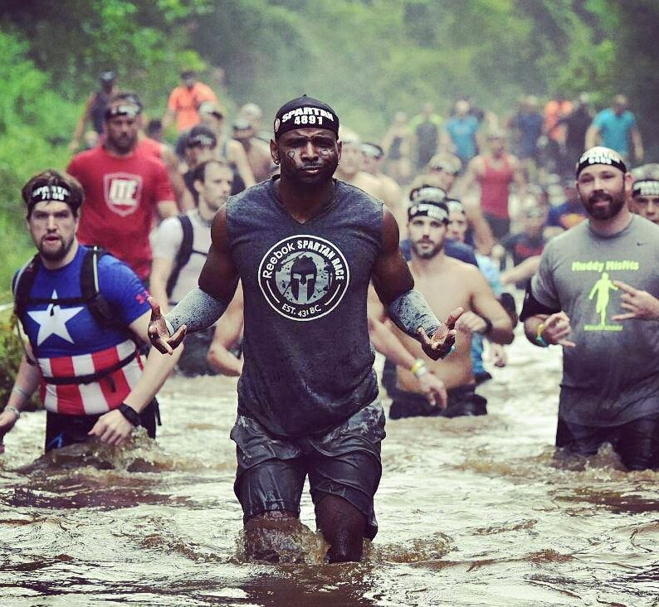
He wants us to be the leaders we were meant to be. Be
#MadeForWhatYouTrainFor in fitness and in life. #M4T4.

Slide 5
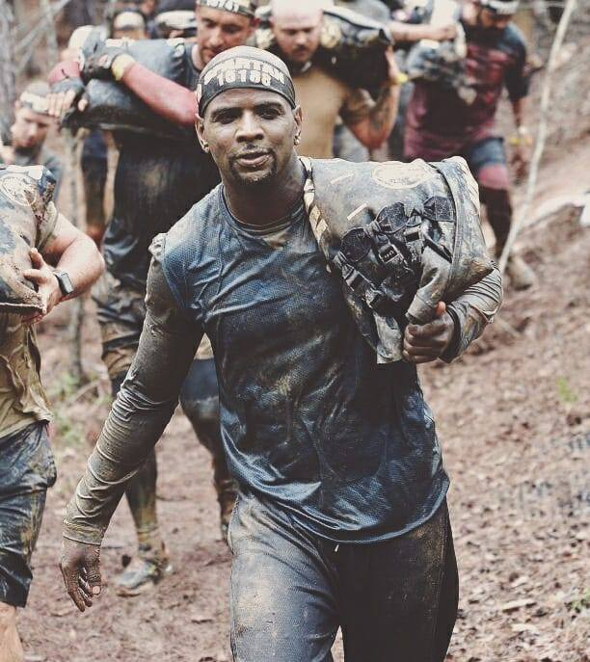
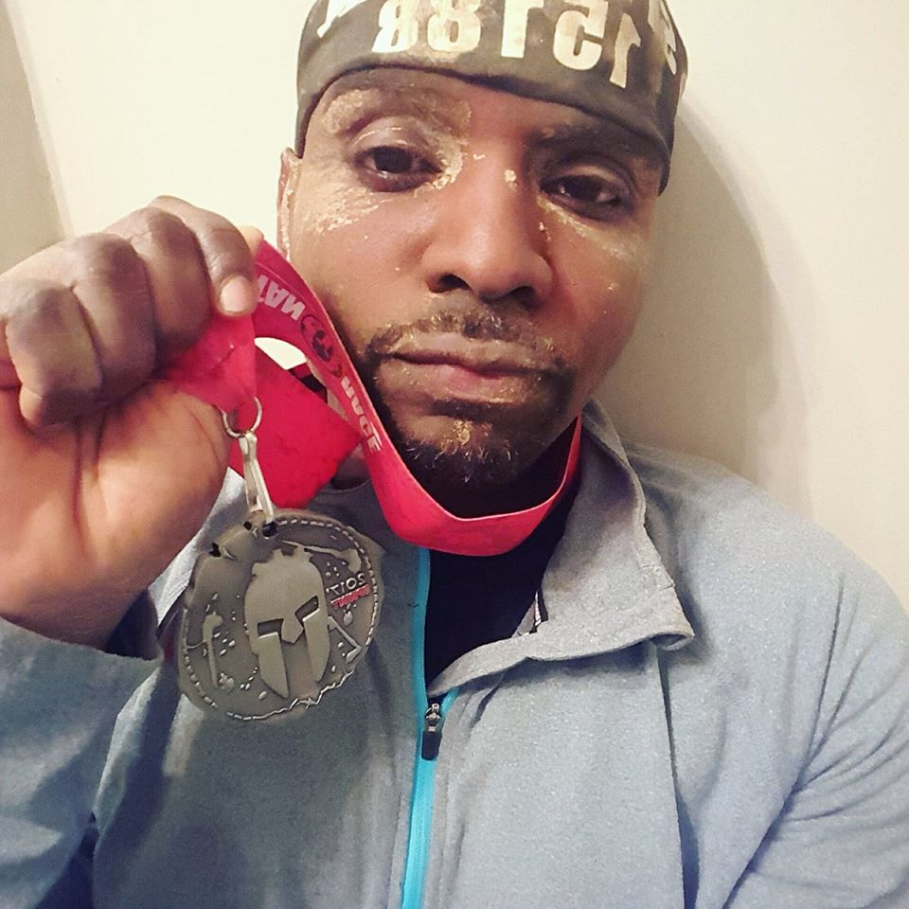

Slide 6
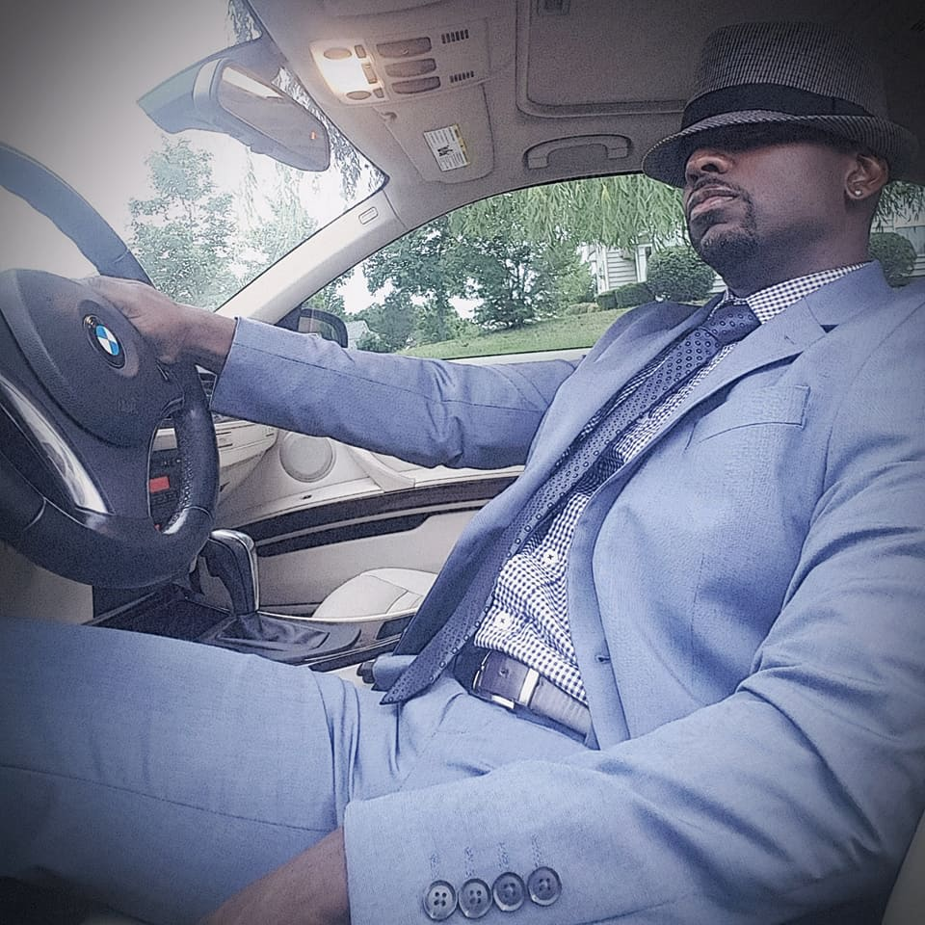

Slide 7
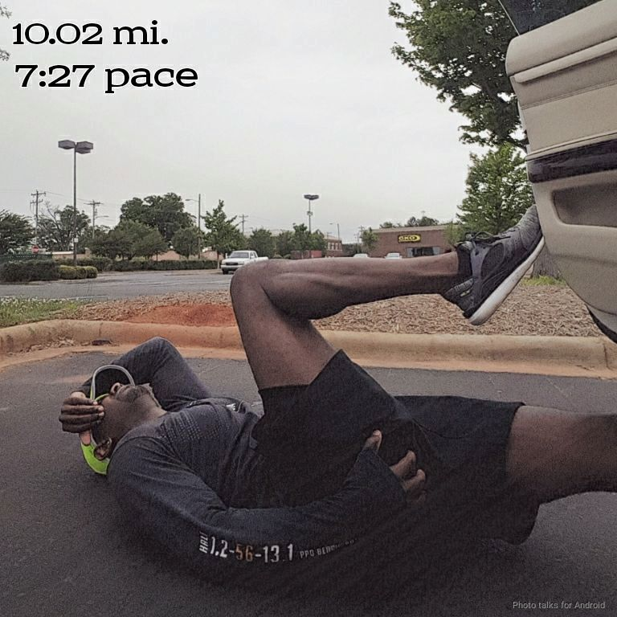

Slide 8
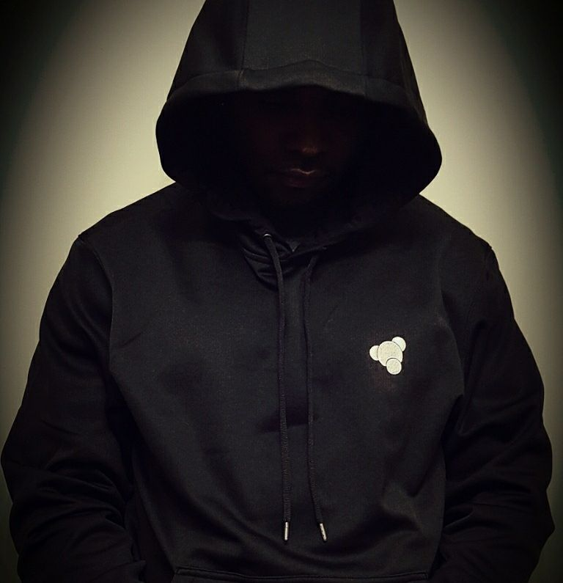
I'm just a guy...
doing some stuff that you can. My heart beats like yours; my blood courses like yours; my eyes see like yours; my mind wants like yours. I'm made like you; inspired by you. I'm made for life, I train for life.

Slide 9
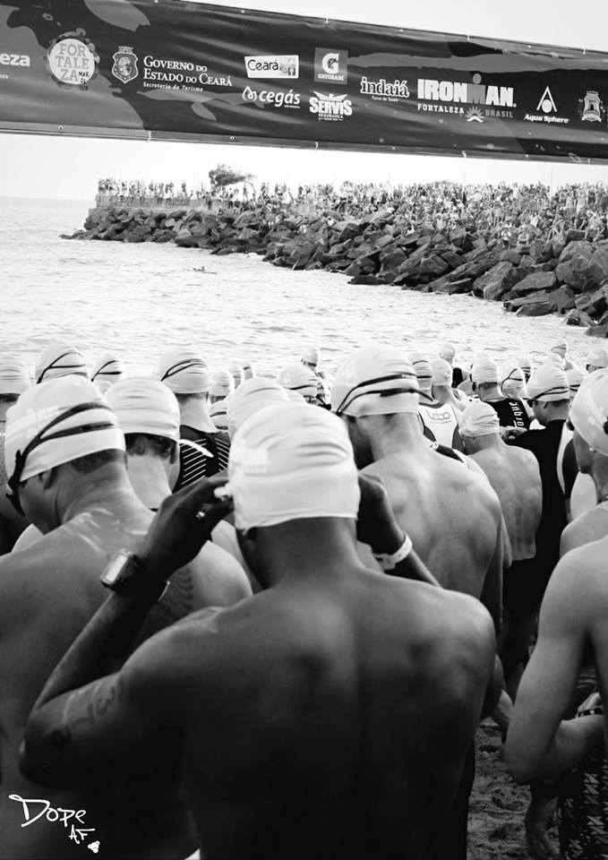

Slide 10
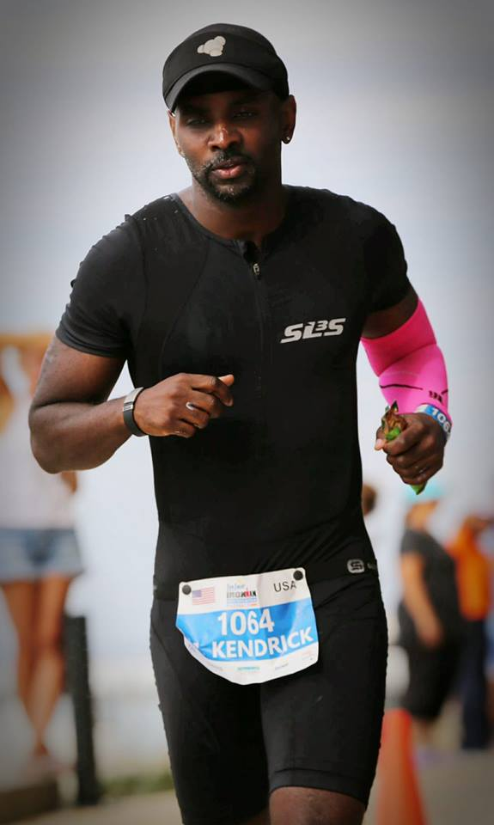
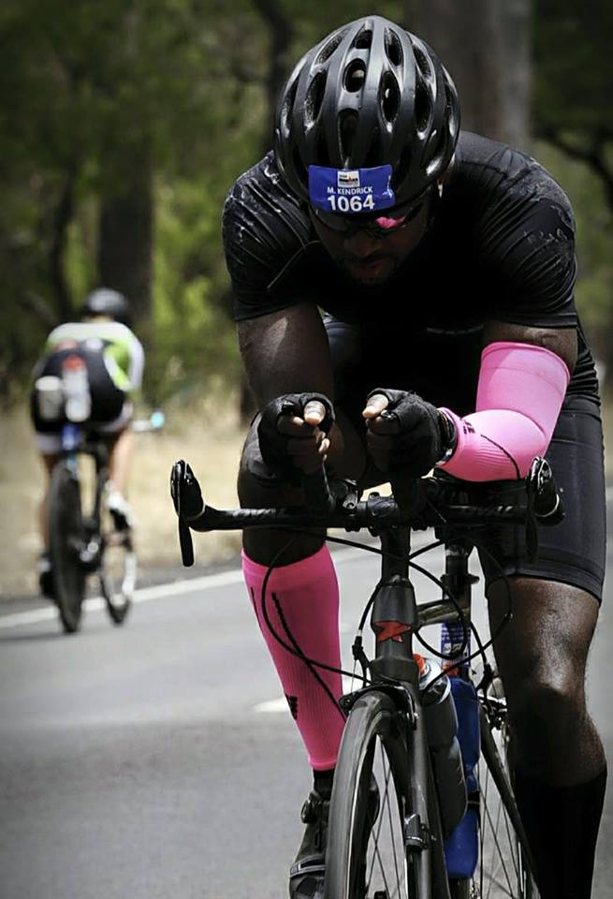

Slide 11
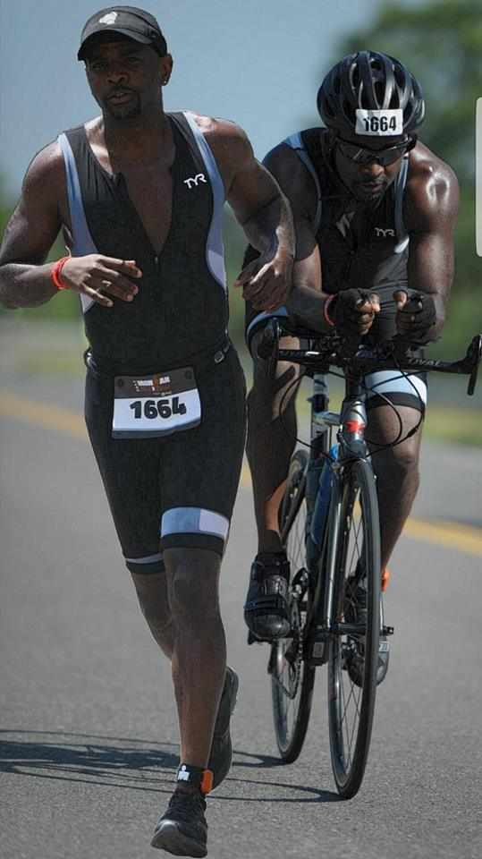
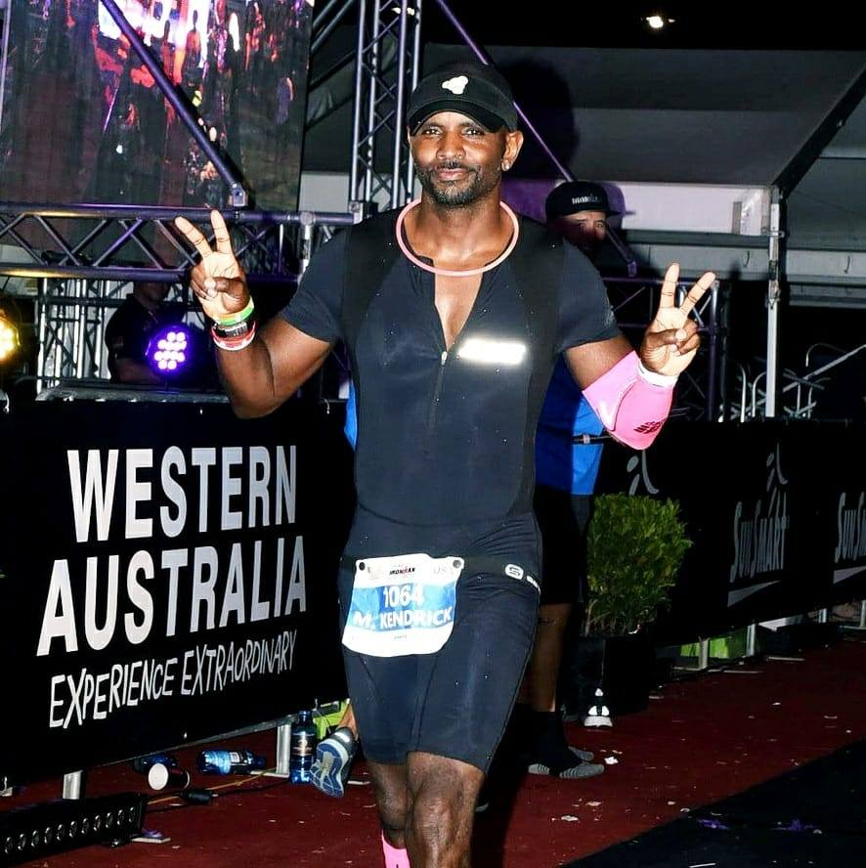

Slide 12
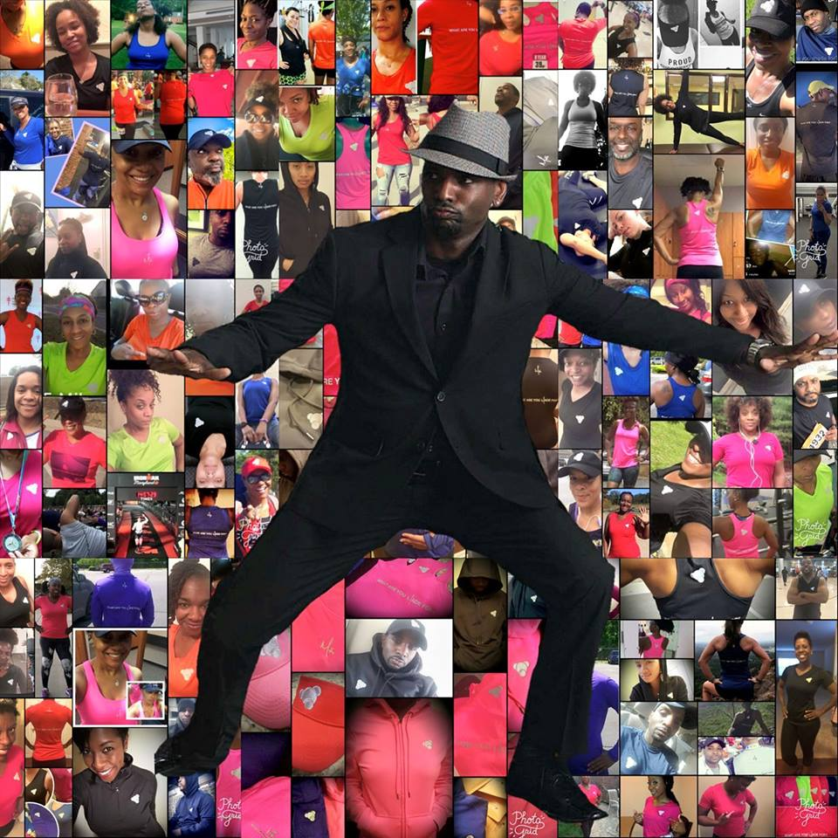
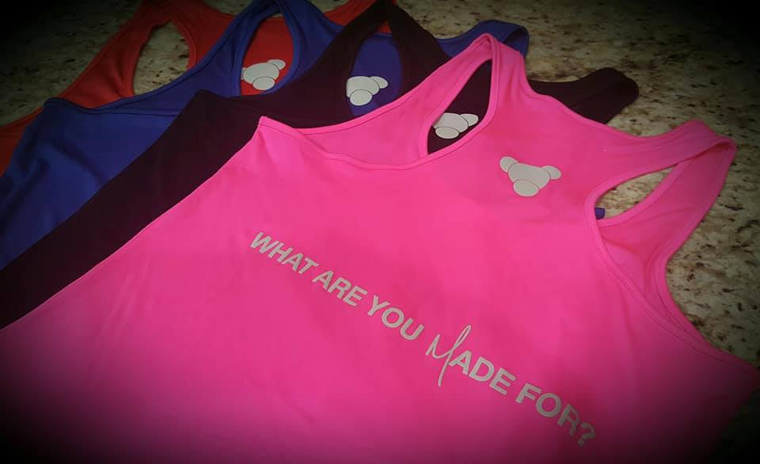
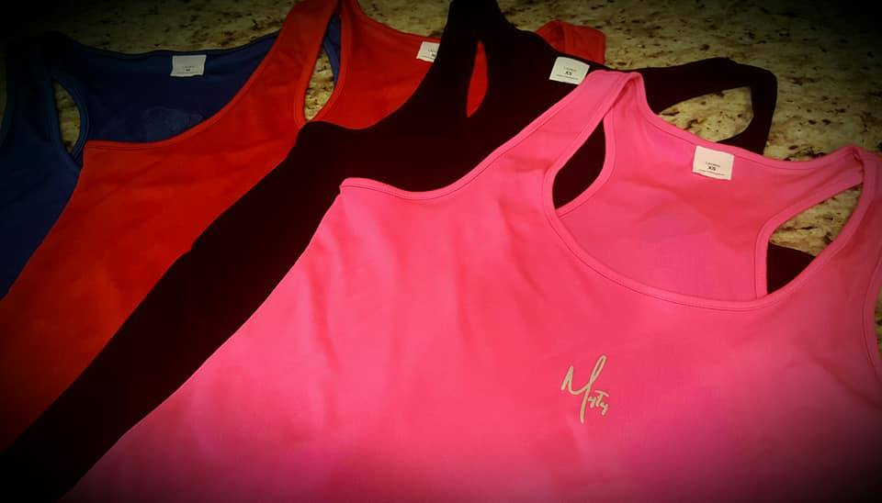

Slide 13
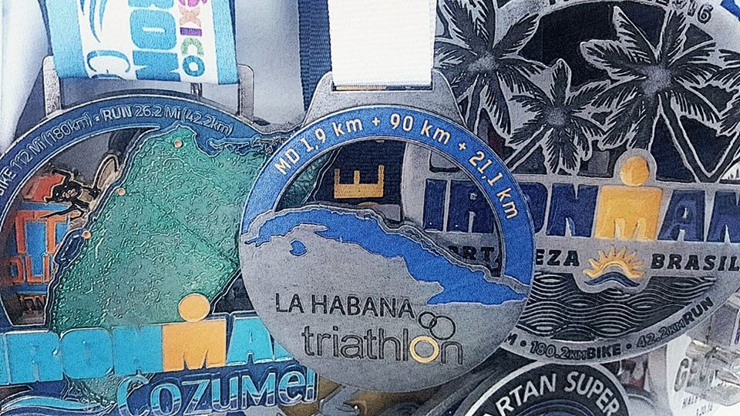

Slide 14
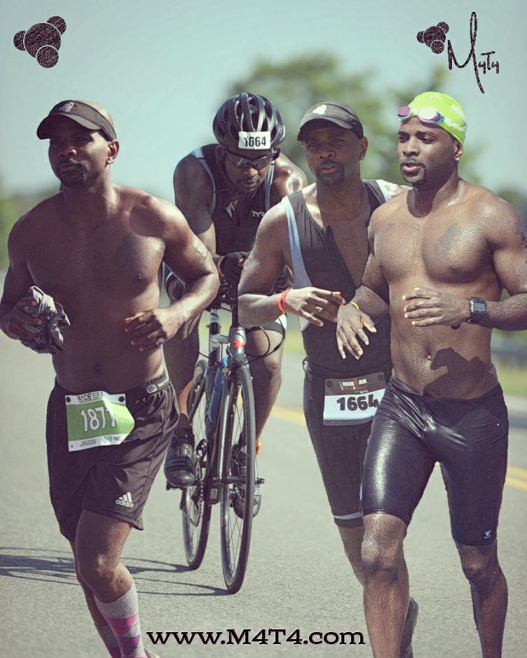
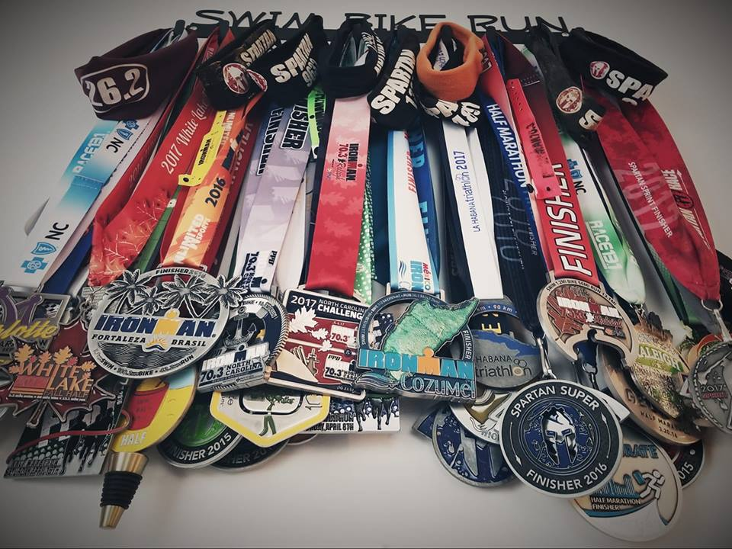
In fitness and life, be your greatest competition

Slide 15
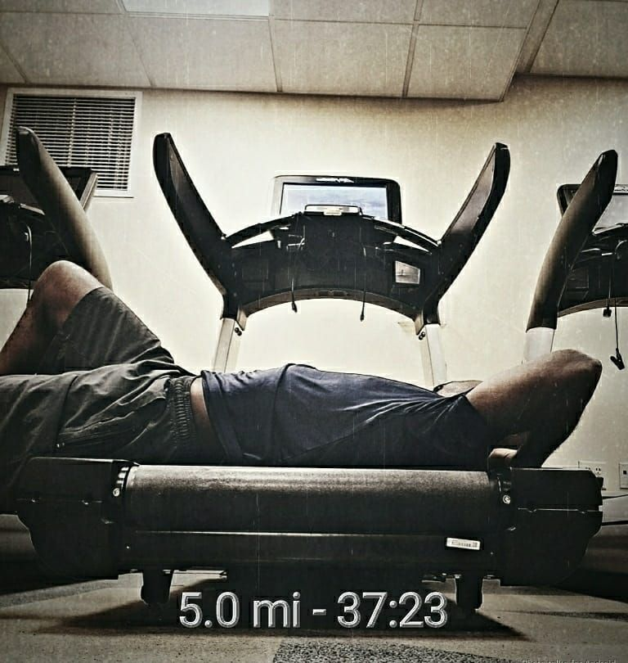

Slide 16
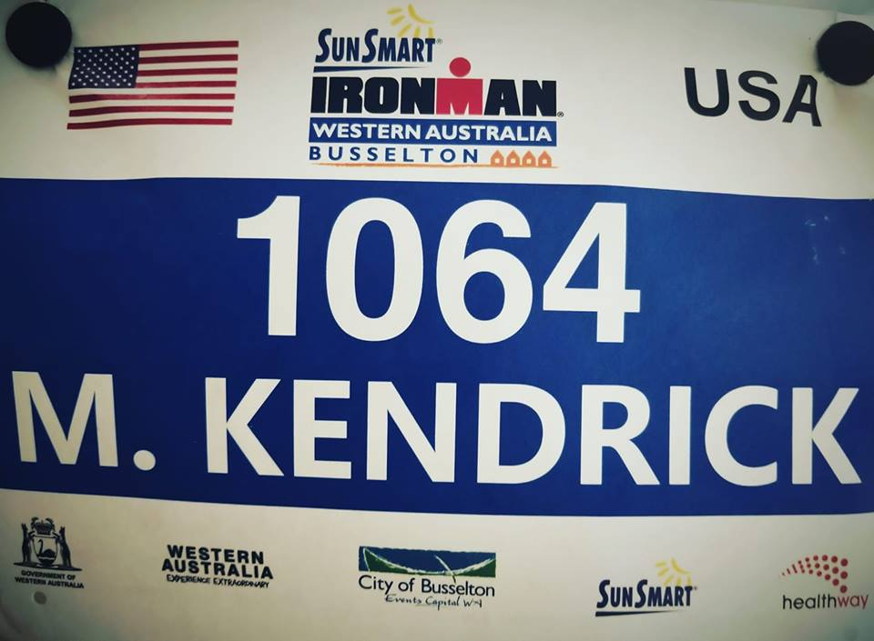

Slide 18
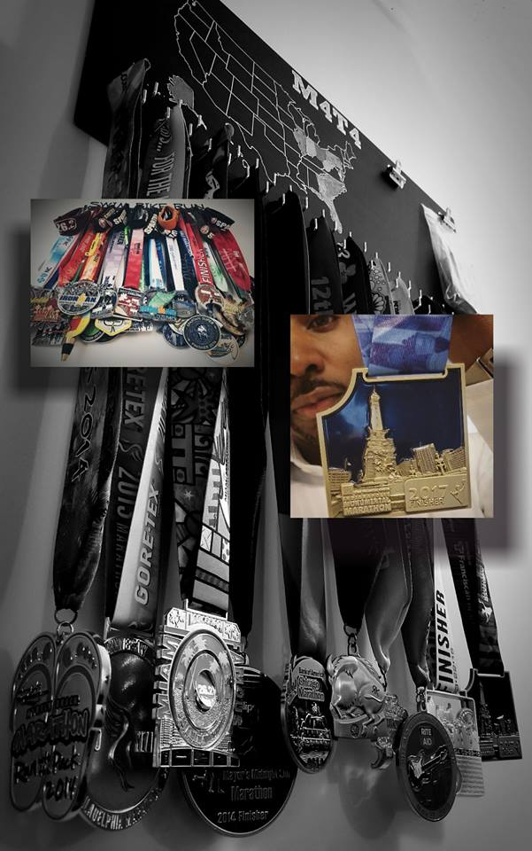
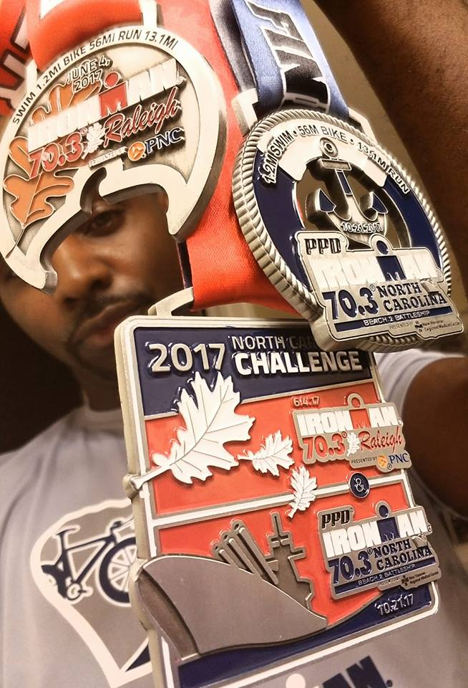
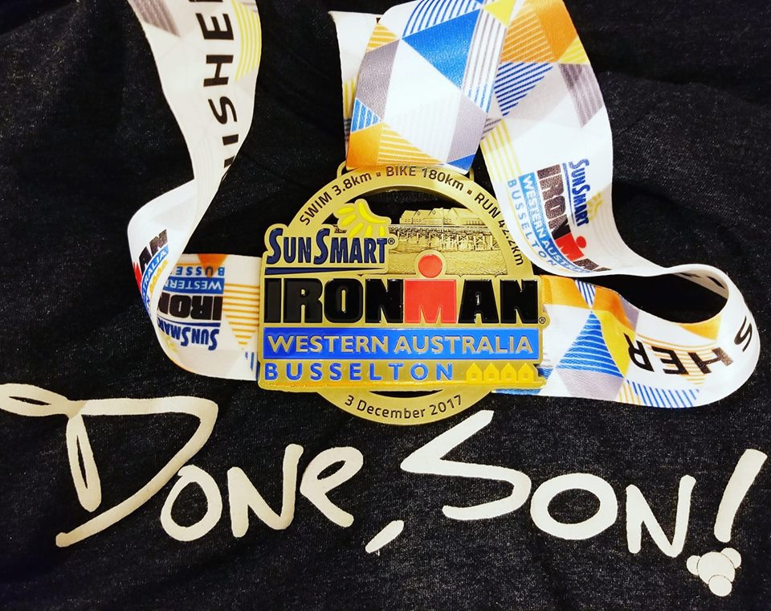

Slide 19
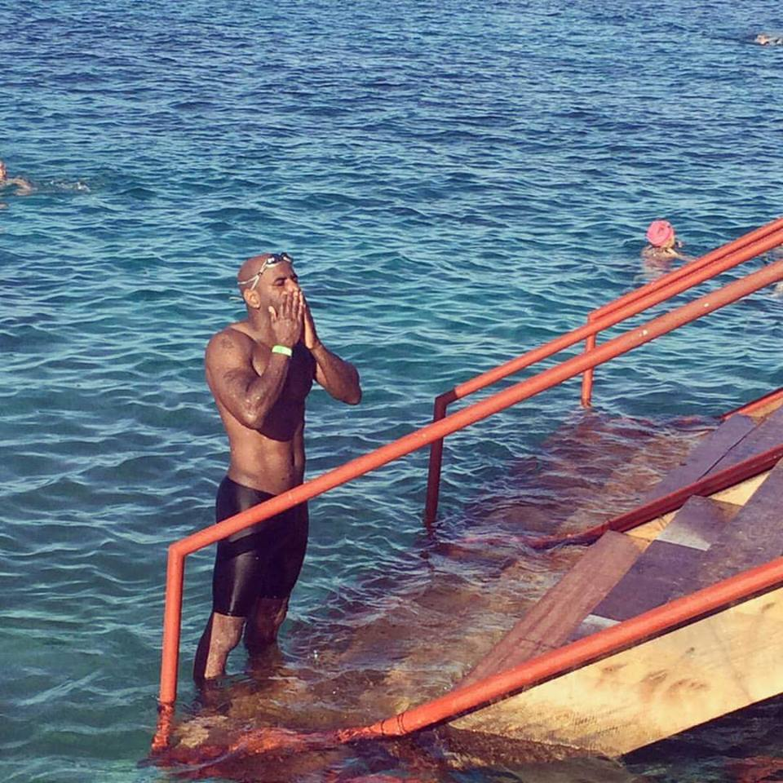

Slide 20
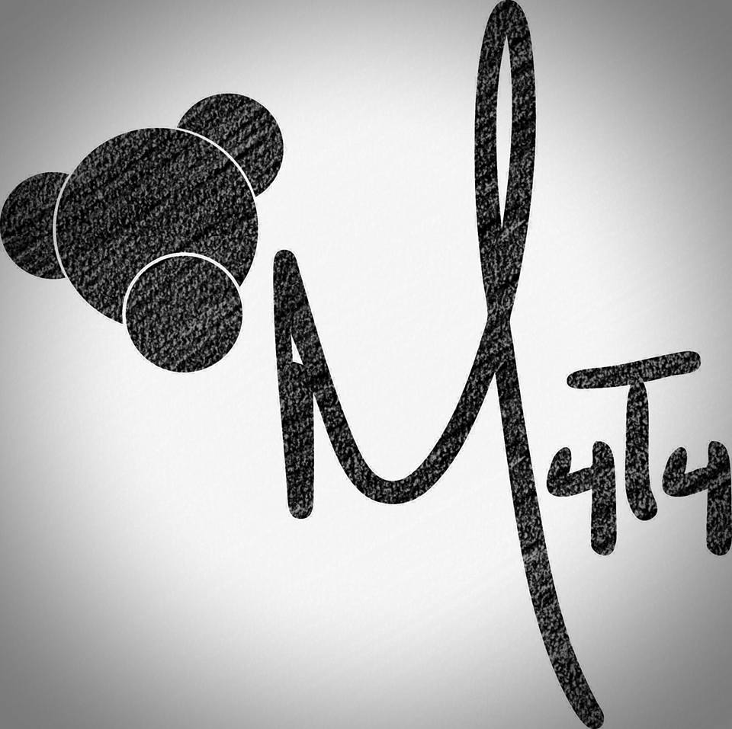

Slide 21
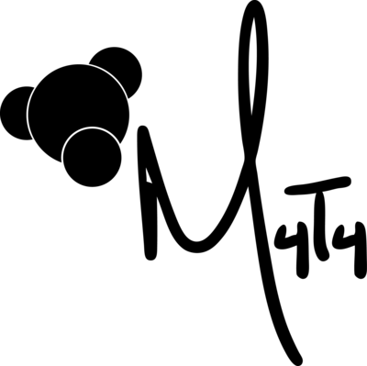
M. Kendrick Miles
Ironman destinations completed in the United States, Cuba, Brazil, Cozumel, Cabo, and Australia.
11 Half Ironman distance races completed
12 full marathons in 12 different states that includes Alaska (38 to go)
Approximately 30 or so half marathons.
14 Spartan races
1 Tough Mudder
Approximately 20 or so triathlons of smaller distances completed.
All of this has been done since October 2011 which was my first sprint triathlon.
I have somewhere in the neigborhood of 70 to 80 medals but I’ve actually never counted.
M4T4 – Made For What You Train For
is a brand with a concept applicable to all things progressive. In your life #WhatAreYouMadeFor

