Slide 1

Perception of Organizational Structure
Mongiello Holdings, LLC, The Inn of the Patriots, LLC, The US Presidential Culinary Museum, The US Presidential Service Center, Mongiello Associates Strategic Marketing, Laurel Placement, The Intercontinental Academy of Household Hotel and Resort Management (IAHHRM)
And official organizational chart of the corporations and team with five-year projections of changing roles
Presented by Martin CJ Mongiello, MBA, at Lenoir Rhyne University Graduate School for Leadership attaining a second Master’s degree leading to entering a Doctorate program of marketing and data science.

Slide 2
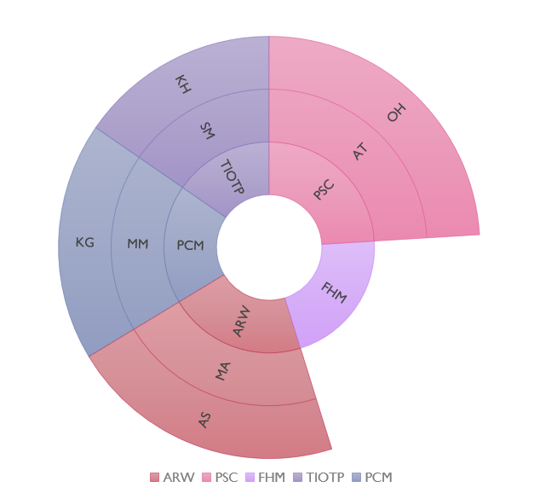
My Perception of the cUrrent Organizational Structure
Mongiello Holdings, LLC, The Inn of the Patriots, LLC, The US Presidential Culinary Museum, The US Presidential Service Center, Mongiello Associates Strategic Marketing, Laurel Placement, The Intercontinental Academy of Household Hotel and Resort Management (IAHHRM)
The Inn of the Patriots (TIOTP),
Presidential Service Center (PSC), American Revolutionary War Living History Center (ARWLHC), Presidential Culinary Museum (PCM), US Food History Museum (FHM)
Our primary leadership team members are: (KH) Kim Hambright, Antwain Thomas (AT), Orlando Herrera (OH), Stormy Mongiello (SM), Alexis Skidmore (AS), Marti Mongiello (MM), Mark Anthony (MA), and Krister Gustafsson (KG). Additional support is received from Mike Mongiello, Chairperson at Mongiello Associates and several other Trustees in Los Angeles, CA, London, UK, and Washington, DC.
Currently operating in a wheel fashion the companies support, and are equal, to positions and fit. No one position is allowed to be better than another.
Presented by Martin CJ Mongiello, MBA, at Lenoir Rhyne University Graduate School for Leadership attaining a second Master’s degree leading to entering a Doctorate program of marketing and data science.

Slide 3
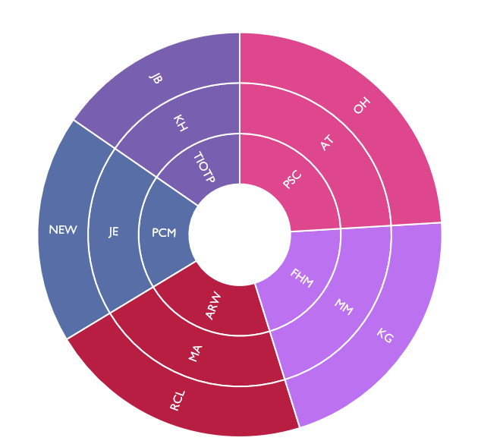
official organizational chart of the corporations and team with five-year projections of changing roles
Mongiello Holdings, LLC, The Inn of the Patriots, LLC, The US Presidential Culinary Museum, The US Presidential Service Center, Mongiello Associates Strategic Marketing, Laurel Placement, The Intercontinental Academy of Household Hotel and Resort Management (IAHHRM)
The Inn of the Patriots (TIOTP),
Presidential Service Center (PSC), American Revolutionary War Living History Center (ARWLHC), Presidential Culinary Museum (PCM), US Food History Museum (FHM)
Our primary leadership team members are: (KH) Kim Hambright, Antwain Thomas (AT), Orlando Herrera (OH), Stormy Mongiello (SM), Alexis Skidmore (AS), Marti Mongiello (MM), James Blakely (JB), Mark Anthony (MA), Lilah Blackstone, Esquire (LB), Joe Euton (JE), Renee Crichter Lyons (RCL), and Krister Gustafsson (KG). Additional support is received from Mike Mongiello, Chairperson at Mongiello Associates and several other Trustees in Los Angeles, CA, London, UK, and Washington, DC.
Continuing to operate in a wheel fashion the companies support, and are equal, to positions and fit. No one position is allowed to be better than another.
Lilah Blackstone, Esquire and Stormy Mongiello, PhD (projected finishing her PhD) would move into the role of joint-chairpersons of all companies.
LB & SM
Presented by Martin CJ Mongiello, MBA, at Lenoir Rhyne University Graduate School for Leadership attaining a second Master’s degree leading to entering a Doctorate program of marketing and data science.

Slide 4
Perception of Organizational Structure
Mongiello Holdings, LLC, The Inn of the Patriots, LLC, The US Presidential Culinary Museum, The US Presidential Service Center, Mongiello Associates Strategic Marketing, Laurel Placement, The Intercontinental Academy of Household Hotel and Resort Management (IAHHRM)
And official organizational chart of the corporations and team with five-year projections of changing roles
Mongiello Holdings, LLC, The Inn of the Patriots, LLC, The US Presidential Culinary Museum, The US Presidential Service Center, Mongiello Associates Strategic Marketing, Laurel Placement, The Intercontinental Academy of Household Hotel and Resort Management (IAHHRM)
301 Cleveland Avenue, Grover, NC 28073 704-937-2940 704-490-3947
www.theinnofthepatriots.com www.presidentialservicecenter.org www.presidentialculinarymuseum.org
Presented by Martin CJ Mongiello, MBA, at Lenoir Rhyne University Graduate School for Leadership attaining a second Master’s degree leading to entering a Doctorate program of marketing and data science.

