Slide 1
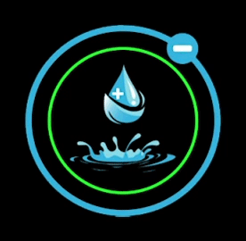

Slide 2
Benefits Of Hydrogen Water
Powerful Antioxidant
Promotes Steady Energy
Reduces Inflammation
Boosts Health at the Cellular Level

Slide 3
THE REAL ENERGY DRINK
Pre & Post - Workout Energy Drink
Promotes Quick Recovery After Workouts
Introduces Steady Energy
Reduces Chronic Inflammation
Improves Endurance
Increases Blood Flow
Complete Hydration

Slide 4
IMPROVES COGNITIVE PERFORMANCE
INCREASES FOCUS
IMPROVES MEMORY
IMPROVES SLEEP

Slide 5
Health Benefits
IMPROVES YOUR HEALTH AT THE CELLULAR LEVEL
PROMOTES A HEALTHY IMMUNE SYSTEM
FIGHTS FREE RADICAL CELLS
IMPROVES COGNITIVE FUNCTION
REDUCES STRESS LEVELS
IMPROVES YOUR MOOD

