Slide 1
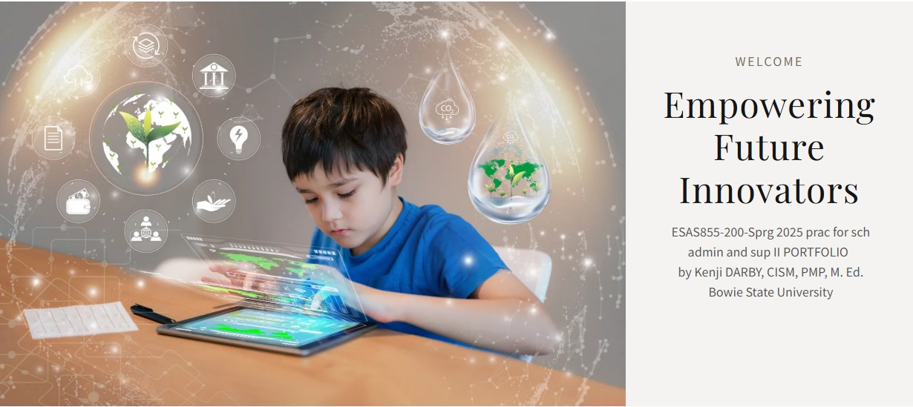
ESAS855-200-Sprg 2025 prac for sch admin and sup II PORTFOLIO by Kenji DARBY, CISM, PMP, M. Ed. darbyk0528@students.bowiestate.edu Institution: Bowie State University Title: Integrating Technology to Build Tomorrow’s STEM Workforce

Slide 2
E-PORTFOLIO by Kenji DARBY, CISM, PMP, M. Ed.
An academic portfolio demonstrating the effective application of the Educational Leadership Constituent Council (ELCC) Standards.

Slide 3
Portfolio CONTENTS
Contents
ESAS Practicum E-Portfolio Rubric Contents:
Practicum Contract
Mentor Contract
Work Hours Log
Practicum Completion Verification
Reflective Journal Entries
Action Project
E-Portfolio Additional Contents
About the Author
Professional & Academic Goals
Educational System: SME Academy (Action Project)
Educational Vision: Practicum Plan (Action Project)
ELCC Standards
ELCC Weekly Logs

Slide 4

About the author
Kenji Darby, CISM, PMP, M. Ed, Director & Technology Chair, Family and School Services/Admissions and Enrollment
My name is Kenji Darby, CISM, PMP, M. Ed, I’m a multifaceted educational professional who has significantly contributed to the world of education, literature, philanthropy, and cybersecurity. As an author, an Award-Winning Sr. Department of Defense (DoD) Cybersecurity Subject Matter Expert (SME) & Instructor, I currently serve as the Director & Technology Chair, of Family and School Services/ International Admission and Enrollment for SME Academy & Board Member of the Cybersecurity Advisory Council of Prince George’s County, Maryland, where for 15+ years I have helped shape policies and initiatives related to cybersecurity in the region. As Chairman & Instructor for the Academy Science Technology & Engineering (STEM) Program, my aspirations as an educator include providing students with supplemental STEM curricula/activities and exposure to STEM concepts.
I earned my Bachelor of Arts (BA) degree in English, a Master’s in Education (M.Ed.) in Curriculum and Instruction, a Minor (UMNR) in African American Studies at Pennsylvania State University, and a Master’s Certificate in Government Contracting at the George Washington School of Business. I also obtained Department of Defense (DoD) 8570 Approved certifications: the Certified Information Security Manager (CISM) and the Project Management Professional (PMP). My academic achievements have helped to inform my work as an Instructor at the SME Academy. My work aims to establish the curriculum and technology integration in Science Technology Engineering & Math(STEM) curricula as it has become a reality in modern education, by creating the skills that are so crucial for the fields of Science, Technology, Engineering, and Mathematics. Since the Common Core Standards lay great emphasis on problem-solving, reasoning, and application-based learning, they align hand and hand with the competency requirements for STEM. Embedding technology into the process of instruction in mathematics for better practice of theoretical knowledge and transforms the learning environment into an innovative and analytical one.​
My research has shown that technology integration improves student engagement, enhances conceptual understanding, and fosters a growth mindset. This aligns with Bandura’s Social Learning Theory. Furthermore, since STEM industries continue to drive global innovation, Common Core Mathematics aligns well with technology to ensure that graduates can meet the demands for a rapidly changing workforce. This is supported by not only performance data but also engagement metrics.

Slide 5
Professional & Academic Goals
Kenji Darby, CISM, PMP, M. Ed, Professional & Academic Goals
Professional Goals:
Academic Goals:
As the Chief Executive Officer (CEO) of Omnisource Consulting, Inc. My goal is to acquire lucrative STEM contracts in 2025 through the United States.
As an Author and Chairman of a STEM Program, my goal is to publish (4) STEM Books & or curriculum programs in collaboration with SME Academy in 2025.
As a Board Member of the Cybersecurity Advisory Council of Prince George’s County, Maryland, I desire to expand policies and initiatives related to cybersecurity in the region.
Earn acceptance into Bowie State University Ph.D. program by 2025
Become a Bowie State Professor by 2030

Slide 6

ACTION Project 1 Educational SYSTEM Overview: SME Academy Grades: 7-12 (Pre-College) Population %: Black-41% Hispanic-32% Asian- 4% White-22% Other-1% Affiliate: SME Cyber LLC
Overview: SME Academy Mission & Vision
SME Academy
The mission of SME Academy is to foster innovation, problem-solving, and critical thinking in the field of cybersecurity. Our program equips students with the education, training, and essential skillsets needed to earn industry-recognized certifications, preparing them for successful careers in cybersecurity.
Vision: We believe early Exposure will broaden student participation and equip any youth who wishes to join the future STEM endeavors and workforce.

Slide 7

ACTION Project 1 Educational SYSTEM Overview: SME Academy Grades: 7-12 (Pre-College) Population %: Black-41% Hispanic-32% Asian- 4% White-22% Other-1% Affiliate: SME Cyber LLC
GOALS: SME Academy
The Goal of the SME Academy is to provide diversified experiences for students in the STEM disciplines. We believe in (4) Pillars; Collaboration, Early Exposure, Cultivation, and Building.
Collaborate: Our goal is to collaborate with the STEM Subject Matter Experts (SME). We provide pre-college students (6-12) with supplemental STEM curricula/activities and exposure to STEM concepts to emphasize the importance of STEM education and how it will improve employment options for high school and college graduates in an economy that is increasingly based on Science and Information Technology.
Early Exposure: Program collaboration will broaden student participation and equip any youth who wishes to join the future STEM endeavors and workforce,
Cultivating Pre-College Students who have a strong interest in mathematics, the natural sciences, and technology are trained to enter the education profession and become STEM teachers
Building and strengthening the STEM workforce at the regional and national level is a major priority for life sciences companies seeking a skilled diverse workforce.

Slide 8
Action Project 2: EDUCATIONAL VISION PRACTICUM PLAN
Statement of Purpose: The purpose of this practicum is to gain hands-on experience in educational leadership and administration. I am to develop a deeper understanding of school operations, leadership and decision-making processes at the administrative level. This experience will allow me to build on my background as an educator by allowing me the opportunity.
Goals:
To gain practical experience in school administration by working closely with school administration.
To develop leadership skills that align with the leadership standards, focusing on instructional leadership, school management, and community engagement.
To understand the process of data-driven decision making and its ability to improve student outcomes and school operations.
Description of Activities: The major activities of my practicum will involve working closely with the administration to oversee and participate in various administrative tasks. Some of these key tasks are;
Attending leadership meetings and contributing to discussions on school operations. 2.Assisting with analyzing student performance data and helping to create action plans for instructional improvement.
Participating in parent and community meetings to better understand the role of school leadership in fostering family and community engagement.
Assisting in administrative tasks such as managing school operations and staff/ student management.
Evaluation: The following criteria will be used to evaluate whether or not my practicum goals were achieved:
Completion of 150 experience hours that will be documented through a log.
Regular feedback from my mentor that assesses my progress in the key areas of my experience.
Reflective journals to show my understanding of school administration and how my experiences relate to my coursework. A practicum portfolio that summarizes my experiences and contributions to the school.

Slide 9
ISSLC Standards
The Interstate School Leaders Licensure Consortium
(ISSLC Standards)
Standard 1: An educational leader promotes the success of every student by facilitating the development, articulation, implementation, and stewardship of a vision of learning that is shared and supported by all stakeholders.
Standard 2: An educational leader promotes the success of every student by advocating, nurturing, and sustaining a school culture and instructional program conducive to student learning and staff professional growth.
Standard 3: An educational leader promotes the success of every student by ensuring management of the organization, operations, and resources for a safe, efficient, and effective learning environment.
Standard 4: An educational leader promotes the success of every student by collaborating with faculty and community members, responding to diverse community interests and needs, and mobilizing community resources.
Standard 5: An educational leader promotes the success of every student by acting with integrity, fairness, and in an ethical manner.
Standard 6: An educational leader promotes the success of every student by understanding, responding to, and influencing the political, social, economic, legal, and cultural context.

Slide 10
ELCC Leadership Standards
The Interstate School Leaders Licensure Consortium
(ELCC Standards)
ELCC Standard 1.0: A building-level education leader applies knowledge that promotes the success of every student by collaboratively facilitating the development, articulation, implementation, and stewardship of a shared school vision of learning through the collection and use of data to identify school goals, assess organizational effectiveness, and implement school plans to achieve school goals; promotion of continual and sustainable school improvement; and evaluation of school progress and revision of school plans supported by school-based stakeholders.
ELCC Standard 2.0: A building-level education leader applies knowledge that promotes the success of every student by sustaining a school culture and instructional program conducive to student learning through collaboration, trust, and a personalized learning environment with high expectations for students; creating and evaluating a comprehensive, rigorous and coherent curricular and instructional school program; developing and supervising the instructional and leadership capacity of school staff; and promoting the most effective and appropriate technologies to support teaching and learning within a school environment.
ELCC Standard 3.0: A building-level education leader applies knowledge that promotes the success of every student by ensuring the management of the school organization, operation, and resources through monitoring and evaluating the school management and operational systems; efficiently using human, fiscal, and technological resources in a school environment; promoting and protecting the welfare and safety of school students and staff; developing school capacity for distributed leadership; and ensuring that teacher and organizational time is focused to support high-quality instruction and student learning.

Slide 11
ELCC Standards Continued.
(ELLC Standards)
ELCC Standard 4.0: A building-level education leader applies knowledge that promotes the success of every student by collaborating with faculty and community members, responding to diverse community interests and needs, and mobilizing community resources on behalf of the school by collecting and analyzing information pertinent to improvement of the school’s educational environment; promoting an understanding, appreciation, and use of the diverse cultural, social, and intellectual resources within the school community; building and sustaining positive school relationships with families and caregivers; and cultivating productive school relationships with community partners.
ELCC Standard 5.0: A building-level education leader applies knowledge that promotes the success of every student by acting with integrity, fairness, and in an ethical manner to ensure a school system of accountability for every student’s academic and social success by modeling school principles of self-awareness, reflective practice, transparency, and ethical behavior as related to their roles within the school; safeguarding the values of democracy, equity, and diversity within the school; evaluating the potential moral and legal consequences of decision making in the school; and promoting social justice within the school to ensure that individual student needs inform all aspects of schooling.
ELCC Standard 6.0: A building-level education leader applies knowledge that promotes the success of every student by understanding, responding to, and influencing the larger political, social, economic, legal, and cultural context through advocating for school students, families, and caregivers; acting to influence local, district, state, and national decisions affecting student learning in a school environment; and anticipating and assessing emerging trends and initiatives to adapt school-based leadership strategies.
ELCC Standard 7.0: A building-level education leader applies knowledge that promotes the success of every student through a substantial and sustained educational leadership internship experience that has school-based field experiences and clinical internship practice within a school setting and is monitored by a qualified, on-site mentor.

Slide 12
Application of ELCC Standards .
Application of the Educational Leadership Constituent Council (ELCC) Standards.
Throughout my 12-week practicum experience, I have developed a comprehensive plan for SME Academy to communicate the school's mission & vision to the appropriate school constituencies (ELCC 1.1) which included all of the stakeholders (Staff, Teachers, Students, Parents, etc.). In addition, I also developed a curriculum and a program that incorporated cultural competence using instructional practices (ELCC2.1).
The educational dilemma that I chose to target was the lack of representation of minorities in the subjects of Science Technology Engineering and Math (STEM). I spent the next (12) weeks formulating strategies & developing collaboration to address this dilemma (ELCC 5.4), and to develop curriculum and programs based on students’ identity by building learning communities, conducting research and learning opportunities, while also providing career-related mentoring, including presenting and attending conferences on science, technology, engineering and mathematics (STEM).

Slide 13
Contracts & Practicum Completion Verification
Educational Leadership Practicum Handbook for School Administration and Supervision
Practicum Contract
Mentor Contract
Practicum Completion Verification
Control Key + Click the link to view all contracts.
Contracts & Practicum Completion Verification

Slide 14
ELLC Weekly LOGS & REFLECTIONs
Educational Leadership Constituent Council (ELCC) Weekly Logs and Reflection
ELCC Program Standard 1.0
ELCC Program Standard 2.0
ELCC Program Standard 3.0
ELCC Program Standard 4.0
ELCC Program Standard 5.0
ELCC Program Standard 6.0
ELCC Program Standard 7.0
Control Key + Click the link to view logs & reflections.
ELLC Weekly Logs & Reflections

Slide 15

Implementing Solutions
Instructional Maintenance and Improvement
Professional Development and Services
Pupil Development and Services
Administration of Facilities and Finance
Organizational Relationships and Services

Slide 16
Cybersecurity Workforce Development and Training for Underserved Communities Program Overview of (ELCC) Implementation for 12 weeks
ELCC STANDARD ELEMENTS: Colloaborating, Developing, implement a shared vision for the School.
ELCC 1.1: Candidates understand and can collaboratively develop, articulate, implement, and steward a shared vision of learning for a school.
ELCC 1.2: Candidates understand and can collect and use data to identify school goals, assess organizational effectiveness, and implement plans to achieve school goals.
ELCC 1.3: Candidates understand and can promote continual and sustainable school improvement.
ELCC 1.4: Candidates understand and can evaluate school progress and revise school plans supported by school stakeholders.
Cybersecurity Workforce Development and Training for Underserved Communities Program.
Over this 12-week duration, I worked with the SME Academy to develop STEM curriculum and Workforce Development Training for students Underserved Communities (CWD) program addresses the cyber workforce shortage through outreach to and hands-on training for potential cyber staff of all ages. By utilizing cooperative agreements with community-based, non-profit organizations, the program helps individuals develop their cyber skills through entry-level training and apprenticeship programs.
Since the program focuses on the aptitude of the individuals rather than their educational background, The SME Academy is helping to support workforce development across traditionally underserved communities, and students of color.
The program also supports the innovative to training and recruitment of cyber professionals, to increase diversity across the cyber workforce. This provides different perspectives, which can enable cyber professionals to tackle cyber issues from new angles and can help achieve many of the goals of the Diversity, Equity, Inclusion, Accessibility (DEIA) Executive Order.

Slide 17
Cybersecurity Workforce Development and Training for Underserved Communities Program STRATEGY
ELCC STANDARD ELEMENTS: Collaborating, Developing, and implementing a shared vision for the School.
ELCC 1.1: Candidates understand and can collaboratively develop, articulate, implement, and steward a shared vision of learning for a school.
ELCC 1.2: Candidates understand and can collect and use data to identify school goals, assess organizational effectiveness, and implement plans to achieve school goals.
ELCC 1.3: Candidates understand and can promote continual and sustainable school improvement.
ELCC 1.4: Candidates understand and can evaluate school progress and revise school plans supported by school stakeholders.
The Cybersecurity Workforce Development and Training for Underserved Communities (CWD) program aims to:
Develop and implement a comprehensive strategy that establishes lanes to develop and retain cybersecurity professionals
Decrease the cybersecurity workforce shortage by placing graduates into entry-level roles
Deliver entry-level cybersecurity training to prospective talent from nontraditional places
Provide hands-on and professional development experience through apprenticeships

Slide 18

Research & StATICS

Slide 19
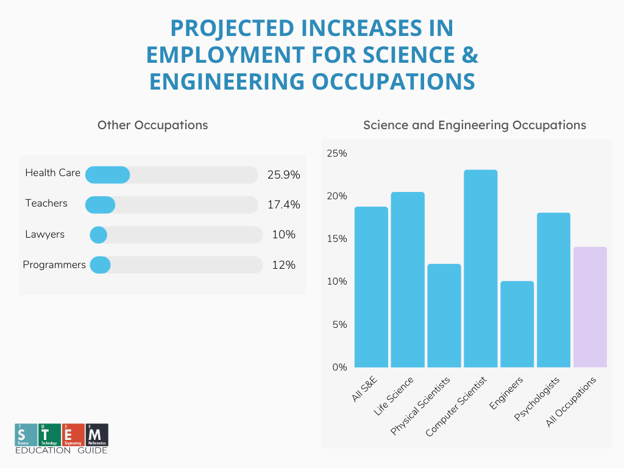
Week 1 REFLECTION: Educational Leadership Constituent Council (ELCC) Standard (1.1), (2.1),(5.4),(2.2),(4.3). Over 10.2 million people work in a STEM field in the US as of 2020. STEM jobs are projected to grow 8.8% between 2017 and 2029.
I developed a draft comprehensive plan for SME Academy to communicate the school's mission & vision to the appropriate school constituencies (ELCC 1.1) which included all of the stakeholders (Staff, Teachers, Students, Parents, etc.). In addition, I also developed a draft curriculum and a program that incorporated cultural competence using instructional practices (ELCC2.1).
The educational dilemma that I chose to target was the lack of representation from minorities in the subjects of Science Technology Engineering and Math (STEM). I spent this week formulating strategies to address the dilemmas (ELCC 5.4), and im starting to draft curriculum and programs based on students’ identities by building learning communities and conducting research and learning opportunities.

Slide 20
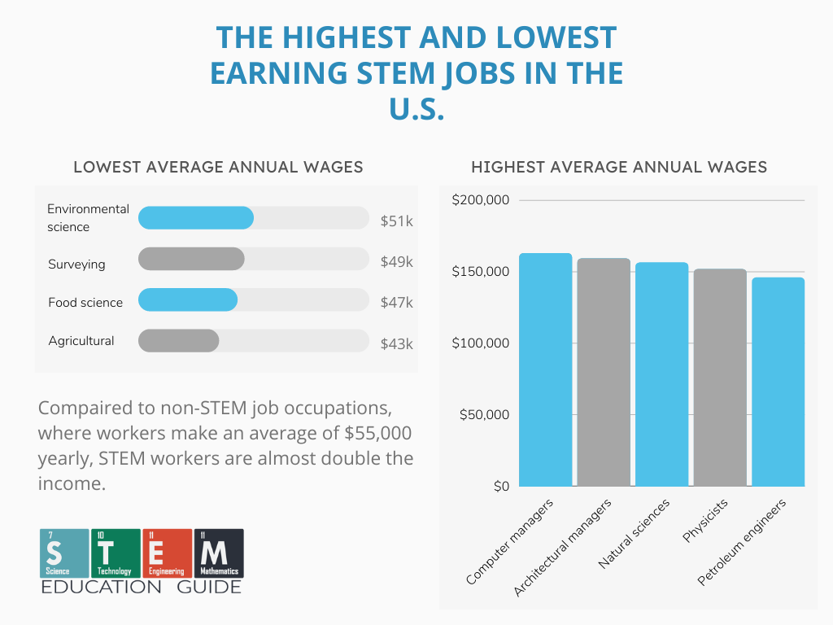
Week 2 REFLECTION: Educational Leadership Constituent Council (ELCC) Standard (1.1), (2.1),(5.4),(2.2),(4.3) STEM undergraduate degrees generated larger graduate premiums for individuals and the public purse than non-STEM subjects
Continue to develop a draft comprehensive plan for SME Academy to communicate the school's mission & vision to the appropriate school constituencies (ELCC 1.1) which included all of the stakeholders (Staff, Teachers, Students, Parents, etc.). In addition, I also developed a draft curriculum and a program that incorporated cultural competence using instructional practices (ELCC2.1). I drafted school-based measures to measure performance.
I spent this week formulating strategies to address the dilemmas (ELCC 5.4), and im starting to draft curriculum and programs based on students’ identities by building learning communities and conducting research and learning opportunities

Slide 21

Week 3 REFLECTION: Educational Leadership Constituent Council (ELCC) Standard (1.1), (2.1),(5.4),(2.2),(4.3) In July-September 2022, 2.8 million people were employed in professional scientific and technical occupations in the UK, representing approximately 8.5% of a total workforce of 32.7 million
I completed a comprehensive plan for SME Academy to communicate the school's mission & vision to the appropriate school constituencies (ELCC 1.1) which included all of the stakeholders (Staff, Teachers, Students, Parents, etc.). In addition, I also developed a curriculum and a program that incorporated cultural competence using instructional practices (ELCC2.1).
I Implemented research to target the lack of representation from minorities in the subjects of Science Technology Engineering and Math (STEM). I continued to draft and collaborate on strategies to address the lack of minority representation (ELCC 5.4),to develop curriculum and programs based on students’ identity by building learning communities, conducting research and learning opportunities. I worked 1 on 1 with students this week, and provided career-related mentoring. I also attended my first school board meeting

Slide 22

Week 4 REFLECTION: Educational Leadership Constituent Council (ELCC) Standard (1.1), (2.1),(5.4),(2.2),(4.3). The average salary for all STEM workers is $100,900. Compared to other non-STEM job occupations where workers make an average of $55,000 a year.
I worked with the administration staff to discuss ideas on how to implement a communication strategy and plan to communicate the school's mission & vision to the appropriate school constituencies (ELCC 1.1) which included all of the stakeholders (Staff, Teachers, Students, Parents, etc.). I also worked with the IT Department. I continued to develop a curriculum and a program that incorporated cultural competence using instructional practices while incorporating technology specifically computer-based learning (ELCC2.1). In addition, I continued to implement research based on my supervisor's feedback.
I spent this week continuing to develop curriculum and programs based on students’ identities by building learning communities and conducting research and learning opportunities. while also providing career-related mentoring, including presenting and attending conferences on science, technology, engineering, and mathematics (STEM).

Slide 23
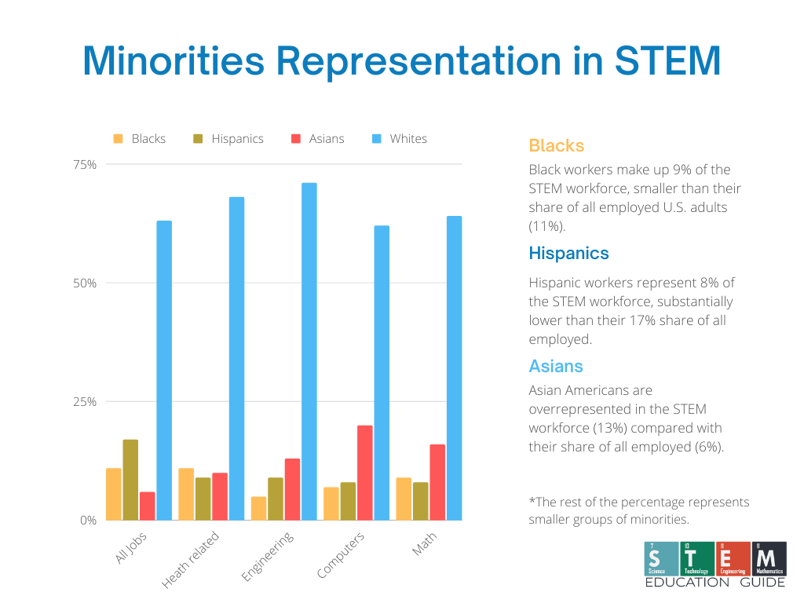
Week 5 REFLECTION: Educational Leadership Constituent Council (ELCC) Standard (1.1), (2.1),(5.4),(2.2),(4.3). The average median hourly wage for STEM jobs is $38.85 the median earnings for all other types of jobs in the US – $19.30.
I worked with the administration staff to discuss ideas on how to implement a communication strategy and plan to communicate the school's mission & vision to the appropriate school constituencies (ELCC 1.1) which included all of the stakeholders (Staff, Teachers, Students, Parents, etc.). I also worked with the IT Department. I continued to develop a curriculum and a program that incorporated cultural competence using instructional practices while incorporating technology specifically computer-based learning (ELCC2.1).
I spent this week continuing to develop curriculum and programs based on students’ identities by building learning communities and conducting research and learning opportunities. while also providing career-related mentoring, including presenting and attending conferences on science, technology, engineering, and mathematics (STEM).

Slide 24

SOLUTION BASED APPROACH

Slide 25
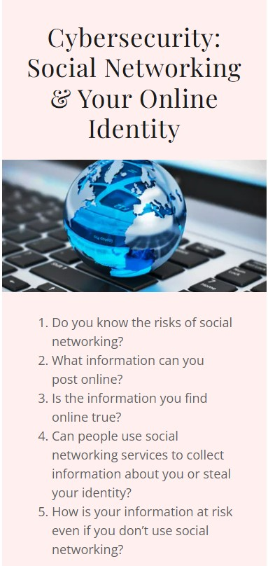
Week 6 REFLECTION: Educational Leadership Constituent Council (ELCC) Standard (1.1), (2.1),(5.4),(2.2),(4.3). The USA is only 38th of 71 countries in Math and 24th in Science This statistic is from the Program for International Student Assessment (PISA).
This week, I continued to work with the administration staff to discuss ideas on how to implement a communication strategy and plan to communicate the school's mission & vision to the appropriate school constituencies (ELCC 1.1) which included all of the stakeholders (Staff, Teachers, Students, Parents, etc.). I also worked with the IT Department to formulate messages of social media. I completed a STEM curriculum based on Cybersecurity: Social Media & Your Online Identity. I continued to develop a program that incorporated cultural competence using instructional practices while incorporating technology specifically computer-based learning (ELCC2.1).
I continued to develop curriculum and programs based on students’ identities by building learning communities and conducting research and learning opportunities. I also providing career-related mentoring in addition to talking with parents this week during parent-teacher conferences.

Slide 26
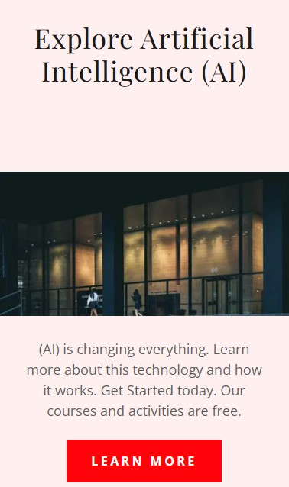
Week 7 REFLECTION: Educational Leadership Constituent Council (ELCC) Standard (1.1), (2.1),(5.4),(2.2),(4.3). According to the National Math and Science Initiative, only 36% of students are ready for college-level science courses.
This week, I continued to work with the administration staff to discuss ideas on how to implement a communication strategy and plan to communicate the school's mission & vision to the appropriate school constituencies (ELCC 1.1) which included all of the stakeholders (Staff, Teachers, Students, Parents, etc.). I also worked with the IT Department to formulate messages of social media.. I completed a STEM curriculum based I continued on Cybersecurity: Explore Artificial Intelligence (AI). to develop a program that incorporated cultural competence using instructional practices while incorporating technology specifically computer-based learning (ELCC2.1).
I continued to develop curriculum and programs based on students’ identities by building learning communities and conducting research and learning opportunities. I also provide career-related mentoring in addition to talking with community members.

Slide 27
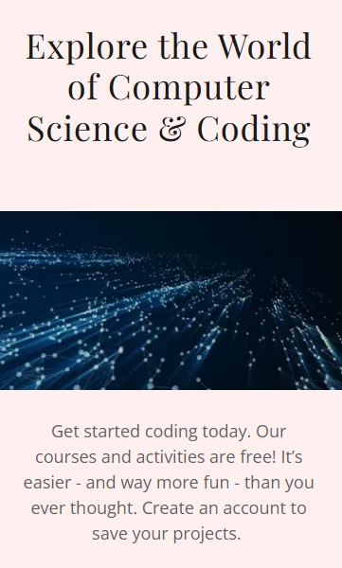
Week 8 REFLECTION: Educational Leadership Constituent Council (ELCC) Standard (1.1), (2.1),(5.4),(2.2),(4.3). While only 36% of students are ready for college science, 44% of high school students are prepared for college-level math
This week, I continued to work with the administration staff to discuss ideas on how to implement a communication strategy and plan to communicate the school's mission & vision to the appropriate school constituencies (ELCC 1.1) which included all of the stakeholders (Staff, Teachers, Students, Parents, etc.). I also worked with the IT Department to create virtual-based learning to help students learn at self-paced. I completed a STEM curriculum based on Cybersecurity: Explore the World of Computer Science & Coding. I continued to develop a program that incorporated cultural competence using instructional practices while incorporating technology specifically computer-based learning (ELCC2.1).
I continued to develop curriculum and programs based on students’ identities by building learning communities and conducting research and learning opportunities. I also provide career-related mentoring in addition to talking with community members as well as attending a school meeting. I also incorporated research.

Slide 28

Solution based Approach that also supports the community – Developing a STEM workforce

Slide 29
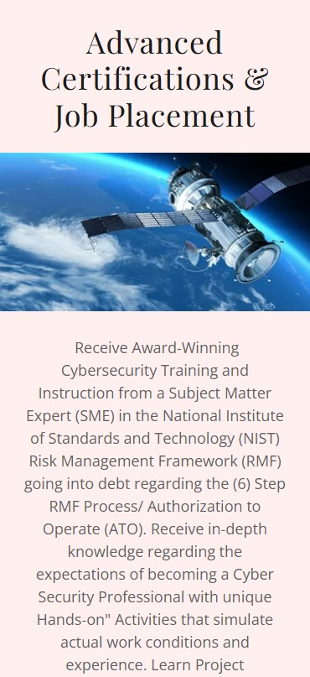
Week 9 REFLECTION: Educational Leadership Constituent Council (ELCC) Standard (1.1), (2.1),(5.4),(2.2),(4.3). Black workers make up 9% of the STEM workforce, smaller than there share of all employed U.S. adults (11%)
This week worked to update the school's website and also I developed the school's goals, and informed the appropriate school constituencies (ELCC 1.1) which included all of the stakeholders (Staff, Teachers, Students, Parents, etc.). I also worked with the IT Department to create virtual-based learning to help students learn self-paced. I developed a STEM curriculum based on the Cybersecurity Certification Program in collaboration with SME Cybersecurity the NGO Community Partner. I developed this program to engage the students by parents as well. I continued to develop a program that incorporated cultural competence using instructional practices while incorporating technology specifically computer-based learning (ELCC2.1).
I continued to develop curriculum and programs based on students’ identities by building learning communities and conducting research and learning opportunities. I also provide career-related mentoring in addition to talking with community members as well as attending a school meeting. I also incorporated research.

Slide 30

Week 10 REFLECTION: Educational Leadership Constituent Council (ELCC) Standard (1.1), (2.1),(5.4),(2.2),(4.3). Hispanics workers represent 8% of STEM workforce, substantially lower than their 17% of all employed
This week worked to update the school's website and also I developed the school's goals, and informed the appropriate school constituencies (ELCC 1.1) which included all of the stakeholders (Staff, Teachers, Students, Parents, etc.). I also worked with the IT Department to create virtual-based learning to help students learn self-paced. I developed a STEM curriculum based on the Cyber Work Force in collaboration with SME Cybersecurity the NGO Community Partner.This program would not only engage the students but parents as well. I continued to develop a program that incorporated cultural competence using instructional practices while incorporating technology specifically computer-based learning (ELCC2.1).
I continued to develop curriculum and programs based on students’ identities by building learning communities and conducting research and learning opportunities. I also provide career-related mentoring in addition to talking with community members as well as attending a school meeting. I also incorporated research.

Slide 31
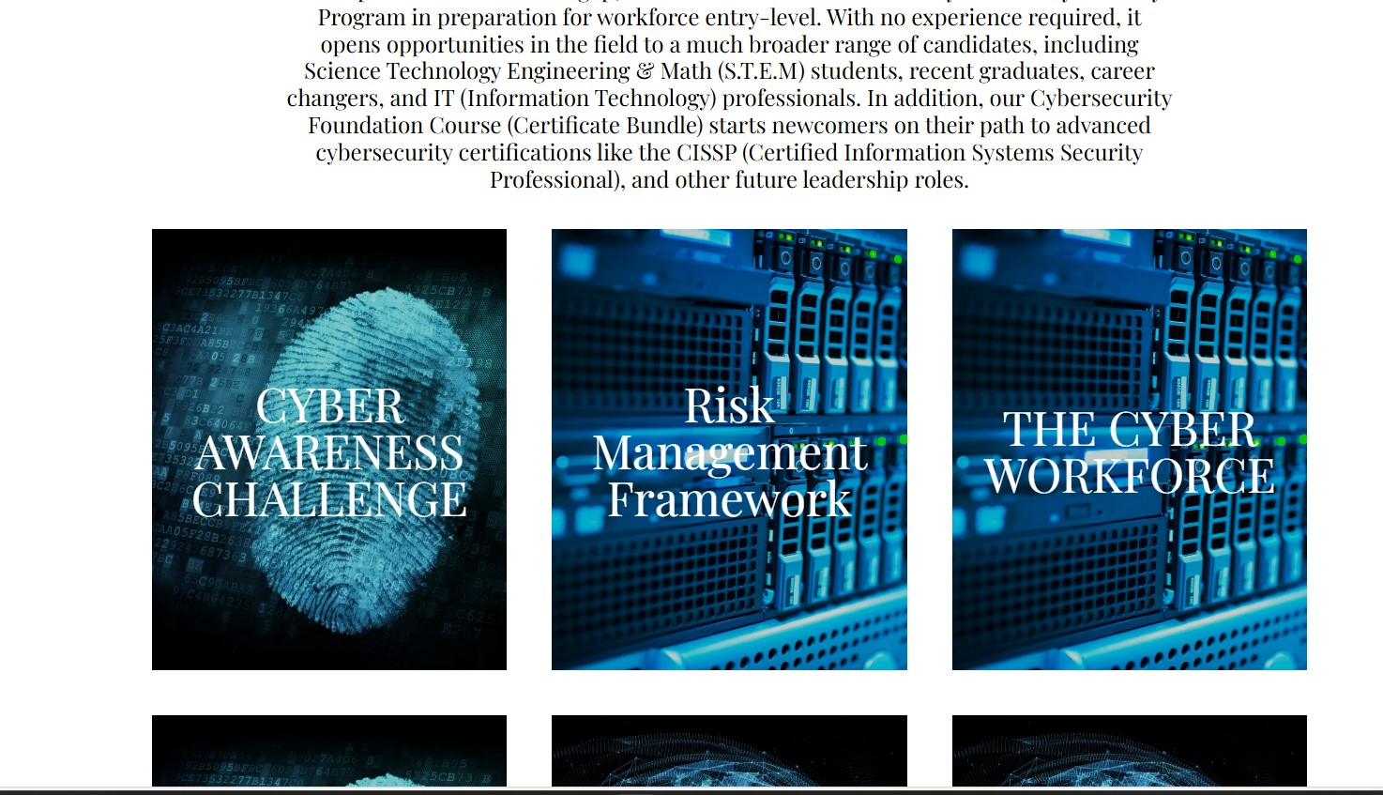
Week 12 REFLECTION: Educational Leadership Constituent Council (ELCC) Standard (1.1), (2.1),(5.4),(2.2),(4.3). 71% of Engineers are White, Blacks and Hispanics Receive The least Amount of STEM Degrees.
Throughout my practicum experience, I developed a comprehensive plan for SME Academy to communicate the school's mission & vision to the appropriate school constituencies (ELCC 1.1) which included all of the stakeholders (Staff, Teachers, Students, Parents, etc.). In addition, I also developed a curriculum and a program that incorporated cultural competence using instructional practices (ELCC2.1).
The educational dilemma that I chose to target was the lack of representation from minorities in the subjects of Science Technology Engineering and Math (STEM). I spent the next several weeks formulating strategies to address the dilemmas (ELCC 5.4), and to develop curriculum and programs based on students’ identity by building learning communities, conducting research and learning opportunities, while also providing career-related mentoring, including presenting and attending conferences on science, technology, engineering and mathematics (STEM)

Slide 32
METRICS of PROGRAM SUCCESS
METRIC | MEASUREMENT | TARGET | ACTUAL
Student attendance | # of attendees | 150 | 120
Engagement duration | Minutes | 60 | 75
Number of Programs | # of Programs | 5 | 5
Positive feedback | Percentage (%) | 90 | 95
Rate of information retention | Percentage (%) | 100 | 95
Cybersecurity STEM Program Development

Slide 33

Thank you
Kenji Darby, CISM, PMP,M. Ed​​
202-577-6279​
kenji@omnisource.info​
www.Omnisource.info​

