Slide 1
Welcome to
the 2024 Volunteer Conference
GROW YOUR TROOP

Slide 2
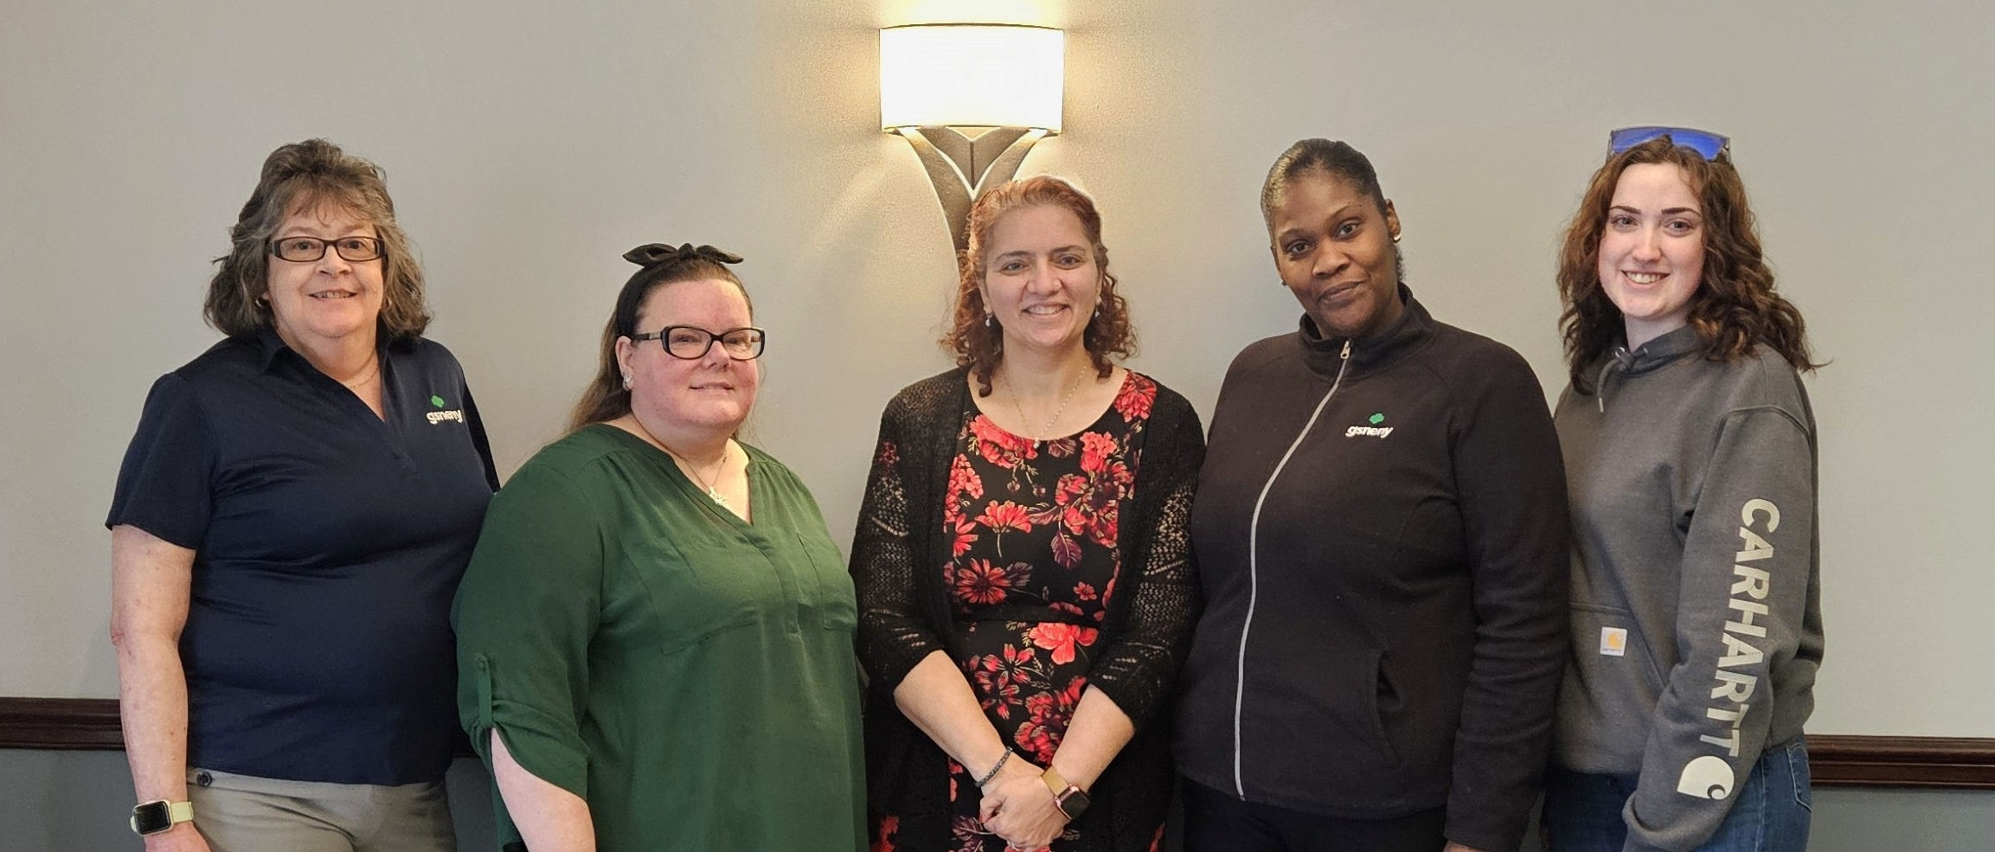
The Volunteer Service Team would like to Thank you for attending the
2024 Volunteer Conference!
Notes:
Team photo…Pictured: Cyndi, Kara, Meena, Renee and Bri.

Slide 3
Welcome to
GROW YOUR TROOP
What’s even more fun than a new year of Girl Scouts?
Welcoming new girls to your troop!
Notes:
Welcome everyone to Grow your troop session!

Slide 4
GROW YOUR TROOP
In this session we will be talking about ways to grow your troop!
*Girl Members
*Adult Members
*Lifetime Members
Notes:
We will be breaking the agenda into two sections.
First, we will be talking about ways to increase girl members
than adult members which can include LTM
Do you want to expand your girls’ network and bring new voices and perspectives into their world?
Consider welcoming more girls into your troop!
Growing your troop is a great way to share the power of the Girl Scout experience.
And in the spirit of sisterhood, you’ll help your girls make new friends (and keep the old).
So, if you’re ready to introduce more girls to Girl Scouting, what’s the best way to get the word out?

Slide 5
What are some of the ways to
invite girls to your troop?
*List your troop in the Opportunity Catalog.
Open more available membership spots for your troop.
*Distribute and post flyers at schools and in your community.
*Share troop openings on social media.
*Girls can invite one or multiple girls with an invitation. (like a Birthday Party Invitation)
*Bring a friend.
(maybe both girls get a patch or something small)
There will be time
Notes:
What are some of the ways to get the word out about joining your troop?
There are many, but today we are focusing on 5! Read the slide.
Most of these steps are self explanatory but I would like to dive a little deeper into the Opportunity catalog by showing the 6 easy steps you can take to update your troop.

Slide 6
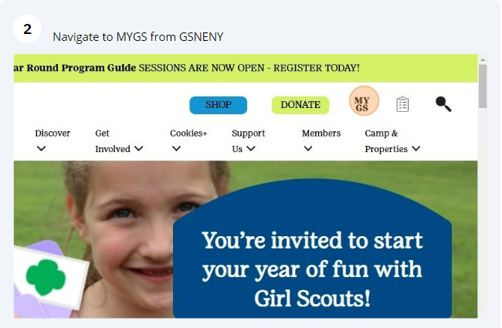
How To Save Changes in Troop Management System
Log onto….https://www.girlscoutsneny.org/
Notes:
Ask for a raise of hands…Does everyone know what the opportunity catalog is and how to access it in the Volunteer Tool Kit?
Let's review the 6 easy steps with some screen shots.
1. Log onto GSNENY website
https://www.girlscoutsneny.org/
2. Go to MYGS (shown in upper right with a pink circle on this slide

Slide 7
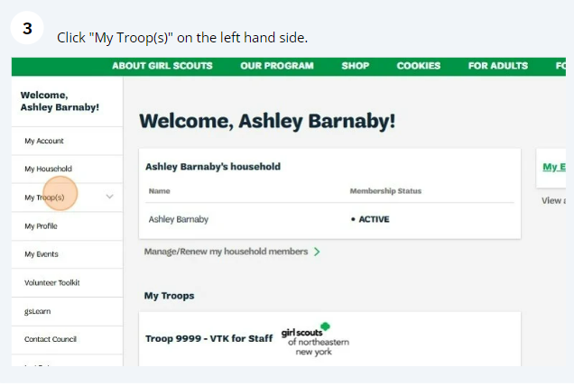
Notes:
3. Click on my troops on the left-hand side, noted with a pink circle.
All your troops that you are the leader for will appear

Slide 8
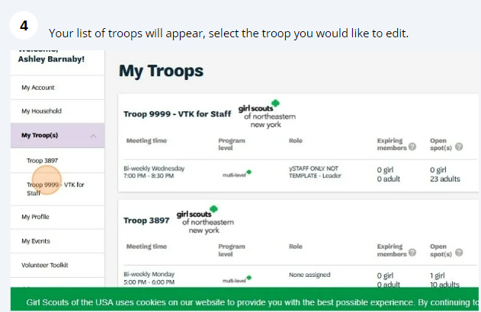
Notes:
4. Click on which troop you would like to edit

Slide 9
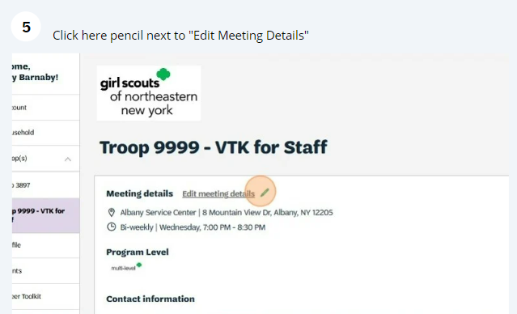
Notes:
5. Click the pencil next to meeting details (highlighted above in pink circle)

Slide 10
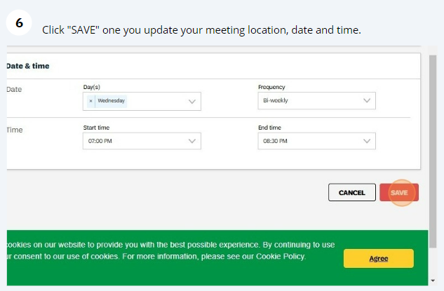
Notes:
6. Update info for:
Day
Frequency
Start time
End time
To increase # of girls and adult spots available in your troop email the Customer Care Department or your recruiter.
There are thousands of girls all over the country waiting to find the perfect troop, and likely hundreds right in your area?
We need to do our part to help these girls find their homes in Girl Scouts!
The is the perfect way to tell new members about what your troop likes to do and what makes you, you.
You fill in all the details about the age levels of your girls,
when you meet,
and what kinds of activities you enjoy,
which helps new Girl Scouts and volunteers find their perfect match.

Slide 11
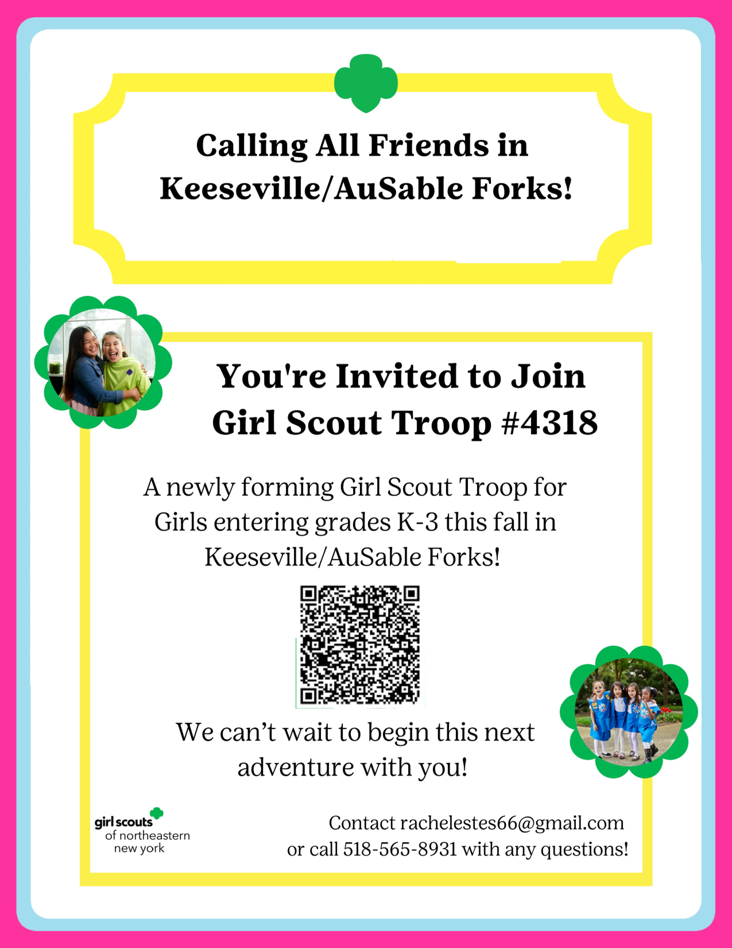

Create & Distribute
Fliers
*Email your Membership Recruiter Specialist with the information wanted on your flier and they will create one with a QR code.
*Call schools and ask them if they will send or post the flier inviting girls to your troop or an event. (Find out which format is best, printed copies or email for them to post on Parent Square).
*Post flier on bulletin boards in your community.
*Share it on social media individual and community pages
Notes:
What’s one of the most effective recruiting techniques, according to our volunteer experts?
Being present at schools and other places where girls in your community assemble.
Putting a “face” to the troop is very impactful.
You can also encourage the girls to speak up at or outside of recruitment events!

Slide 12
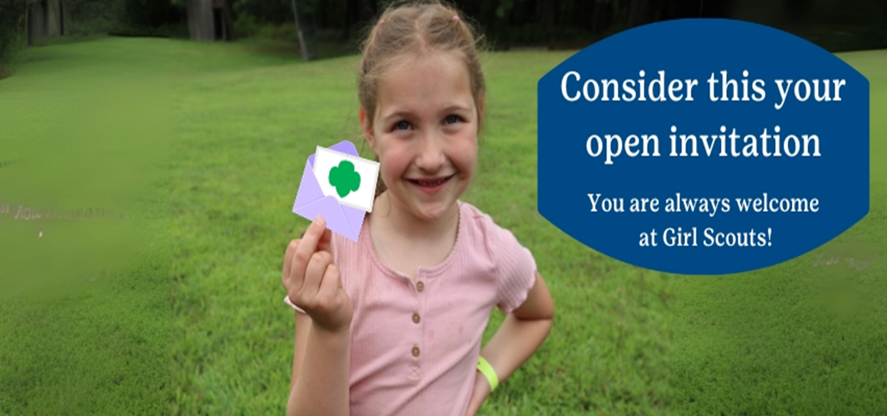
Studies show Girls love to be invited to events and parties!
Notes:
Some think they must be invited to join Girl Scouts.
We have 3 different style invitations you can use with your existing girls in your troop and ask them to invite a non- member friend
Maybe the girl recruiting can get a patch or small token of appreciation.

Slide 13
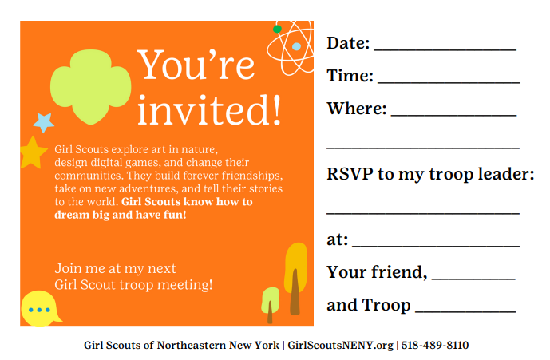
Bring a Friend invitation
Notes:
This is one sample of the invitation available for you to use….of course, your girls can make their own also.
We have handouts, you can also reach out to your Membership Recruiter Specialist for an emailed copy.

Slide 14
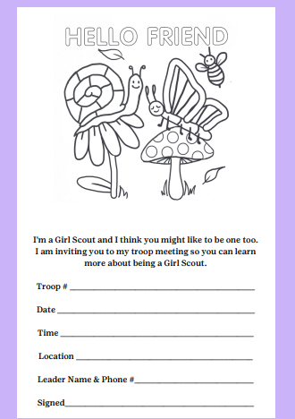

Notes:
This is another format of another invitation available for you to use…. This one has a coloring activity

Slide 15
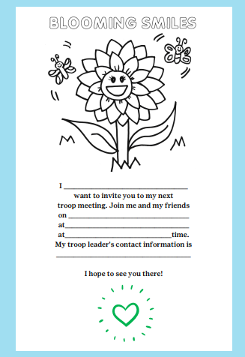

Notes:
This is another sample of the invitation available for you to use…. Wording is a little different from the previous one.

Slide 16
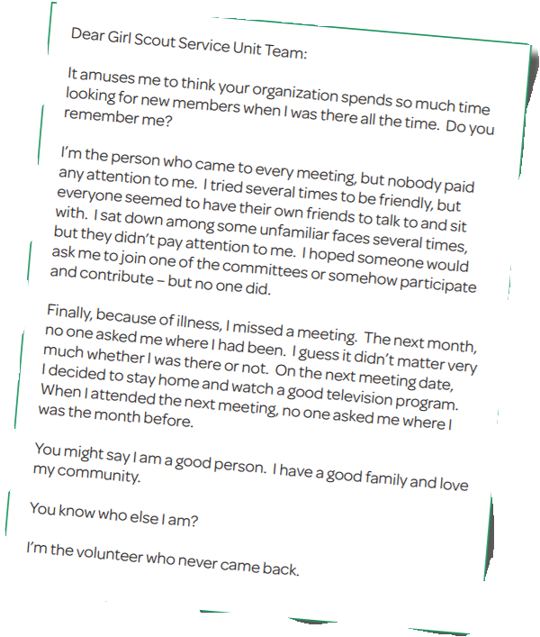

WAYS ADULTS CAN HELP
Gather information about them!
Parent/Caregivers want to volunteer but most are never asked.
Notes:
After all, new members bring fresh ideas,
different ways of looking at things,
and excitement that can spark creativity and energize everyone.
Plus, introducing new friends to Girl Scouting allows existing members to flex their leadership skills and build confidence.
Basically, everybody wins!
Read the letter above

Slide 17
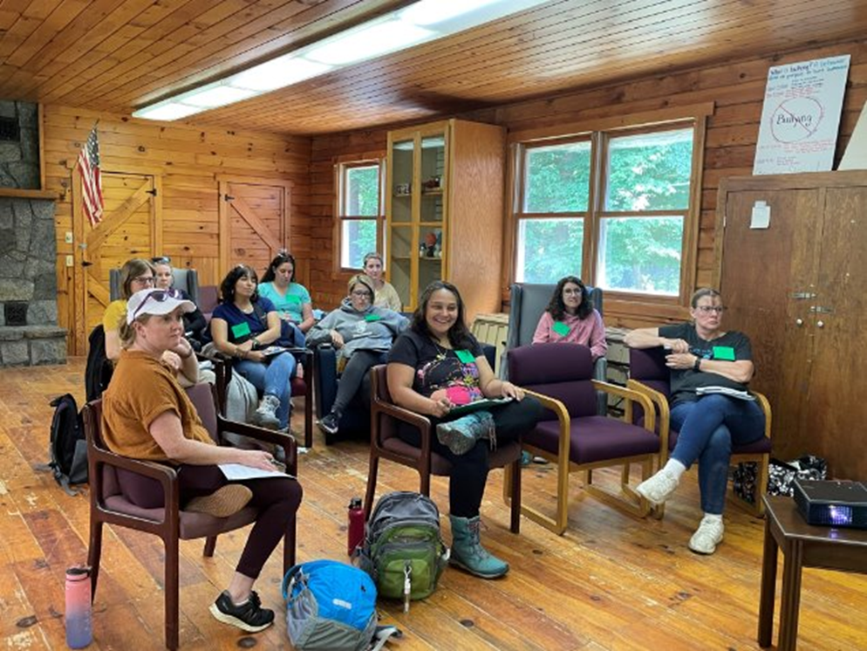
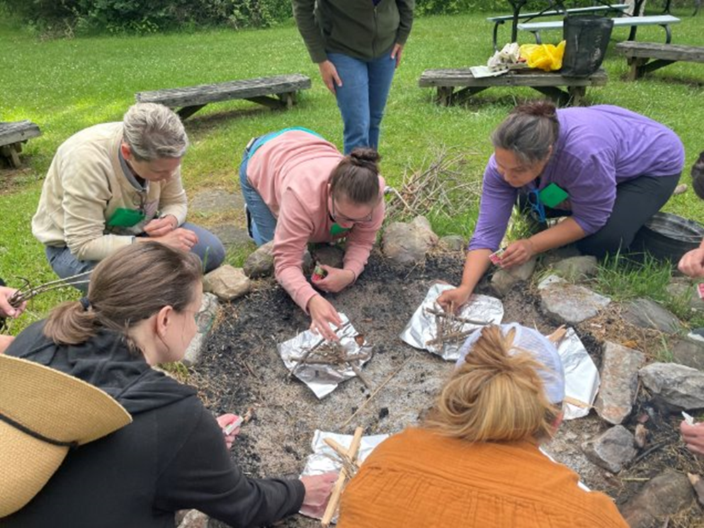
Notes:
A few pictures of volunteers from outdoor education learning new skills so their troop can share more adventures with the girls.

Slide 18
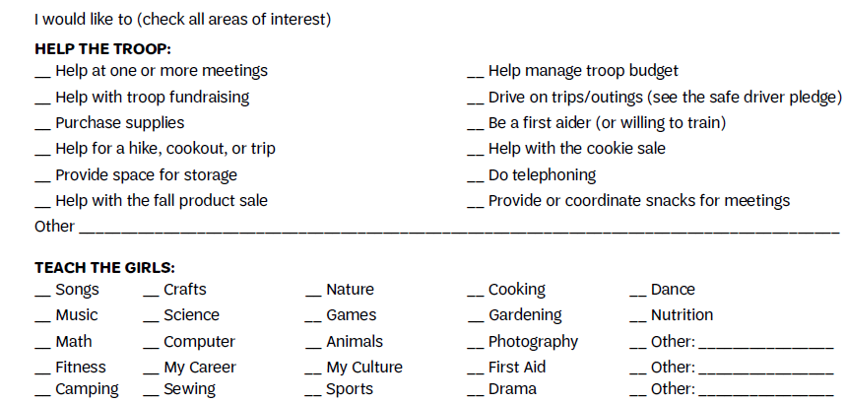
Notes:
Each troop needs the help of adults to provide a quality Girl Scout experience.
This section pictured on this slide is on the Ways Adults Can Help form.
Handout is available

Slide 19
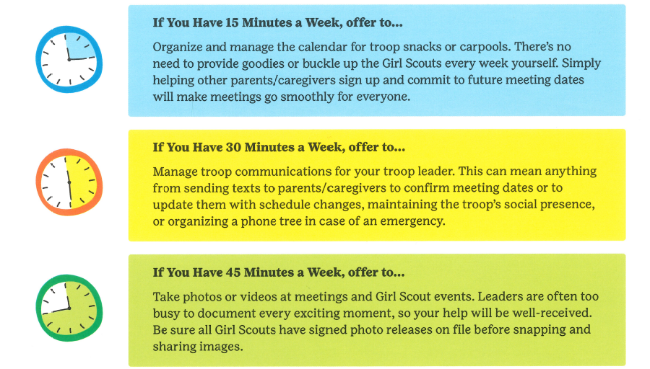
Notes:
Want to play a meaningful role in your Girl Scout’s experience but not sure where to start?
Here are some ways with less than an hour time commitment.

Slide 20
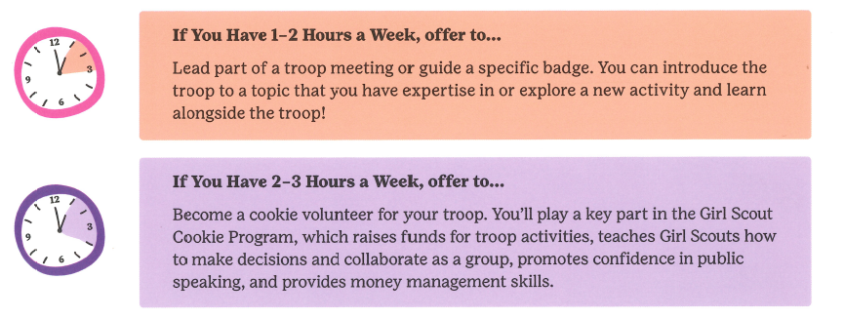
Notes:
If you have more time available in your schedule, here are a few more ways to help your troop.

Slide 21

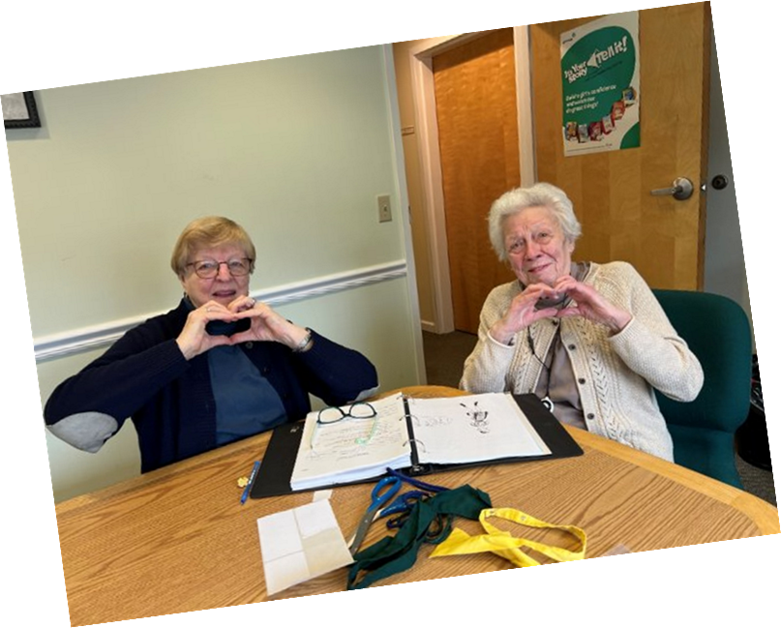
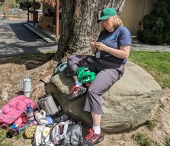
Invite Lifetime Members to Participate in your Troop?
Notes:
Does your troop have Lifetime members that aren’t active in your troop?
If yes, reach out to them, search out their interest and how it can align with your troop and girls.
Their interest and experiences can be shared with the girls.

Slide 22
3-Important tips to help families
make the decision to join Girl Scouts!
*Your/Their body language
*Asking more questions
*Listening to prospective family's concerns
Notes:
Be aware of yours and their body language- this can tell you a lot are they shy, nervous, uncomfortable etc..
Always make eye contact.
Ask questions to engage conversation and to get to know them and their needs for their family
And the best way to get to know what concerns or needs they have is by Always do more listening than talking

Slide 23
Thoughts?
Questions?
Things to share?

Slide 24



